Slide 1
The Making of Modern Celebrity
Professor Christopher Cook

Slide 2
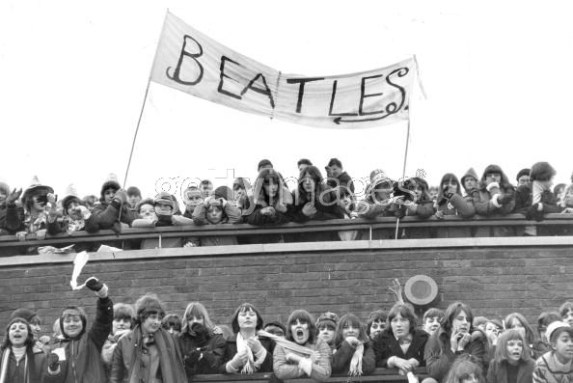

Slide 3
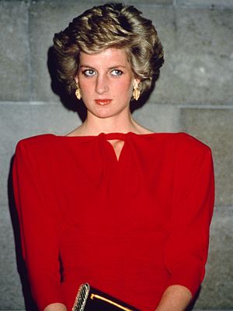
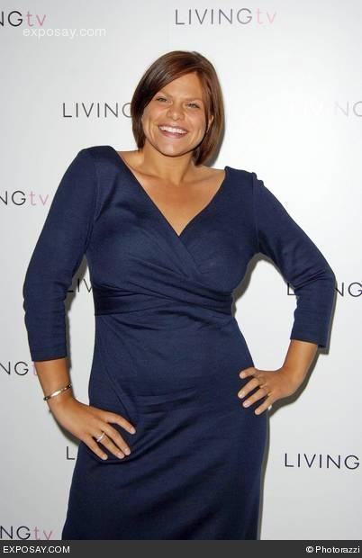

Slide 4
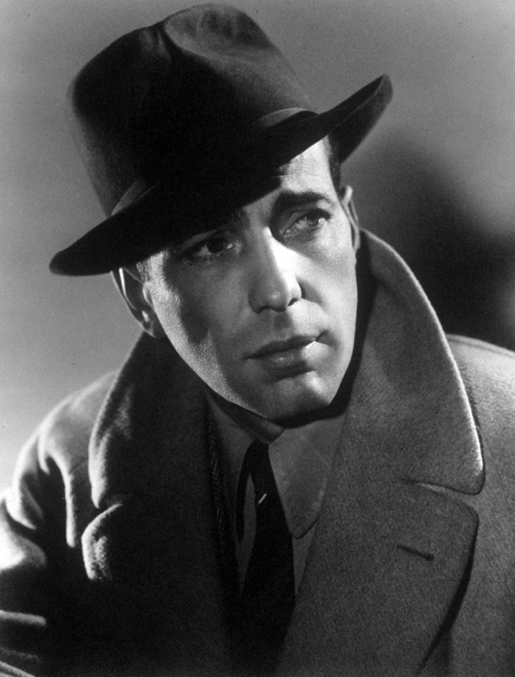

Slide 5
CASABLANCA
THE TRAILER
http://www.youtube.com/watch?v=INBmVxAsdFE

Slide 6
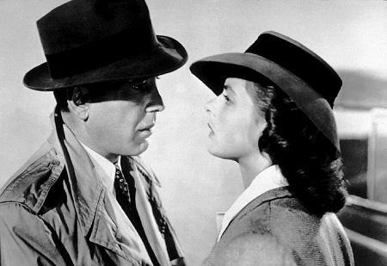

Slide 7
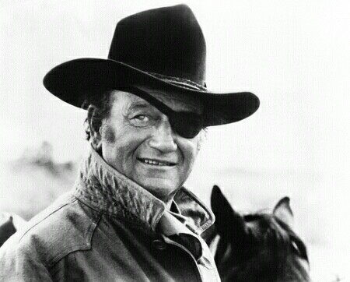

Slide 9
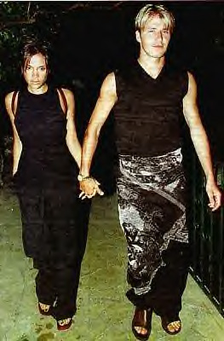

Slide 10
GAMSON’S ‘AUDIENCE TYPES
Traditional
Second Order Traditional
Postmodernist
Game Player: Gossip
Game Player: Detective

Slide 11
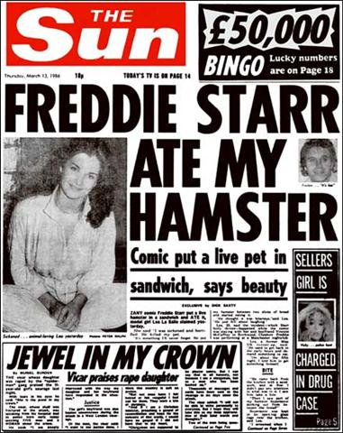

Slide 12
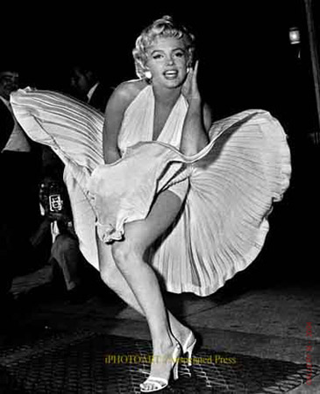

Slide 13
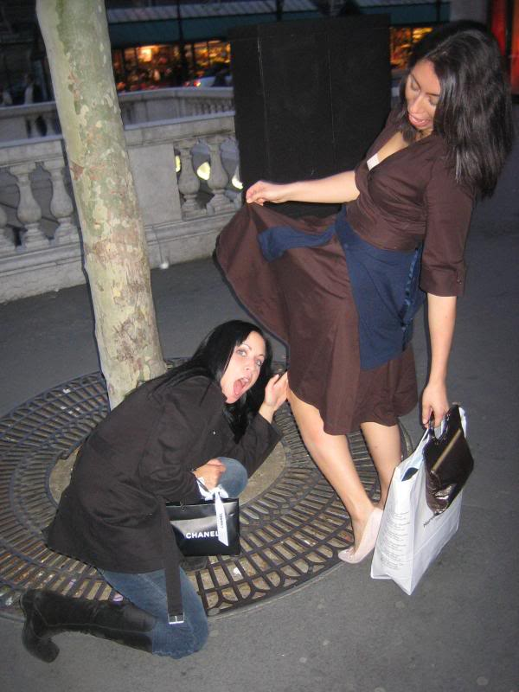

Slide 15
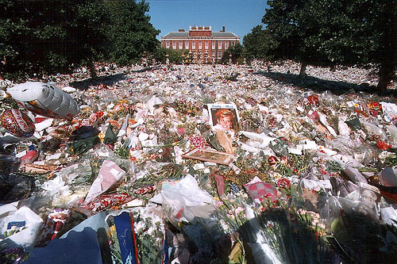
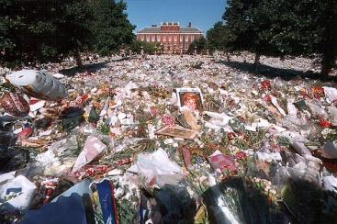

Slide 16
“To the extent that organised religion has declined in the West, celebrity culture has emerged as one of the replacement strategies that promotes new orders of meaning and solidarity. As such, notwithstanding the role that some celebrities have played in destabilising order, celebrity culture is a significant institution in the normative achievement of social integration.”
Chris Rojek ‘Celebrity’ - 2001

Slide 17
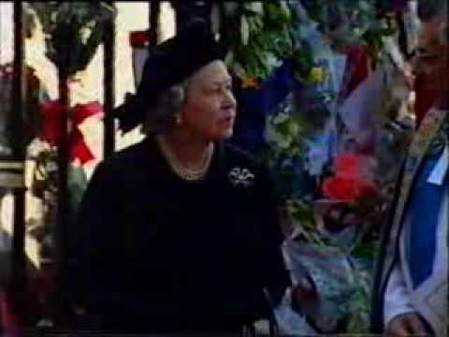

Slide 18
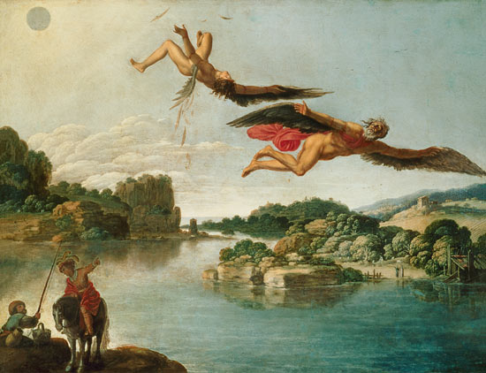

Slide 19
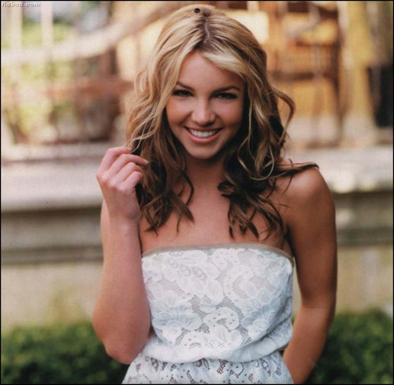

Slide 20
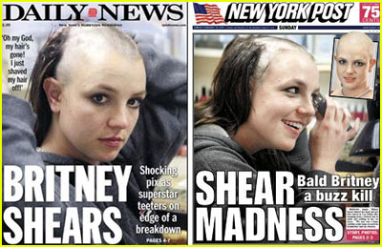

Slide 21
JADE GOODY
After being evicted from Celebrity Big Brother
http://www.youtube.com/watch?v=9TEkhIAQa0M&NR=1\

Slide 22
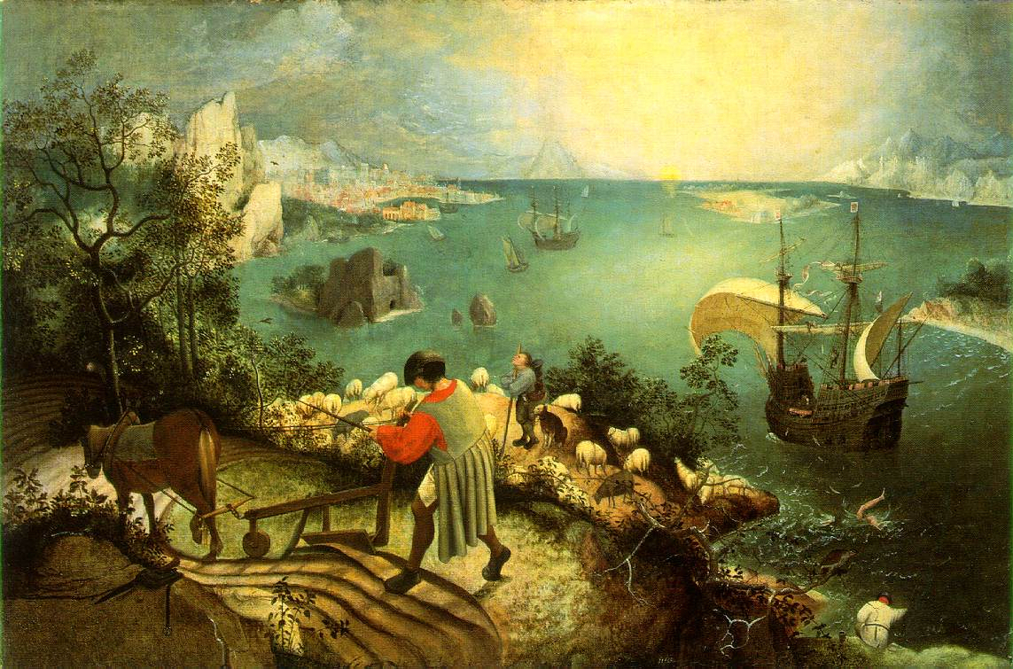

Slide 23
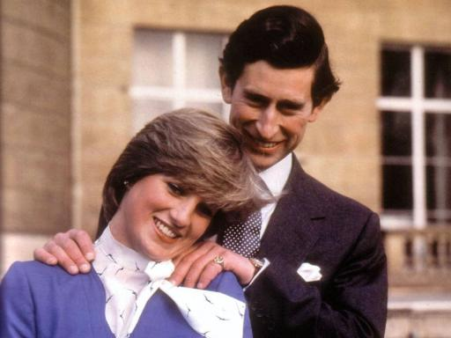

Slide 24
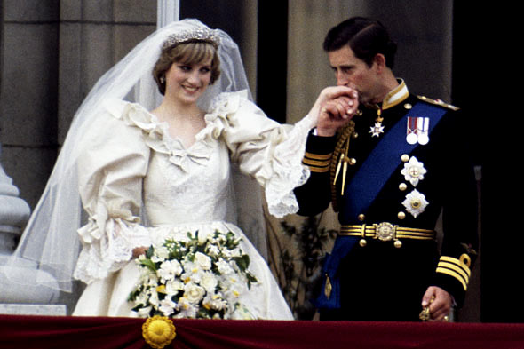

Slide 25
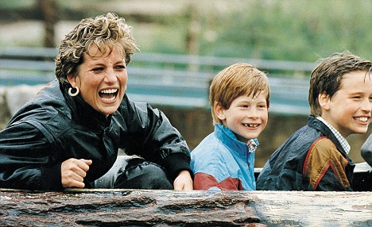

Slide 27
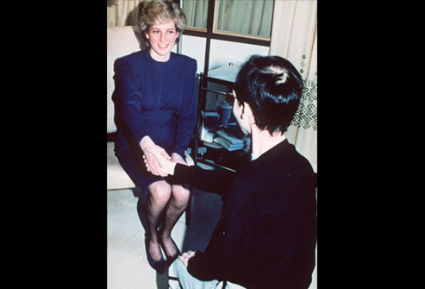

Slide 28
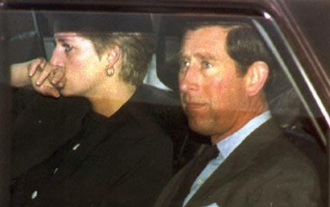

Slide 29
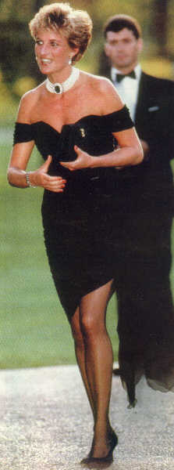

Slide 30
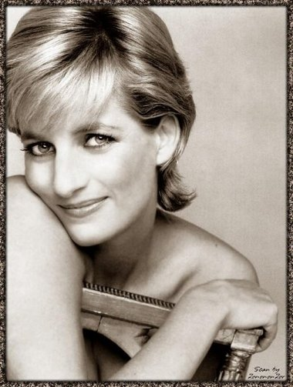

Slide 31
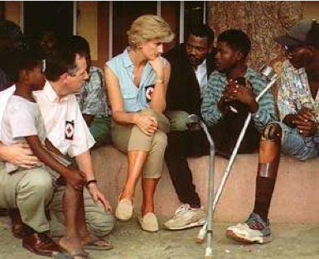

Slide 32
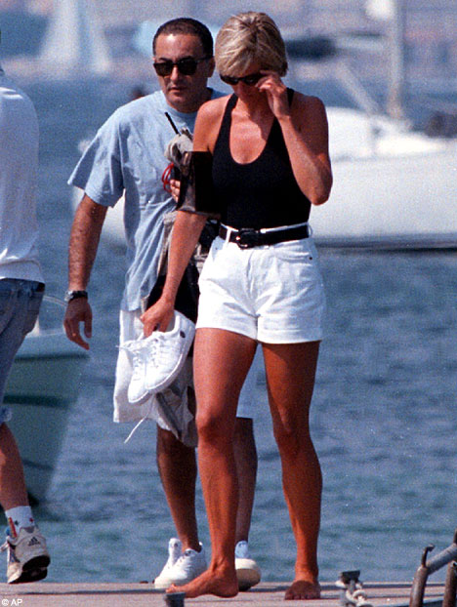

Slide 33
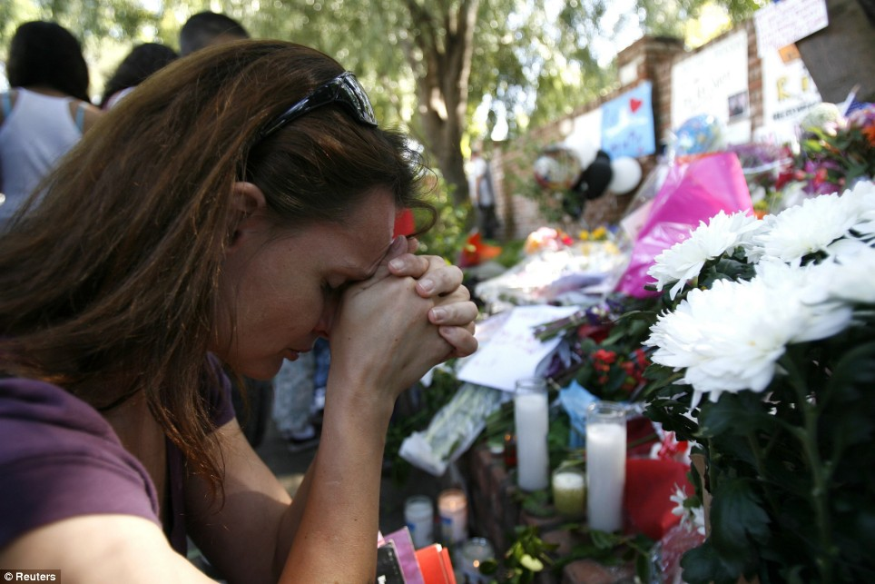

Slide 34
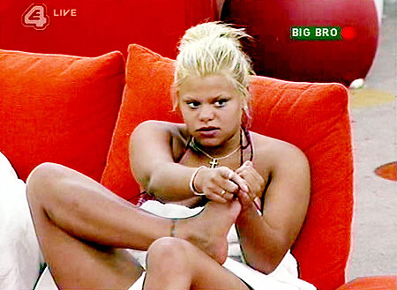

Slide 39
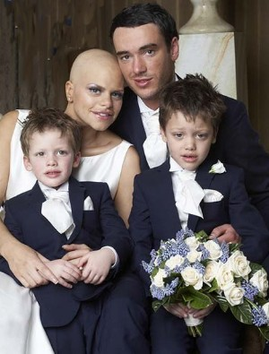

Slide 40
