Slide 1
A new theory of economic growth Or at least Keynes reinvented and brought up to date in the 21st Century Lecture in memory of the late Sir Donald MacDougall
Third Gresham Lecture
Douglas McWilliams
Mercers School Memorial Professor of Commerce at Gresham College
with Charles Davis, Head of Macroeconomics Cebr and
Oliver Hogan, Head of Microeconomics Cebr
Centre for economics and business research ltd
Unit 1, 4 Bath Street, London EC1V 9DX
t: 020 7324 2850 f: 020 7324 2855 e: advice@cebr.com w: www.cebr.com

Slide 2
Objective
To find a new theory of economic growth that explains best what is happening and what is likely to happen
To understand the policy implications of this new theory

Slide 3
Overview
The historical context
Traditional theories of economic growth
Why we need a new theory – the failed forecasts
Balance of Payments constrained growth
Bringing in an inflation constraint as well
The policy implications

Slide 4
The three big changes from the past
The ‘supercompetitiveness’ of the emerging economies;
The continuing shift in the terms of trade in favour of primary products and away from finished goods and services; and
The likelihood that overall world economic growth will be constrained because of limits from the lack of natural resources, meaning that some of the enhanced economic growth in the emerging economies will be at the expense of lower growth in the mature economies.

Slide 5
The traditional growth theory
The three characteristics of traditional growth theory are:
Growth in the medium to long term is determined by the availability of resources of labour and capital, and the productivity with which they are used;
Inflation is determined with respect to an inflation augmented wage equation, where wages (or more precisely the rate of change of wages) are determined by labour market conditions and expected inflation (this is sometimes called the expectations augmented Phillips curve – the Phillips curve being a crude representation of the short term relationship between inflation and unemployment); and
The labour market condition which makes inflation non accelerating is called the NAIRU – the non-accelerating inflation rate of unemployment.
This is the Solow-Swan model with the Friedman and Phelps addition of the inflationary conditions in the labour market.

Slide 6
The credibility of the traditional theory is that its forecasts were better than its opponents – especially the gang of 364
‘(a) there is no basis in economic theory or supporting evidence for the Government’s belief that by deflating demand they will bring inflation permanently under control and thereby induce an automatic recovery in output and employment;
(b) present politics will deepen the depression, erode the industrial base of our economy and threaten its social and political stability;
(c) there are alternative policies; and
(d) the time has come to reject monetarist policies and consider urgently which alternative offers the best hope of sustained recovery.’
Friday 13 March 1981

Slide 7
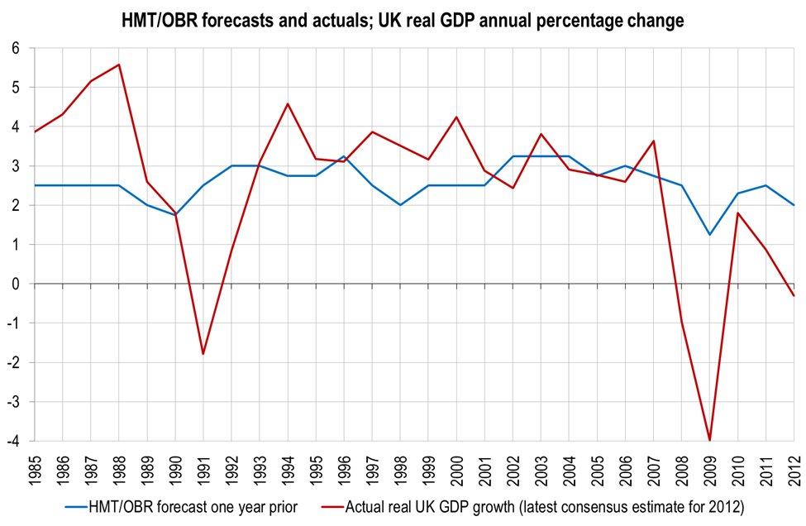
The Treasury/OBR’s forecasting track record for GDP……

Slide 8
The Treasury/OBR’s forecasting errors for GDP

Slide 9
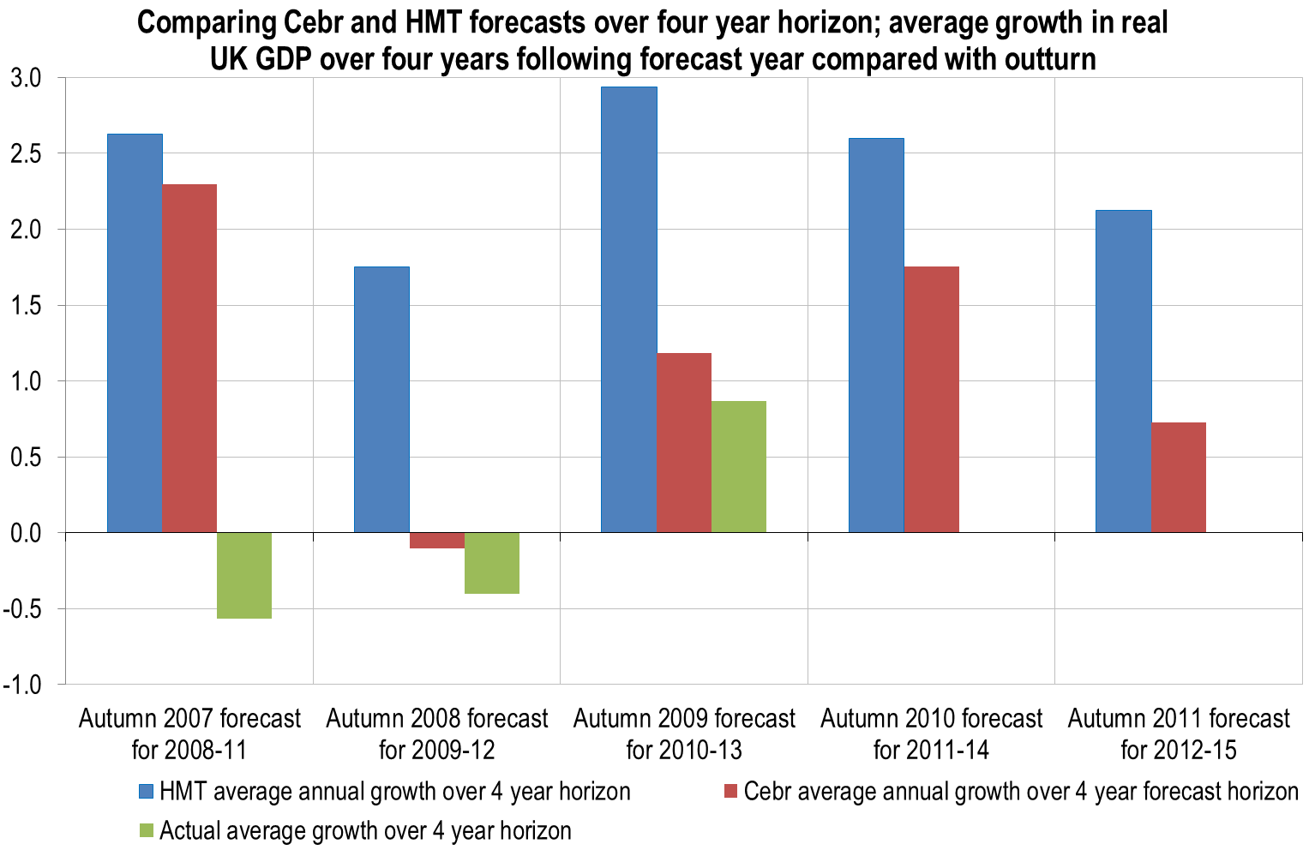
Cebr’s forecasts have recently been very much closer than Treasury/OBR (and indeed anyone else)

Slide 10
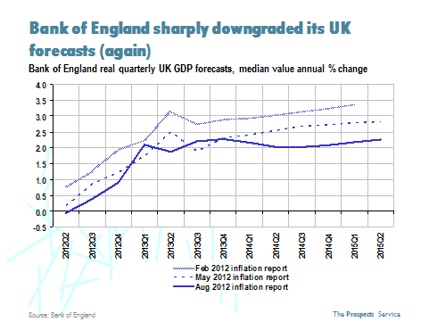
The Bank doesn’t publish medium term forecasts – but it has been consistently revising down its short term forecasts

Slide 11
Balance of payments constrained growth
The static balance of payments growth model was produced by Sir Roy Harrod in the 1930s.
If M = mY and X=M, then Y=X/m.
M=imports, Y=GDP, X=exports, m=marginal propensity to import
So GDP is equal to exports divided by the propensity to import.
The dynamic version of this, known as Thirlwall’s Law after the distinguished economist Professor Tony Thirlwall from Kent University, is that the long run growth of a country can be approximated by the ratio of the growth of exports to the income elasticity of demand for imports

Slide 12
Bringing in the inflation constraints
Inflation;
an adjustable real exchange rate. For this to work, of course, the Marshall Lerner conditions have to be met. The condition states that, for a currency devaluation to have a positive impact on trade balance, the sum of price elasticity of exports and imports (in absolute value) must be greater than 1. But this is generally the case for small countries (and today most countries are in economic terms small) at least in the long term provided that inflationary pressure from the devaluation can be constrained;
changes in the underlying competitive position affecting both exports and imports; and finally
changes in the terms of trade.

Slide 13
The new model – inflation and balance of payments constraints
A target for expected inflation;
Inflation as a function of expectations and both imported inflation and the domestic market, especially the labour market;
Imported inflation as a function of the exchange rate and exogenously given trend in import prices;
A balance of payments that has in the long run to balance on some definition;
A propensity to import (in volume terms) based on competitiveness which in turn is affected by the exchange rate as well as the competitiveness of other economies;
Import values equal to volume times price;
A propensity to export based on competitiveness which in turn is affected by the exchange rate as well as the competitiveness of other economies;
Export volumes a function of world trade and hence world GDP and the propensity to export; and
Import volumes a function of domestic demand and implicitly domestic GDP and the propensity to import.

Slide 14
Because the constraints are inflation and the balance of payments, policies that particularly assist in keeping within these constraints have a higher powered benefit for the objective of maximising growth within these constraints
The new model – implications for policy

Slide 15
US in the 1930s had unemployment averaging above 20%
In early 30s prices were falling by 9.0% per annum
UK today unemployment is 7.8% and falling
Prices rising 2.7%
Difference from Keynes’s time

Slide 16
Unfortunate that most Western economies and some Eastern economies are cutting deficits AT THE SAME TIME
And that this is a time when monetary policy is less easy to make effective because of the limits on QE
So there is a strong case for a ‘coalition of the willing’
International economic policy

Slide 17
UK domestic economic policy
Probably some scope for relaxed inflation target
Policy constrained by likely market response so needs to retain credibility
Believe that it is more important to reduce public spending in the long term – because it has led to excess taxes and it has gone beyond the point of diminishing returns – need spending target of 30-40% of GDP
Probably some scope on deficit – so no need to pull back increase in deficit from slower growth
V important to avoid policies that reduce competitiveness eg 50p tax
V important to avoid policies that raise inflationary expectations like VAT rise or potential fuel duty rise

Slide 18
A new theory of economic growth Or at least Keynes reinvented and brought up to date in the 21st Century Lecture in memory of the late Sir Donald MacDougall
Douglas McWilliams, Mercers’ School Memorial Professor of Commerce at Gresham College and Chief Executive of Cebr
Charles Davis, Head of Macroeconomics Cebr and
Oliver Hogan, Head of Microeconomics Cebr

