Slide 1
Fermat’s Theorems
Raymond Flood
Gresham Professor of Geometry

Slide 2
Newton’s Laws
Tuesday 21 October 2014
Euler’s Exponentials
Tuesday 18 November 2014

Slide 3
Fourier’s Series
Tuesday 20 January 2015
Möbius and his band
Tuesday 17 February 2015

Slide 4
Cantor’s Infinities
Tuesday 17 March 2015

Slide 5
Pierre de Fermat 160? - 1665
Fermat and Descartes founders of analytic geometry
Fermat principle of least time
Fermat and Pascal laid the foundations of modern probability theory
Number theory

Slide 6
Founders of Analytic Geometry
Pierre de Fermat (160?–1665)
René Descartes(1596–1650)
Analytic geometry – using algebra and a system of axes along which lengths are measured to solve geometric questions

Slide 7
Fermat’s Principle: “nature operates by the simplest and expeditious ways and means”
Refraction of light
A ray of light goes from Q₁ in air to Q₂ in water touching the boundary between the air and water at the point R.
From Fermat’s Principle of Least Time we want R to be chosen to make the total time of travel as small as possible.
Q₁R/v₁ + RQ₂/v₂
Minimised when α the angle of incidence and β the angle of refraction are related by
sin α/ sin β = v₁/v₂

Slide 8
Founders of Modern Probability
Pierre de Fermat (160?–1665)
Blaise Pascal (1623–1662)

Slide 9
A gambling problem: the interrupted game
What is the fair division of stakes in a game which is interrupted before its conclusion?
Example: suppose that two players agree to play a certain game repeatedly to win £64; the winner is the one who first wins four times.
If the game is interrupted when one player has won two games and the other player has won one game, how should the £64 be divided fairly between the players?

Slide 10
Interrupted game: Fermat’s approach
Original intention: Winner is first to win 4 tosses
Interrupted when You have won 2 and I have won 1.
Imagine playing another 4 games
Outcomes are all equally likely and are (Y = you, M = me):
YYYY YYYM YYMY YYMM
YMYY YMYM YMMY YMMM
MYYY MYYM MYMY MYMM
MMYY MMYM MMMY MMMM
Probability you would have won is 11/16
Probability I would have won is 5/16

Slide 11
Fermat’s Number Theory
Restricted his work to integers
Primes numbers and divisibility
How to generate families of solutions

Slide 12
Method of Infinite descent
"As ordinary methods, such as are found in books, are inadequate to proving such difficult propositions, I discovered at last a most singular method...which I called the infinite descent. At first I used it to prove only negative assertions, such as ‘There is no right angled triangle in numbers whose area is a square’...
To apply it to affirmative questions is much harder, so when I had to prove
‘Every prime of the form 4n+1 is a sum of two squares’
I found myself in a sorry plight (en belle peine). But at last such questions proved amenable to my methods." -Quoted from Andre Weil's Number Theory

Slide 13
There is no right angled triangle in numbers (integers) whose area is a square
5
4
13
17
12
15
3
Area = 6
5
Area = 30
8
Area = 60

Slide 14
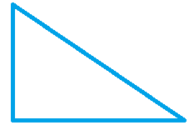
There is no right angled triangle in numbers (integers) whose area is a square
5
4
13
17
12
15
3
Area = 6
5
Area = 30
8
Area = 60
Suppose this is a triangle with integer sides and area a square

Slide 15
There is no right angled triangle in numbers (integers) whose area is a square
5
4
13
17
12
15
3
Area = 6
5
Area = 30
8
Area = 60
Then there are integers x and y so that the hypotenuse is x² + y²
Suppose this is a triangle with integer sides and area a square
x² + y²
x
Area a square and hypotenuse length x

Slide 16
Fermat on infinite descent
If there was some right triangle of integers that had an area equal to a square there would be another triangle less than it which has the same property. If there were a second less than the first which had the same property there would be by similar reasoning a third less than the second which had the same property and then a fourth, a fifth etc. ad infinitum. But given a number there cannot be infinitely many others in decreasing order less than it – I mean to speak always of integers. From which one concludes that it is therefore impossible that any right triangle of numbers has an area that is a square.

Slide 17
Every prime of the form 4n+1 is a sum of two squares
Let us list all prime numbers of the form 4n + 1
(that is, each is one more than a multiple of 4):
5, 13, 17, 29, 37, 41, 53, 61, … .
Fermat observed that
Every prime number in this list can be written as the sum of two squares:
for example,
13 = 4 + 9 = 2² + 3²
41 = 16 + 25 = 4² + 5².

Slide 18
Fermat primes
Fermat conjectured that if n is a power of 2 then 2^{n} + 1 is prime. Indeed the first few of these numbers are indeed prime:
2¹ + 1 = 3
2² + 1 = 5
2⁴ + 1 = 17
2⁸ + 1 = 257
2¹⁶ + 1 = 65537
But 2³² + 1 = 4294967297 = 641 × 6700417

Slide 19
Fermat primes
Fermat conjectured that if n is a power of 2 then 2^{n} + 1 is prime. Indeed the first few of these numbers are indeed prime:
2¹ + 1 = 3
2² + 1 = 5
2⁴ + 1 = 17
2⁸ + 1 = 257
2¹⁶ + 1 = 65537
But 2³² + 1 = 4294967297 = 641 × 6700417
Because 2³² + 1 = (2³² + 5⁴×2²⁸) – (5⁴×2²⁸ – 1)
Now 641 = 2⁴ + 5⁴ and = 5×2⁷ +1
So 2³² + 1 = 2²⁸(2⁴ + 5⁴) – (5×2⁷ + 1) (5×2⁷ - 1) (5²×2¹⁴ + 1)

Slide 20
Pell’s equation
C x² + 1 = y²
Fermat challenged his mathematical contemporaries to solve it for the case of C = 109
109 x² + 1 = y²
The smallest solution is
x = 15,140,424,455,100 and
y = 158,070,671,986,249

Slide 21
Modular Arithmetic
We define a ≡ b mod n and say a is congruent to b mod n whenever a and b have the same remainders when we divide by n. An equivalent way of describing this is that n divides a – b.
Examples: 35 ≡ 11 mod 24, 18 ≡ 11 mod 7, 16 ≡ 1 mod 5
If a ≡ b mod n and c ≡ d mod n
Addition: a + c ≡ b + d mod n
Multiplication: ac ≡ bd mod n
Cancellation: If ac ≡ bc mod p and p is a prime and p does not divide c then a ≡ b mod p.

Slide 22
Fermat’s Little Theorem
Pick any prime, p and any integer, k, smaller than p.
Raise k to the power of p – 1 and find its remainder on dividing by p.
The answer is always 1 no matter what p is or k is!
k^{p – 1} ≡ 1 mod p
Pick your p = 7, k = 5
Then we know that 5^{7 – 1} = 5⁶ leaves a remainder of 1 when divided by 7.

Slide 23
Fermat’s little theorem: Proof
p = 7 k = 5 prove 5^{7 – 1} ≡ 1 mod 7
List A: 1, 2, 3, 4, 5, 6, mod 7
Multiply each by k = 5
List B: 5, 10, 15, 20, 25, 30, mod 7
When we write it mod 7 we obtain list A in a different order.
List C: 5, 3, 1, 6, 4, 2, mod 7
So the terms in list A multiplied together are the same mod 7 as the terms in list B multiplied together.
5.1.5.2.5.3.5.4.5.5.5.6 ≡ 1.2.3.4.5.6 mod 7
5⁶.1.2.3.4.5.6 ≡ 1.2.3.4.5.6 mod 7
We can cancel 1.2.3.4.5.6 as it is not divisible by 7 to get
5⁶ ≡ 1 mod 7

Slide 24
Primality testing
Pick any prime, p and any integer, k, smaller than p.
k^{p – 1} ≡ 1 mod p
So the consequence is that if for any choice of a the remainder is not 1 then the number p is not prime.
For example: a = 2 and modulus, p, is 15
2¹⁴ mod 15 ≡ 2⁴ x 2⁴ x 2⁴ x 2² mod 15
≡ 16 x 16 x 16 x 4 mod 15
≡ 1 x 1 x 1 x 4 mod 15 ≡ 4 mod 15

Slide 25
RSA Algorithm
Ronald Rivest, Adi Shamir and Leonard Adleman
Publish N and E

Slide 26
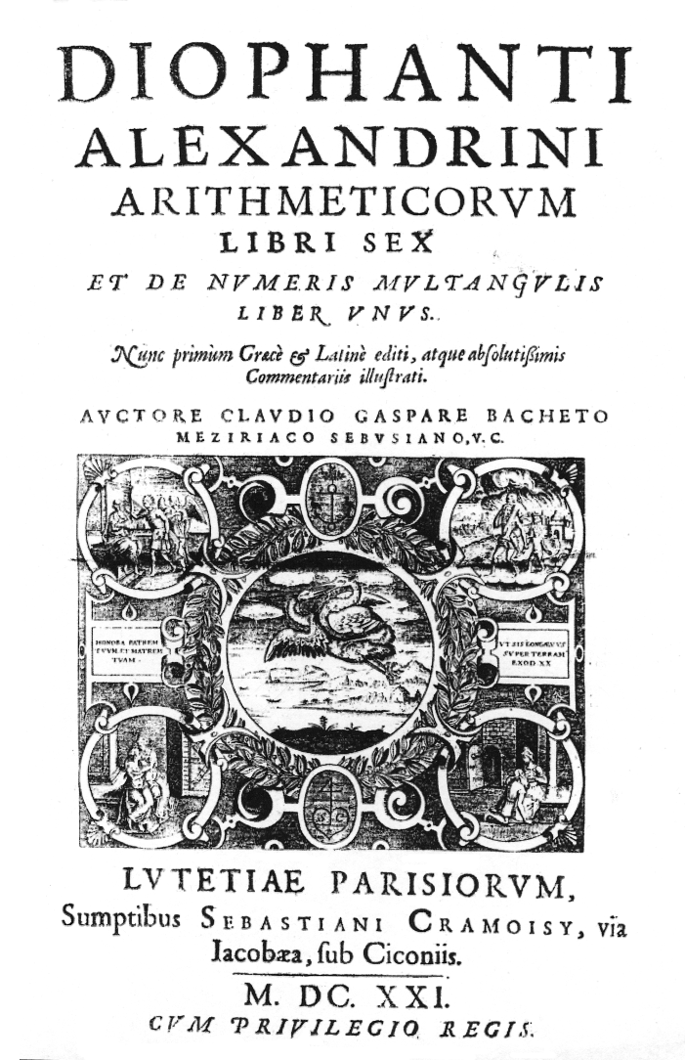
Fermat’s marginal note
A 1621 French edition of Diophantus’s Arithmetica
Fermat’s marginal note published in his son’s edition of Diophantus’s Arithmetica

Slide 27
Fermat’s marginal note
Cubum autem in duos cubos, aut quadratoquadratum in duos quadratoquadratos, et generaliter nullam in infinitum ultra quadratum potestatem in duos eiusdem nominis fas est dividere cuius rei demonstrationem mirabilem sane detexi. Hanc marginis exiguitas non caperet
It is impossible to separate a cube into two cubes, or a fourth power into two fourth powers, or in general, any power higher than the second, into two like powers. I have discovered a truly marvellous proof of this, which this margin is too narrow to contain.

Slide 28
Fermat’s ‘Last Theorem’
The equation
x^{n} + y^{n} = z^{n}
has no whole number solutions if n is any integer greater than or equal to 3.
Only need to prove for n equal to 4 or n an odd prime.
Suppose you have proved the theorem when n is 4 or an odd prime then it must also be true for every other n for example for n = 200 because x²⁰⁰ + y²⁰⁰ = z²⁰⁰ can be rewritten (x⁵⁰)⁴ + (y⁵⁰)⁴ = (z⁵⁰)⁴
so any solution for n = 200 would give a solution for n = 4 which is not possible.

Slide 29
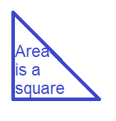
The case n = 4
Suppose there is a solution in integers to the equation
x⁴ + y⁴ = z⁴
This can be written
(x²)² + (y²)² = (z²)²
We can use it to find another right angled triangle with integer sides whose area is a square
BUT Fermat had used his method of infinite descent to show that such a triangle was impossible

Slide 30
First 200 years
Fermat did n = 4
Euler did n = 3 in 1770
Legendre and Peter Lejeune-Dirichlet did n = 5 in 1825
Gabriel Lamé did n = 7 in 1839

Slide 31
Sophie Germain, 1776 - 1831
x^{n} + y^{n} = z^{n}
If n is any prime number less than 100, then there are no positive integer solutions if x, y and z are mutually prime to one another and to n.
Sophie Germain aged 14

Slide 32
A False Proof, 1847
x^{n} + y^{n} = (x + y)(x + ζy)(x + ζ²y) ⋅⋅⋅(x + ζ^{n – 1} y)
where ζ^{n} = 1
Suppose this equals z^{n} for some z.
He concluded that each factor was also an nth power. Then he could derive a contradiction.
But the conclusion that each factor was also an nth power was wrong!
Unique prime factorization does not always hold!

Slide 33
Ernst Kummer 1810 - 1893
Ideal numbers
Algebraic number theory
Fermat’s last theorem proved for regular primes

Slide 35
Andrew Wiles lectures on elliptic curves

Slide 36
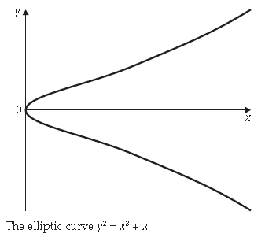
The Breakthrough
Elliptic Curve
y² = x³ + rx² + sx + t,
for some integers r, s and t

Slide 37
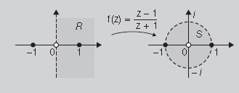
The Breakthrough
Elliptic Curve
y² = x³ + rx² + sx + t,
for some integers r, s and t
Modular form
A way of generalizing the Möbius transformations
f(z) = (az + b)/(cz + d)

Slide 38
The Breakthrough
Elliptic Curve
y² = x³ + rx² + sx + t,
for some integers r, s and t
Modular form
A way of generalizing the Möbius transformations
f(z) = (az + b)/(cz + d)
Taniyama – Shimura Conjecture
Every elliptic curve is associated with a modular form

Slide 39
Suppose a ^{p} + b ^{p} = c ^{p}
Then y² = x³ +(b^{p} - a^{p}) x² - a^{p}b^{p} x
would have such bizarre properties that it could not be modular, thereby contradicting the Taniyama–Shimura conjecture.
Wiles set himself the task of proving the special case of the Taniyama–Shimura conjecture that implied the truth of Fermat’s last theorem.

Slide 40
References
Pierre de Fermat, Complete Dictionary of Scientific Biography, Michael S Mahoney
http://www.encyclopedia.com/topic/Pierre_de_Fermat.aspx
Simon Singh, Fermat’s Last theorem, Fourth Estate, 1998
BBC Horizon Program on Fermat’s Last Theorem is available from the BBC at
http://www.bbc.co.uk/programmes/b0074rxx

Slide 41
1 pm on Tuesdays Museum of London
Fermat’s Theorems: Tuesday 16 September 2014
Newton’s Laws: Tuesday 21 October 2014
Euler’s Exponentials: Tuesday 18 November 2014
Fourier’s Series: Tuesday 20 January 2015
Möbius and his Band: Tuesday 17 February 2015
Cantor’s Infinities: Tuesday 17 March 2015

