Slide 1

Wicked Economics & Better Decisions
The Price of Fish
Making Sense Of The Way The World Really Works
17 November 2011

Slide 2
Fish (& Chip) Stands

Slide 3
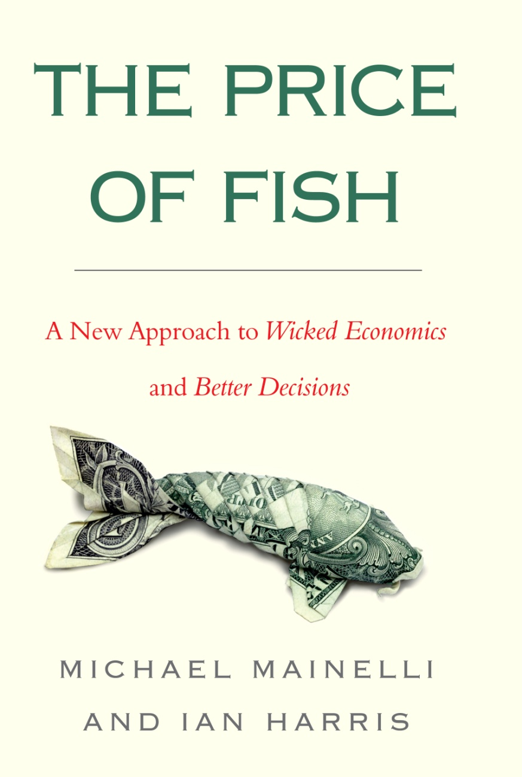
30+ Lectures: 1 Book

Slide 4
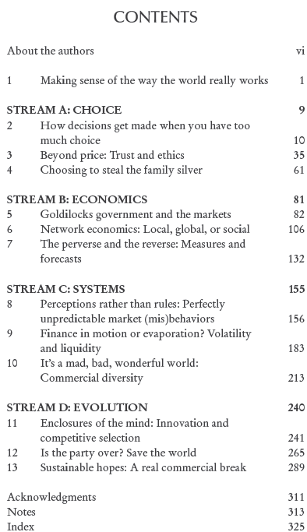
Peek Inside

Slide 5
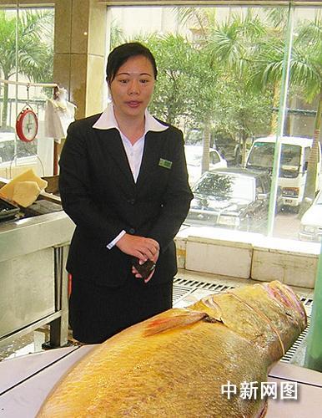
Giant Yellow Croaker
[Source: http://news.sohu.com/20070403/n249151441.shtml]

Slide 6
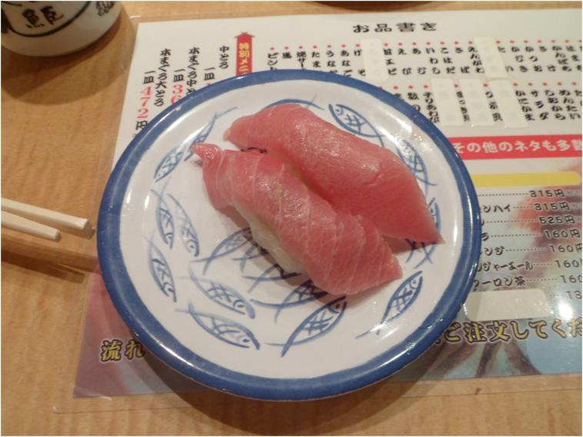
2,000,000 Years of Commerce and We Still Don’t Know The Price Of Fish
[Photo courtesy of Nicolas Mainelli]

Slide 7
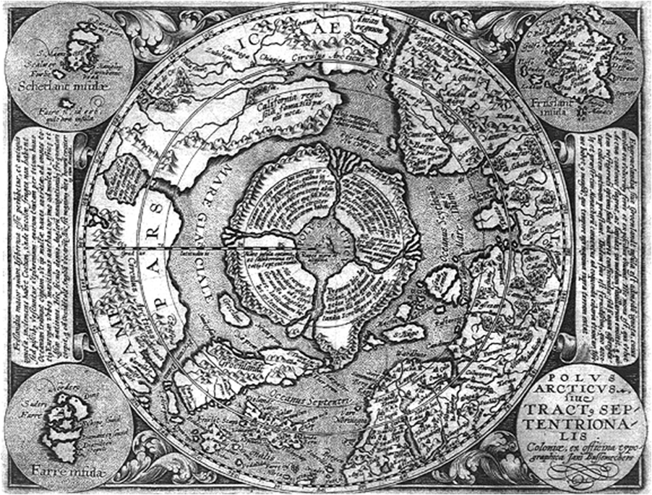
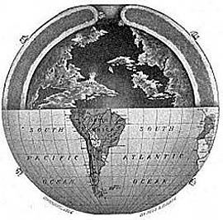
The Way The World Really Works

Slide 8

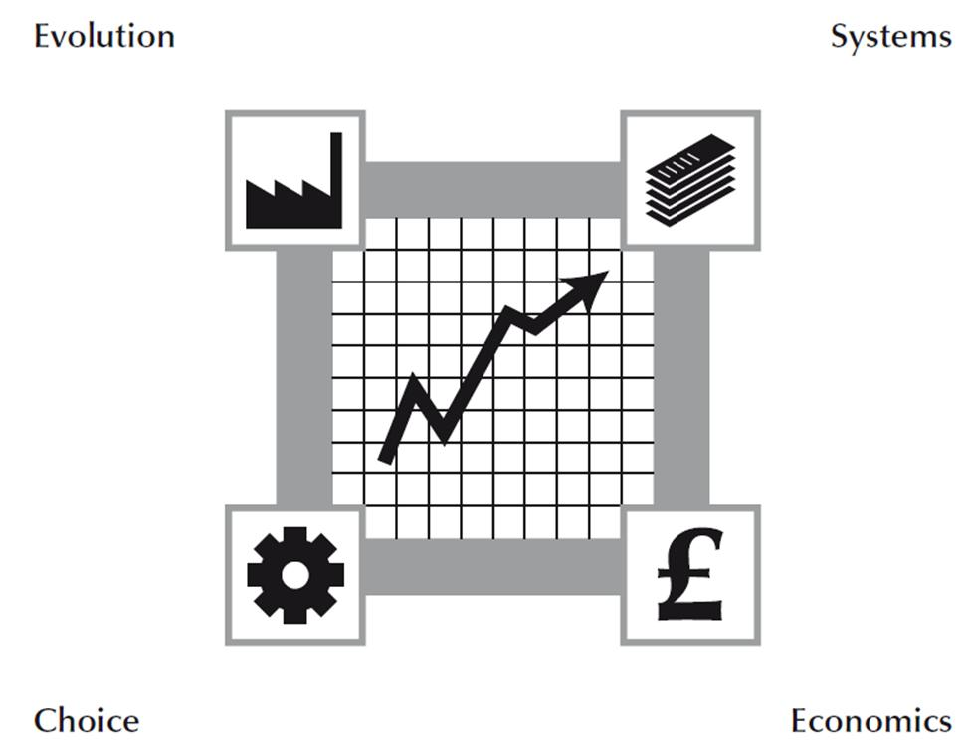

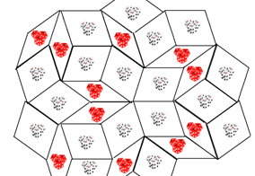
Great Debates

Slide 9
Real Commerce Road Map
Systems
Evolution
Equitable
Commerce
Choice
Sustainable
Economics

Slide 10
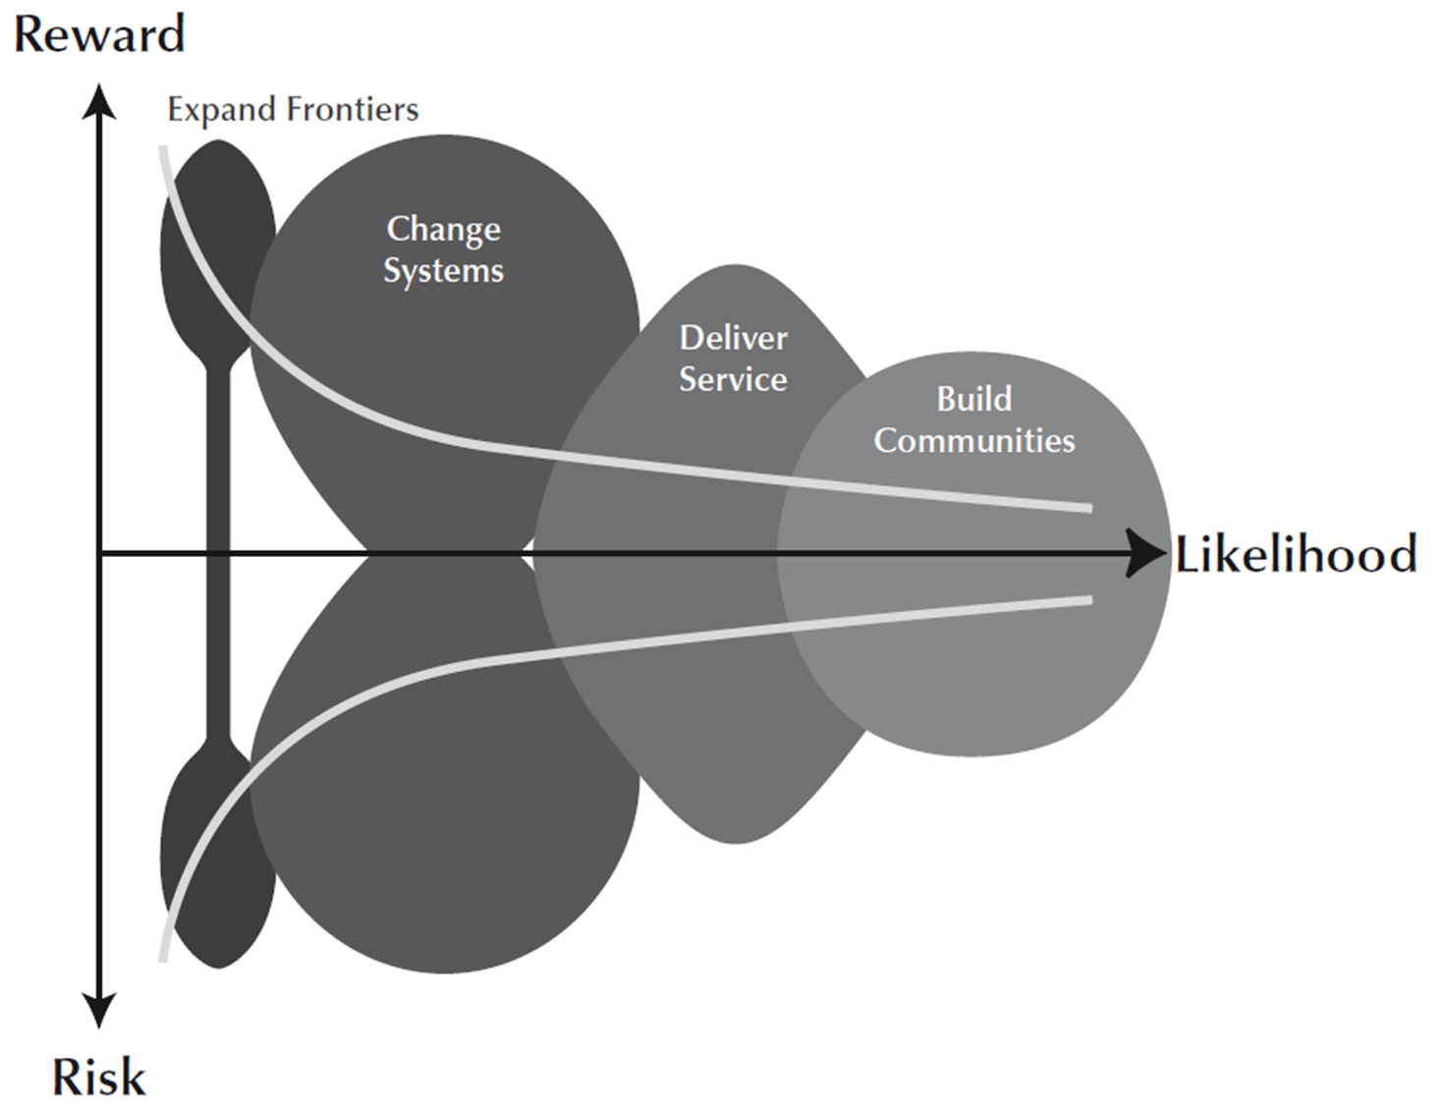
Risk/Reward Approaches

Slide 11
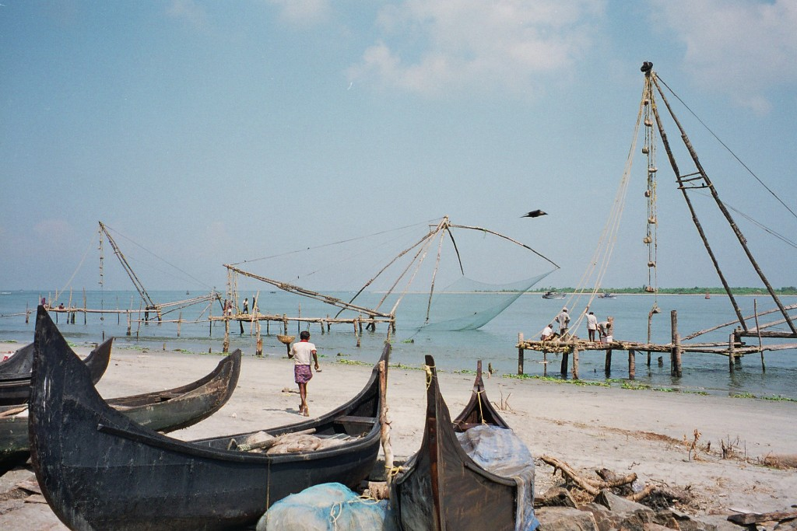
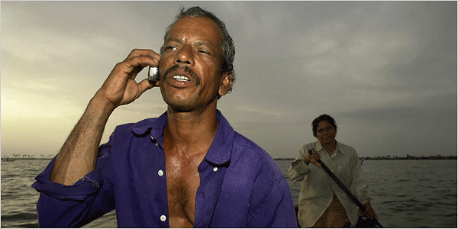
Discounting Your Plaice In The Community
Near Cochin, Kerala
[Photograph by Ian]
[Source: http://www.tribuneindia.com/2004/20040622/nation.htm]

Slide 12
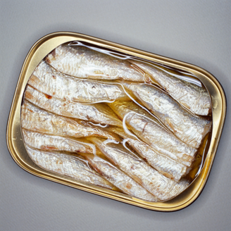
Trading Sardines Or Eating Sardines?

Slide 13
What Is Real Commerce?
Consilience – economics, evolution, systems, choice
Catallactics – communities and exchange are core
Meta-commerce goals – justified trust:
  communities exchanging through space – equitable globalisation & trust
  communities transferring through time – sustainable long-term resources

Slide 14





More Questions?
London Accord
Financial Centre Futures
Meta-Commerce
Eternal Coin

Slide 15
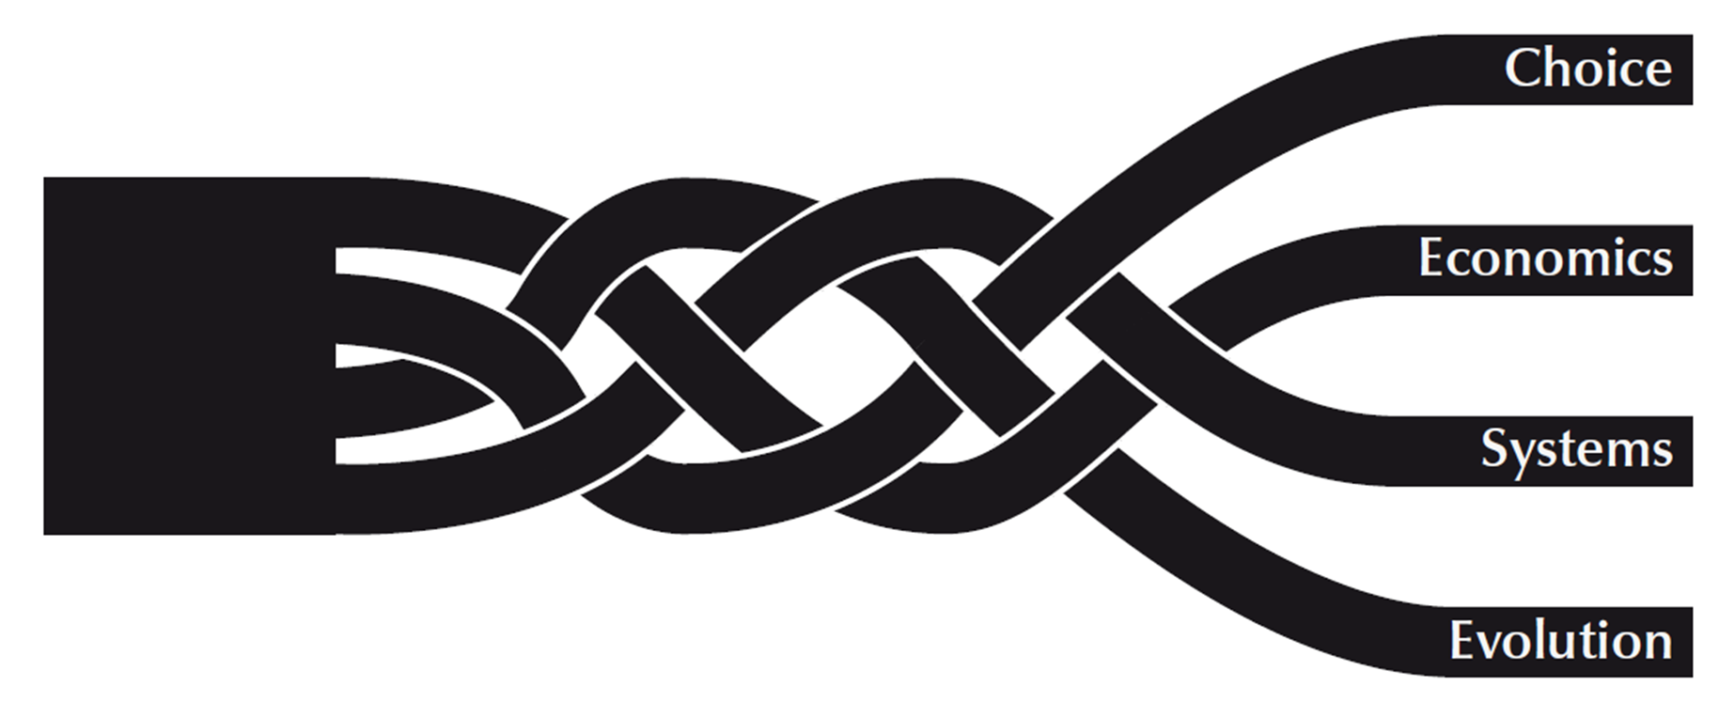
Price Your Own Fish
Ian Harris

Slide 16
Mainelli-English Translation Part One
Mainelli: Do you have a minute?
Translation: You might as well write off the rest off the day.
Mainelli: Can you spare five minutes?
Translation: You might as well write off the rest off the week.
Mainelli: Tell me if you think this is a dumb idea......
Translation: You are about to hear the most harebrained scheme ever.
(Extracted from “Teach Yourself Mainelli”, Ian Harris, 1990)

Slide 17
Mainelli-English Translation Part Two
Mainelli: That article is somewhere in that pile of papers over there.
Translation: I haven't the faintest idea which article you mean, but I probably threw it away without looking at it.
Mainelli: That isn't really my main field of interest.
Translation: I don't know anything at all about that subject.
Mainelli: I did some research on that subject at one time.
Translation: I think I read an article on that in the Economist once.
(Extracted from “Teach Yourself Mainelli”, Ian Harris, 1990)

Slide 18
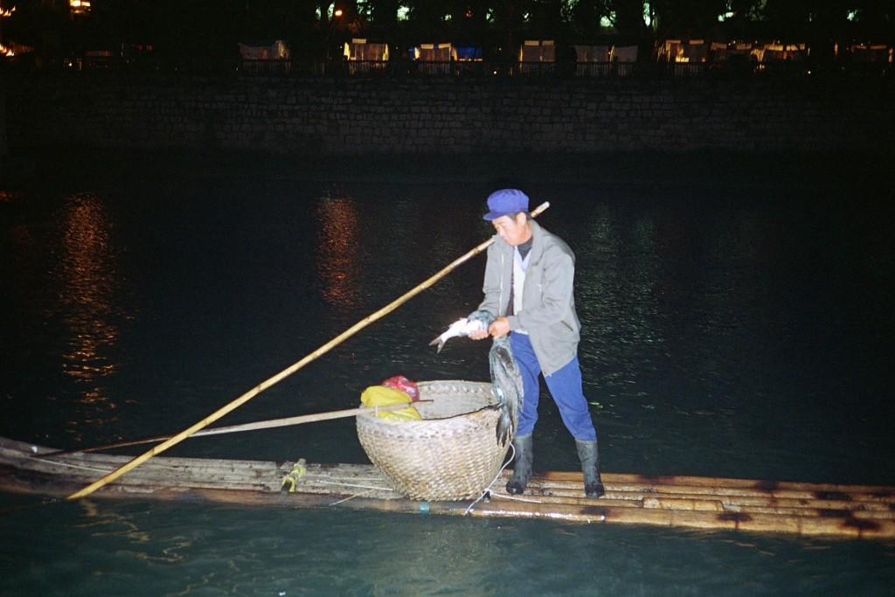
Traditional Chinese Fishing, Keeps It Simple

Slide 19
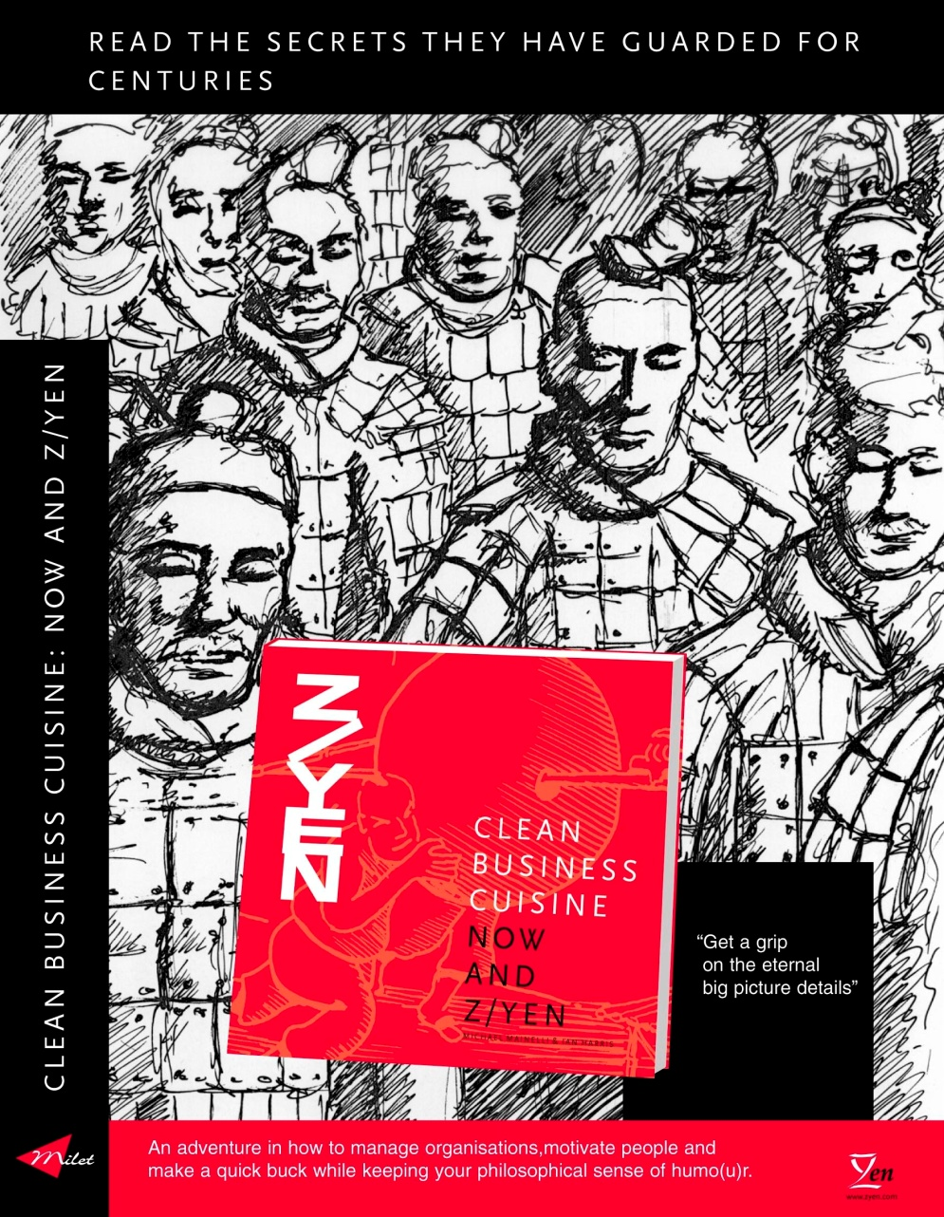
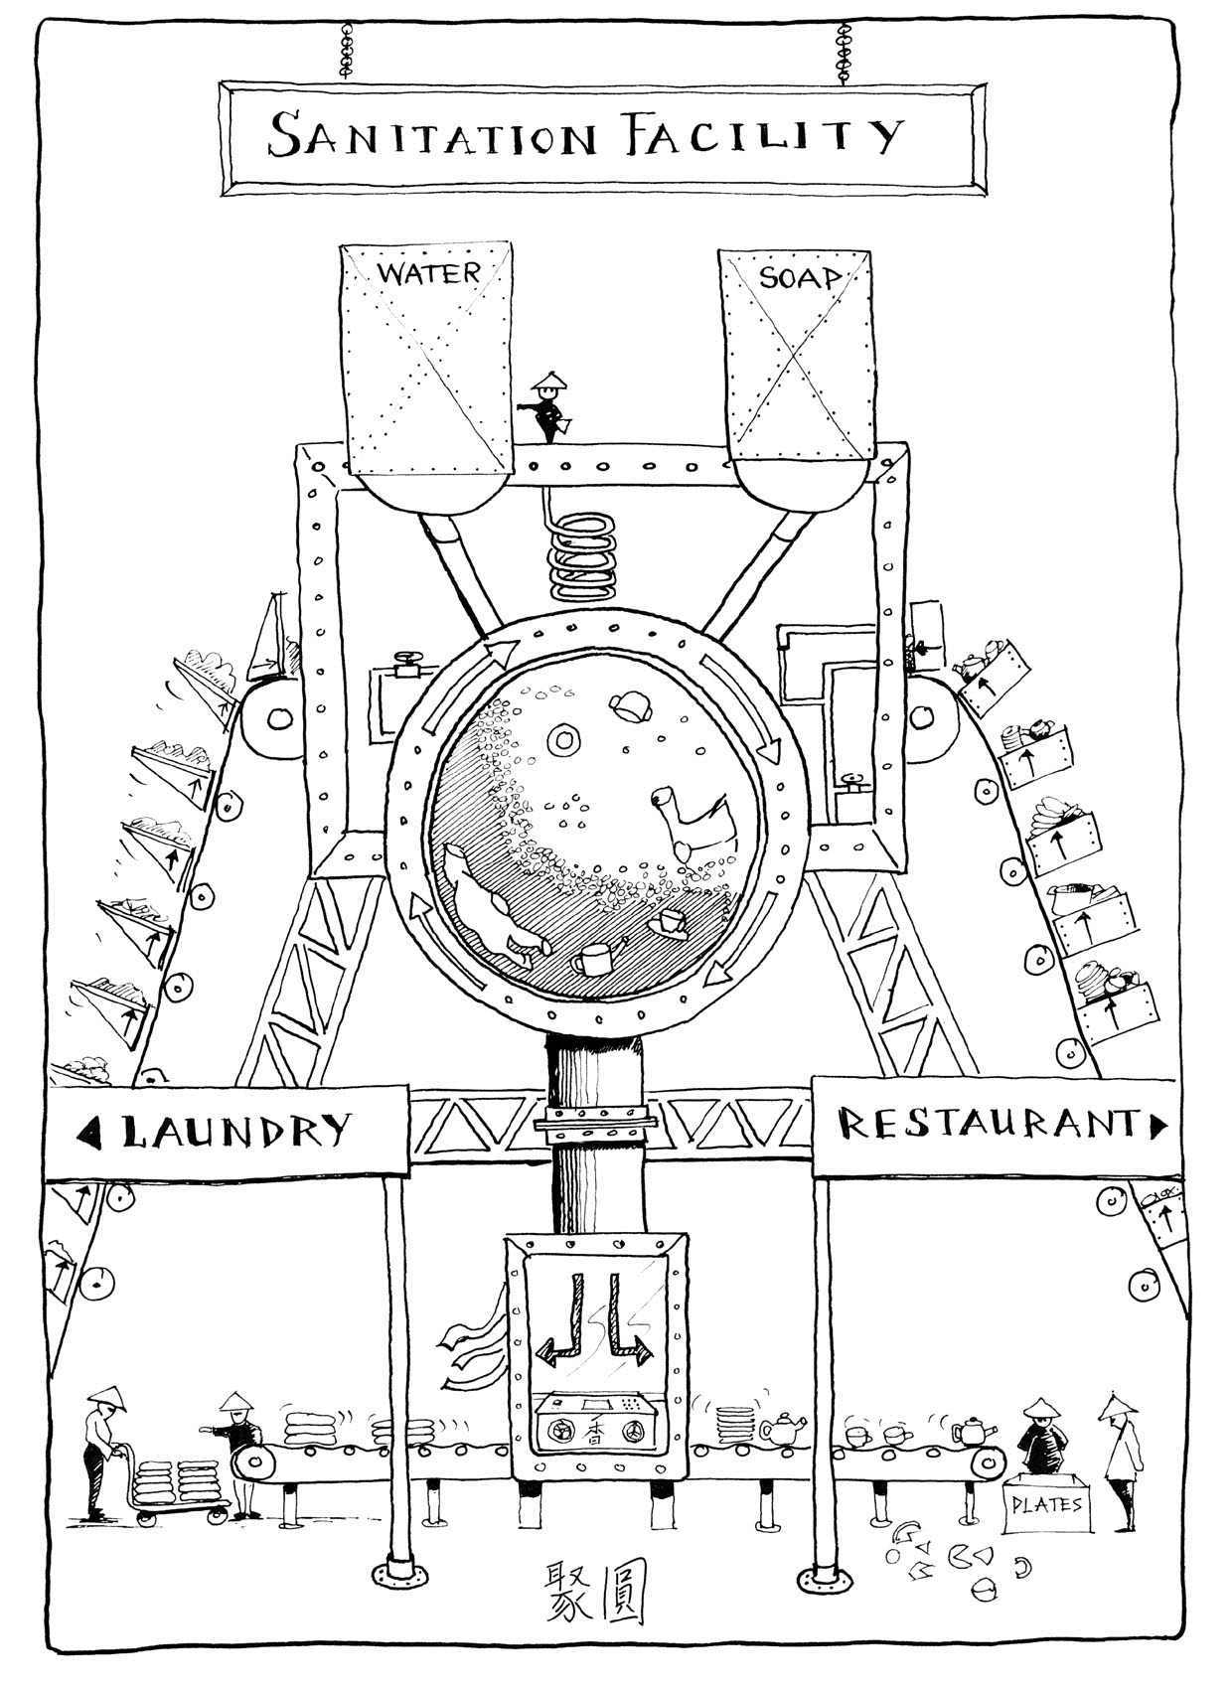
Clean Business Cuisine

Slide 20
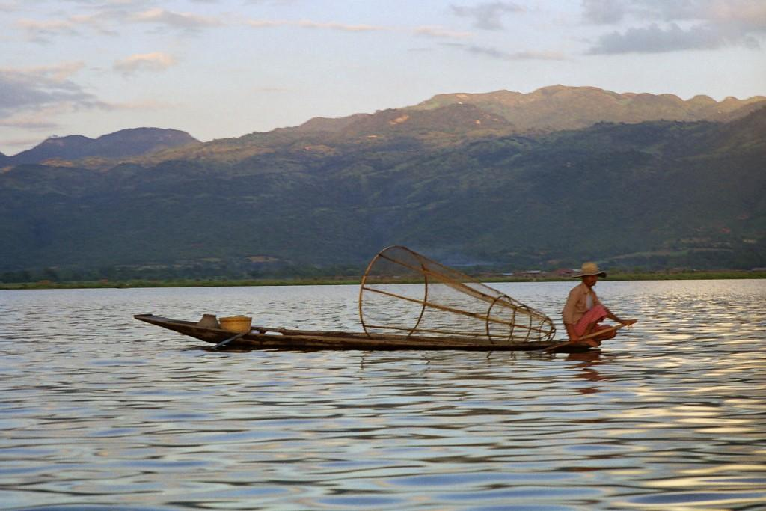
Intha Fisherman on Inle Lake, Burma

Slide 21
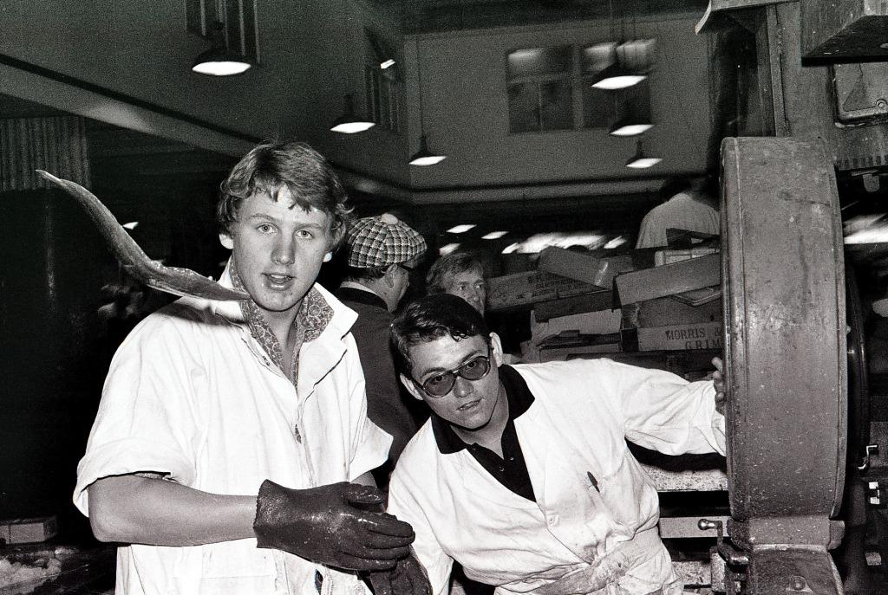
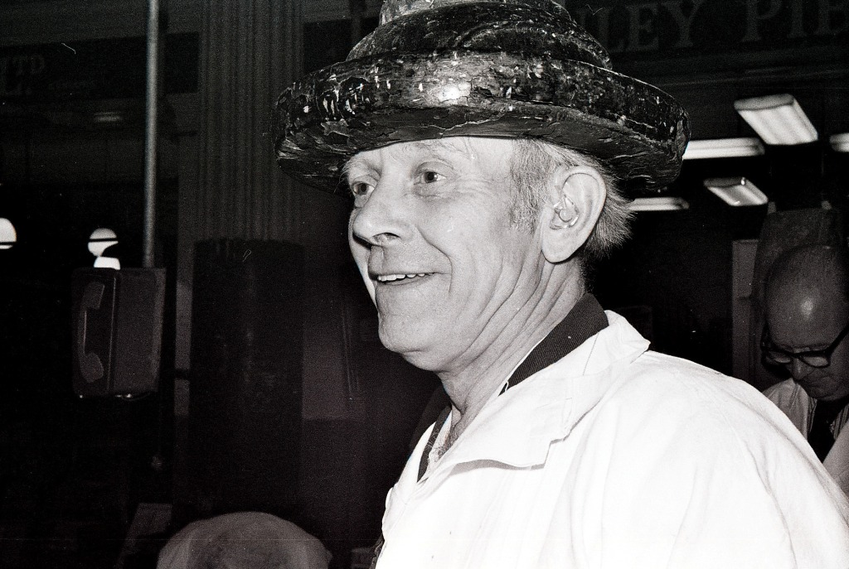
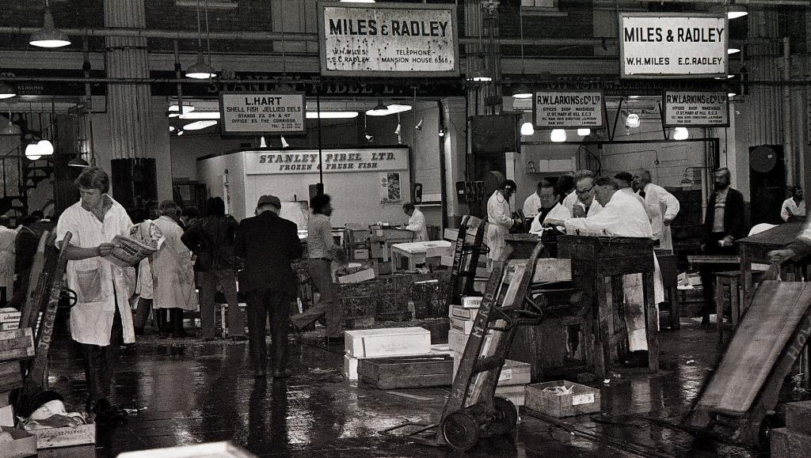
Old Billingsgate Market, c1977
[Photographs by Ian]

Slide 22
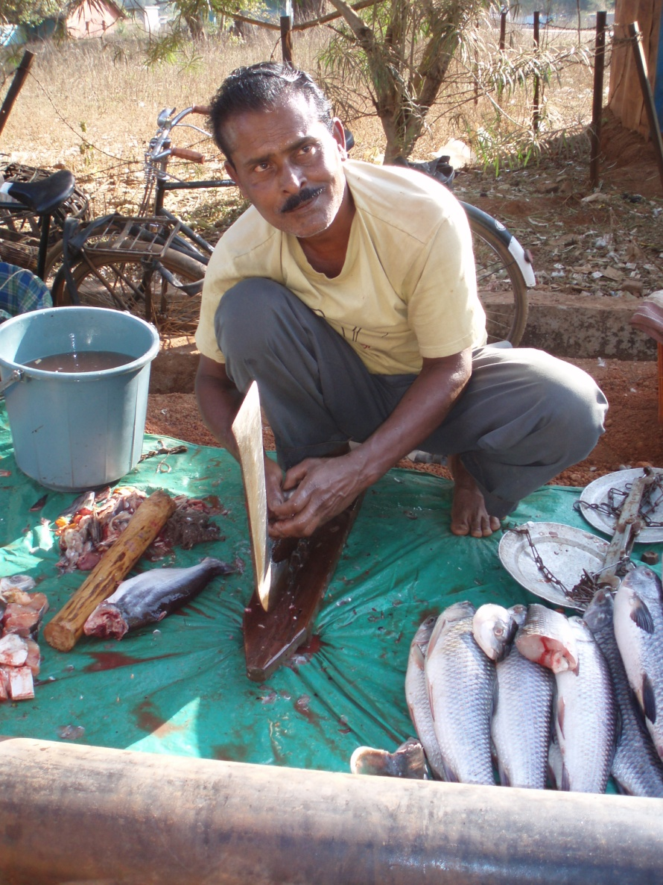
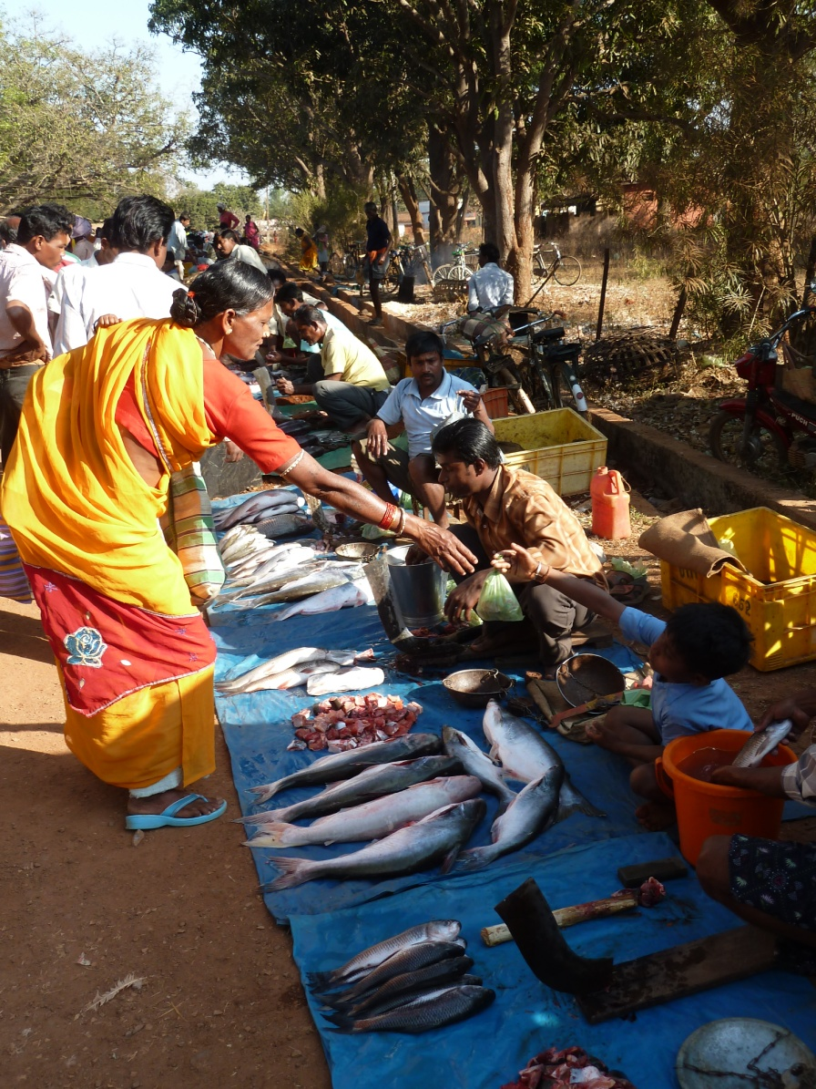
Commerce in the Community
[Nagarnar Market, Bastar, Central India. Photographs By Ian and Janie]

Slide 23
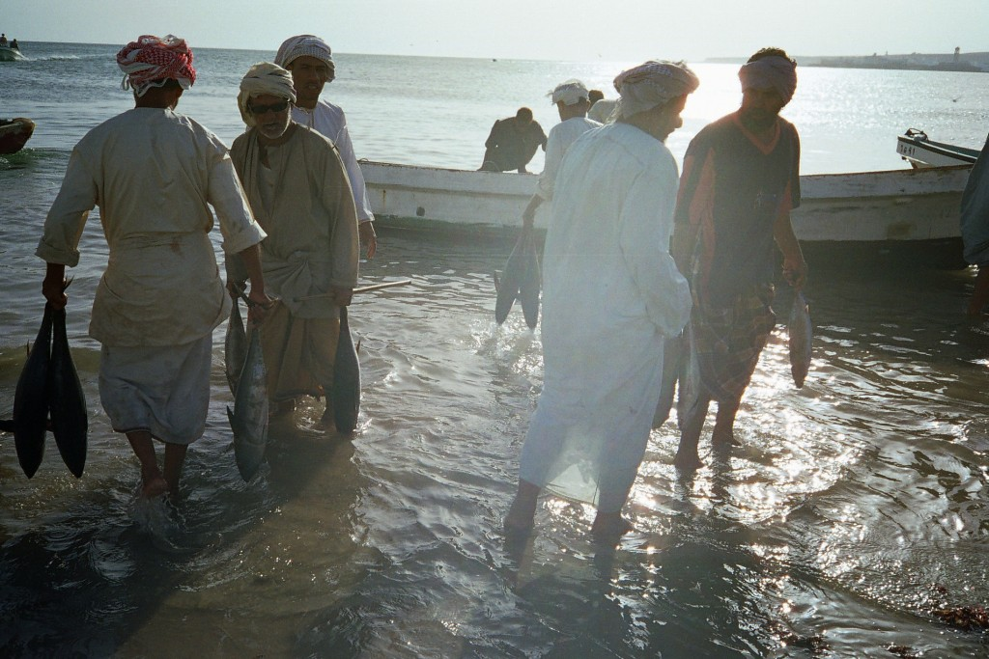
Early Morning Fish, Sur, Oman
[Photograph by Janie]

Slide 24
Price Your Own Fish
Thank you!

