Slide 1

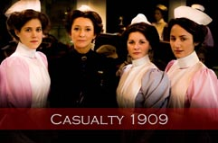

Acting on Evidence:
Medical Advice and Historical Drama
Professor John Powell, 18 October 2012

Slide 2
The role of the medical advisor
Concept
Treatment
First script
Series scripts
Production
Post-production

Slide 3
authenticity vs drama?

Slide 4
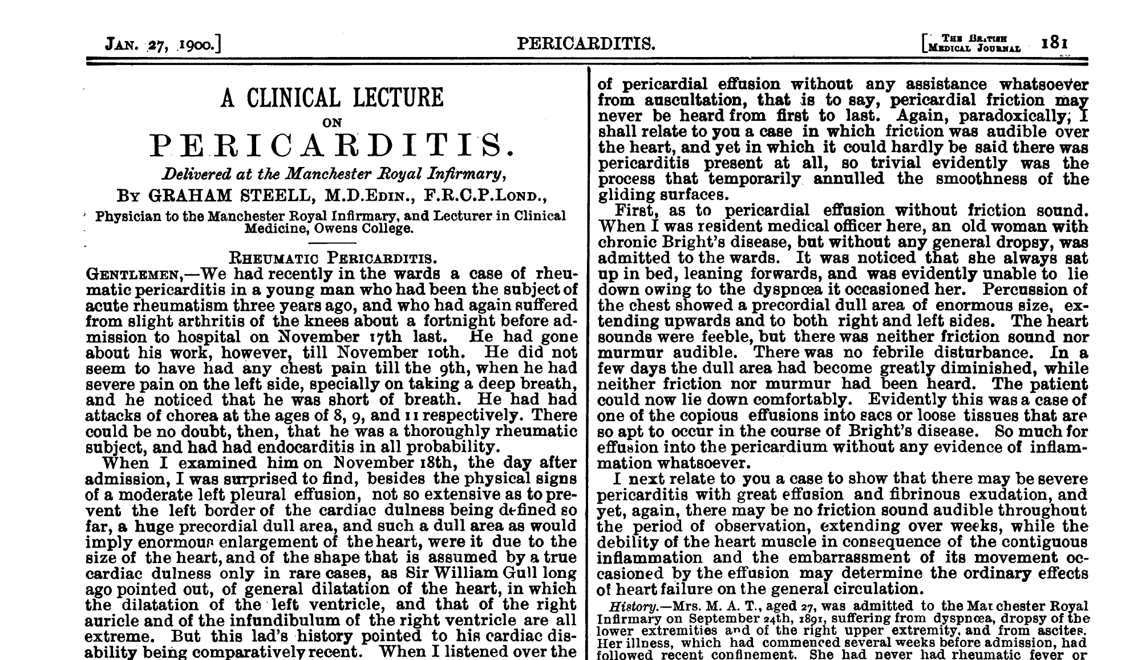

Slide 5
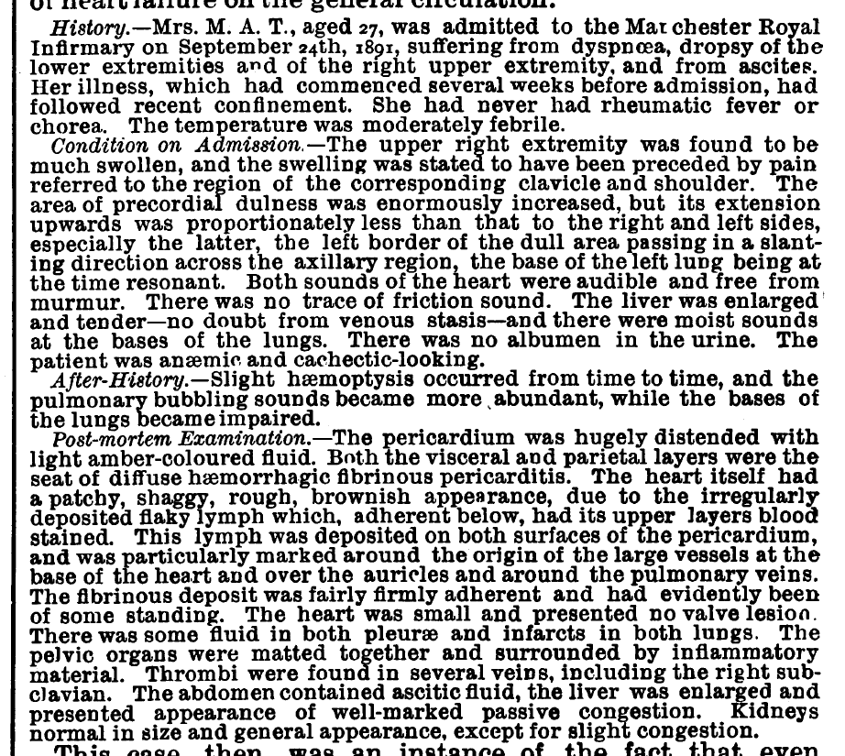

Slide 6


Slide 8
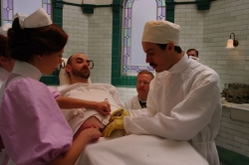

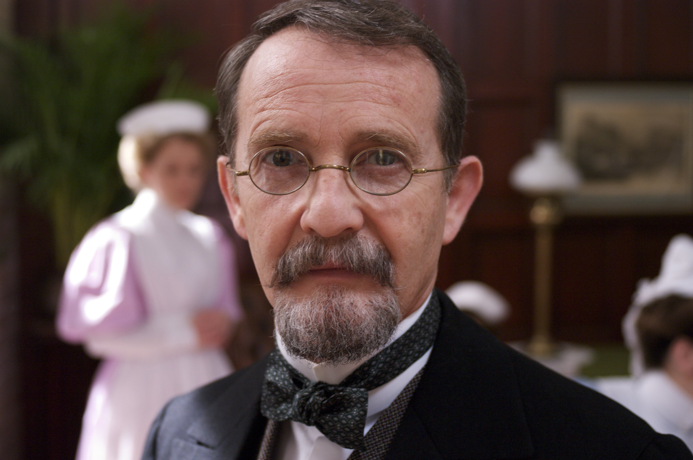

Slide 9
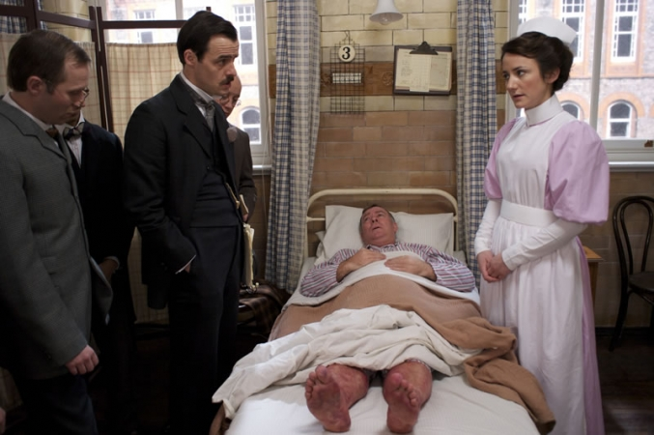

Slide 10


Slide 11
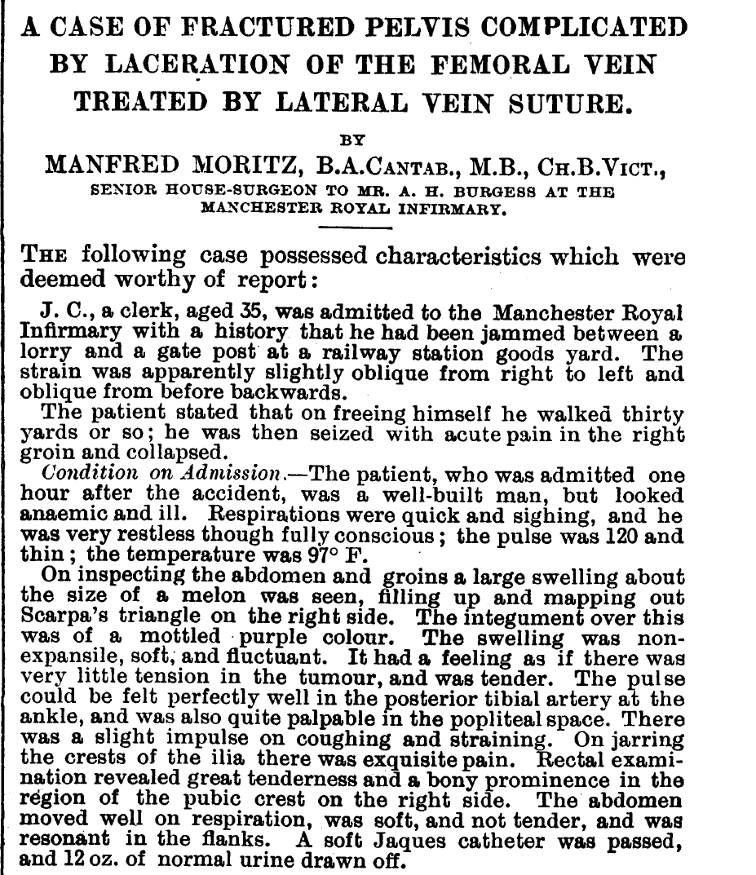

Slide 12
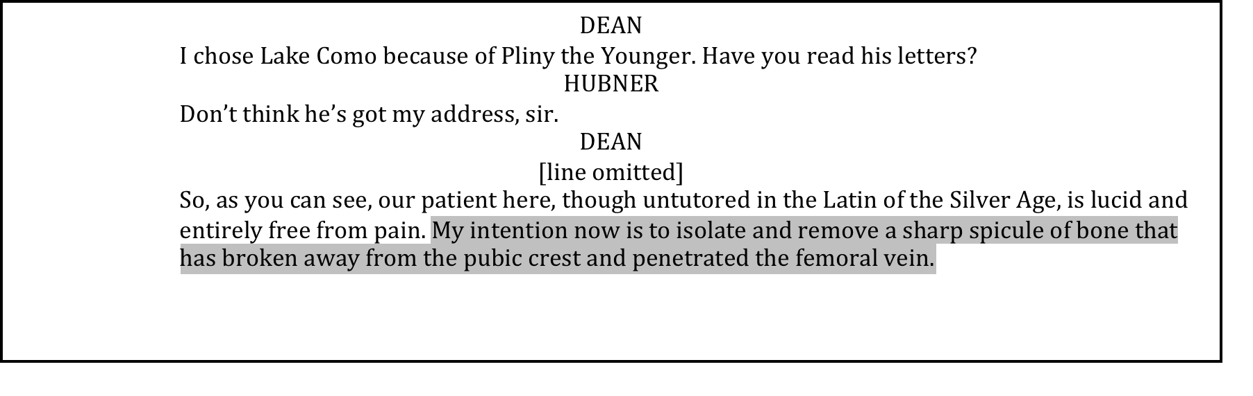

Slide 13
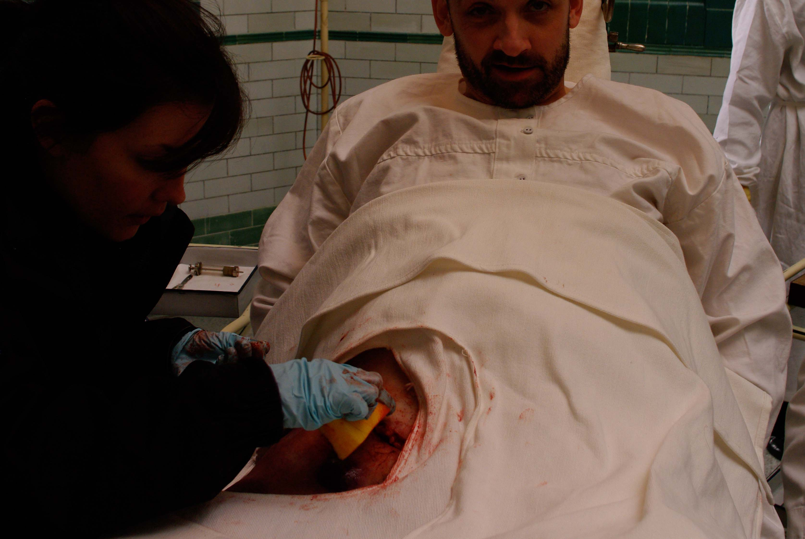

Slide 14
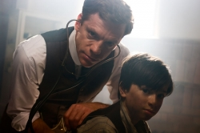

Slide 15
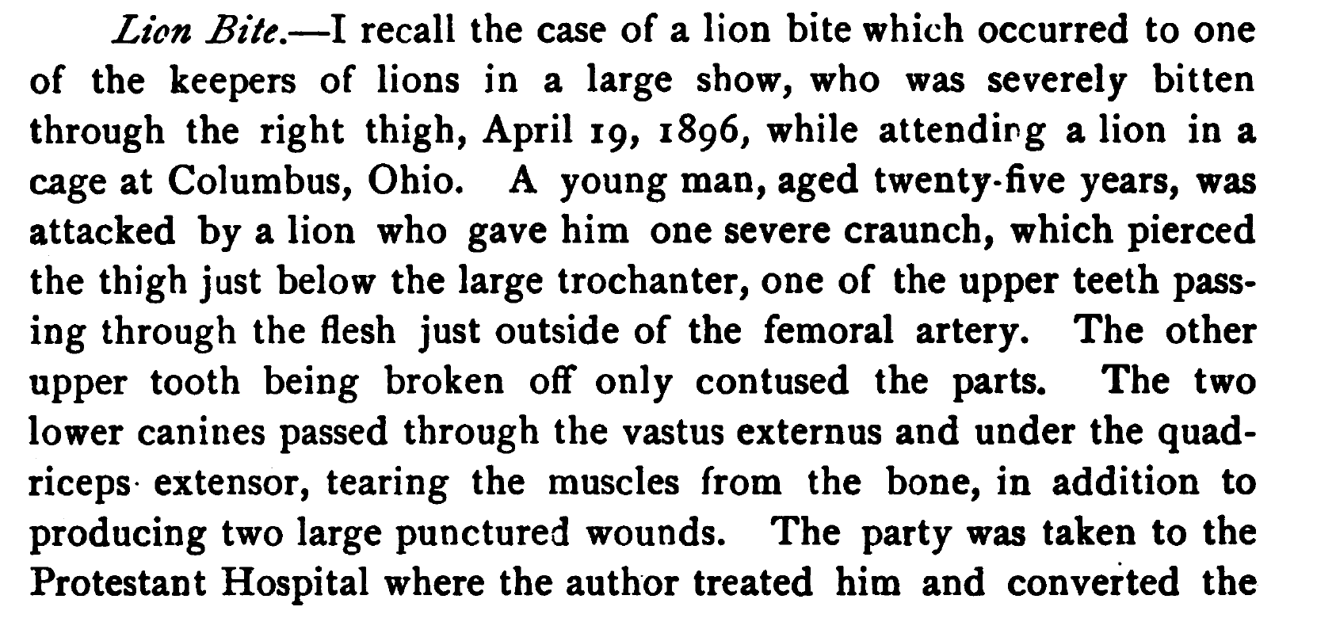

Slide 16

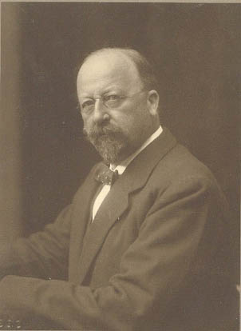

Slide 17
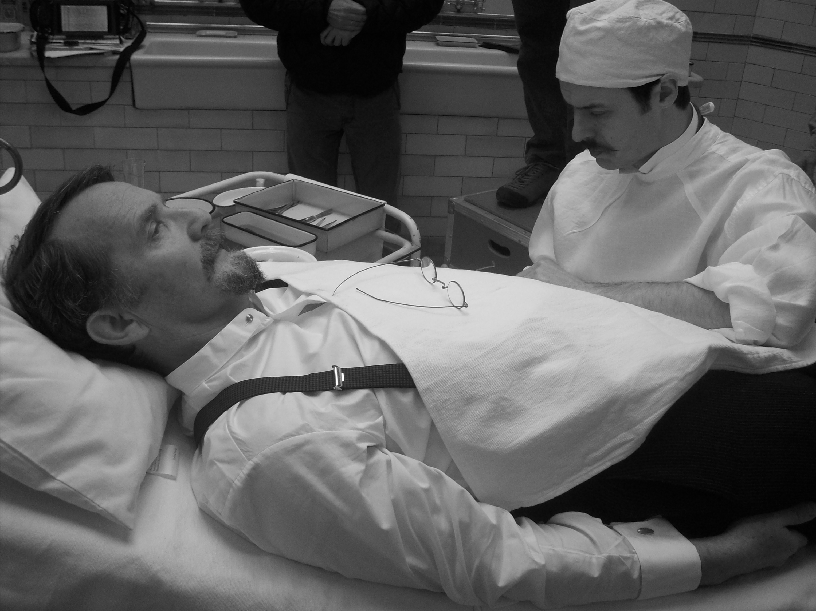
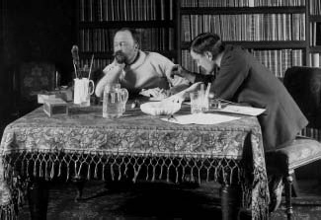

Slide 18
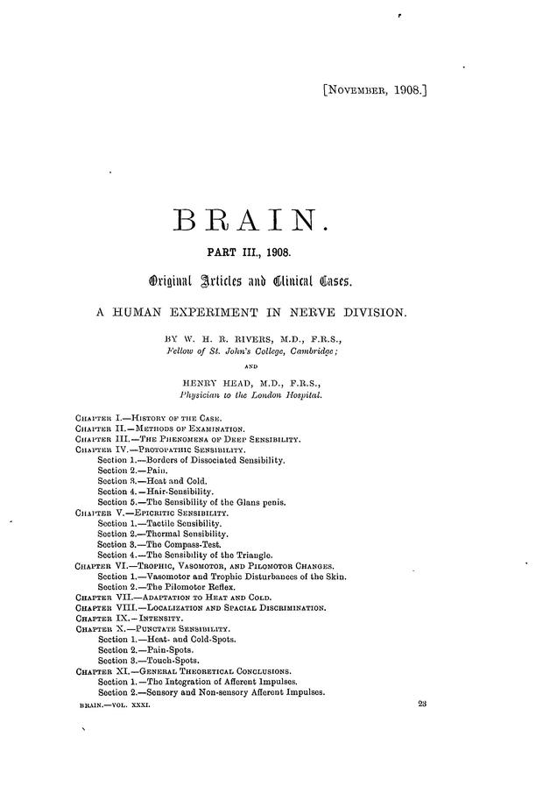

Slide 19
“An incision 6 1/2 in. (16'5 cm.) long was made in the outer bicipital fossa extending along the axial line of the left upper extremity ; this wound was almost exactly bisected by the fold of the elbow. After turning back the skin, the supinator longus was hooked outwards, and the radial nerve (ramus superficialis nervi radialis) was divided at the point where it arises from the musculo-spiral (N. radialis). A small portion was excised, and the ends united with two fine silk sutures. The external cutaneous nerve (N. cutaneus antibrachii lateralis) was also divided where it perforates the fascia, above the point where its two branches are given off to supply the anterior and posterior aspects of the pre-axial half of the forearm. The nerve was sutured with fine silk, and the wound was closed with silk sutures, without drainage. The limb was put up on a splint with the forearm flexed at the elbow, and the whole hand was left free for testing. The wound healed by first intention.”

