Slide 1
IS ONE INDIVIDUAL's radicalism another's right to free speech?
Johanne Delahunty qc

Slide 2
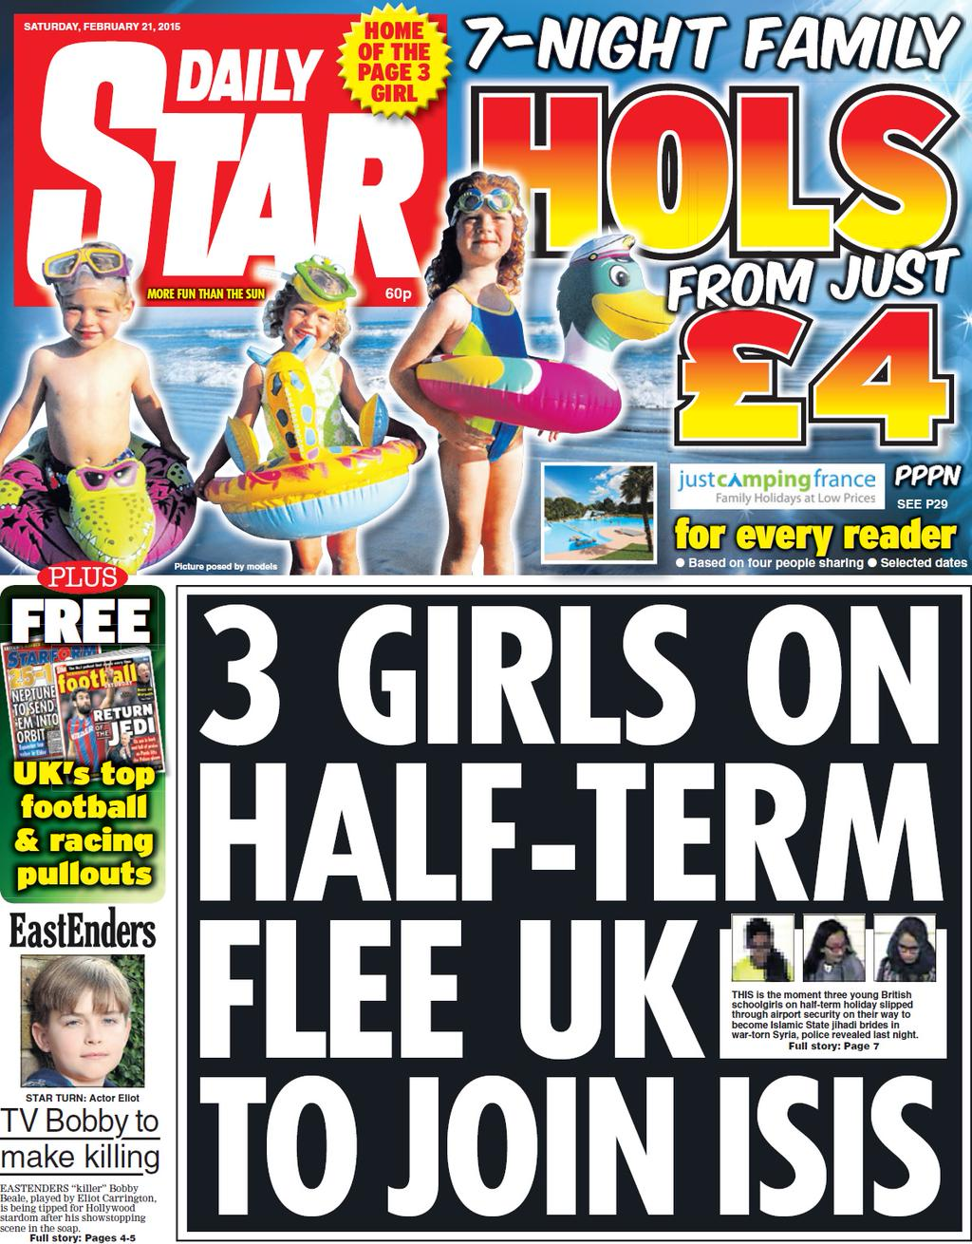
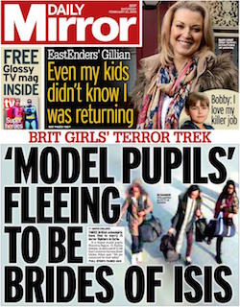
Introduction
IS ONE INDIVIDUAL's radicalism another's right to free speech?
Behind the headlines
Protect children
Radicalism cases
High Court
Guidance

Slide 3
“Radicalisation Cases in the Family Court”
IS ONE INDIVIDUAL's radicalism another's right to free speech?
'The recent months have seen increasing numbers of children cases coming before the Family Division and the Family Court where there are allegations or suspicions: that children, with their parents or on their own, are planning or attempting or being groomed with a view to travel to parts of Syria controlled by the so-called Islamic State; that children have been or are at risk of being radicalised; or that children have been or at are at risk of being involved in terrorist activities either in this country or abroad’.

Slide 4
areas to explore
IS ONE INDIVIDUAL's radicalism another's right to free speech?
What do we mean by ‘radicalisation’ in a family court?
Human Rights
What’s the problem?
Stage 1: The trigger for intervention
Routes to protection
Stage 2: Threshold
Evidence gathering: what is relevant?
Police co-operation and its limitations
Stage 3: Disposal: what happens to the child and the family?

Slide 5
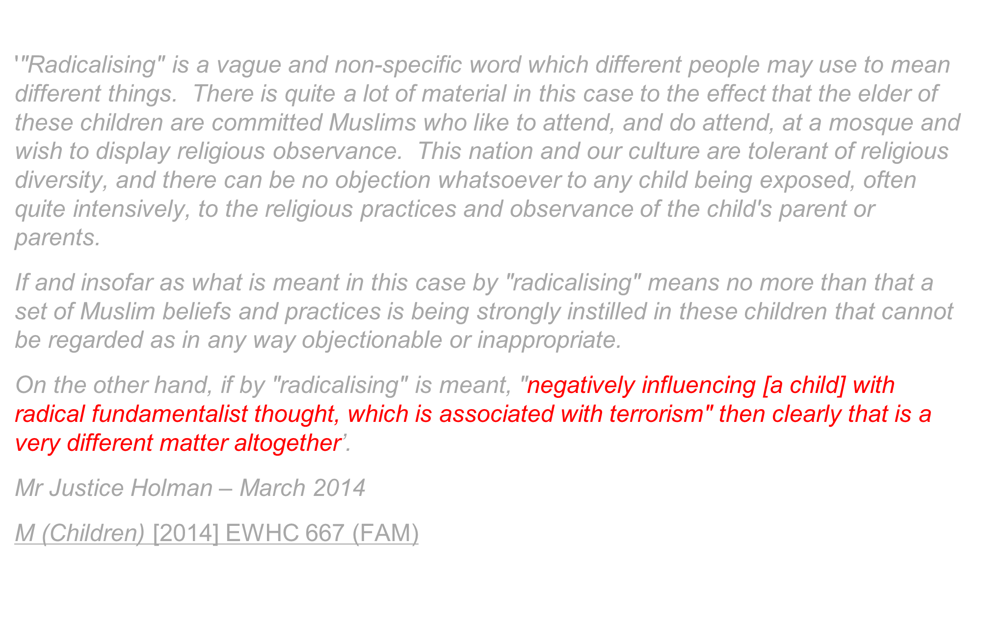
What do we mean by ‘radicalisation’ in a family court?
IS ONE INDIVIDUAL's radicalism another's right to free speech?
“Radicalisation refers to the process by which a person comes to support terrorism and extremist ideologies associated with terrorist groups.”
First definition March 2014 Holman J
Prevent Duty Guidance
Academic papers
Family Court procedures

Slide 6
HUMAN RIGHTS
IS ONE INDIVIDUAL's radicalism another's right to free speech?
Article 9: everyone has the right to freedom of thought, conscience and religion
Article 10: the right to freedom of expression
Article 11: the right to freedom of association
Article 8: the right to respect for his or her private and family life, home and correspondence.
Article 6: Right to Fair trial: everyone is entitled to a fair and public hearing.
Limitations
Article 8 Private Life And Family Life
Family life
Any stable relationship included
May be affected when the state intervenes to separate family members e.g. removing a child into care, deporting a family member
Private life
Personal autonomy (travel)
Private information (social media)
State surveillance (being filmed at demonstrations)

Slide 7
Re B (Care Proceedings; Appeal) Lord Wilson
IS ONE INDIVIDUAL's radicalism another's right to free speech?
‘Counsel seeks to develop Hedley J’s point. He submits that “many parents are hypochondriacs, many parents are criminals or benefits cheats, many parents discriminate against ethnic or sexual minorities, and many parents support vile political parties or belong to unusual or militant religions. All of these follies are visited upon their children, who may well adopt or ‘model’ them in their own lives but those children could not be removed for those reasons." I agree’.
Para 28

Slide 8
What’s the problem?
IS ONE INDIVIDUAL's radicalism another's right to free speech?
Risk of serious harm to a child
Nature of risks
Impact of exposure to material
Counter risks of intervention

Slide 9
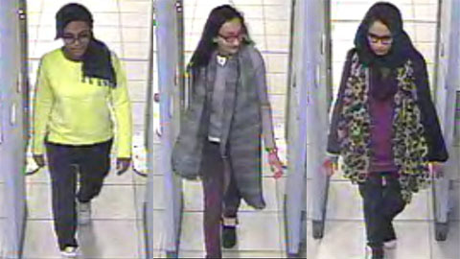
Stage 1: The trigger for intervention
IS ONE INDIVIDUAL's radicalism another's right to free speech?
Children planning, attempting or being groomed to travel to Syria;
Parents planning or attempting to travel to Syria with their children;
Children at risk of being radicalised (within the home or by outside influences); and
Children at risk of being involved in terrorist activities.
Metropolitan Police

Slide 10
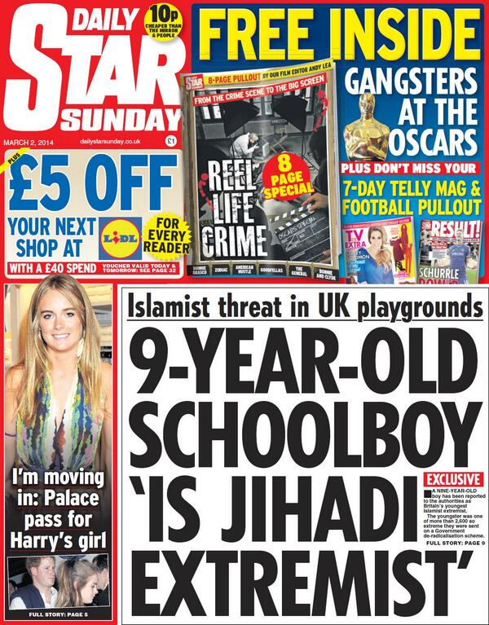
Routes to protection
IS ONE INDIVIDUAL's radicalism another's right to free speech?
Police Protection
Emergency Protection Order
Wardship
Part IV Children Act 1989

Slide 11
Stage 2: Threshold
IS ONE INDIVIDUAL's radicalism another's right to free speech?
Children Act 1989 s31(2)
(2) A court may only make a care order or supervision order if it is satisfied—
(a) that the child concerned is suffering, or is likely to suffer, significant harm; and
(b) that the harm, or likelihood of harm, is attributable to—
(i) the care given to the child, or likely to be given to him if the order were not made, not being what it would be reasonable to expect a parent to give to him; or
(ii) the child’s being beyond parental control.
Threshold - previous lecture
Radical belief system
Same criteria as any family case
Appendix to handout
http://marciamountshoop.com/2012/05/03/open-door-living/

Slide 12
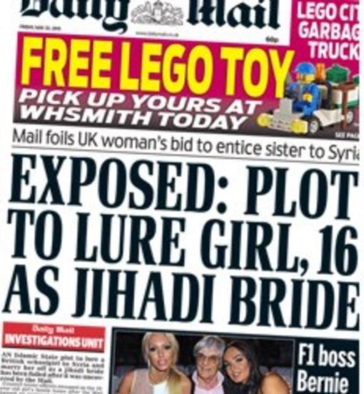
Evidence gathering: what is relevant?
IS ONE INDIVIDUAL's radicalism another's right to free speech?
Between January 2012 to December 2015 1839 children aged 15 and under were referred to ‘Channel’
"Prevent" duty
"Channel"
Needs to be a child at risk

Slide 13
Police co-operation and its limitations
IS ONE INDIVIDUAL's radicalism another's right to free speech?
"Radicalisation in the Family Courts" Guidance
Police intelligence
Local Authority evidence
Disclosure guidelines
Jigsaw
ISIS Manual
Future co-operation?
http://www.flacso.org/

Slide 14
Pieces of the jigsaw
IS ONE INDIVIDUAL's radicalism another's right to free speech?
Potential relevance:
a baby has not been immunised,
a child attends a faith school or are home schooled,
a family prays at a particular mosque or seeks guidance from a particular Imam.
Financial activity:
eBay activity
unsecured credit
When en route to a port /airport,
has the male family member shaved his beard and adopted western clothing?
has a female removed her burka, revealed her hair and face and wears western clothing
If a short family trip has been planned, why
is the car packed with multiple packs of bulk nappies,
47 items of underwear,
114 sanitary towels,
multiple unused sealed SIM cards
cash concealed around the car and on the children and families persons?

Slide 15
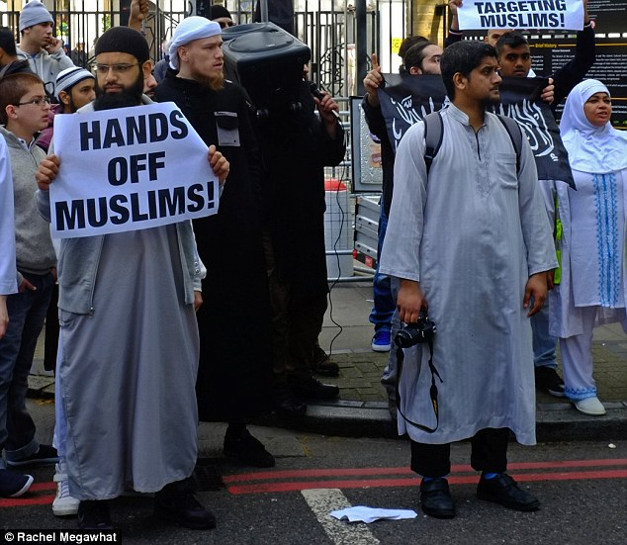
Stage 3: Disposal:
what happens to the child and the family?
IS ONE INDIVIDUAL's radicalism another's right to free speech?
No placements to date permanently outside family network
No criticism of parenting
Wider family network
GPS
Risks in decisions made

Slide 16
Concluding remarks
IS ONE INDIVIDUAL's radicalism another's right to free speech?
A fluid situation
No new law
Applicable to other situations
Rooted in Family Law and Human Rights Act
Protection of the child is constant
http://quotesgram.com/thank-you-for-listening-quotes/

Slide 17
future lectures
IS ONE INDIVIDUAL's radicalism another's right to free speech?
When Legal Worlds Collide
Thursday 26th January 2017
Guilty Until Proven Innocent
Thursday 2nd March 2017
Expert Witnesses: A Zero Sum Game?
Thursday 2nd March 2017

