Slide 1
Gardening Entrepreneurs
Professor Sir Roderick Floud

Slide 2
Topics
1. Introduction
2. Entrepreneurship:
2.1 Seizing an opportunity
2.2 Organising the work
2.3 Managing money
3. Conclusion

Slide 3
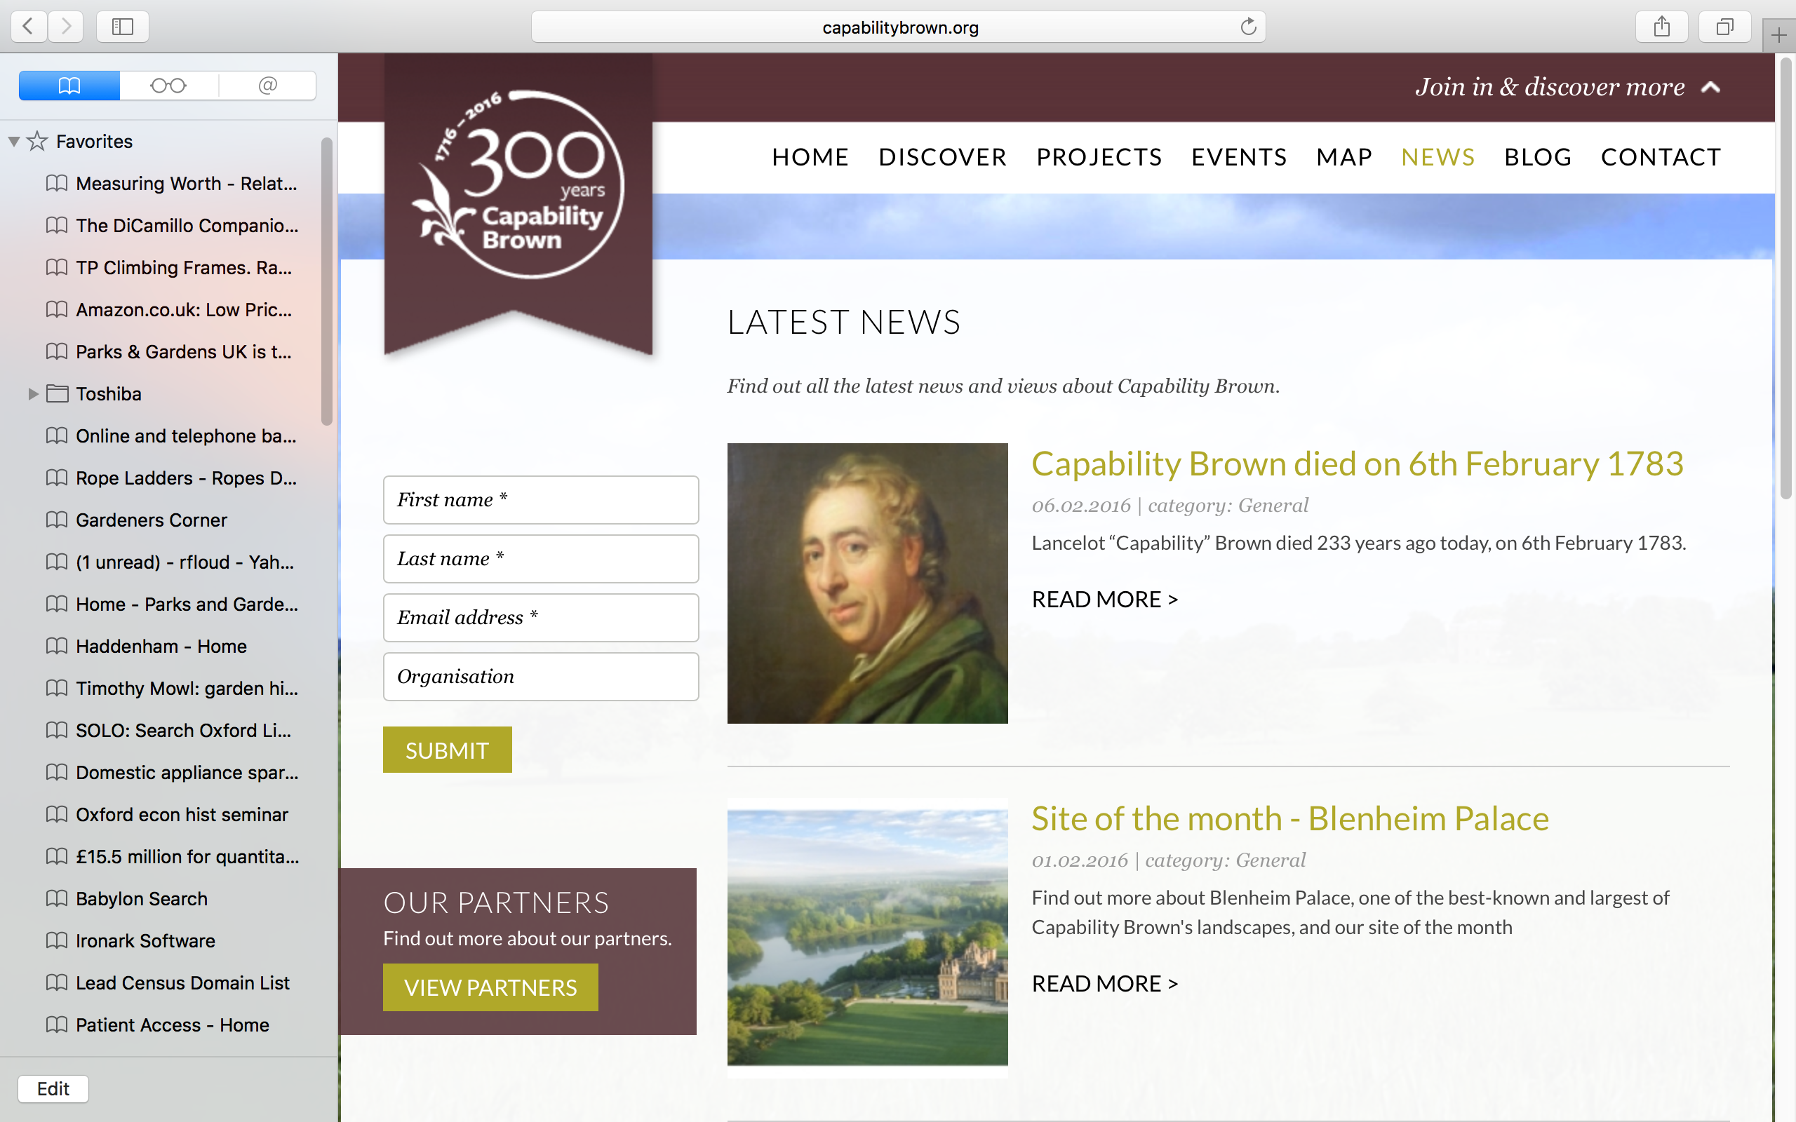

Slide 4
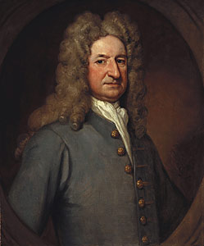
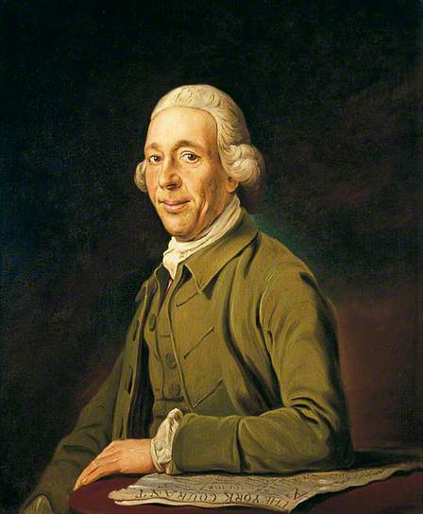
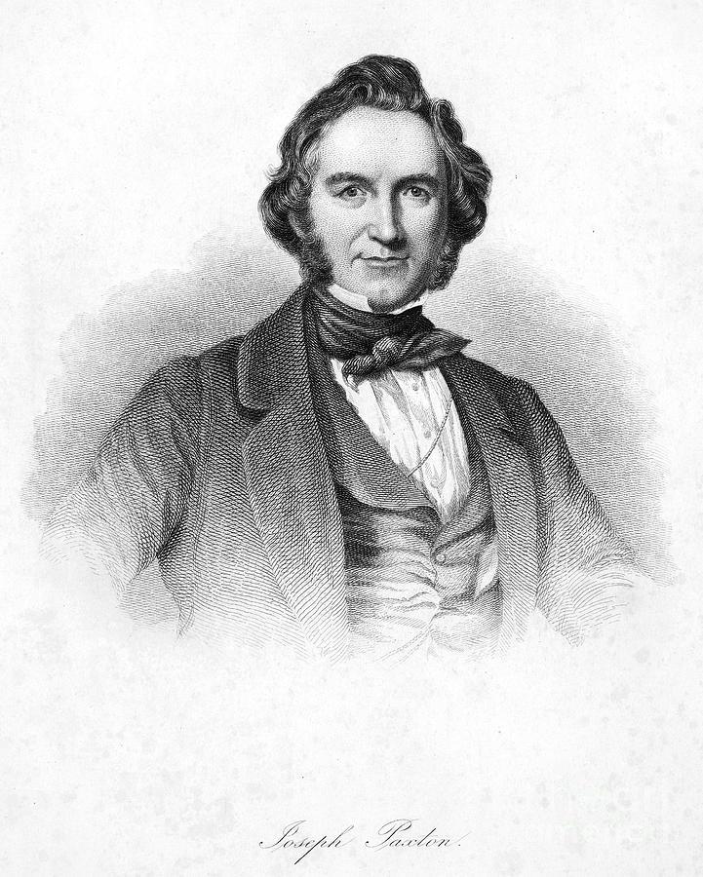
Henry Wise
Lancelot Brown
Joseph Paxton

Slide 5
Henry Wise (1653-1738)

Slide 6
Plan of Brompton Park Nursery, Kensington

Slide 7
Brompton Stocks or Gillyflowers

Slide 8
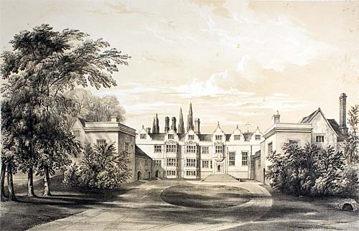
Warwick Priory

Slide 9
Lancelot “Capability” Brown (1716-1783)

Slide 10
Kiddington Hall

Slide 11
Grimsthorpe Castle

Slide 12
Grecian Valley, Stowe

Slide 13
Croome Court

Slide 14
Fenstanton Manor

Slide 15
Sir Joseph Paxton (1803-1865)

Slide 16
Chatsworth, Brown landscape from the Cascade

Slide 17
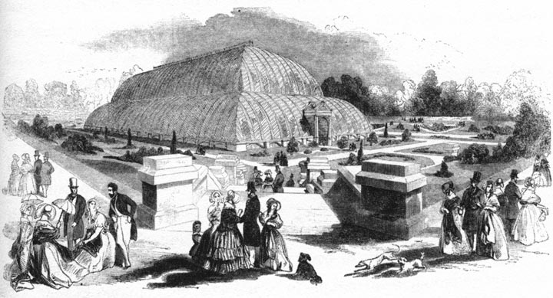
Chatsworth: The Great Stove

Slide 18
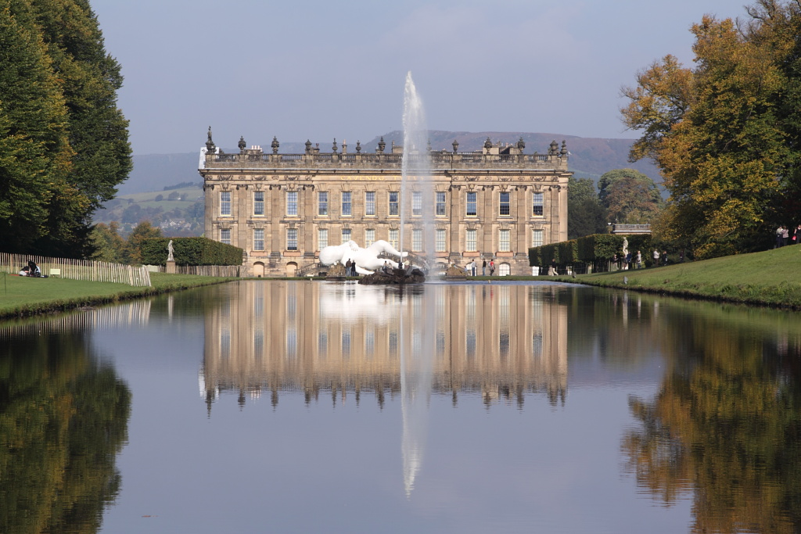
Chatsworth: the Emperor Fountain

Slide 19
Mentmore and Chateau de Ferrières

Slide 20
Henry Wise
Lancelot Brown
Joseph Paxton

Slide 21
How rich were they?
Name | Date | £ at time | £ today
Henry Wise (at death) | 1737 | £100,000 | £305 million
Lancelot Brown (salary at Stowe) | 1741 | £25 | £69,580
Lancelot Brown (contracts) | 1761-1783 | £320,000 | £718 million
Lancelot Brown purchase of Longstanton estate | 1767 | £13,000 | £29.35 million
Lancelot Brown (bequests at death) | 1783 | >£10,000 | >£19.3 million
Joseph Paxton (salary at Chatsworth) | 1826 | £70 | £100,200
Joseph Paxton (at death) | 1865 | >£180,000 | >£158.2 million

Slide 22
1. Seizing an opportunity
2. Organising the work
3. Managing money

Slide 23
Royal spending

Slide 24
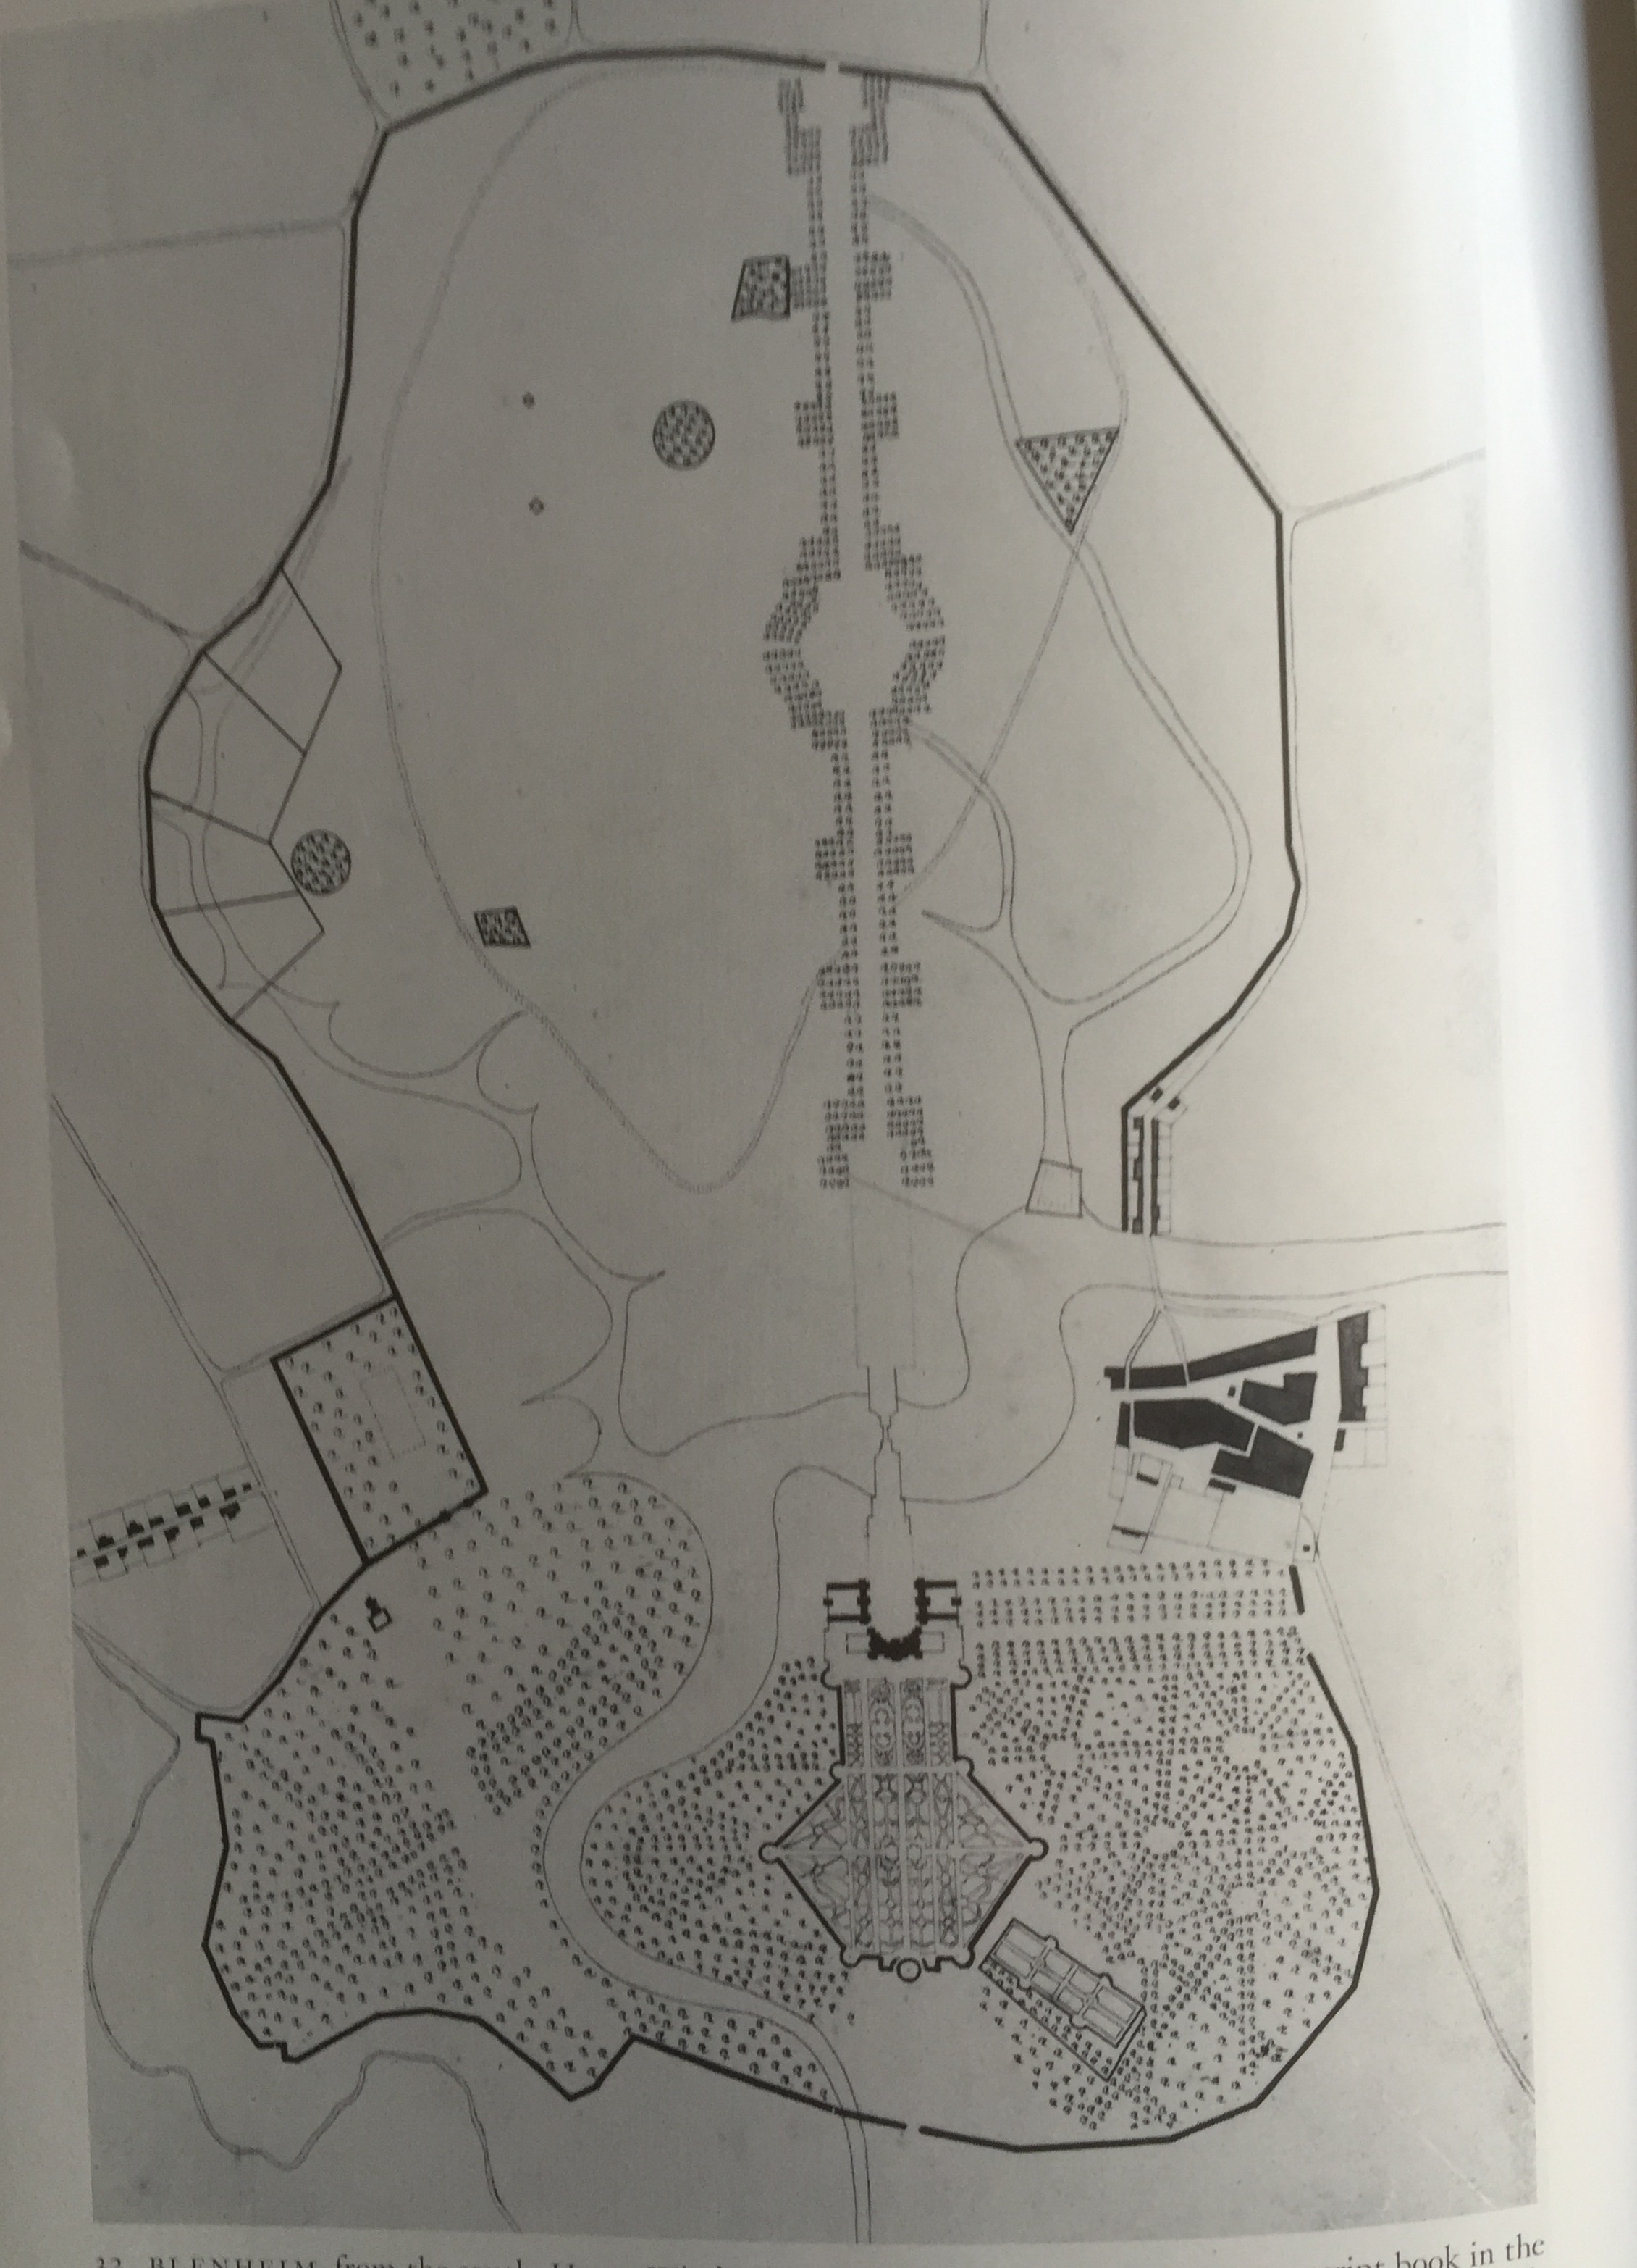
The Wise Garden at Blenheim

Slide 25
Painshill

Slide 26
The Crystal Palace,
Hyde Park

Slide 27
The Crystal Palace and gardens:
Sydenham

Slide 28
Wrest Park

Slide 29
Brown account book

Slide 30
Privy Garden from Hampton Court Palace

Slide 31
1. Seizing an opportunity
2. Organising the work
3. Managing money

Slide 32
Wise contract as Royal Gardener

Slide 33
Blenheim Palace and lake

Slide 34
Blenheim cascades

Slide 35
Greenhouses for the millions

Slide 36
1. Seizing an opportunity
2. Organising the work
3. Managing money

Slide 37
Conclusion

Slide 38
Henry Wise
Lancelot Brown
Joseph Paxton

