Slide 1
How to make Western economies more competitive
Fourth Gresham Lecture
Douglas McWilliams
Mercers School Memorial Professor of Commerce at Gresham College
Centre for economics and business research ltd
Unit 1, 4 Bath Street, London EC1V 9DX
t: 020 7324 2850 f: 020 7324 2855 e: advice@cebr.com w: www.cebr.com

Slide 2
Objective
To discuss economic policies necessary to prevent the Western world falling into a competitiveness trap
Discuss in the UK context but conclusions applicable not only to the rest of Western Europe but also to other Western economies like the US

Slide 3
Overview
The earlier lectures
The new theory of economic growth
Exchange rate policy
Competitiveness policy
Counter inflation policy
The economic payoff

Slide 4
Key points from the earlier lectures
The ‘supercompetitiveness’ of the emerging economies;
The continuing shift in the terms of trade in favour of primary products and away from finished goods and services; and
The likelihood that overall world economic growth will be constrained because of limits from the lack of natural resources, meaning that some of the enhanced economic growth in the emerging economies will be at the expense of lower growth in the mature economies.

Slide 5
The new growth theory
Economic growth is not simply a function of supplies of factors but is constrained by demand
Demand is particularly affected by the balance of payments position
Demand is also limited by inflationary tendencies – for example though its impact on the exchange rate
Factors of production are endogenous

Slide 6
Three critical elements of policy
Exchange rate policy
Competitiveness policy
Counter inflation policy

Slide 7
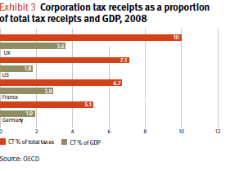

Slide 8
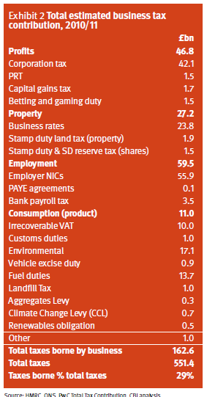

Slide 9
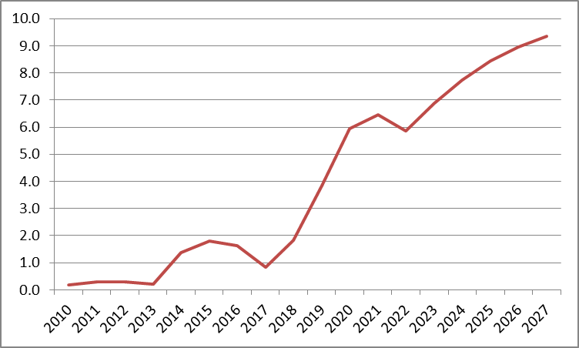
The 2020 Tax Commission’s proposals were estimated to boost GDP by 10% after 17 years
Impact on GDP compared with base case (%)

Slide 10
The City’s impact on the balance of payments current account
£ millions per annum

Slide 11
Cost of living compared with the US – IMF data
Afghanistan | 47.9
India | 40.8
China | 64.3
Russia | 61.6
Greece | 98.1
Korea | 74.1
Spain | 99.4
Italy | 109.7
Japan | 133.9
France | 121.1
UK | 109.4
Germany | 111.4
Australia | 153.8
Canada | 124.5
Ireland | 116.6
US | 100.0
Singapore | 75.7
Norway | 158.5

Slide 12
Cost of living in the UK compared with the OECD average
Actual individual consumption (2) | 111
Food and non-alcoholic beverages (3) | 105
Food (4) | 105
Bread and cereals (5) | 96
Meat (6) | 123
Fish (7) | 76
Milk, cheese and eggs (8) | 98
Oils and fats (9) | 95
Fruits, vegetables, potatoes (10) | 120
Other food (11) | 95
Non-alcoholic beverages (12) | 116
Alcoholic beverages, tobacco and narcotics (13) | 156
Alcoholic beverages (14) | 122
Tobacco (15) | 211
Clothing and footwear (16) | 103
Housing, water, electricity, gas and other fuels (17) | 118
Household furnishings, equipment and maintenance (18) | 106
Health (19) | 96
Transport (20) | 131
Personal transport equipment (21) | 108
Communication (22) | 97
Recreation and culture (23) | 114
Education (24) | 108
Restaurants and hotels (25) | 112
Miscellaneous goods and services (26) | 115
Actual individual consumption (2) | 111
Food and non-alcoholic beverages (3) | 105
Food (4) | 105
Bread and cereals (5) | 96
Meat (6) | 123
Fish (7) | 76
Milk, cheese and eggs (8) | 98
Oils and fats (9) | 95
Fruits, vegetables, potatoes (10) | 120
Other food (11) | 95
Non-alcoholic beverages (12) | 116
Alcoholic beverages, tobacco and narcotics (13) | 156
Alcoholic beverages (14) | 122
Tobacco (15) | 211
Clothing and footwear (16) | 103
Housing, water, electricity, gas and other fuels (17) | 118
Household furnishings, equipment and maintenance (18) | 106
Health (19) | 96
Transport (20) | 131
Personal transport equipment (21) | 108
Communication (22) | 97
Recreation and culture (23) | 114
Education (24) | 108
Restaurants and hotels (25) | 112
Miscellaneous goods and services (26) | 115
OECD average = 100
Source: OECD

Slide 13
Regional population density, the Netherlands, Switzerland, Germany, Belgium and the UK

Slide 14
Prices lower by 8%
Real income gain of £2,000 per household
GDP 15% higher after 10 years
The gains from a counter inflation policy

Slide 15
How to make Western economies more competitive
Fourth Gresham Lecture
Douglas McWilliams
Mercers School Memorial Professor of Commerce at Gresham College
Centre for economics and business research ltd
Unit 1, 4 Bath Street, London EC1V 9DX
t: 020 7324 2850 f: 020 7324 2855 e: advice@cebr.com w: www.cebr.com

