Slide 1
21st Century Threats – HIV/AIDS
Gresham College, Feb. 27, 2012
By Markus Haacker

Slide 2
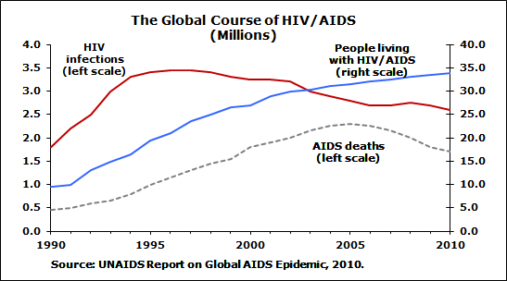
Figure No. 2

Slide 3
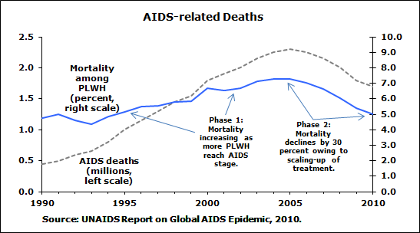
Figure No. 3

Slide 4
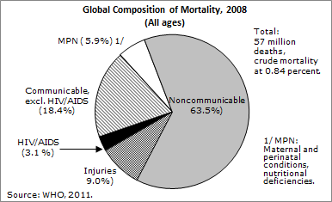
Figure No. 4

Slide 5
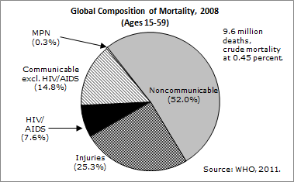
Figure No. 5

Slide 6
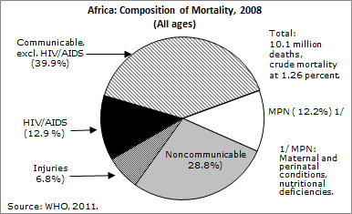
Figure No. 6

Slide 7
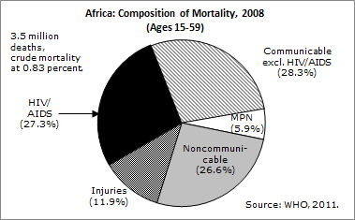
Figure No. 7

Slide 8
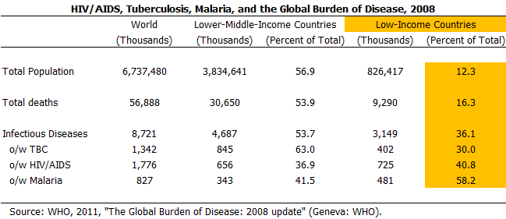

Slide 9
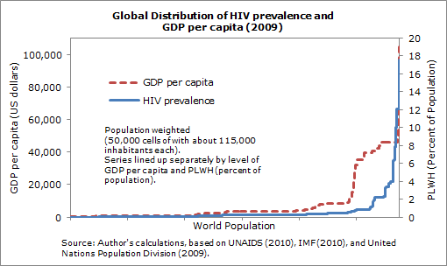

Slide 10
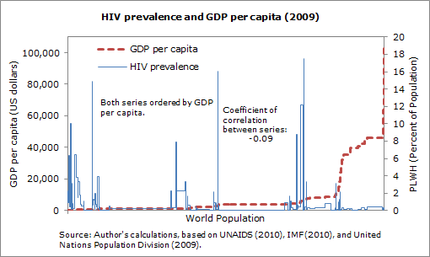

Slide 11
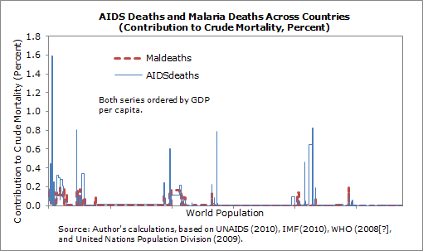

Slide 12
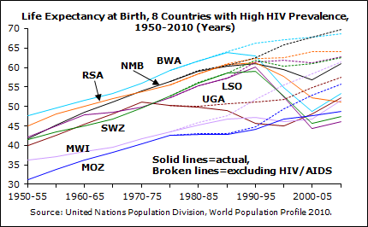

Slide 13
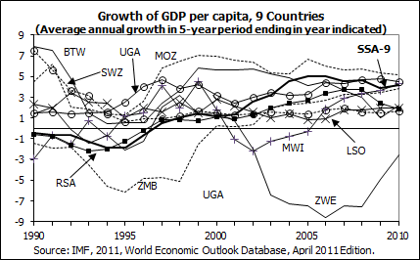

Slide 14
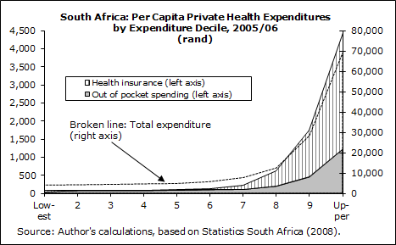

Slide 15
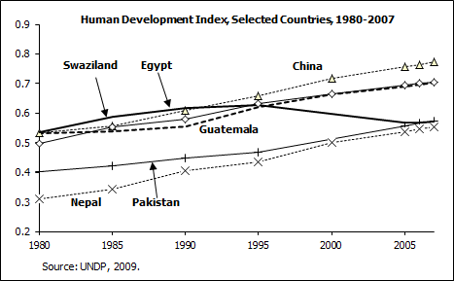
Figure No. 15

Slide 16
Figure No. 16

Slide 17
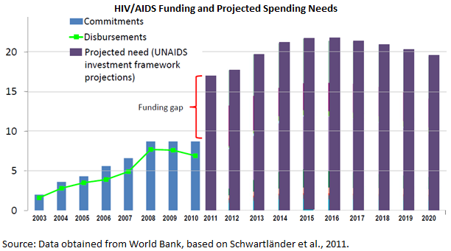
Figure No. 17

Slide 18
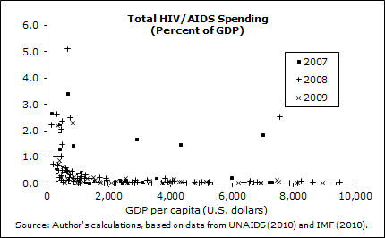
Figure No. 18

Slide 19
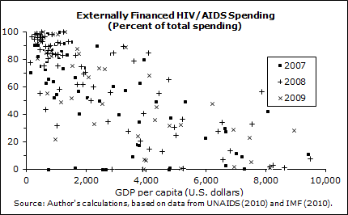
Figure No. 19

Slide 20
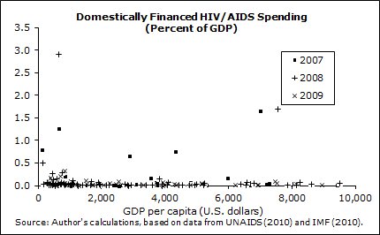
Figure No. 20

Slide 21
Thank you for your attention. I will be happy to answer your questions, after the lecture or by email (contact@devgro.com). My website provides many publications on economic and financial aspects of HIV/AIDS and the global response (http://mh.devgro.com).

