Slide 1
Killing Us Softly:
How Demographics Drives Global Economics
Gresham College
May 2013

Slide 2
The creation of wealth
Killing Us Softly: How Demographics Drives Global Economics
Basic economic accounting suggests that economic growth depends on how many people are working and their productivity.
  Globally working age populaces beginning to fall, at times dramatically
Can we maintain present levels of prosperity?
  Dependency ratios across much of Europe are now rising
How might prosperity be generated in future?
  How might we cope with present trends being extended?
Notes:
2
Demographics are long term – longer than the typical political time horizon
Look back as far as you might want to look forward, if only to get an idea of how things might change, and how they might not.
For decades, economists and social thinkers have debated the influence of population change on economic growth. Three alternative positions define this debate: that population growth restricts, promotes, or is independent of economic growth. Proponents of each explanation can find evidence to support their cases. All of these explanations, however, focus on population size and growth. In recent years, however, the debate has under-emphasized a critical issue, the age structure of the population (that is, the way in which the population is distributed across different age groups), which can change dramatically as the population grows. Because people's economic behaviour varies at different stages of life, changes in a country's age structure can have significant effects on its economic performance.
Demographics is in many ways much more certain than any other long term forecast, but that does not make it in any way certain at all. Let’s try and draw some conclusions – without reverting to simple extrapolations!

Slide 3

Global population
Notes:
Looking at the world in terms of population, as opposed to land mass, we get the following sort of map.
Clearly we can see that the world’s second largest country geographically, where I was bporn, is not as important in population terms as the UK, which is why Mark Carney is coming here.
Let’s look at some demographic concepts.

Slide 4
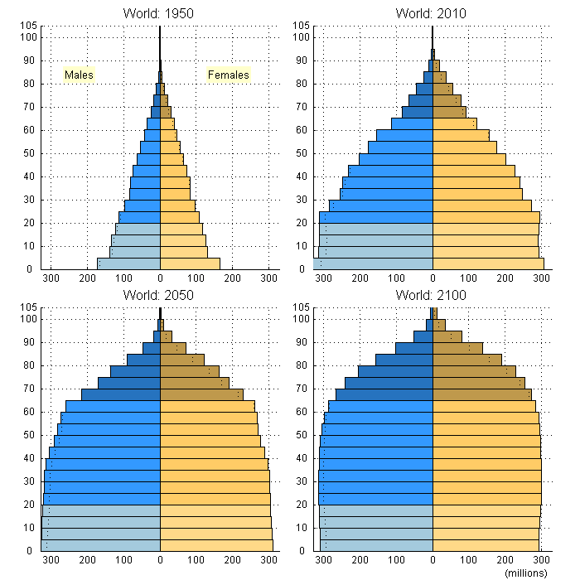
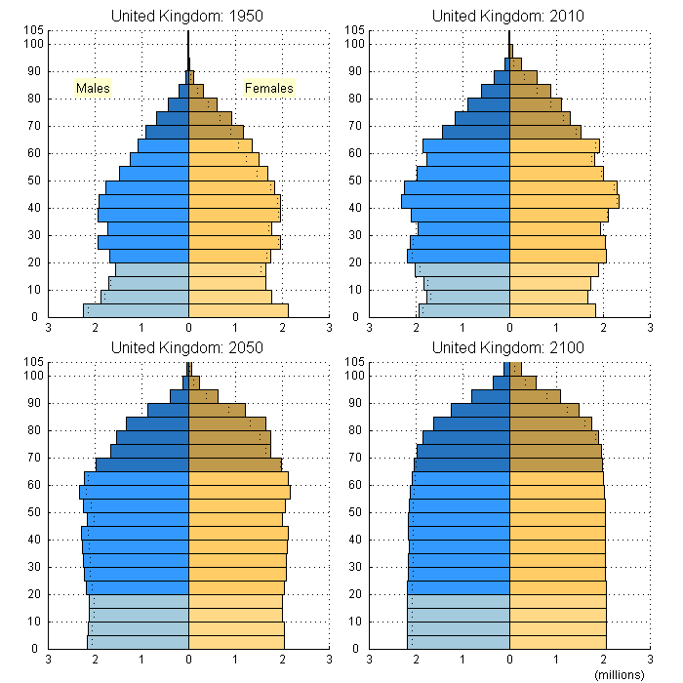
Global population trends
The world is getting older… birth rate has fallen by 50% since 1950
The challenge is shifting from one of dependent children, to dependent adults
Source: UN Population Database
Notes:
Given the way in which global age distributions have developed, it is easy to see why welfare states were constructed in the way that they were, equally it is easy to see why they are no longer sustainable and the way in which the post war period with a rising number of people coming onto the jobs market could lead to substantial economic growth.
The Second World War had a dramatic effect on Europe and to a lesser extend the United States, but the main effect was not deaths, but a lack of births.
There has been a lot of commentary on dependency ratios, as we shall see this is not a difficult problem to solve, it is just that the choices are so hard. But looking at dependency ratios obscures the more difficult and important challenge, how do economics and societies cope with lower levels of economic activity. In other words a dependency ratio is concerned with those in receipt of welfare, but the bigger problem is actually the creation of sufficient wealth in the first place.
Birth rate = Number of births over a given period divided by the person-years lived by the population over that period. It is expressed as number of births per 1,000 population.

Slide 5
Global fertility rates
Development clearly has a negative correlation with numbers children
Driving factors include: increased life expectancy, reduced childhood mortality, improved female literacy and independence, urbanization dependency on state rather than family for welfare and cost of large families.
Data suggests there is a minimum level of fertility: the number of countries with total fertility rates of less than 1.3 fell from 21 in 2003 to five in 2008.
Global Fertility and GDP (PPP)
(2009 data)
Source: CIA World Fact book 2009
Notes:
What has happened as we have become more prosperous? We can afford more children, but we choose not to have them.
By 2060, estimates are that global birth rates will be ~11-12/1000, in line with where US and Europe are today
Urban hubs really depend upon continually drawing in people from rural areas/smaller cities and towns. Singapore is not on the chart, but is even more dramatic than HK

Slide 6
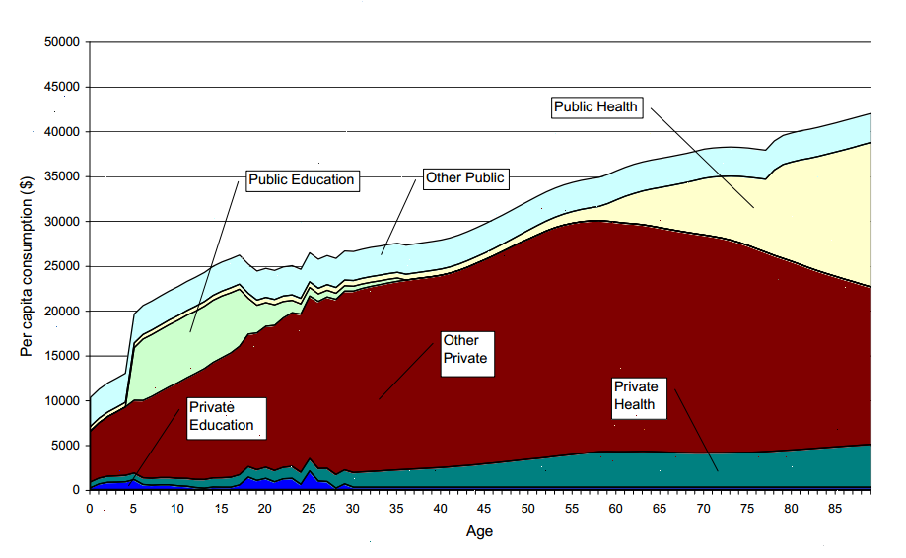
Life cycle economics
US Life Cycle Economic Consumption
(2009 data)
Baby Boomers
Source: NBER
Notes:
It is not just the number of people which is a critical factor, but the age profile of those people.
In the initial stages of a young and growing populace, there is a demographic dividend: more workers enter the market, there demands on the rest of society are low. This changes as time goes on and by late 60’s they are looking to draw considerable sums from the state.
Similar studies have been done on emerging economies revealing that for many emerging economics, public health spending is negligible.
Questions arise:
Can an economy afford to meet the demands of the populace
This chart does over state the seriousness of the problem, it shows not just an ideal, but assumes everyone lives to 90 years of age. That said, given the baby boomers are now hitting 65, it does seem reasonable to imagine they will live at least for the next 15 years.

Slide 7
UK – Variants in population projections
UK presently has a working age populace of 41 million
WAP is predicted to increase by 2 mln workers 2050
  High variant sees WAP population reach 65 mln by 2100, low variant sees population drop to 24 mln; median expects 42 mln.
In all cases UK working age populace is due to fall as a per cent of total population – so dependency ratios are set to worsen
UK Working Age Populace
(15-64/Total Population)
Source: UN Population Database
Notes:
Significant increase in population starts in early 1960’s, the baby boom trails in the mid 1970’s. When MacMillan said “You have never had it so good”, people responded!
What are the variables that lead to such differing outcomes?
Retirement ages vary - most people do not make it to 65 before they retire; while there is clearly a trend to not having a specific date for retirement, there is also an imperative people should be looking to remain in the workforce for a longer period of time.
Immigration / emigration (UK has in the last 10 years undergone largest net migration it has experienced in centuries) may yet change these projections, but the political cost of such changes is high and the needs and demands of new immigrants may differ widely from an ageing indigenous populace. Evidence from the Milken Institute in the US is that recent immigrants want services such as schools, they are less keen on financing of healthcare and pensions.
There is some variance in fertility rates, we are just coming through a period when many women seem to have delayed having children. For a time it seems that would not have children at all, but in fact they have simply delayed matters by 5-10 years.

Slide 8
UK – Working Age Population + Productivity vs GDP
Long Term – Growth is dependant on Population and Productivity increases
On average growth in WAP populace has accounted for ~20% of total growth.
GDP is consumption measure; Productivity an output measure
UK: WAP + Prod vs GDP
(1960 = 100)
Source: ONS, UN Population Database
Notes:
So what is the historic effect of demographics as opposed to productivity increases, historically the trends in the wider populace have added approximately 20% to the total growth figure.
More recently (last 5 years) demographic effect has been more muted as we reached a demographic plateau and are only now beginning to see falls in the working age populace. But this muting has been masked by significant disruption to the rest of the economy. It does not mean the effect is not there, it is just not observable given all the other factors at play.

Slide 9
Developed world – Working Age Population
Demographics drive economic growth
Baby Boom – starts in 1955, runs to 1970’s
  Key was economic prosperity of 1950’s, not return of soldiers
US and European working age population now at all time peak, set to decline by 0.4% to 0.8% through 2040
Developed World Working Age Populace
(% 15-64/Total Population )
Source: UN Population Database
Notes:
The demographics of the UK are remarkably similar to other European countries and the United States, although the US baby boom started in the 1950’s as prosperity came to the US first. The exceptions are those countries which did not participate in WWII (Sweden, Ireland etc), where there is a markadly less obvious baby boom.

Slide 10
BRIC - Working Age Population
Developing economics have traditionally had large youth dependency issues
Challenge is to gainfully employ people entering the workforce
China WAP peaks in 2015, falls by 0.5% p.a. afterwards, Russia peaked in 2005, now falling by 0.7%
Forecasting through 2035: Brazil growing by 0.4%, India growing by 1.1%
BRIC WAP
(% 16-64/Total Pop)
Source: ONS, UN Population Database
Notes:
From being a positive boost to an economy, demographics are set to become a negative factor, in the case of China, it will amount to a lowering of growth by 1% p.a.
Populace is going to be predominantly urban: now at 50%/50%, by 2050 it is forecast to be 2:1
Some countries are unlikely to make it, for instance Egypt is experiencing a rapid population growth leading to GDP fall of -2.0% p.a.

Slide 11
Implications of demographic trends
Solutions to rising dependency ratio
UK workforce is forecast to fall by just 1% through 2050
Retire later
Improve automation/productivity
Improve workforce participation rates
Improve workforce flexibility
Accept stagnant (or declining) standard of living
Notes:
Now a negative outcome is NOT inevitable!

Slide 12
UK – Working Age Population + Productivity FORECAST
Demographics are set to flatten over coming decades and at times WAP will fall.
Assuming productivity increases of last decade can be maintained, GDP outlook can be assumed to follow a similar trend to that set out below
UK: WAP + Prod FORECAST
(1960 = 100)
Source: ONS, UN Population Database
Notes:
If we do nothing, here is a potential, even likely, trend scenario for the UK. And let’s be clear, growth of around 1% feels like a recession.
Lower rate of growth makes industrial transformation more difficult; pressure on becoming more agile and flexible, or suffering from declining living standards.

Slide 13
Retire later
Simply moving the retirement age to 70 has small but limited effect on dependency ratio
Key is that later retirement means ~25% fewer years of dependency as well as more time to save for those years of dependency
UK Dependency Ratio
(Dependents/WAP)
Source: UN Population Database
Notes:
The government has announced a program of equalising and raising the retirement age, The previous Labour government set out plans, based on recommendations from Lord Turner, to steadily increase the state pension age to 68 for both men and women over the next four decades.
The coalition government is set to link state pension age to life expectancy. This could see it hit 73 for today's 33 year-olds and 77 for those just finishing their A-Levels.

Slide 14
Improve productivity
UK productivity fits into the middle range of G7 countries, with Italy and Canada
UK productivity has averaged 2.6% per annum since 1997
International per hour Productivity
(UK = 100)
Disaggregated UK Productivity
(2009 = 100)
UK manufacturing productivity has had a CAGR of 0.6% since 1997, services 2.6%
Source: ONS
Notes:
Is there scope to counter the demographic downturn by being more productive?
UK has significant scope to improve productivity
Prof Robert Solow quipped in 1987 – “You can see computers everywhere except productivity statistics”
Baumol effect, service sector productivity is difficult to achieve the same sorts of productivity gains as seen in the manufacturing sector. Service costs rise with the wider economy and service sector productivity rises with rises in Total Factor Productivity and outsourcing of services.
Drivers of Productivity:
Initial skills of individual
Skills learned on the job
Amount invested in individual or their workplace to improve productivity
Wider economic and social framework

Slide 15
Improve productivity – where to now?
Growth of service sector, and high value added service sector places increasing value on intellectual capital
Income dispersion mirrors rise in pay linked to individual intellectual contribution to work
UK Productivity by Qualification
(1998 = 100)
UK Productivity by Age
(1998 = 100)
Older workers have shown a marked increase in productivity as the nature of work has shifted
Decline in youth productivity mirrors decline in low skilled productivity
Source: ONS

Slide 16
Improve workforce participation rates
Unemployment matters, but employment is what counts – they are often not opposite sides of the same coin.
Simply raising UK employment rate by ~6% will largely counter the decline in WAP/Pop ratio
Employment Rates
(% of total Pop)
Source: OECD
Notes:
Employment in the UK has held up remarkably well in the last few years, but that does not mean longer term demographic trends will not at some point assert themselves.
While there has been a good deal of focus on getting long term unemployed back into work, from a wider economic perspective, there is an imperative to get people working, which does not necessarily mean focusing on long term unemployed. There is evidence of a clear hierarchy of gaining employment:
Short term unemployed
New to the labour force
Return of recent emigrants and new immigrants
Long term unemployed

Slide 17
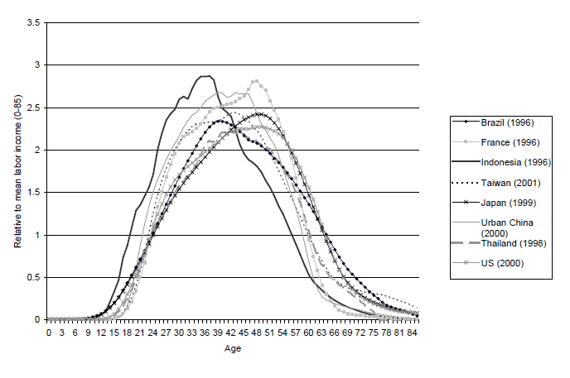
Improve work force flexibility
Enhance flexibility and agility of workforce
Employers will naturally turn to older workers as make-up of workforce changes
Employees must accept that earnings peak in early 40s in developing countries and early 50’s in developed countries
Per Capita Income
(Relative to total income)
UK Private vs Public Sector Employment
(1997 = 100)
If raising the workforce participation rate is difficult, there is another option
Shift more people to wealth creating (or at least not wealth dependant) parts of the economy
Source: ONS
Notes:
The fact is that while employers have to focus on ways to best employ older people, older people themselves need to accept both the fact that they are going to be working longer, and that in the later part of their career they may well not be earning as much as they did at the peak.
In addition, moving a portion of the 25% of workers presently employed in the public sector to the to private sector offers additional scope for maintaining over all levels of economic activity, as well as lowering the total tax burden.

Slide 18
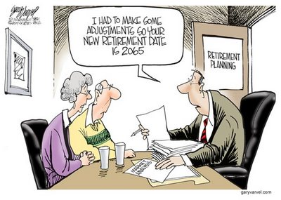
The future
Plan on retiring later
Drive up productivity
Get more people working productivly
Embrace agility
OR
Notes:
18

Slide 19

Urbanisation
Notes:
What we have seen is that highly urbanised areas do tend to have lower demographic growth rates. These areas are dependant upon drawing in new talent to continue to thrive.
In 1800 only about 3% of world population lived in urban areas
Today, 50% of world population lives in urban areas
Currently, there are 23 cities with >10 million population
By 2025, there will be 37 cities with >10 million population
The first city with 1+ million was probably London (in 1811)
Today, there are 456 cities with more than 1 million inhabitants
1.4 billion people live in cities with >1 million
600 urban centres, with a fifth of the world’s population, generate 60% global GDP
The “cluster effect” suggests that cities can be the engines of economic growth, although by no means all of the 456 cities of over a million are going to be such engines.
World Population
1 billion in 1804
2 billion in 1927 (123 years later)
3 billion in 1960 (33 years later)
4 billion in 1974 (14 years later)
5 billion in 1987 (13 years later)
6 billion in 1999 (12 years later)
7 billion in 2012 (13 years later) – for the first time the time to add another billion is lengthening
8 billion in 2026 (14 years later)
9 billion in 2043 (17 years later)
Source: Population Division, Department of Economic and Social Affairs, UN Secretariat. Population Newsletter No 66, December 1998; and United Nations, World Population Prospects: The 2000 Revision

Slide 20
Conclusions
Do demographics drive an economy, or do economics drive demographics?
Demographics are not destiny, but they are a noteworthy determinant of economic potential.
On present trends, the new UK trend rate of growth will be ~1%, well below individual productivity increases
Do we need growth?
There are ways to cope, not easy, but not impossible.
Notes:
Keynes warned that the effect of a growing populace was likely to be over optimism, and the effect of a shrinking populace the opposite, with a particular emphasis on negative outlook during the period of transition.
Japan was the first country to experience the demographic change, is it a template for the rest of us? Without economic growth, societies become fixated on income distribution, rather than on building greater prosperity and wealth, with the result they tend to be far less happy places.

