Slide 1
Innovation in the social sciences
Roderick Floud
Provost, Gresham College London

Slide 2
Horizon 2020
… will “boost research, innovation and competitiveness in Europe……”
“Horizon 2020 provides direct stimulus to the economy and secures our science and technology base and industrial competitiveness for the future, promising a smarter, more sustainable and more inclusive society”

Slide 3
“Innovation and Research Strategy for Growth”
“The Coalition Government is putting innovation and research at the heart of its growth agenda. Innovation is essential to competitiveness and higher living standards.”
Department of Business,
Innovation and Skills 2011
David Willetts

Slide 4
Challenges for Horizon 2020
Health, demographic change and well-being
Food security, sustainable agriculture, marine and maritime research and the bio economy
Secure, clear and efficient energy
Smart, green and integrated transport
Climate action, resource efficiency and raw materials
Inclusive, innovative and secure societies

Slide 5
Innovation: the Oslo manual
“Innovation is the implementation of a new or significantly improved product (good or service), or process, a new marketing method, or a new organisational method in business practices, workplace organisation of external relations.”

Slide 6
Drivers of growth
“Market services have become the main driver of the economy and the major contributor to productivity growth, especially as the use of information and communications technology (ICT) services has grown. Services are also the main source of job creation across the OECD area.”
OECD 2005

Slide 7
Share of agriculture, industry and services in employment, 1700-2002
Source: OECD 2006

Slide 8
Share of manufacturing in total employment, 1970-2003 – G7 countries
Source: OECD 2006

Slide 9
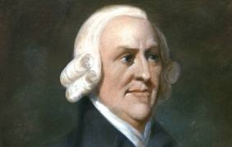
Theories of value
Francois Quesnay
1694-1774
"But though labour be the real measure of the exchangeable value of all commodities, it is not that by which their value is commonly estimated... Every commodity, besides, is more frequently exchanged for, and thereby compared with, other commodities than with labour."
Adam Smith,
The Wealth of Nations, 1776
Adam Smith
1723-1790

Slide 10
Romanticism
“A consumer or service economy will never make us happy. It is time to rescue ourselves economically, and in terms of wellbeing, through more of us making intelligent, useful and profitable things contentedly and well.”
Jonathan Glancey The Guardian
“Doing it the German Way, 31/12/2011”

Slide 11
Measuring services

Slide 12
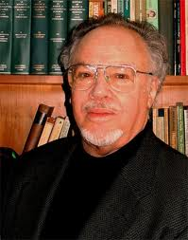
Explaining invention and innovation
Nathan
Rosenberg
“…. there has been precious little done trying to unpick what it is that accounts for technological dynamism, for the rate and direction of inventive activity.”
“One reason we have so much difficulty in modelling technological change is that it isn’t just one thing, it’s not even just one big thing, it’s a great many small things.”
Nathan Rosenberg
Paul David

Slide 13
Annual publications on British social and economic history per individual member of the Economic History Society
Source: previous slides

Slide 14
A market test: CUP sales in economic and social history
Year |  | Books sold | Total value
 |  |  | £
2006-7 |  | 15128 | 271,343
2007-8 |  | 17958 | 265,940
2008-9 |  | 19158 | 370,379
2009-10 |  | 21447 | 428,932
2010-11 |  | 21968 | 533,365
Source: Michael Watson (Cambridge University Press). The data relate to a broad definition of economic and social history, similar to that used for the Annual List of Publications

Slide 15
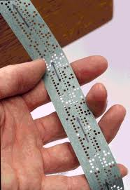
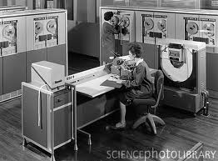
From Newton to the KDF9
Isaac Newton
The first decade
Paper tape
KDF9 computer

Slide 16
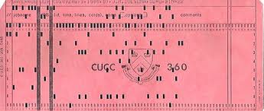
IBM 360 to the iPhone
1960s
The next decades
From punch cards..
1980s
to bubble memory…
to laptops …
2000s
and the iPhone

Slide 17
Innovation – or creativity?
“The phenomenon by which human activity generates something that has some kind of value.”
Prof. John Sloboda 2012
“Innovation is the implementation of a new or significantly improved product (good or service), or process, a new marketing method, or a new organisational method in business practices, workplace organisation of external relations.”
Oslo definition
The common pattern underlying creativity is the “shaking together of already existing but previously separate areas of knowledge, frames of perception or universes of discourse”
Arthur Koestler 1967

Slide 18
The growth of the British economy
Real gross domestic product, 1600-2010, in the prices of 2008

Slide 19
The population of the UK, 1600-2010
Source: www.measuringworth.com

Slide 20
Birth and Death rates, 1541-1799
Source: Wrigley and Schofield The Population History of England

Slide 21
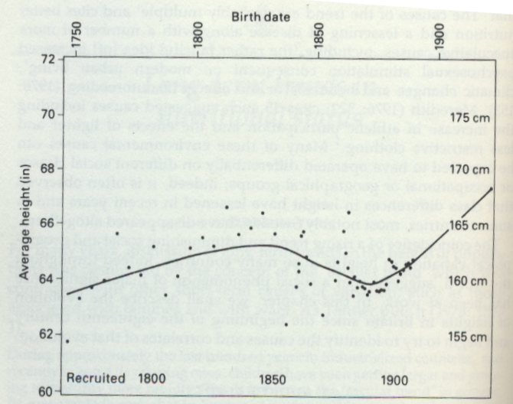
Height of British military recruits, 1750-1914

Slide 22
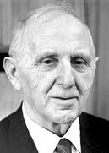
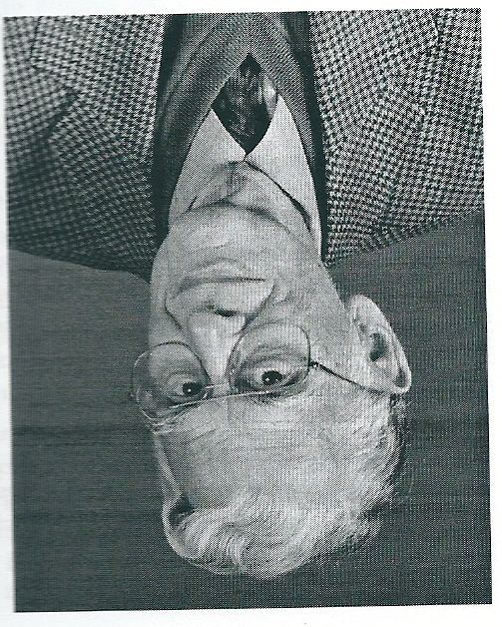
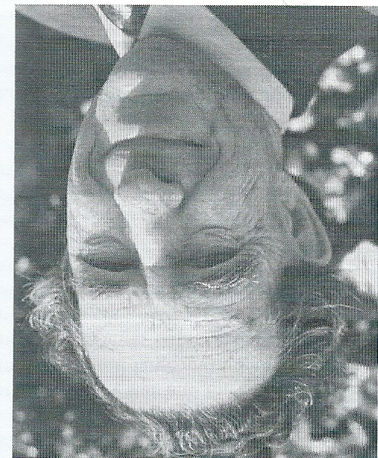
Teamwork in the 1950s
“British Economic Growth, 1688-1959 was possibly the most influential single work of the last half-century in this country”
E. A. Wrigley
“It opened up the field and opened doors for others.”
Stephen Broadberry
Simon Kuznets
Phyllis Deane
W.A. (Max) Cole
Charles Feinstein

Slide 23
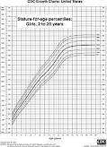
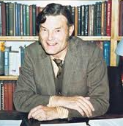
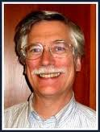
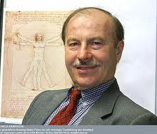
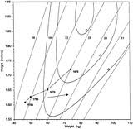
Teamwork: Anthropometric History
“Braudel believed strongly in what he called ‘inter-science’, which was for him more than just the rhetoric of interdisciplinarity. Rather, it represented the ecumenical coming together of scholars pursuing a single enterprise, in which history and social science were part of an undifferentiated cloth of social analysis.”
I. Wallerstein 2003

Slide 24
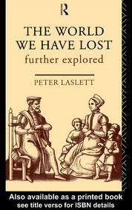
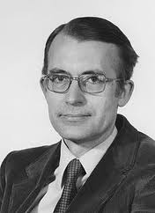
Leadership and ambition in population history
“Our ambition, which set us apart from the leading demographic institutes of France, was to link demography to social and economic change … as a means to understanding the wider economy.”
E.A. (Tony) Wrigley

Slide 25
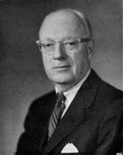
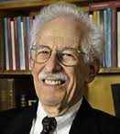
Argument
History must not succumb “to the dehumanizing methods of the social sciences” and “worship at the shrine of the Bitch-goddess, Quantification.”
Carl Bridenbaugh
“We had the tools and, since we had the tools, we were in a sense messengers of the Messiah.”
Peter Temin

Slide 26
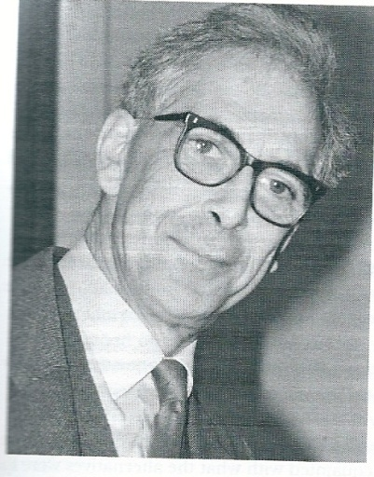
Argument continued
“My style at the time was like Lenin confronting the Mensheviks.”
Robert W. (Bob) Fogel
“I was privately a little surprised that they made such a song and dance about the novelty of the cliometric approach … I couldn’t help discerning an element of self-advertisement.”
R.C.O. (Robin) Matthews
“One needs to locate oneself on a spectrum which has clarity at one end and comprehensiveness on the other.”
E.A. (Tony) Wrigley

Slide 27
Money

Slide 28
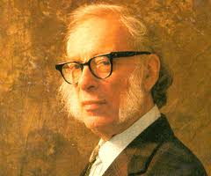
Luck
“You’ve got to be lucky”
R. W. (Bob) Fogel
“The important words in science are not ‘Eureka’, but ‘that’s funny’”
Isaac Asimov

Slide 29
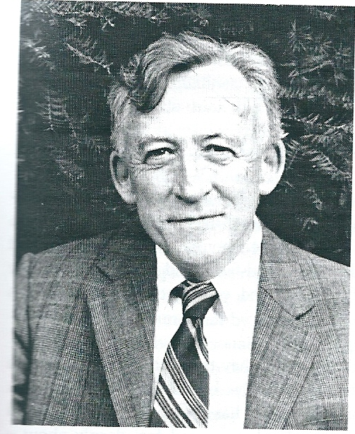
The role of others
“Most of the major things I’ve done were done on someone else’s suggestion.”
R.C.O. (Robin) Matthews
“… there are only a few pieces in my bibliography that were not done more or less at somebody’s request, or as part of a larger project, sometimes one of my own devising.”
William (Bill) Parker

Slide 30
Challenges for Horizon 2020
Health, demographic change and well-being
Food security, sustainable agriculture, marine and maritime research and the bio economy
Secure, clear and efficient energy
Smart, green and integrated transport
Climate action, resource efficiency and raw materials
Inclusive, innovative and secure societies

