Slide 1
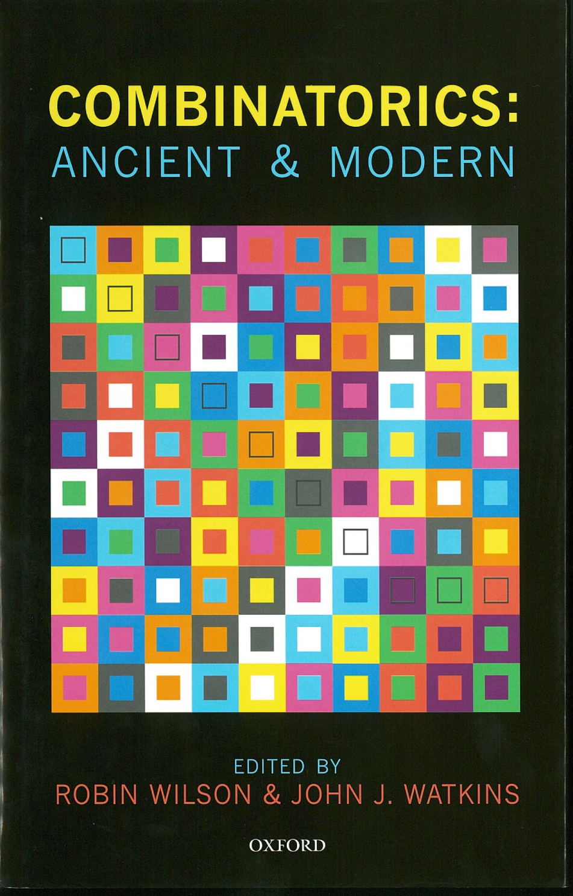
The Mathematics that Counts
Robin Wilson
and John J. Watkins

Slide 2
What is Combinatorics?
Combinatorics is concerned with selecting, arranging and counting collections of objects – for example:
permutations and combinations
graphs and networks
map-colouring problems
problems involving finite sets
latin squares and sudoku puzzles

Slide 3
Combinatorics: Ancient . . .
Foreword by Ron Graham, former AMS/MAA President
Part I: Introduction
Two thousand years of combinatorics [Donald E. Knuth]
Part II: Ancient Combinatorics
1. Indian combinatorics
2. China
3. Islamic combinatorics
4. Jewish combinatorics
5. Renaissance combinatorics
6. The origins of modern combinatorics
7. The arithmetical triangle

Slide 4
. . . & Modern
Part III: Modern Combinatorics
8. Early graph theory
9. Partitions
10. Block designs
11. Latin squares
12. Enumeration (18th–20th centuries)
13. Combinatorial set theory
14. Modern graph theory
Part IV: Aftermath
A personal view of combinatorics [Peter J. Cameron]

Slide 5
I Ching (c.1100 BC)

Slide 6
Permutations: Vishnu

Slide 7
Marin Mersenne’s music (1638)

Slide 8
Sefer Yetsirah (2nd–8th century)

Slide 9
Permutable poetry (1617)
Tot tibi sunt dotes, Virgo, quot sidera caelo.
(Thou hast as many virtues, O Virgin, as there are stars in heaven.)
Tot dotes tibi, quot caelo sunt sidera, Virgo.
Dotes tot, caelo sunt sidera quot, tibi Virgo.
Dotes, caelo sunt quot sidera, Virgo tibi tot.
Sidera quot caelo, tot sunt Virgo tibi dotes.
Quot caelo sunt sidera, tot Virgo tibi dotes.
Sunt dotes Virgo, quot sidera, tot tibi caelo.
Sunt caelo tot Virgo tibi, quot sidera, dotes.
Dactyl – spondee – spondee – spondee – dactyl – spondee
(Dum-diddy dum-dum dum-dum dum-dum dum-diddy dum-dum)

Slide 10
ben Gerson’s Maasei Hoshev (1321)
Proposition 63:
If the number of permutations of a given number of different elements is equal to a given number, then the number of permutations of a set of different elements containing one more number equals the product of the former number of permutations and the given next number.
P(n + 1) = (n + 1) × P(n)
(n + 1)! = (n + 1) × n!

Slide 11
Combinations: Suśruta’s six tastes
Medicine can be
sweet, sour, salty, pungent, bitter, or astringent.
How many combinations are there
when taken one at a time? 6
when taken two at a time? 15
when taken three at a time? 20
when taken four at a time? 15
when taken five at a time? 6
when taken six at a time? 1

Slide 12
Varahamihira’s sixteen ingredients

Slide 13
Sefer Yetsirah (2nd–8th century)
God drew them, combined them, weighed them, interchanged them, and through them produced the whole creation and everything that is destined to be created.
For two letters, he combined the aleph with all the other letters in succession, and all the other letters again with aleph; bet with all, and all again with bet; and so the whole series of letters.
Thus, there are (22 × 21)/2 = 231 formations in total.

Slide 14
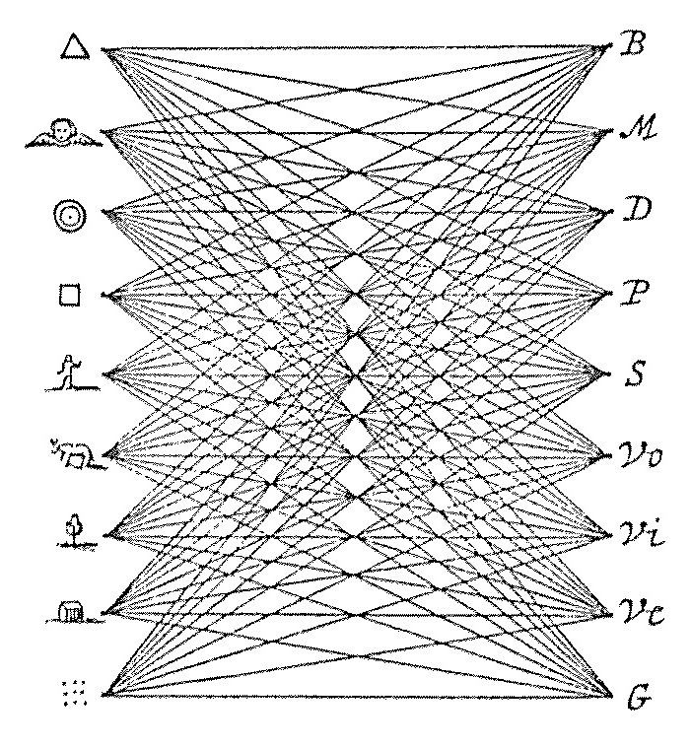
Ramon Llull (c.1232–1315)

Slide 15
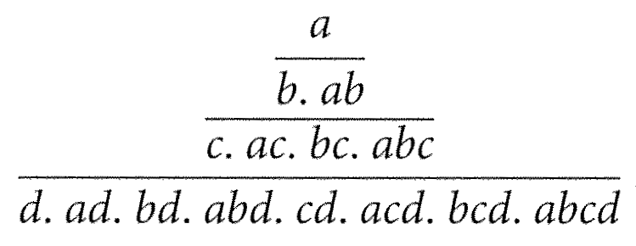
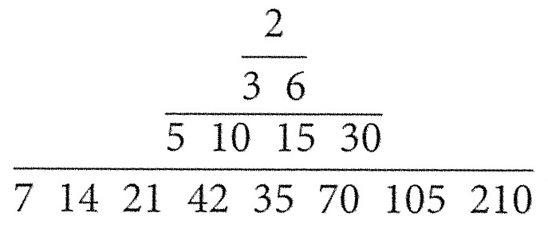
Frans van Schooten (1657)
All the combinations of four letters a, b, c, d:
All the divisors of 210:

Slide 16
Formula for combinations
The number of combinations of k objects selected from a set of n objects is

Slide 17
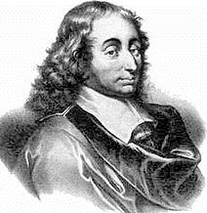
Pascal’s triangle

Slide 18
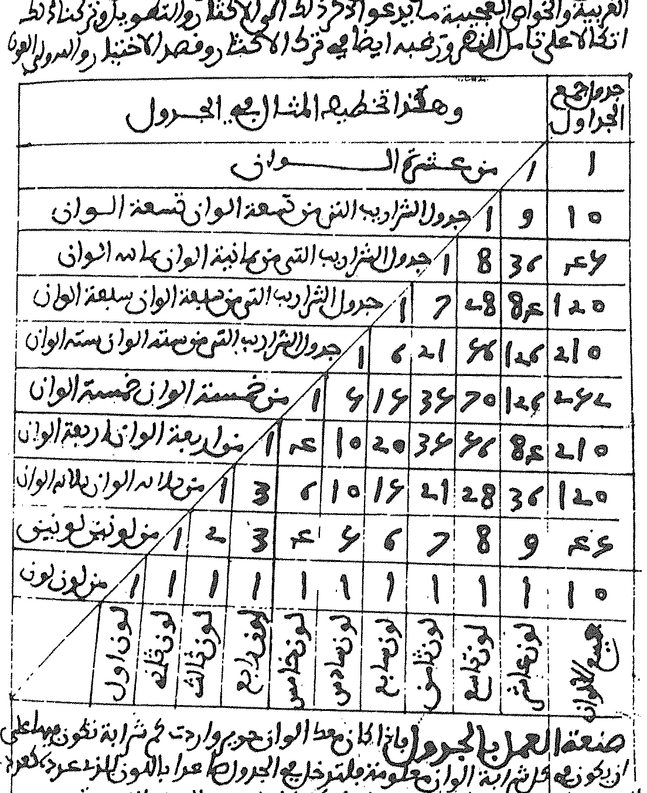
Al-Karaji (1007) and Ibn Munim (c.1200)

Slide 19
Zhu Shijie (1303)

Slide 20
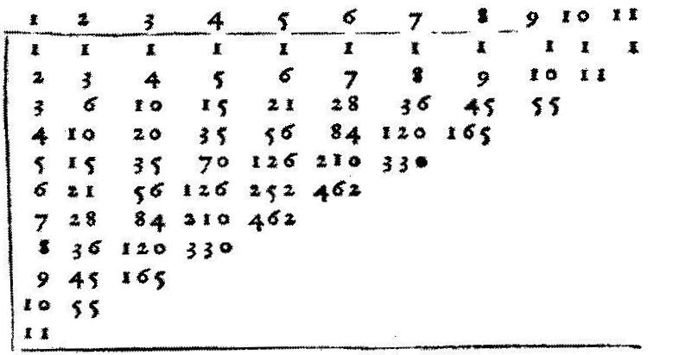
Girolamo Cardano (1570)

Slide 21
Niccolò Tartaglia (1556)

Slide 22
Marin Mersenne (1636)

Slide 23
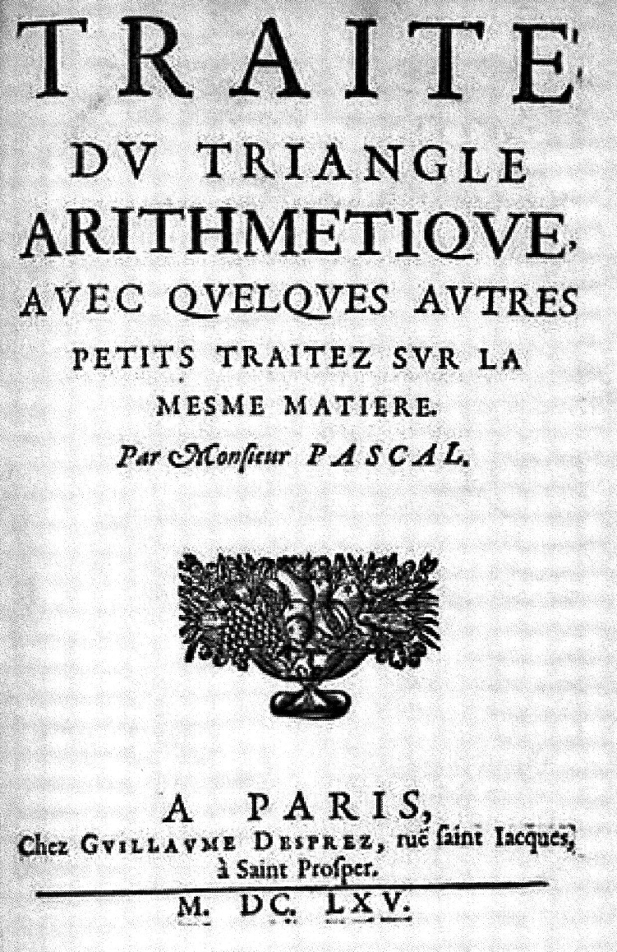
Blaise Pascal (1654/1665)

Slide 24
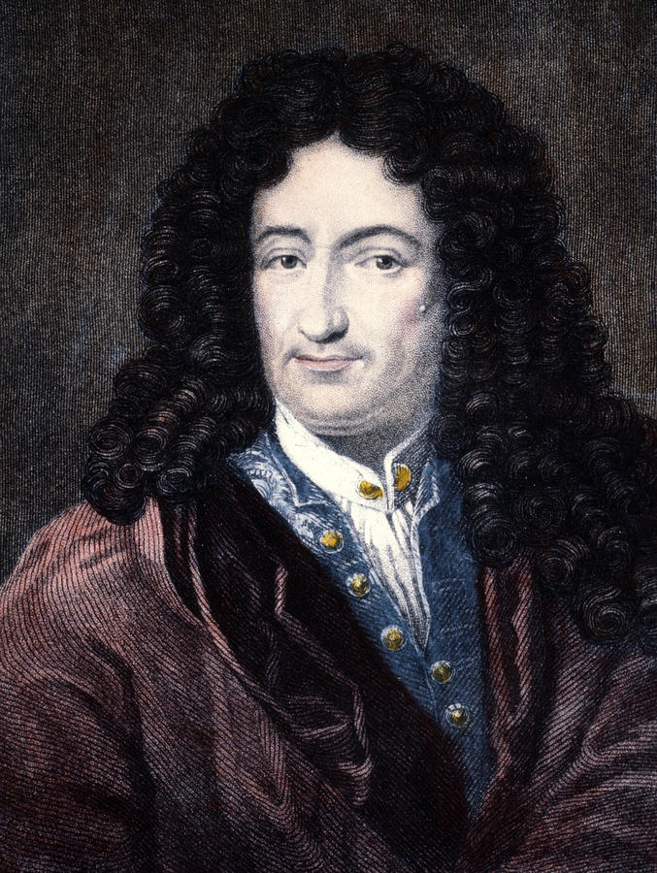
Leibniz’s De Arte Combinatoria (1666)

Slide 25
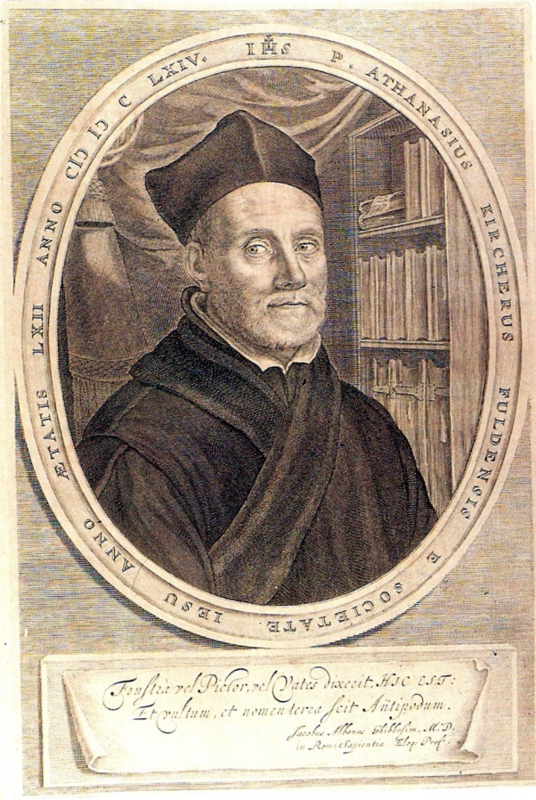
Kircher’s Ars Magna Sciendi (1669)

Slide 26
Combinatorial dice

Slide 27
De Montmort’s Jeux de Hazard (1708)

Slide 28
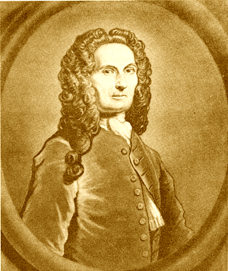
De Moivre’s Doctrine of Chances (1718)

Slide 29
Principle of Inclusion–Exclusion

Slide 30
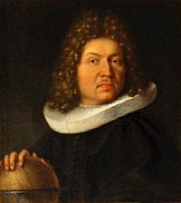
J. Bernoulli’s Ars Conjectandi (1713)

Slide 31
Bernoulli numbers

Slide 32
Leonhard Euler (1707–1783)

Slide 33
Königsberg bridges problem (1735)

Slide 34
Euler’s solution
If the number of bridges is even for all areas, then the journey is possible, starting from any area.
If the number of bridges is odd for exactly two areas, then the journey is possible, starting in one area and ending in the other.
If the number of bridges is odd for more than two areas, then such a journey is impossible.

Slide 35
Listing’s diagram (1847)

Slide 36
Hamilton’s Icosian Game (1859)

Slide 37
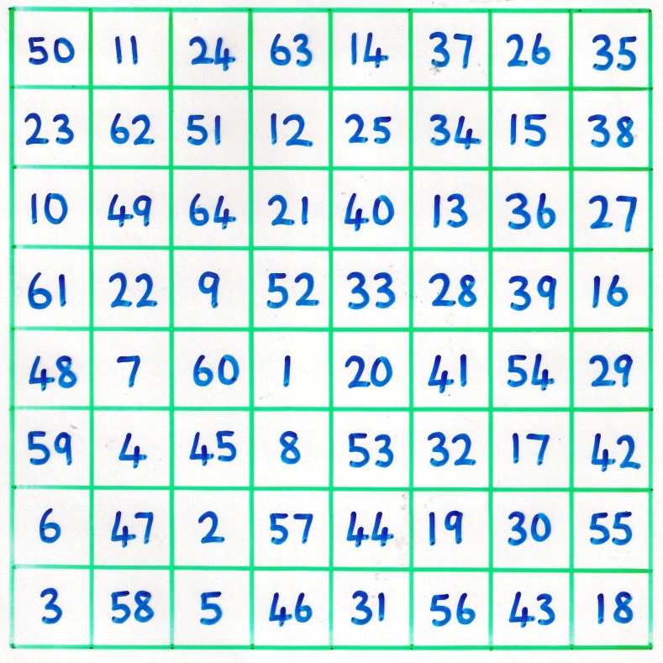
Knight’s tour problem

Slide 38
Euler’s polyhedron formula (1750)
For a polyhedron with F faces, V vertices and E edges:
F + V = E + 2

Slide 39
Counting trees and molecules
The trees with six vertices
n-butane 2-methyl propane

Slide 40
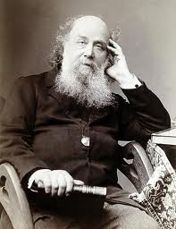
Sylvester’s chemical trees (1878)

Slide 41
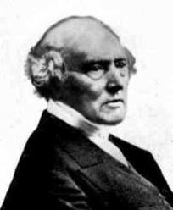
Lady’s and Gentleman’s Diary (1850)

Slide 42
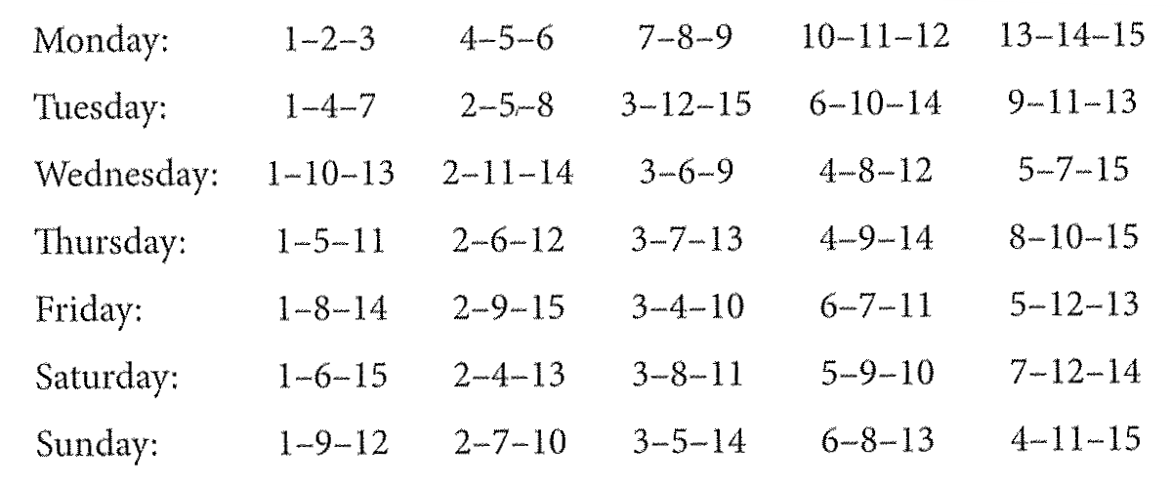
Kirkman’s ‘Schoolgirls problem’
Fifteen young ladies in a school walk out three abreast for seven days in succession: it is required to arrange them daily, so that no two shall walk twice abreast.

Slide 43
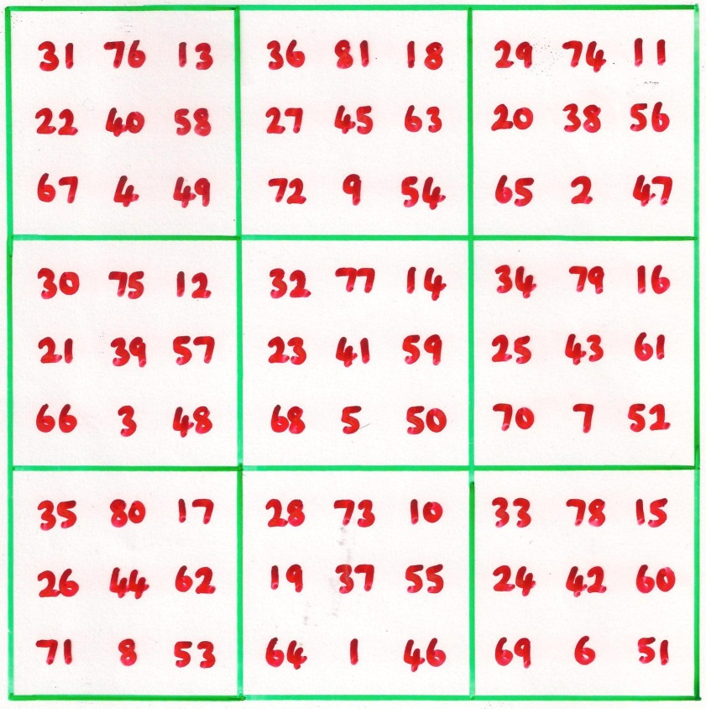
Chinese magic squares

Slide 44
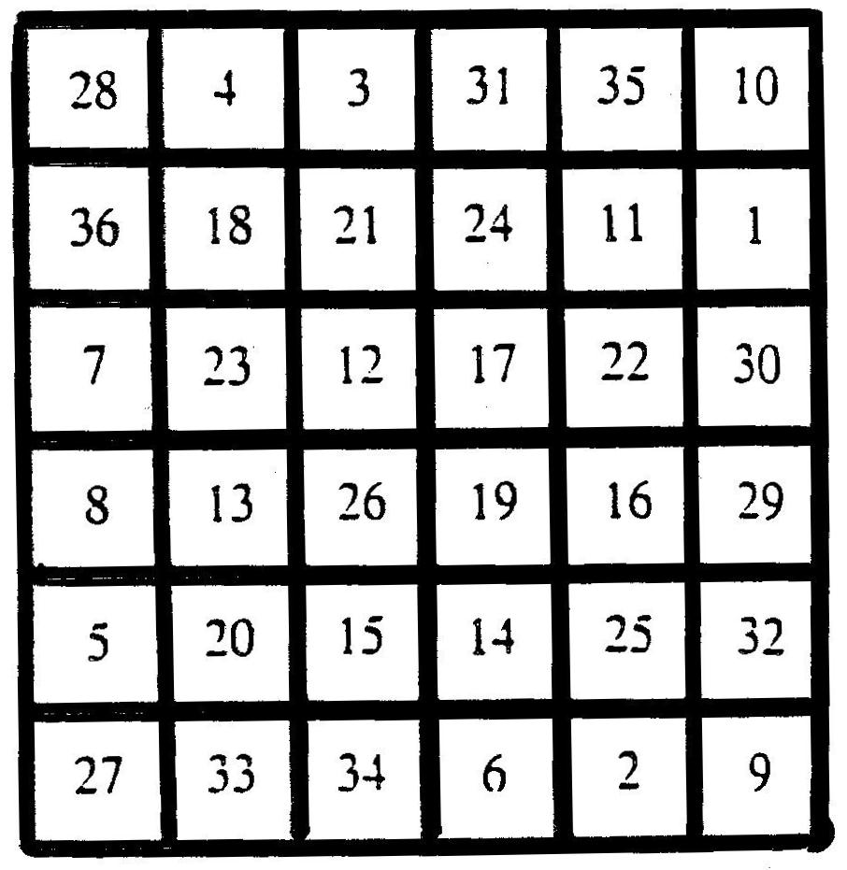
Iron plate found at Xian

Slide 45
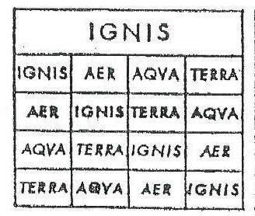
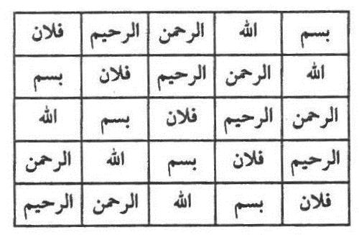
Three latin squares

Slide 46
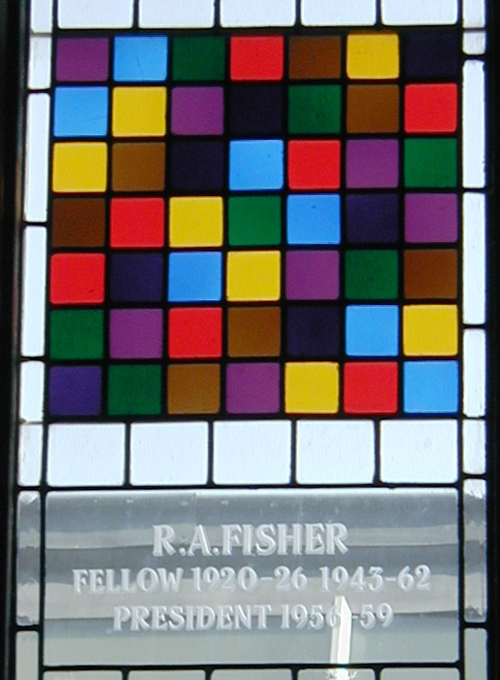
Two 7 × 7 latin squares

Slide 47
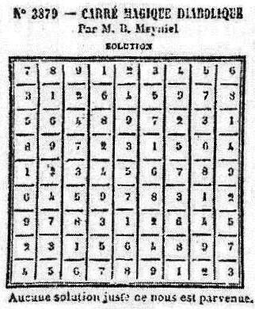
Latin square puzzle (1895)
Fill in the empty squares
Published (sudoku) solution

Slide 48
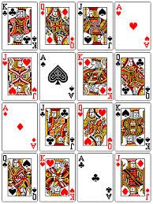
Sixteen court card puzzle (1612)

Slide 49
Euler’s ‘36 officers’ problem (1782)
Arrange thirty-six officers, of six different ranks and from six different regiments, in a square array so that each row and column includes officers of all six ranks and all six regiments.
Euler believed that this was impossible.
Moreover, he claimed that such a problem is impossible for an n x n array, when
n = 2, 6, 10, 14, 18, . . .

Slide 50
‘Euler’s spoilers’

Slide 51
Orthogonal 10 × 10 latin squares (1959)

Slide 52
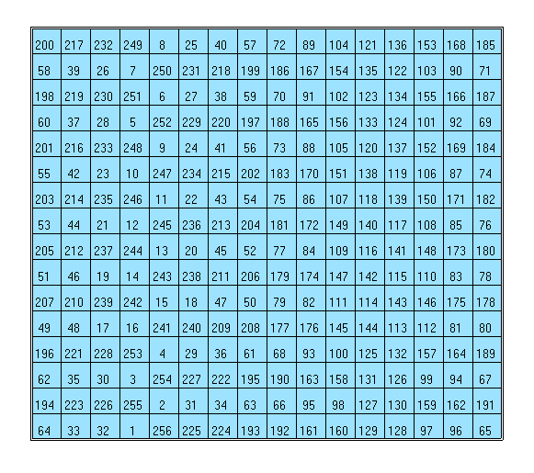
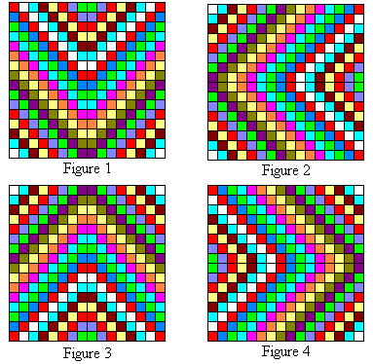
Benjamin Franklin’s amazing square

Slide 53
Paul Erdős (1913–1996)

Slide 54
Good Will Hunting

Slide 55
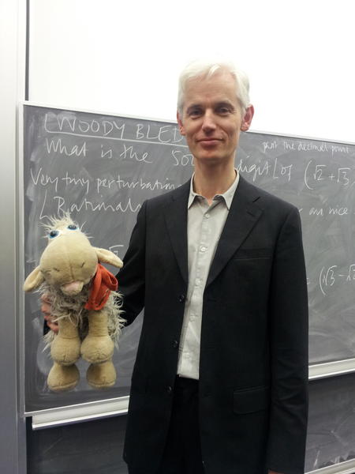
Recent combinatorial prizewinners
Tim Gowers
Endre Szemerédi

Slide 56
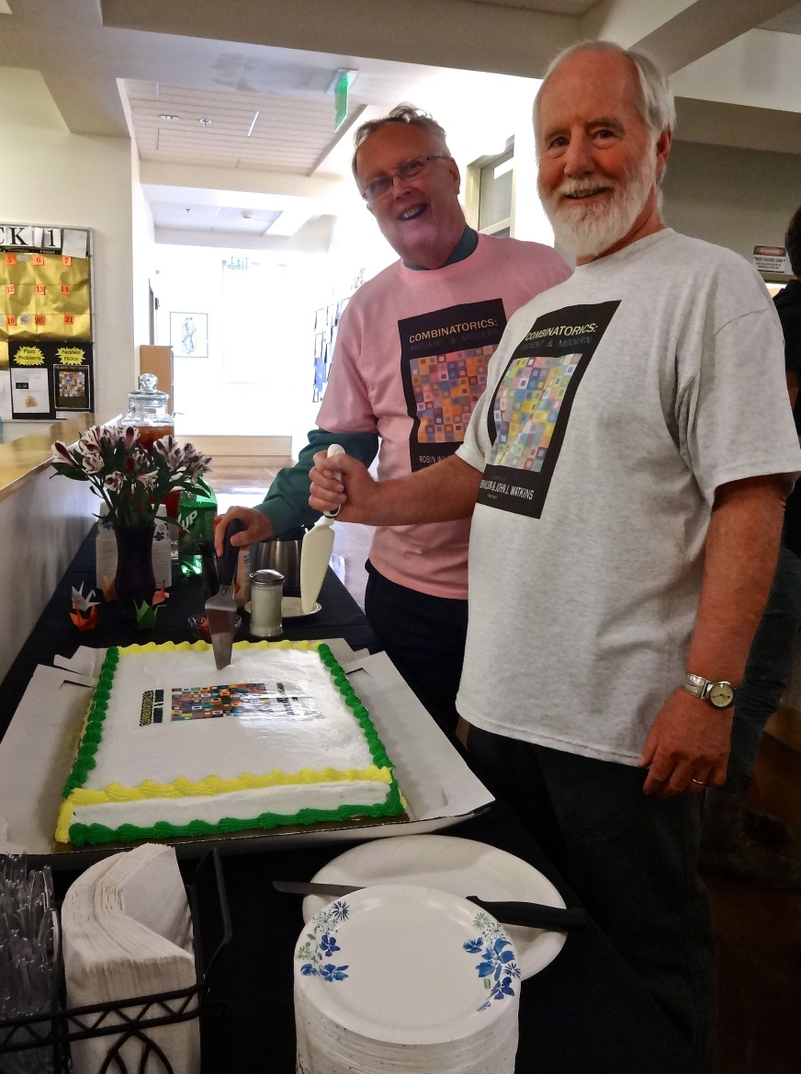
Celebrating Combinatorics

Slide 58
Sauveur’s 7 × 7 latin squares (1710)

