Slide 1
Dr Johnson’s House Biography and display
Morwenna Rae Donald Hyde Curator Dr Johnson’s House

Slide 2
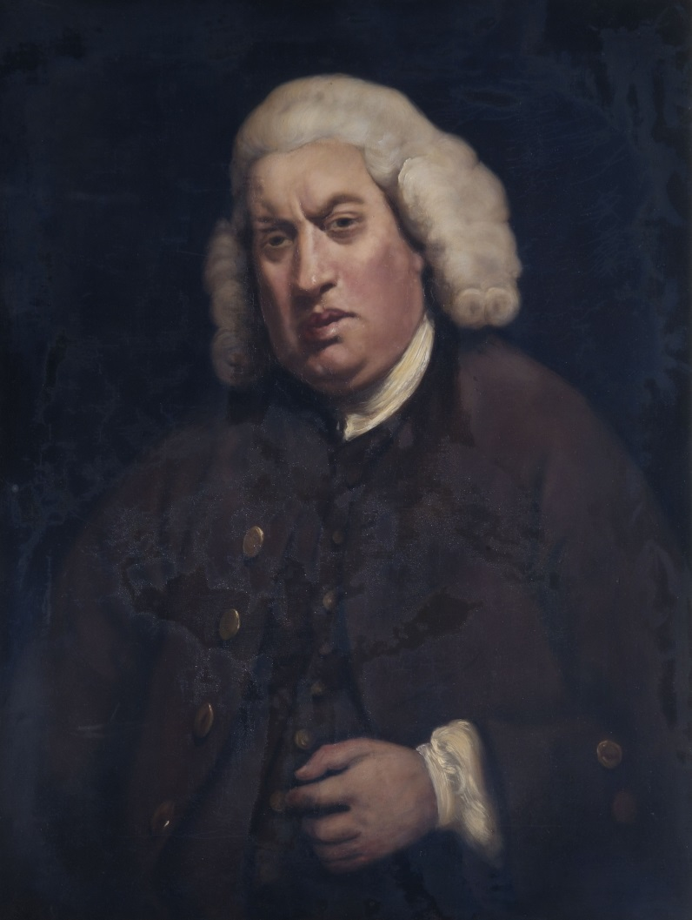

Slide 3
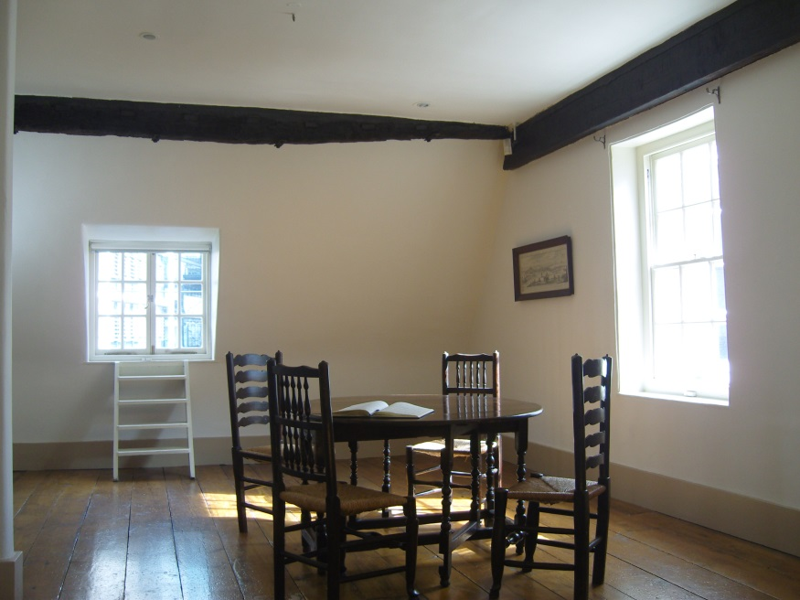
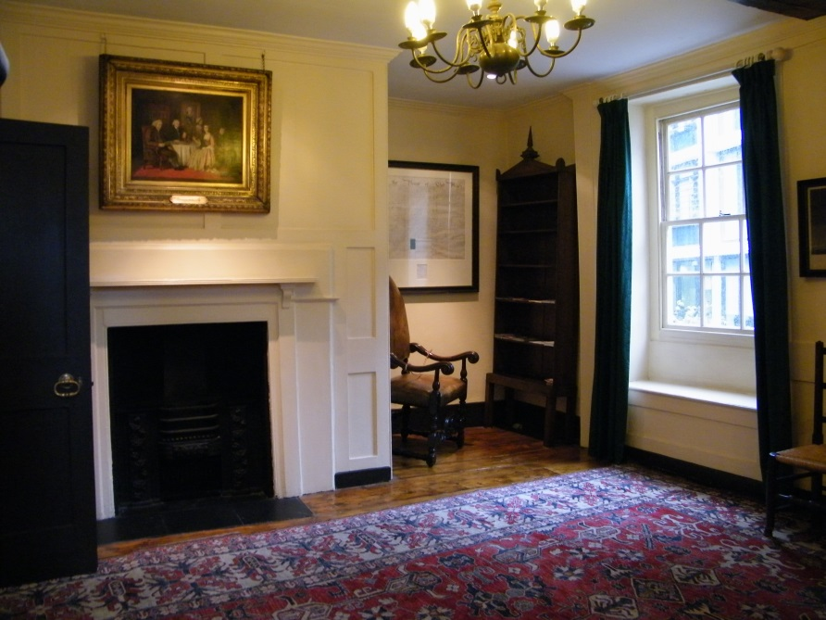

Slide 4
17 Gough Square c. 1900

Slide 5
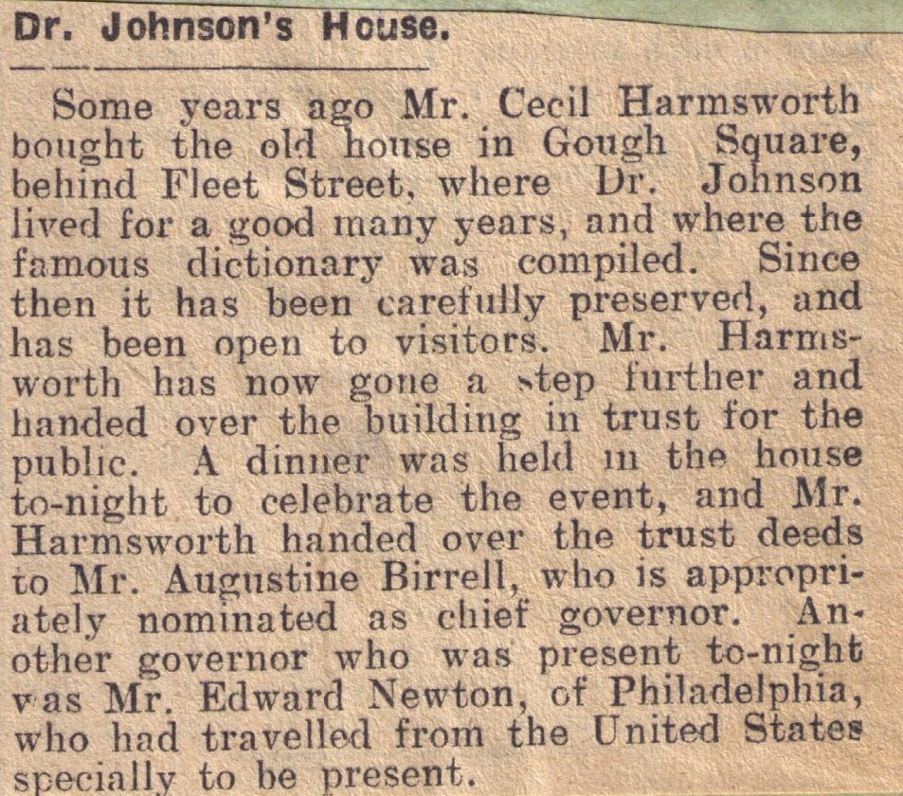

Slide 6
Cecil Harmsworth

Slide 7
From the first, the intention was that the House should never come to be regarded as a Museum or as an emporium of irrelevant 18th-century bric-a-brac. It was to be a Johnson House open wide to his admirers and available for occasional tea parties and more robust festivities. A house without fun and laughter and good talk could never be regarded, it was felt, as a suitable memorial to the man who shook laughter out of you whether you willed it or not and who lived to stretch his legs under the table and “have his talk out”. Cecil Harmsworth, 1944

Slide 8
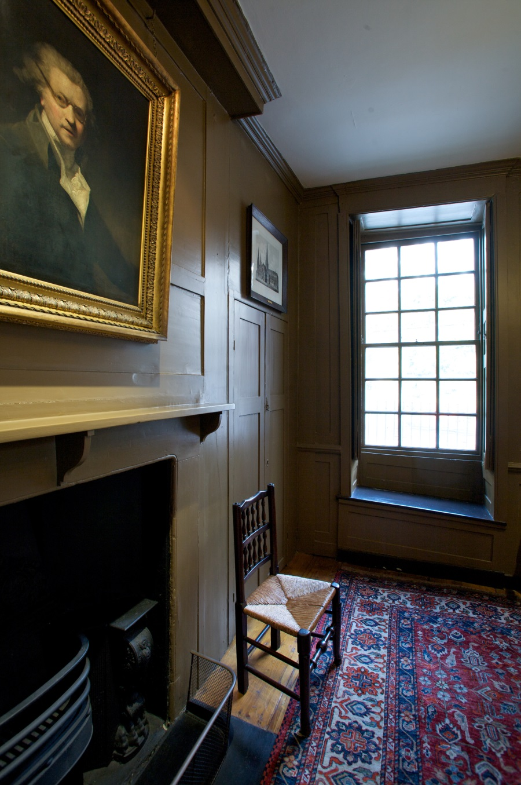

Slide 9
Samuel Johnson
After John Opie, 19th century Oil on canvas

Slide 10
Samuel Johnson’s Birthplace
Harry Goodwin, 20th century Oil on board

Slide 11
James Boswell
W Daniel after George Dance, RA Engraving

Slide 12
Portrait of a man (reputed to be Francis Barber)
After Sir Joshua Reynolds Oil on canvas

Slide 14
Robert Dodsley
After Sir Joshua Reynolds 18th century Oil canvas

Slide 16
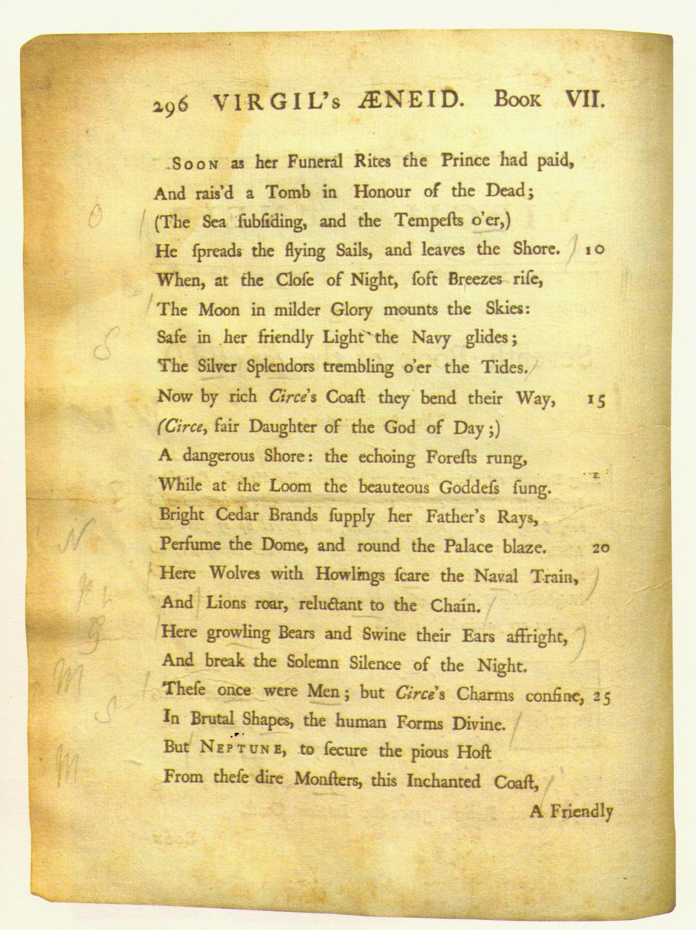
Marks start of quotation
Marks end of quotation
First letter in margin
silver
Notes:
Virgils’ A-NEE – ID
1740 Translation by Mr Pitt
SILVER
“The Silver Splendors trembling o’er the Tides”

Slide 17
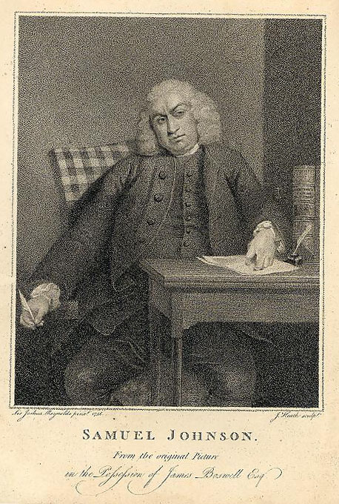

Slide 19
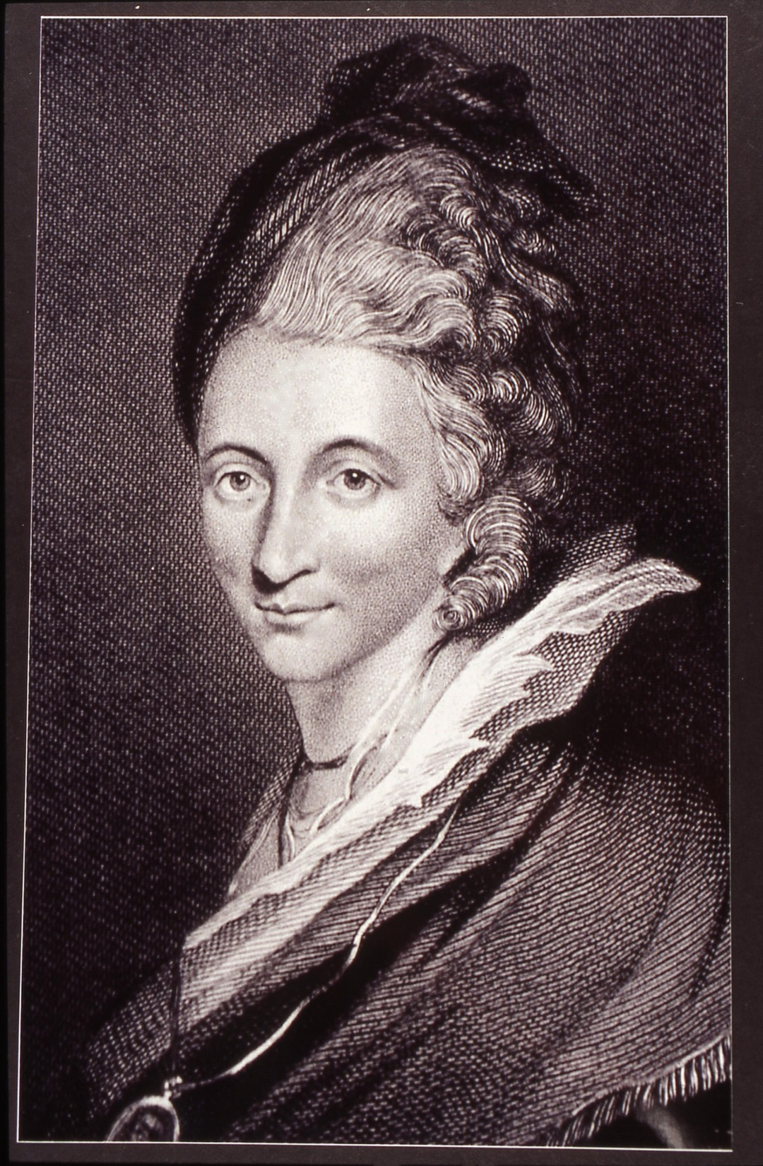

Slide 21
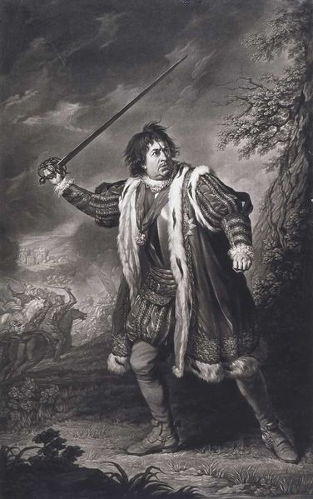
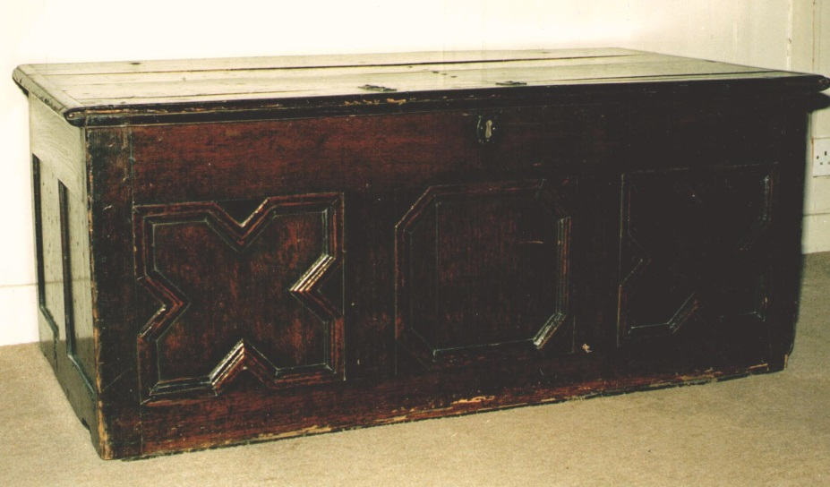
David Garrick

Slide 22
Garrick and Mrs Pritchard in Macbeth
Valentine Green after Zoffany, 1776 Engraving

Slide 23
Mr Garrick as Richard III
J Dixon after N Dance, 1772 Engraving

Slide 24
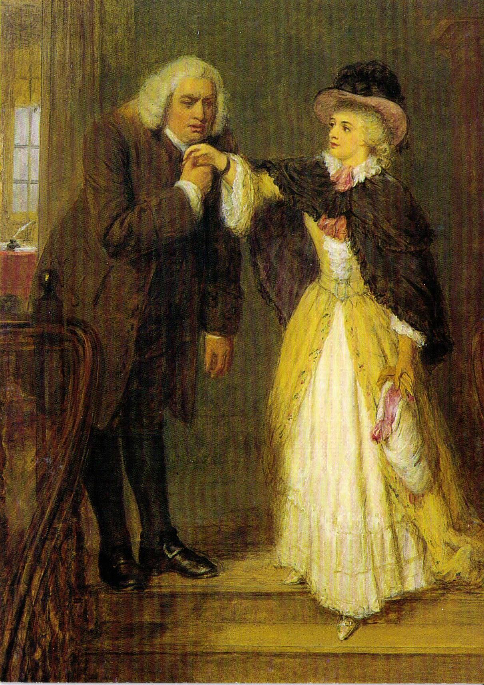

Slide 26
Elizabeth Johnson
Unknown artist, c. 1735 Photograph of oil on canvas

Slide 27
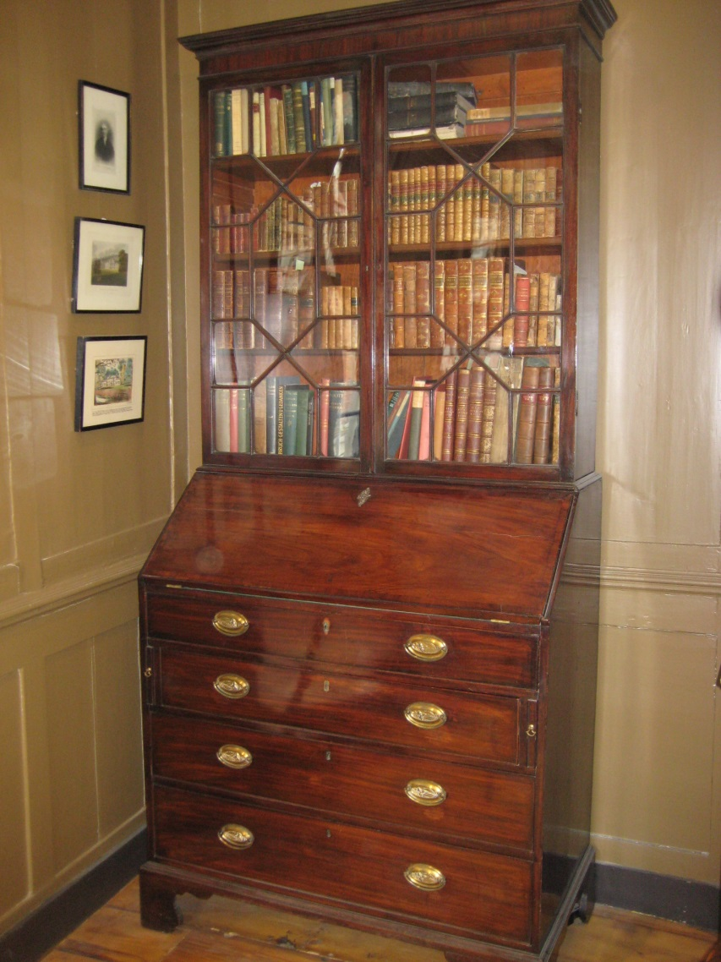
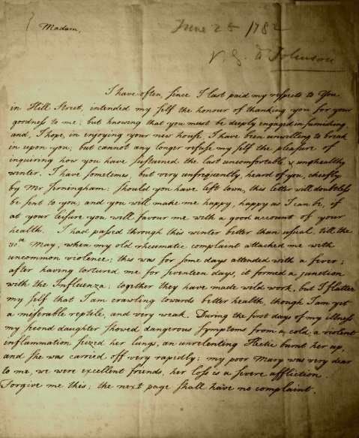
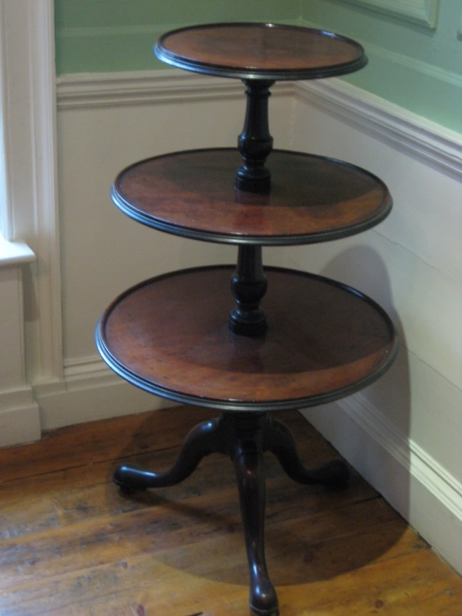
Elizabeth Carter

Slide 28
Edward Cave (1691 – 1754)
Unknown artist Oil on canvas

Slide 31
Dr Johnson’s House 17 Gough Square, London, EC4A 3DE www.drjohnsonshouse.org
Open Monday – Saturday, 11am-5pm
Late night opening tonight, 18 June 2014, 6pm – 8pm

