Slide 1
Autumn Conference 2010
Environmental, Social & Governance Data and Intellectual Property

Slide 2
Welcome
Mark Boleat
Deputy Chairman, Policy & Resources Committee
City of London Corporation

Slide 3
Agenda
14:30 - 14:45 Welcome
14:45 - 15:15 Keynote
Dr Simon Jackman, NERC
15:15 - 16:00 Panel – Where’s the Data? Water
16:00 - 16:15 Break
16:15 - 16:30 Keynote
Claudia Quiroz, Cheviot
16:30 - 17:15 Panel – The Value of Green Intellectual Property
17:15 - 17:30 Closing Remarks
17:30 - 18:30 Reception

Slide 4
Keynote Speech 1
“Water: What’s the Data?”
Dr Simon Jackman
Head of Knowledge Exchange
Natural Environment Research Council

Slide 5
Panel 1 – 15:15 to 16:00
“Water – Where’s the Data?”
Neil Eckert, Chairman, Aggregated Micro Power plc
Dr Simon Jackman, Head of Knowledge Exchange, NERC
Carlota Garcia-Manas, Co-Head of Research, EIRIS
Chair: Professor Michael Mainelli, Z/Yen Group

Slide 6
16:00 to 16:15

Slide 7
Keynote Speech 2
“The Challenges in Constructing a Sustainable Fund”
Claudia Quiroz
Fund Manager
Cheviot Asset Management

Slide 8
Panel 2 – 16:30 to 17:15
“The Value of Green Intellectual Property”
Claudia Quiroz, Fund Manager, Cheviot Asset Management
Jonathan Nugent, Solicitor, PricewaterhouseCoopers Legal LLP
Radomir Tylecote, PhD Candidate, Imperial College London
Chair: Professor Michael Mainelli, Z/Yen Group

Slide 9
Closing Remarks
Professor Michael Mainelli
Z/Yen Group & London Accord

Slide 10
Behind Today

Slide 11
The Story So Far
2010
105 Reports
2009
Index-linked carbon bonds
2008
ESG growth
2008
Policy impact
2007 report
2007
Report Launch
2006
Recruitment
2005
Concept

Slide 12
Community

Slide 13
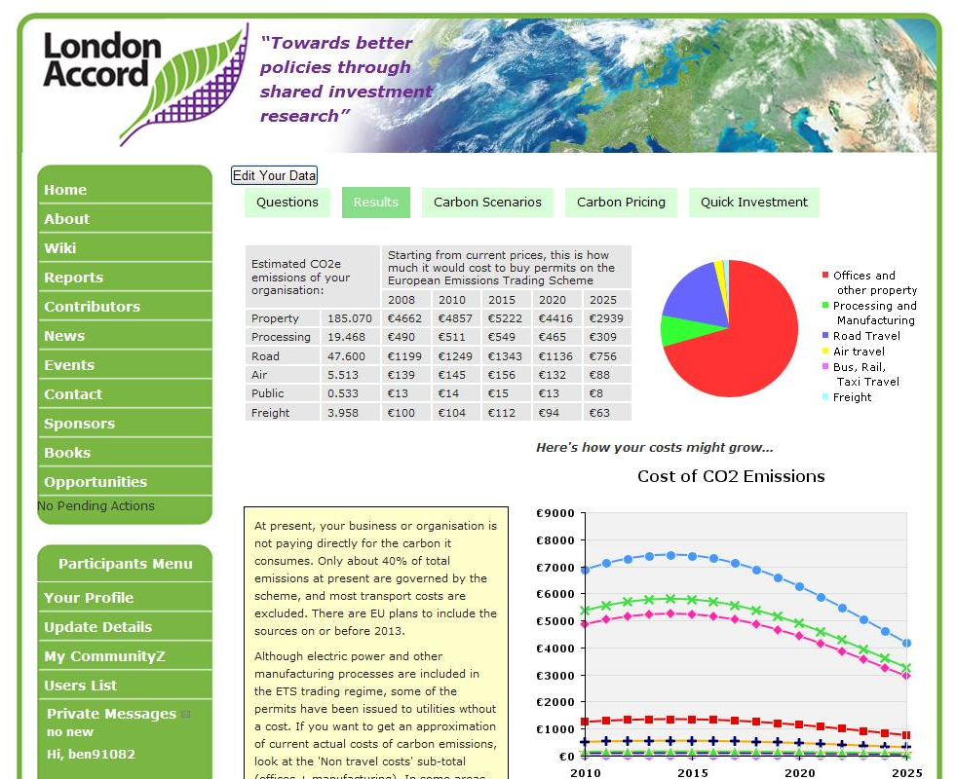
Tools

Slide 14
Outlook 2011
Collaboration with Natural Environment Research Council on water, forestry and biodiversity:
Symposium – “Finance, Biodiversity and Managed Ecosystems: Where’s the Data?” – 15 November, 15:00 to 17:00
Long Finance Initiative
Roundtable “Long Governance: Is Reform Still Needed?” – 24 November, 09:30 to 12:30

Slide 15
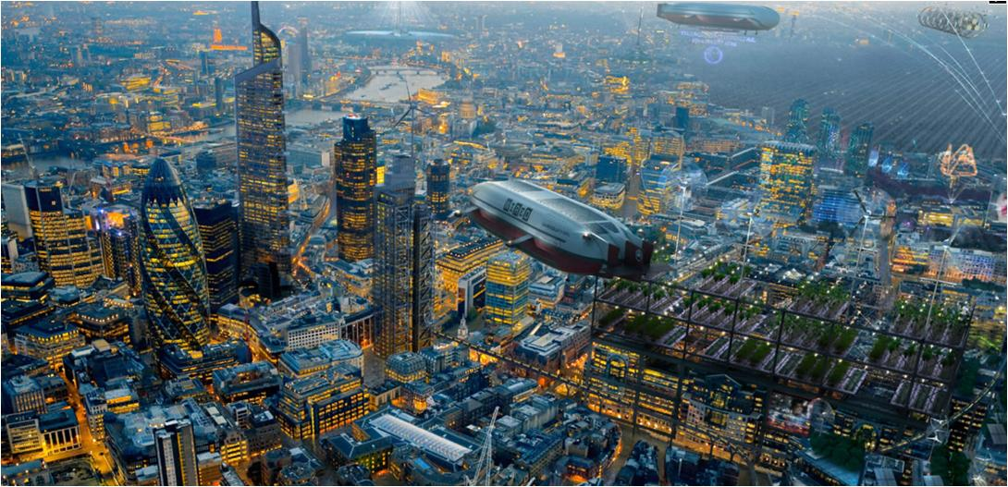
Reception “London Futures ”

Slide 16
Thank You!

