Slide 1

Sorting out transport in London
Seventh Gresham Lecture
Douglas McWilliams
Mercers’ School Memorial Professor of Commerce at Gresham College
Centre for economics and business research ltd
Unit 1, 4 Bath Street, London EC1V 9DX
t: 020 7324 2850 f: 020 7324 2855 e: advice@cebr.com w: www.cebr.com

Slide 2
Objective
To describe how the London economy is changing
To understand the transport needs of the changing economy
To suggest how London transport could be better managed

Slide 3
Overview
The international context
The new London economy – City still important but not as much so
The rise of the ‘flat white economy’
The transport needs
The state of transport in London
The cost of transport in London
The management of the road network
How to make it better
The economic benefits of making it better

Slide 4
Implications of global shift
Intense international trade competition – the new economies are not just competitive but ‘supercompetitive’ because they have an entirely new cost basis
Rising real prices of natural resources – food, energy, fuel, materials
Slower growth in the Western world and faster growth in the emerging economies
Lower interest rates as a result of savings glut (see currencies and interest rate section later)
More volatile international economy

Slide 5
Stripping out effects of population growth, spending per household in 2013 will decline to lowest level since 2002
Real consumer spending per household (constant 2009 prices)
Source: ONS, Cebr

Slide 6
Transport and housing costs are taking up a rising share of household spending
Percentage of total expenditure on selected goods categories in the UK 1965-2030
Source: ONS Consumer Trends, Cebr analysis

Slide 7
‘Essentials’ are costing more in relative terms – and emerging market growth means this trend will continue
Essential spending as a share of total expenditure in UK current prices, 1965-2030
Source: ONS Consumer Trends, Cebr analysis

Slide 8
UK overview
London’s economy continues to outperform the UK’s even after the financial crunch
Real London and UK gross domestic product, annual percentage change (London in blue, UK in red)
Source: Office for National Statistics, Cebr analysis

Slide 9
Central London Employment
Business services to help boost Central London employment alongside ailing City economy
Central London employment *, by industry, index 2004 = 100
* Absolute numbers and definitions can be found in the appendix
Source: Office for National Statistics, Cebr analysis

Slide 10
Central London Employment
Emerging technological and creative sectors to become increasingly important for central London’s economy
Central London employment *, MIC sectors, thousands
Forecast
Source: Office for National Statistics, Cebr analysis

Slide 11
UK overview
The number of employees in London continues to rise rapidly
Number of employees in London, thousands
Source: Office for National Statistics, Cebr analysis

Slide 12
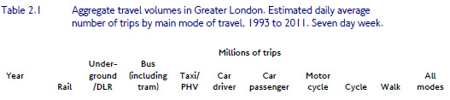


Slide 13
London’s bus fleet is now by far the largest in any major developed city in the world
Source: Singapore Land Transport Academy Journal November 2011

Slide 15
Despite measures to encourage public transport, the car remains the single most used mode of transport in London

Slide 16
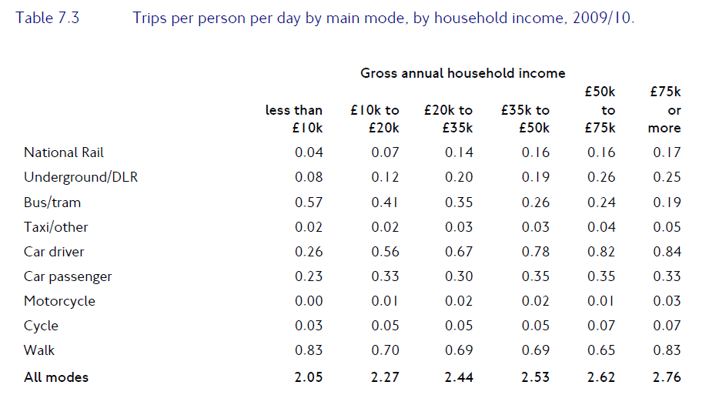
Higher income groups place great value on individual modes of transport

Slide 17
Tax shares paid by London’s higher income groups
Annual income | % of taxpayers | % of income tax
>£200,000 | 1.5% | 40.1%
>£150,000 | 2.3% | 45.2%
>£100,000 | 4.0% | 52.8%
>£70,000 | 7.6% | 61.5%

Slide 18
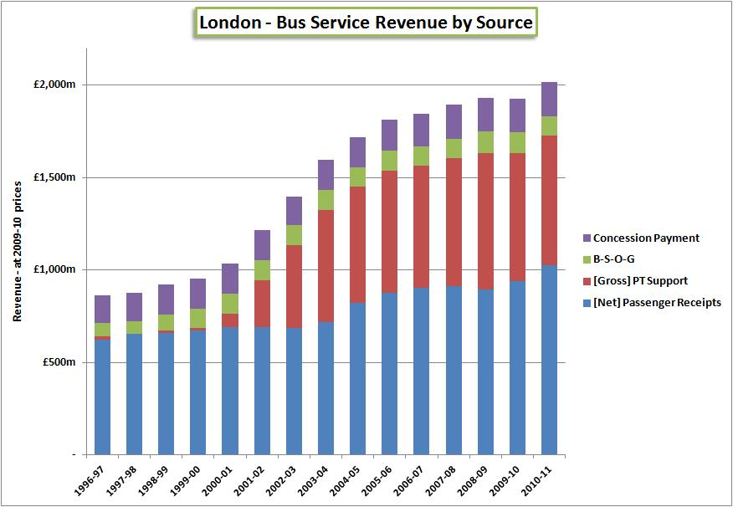
The cost of bus services in London has exploded…..
Source: http://www.alanhowesworld.com/topics/support/bus-industry-performance/

Slide 19
London’s tube fares are about double those in other major Cities
Source: Singapore Land Transport Academy Journal November 2011

Slide 20
The ratio of running costs to purchase costs for cars has changed dramatically
Source: Retail Prices Index

Slide 21
New data shows falling vehicle usage in London

Slide 22
The fall in vehicle usage in Central London has been especially sharp

Slide 23
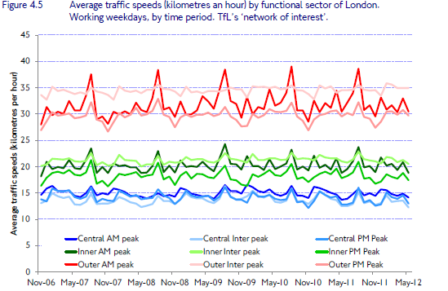
GPS data seems to show no change in traffic speeds since 2006

Slide 24
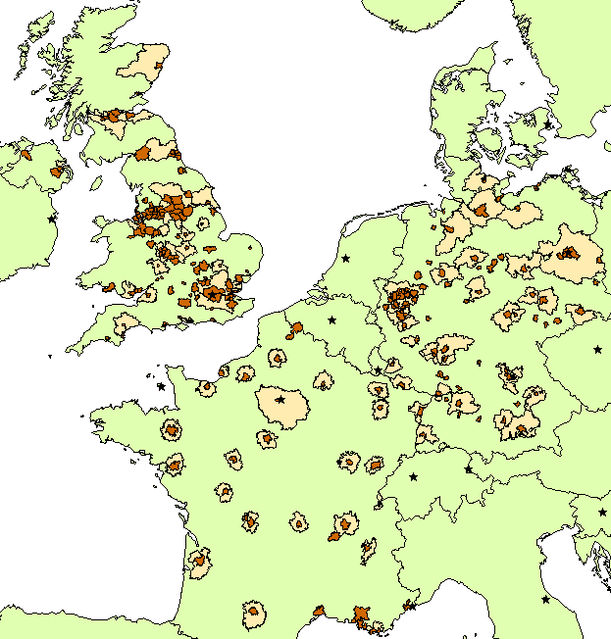
Cebr European congestion study – areas of study

Slide 25
Annual wasted hours per vehicle and total employment for Large Urban Zones in UK, 2011
Large Urban Zone (LUZ) | Annual wasted hours per vehicle (2011) | Employment (2011)
London | 66.1 | 4,107,500
Manchester | 45.1 | 1,162,300
Liverpool | 38.8 | 519,200
Birmingham | 34.0 | 972,300
Belfast | 33.8 | 107,000
Newcastle upon Tyne | 32.9 | 510,600
Nottingham | 32.1 | 216,100
Bradford-Leeds | 30.3 | 999,500
Edinburgh | 29.3 | 448,700
Sheffield | 28.9 | 557,000
Portsmouth | 28.3 | 115,500
Glasgow | 27.3 | 796,500
Bristol | 25.6 | 564,500
Cardiff | 25.2 | 204,500
Coventry | 25.2 | 168,700
Stoke-on-Trent | 25.0 | 97,700
Leicester | 24.2 | 191,900
Kingston-upon-Hull | 23.0 | 151,000
United Kingdom (LUZs only) | 39.2 | 11,890,500
Source: ONS, INRIX, Cebr analysis

Slide 26
Table 4 Direct and indirect household impacts of idling in traffic in UK, euros per year, 2011
 | Aggregate, €m |  | Individual (per car-commuting household), €
 | UK | London | UK | London
Direct costs (higher fuel and value of time costs) | €3,620 | €1,358 | €442 | €994
Indirect costs (higher costs of goods & services) | €1,320 | €539 | €124 | €163
Total | €4,940 | €1,896 | €566 | €1,157
Source: INRIX, Cebr analysis

Slide 27
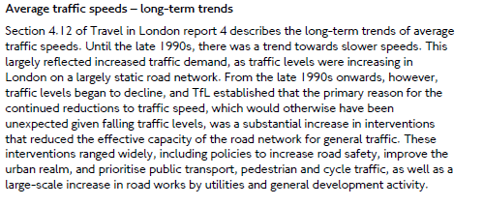

Slide 29
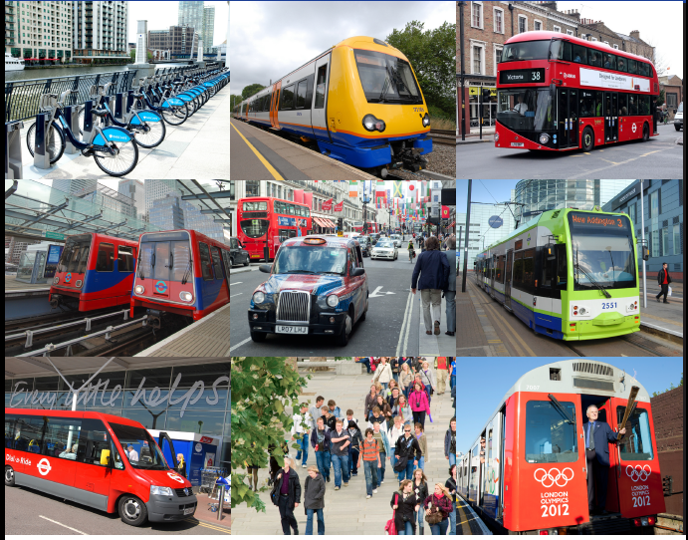
Spot the car, lorry or van…..

Slide 30
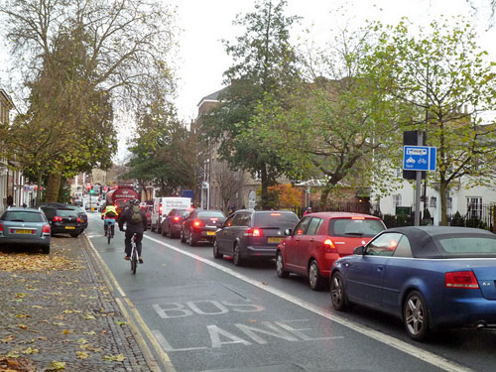
The best use of road space?

Slide 31
The solution to optimising London’s transport
A new roads authority that is charged with maximising the benefits from the roads in an ideology-free way and ensuring roadworks and construction minimise their negative impact
New cycle lanes to segregate cyclists from vehicles (especially buses and heavy lorries) on arterial routes
Securing new private sector investment in underground roads
Continuing TfL’s programme of investment in tube and rail networks – eg Northern Line Extension; CrossRail 2 from Chelsea to Hackney and other tube and rail capacity increases
Achieving TfL’s plans to reduce costs by £9.8 billion cumulatively to 2017/18 – and extending the cost cutting programme over the next 10 years
Economic congestion charging to limit vehicle demand
Limits on vehicle size – or if not then heavy taxation of large vehicles

Slide 32

Socio-Economic Impact
Centre for Economic and Business Research
Agglomeration and business travel efficiency benefits
Notes:
32

Slide 33
Socio-Economic Impact – UK GDP

Slide 34
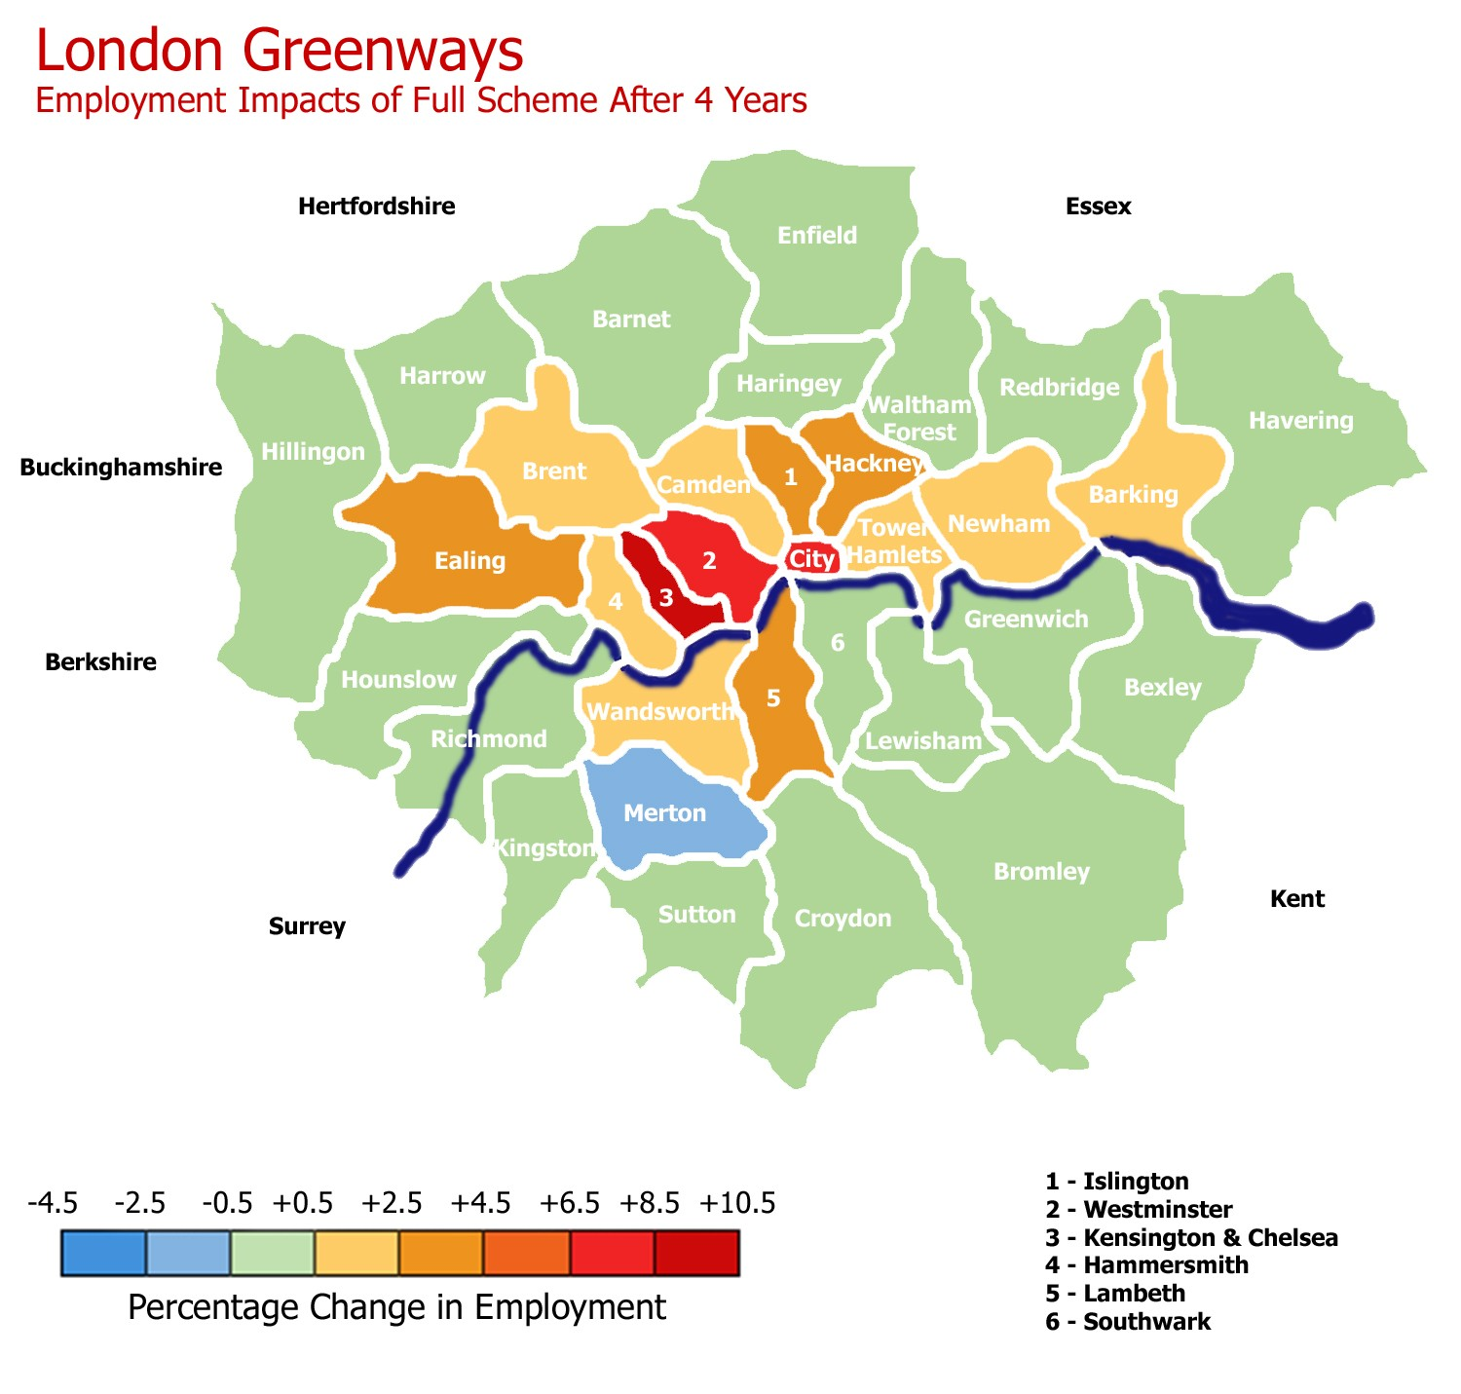
Socio-Economic Impact

Slide 35
The benefits
Cost reductions - £2 billion per annum already planned – another £2 billion realistic
Gains from underground roads - £6 billion to London GDP from complete system
Net benefits from improved tube and rail – scaled from Crossrail – c £2 billion
Control bus usage by price - £500m plus congestion reduction
Smaller benefits – Boris bikes, better control of roadworks and contruction etc c £500m
Total benefits c £13,000 million or c £4,000 per household

Slide 36
Sorting out transport in London
Douglas McWilliams, Mercers’ School Memorial Professor of Commerce at Gresham College and Chief Executive of Cebr

