Slide 1
Notes:
Klugman

Slide 2
Notes:
, Jane Bernal on Margot Heinemann

Slide 3
Notes:
Phil Cohen on Len Jones

Slide 4
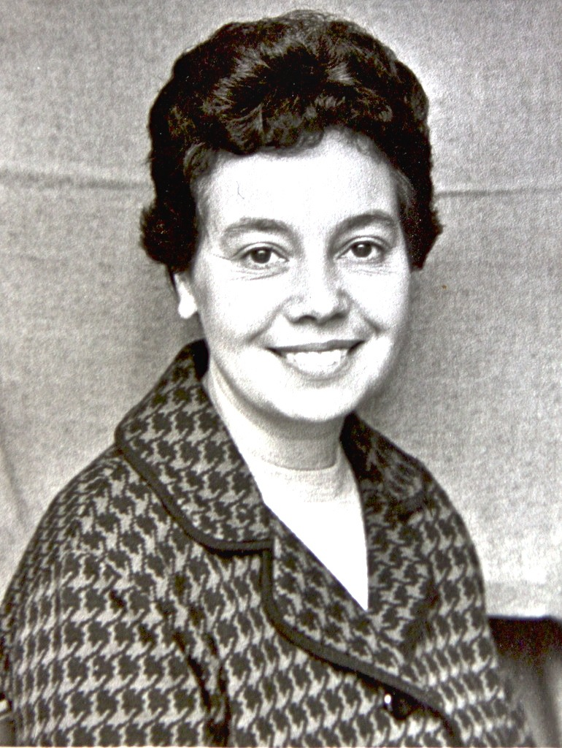
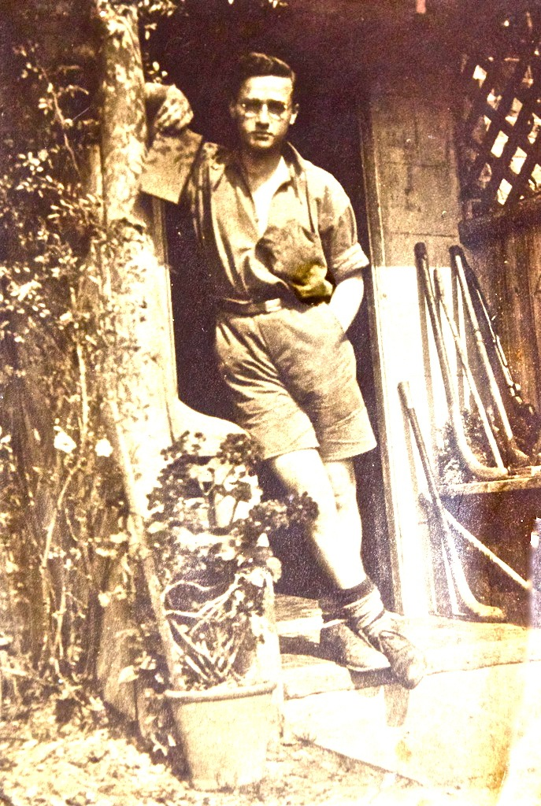
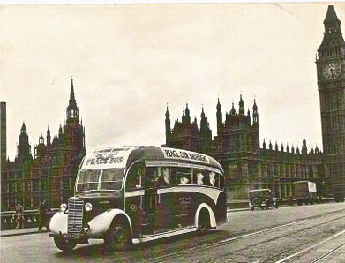
Notes:
Norma Cohen on Eric and Eve Cohen

Slide 5
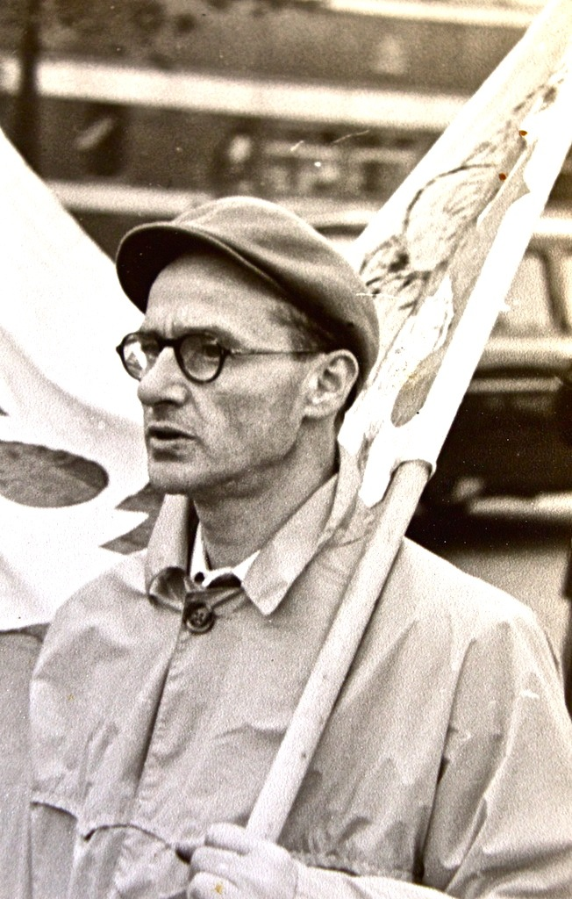
Notes:
Norma Cohen on Eric and Eve Cohen

Slide 6
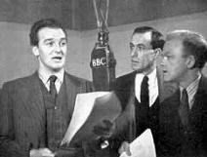
Notes:
Jean McCrindle on Alex McCrindle

Slide 7
Notes:
James MacGibbon

Slide 8
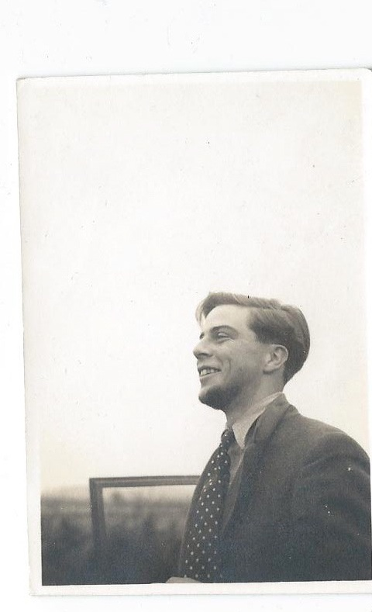
Notes:
Elizabeth Dolan on Richard and Mary Clarke

