Slide 1
SHOULD WE TRUST A THEORY
Joseph Silk (IAP/JHU/Oxford)
Gresham Lecture, 71 February 2017

Slide 2
Inflation
Boltzmann brains
String theory
The Multiverse

Slide 3
Where did the universe come from?
This is a deep question.
It opens the door to the philosophers
who have a lot to say about untestable theories
as do some physicists

Slide 4
THE BLACK SWAN TEST

Slide 5
As viewed by a room full of philosophers Some swans are white, some are black, some are black and white.
at least one swan has a black side
consider a herd of these unilateral swans
Is left-right parity conserved?
would their progeniture be asymmetrically left or right?

Slide 6
As viewed by a room full of string theorists Some swans are white, some are black
Swan negritude is truly rare
It is the greatest problem in (bio)physics
There must be an anthropic explanation

Slide 7
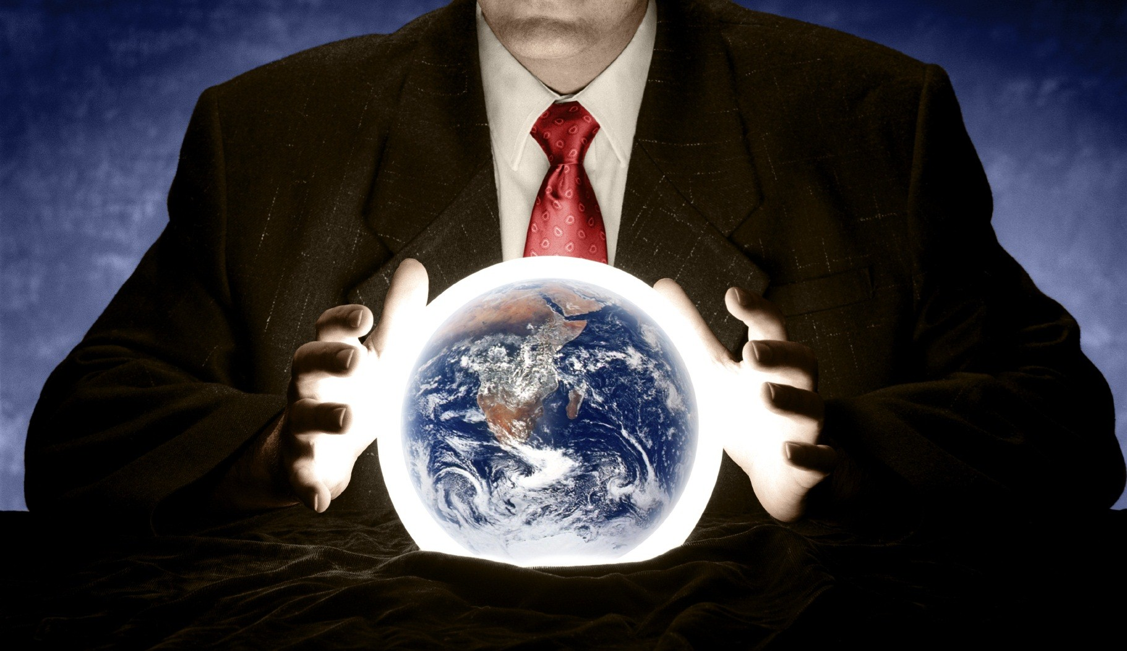
PHILOSOPHY
The ontology and epistemology of swan asymmetry launched
a new field of philosophy which soon split into different areas:
empiricist realism, positivist constructivism and
post-modernist methodology.

Slide 8
PHYSICS
Physics and Astronomy persuaded the funding agencies to launch major research initiatives
in fundamental biophysics and exoplanet oceanography to answer the key questions:
where is their origin? What (DNA) are they made of? What is their future evolution?

Slide 9
Inflation
Boltzmann brains
String theory
The Multiverse

Slide 10
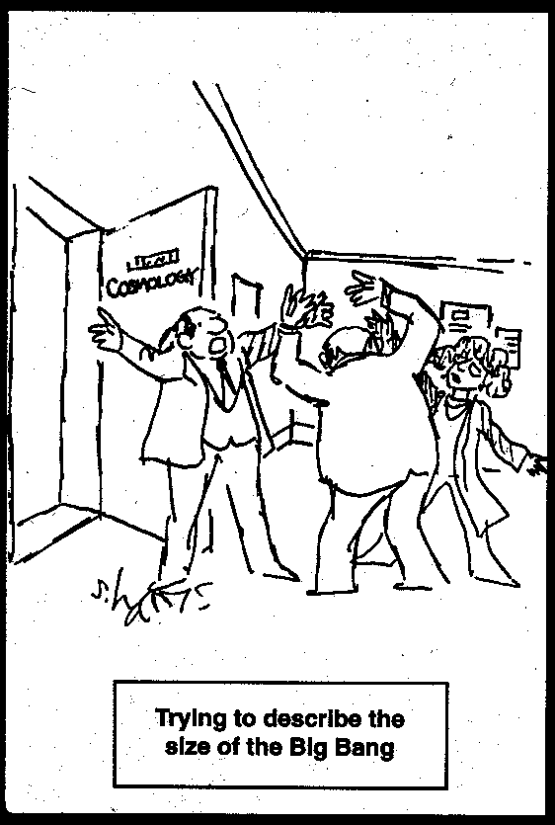
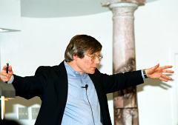
Why is our universe so big? Why is it so uniform? Why is it isotropic, why it does not rotate? Why parallel lines do not intersect?... large size, flatness, isotropy and uniformity of the universe should not be dismissed as trivial facts of life… they should be considered as experimental data requiring an explanation, provided with the invention of inflation.
Andre Linde 2015
It’s hard to build models of inflation that don't
lead to a multiverse.
everything can be created from nothing...it is fair to
say that the universe is the ultimate free lunch
Alan Guth 1997

Slide 11
there are theories that are intrinsically untestable
there are theories that are generically untestable, but testable if the dice roll favorably
there are theories that are generically testable in the remote future, given bigger, better, more expensive telescopes and experiments.
INFLATION

Slide 12
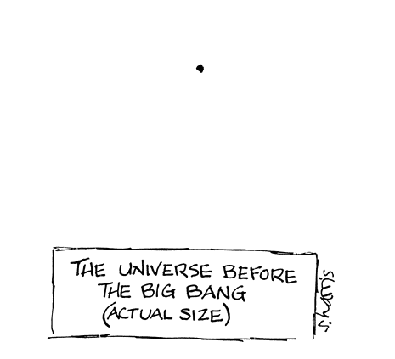
1980s inflation
made 3 predictions:
flatness of space
2. size of the universe
density fluctuations
…the seeds from which
galaxies formed

Slide 13
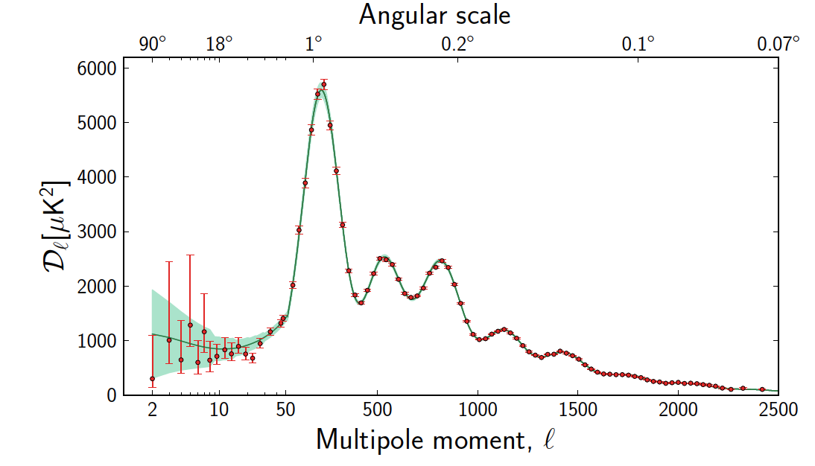
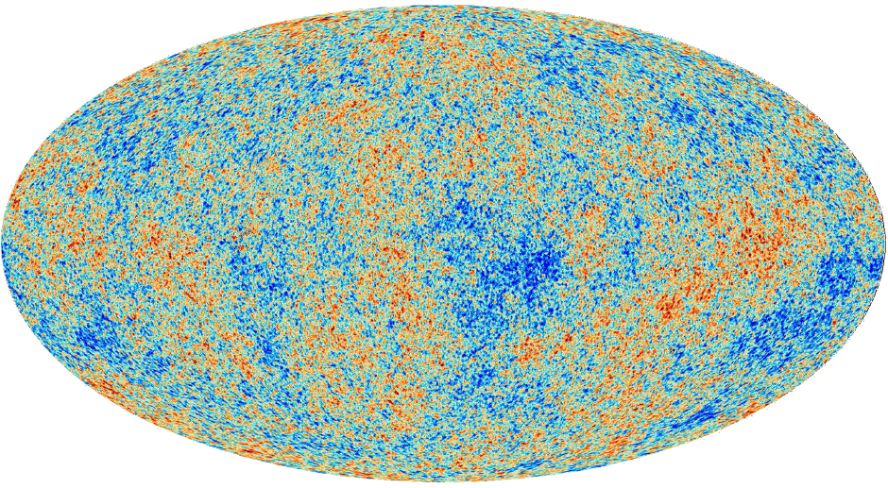
Of course to explain the late universe requires a lot of dirty physics.
Its a bit like predicting the weather in London
But the early universe
is much simpler!
In fact it just takes 6
numbers to characterise
the map of the microwave
background fluctuations
Planck Telescope 2016

Slide 14
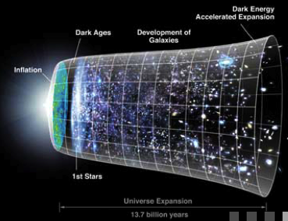
A Brief History of Everything

Slide 15
THE OLD BIG BANG
THE NEW BIG BANG

Slide 16
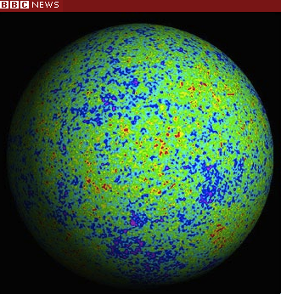
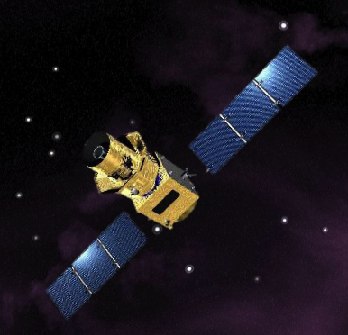
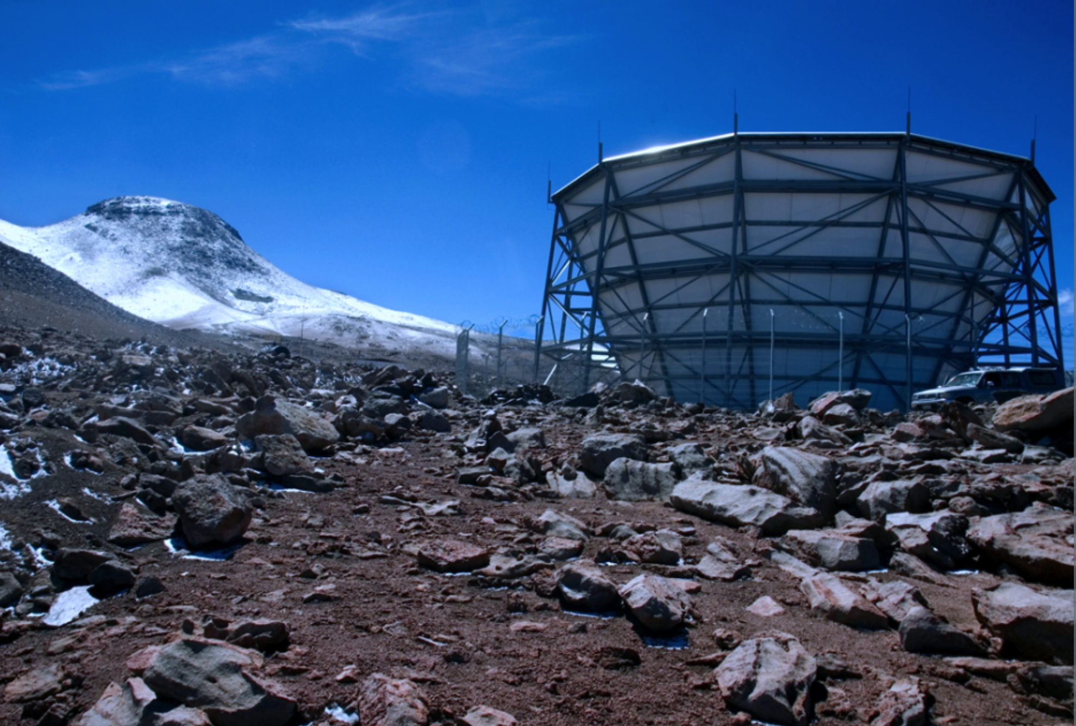
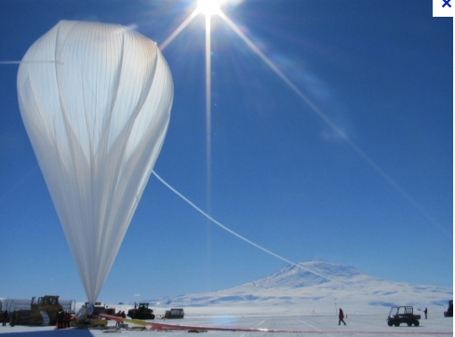
Inflation predicts gravity waves that distort the Cosmic Microwave Background
Gravity waves
Density fluctuations
PIXIE (for 2022 NASA launch?)
Satellites: LiteBIRD (JAXA launch in 2022?)
CORE (ESA launch in 2029?)
South Pole
Atacama
ground/balloon experiments 2020
But there is no guarantee of a signal!

Slide 17
Not only is inflation hard to test
But it has problems, such as
Inflation
Boltzmann brains
String theory
The Multiverse

Slide 18
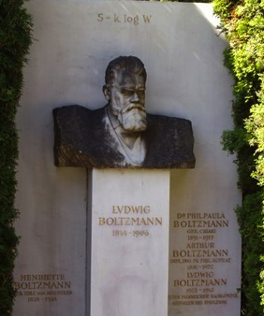
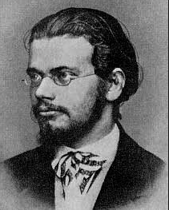
Entropy =k log (Number of states)
Ludwig Boltzmann
Austrian physicist 1844-1906

Slide 19
The 2nd Law of Thermodynamics
Entropy (disorder) cannot decrease
Fortunately it’s a statistical law
The universe began in a state of incredibly high entropy
we are very evolved….
in a state of low entropy
So we are a local fluctuation

Slide 20
Entropy is time’s arrow
Entropy measures the number of states =k log N
Organisation reduces N
Rene Magritte
Time’s arrow?

Slide 21
The observed universe is a rare fluctuation
The most likely fluctuation consistent with everything you know is simply your brain (complete with memories…) fluctuating briefly out of chaos and then immediately
equilibrating back into chaos again.
A. Albrecht and L. Sorbo (2004)
Here’s an example. The kids’ bedroom gets messier and messier.
But wait long enough, just by chance, they’ll throw all the mess
into the cupboard. It’s a very, very rare event!

Slide 22
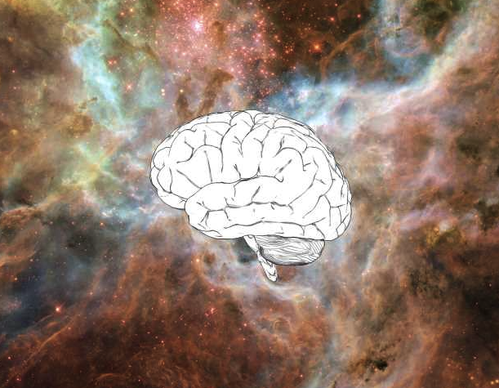
Boltzmann’s paradox
The infinite universe should be teeming with Boltzmann brains that come and go in an instant. We, the earth, the stars, are incredibly more unlikely.
A problem for eternal inflation and the multiverse

Slide 23
The final frontier
Inflation
Boltzmann brains
String theory
The Multiverse

Slide 24
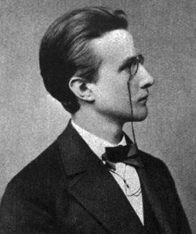
Planck had 3 constants
cspeed of light GNewton’s constant of gravitation
hPlanck’s constant
Max Planck
German physicist
1858-1947
These necessarily retain their meaning
for all times and for all civilizations,
even extra-terrestrial and non-human ones,
and can therefore be designated as natural units
― Max Planck

Slide 25
The Planck length
√ = 1.6 ✕ 10⁻³³ cm
hG
c³
the higher the energy the smaller the scales we probe
The scale is small but we have made amazing progress:
we have gone from atomic scales 10⁻⁸ cm to
nuclear collider scales 10⁻¹⁷ cm in a century
The final frontier is the beginning of the universe

Slide 26
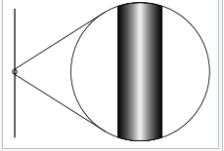
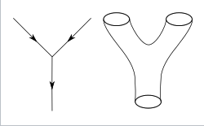
Need to unify quantum theory and gravitation to understand where we came from.
Which brings us to string theory
Particles aren’t point-like,
but tiny closed loops in 10 dimensions
Scale is Planck length

Slide 27
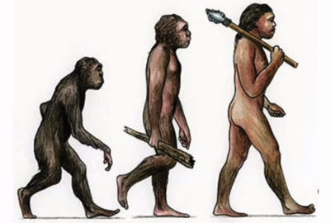
String theory has been very successful
We can’t see atoms or quarks
10⁻¹³ cm
Yet thanks to many applications in everyday life
we are convinced that they exist
How could we possibly hope to prove that
so much tinier strings exist?
10⁻³³ cm
We can’t, yet
19th century
20th
Though another view is that
we don’t need to! Because
it explains so much…
21st

Slide 28
Experiment is the only means of knowledge at our disposal. Everything else is poetry, imagination.
― Max Planck
Here is another view, with apologies to
T. H. White, in The Once and Future King
Everything not forbidden by the laws of physics is compulsory, somewhere.

Slide 29
CHALLENGES
1. Planck scale is incredibly small
the Big Bang is our best bet for testing string theory
but so far there are no good ideas!
2. Fundamental constants of nature are random
which brings us to an extraordinary hypothesis
…..there were many Big Bangs

Slide 30
The biggest problem in physics
Inflation
Boltzmann brains
String theory
The Multiverse

Slide 31
“Large size, flatness, isotropy and uniformity of the universe should be considered as experimental data requiring an explanation… which was provided with the invention of inflation.”
Testable, in principle
“Our world may consist of infinitely many exponentially large parts, … the interior of each of them behaves as if it were a separate universe.”
We call this the multiverse. Its untestable.
But does this mean it’s not physics?
Andre Linde 2015

Slide 32
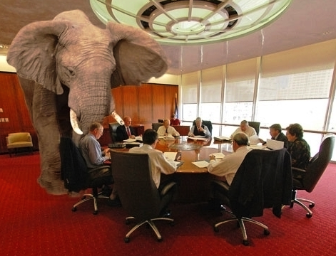

Slide 33
observe
75%
4%
21%
predict
The worst prediction in physics!

Slide 34
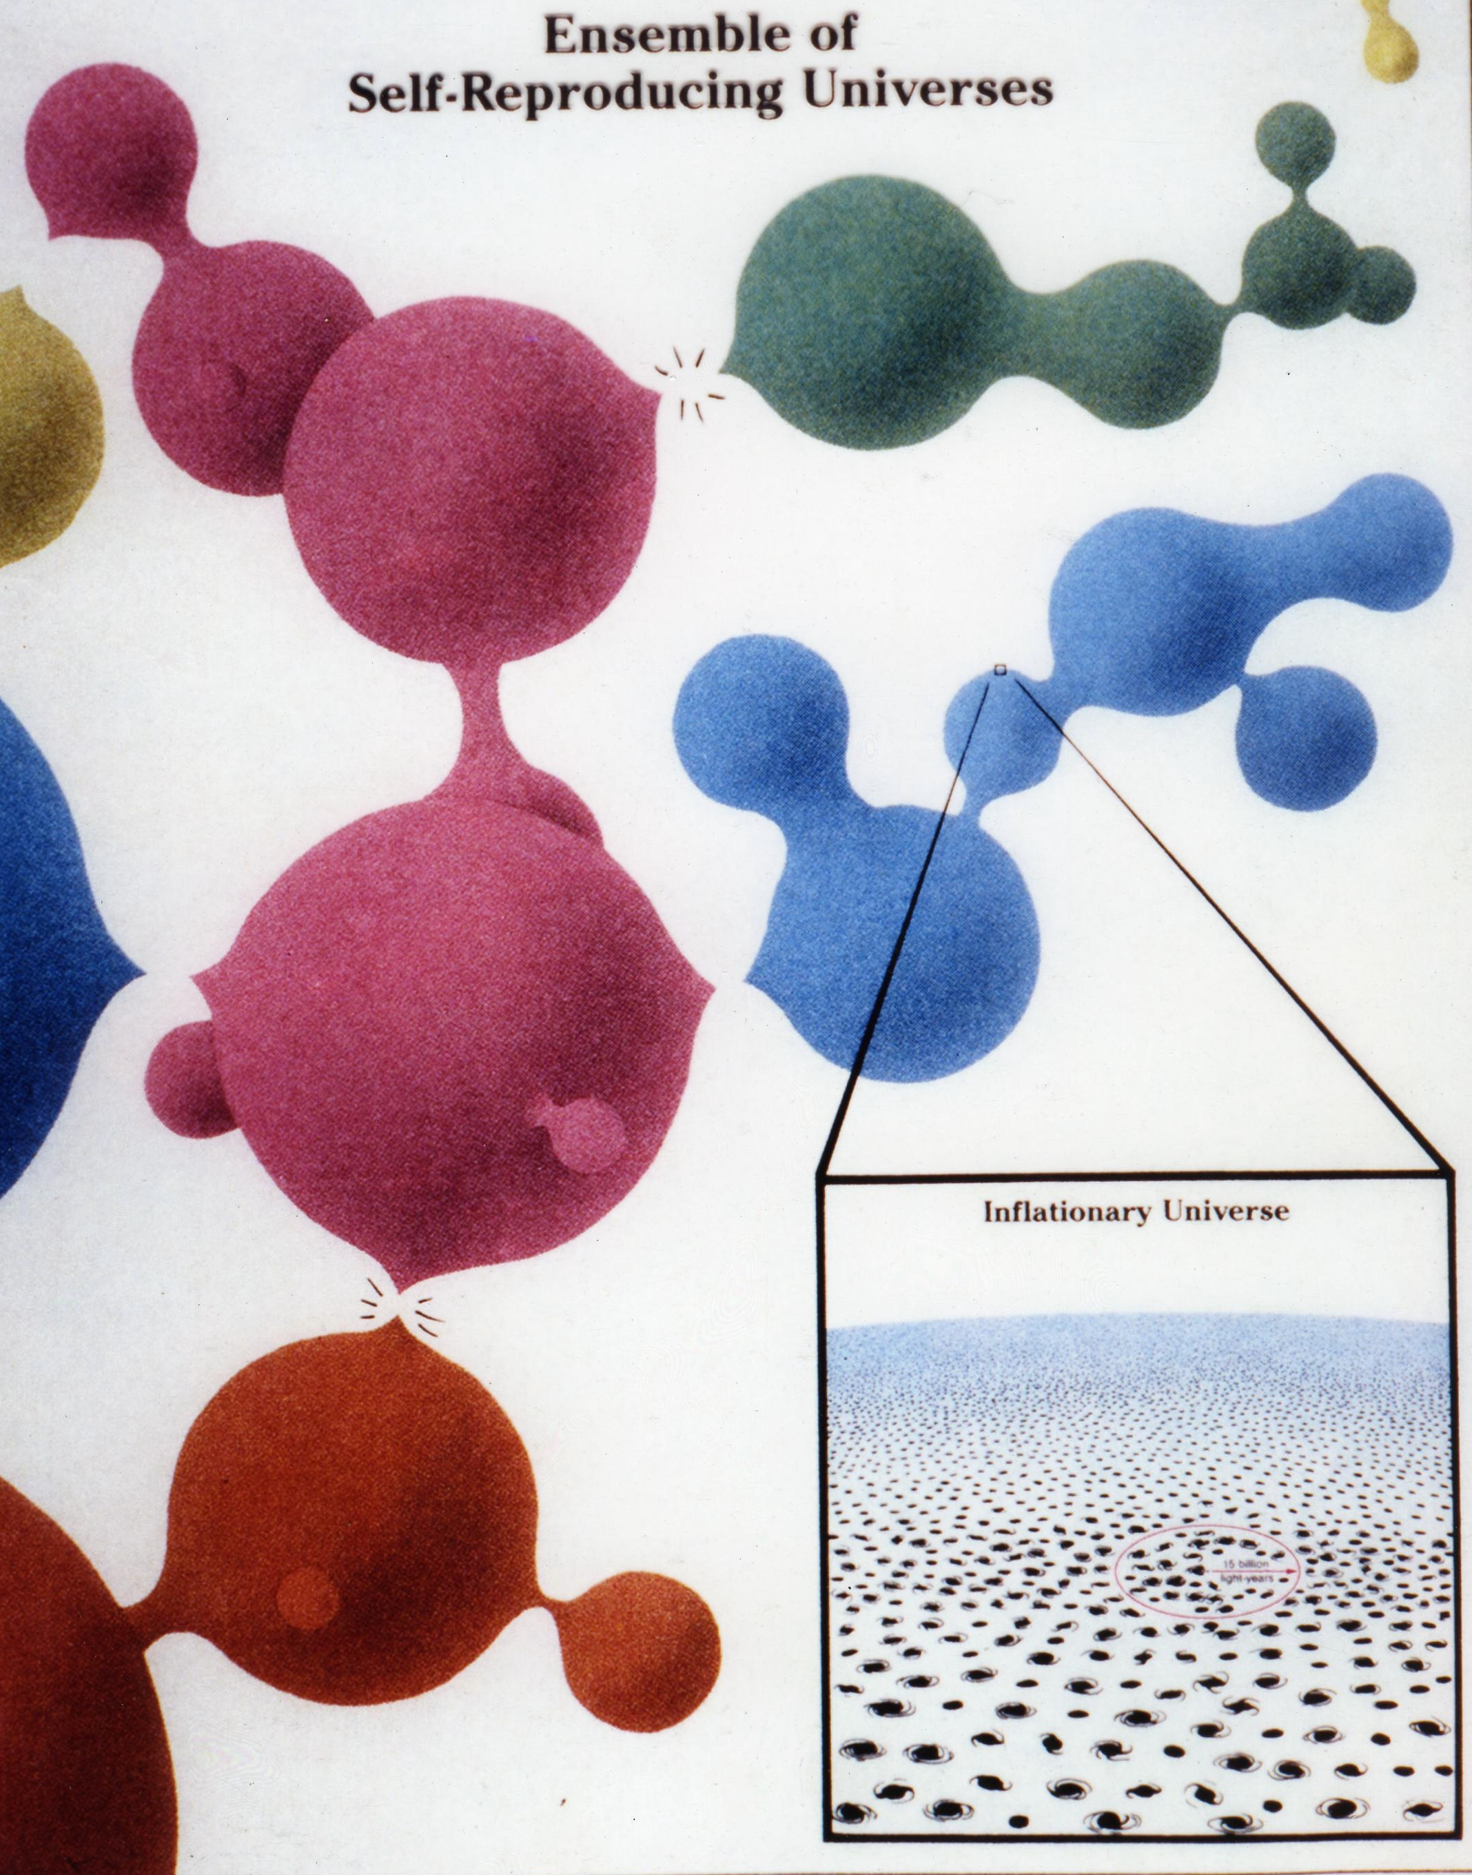
Eternal inflation produces
a nearly infinite number of
inaccessible universes
Motivates
multiverse
explanation
of why dark
energy is so
small
Notes:
34

Slide 35
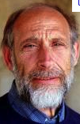
We live in one tiny pocket where the value of the cosmological constant is consistent with our kind of life Leonard Susskind
A. Linde
The multiverse theory can’t make any predictions … it can explain anything… George Ellis

Slide 36
Science cannot solve the ultimate mystery of nature. And that is because, in the last analysis, we ourselves are a part of the mystery that we are trying to solve.
― Max Planck, Where is Science Going?
But Planck didn’t know about string theory

Slide 37
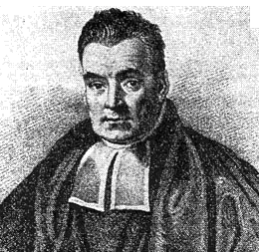
How to evaluate our trust in a theory:
calculate the odds that it may be “true”
Reverend Thomas Bayes 1701-1761
probability that something is “true” based on data ╳ prior
99% chance of testing positive if sick (data) and 1% of population are sick (prior)
Suppose you test positive; what is the chance of your being sick ?
But 1% of healthy people will test positive, so
its 50%!
only half the people sent to the hospital are sick!

Slide 38
The probability that a multiverse exists
To establish a prior, I note that the multiverse is easy to make; it requires quantum mechanics and general relativity…I will start with a prior of 50%. I will first update this with the fact that the observed cosmological constant is not enormous. Now, if I consider only known theories, this pushes the odds of a multiverse close to 100%. But I have to allow for the possibility that the correct theory is still undiscovered…The second update is that the vacuum energy is not exactly zero…The final update is the fact that our outstanding candidate for a theory of quantum gravity, string theory, most likely predicts a multiverse…So this is my estimate for the likelihood that the multiverse exists: 94%.
Joseph Polchinski, 2016

Slide 39
There is a nearly infinite number of infinite universes
in the multiverse
In a multiverse there is another you

Slide 40
There would be an infinite number of other yous,
all identical copies, with your past, your memories…
the leading theory for what happened in the early universe
suggests that space isn’t merely really really big, but actually
infinite, containing infinitely many exact copies of youi
Max Tegmark, Our Mathematical Universe
, and even more near-copies living out every possible variant
of your life
NO!

Slide 41
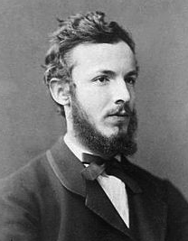
“Some infinites are bigger
than other infinites”
Counting integers is an infinite sequence
But counting irrational numbers
between 0 and 1 is infinity²
Georg Cantor
German mathematician
1845-1918

Slide 42
In the multiverse
there are an infinite number of planets,
inhabited by an infinite number of people
the total is an (infinitely large) integer
But you are so complex that it would take a larger infinity to clone you and your memories
There aren’t enough stars
in the infinite multiverse
to clone the identical you!

Slide 43
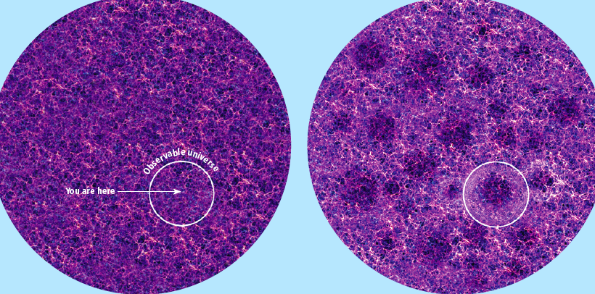
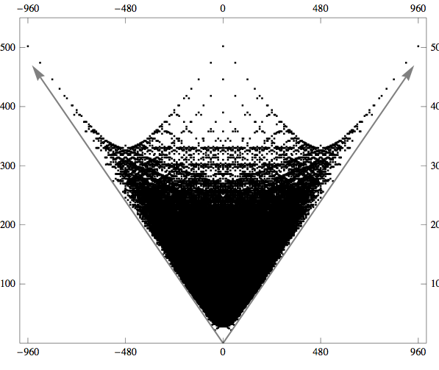
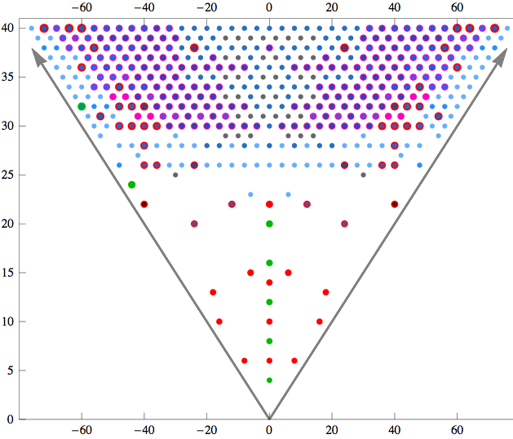
We may seek an astrophysical explanation
e.g. a very big void
P. Ferreira
Clifton & Ferreira 2008
Or hope for a fundamental physics theory
10⁵⁰⁰ Calabi-Yau manifolds to 3
But now its 10¹⁷²⁰⁰⁰ !
Candelas et al 2012
Taylor & Wang 2016

Slide 44
I would bet that at the turn of the 22nd century philosophers and physicists will look nostalgically at the present and recall a golden age in which the narrow provincial 20th century concept of the universe gave way to a bigger better [multiverse] ... of mind-boggling proportions.
Leonard Susskind 2006
The very nature of the scientific enterprise is at stake in the
multiverse debate: the multiverse advocates are proposing
weakening the nture of scientific proof in order to claim that
multiverses provide a scientific explanation. This is a
dangerous tactic… Because multiverses can explain anything,
the answer is likely to be there is none.
George Ellis 2015

Slide 45
