Slide 1
Human Rights: Developments
By
Professor Sir Geoffrey Nice QC
Gresham Professor of Law

Slide 2
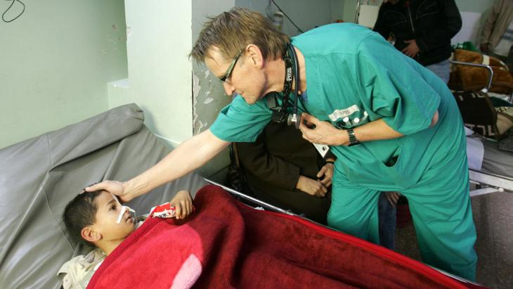
Dr Mads Gilbert

Slide 3
Dr Mads Gilbert
“We still have lakes of blood on the floor in the emergency room, piles of dripping blood soaked bandages to clear out. Cleaners are everywhere swiftly shoveling the blood and discarded tissues, hair, clothes, cannulas, and the leftovers from death – all taken away to be prepared again to be repeated all over.”

Slide 4
Dr Mads Gilbert
“It is completely unacceptable to restrict the movement of humanitarian personnel – much needed in Gaza now after the last bombardment,” he said.
“I will not be stopped from returning to Gaza to do medical work. There are different attempts going on to conceal the reality on the ground for the good people of Gaza – this is one of them – and we must persist in resisting attempts to shutdown Gaza from the world.

Slide 5
An Israeli foreign ministry spokesman, Paul Hirschson
Dr Gilbert was “not on the side of decency and peace and he’s got a horrible track record. I wouldn’t be surprised if his acquaintances are among the worst people in the world.”

Slide 6
Israel – Gaza Erez Crossing

Slide 7
The Human Rights Act 1998
An Act to give further effect to rights and freedoms guaranteed under the European Convention on Human Rights;
Introduction
The Convention Rights.
In this Act “the Convention rights” means the rights and fundamental freedoms set out in—
Articles 2 to 12 and 14 of the Convention,

Slide 8
Interpretation of legislation.
So far as it is possible to do so, primary legislation and subordinate legislation must be read and given effect in a way which is compatible with the Convention rights
Declaration of incompatibility.
...in any proceedings in which a court determines whether a provision of primary legislation is compatible with a Convention right.
If the court is satisfied that the provision is incompatible with a Convention right, it may make a declaration of that incompatibility.

Slide 9
.
Article 2
Right to life Everyone’s right to life shall be protected by law. No one shall be deprived of his life intentionally save in the execution of a sentence of a court following his conviction of a crime for which this penalty is provided by law.
Article 3
Prohibition of torture
No one shall be subjected to torture or to inhuman or degrading treatment or punishment.
Article 4
Prohibition of slavery and forced labour.
No one shall be held in slavery or servitude. No one shall be required to perform forced or compulsory labour.
Everyone who is deprived of his liberty by arrest or detention shall be entitled to take proceedings by which the lawfulness of his detention shall be decided speedily by a court and his release ordered if the detention is not lawful.

Slide 10
Article 5
Right to liberty and security
Everyone has the right to liberty and security of person. No one shall be deprived of his liberty save in the following cases and in accordance with a procedure prescribed by law:
Everyone who is arrested shall be informed promptly, in a language which he understands, of the reasons for his arrest and of any charge against him.
Everyone arrested or detained in accordance with the provisions of paragraph 1(c) of this Article shall be brought promptly before a judge or other officer authorised by law to exercise judicial power and shall be entitled to trial within a reasonable time or to release pending trial. Release may be conditioned by guarantees to appear for trial

Slide 11
Article 6
Right to a fair trial…………
Article 7
No punishment without law
Article 8
Everyone has the right to respect for his private and family life, his home and his correspondence.

Slide 12
Article 9
Freedom of thought, conscience and religion
Article 10
Freedom of expression
Article 11
Freedom of assembly and association
Article 12
Right to marry Men and women of marriageable age have the right to marry and to found a family, according to the national laws governing the exercise of this right.

Slide 13
Article 14
Prohibition of discrimination. The enjoyment of the rights and freedoms set forth in this Convention shall be secured without discrimination on any ground such as sex, race, colour, language, religion, political or other opinion, national or social origin, association with a national minority, property, birth or other status.
The First Protocol
Article 1 Protection of property
Article 3 Right to free elections
PART 3 ARTICLE 1 OF THE THIRTEENTH PROTOCOL The death penalty shall be abolished. No one shall be condemned to such penalty or executed

Slide 14
United Kingdom Independence Party
UKIP will withdraw from the jurisdiction of the European Court of Human Rights.
UKIP will reverse the government’s opt-in to EU law and justice measures, including the European Arrest Warrant and European Investigation Order. We will replace the EAW with appropriate bi-lateral agreements.
UKIP will not give prisoners the vote.
We will repeal the Human Rights Act and replace it with a new British Bill of Rights. The interests of law-abiding citizens & victims will always take precedence over those of criminals.

Slide 15
CONSERVATIVE PARTY
In future, the UK courts will interpret legislation based upon its normal meaning and the clear intention of Parliament, rather than having to stretch its meaning to comply with Strasbourg case-law.
Limit the use of human rights laws to the most serious cases. The use of the new law will be limited to cases that involve criminal law and the liberty of an individual, the right to property and similar serious matters. There will be a threshold below which Convention rights will not be engaged, ensuring UK courts strike out trivial cases. We will work with the devolved administrations and legislatures as necessary to make sure there is an effective new settlement across the UK.

Slide 16
CONSERVATIVE PARTY
For instance: We will set out a clearer test in how some of the inalienable rights apply to cases of deportation and other removal of persons from the United Kingdom. The ECtHR has ruled that if there is any ‘real risk’ (by no means even a likelihood) of a person being treated in a way contrary to these rights in the destination country, there is a bar on them being sent there, giving them in substance an absolute right to stay in the UK. Our new Bill will clarify what the test should be, in line with our commitment to prevent torture and in keeping with the approach taken by other developed nations.

Slide 17
CONSERVATIVE PARTY
The Convention recognises that people have civic responsibilities, and allows some of its rights to be restricted to uphold the rights and interests of other people. Our new Bill will clarify these limitations on individual rights in certain circumstances. So for example a foreign national who takes the life of another person will not be able to use a defence based on Article 8 to prevent the state deporting them after they have served their sentence.
Prevent our laws from being effectively re-written through ‘interpretation’

Slide 18
ABU HAMZA

Slide 20
The Charter of Fundamental Rights of the EU
brings together in a single document the fundamental rights protected in the EU. The Charter contains rights and freedoms under six titles: Dignity, Freedoms, Equality, Solidarity, Citizens' Rights, and Justice. Proclaimed in 2000, the Charter has become legally binding on the EU with the entry into force of the Treaty of Lisbon, in December 2009.
Why the EU Charter of Fundamental Rights exists
The rights of every individual within the EU were established at different times, in different ways and in different forms.

Slide 21
For this reason, the EU decided to clarify things and to include them all in a single document which has been updated in the light of changes in society, social progress and scientific and technological developments: this document is the Charter of Fundamental Rights of the European Union .
It entrenches:
all the rights found in the case law of the Court of Justice of the EU;
the rights and freedoms enshrined in the European Convention on Human Rights
other rights and principles resulting from the common constitutional traditions of EU countries and other international instruments

Slide 22
The Charter sets out a series of individual rights and freedoms.
The Charter is a very modern codification and includes 'third generation' fundamental rights, such as: data protection;
guarantees on bioethics; and transparent administration
The Charter is consistent with the European Convention on Human Rights adopted in the framework of the Council of Europe: when the Charter contains rights that stem from this Convention, their meaning and scope are the same.

Slide 23
PREAMBLE
The peoples of Europe, in creating an ever closer union among them, are resolved to share a peaceful future based on common values.
Conscious of its spiritual and moral heritage, the Union is founded on the indivisible, universal values of human dignity, freedom, equality and solidarity; it is based on the principles of democracy and the rule of law. It places the individual at the heart of its activities, by establishing the citizenship of the Union and by creating an area of freedom, security and justice.
To this end, it is necessary to strengthen the protection of fundamental rights in the light of changes in society, social progress and scientific and technological developments by making those rights more visible in a Charter.

Slide 24
Article 3 Right to the integrity of the person Everyone has the right to respect for his or her physical and mental integrity. In the fields of medicine and biology, the following must be respected in particular: the free and informed consent of the person concerned, according to the procedures laid down by law, the prohibition of eugenic practices, in particular those aiming at the selection of persons, the prohibition on making the human body and its parts as such a source of financial gain, the prohibition of the reproductive cloning of human beings.

Slide 25
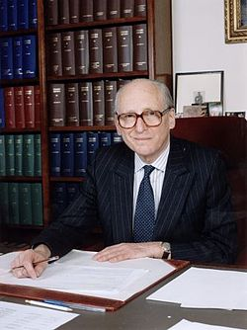
LORD BINGHAM
“Which of these rights, I ask, would we wish to discard? Are any of them trivial, superfluous, unnecessary? Are any of them un-British? There may be those who would like to live in a country where these rights are not protected, but I am not of their number.”

Slide 26
Future Law Lectures
‘Cases I Have Known’
04 March 2015
Srebrenica: Genocide and Trial
01 April 2015
Srebrenica: Justice and Legacy
06 May 2015

