Slide 1
PREDICTABLE SURPRISES
Why we never expect the un-expected

Slide 2
The Over-Confidence Trap
Why we think we can control chance ….

Slide 3
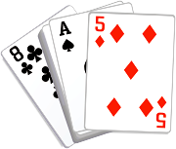
Lessons in gambling behaviour
Players tend to bet more if they can deal the cards

Slide 4
Early wins ….
in games of chance encourage players to bet more

Slide 5
OVER-CONFIDENCE
Over-confidence can lead to inordinate risk taking
Leads us to over-estimate what we can achieve and under-estimate difficulties
Leads us to over-value ourselves and de-value other people
Can lead us to blame failure on others or on factors beyond our control

Slide 6
Nothing succeeds like success

Slide 7
SUCCESS
Repeated success can lead to an illusion of invulnerability.
If we experience repeated success we expect to succeed.
Yet repeated success can tempt us to abandon the very things that made us successful in the first place.
Repeated success also encourages risk-taking.

Slide 8

VIVIDNESS TRAPS
What worries you more, dying in an air crash or a car crash?

Slide 9

Vivid events seem ….
nearer, and,
more probable than they really are.

Slide 10
Wow! Grab it!
Too good to lose?

Slide 11
Confirmation traps
We tend to pay more attention to information that confirms what we want to hear.
We tend to down-play or even ignore contradictory information.

Slide 12
Experience can become a trap
If we think we have seen and heard it all before
Or if we notice similarities between past and present cases but miss important differences.

Slide 13
Anchoring traps
Why we never get a second chance to make a first impression ….

Slide 14
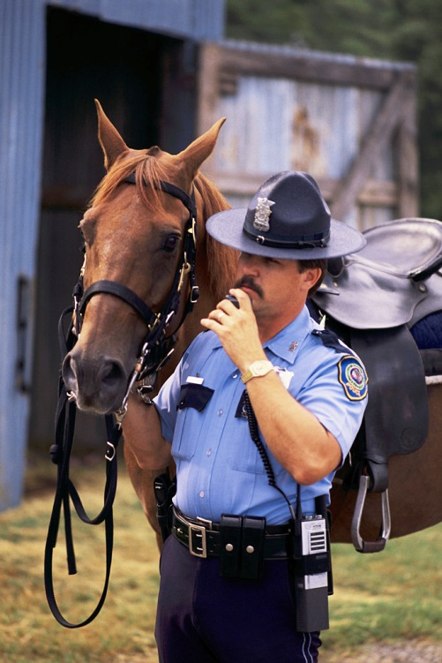
EXPECTATION TRAPS
POLITE NOTICE

Slide 15
PARADOX AND CONTRADICTION
Why “more” of a good thing is not always better.
Why virtuous circles can turn vicious.

Slide 16
Imagine …
two people frantically trying to steady an already steady boat ……

Slide 17
MADNESS
Repeating same ineffective actions and expecting different results.
Or, when something doesn’t work, applying “more of the same”.

Slide 18
The Icarus Paradox
Or why success often contains the seeds of destruction

Slide 19

GETTING DECISIONS MORE RIGHT THAN WRONG

Slide 20

Get real
For example, prioritise

Slide 21
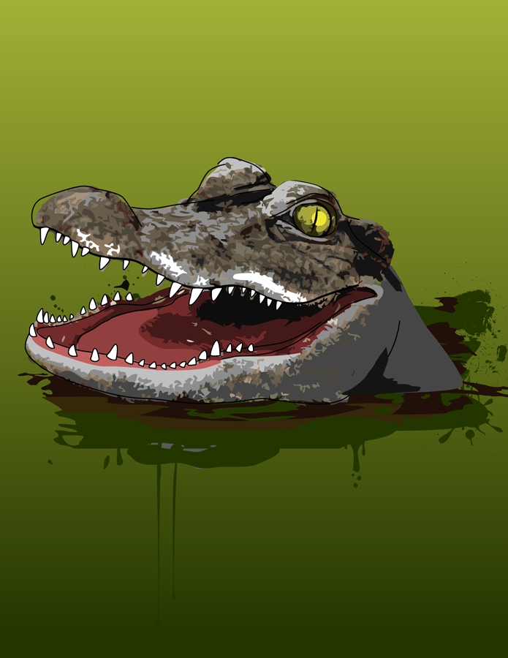

Slide 22
Be Humble
Better still, be very humble
Think it possible, you might be mistaken

Slide 23
ASSUMPTIONS
Ass U Me
(And other sobriquets)

Slide 24
Keep Your Head
and use it!

Slide 25
Who dares not
sometimes wins in the end.

Slide 26
Look again
What might be different?
What might have changed?

Slide 27

Expect the unexpected

Slide 28
Haul Anchor
Find out where the figures came from
Confound perceptions
Bad start can be redeemed by a good end

Slide 29
Quit while ahead
“Only a fool holds out for top dollar.”
(Joesph Kennedy)

Slide 30
Look for the problem behind the problem
What assumptions are you making about the nature of them problem that may be stopping you from seeing a solution.
Remember the drunk who looked for his car keys not where he dropped them but under the lamp-post where the light is good. (Still looking).

Slide 31
Change the approach

Slide 32
THINK!
How might this play out?

Slide 33
To act or not to act….
COMING SOON:
- the psychology of doing nothing.

