Slide 1
Things of darkness: the nature of human violence
Professor Gwen Adshead
February 2015

Slide 2
This thing of darkness, I acknowledge mine…
Other acknowledgements
Colleagues at Broadmoor hospital and Ravenswood house
Professor Jim Gilligan
Anthony Perry and the estate of Evie Williams

Slide 3
The nature of violence
Is violence normal?
Violence world wide: a focus on homicide
Different forms of homicide
Violence as a complex act of human meaning
The ecology of violence: what are the influential factors operate?
Implications for violence prevention

Slide 4
Warning!
So shall you hear
Of carnal, bloody, and unnatural acts,
Of accidental judgments, casual slaughters,
Of deaths put on by cunning and forced cause.

Slide 6
Violence is everywhere
High rates of violence world wide
Especially homicide and suicide
Different rates in different countries
Different victims and perpetrators

Slide 7
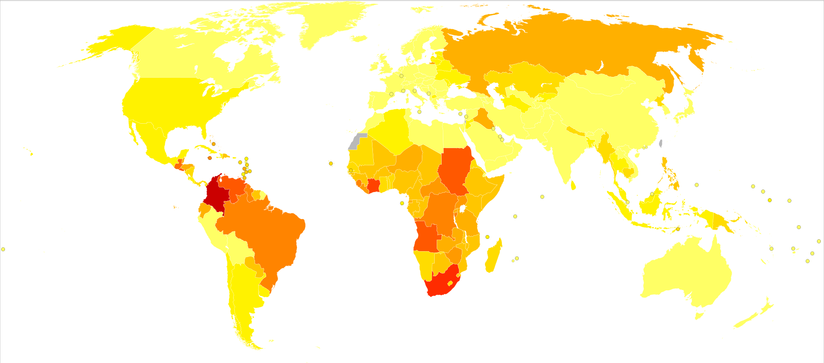
Notes:
Hotspots for violence: the darker the colour, the higher the Homicide rates. These are 2012 data.

Slide 8
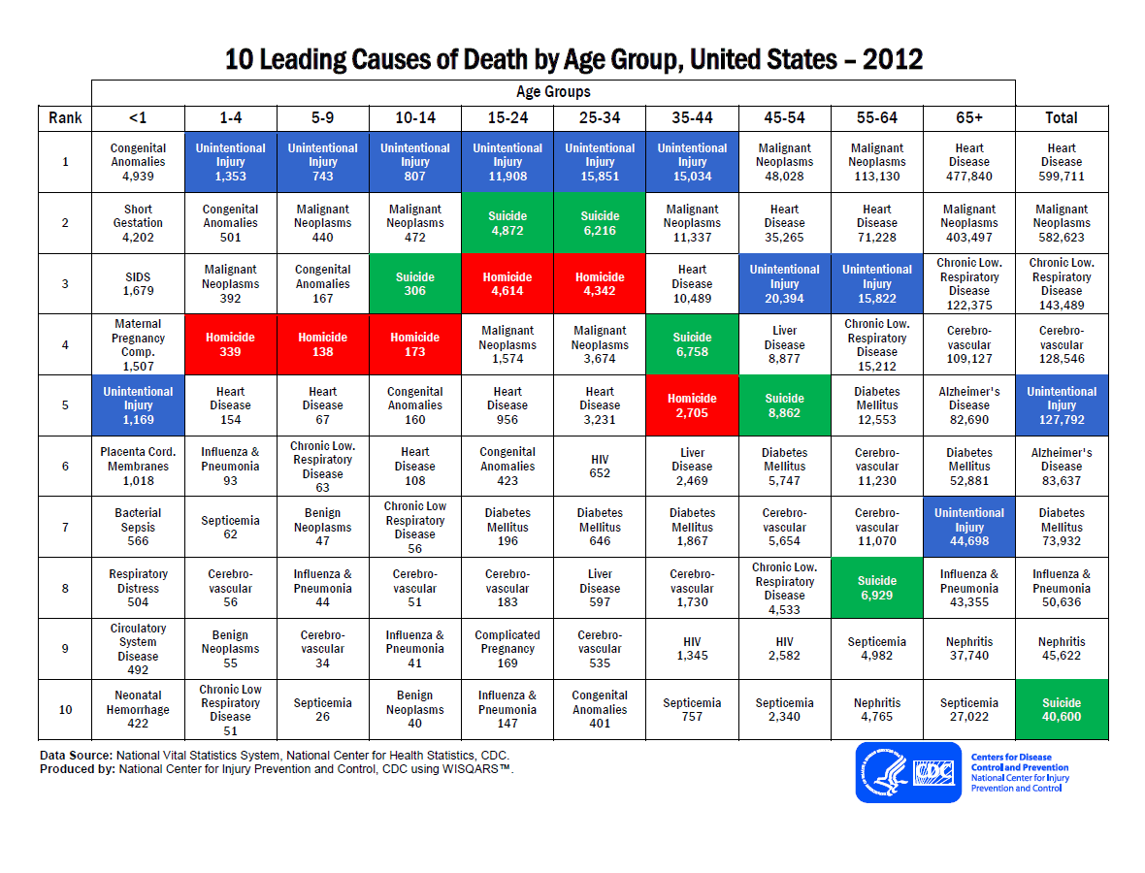
Notes:
Red boxes

Slide 9
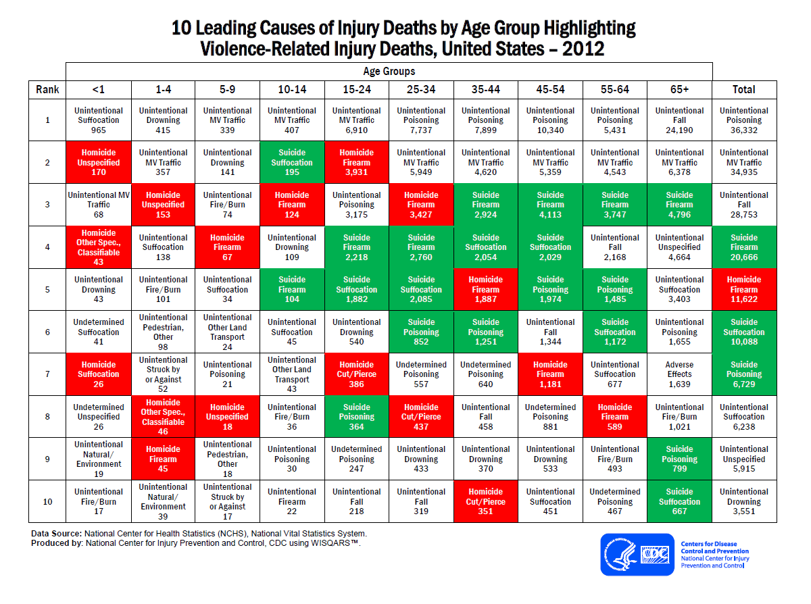
Notes:
Red boxes by age

Slide 10
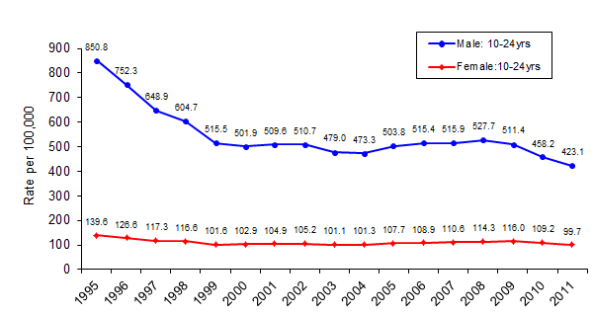
Notes:
Falling homicide rates in the USA

Slide 11
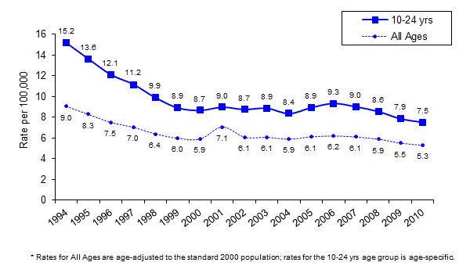
Notes:
And again

Slide 12
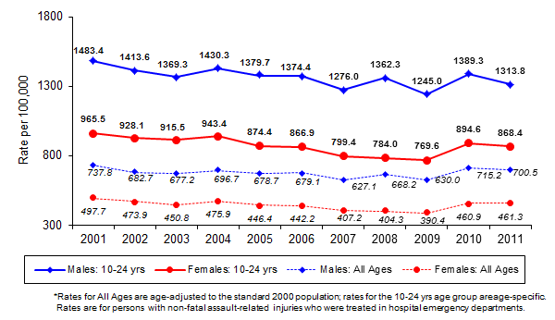
Notes:
Males and females: non fatal violence

Slide 13
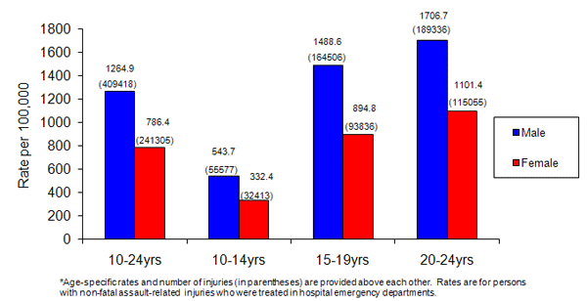
Notes:
The differences by age group

Slide 14
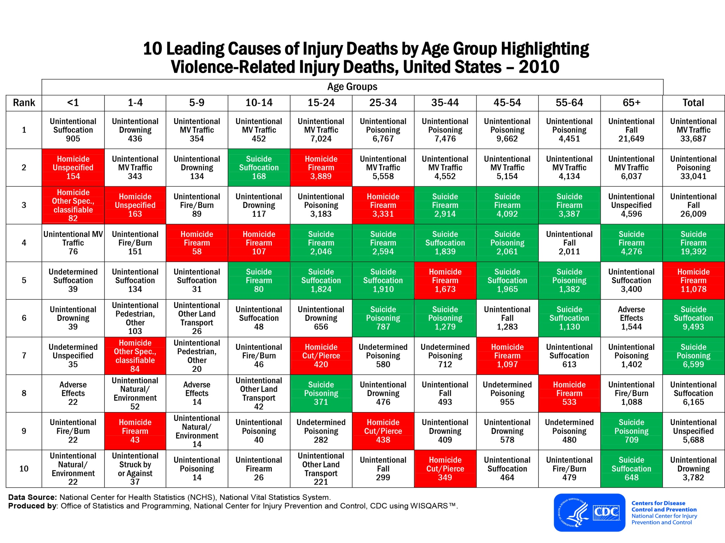
Notes:
Violence related deaths suicide and homicide by age group
The young die by homicide and the old by suicide

Slide 15
Notes:
Not changed much: links of suicide and homicide with technology?

Slide 16
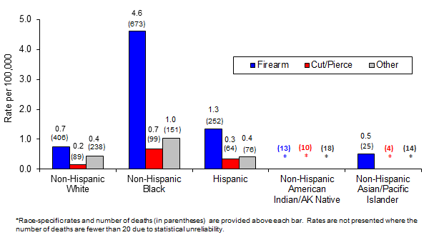
Notes:
Ethnicity and weapons

Slide 17
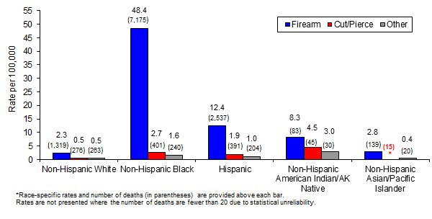

Slide 18
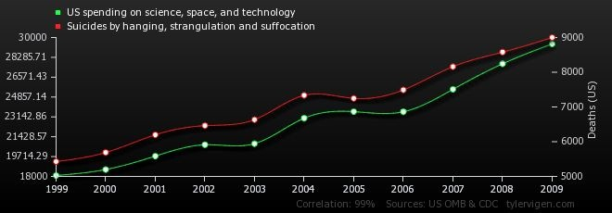

Slide 19
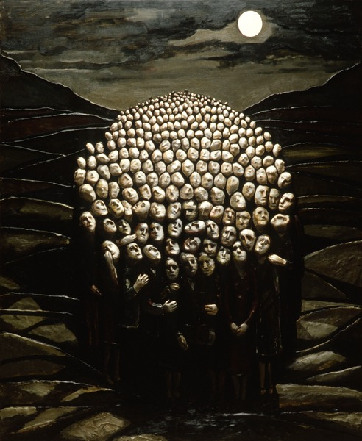

Slide 20
UNODC 2013
Reports on global homicide
Three different motivational groups
Not all the same
Different meanings and communications
Criminal
Relational
Socio-political: killing people for what they represent

Slide 21
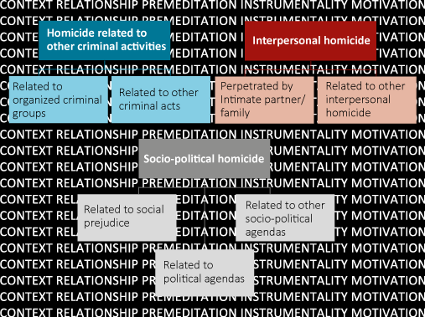
Notes:
UNODC document: motivations for violence

Slide 22
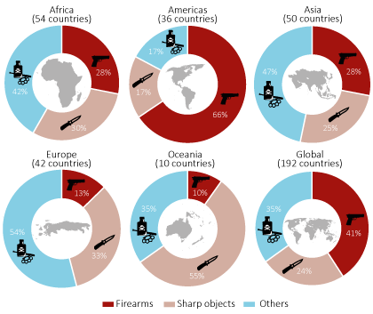

Slide 23
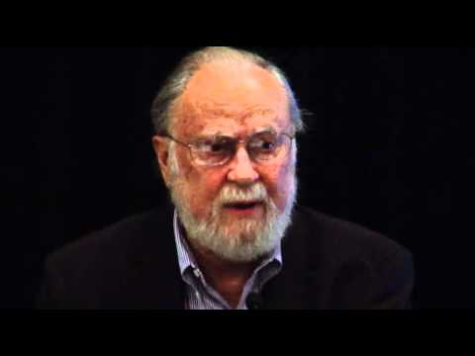

Slide 24
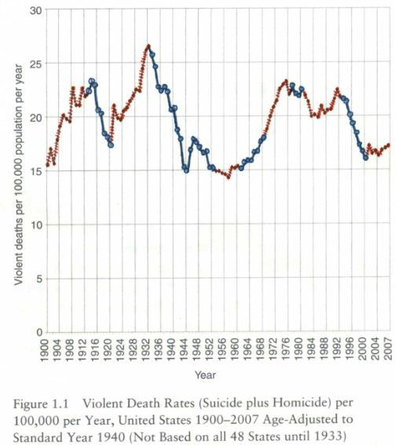

Slide 25
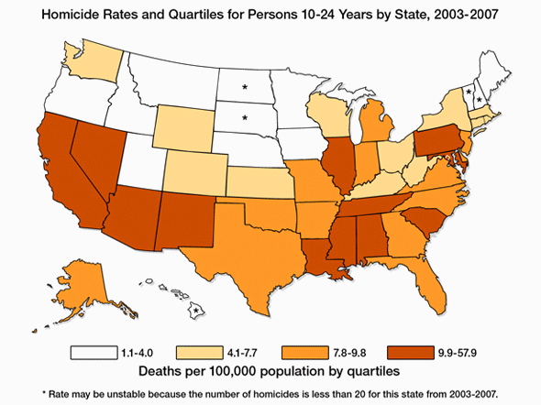
Notes:
The different rates by north and south

Slide 26
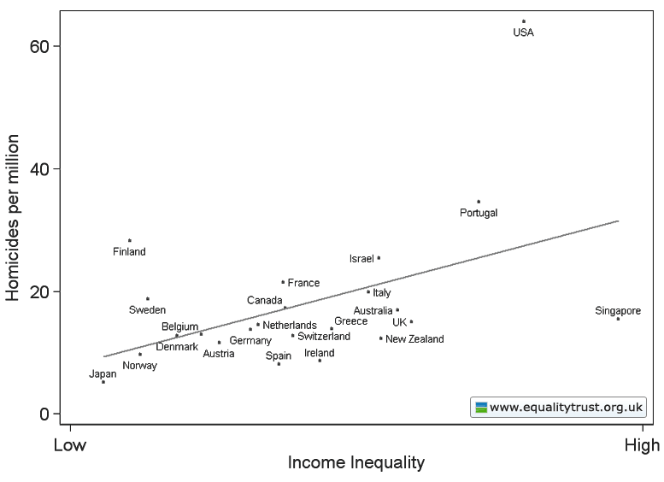
Notes:
The equality trust data

Slide 27
Bartels & Pizarro 2011

Slide 29
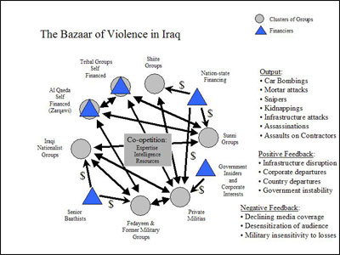

Slide 30
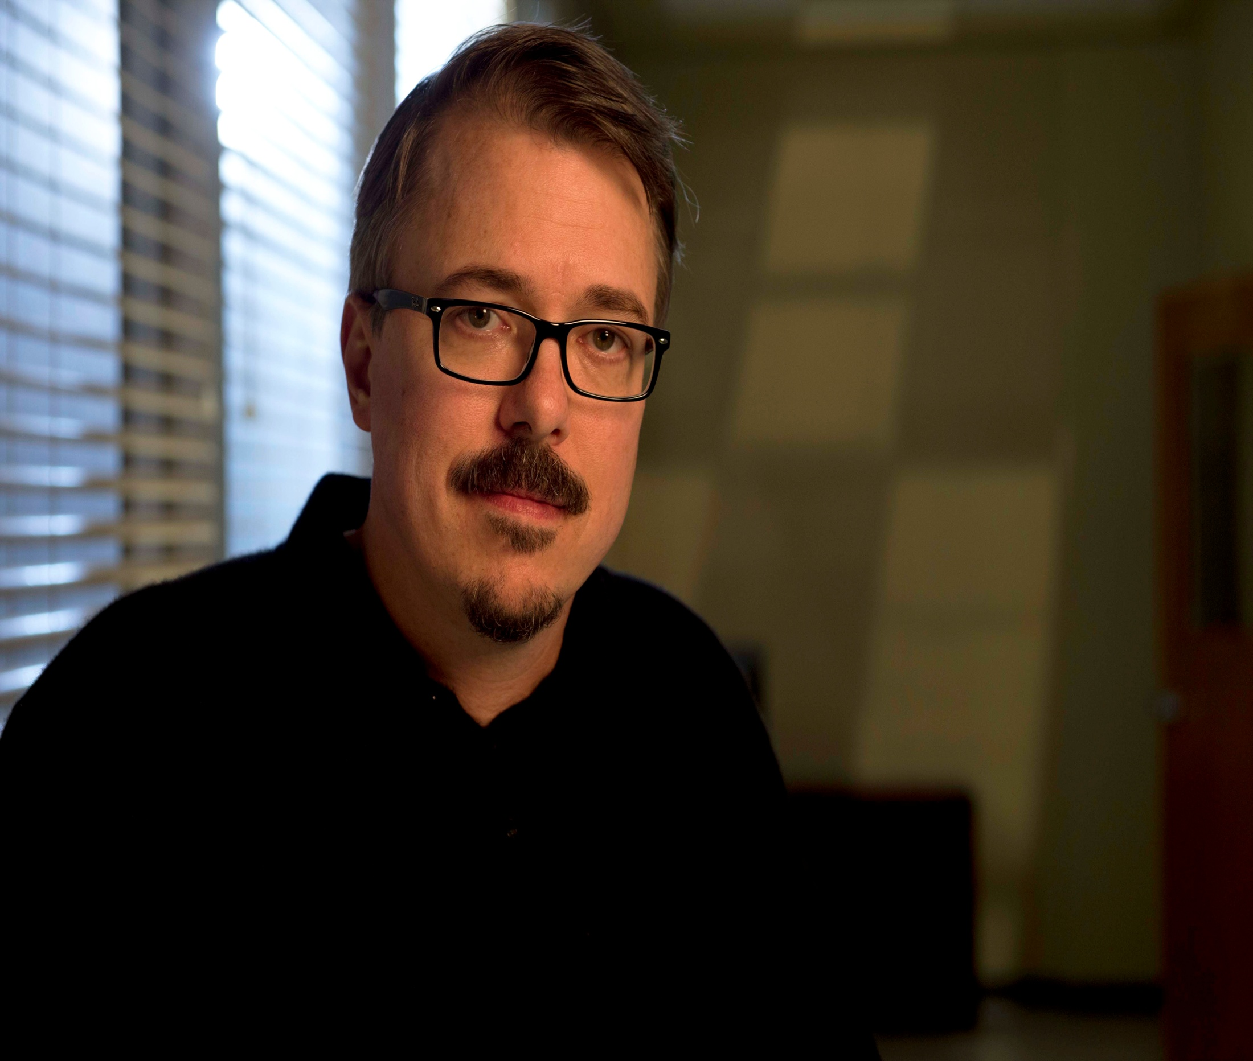

Slide 33
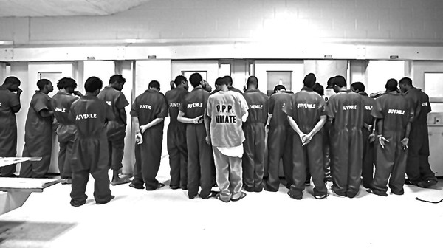

Slide 34
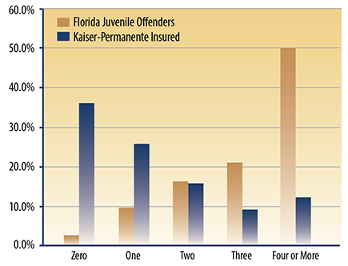
Notes:
Baglivio 2014 Journal of Juvenile justice

Slide 35
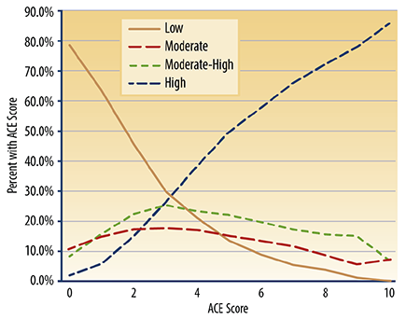
Notes:
Baglivio 2014 Journal juvenile justice

Slide 36
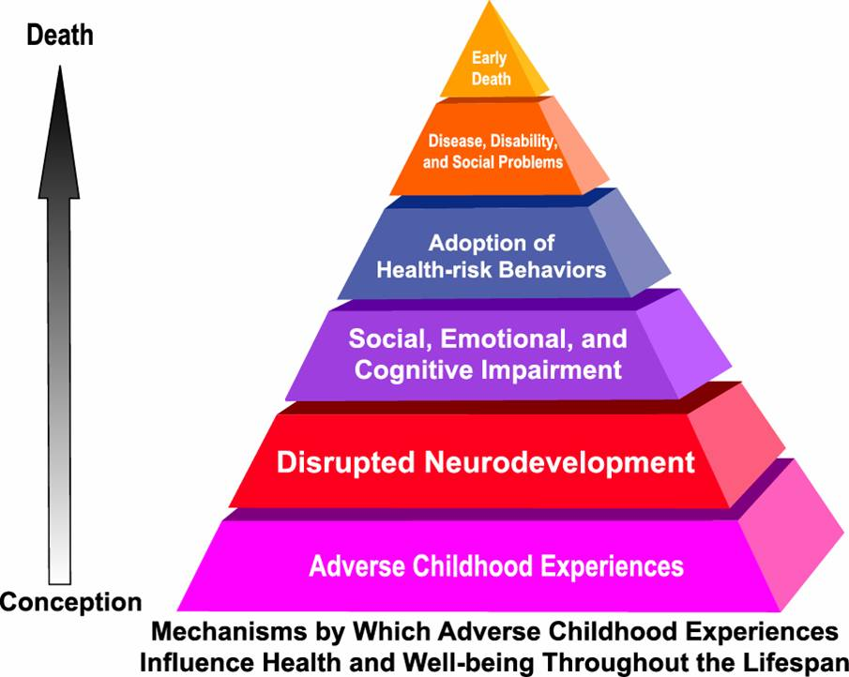

Slide 38
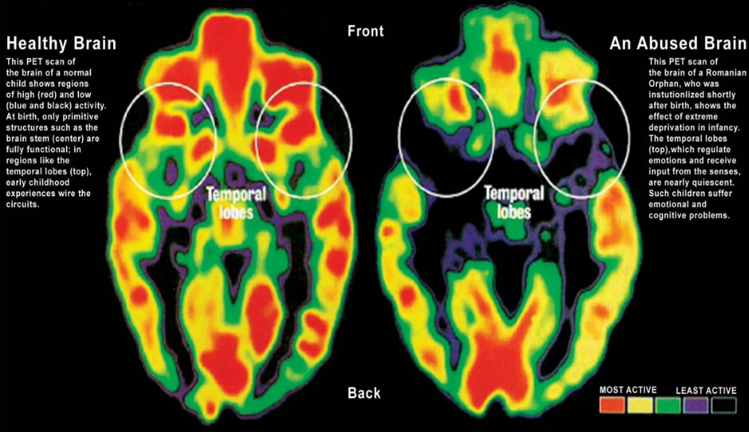

Slide 39
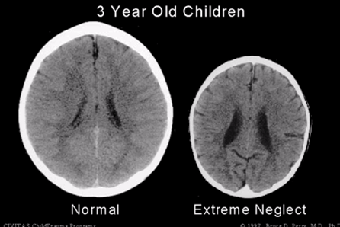

Slide 40
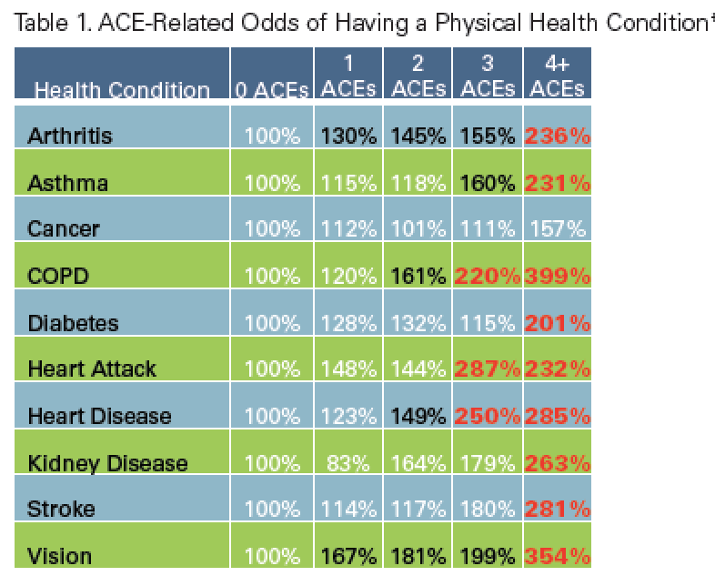

Slide 41
Violence requires explanation
Each act of violence is complex and outcomes are multiply determined
The model of the bicycle lock: the risk “numbers” that must be activated
Why are levels of violence falling?
Violence has meaning for perpetrators
Thinking systemically: from the individual to the social level
Ecology of violence

Slide 42
