Slide 1
Women in Red: Dress, Morality and Visual Culture in the mid-Nineteenth Century
Lynda Nead
Department of History of Art and Screen Media
Birkbeck, University of London

Slide 2
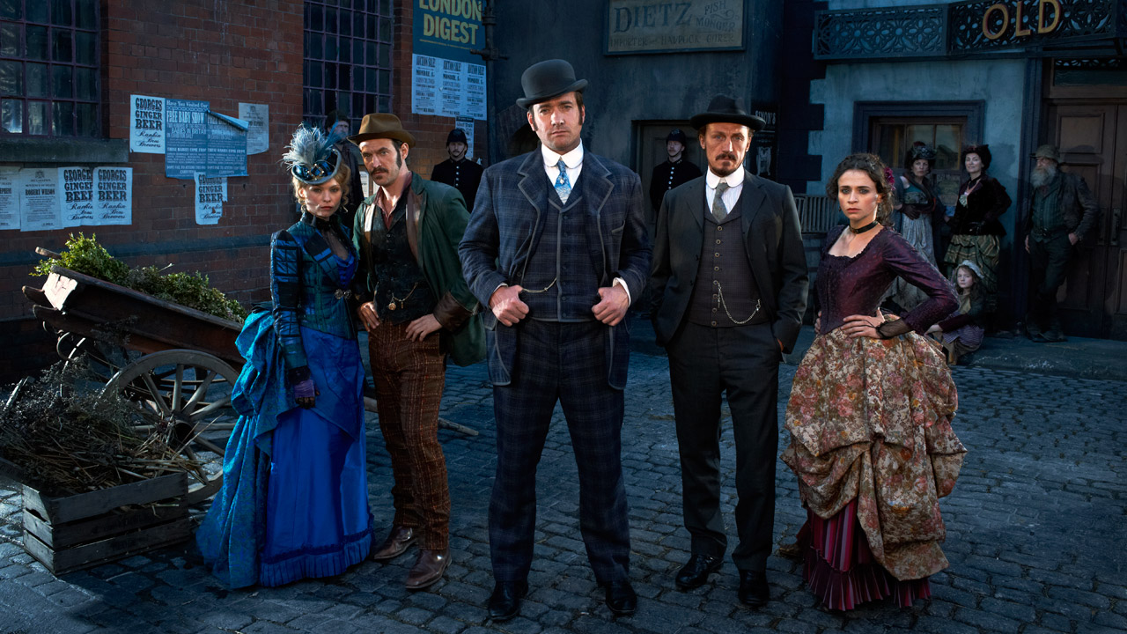

Slide 4
Extract from Charles Baudelaire, ‘The Painter of Modern Life’, publ. 1863
‘She [the courtesan] advances towards us, glides, dances, or moves about with her burden of petticoats, which play the part at once of pedestal and balancing-rod; her eye flashes out from under her hat, like a portrait in its frame. She is the perfect image of the savagery that lurks in the midst of civilization. She has her own sort of beauty, which comes to her from Evil always devoid of spirituality, but sometimes tinged with a weariness which imitates true melancholy. She directs her gaze at the horizon, like a beast of prey; the same wildness, the same lazy absent-mindedness, and also, at times, the same fixity of attention. She is a sort of gipsy wandering on the fringes of regular society, and the triviality of her life, which is one of warfare and cunning, fatally grins through its envelope of show.’

Slide 5
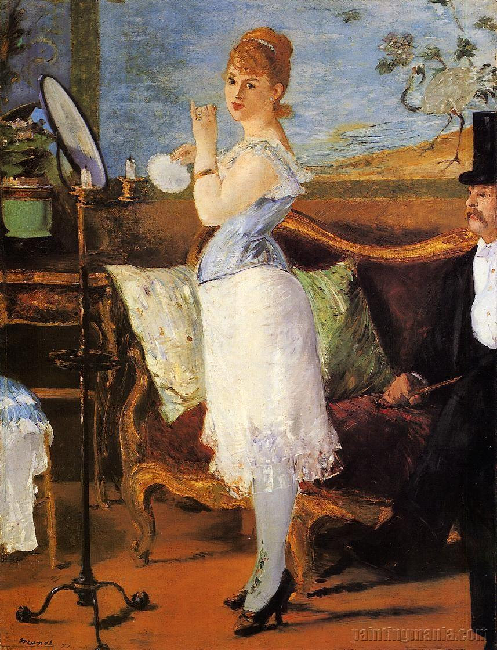

Slide 6
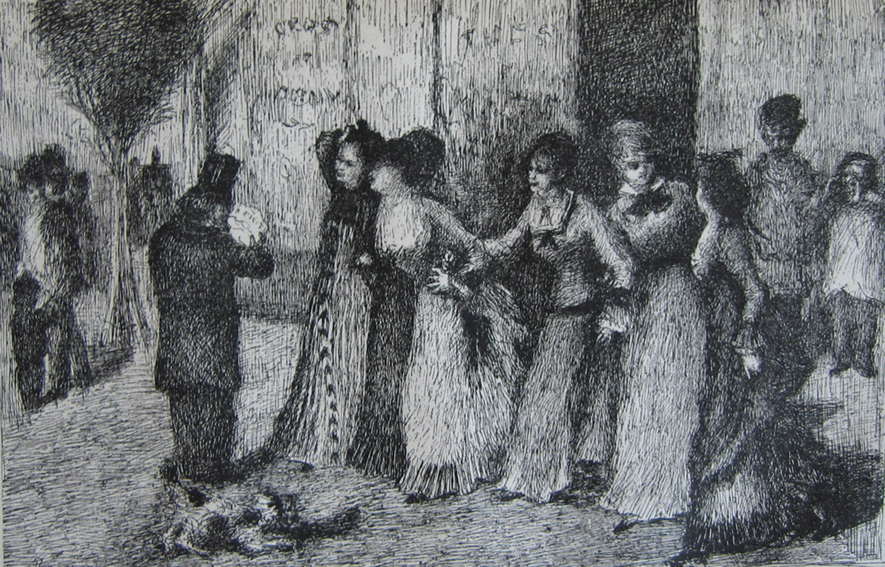

Slide 7
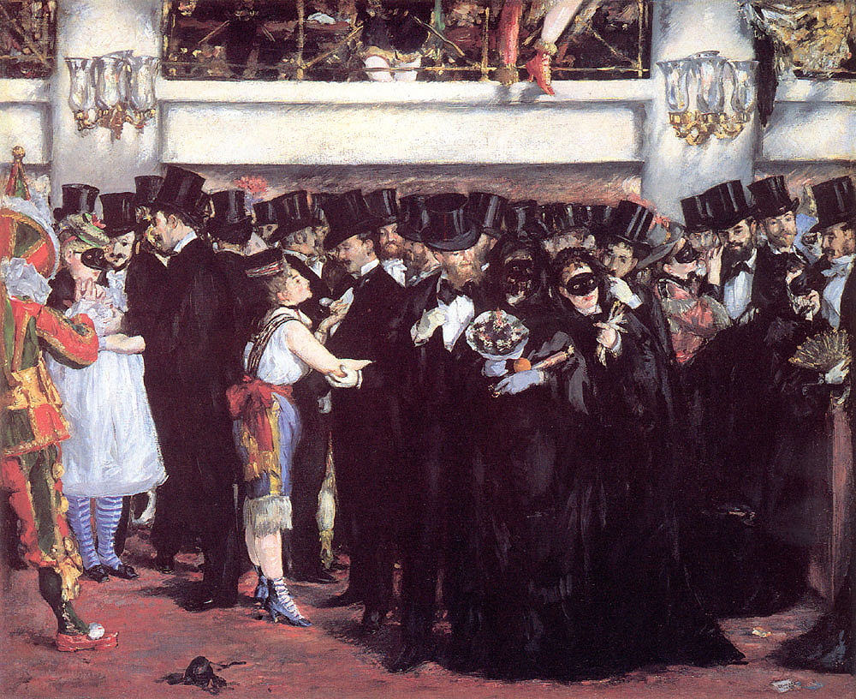

Slide 8
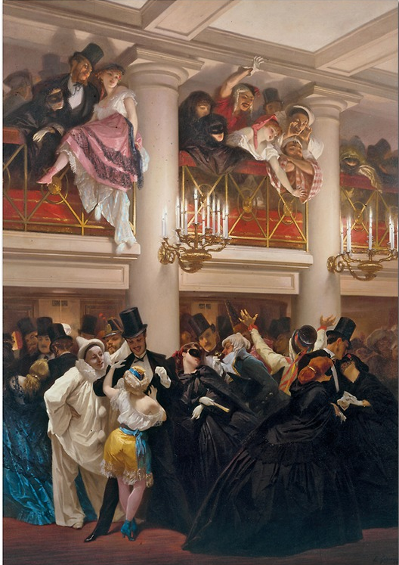

Slide 11
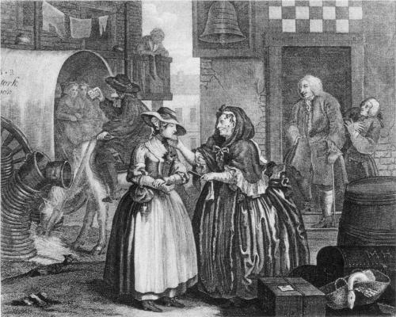

Slide 12
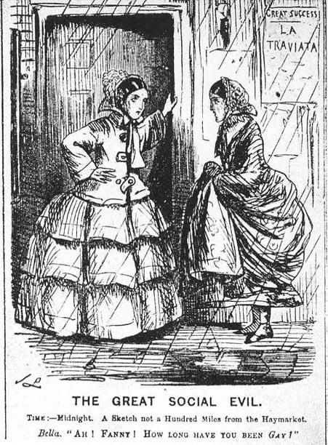

Slide 13
Extract from William Tait, Magdalenism, 1840: ‘Her once, free, and smiling countenance, which bespoke the inward purity of her mind, is now distorted with the workings of her vile and corrupted affections…the effects of sin are not more plainly and fearfully displayed on any class of human beings than on fallen and decayed prostitutes…It may be stated generally, that in less than one year from the commencement of their wicked career, prostitutes bear evident marks of their approaching decay; and that in the course of three years very few can be recognised by their old acquaintances, if they are so fortunate as to survive that period.’ Extract from William Logan, The Great Social Evil, 1871: ‘For the sweet ringing laugh – the wild shriek of mirth or the breast-shattering cough of consumption; for the simple dress – the tawdry rags of what was once a fashionable dishabille, won by the wages and torn to tatters in the service of sin.’

Slide 14
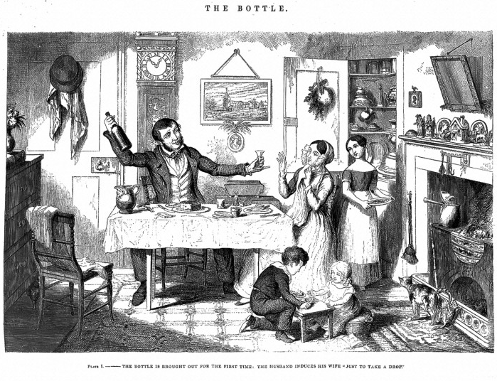

Slide 15
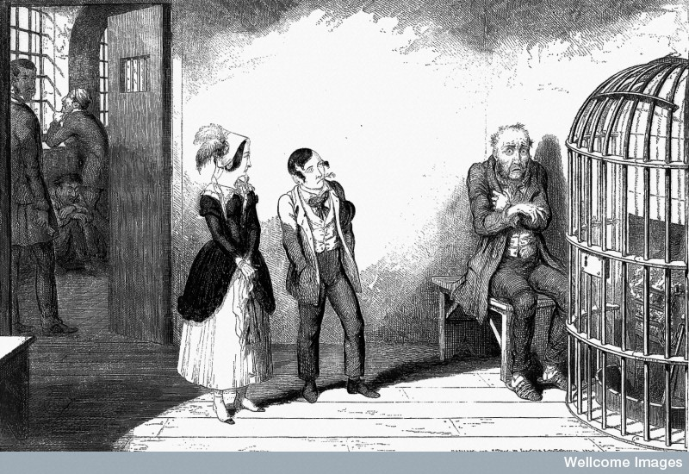

Slide 16
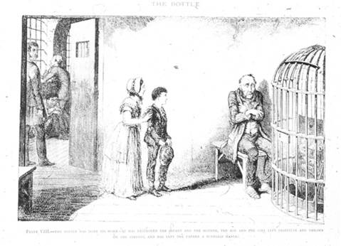

Slide 18
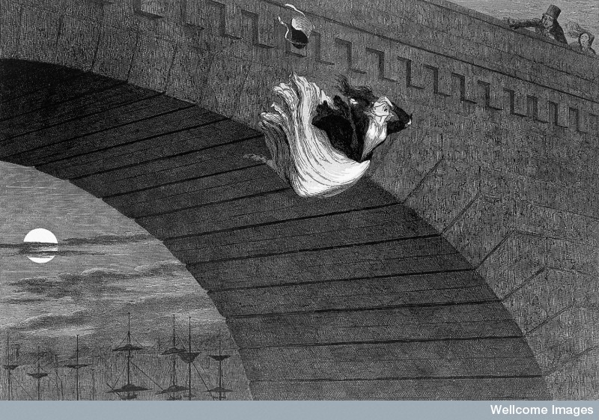

Slide 19
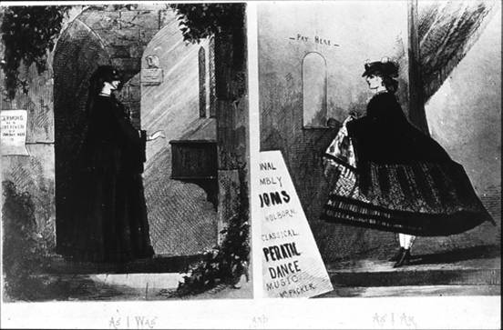

Slide 20
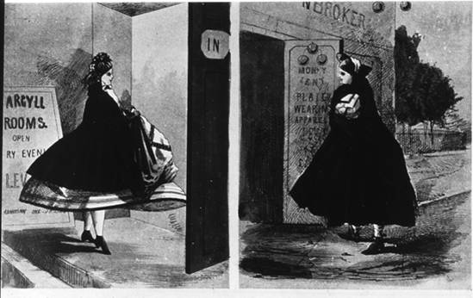

Slide 21
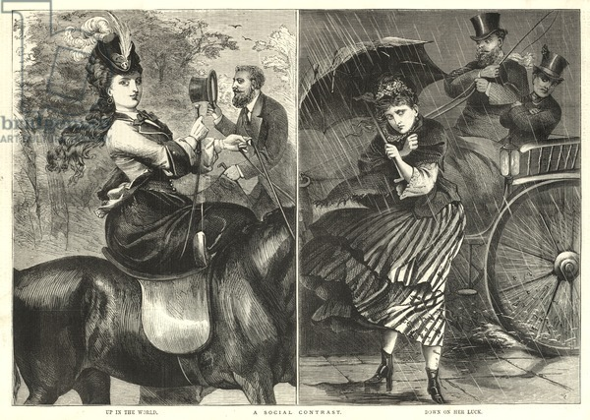

Slide 22
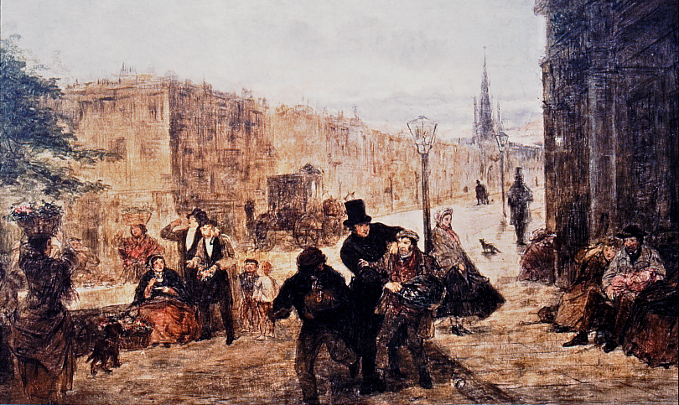

Slide 23
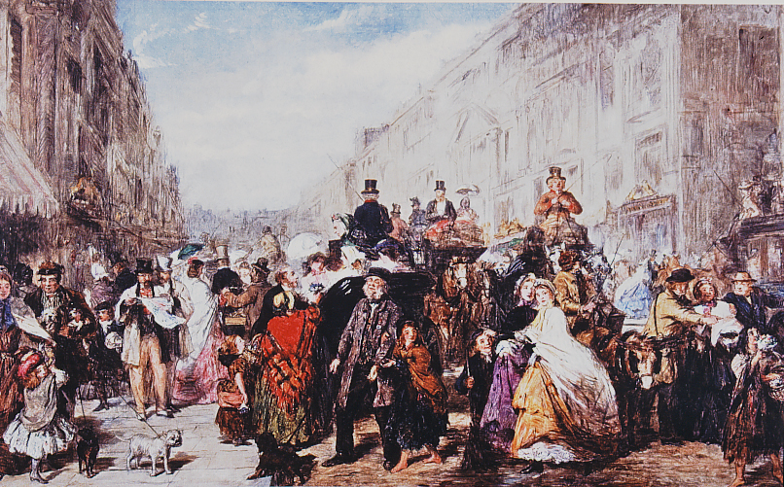

Slide 24
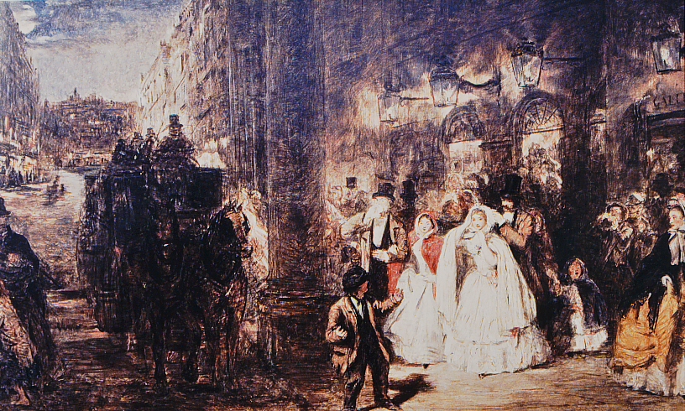

Slide 25
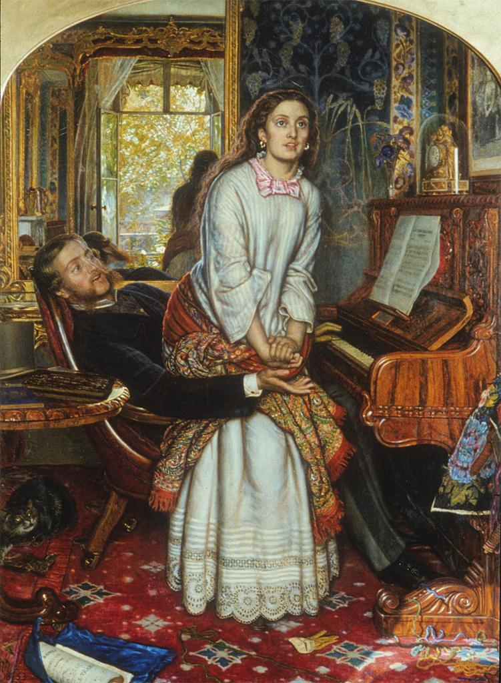

Slide 26
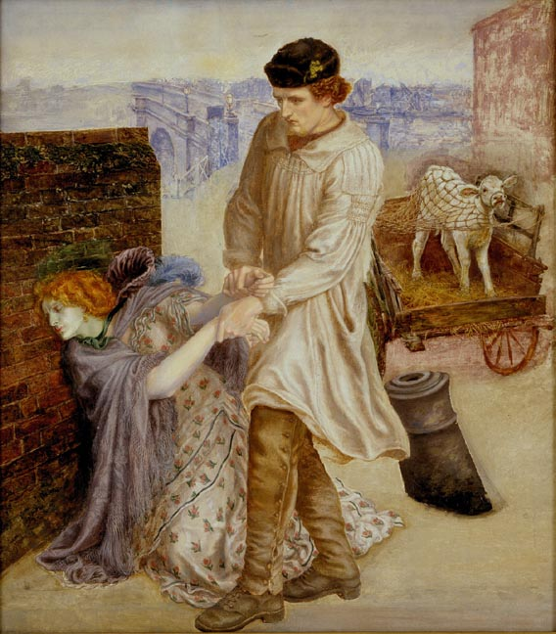

Slide 28
