Slide 1
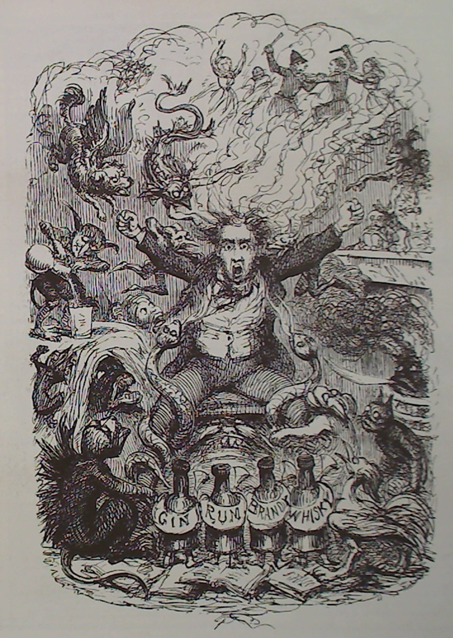
An infernal spark
Drink, addiction and disease
Dr James Nicholls
Alcohol Research UK
London School of Hygiene and Tropical Medicine

Slide 2
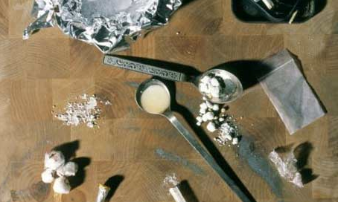

Slide 3


Slide 4


Slide 5
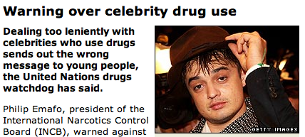
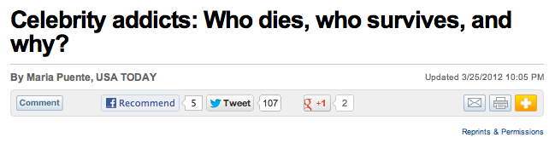
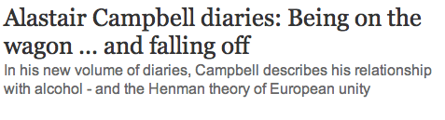
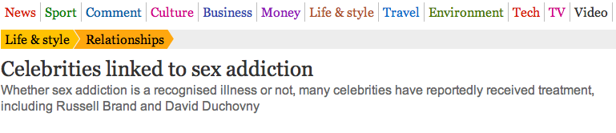
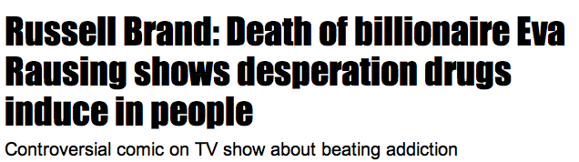
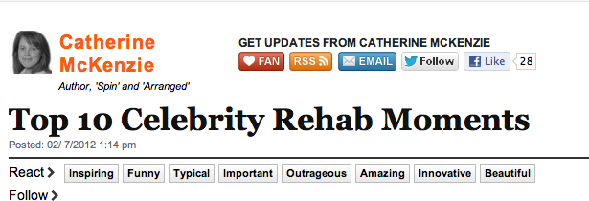

Slide 6
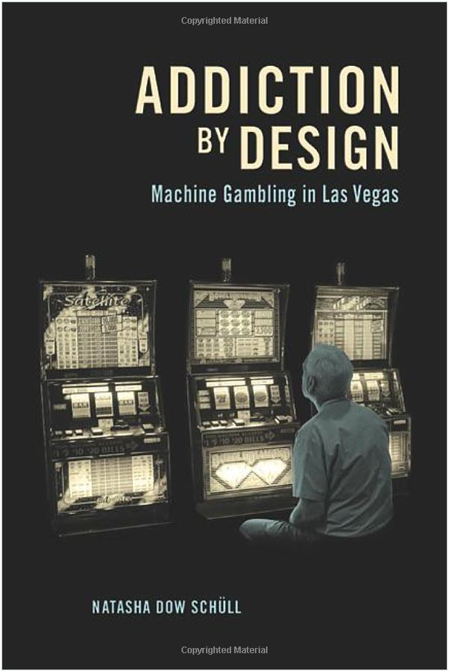

Slide 7
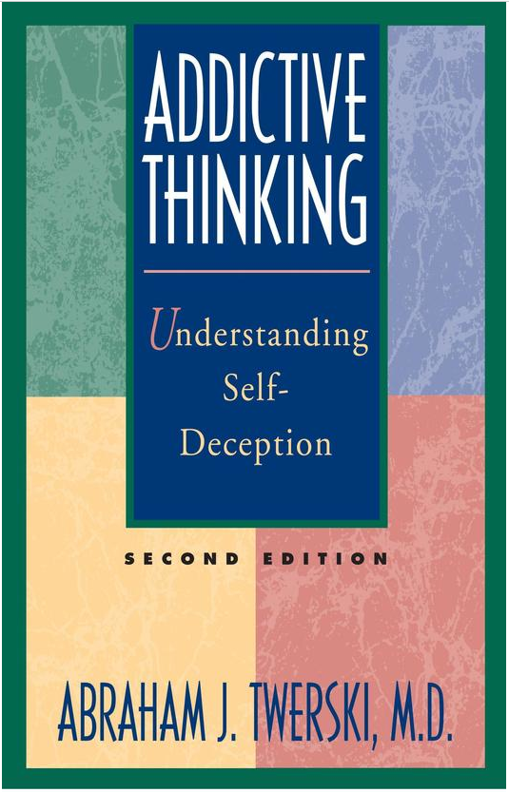

Slide 8


Slide 9
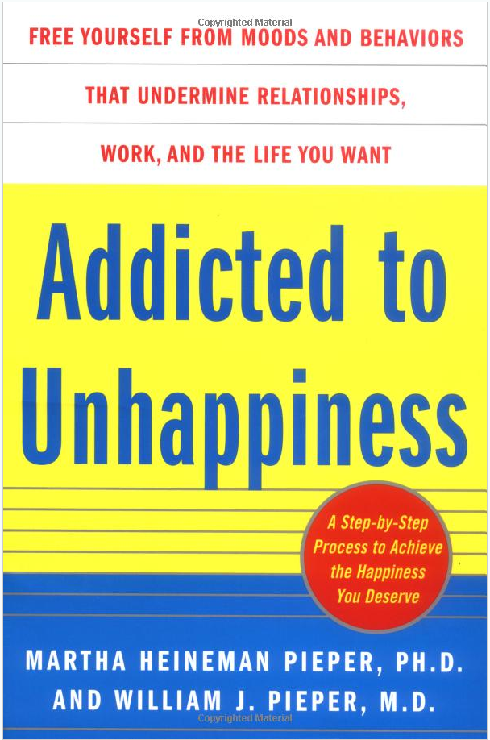

Slide 10


Slide 11


Slide 12


Slide 13
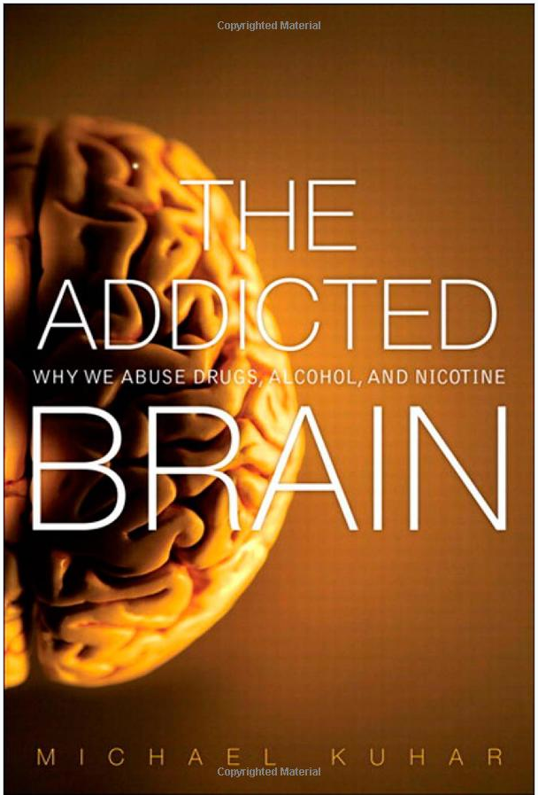

Slide 14
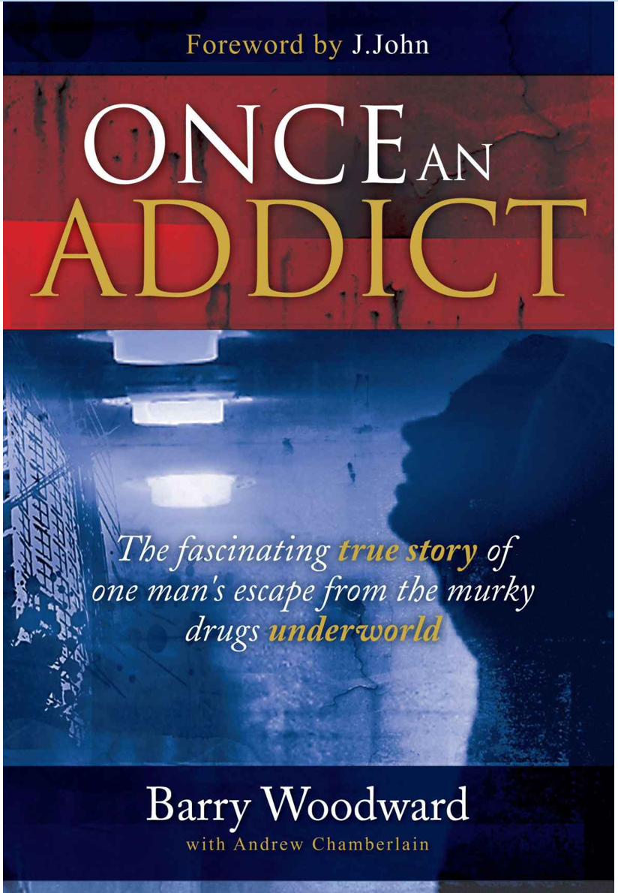

Slide 15
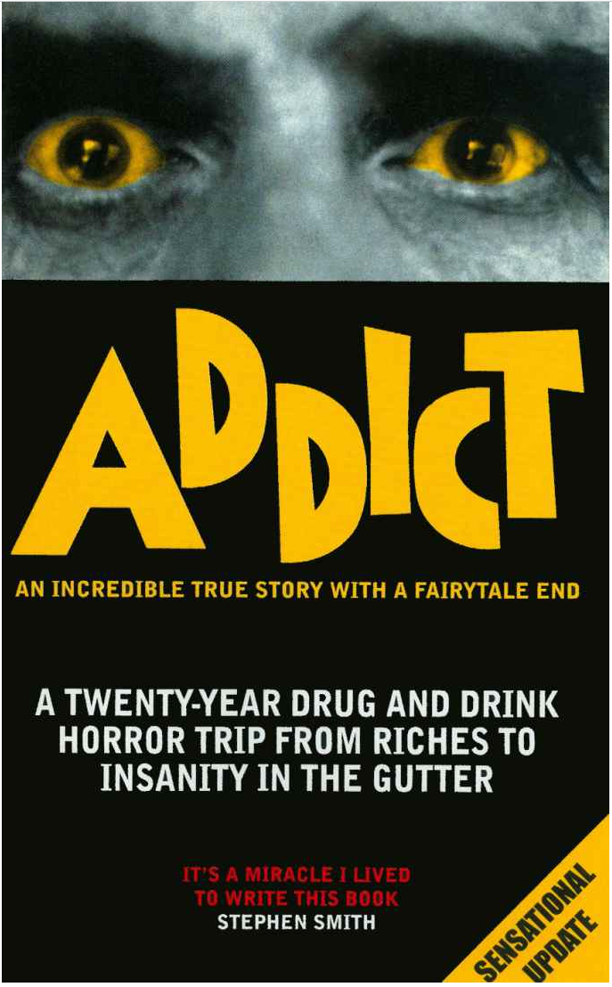

Slide 16
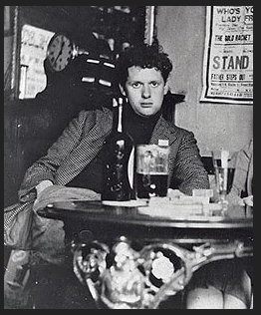

Slide 17
Sin
Disease

Slide 18
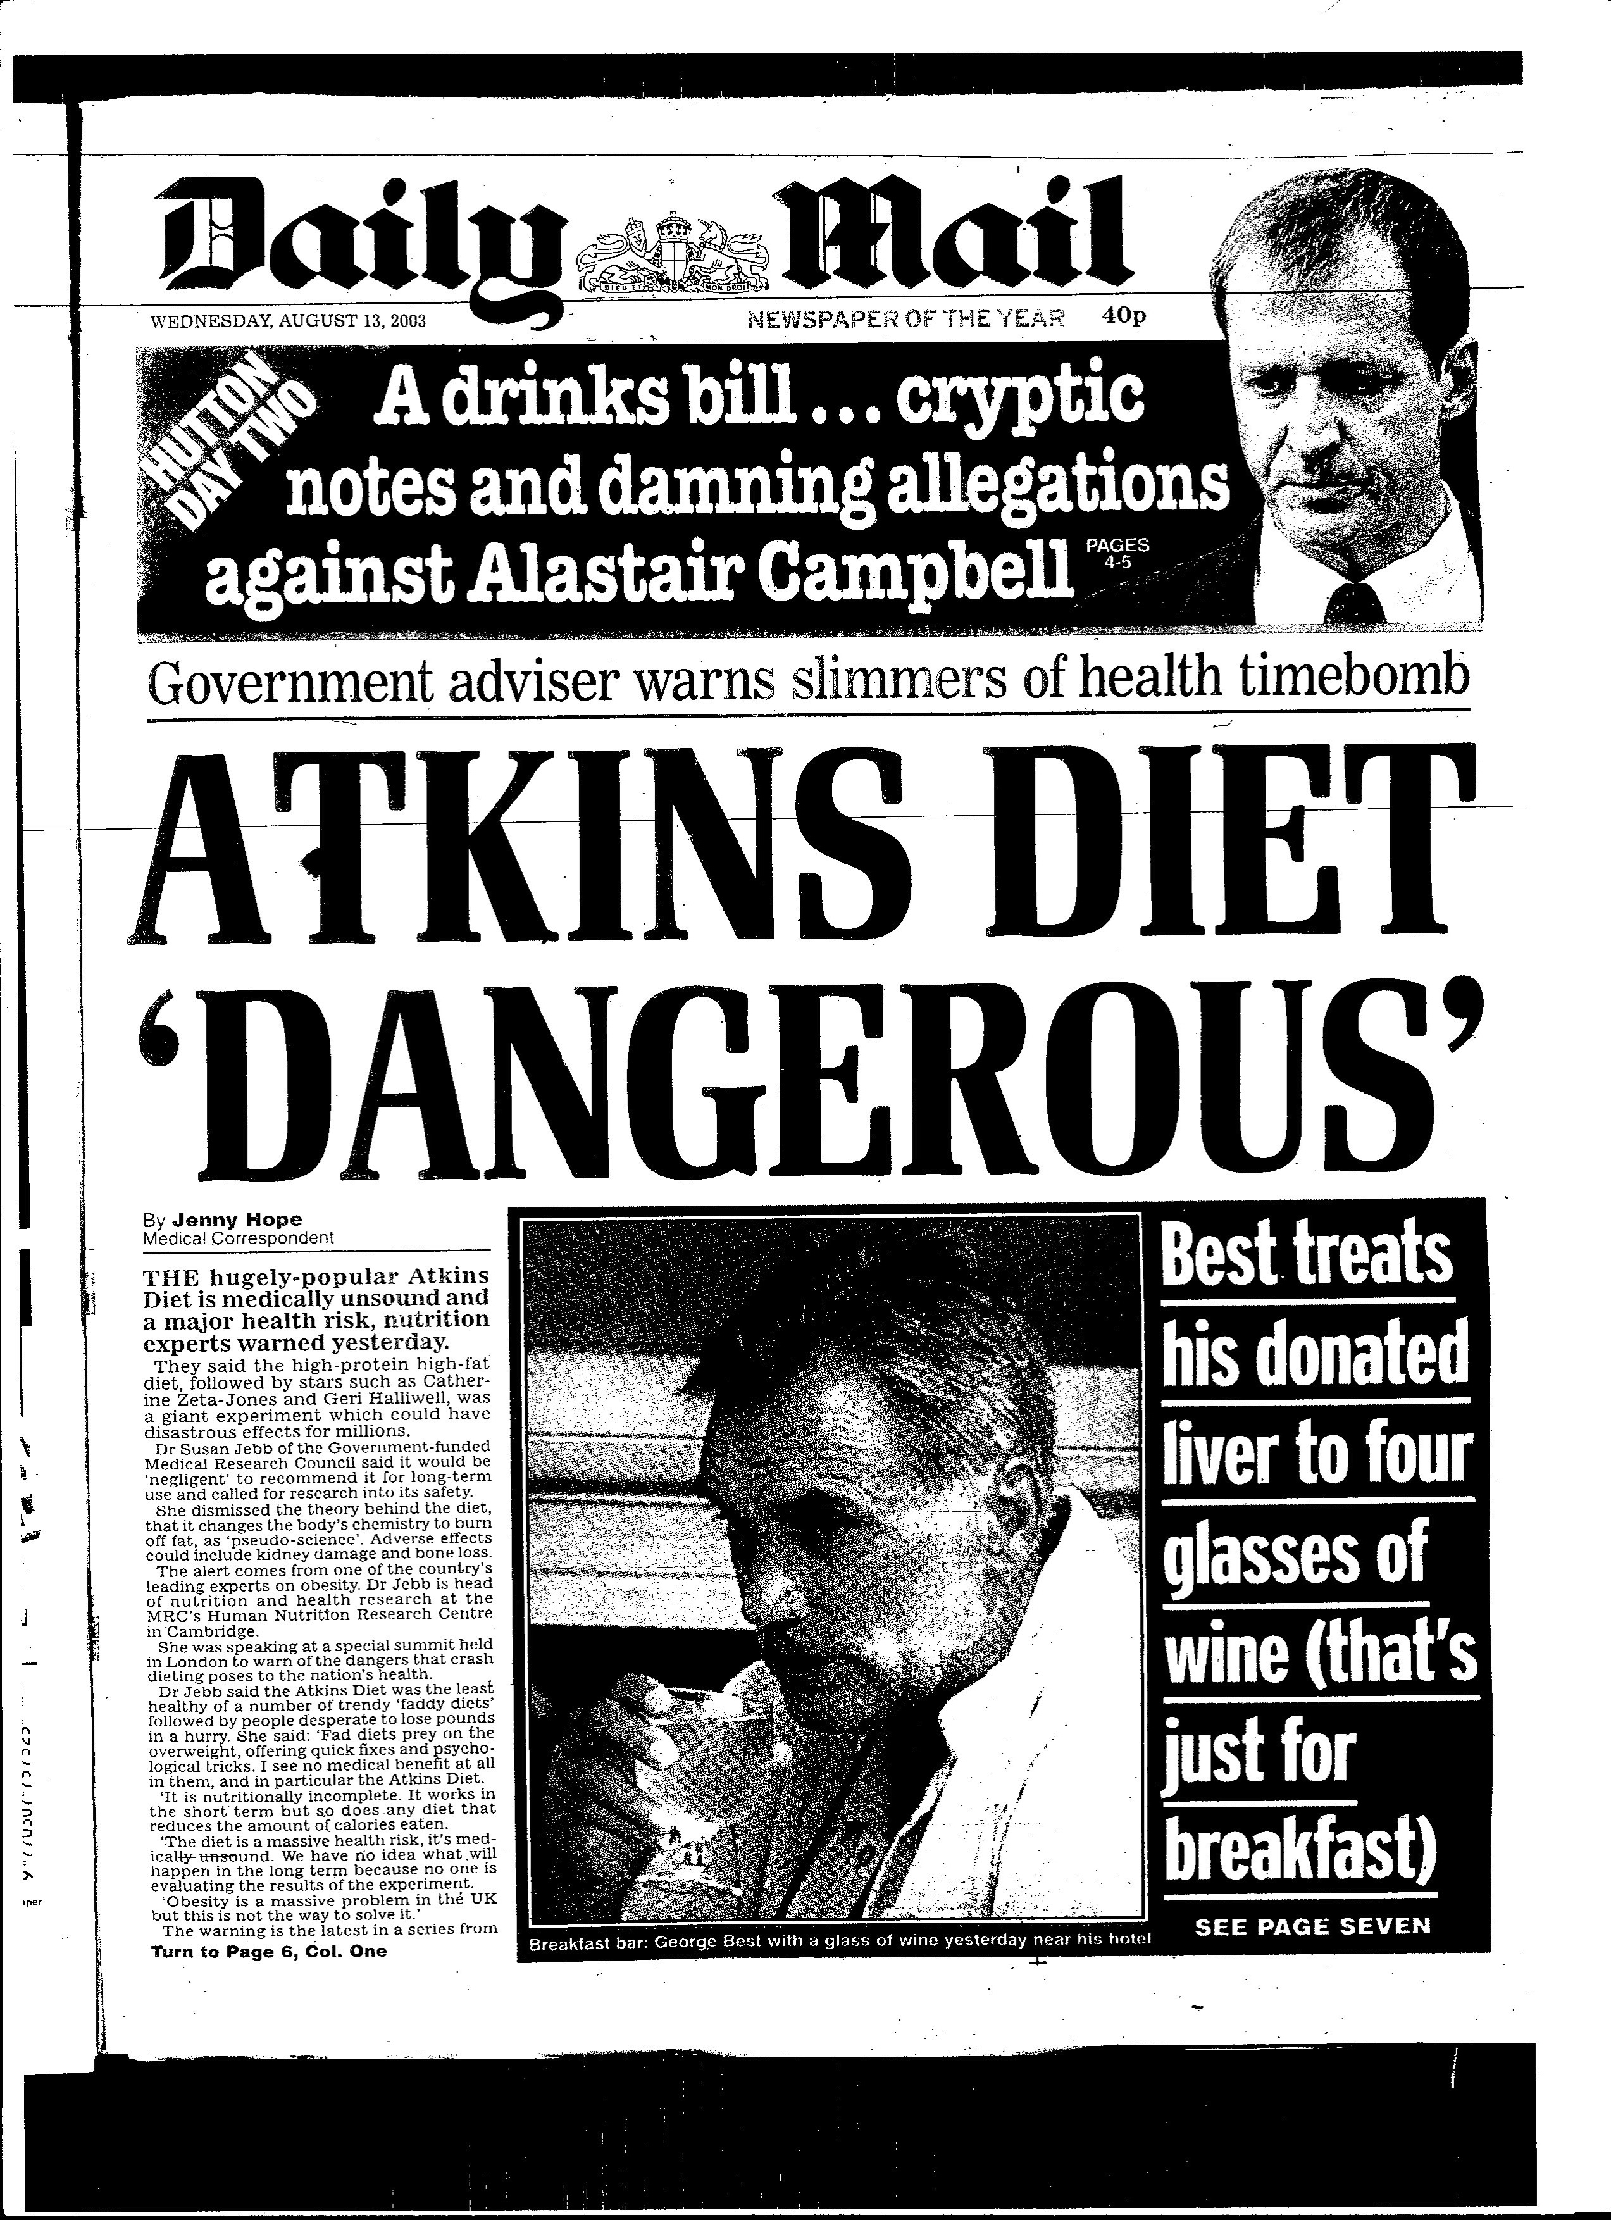

Slide 19
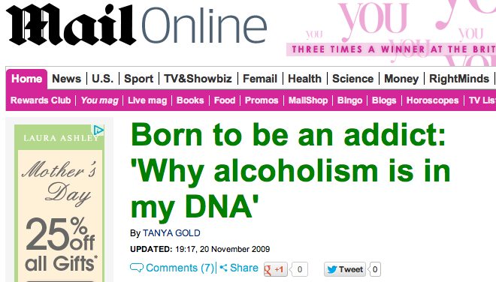

Slide 20
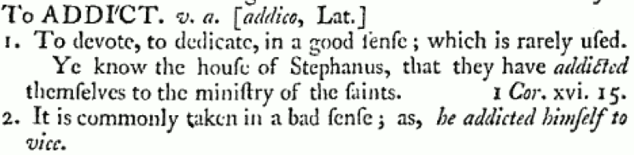
To addict yourself to…
Samuel Johnson, A Dictionary of the English Language (1756)

Slide 21
To addict yourself to…
To become addicted…

Slide 22
To addict yourself to…
To become addicted…
To become an addict …

Slide 23
Sin
Disease

Slide 24
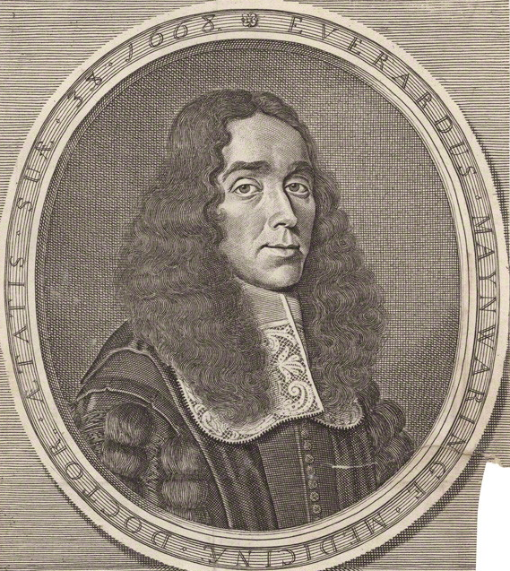
Drunkenness ‘may be properly said to be a disease or sickness; because it has the symptoms and diagnostics of an acute and great disease.’
Everard Maynwaring The Methods and Means of Enjoying Health, Vigour and Long Life (1683)

Slide 25
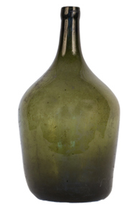
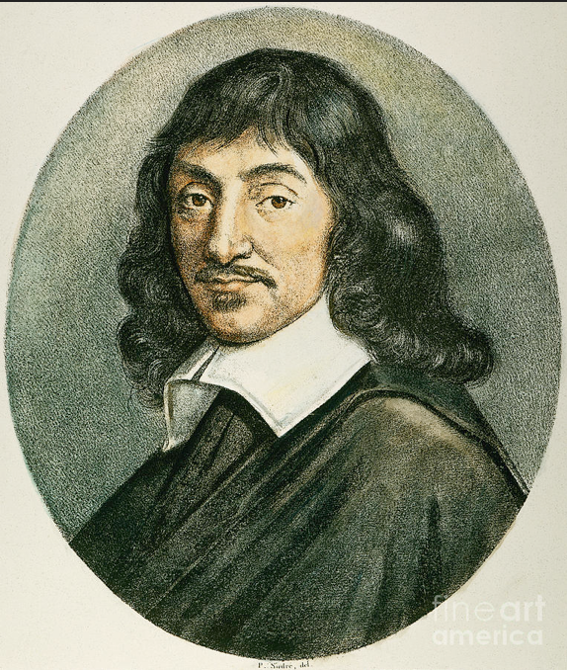
?

Slide 26
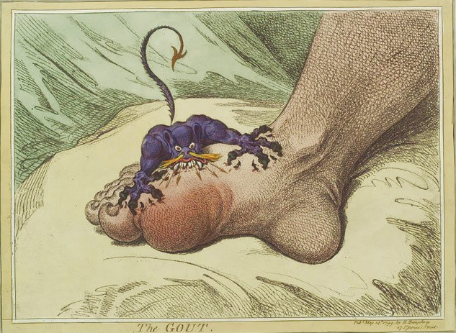

Slide 27
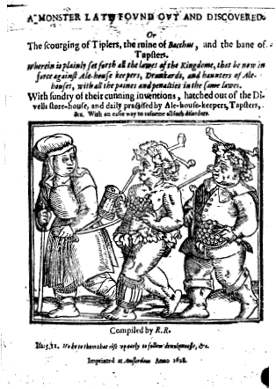
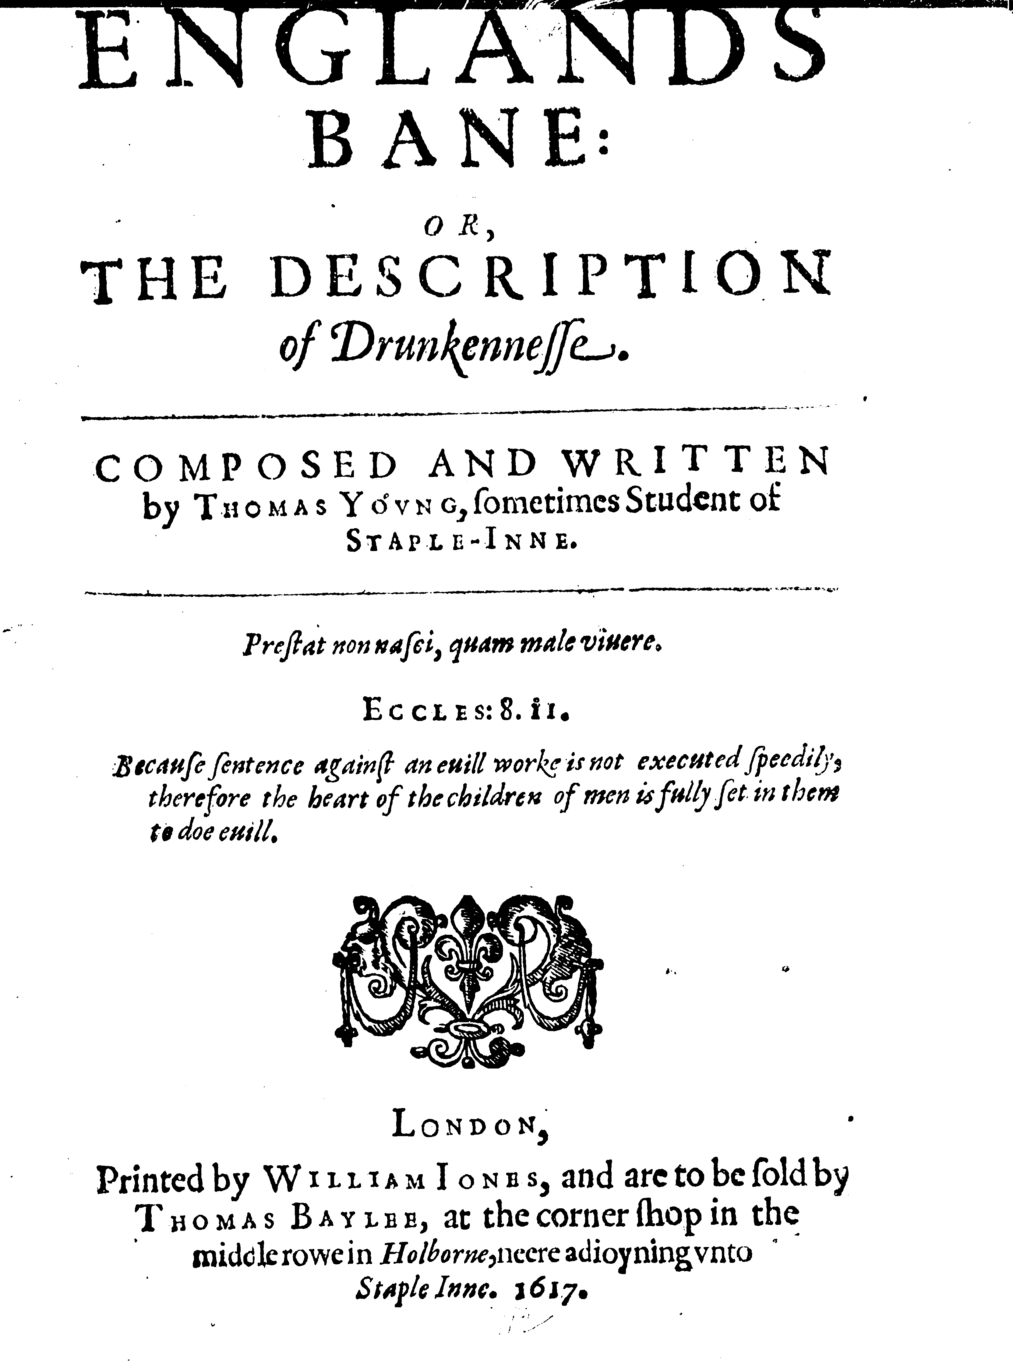
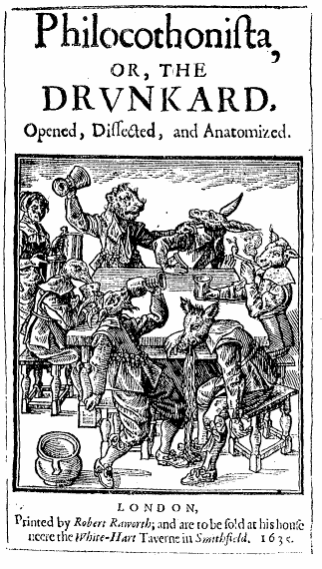

Slide 28
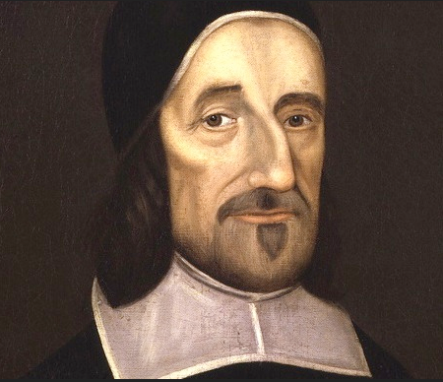
Lack of knowledge (as to physical harm)
Denial (‘their appetite so masters their Reason that they can choose to believe that which they would not have to be true’)
Social norms (the ‘custom of pledging’)
Richard Baxter ‘Directions against drunkenness and all excesses of drink’ in the Christian Directory (1673)

Slide 29
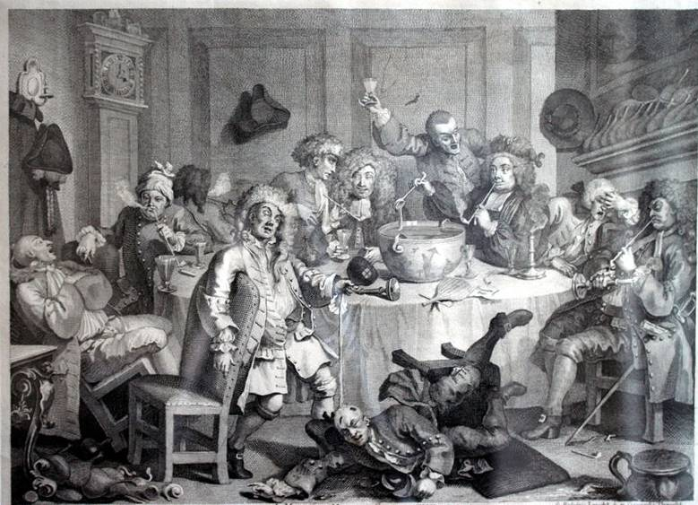
William Hogarth, A Midnight Modern Conversation (1732/3)

Slide 30
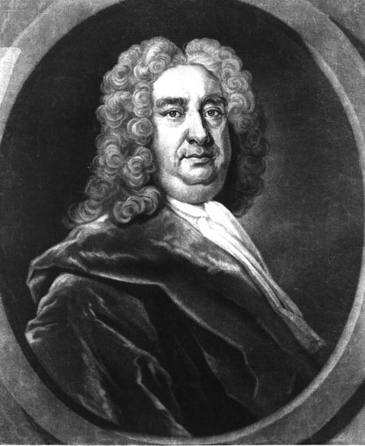
‘The benefits a person who desires nothing but a clear head and strong intellectual faculties would reap by religiously drinking nothing but water are innumerable.’
George Cheyne, An Essay on the Regimen (1740)

Slide 31
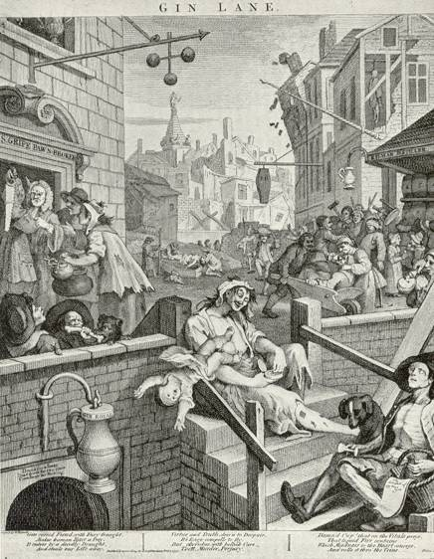
William Hogarth, Gin Lane (1751)

Slide 32
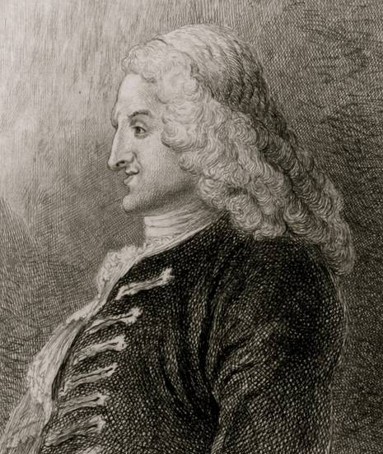
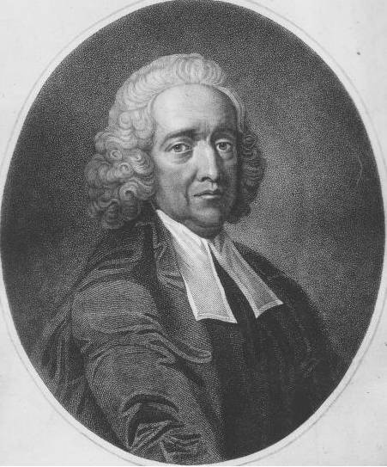
‘… A new kind of drunkenness, unknown to our ancestors, is lately sprung up amongst us …’
Henry Fielding, An Inquiry into the Cause of the Late Increase in Robbers (1751)
As it is ‘extremely difficult for the unhappy habitual dram-drinkers to extricate themselves from this prevailing vice; so much more it becomes the duty of the governors of the nations to withhold from them so irresistible a temptation.’
Stephen Hales, A Friendly Admonition to the Drinkers of Gin, Brandy and Other Distilled Spirituous Liquors (1751)

Slide 33
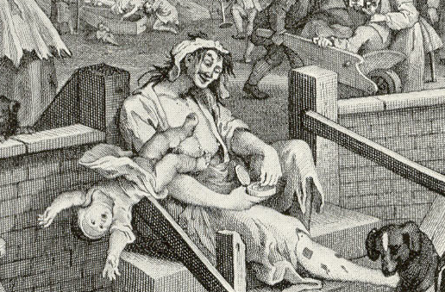
‘What must become of the infant who is conceived in gin … Are these wretched infants … to become our future sailors and our future grenadiers.’
Henry Fielding, An Inquiry into the Cause of the Late Increase in Robbers (1751)
‘But now our common people are so infatuated with Geneva, that … in less than an age, we may expect a fine spindle-shank’d generation.’
Daniel Defoe, Augusta Triumphans (1728)

Slide 34
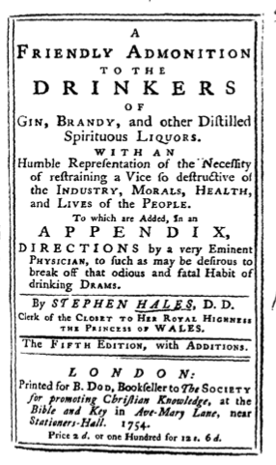
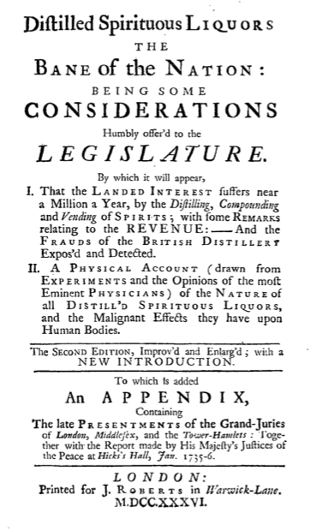
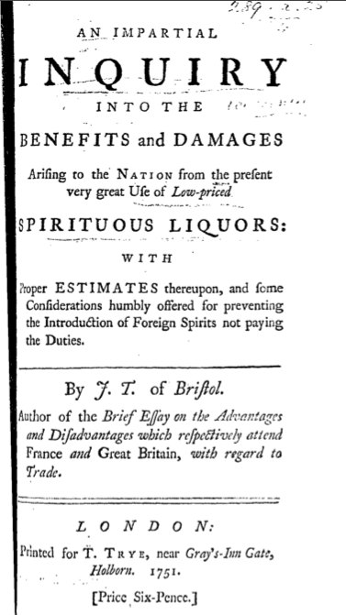

Slide 35
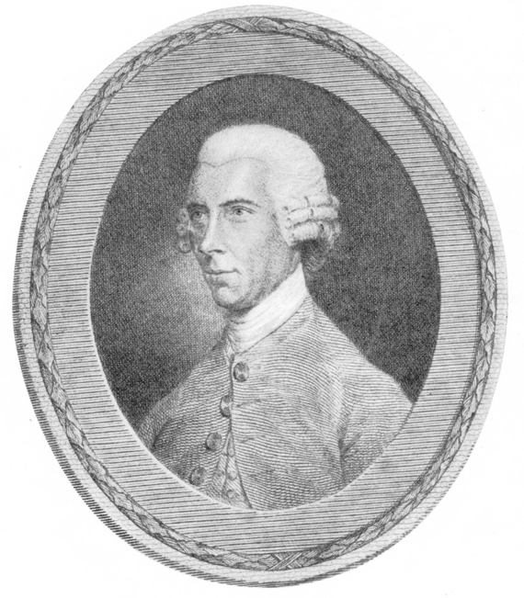
‘…this fascinating poison…’
John Coakley Lettsom, Hints Respecting the Effects of Hard Drinking (1787)

Slide 36
‘The sober person knows nothing of the peturbation, tumult and darkness of an intemperate man’s soul, and is a stranger to those craving, impetuous and ungovernable passions, that tyrannize over him. [He is the victim] of an infernal spark which is absolutely inextinguishable.’
Edward Harwood, Of Temperance and Intemperance: Their Effects on the Body and Mind (1774)

Slide 37
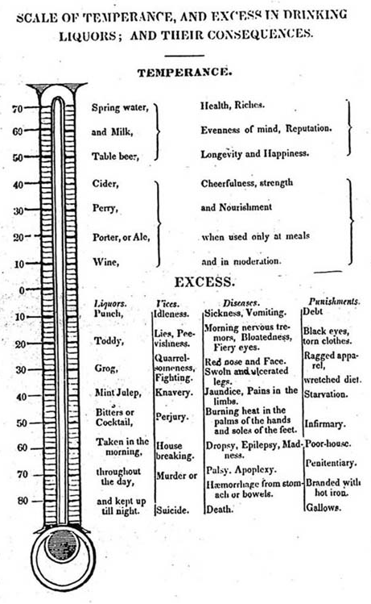
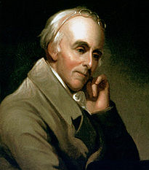
Benjamin Rush, the ‘Moral Thermometer’, from
An Inquiry into the Effects of Spirituous Liquors upon the Human Body (1784)

Slide 38
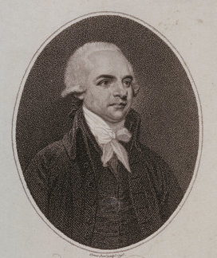
‘In medical language I consider drunkenness to be, strictly speaking, a disease. [The] habit of drunkenness is a disease of the mind … produced by a remote cause.’
Thomas Trotter, An Essay Medical, Philosophical and Chemical on Drunkenness and its Effects on the Human Body (1804)

Slide 39
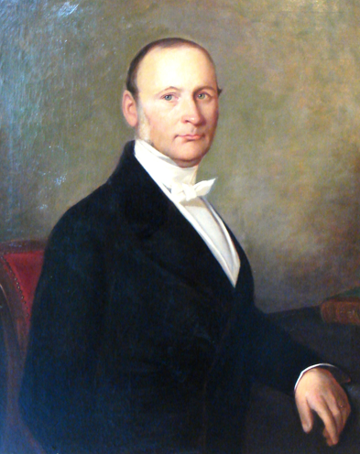
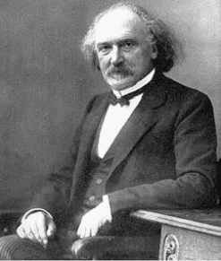

Slide 40
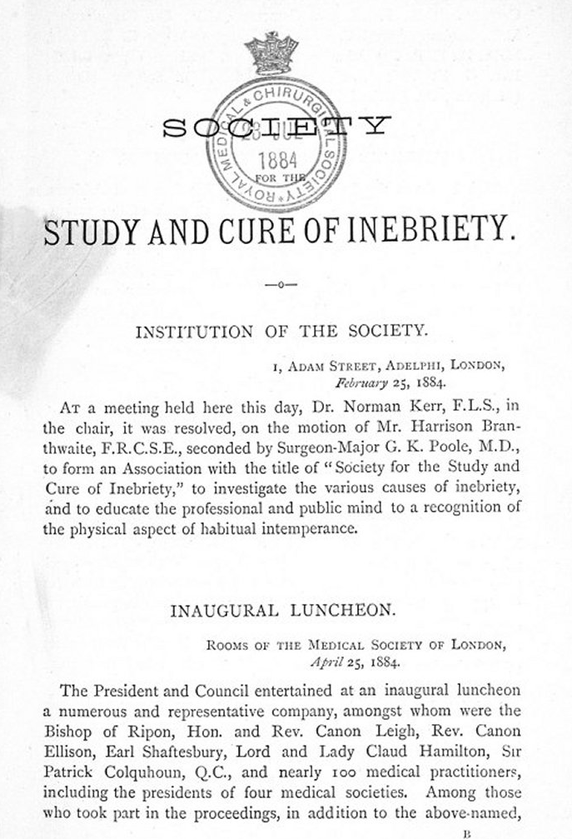
Inebriety is ‘a true disease, as unmistakably a disease as is gout, or epilepsy, or insanity.’
‘In my humble opinion it is sometimes all four [sin, vice, crime and disease] but oftener a disease than anything else, and even when anything else, generally a disease as well.’
Norman Kerr, President’s Inaugural Address to the Society for the Study and Cure of Inebriety (1884)

Slide 42
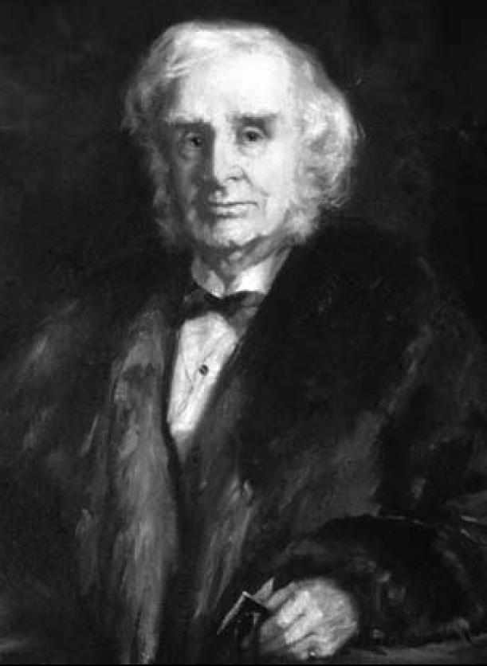
There is ‘a deliberate injustice and inhumanity in … permitting a man to expose himself to the penalties of law, when it has long been apparent that he has not the power to govern his own will and reason.’
Alexander Peddie, The Necessity for Some Legislative Arrangements for the Treatment of Dipsomania, or the Drinking Insanity (1858)

Slide 43
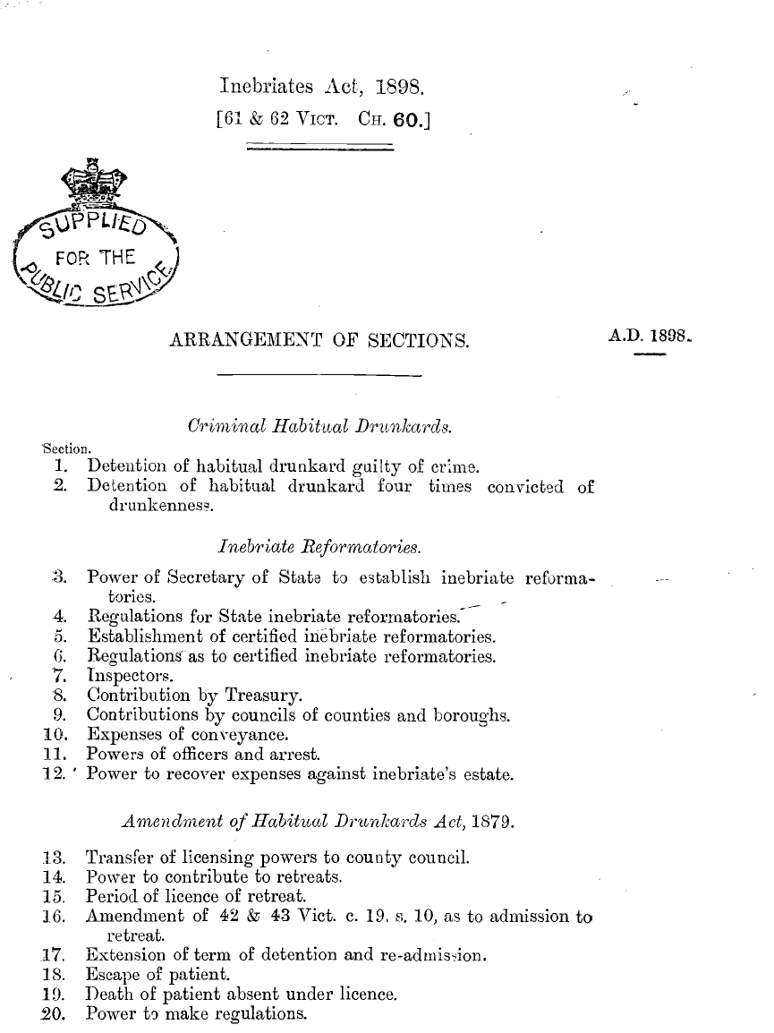

Slide 44
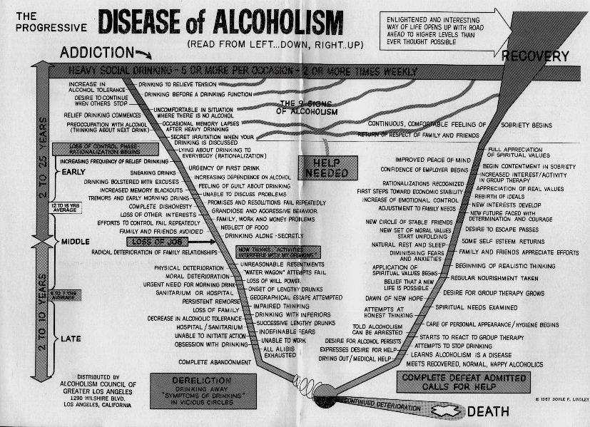

Slide 45
Thank you

