Slide 1
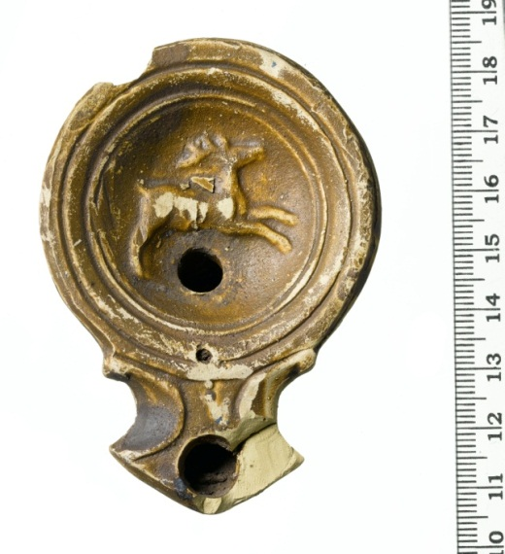
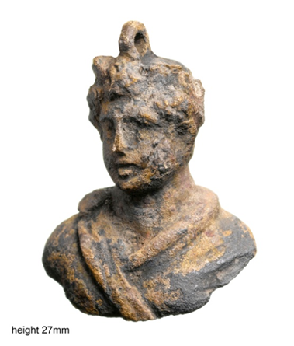
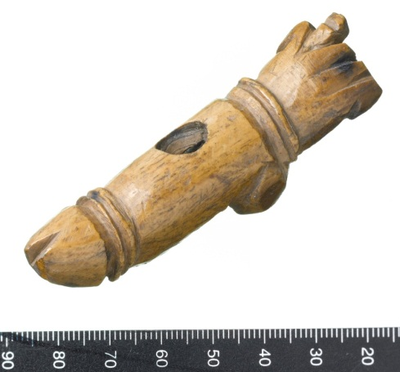
Artefacts and the study of life
in Roman London
Michael Marshall
Notes:
Standard title slide.
Thank GC and MoL
Objects as fragments of human lives
Developer funded excavations
Jigsaw from hell

Slide 2
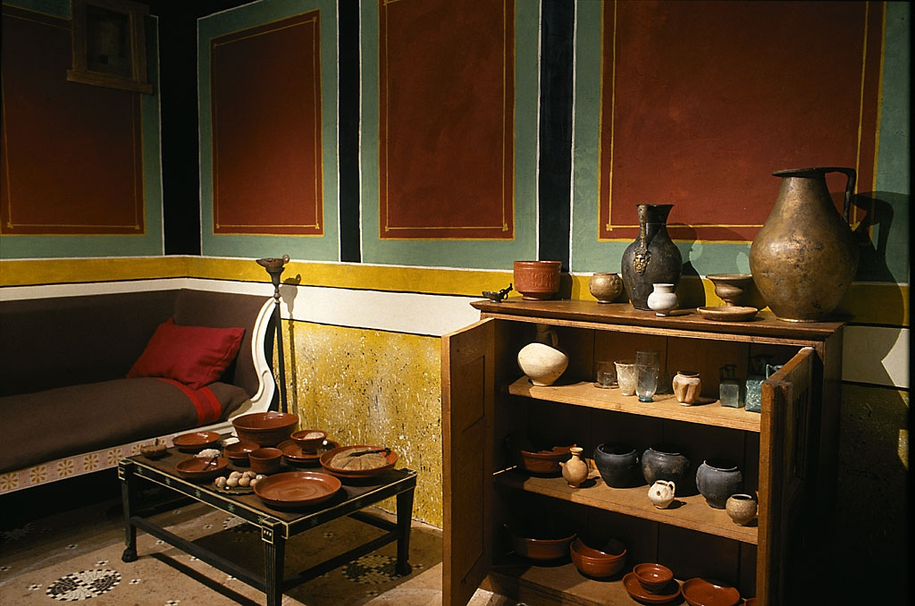
Artefacts that tell stories
Studying artefacts in action
Individual objects that tell stories
Exploring object types
Objects in context
Small finds in a big city
Photograph © Museum of London

Slide 3
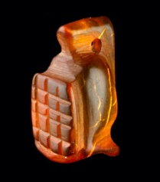
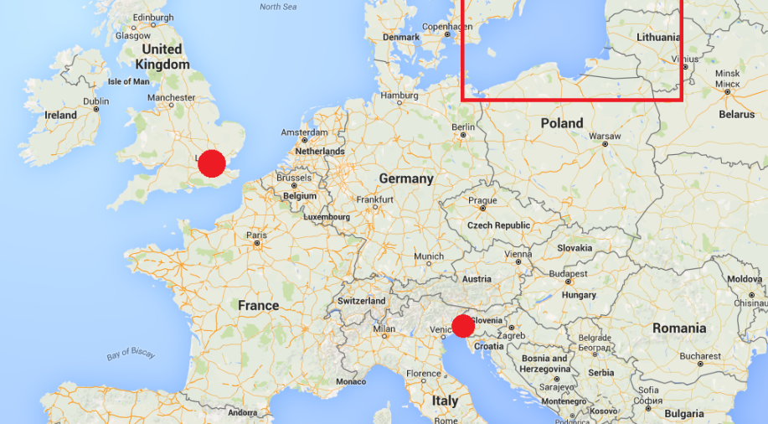
A Roman pendant
Made from amber
Possibly imported from Baltic
Valuable and magical material
(e.g. in Pliny)
London in relation to the Roman amber trade
Carved in shape of Gladiator
helmet
Wear mark on perforation

Slide 4
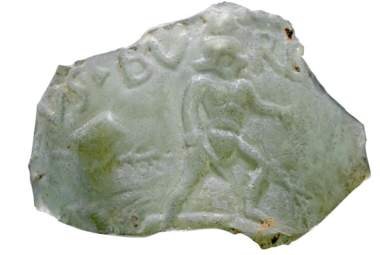
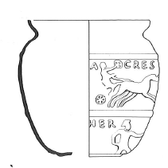
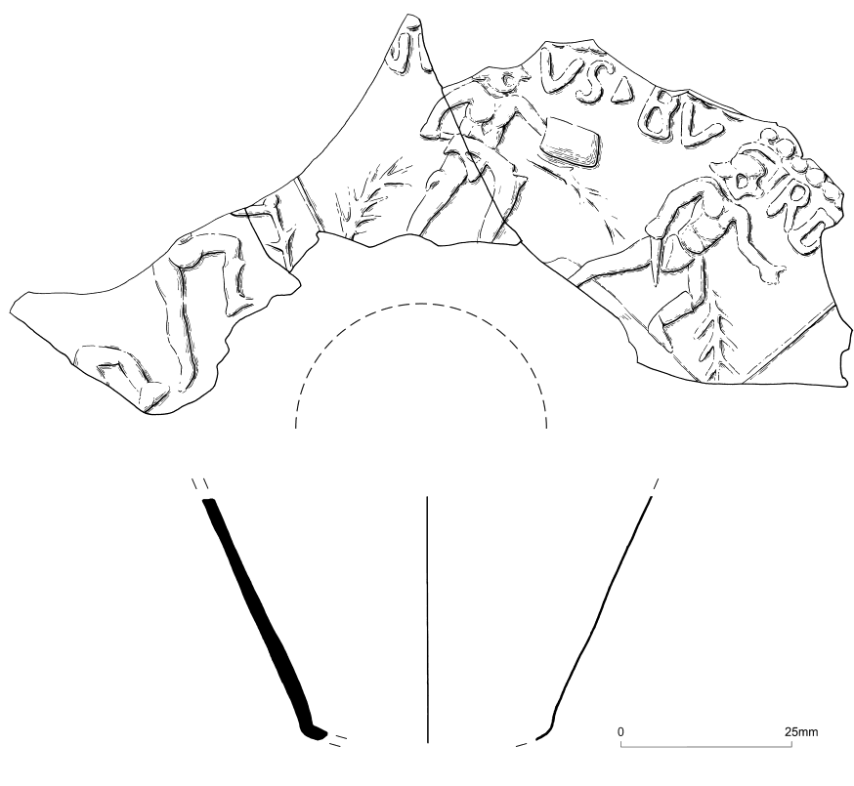
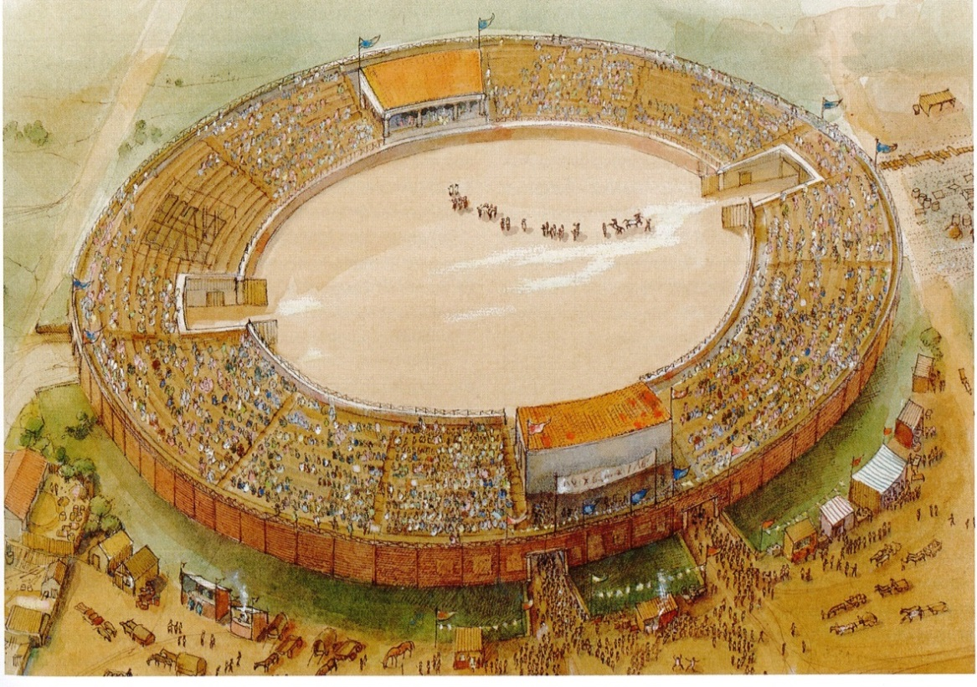
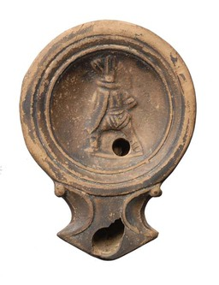
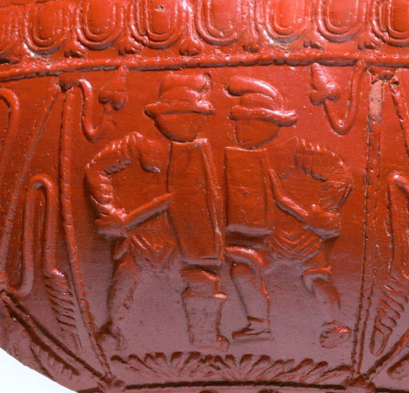
Gladiators in Roman London
Glass cup from
Old Jewry
(Marshall and
Thorp 2014)
Reconstruction of the
amphitheatre at Guildhall Yard
(Bateman et al 2007)
Detail of decoration
on samian pottery
Ceramic oil
Lamp
Image ©
Museum of London

Slide 5
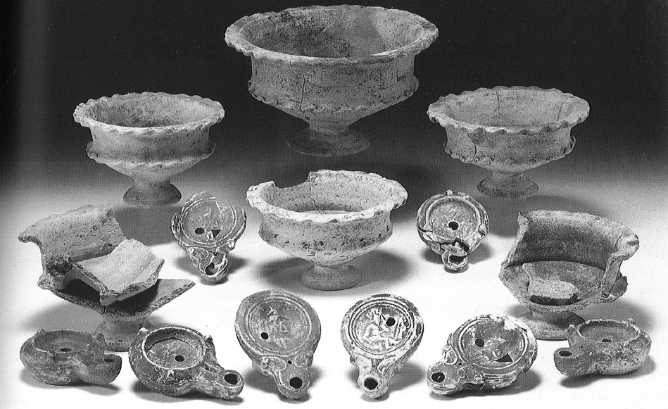
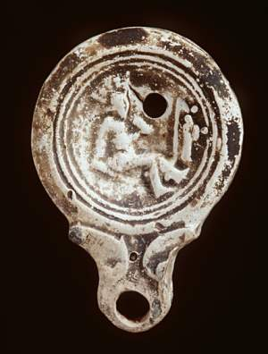
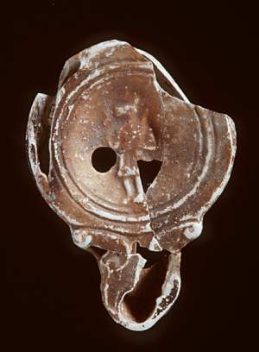
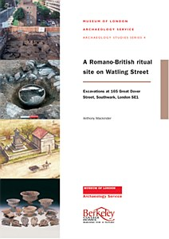
Gladiators and graves
1st century AD
cremation burial
From Southwark
(Mackinder 2000)
Ceramic lamps with gladiators
and Egyptian god
Anubis

Slide 6
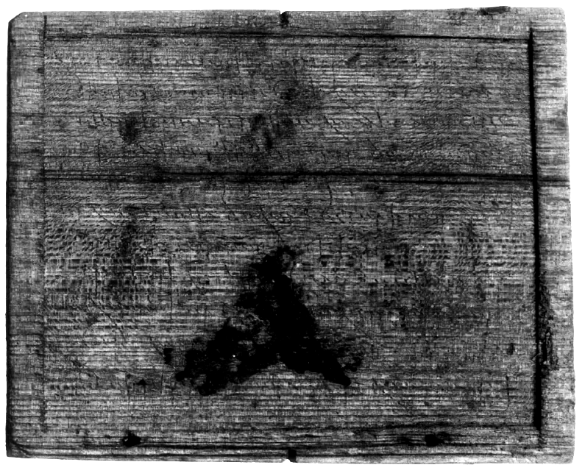
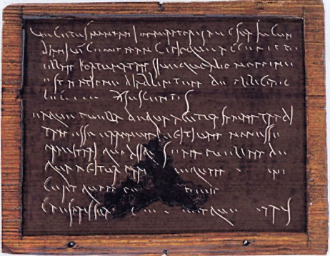
A wooden Roman writing tablet
A Roman wax and
wood writing tablet
from 1 Poultry
describing the sale of
a slave girl named
Fortunata
After Tomlin (2003)
and Hill and Rowsome (2011)

Slide 7
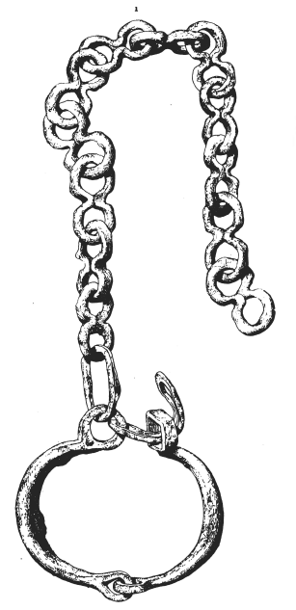
Slavery in Roman London
Vegetus Montani imperatoris Aug(usti) ser(vi) lucundiani vic(arius) emit mancipioque accepit puellam Fortunatam sive quo alio nomine est natione Diablintem de Albiciano LEG[...] (denariis) sescentis ea(m)que puella(m)que de qua agitur sanam traditam esse erronem fugitivam non esse praestari quod si qu[i]s eam puellam de qua agitur par[tem]ve quam [evicerit] cera quam pe[r geni]um [imperatoris] Caesaris scr[ipsit iura]vitque [...]ARIS
'Vegetus, assistant slave of Montanus the slave of the August Emperor and sometime assistant slave of lucundus, has bought and received by mancipium the girl Fortunata, or by whatever name she is known, by nationality a Diablintian, from Albicianus [...] for six hundred denarii.
And that the girl in question is transferred in good health, that she is warranted not to be liable to wander or run away, but that if anyone lays claim to the girl in question or to any share in her, [...] in the wax tablet which he has written and sworn by the genius of the Emperor Caesar
[...]
Translation & transcription by Roger Tomlin
(in Hill and Rowsome 2011)
Iron manacle found in the 19th C at the
National Safe Deposit Company site

Slide 8
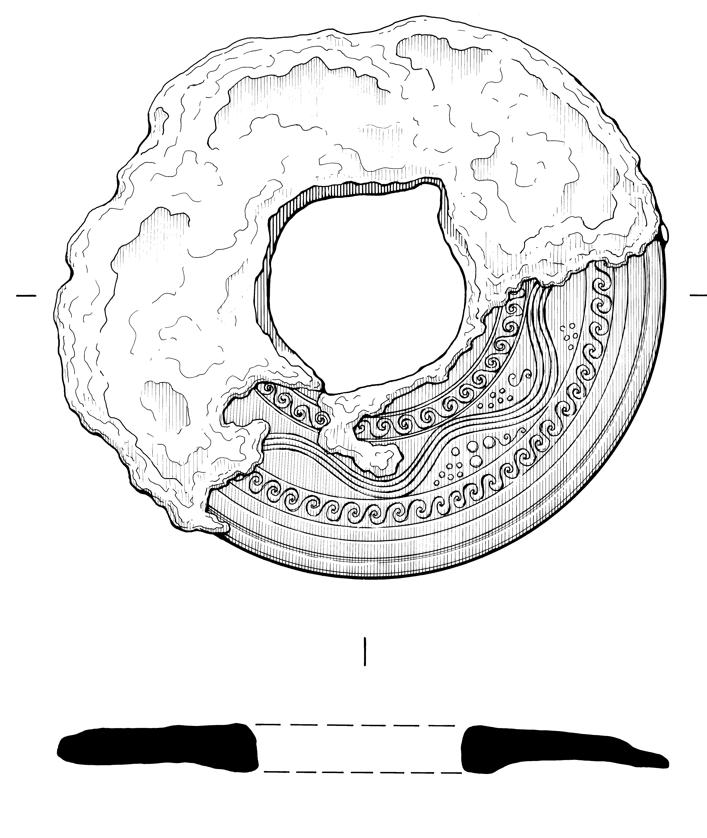
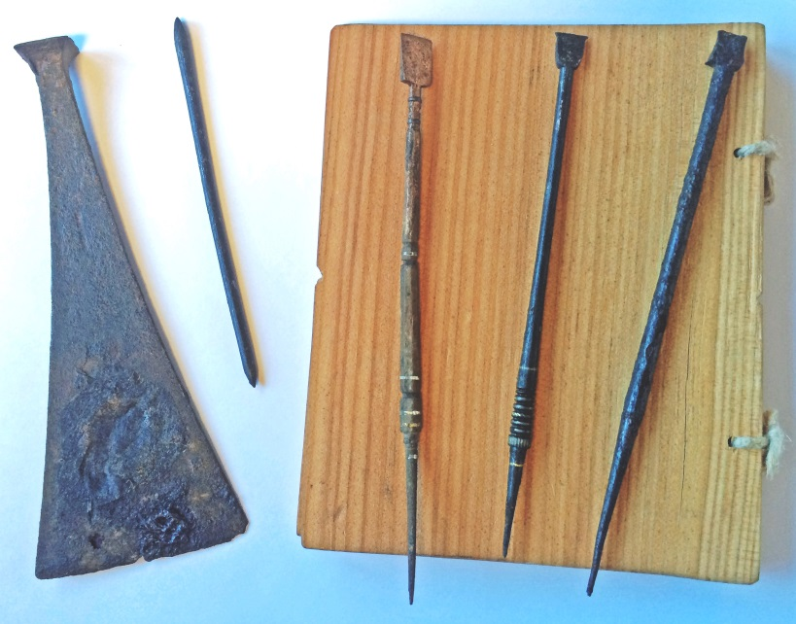
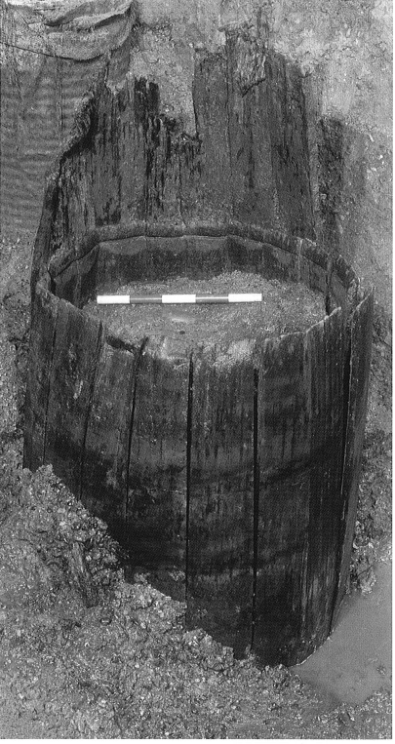
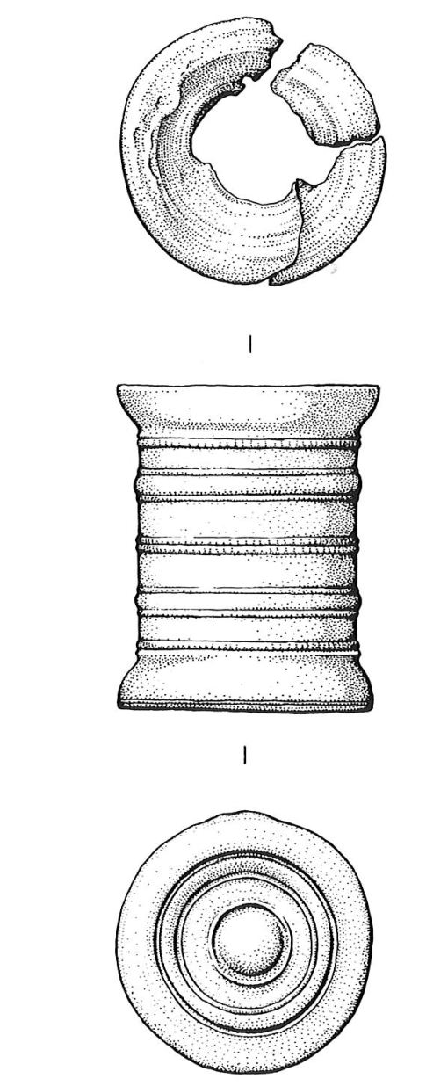
Literate Londoners
Metal inkwells
Silver fir barrel
(abies alba)
Wax spatula, writing tablet
and styli

Slide 9
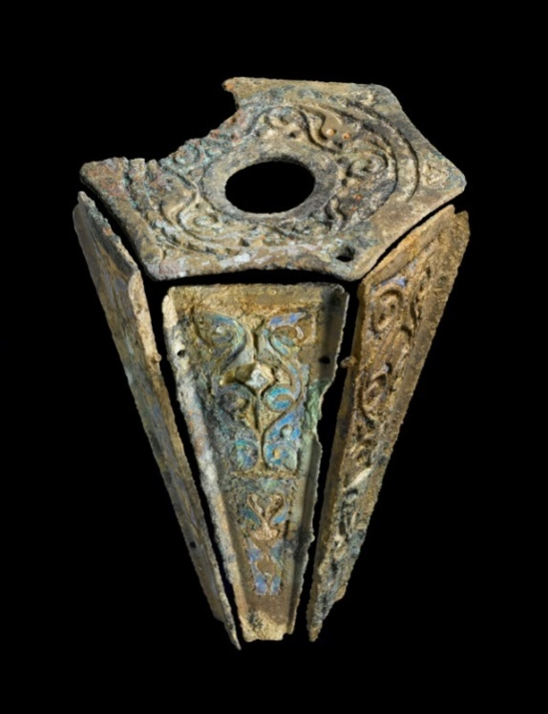
Enamelled flask from Moorgate
Late 1st or 2nd century AD
Complete examples have short neck and wide base
Flask for perfume or oil
Perhaps made in northern England
Roman form but Iron Age influenced decoration

Slide 10
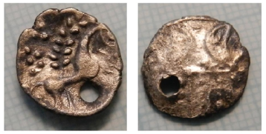
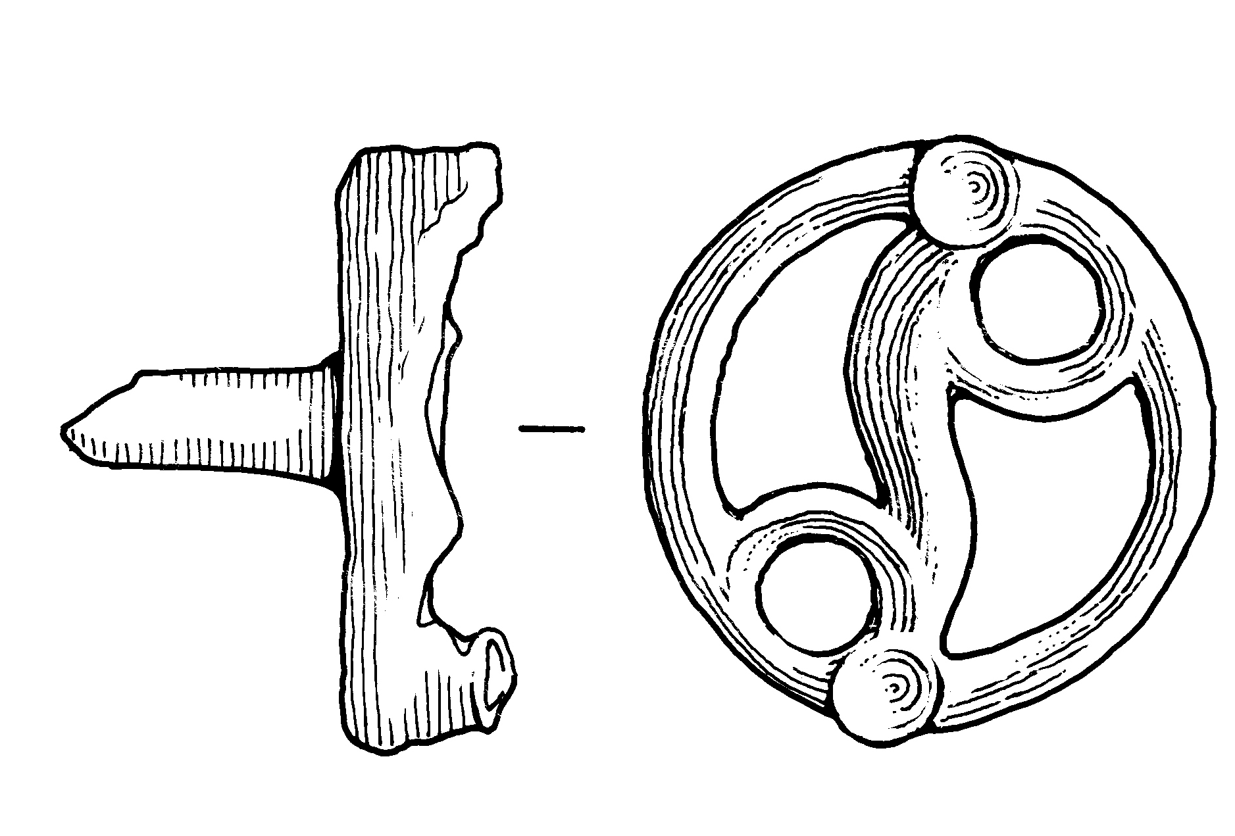
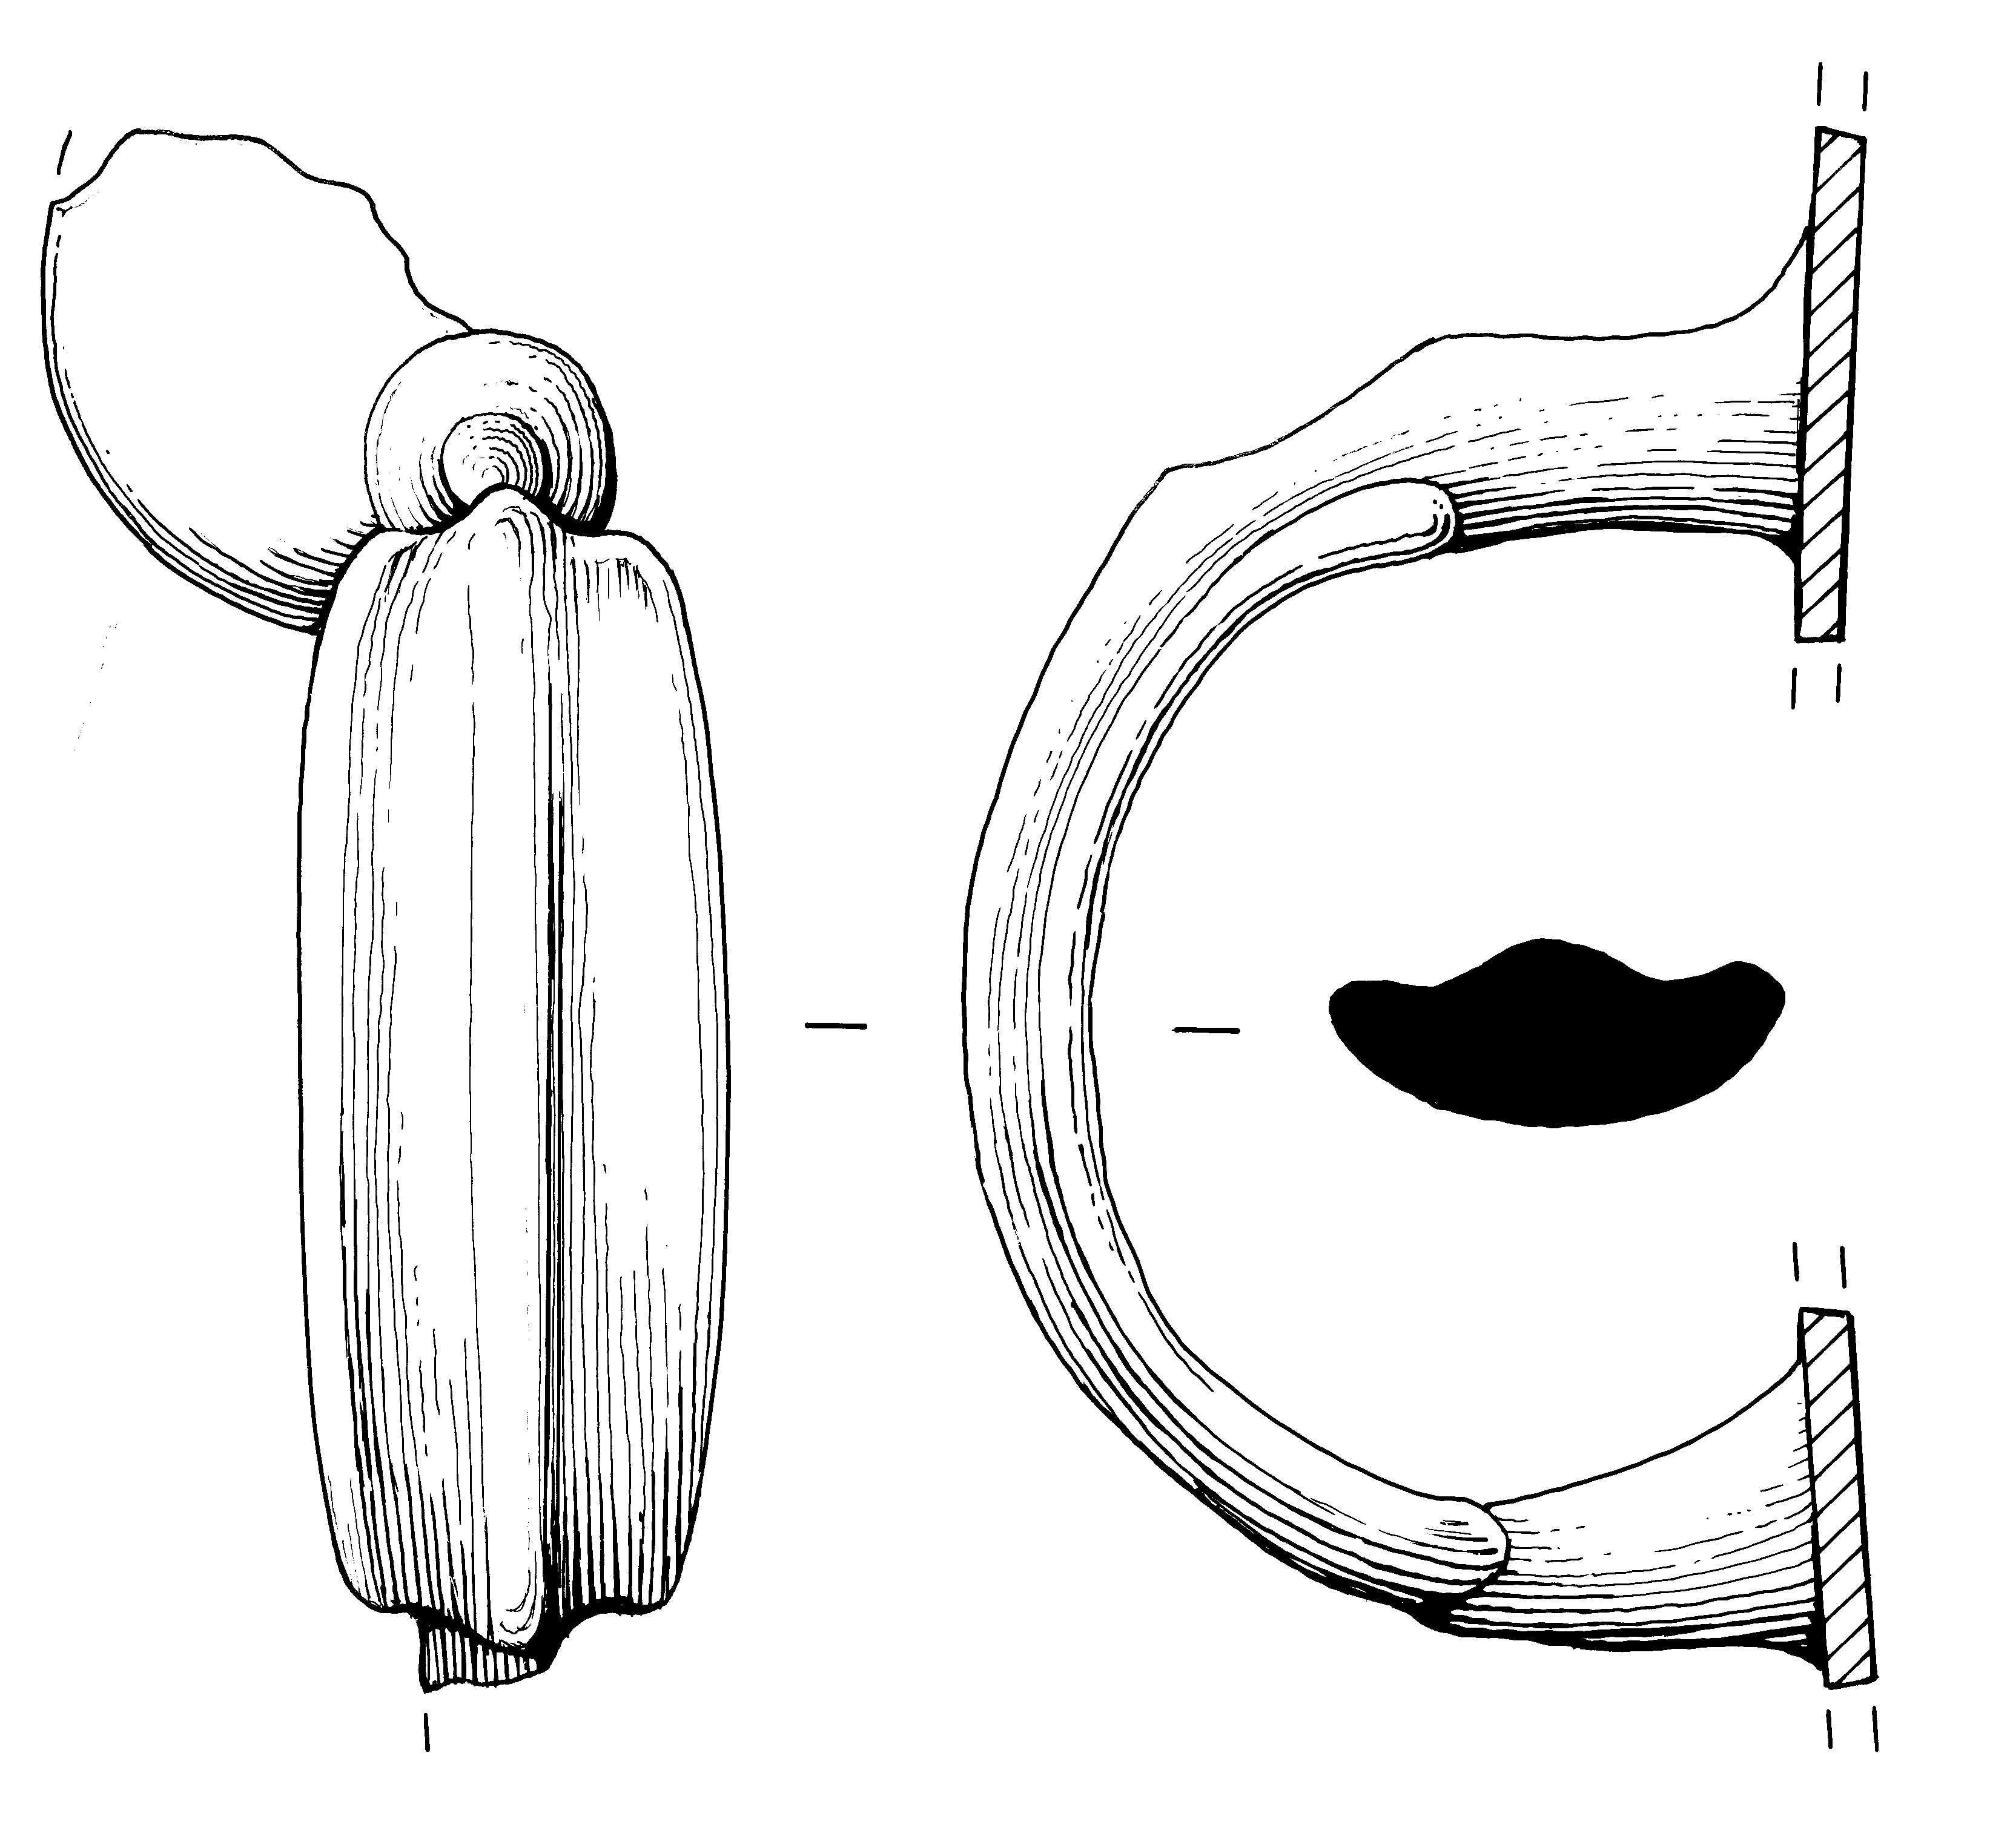
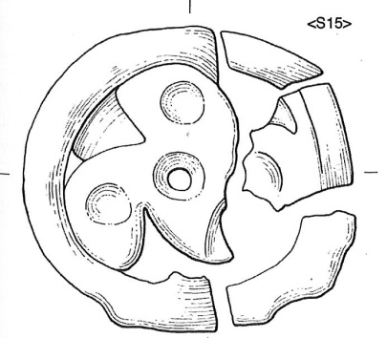
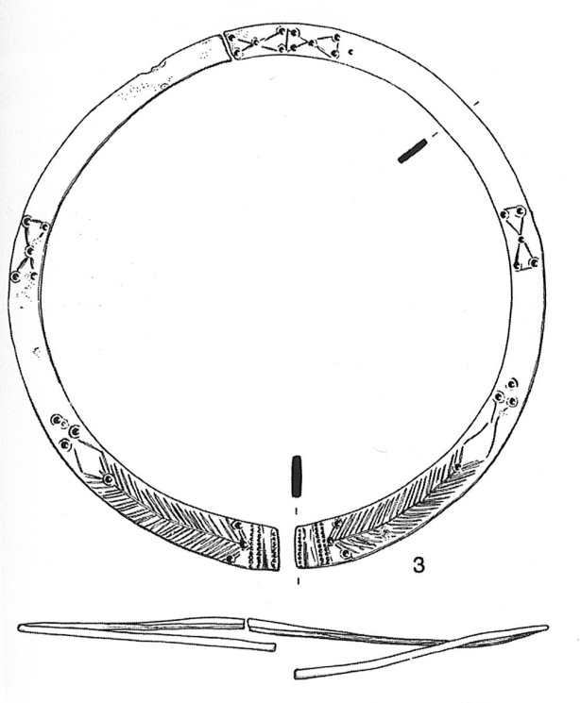
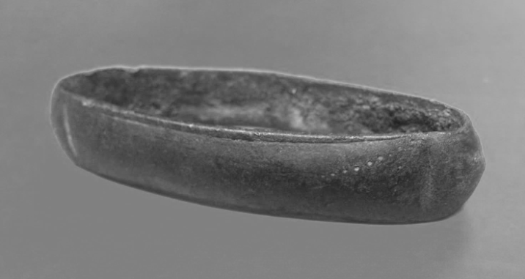
Iron Age style objects in Roman London
Tankard
handle
Perforation Iron Age silver coin
Neck ring
from female
burial
Triskle fittings
Scabbard fitting
Image © Museum of London

Slide 11
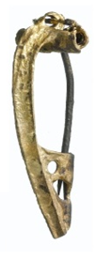
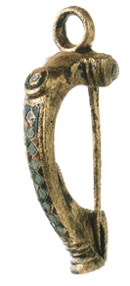
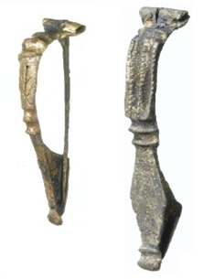
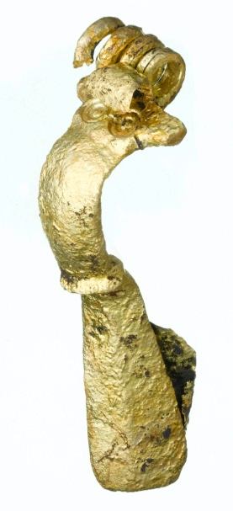
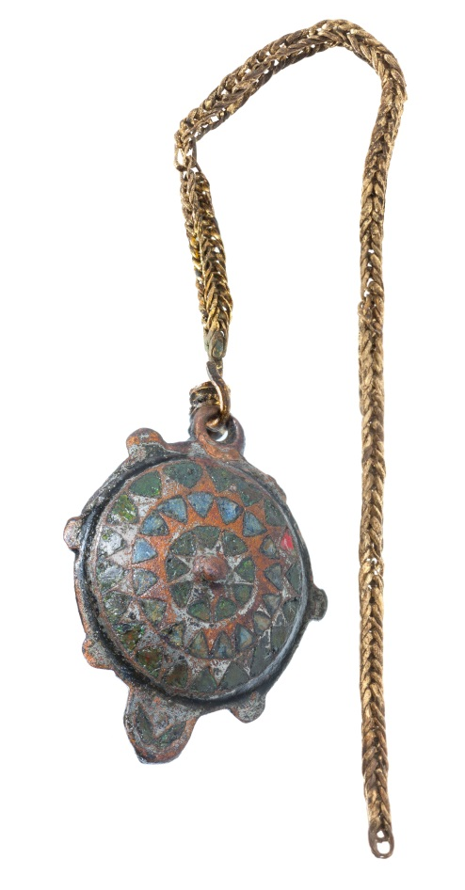
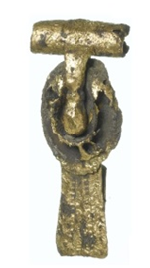
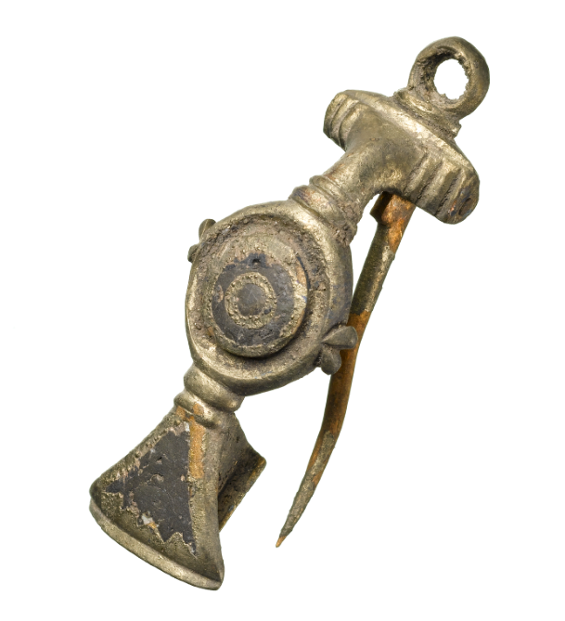
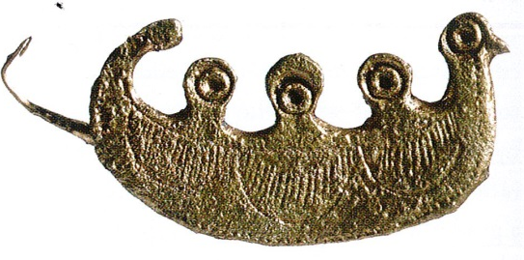
From assemblage to ensemble

Slide 12
The provenance of brooches from the
Middle Walbrook valley
Continental
British

Slide 13
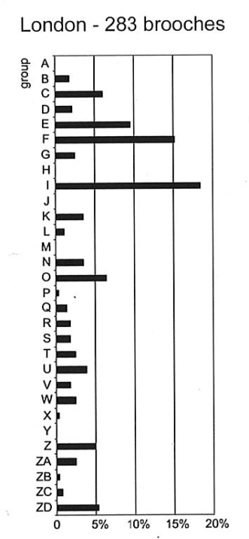
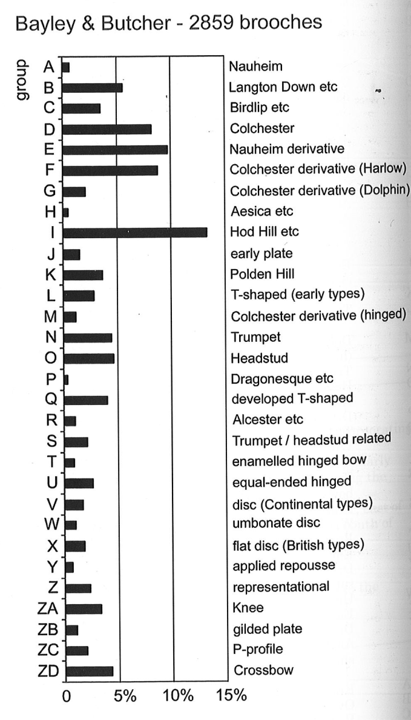
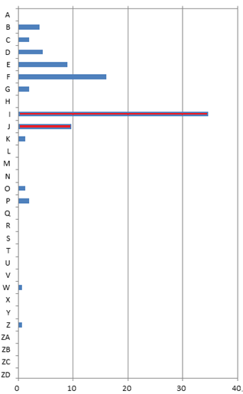
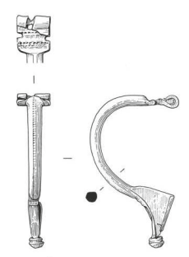
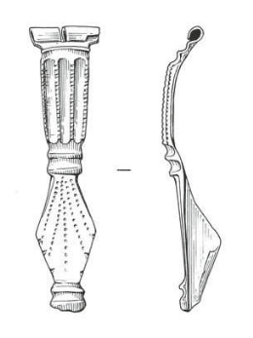
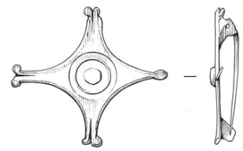
Roman Britain
Bloomberg London – 170 brooches
(comparative data Plouviez 2008; after Bayley and Butcher 2004)
Relative proportion of continental brooch types much higher than normal in relation to contemporary forms

Slide 14
Changing patterns in brooch use during the 1st century AD (c AD 47 – 90) at Bloomberg London

Slide 15
Roman hairpins
in bone and copper-alloy
in the Museum of London
Collections
© Museum of London

Slide 16
London ‘Hairpin gap’?
Bone
Chronological patterns in hairpin type and use
Based on about 200 pins excavated by MOLA

Slide 17
London ‘Hairpin gap’?
Bone
Chronological patterns in hairpin type and use
Based on about 200 pins excavated by MOLA
Metal

Slide 18
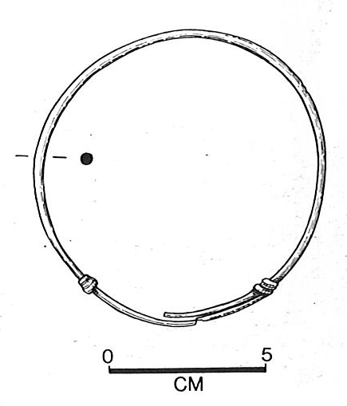
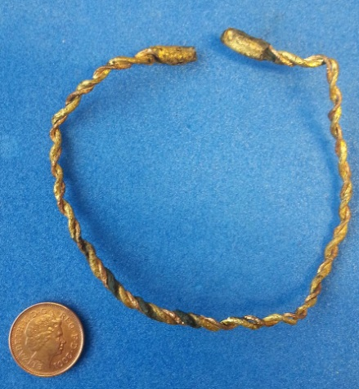
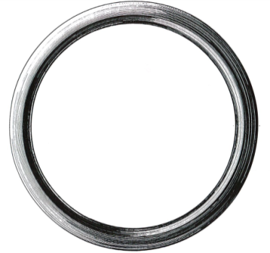
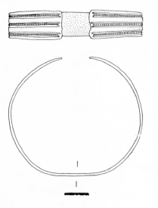
Bracelets and bodies – size matters
Iron
wire
Polychrome
cable
Black
stone
Penannular
armillae

Slide 19
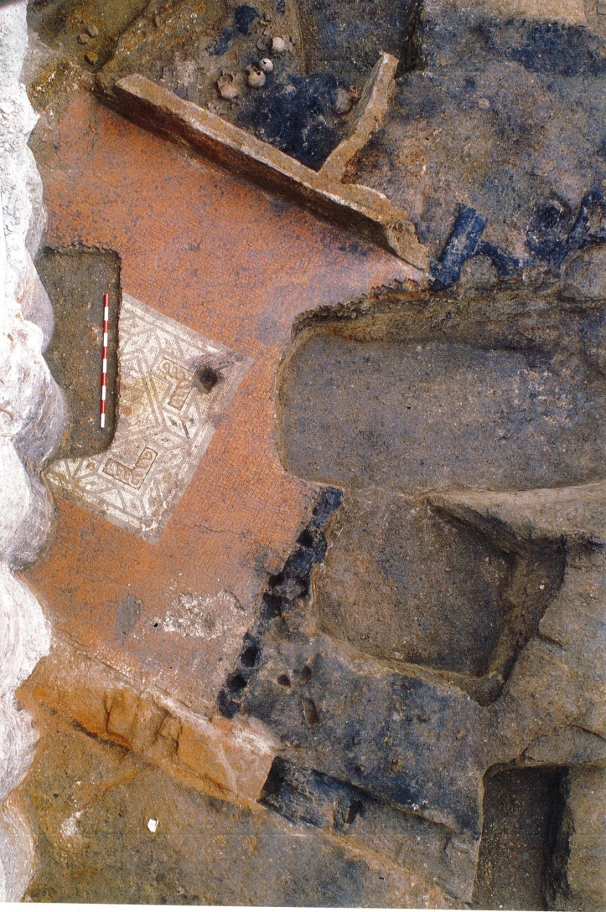
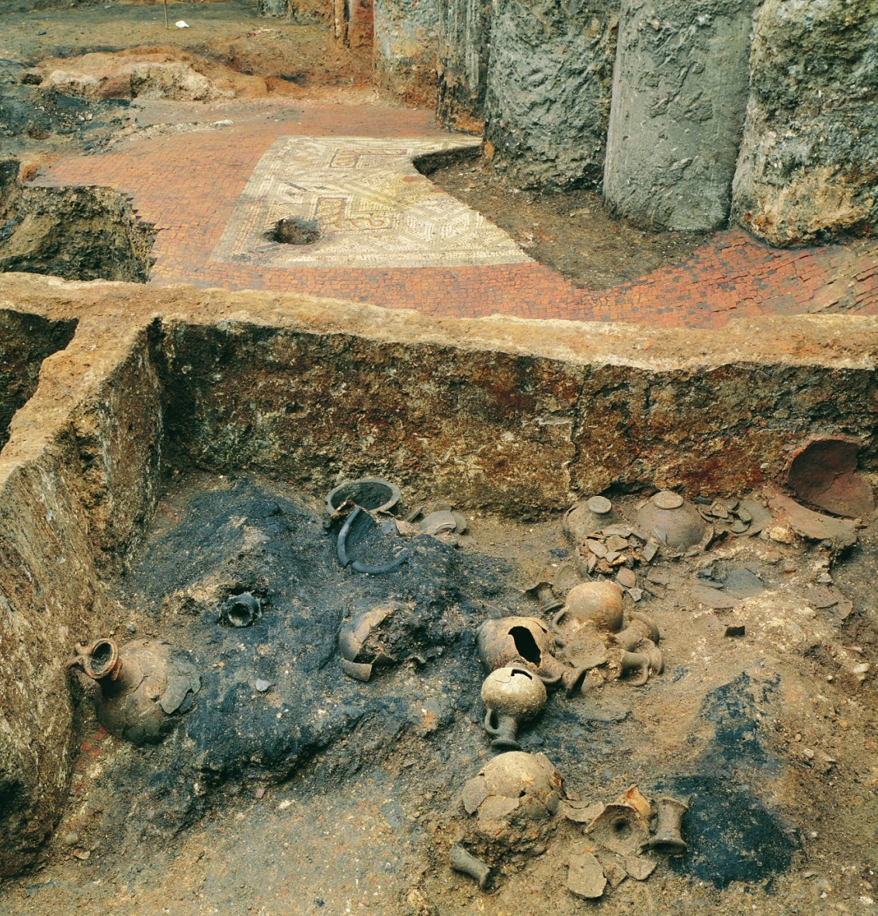
Context is key
Excavation of a Roman house on Gresham Street destroyed by fire (Casson et al 2014)

Slide 20
From the kitchens in
modest homes…
Photographs © Museum of London

Slide 21
… to reception
rooms in luxury
townhouses
Photographs © Museum of London

Slide 22
Recurrent patterns and deliberate deposition
Pots down wells:
Water jars or votive deposits
OR both
Complete pottery drinking vessel
buried under the floor with a lid
and with a brooch inside

Slide 23
Pottery vessel containing
Burnt fruit
Fragment of amber
Uncut gem for a ring
Military belt buckle
Iron key
(Marshall in Blair in prep)
Looking for patterns
Looking for beliefs

Slide 24
Londinium
Fort
Amphitheatre
West
Walbrook
River Thames
Forum
East
London Bridge
Southwark
Reconstruction ©
Peter Froste / Museum of London

Slide 25
Finds linked to sites on
MOLA database

Slide 26
Selected sites from 1st century AD Roman London
Sites colour coded by area

Slide 27
Round
houses
Differences in the development of the street plan and in architecture

Slide 28
Picking pots in
Roman London
Some pottery types
made in local industries

Slide 29
Nice pottery pictures
Imported amphorae
transport vessels
Imported
Samian tableware

Slide 30
Amphora
Amphora particularly common in
the east near the Forum
Walbrook area has
lower proportion of amphora
but plenty of imported continental
tablewares
Storage
Flagons
Table
Drinking
Kitchen / Table
Jars forms most dominant
in the west, probably reflecting
Iron Age traditions
Kitchen / Cooking pots
Statistical analysis of the makeup of pottery assemblages by vessel type / function
using Correspondence Analysis
Quantified by ‘rows’.

Slide 31
Statistical analysis of a sample of 1st century brooches from MOLA sites using Correspondence Analysis, sites divided into four broadly defined zones
Key to main
source areas of type
SE British; Other British; Continental

Slide 32
?Military garb and symbols of authority
Preliminary distribution plot of key Later Roman brooch types and Late Roman belt fittings based on MOLA data and other finds known to the author
(data on Museum of London core collection brooches added courtesy Frank Pemberton)

Slide 33
1st and 2nd C contexts
3rd and 4th C contexts
Preliminary plot of metalworking as seen through the distribution of crucibles. Perhaps indicating a change in the organisation of production over time
Evidence for later Roman metalworking in Southwark published as Hammer 2003

Slide 34
Moils from blowing
iron
Cullet dump
Glass working waste from
Basinghall Street

Slide 35
Yellow and light blue: pre AD 70
Green
Late 1st C
Pink / purple
early 2nd C
Red
mid 2nd C
Dark blue
late 2nd – 3rd
Black
3rd - 4th
LBN08
Good dating and near comprehensive
datasets:
Glass working sites
(Shepherd and Wardle 2009; Forthcoming Basinghall St Monograph)

Slide 36
After Wardle
in Harward et al. 2015) with
new additions
based on MOLA
data
2
LSS85
MLK76
Distribution of horse shoes and rein rings Possibly related to infrastructure network?

Slide 37
Lots of data in need of lots of interpretation!
More grey jars please!
Lots of horses!
Lots of industry!
We prefer British brooches!
More red shiny plates!
I prefer Gaulish brooches!
Imports and trading!
Metalworking!
We need new joined up narratives about people AND their things
I prefer British brooches!
Reconstruction ©
Peter Froste / Museum of London

Slide 38
Acknowledgments
Thank you to Bloomberg and Mitsui Fudosan who are supporting the ongoing projects at Bloomberg London and 8 – 10 Moorgate
Thank you to the many colleagues working on Roman sites and finds from London, far too many to list individually here(!) especially the current Roman finds team at MOLA Angela Wardle, Amy Thorp, Fiona Seeley, Beth Richardson, Charlotte Burn and Ian Betts.
Colleagues at the Museum of London or all their help and permission to use their wonderful images, especially Caroline McDonald and Glynn Davis
Thank you to Frank Pemberton for permission to reference his unpublished work on Roman brooches
Thank you to Gresham College for the opportunity to speak here today
Thanks for listening!

Slide 39
Notes:
End Slide. Please add this slide at the end of all presentations.

