Slide 1
HUMAN RIGHTS – BAD?
GRESHAM COLLEGE 5TH NOVEMBER 2014
GEOFFREY NICE

Slide 2
Article 13 UDHR
1 Everyone has the right to freedom of movement and residence within the borders of each state.
2 Everyone has the right to leave any country , including his own and to return to his country

Slide 3
Article 14
1 Everyone has the right to seek and to enjoy in other countries asylum and freedom from persecution
2 This right may not be invoked in the case of prosecutions genuinely arising from non-political crimes or from acts contrary to the purposes and principles of the United Nations

Slide 4
Article 2 of Fourth Protocol of ECHR:
Article 2 – Freedom of movement
Everyone lawfully within the territory of a State shall, within that territory, have the right to liberty of movement and freedom to choose his residence.
Everyone shall be free to leave any country, including his own.
No restrictions shall be placed on the exercise of these rights other than such as are in accordance with law and are necessary in a democratic society in the interests of national security or public safety, for the maintenance of ordre public, for the prevention of crime, for the protection of health or morals, or for the protection of the rights and freedoms of others.
The rights set forth in paragraph 1 may also be subject, in particular areas, to restrictions imposed in accordance with law and justified by the public interest in a democratic society.
But the UK has signed but not ratified this Protocol

Slide 5
Directive 2004/38/EC
Chapter VI of Directive 2004/38/EC is the key section: RESTRICTIONS ON THE RIGHT OF ENTRY AND THE RIGHT OF RESIDENCE ON GROUNDS OF PUBLIC POLICY, PUBLIC SECURITY OR PUBLIC HEALTH
Article 27 – General principles
1. Subject to the provisions of this Chapter, Member States may restrict the freedom of movement and residence of Union citizens and their family members, irrespective of nationality, on grounds of public policy, public security or public health. These grounds shall not be invoked to serve economic ends.

Slide 6
2. Measures taken on grounds of public policy or public security shall comply with the principle of proportionality and shall be based exclusively on the personal conduct of the individual concerned. Previous criminal convictions shall not in themselves constitute grounds for taking such measures.
The personal conduct of the individual concerned must represent a genuine, present and sufficiently serious threat affecting one of the fundamental interests of society. Justifications that are isolated from the particulars of the case or that rely on considerations of general prevention shall not be accepted.****************
See: by SI 2006/1003 (as amended) r19;r21; r24; r26 6 UK Borders Act 2007, s33(2)

Slide 8
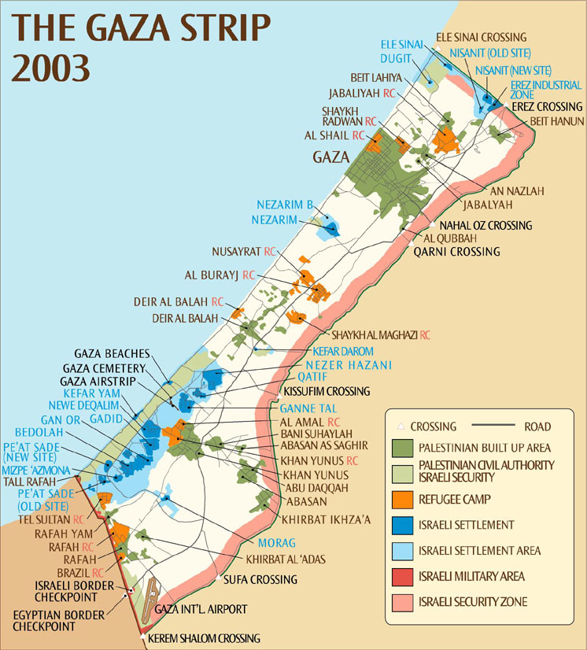

Slide 9
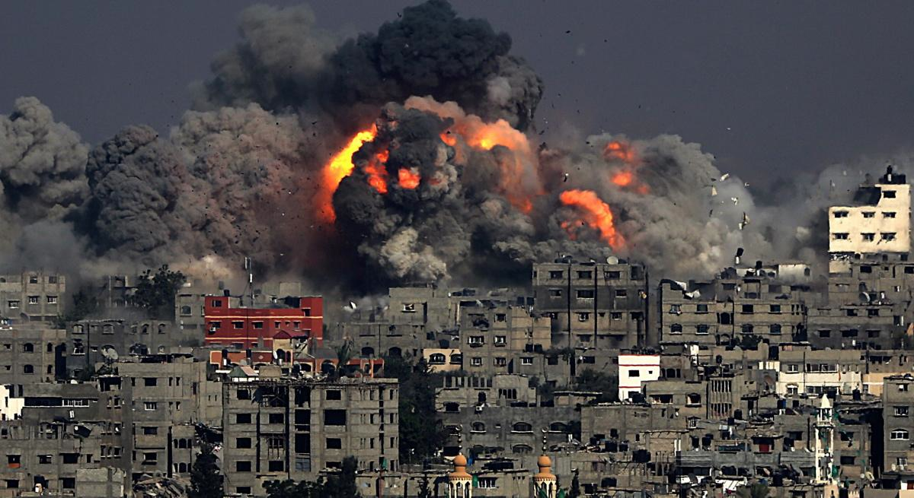

Slide 10
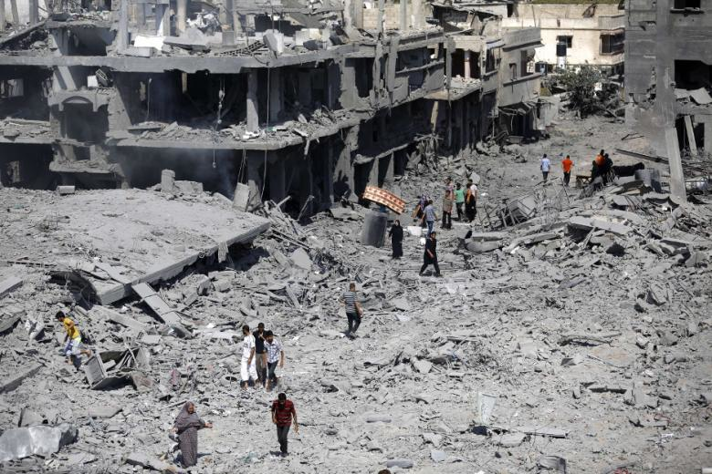

Slide 11
Article 8 of the ECHR
Article 8 – Right to respect for private and family life
1. Everyone has the right to respect for his private and family life, his home and his correspondence.
2. There shall be no interference by a public authority with the exercise of this right except such as is in accordance with the law and is necessary in a democratic society in the interests of national security, public safety or the economic well-being of the country, for the prevention of disorder or crime, for the protection of health or morals, or for the protection of the rights and freedoms of others.

Slide 12
UDHR Article 5 and ECHR Article 3:
'No one shall be subjected to torture or to cruel, inhuman or degrading treatment or punishment'.

Slide 13
Prisoners Voting rights
19th century: from a property-based franchise to the Forfeiture Act 1870
1832, the franchise was given to men who owned land valued at not less than ten pounds.
At common law, before 1870, convicted traitors and felons forfeited their lands
loss of property right > no vote
Persons convicted of a misdemeanour only) did not lose their property rights on conviction and, accordingly, any imprisonment did not legally disenfranchise them unless they were physically prevented by being in prison on the day of the poll.

Slide 14
The Forfeiture Act 1870 removed the rule by which felons forfeited their land. Section 2 of the Act provided that any person convicted of treason or a felony and sentenced to a term of imprisonment exceeding 12 months lost the right to vote at parliamentary or municipal (local) elections until they had served their sentence.
In effect until the Criminal Law Act 1967, which abolished the distinction between felonies and misdemeanours and consequently amended the 1870 Act so that only persons convicted of treason were left disenfranchised.

Slide 15
20th century: Representation of the People Acts 1918-1969
The Representation of the People Act 1918 Electors generally had to be able to prove six months residence at a qualifying address in the parliamentary constituency (or related area) in which they wanted to register. Persons in custody, whether in lunatic asylums or prisons, were specified as not falling within the interpretation of “resident” at those places for the purposes of the new electoral registration requirements.

Slide 16
Successive governments have held the view that prisoners convicted of serious crimes which have warranted imprisonment have lost the moral authority to vote. This position was summarised during questions to the Home Office Minister in the House of Lords in 2003:
Lord Lester of Herne Hill asked her Majesty’s Government: Whether denying prisoners the right to vote affects their ability to persuade Ministers of the Crown and those responsible for the Prison Service to improve the conditions in which they are imprisoned; and whether denying prisoners the right to vote amounts to an additional punishment; and whether this is compatible with Article 25 of the International Covenant on Civil and Political Rights as interpreted by the United Nations Human Rights Committee.

Slide 17
The Minister of State, Home Office (Baroness Scotland of Asthal): It has been the view of successive governments that prisoners convicted of a crime serious enough to warrant imprisonment have lost the moral authority to vote.

