Slide 1
THE DARK SIDE OF
THE UNIVERSE
Joe Silk (IAP, JHU)
Gresham College, 6 April 2016

Slide 2


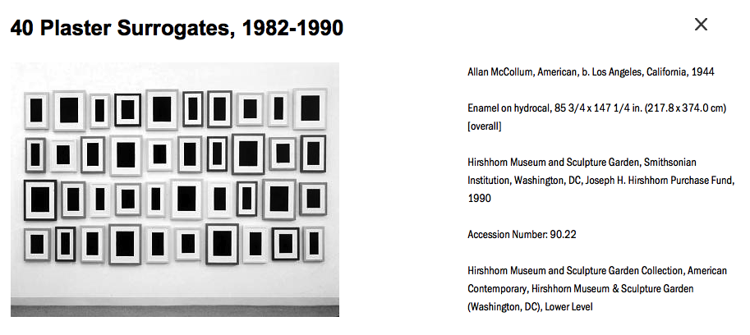

Slide 3


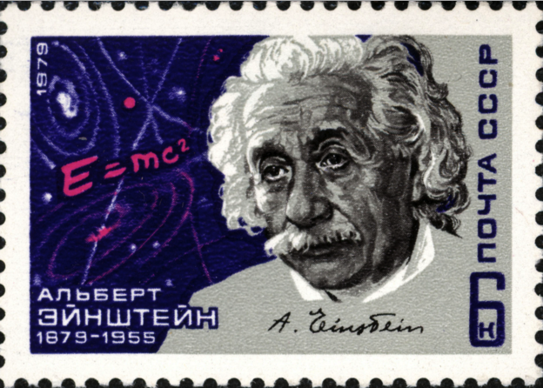
gravity (or potential energy) balances the (kinetic) energy of expansion of the universe
From the 1930s
Albert Einstein
Georges Lemaitre
Cosmology motivates dark matter

Slide 4
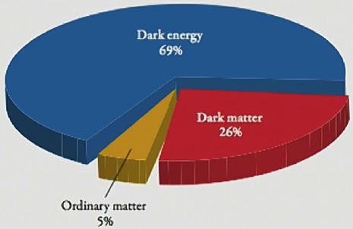
Modern observations of the expanding universe require dark matter (and dark energy)

Slide 5
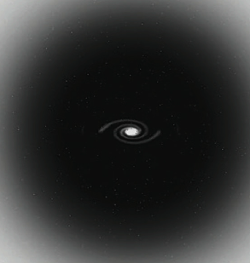
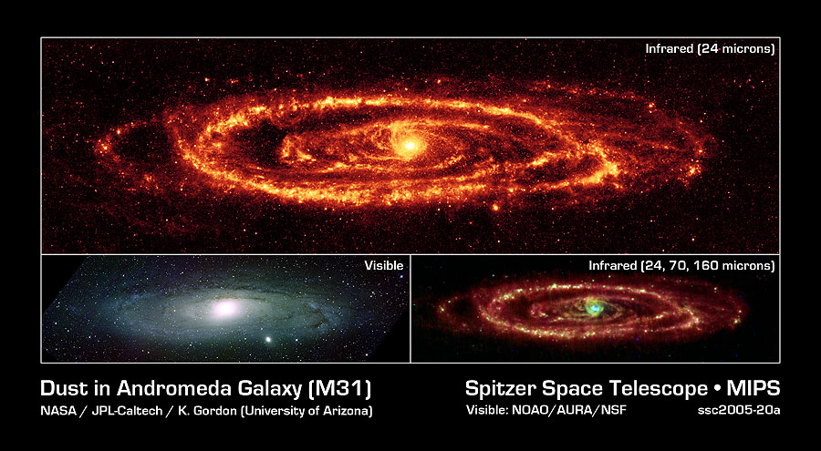
So where is the dark matter?

Slide 6
How to measure dark matter
From rotation speed of a galaxy
V²=G M (inside r) / r
v2
Measure v at radius and infer M (<r)

Slide 7
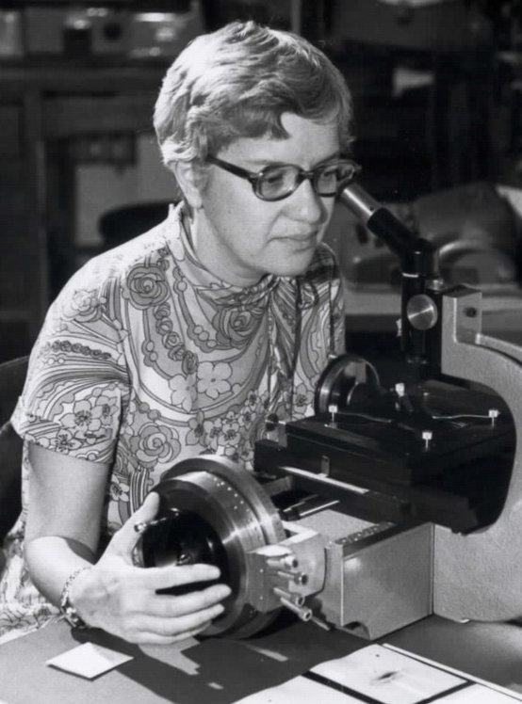
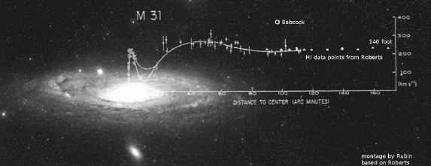

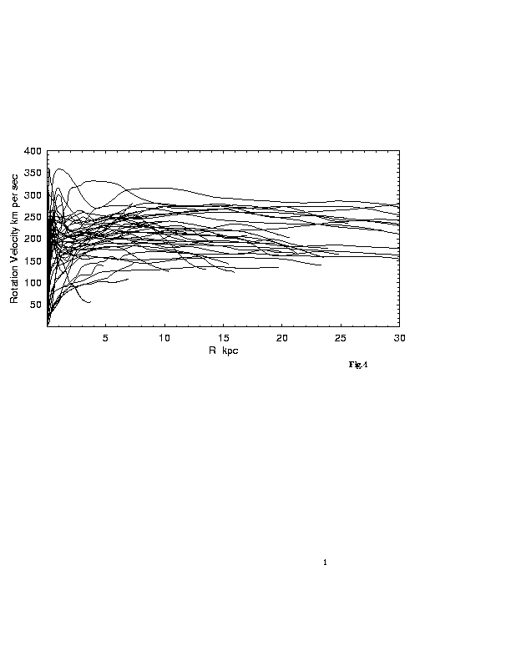
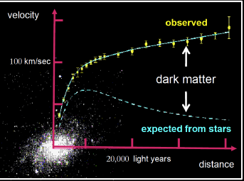
Vera Rubin
Mort Roberts
Sofue + 1999

Slide 8
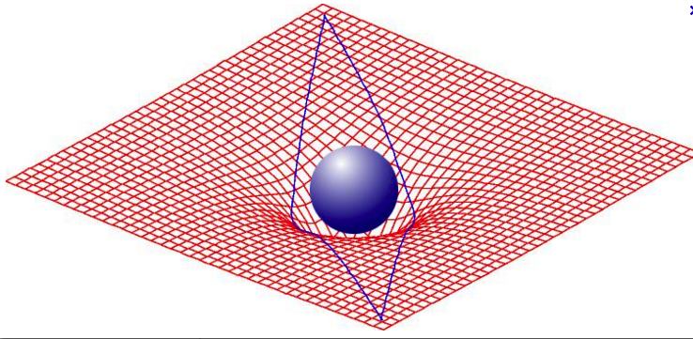
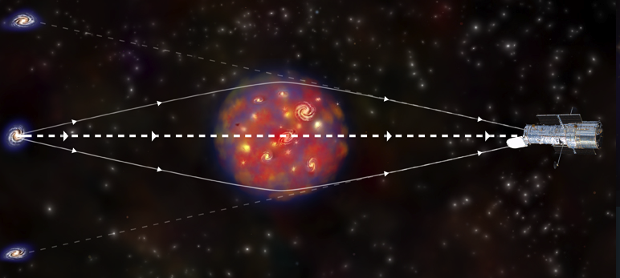
According to Einstein, matter curves space, and space curves light

Slide 9
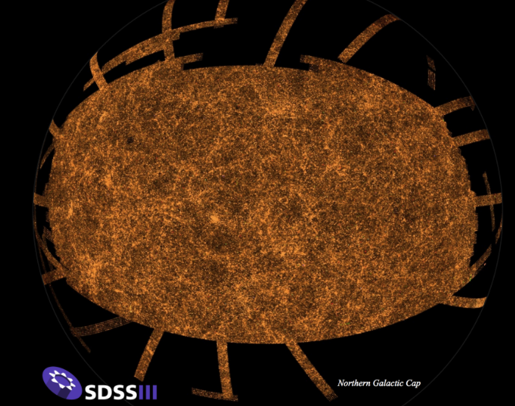
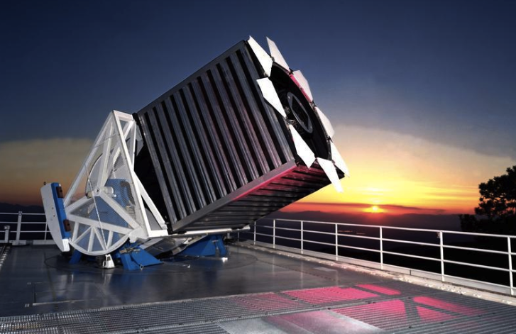
The first modern sky survey
Sloan Digital Sky Survey began 2000 at Apache Point, New Mexico
Notes:
Apache Point NM 2.2 m telescope, 120 megapixels, 1.5 sq deg
0.24 billion stars, 0.25 billion galaxies in northern cap
I million galaxy redshifts, began in 2000.

Slide 10
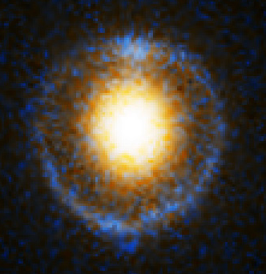
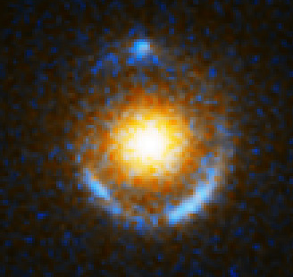
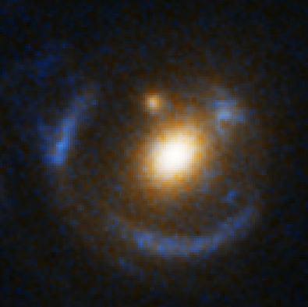
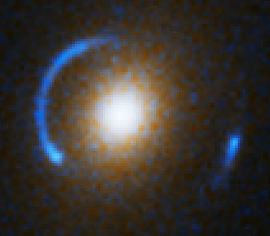
Gravitaional lenses: galaxies from the Sloan digital sky survey

Slide 11
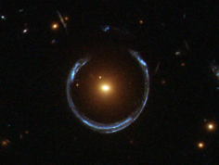
horseshoe gravitational lens

Slide 12
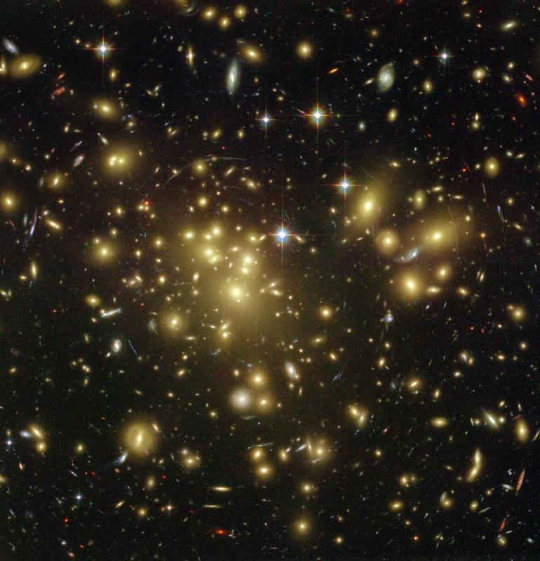
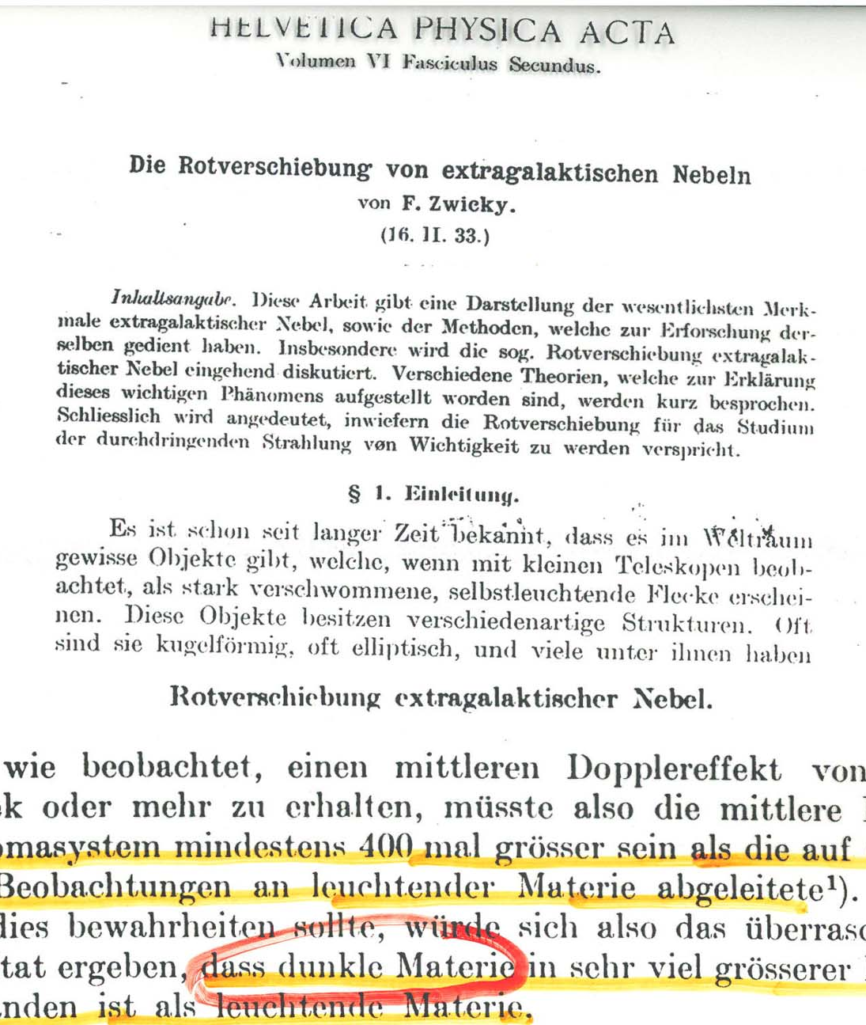
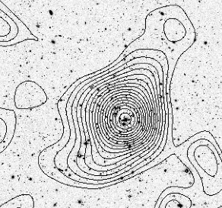
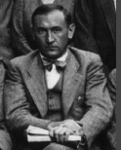
Clusters of galaxies are mosly dark matter
otherwise they’d fly apart

Slide 13
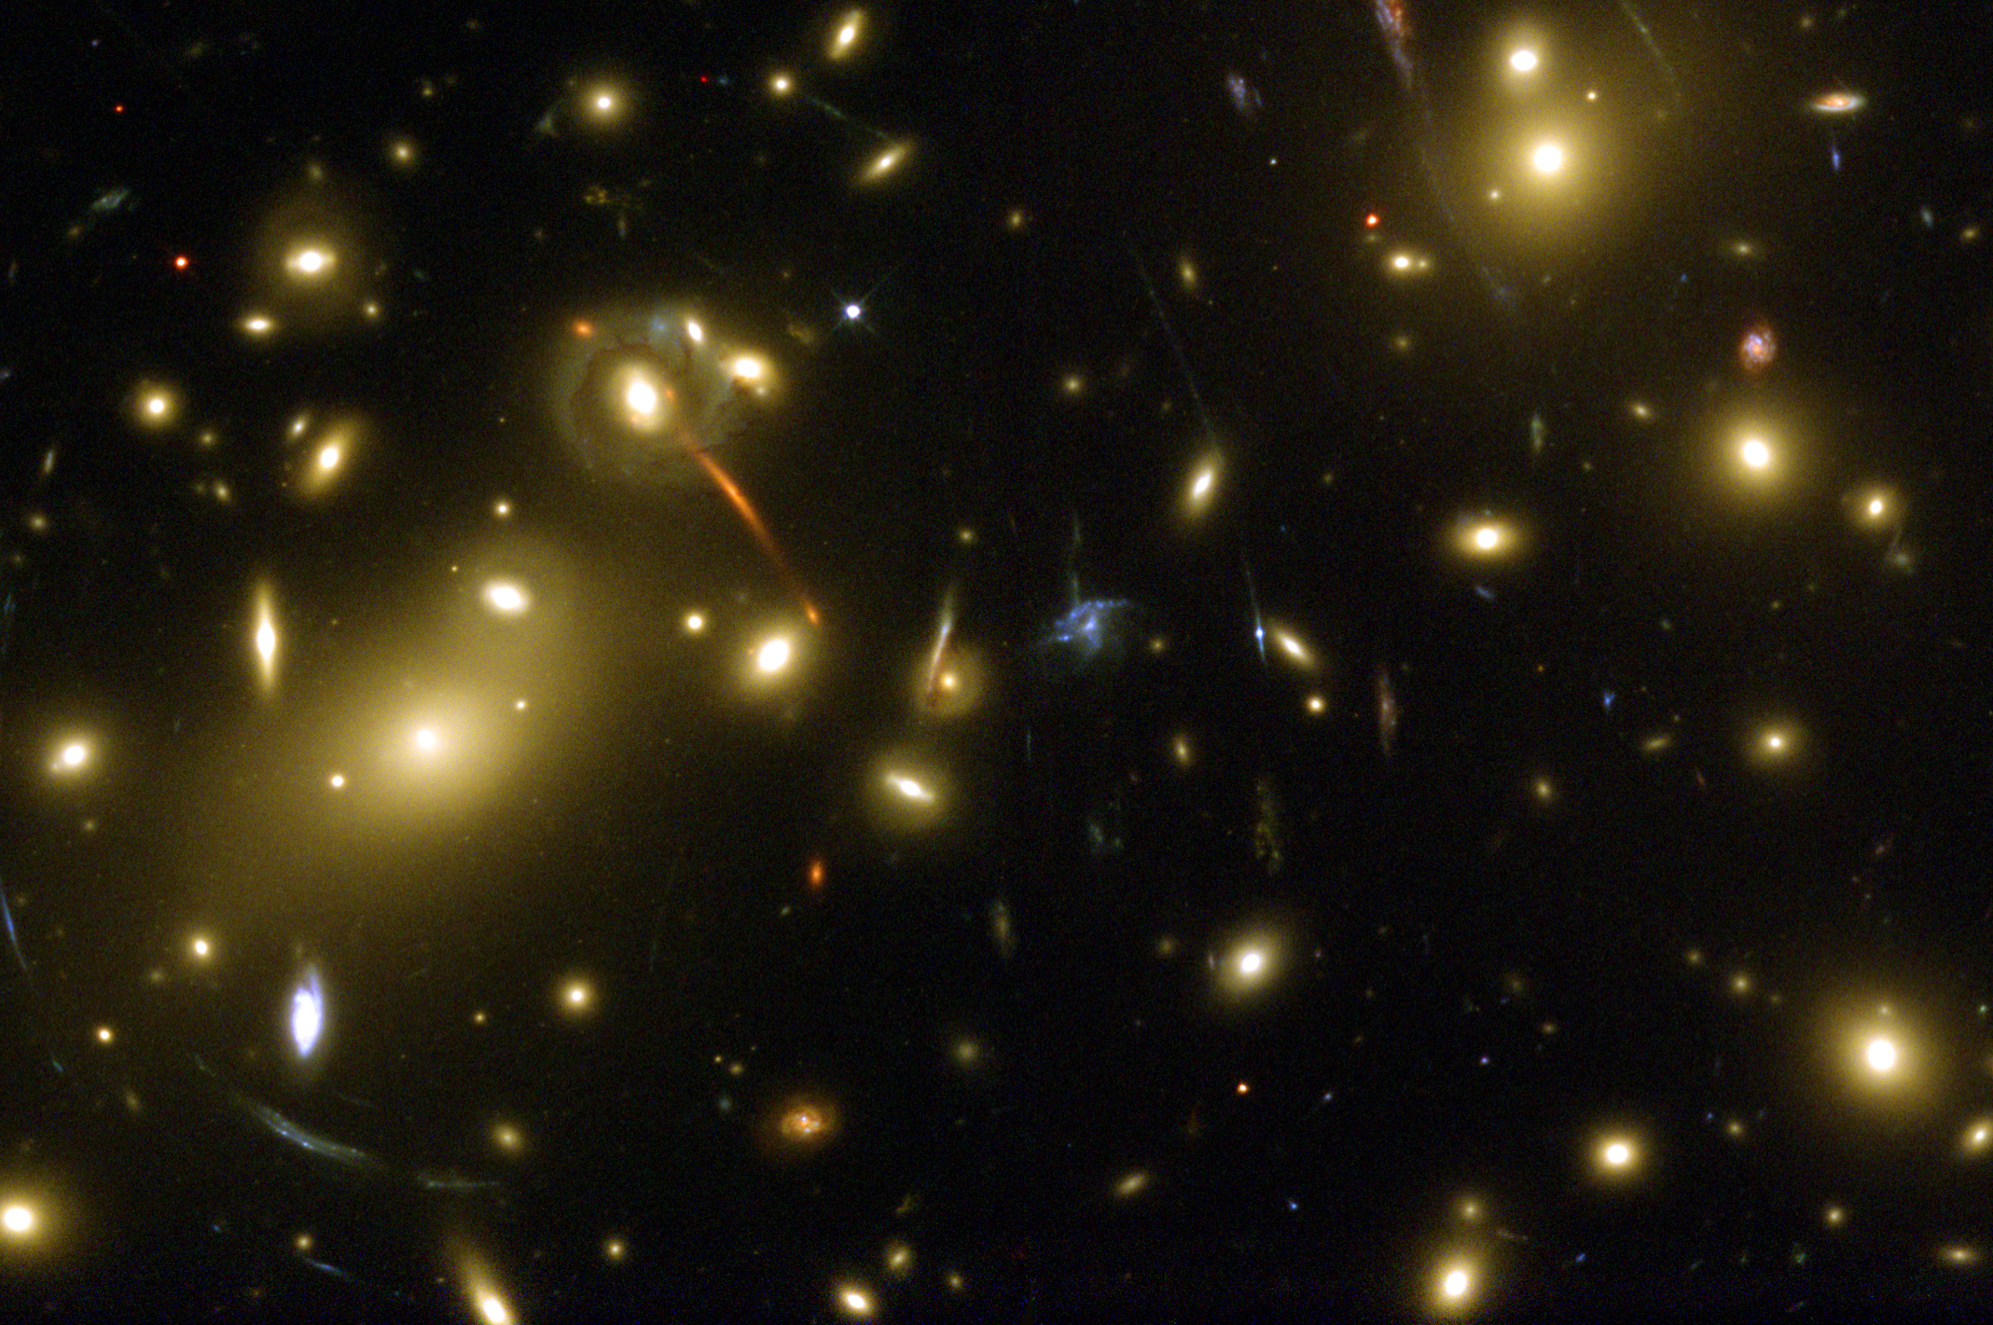
Galaxy cluster lens

Slide 14
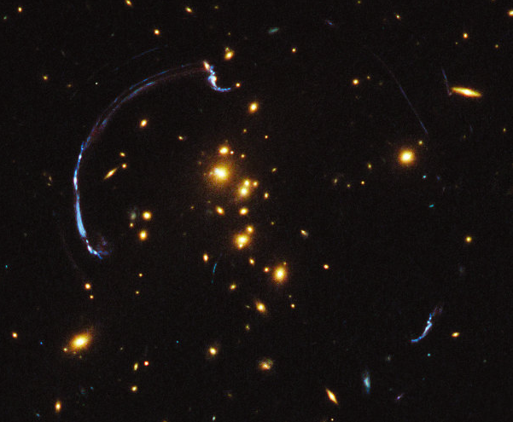
Galaxy cluster lens

Slide 15
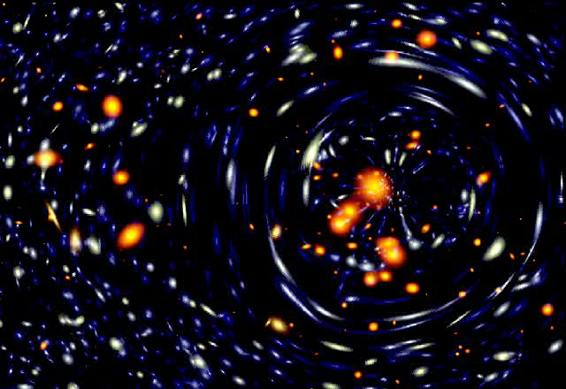
simulation of lensing by a cluster of galaxies

Slide 16
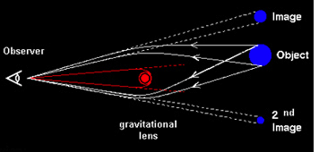
Expect multiple images of lensed galaxy

Slide 17
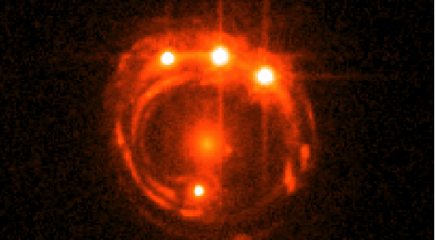
galaxy lensing a quasar

Slide 18
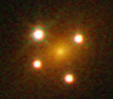
Another example
Einstein cross quasar

Slide 19
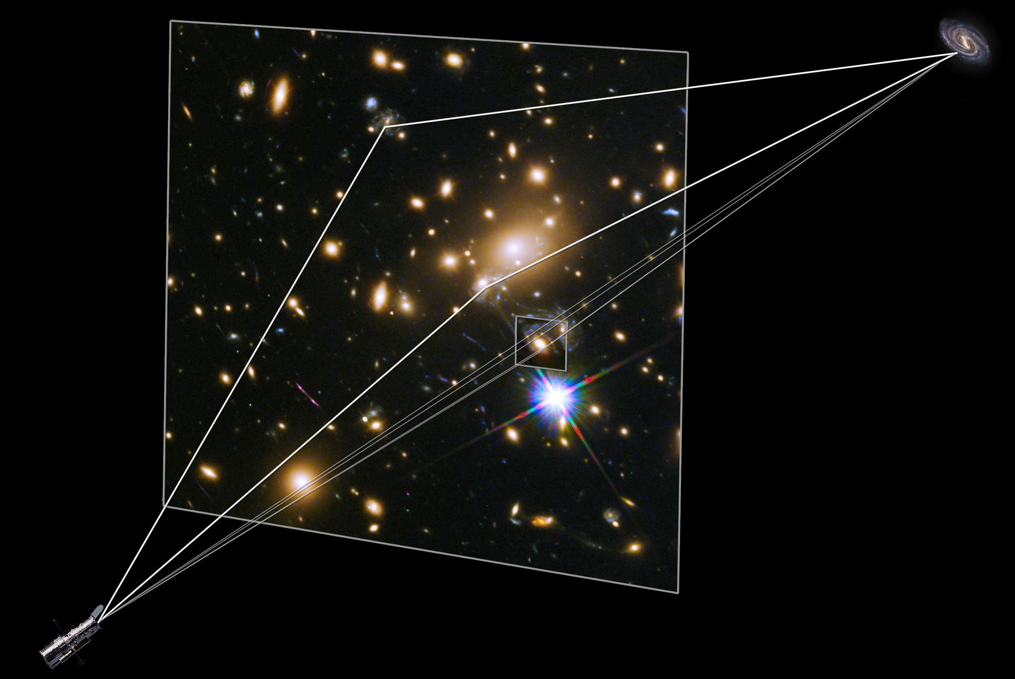
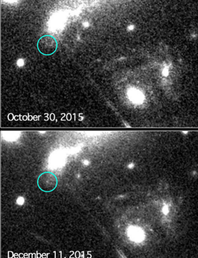
There is a time delay between different lensed images
This image of a lensed
supernova was predicted!

Slide 20
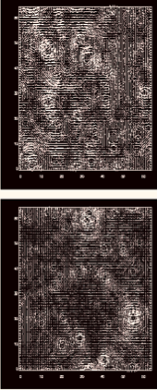
Gravitational lensing measures all the dark matter in the universe
Map of distortions in galaxy images
1/3 critical density of dark matter
and 2/3 dark energy (which doesn’t lens)
Average density of dark matter
just balances expansion energy
THIS IS OUR UNIVERSE!

Slide 21

Ordinary matter, exotic matter….

Slide 22
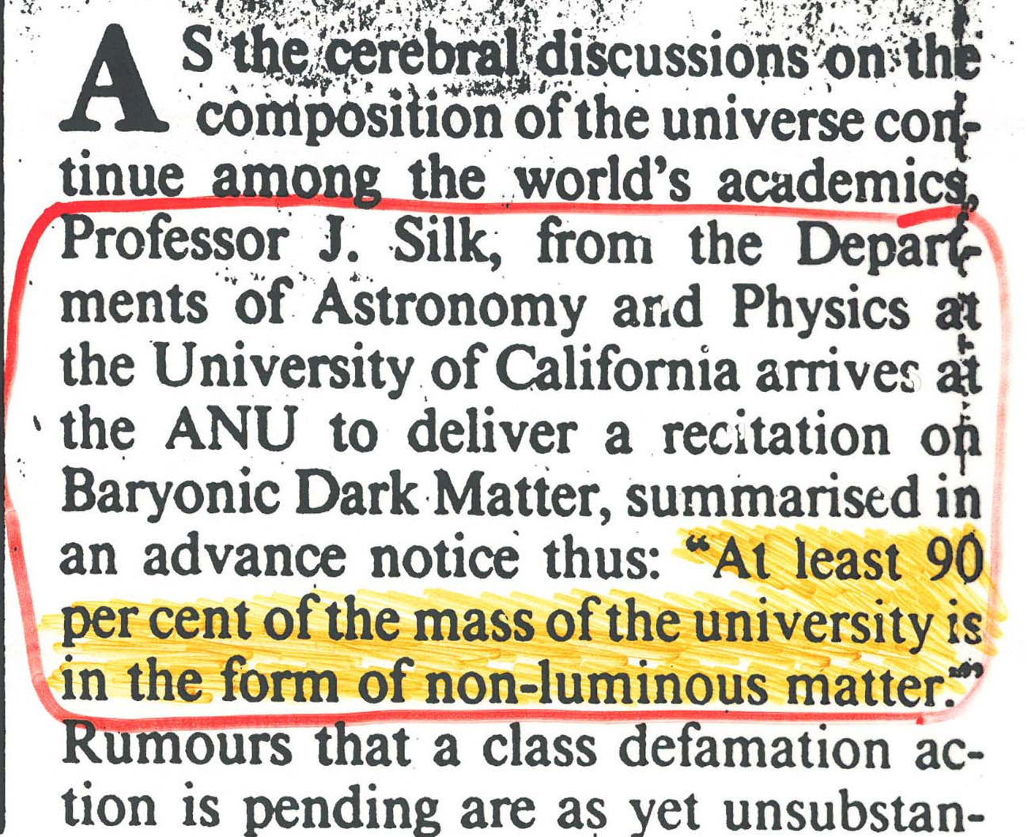
Canberra Times

Slide 23
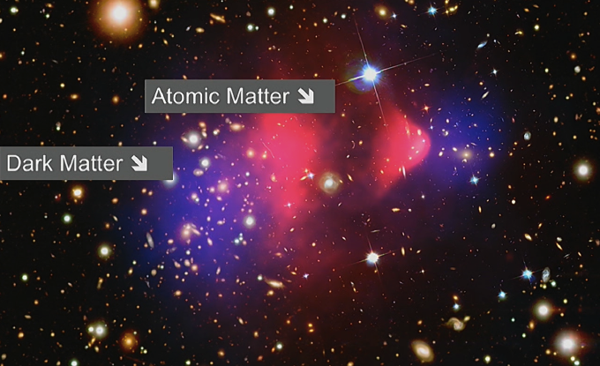
The Bullet cluster of galaxies
Dark matter is weakly interacting

Slide 24
Physicists believe that all elementary particles
were once the same
We call this unification
It happened long ago at incredibly high energy
when the universe was very hot
Supersymmetry unites protons and electrons at a
temperature greater than m_{proton}c² only 10⁻⁶ second
after the Big Bang
SUSY predicts all known particles have superpartners
All are very shoert-lived except the lightest one.
That’s our best dark matter candidate!
We call it a WIMP for Weakly Interacting Supermassive Particle

Slide 25
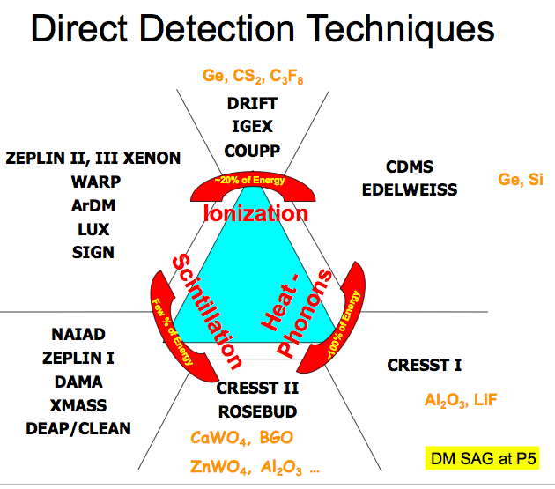
DIRECT DETECTION
many WIMPs pass through us every second
about ten million per sq meter per sec
Experimental techniques
to look for very rare events
Need to shield from cosmic rays

Slide 26

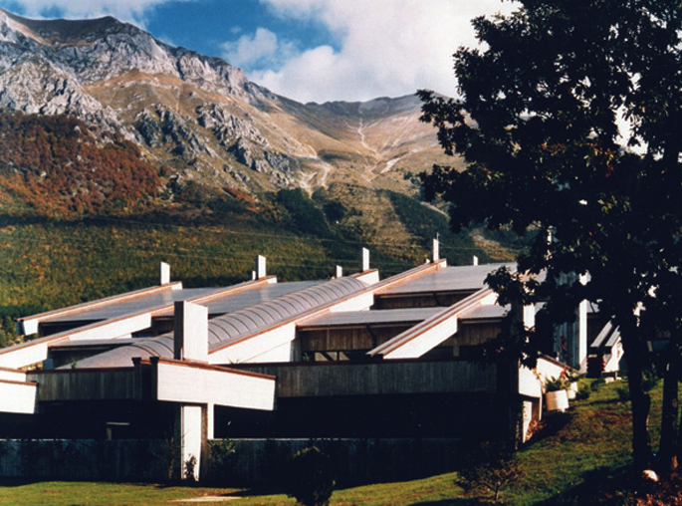
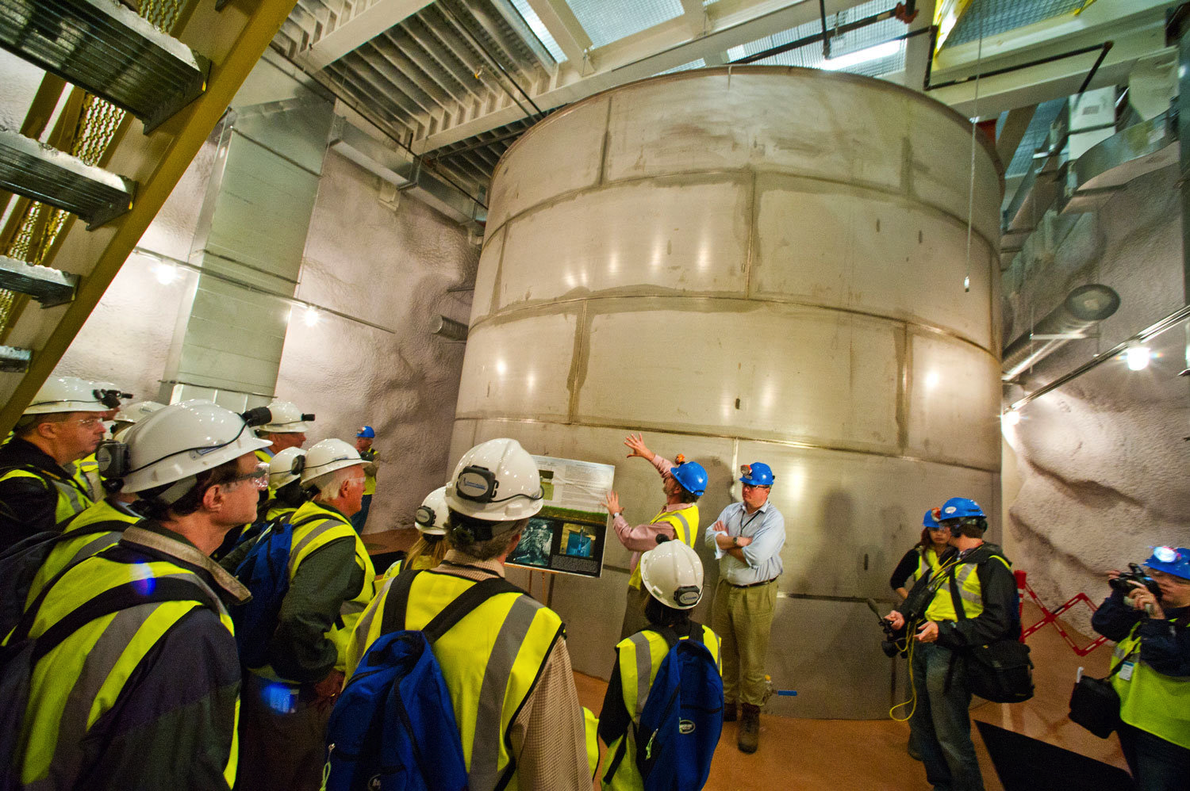
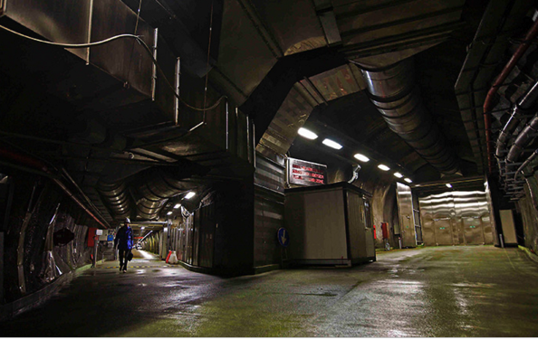
For direct detection,
go deep underground
Notes:
LUX in Gran Sasso

Slide 27
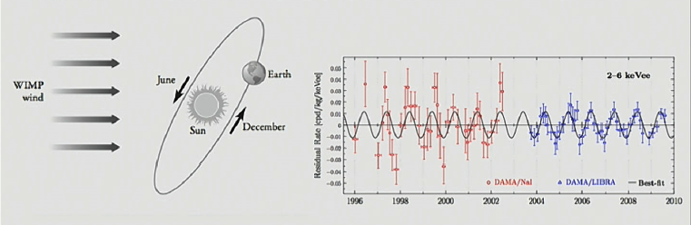
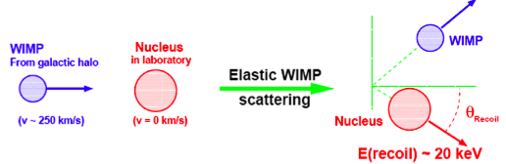

Sodium iodide crystals scintillate
13 yrs, 8.9 σ
This result was a red flag for the competition!
Rita Bernabei

Slide 28
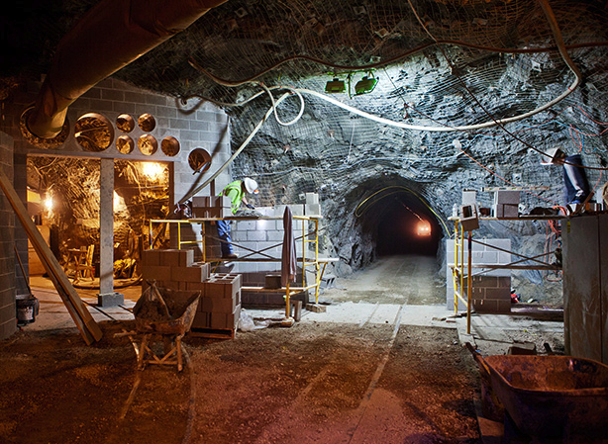

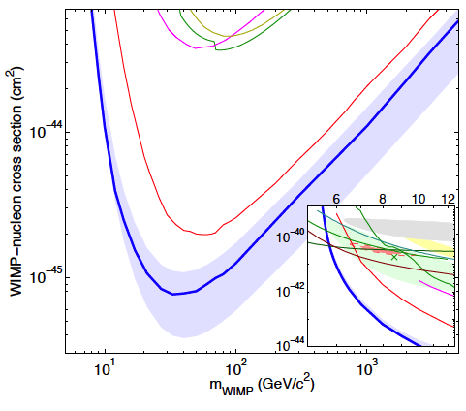
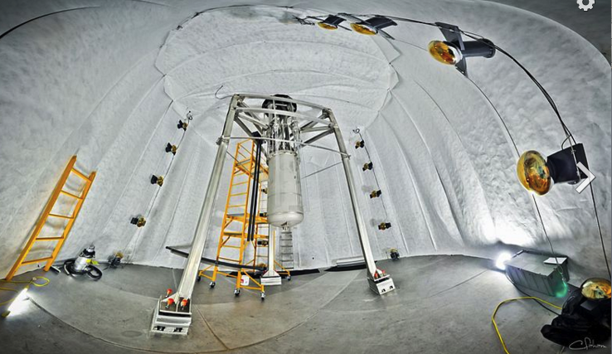
Liquid xenon
scintillations
In the Black Hills of South Dakota,
one mile undergound in a former
gold mine
Rick Gaitskell
LUX
Notes:
Spin-independent elastic scattering is coherent, and all nucleons contribute
I mile deep underground, black hills of S Dakota.
0.3 ton of liquid xenon. Scintillator, look for light flashes, a few per year expected.

Slide 29
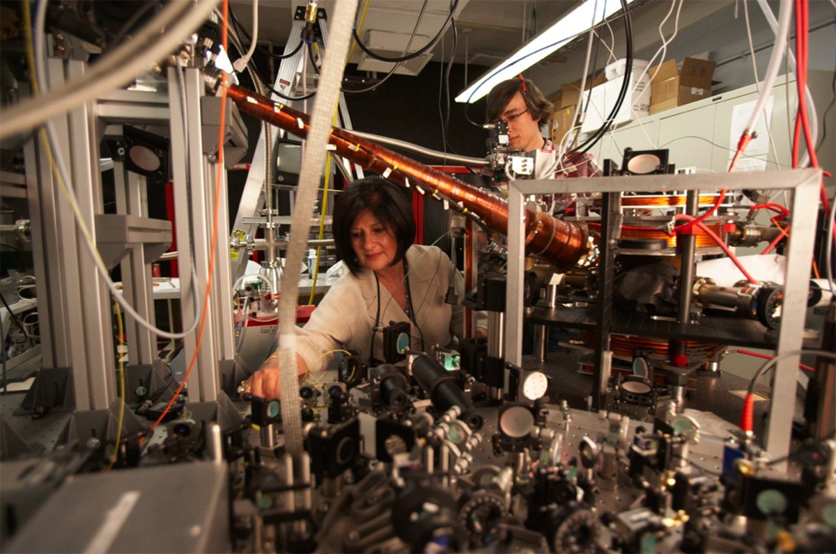
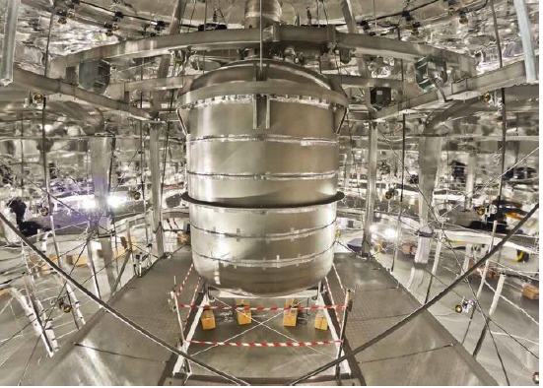
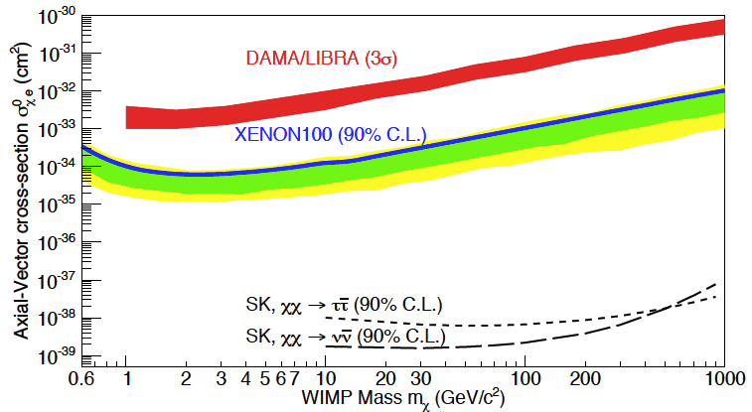
Liquid xenon 1 ton
Under construction
in the Gran Sasso National Lab in Abruzzo, Italy, under 1.4 km of rock, reached by a 10 km freeway tunnel under the Gran Sasso mountain
Elena Aprile

Slide 30
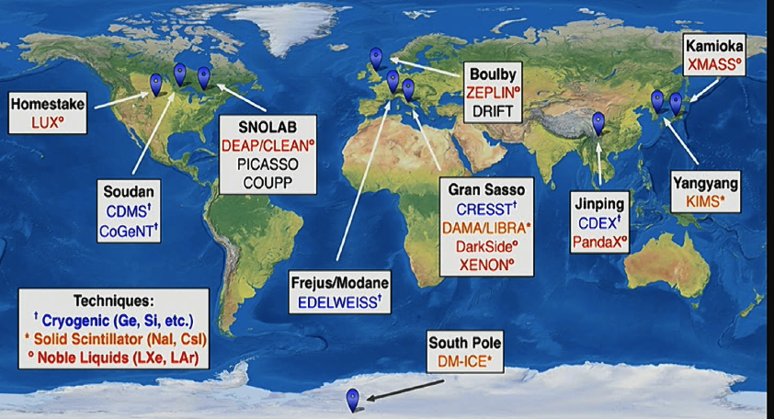
CJPL

Slide 31
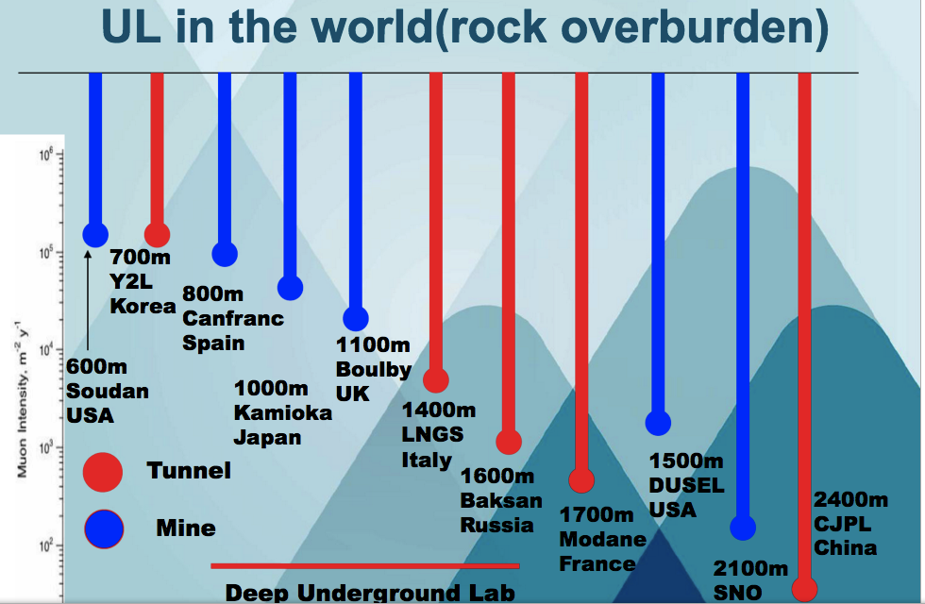

Slide 32
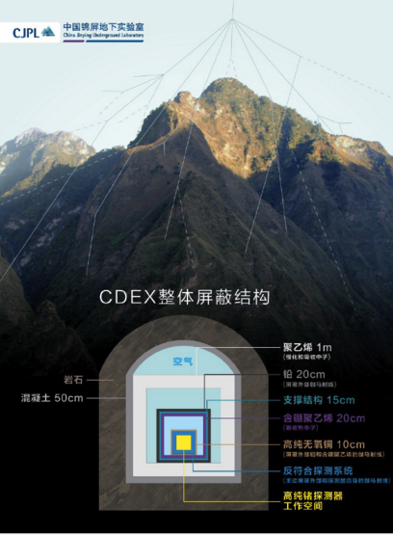

Germnium crystals
PandaX liquid xenon

Slide 33
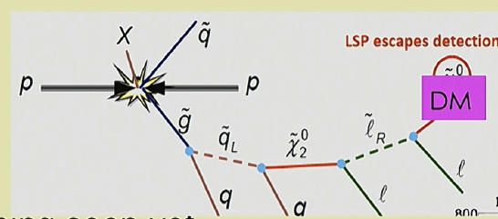
Alternative approach: look for missing energy event in collider: dark matter particle escapes detection

Slide 34
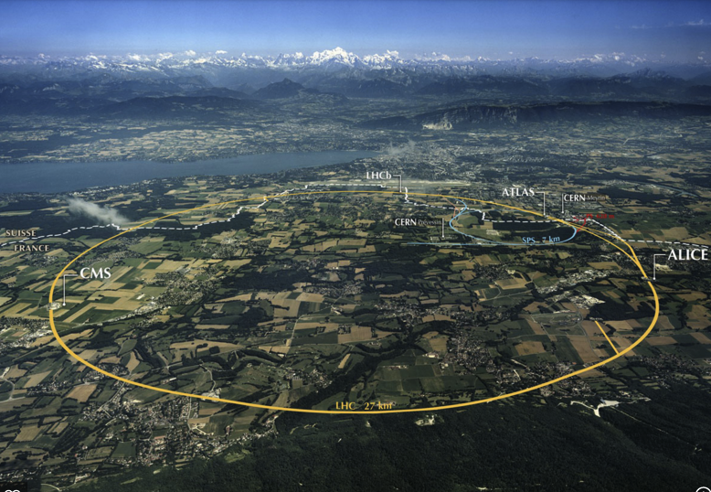


Where to create dark matter

Slide 35




CMS
ATLAS
Notes:
LHC ATLAS

Slide 36
INDIRECT DETECTION
halo WIMPS occasionally annihilate toda
into energetic particles:
Neutrinos, gamma rays, positrons…

Slide 37

Lets begin with the SUN
It’s a collector of dark matter!

Slide 38




ENERGETIC NEUTRINOS FROM WIMPs ANNIHILATING IN THE SUN
ICECUBE at the South Pole
ANTARES in the
Mediterranean Sea

Slide 39

Dark matter annihilations produce high energy positrons.
Normally these are very rare in the cosmic rays thsat bombard the earth
There is a dark matter experiment on board the
International Space Station:
AMS-02 is a cosmic ray detector
Notes:
AM02 on ISS, launched 2011

Slide 40


The mysterious rising positron flux
Possibly a tracer of dark matter…
but pulsar winds are a more likely source!

Slide 41

Fermi inner galaxy excess
Simulation of the
Milky Way halo with 10⁹ dark matter particles each of 4000 suns

Slide 42


Fermi gamma ray telescope discovered an
inner galaxy excess of diffuse gamma ray emission
Could this be dark matter?
Fermi inner galaxy excess

Slide 43


microwave haze towards the galactic centre
Predicted gamma rays
Excluded by HESS
Excluded by EGRET
FERMI reach
Hooper and Zaharias 2007
Finkbeiner 2007
Notes:
43

Slide 44

The Fermi gamma ray bubble
Not dark matter
but an ancient
explosion

Slide 45




faint dwarf galaxies are teeming with dark matter
99% of their mass is dark!

Slide 46






Current searches for indirect detection of particle dark matter
Notes:
46
Veritas
Hawc

Slide 47

The future for dark matter
2019
South: Atacama
North: La Palma

Slide 48

DAMPE launched Dec 2015 by China
Gammas and electrons 5 Gev -10 TeV
0.1 deg resoln at 100 GeV and
energy resolution 1.5%
2025 GAMMA-400 planned by Russia
100MeV to 10 TeV photons and high energy cosmic rays

Slide 49
Dark matter particles annihilate into neutrinos
Neutrino telescopes
Toulon: France
South Pole: US

Slide 50

Super-Kamiokande 60000 tons of purified water
1 km underground in mine in Japan
Hyper-Kamiokande. One million tons 2026
Notes:
Super K 1 km underground in Mozumi mine. 60ktons of purified water
40m cube tank.
11000 photubes 50 cm diameter

Slide 51
Dark matter is here to stay
But what is it?
Many experiments worldwide
In a decade we’d better detect it!
Or else we’ll need to change our theory

