Slide 1
Britain’s Damaged Rivers
Carolyn Roberts
Frank Jackson Foundation
Professor of Environment
And
UK Knowledge Transfer Network

Slide 2
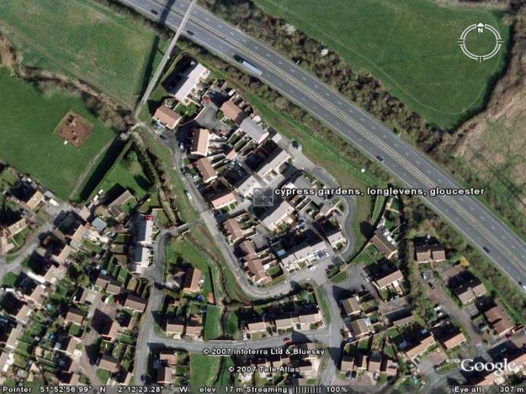

Slide 3
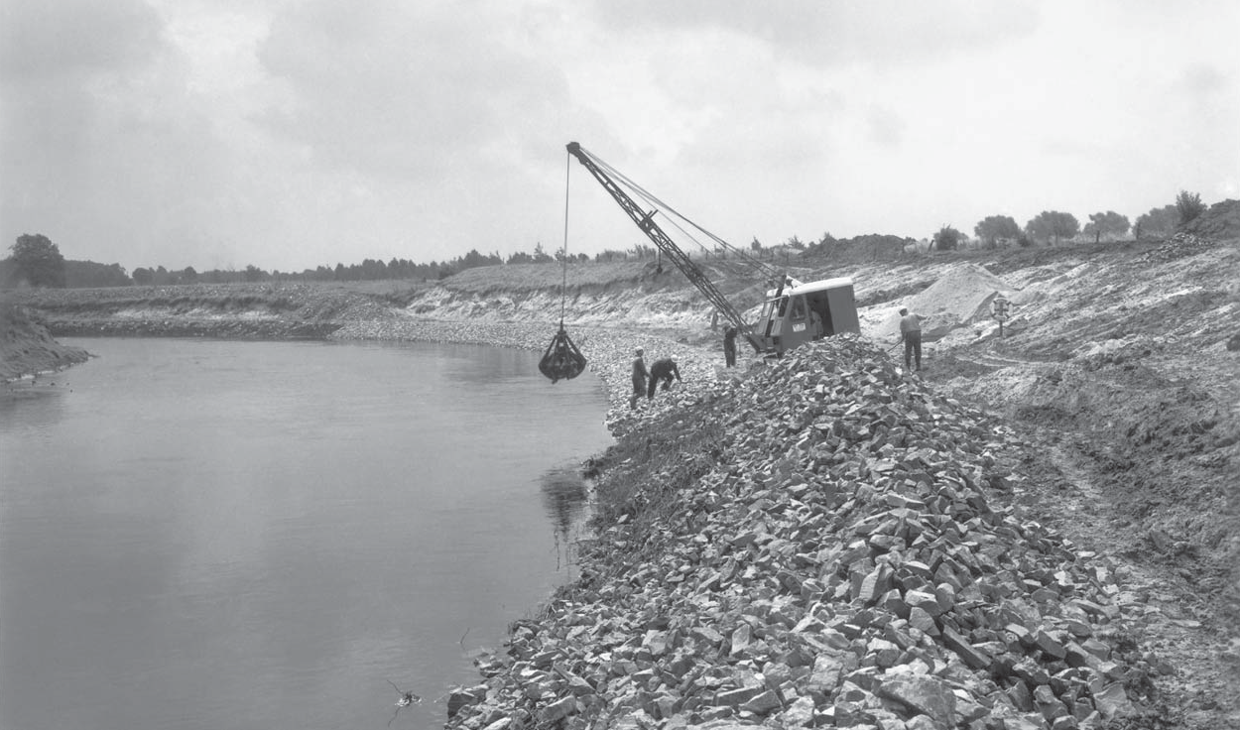
A picture from the 1960s: A construction crew of the Lippeverband securing an undercut bank on the Lippe River, Germany.

Slide 4
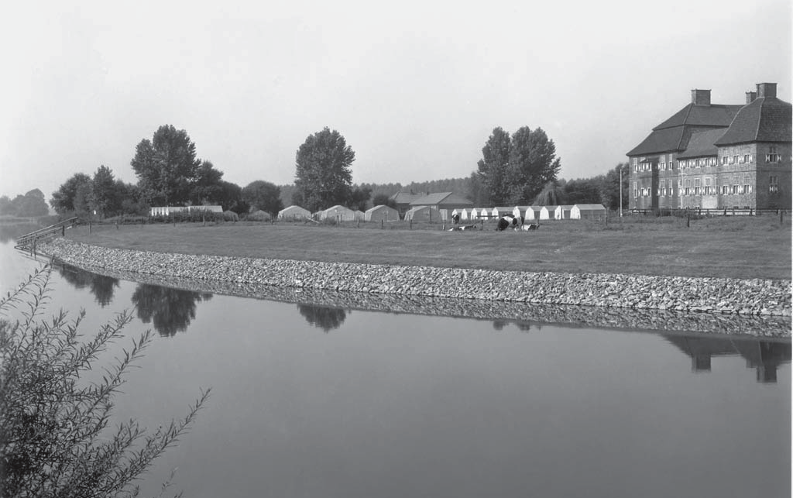
At the beginning of September 1969 the bank had been sloped back and reinforced with a stone rip rap embankment

Slide 5
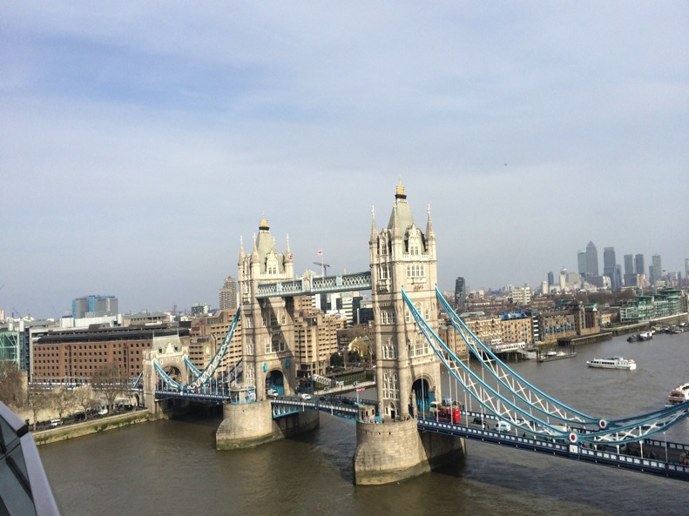

Slide 8
Notes:
I want you to imagine a time long ago, but not very far away….
International body teams up with Earth Day in bid to plant nearly eight billion trees by 2020
The UNFCCC has called on people to show their support for the signing of the Paris Agreement later this month by planting, sketching, photographing, or even hugging a tree.
The international body is seeking to highlight the signing of the landmark climate deal through a global social media campaign. It is making the unusual request alongside the organisers of Earth Day, an annual event which takes place on 22 April - a date which this year coincides with the signing ceremony for the Paris Agreement in New York.
RELATED ARTICLES
Papua New Guinea becomes first country to file offical national climate action plan
Christiana Figueres to step down from UN climate role in July
Two-thirds of people want legally-binding climate deal
Christiana Figueres: Why business matters at COP
Earth Day has chosen trees as its theme for 2016 in order to highlight their important role in maintaining climate stability.
The groups said they are asking people to participate in order to highlight to governments the high levels of public support for the global deal, which aims to limit temperature increases to well below 2C and deliver a net zero emission economy this century.
The new campaign is also hoping to make a practical difference to local environments by encouraging individuals, businesses, and governments to plant nearly eight billion extra trees by 2020.
Christiana Figueres, executive secretary of the UNFCCC, launched the campaign by hugging a Poro tree in her native Costa Rica.
She said planting, hugging or sketching a tree would be "an expression of solidarity, love and hope".
"The Paris Agreement, if fully implemented, offers a prospect of a far better world for billions of people," she said. "Conserving, restoring and extending the Earth's natural or nature-based infrastructure including forests will be a big part of its long term success and long term goal."
Over 100 countries have now said they intend to sign the Paris Agreement at the UN ceremony in New York later month, with India the latest major emitter to endorse the deal. The US, China and the EU have also already signalled they will sign up, meaning countries responsible for at least 61 per cent of all emissions have now pledged to sign the Agreement.
Given states have agreed the deal will enter into force 30 days after at least 55 countries, representing at least 55 per cent of global emissions, ratify it, onerecent analysis from former Marshall Islands adviser Michael Dobson indicated the Paris climate deal could yet enter into force this year - far earlier than many observers expected.
However, as the time taken for governments to ratify international agreements can often take years, the path to full ratification of the Treaty could stretch into 2017.

Slide 9
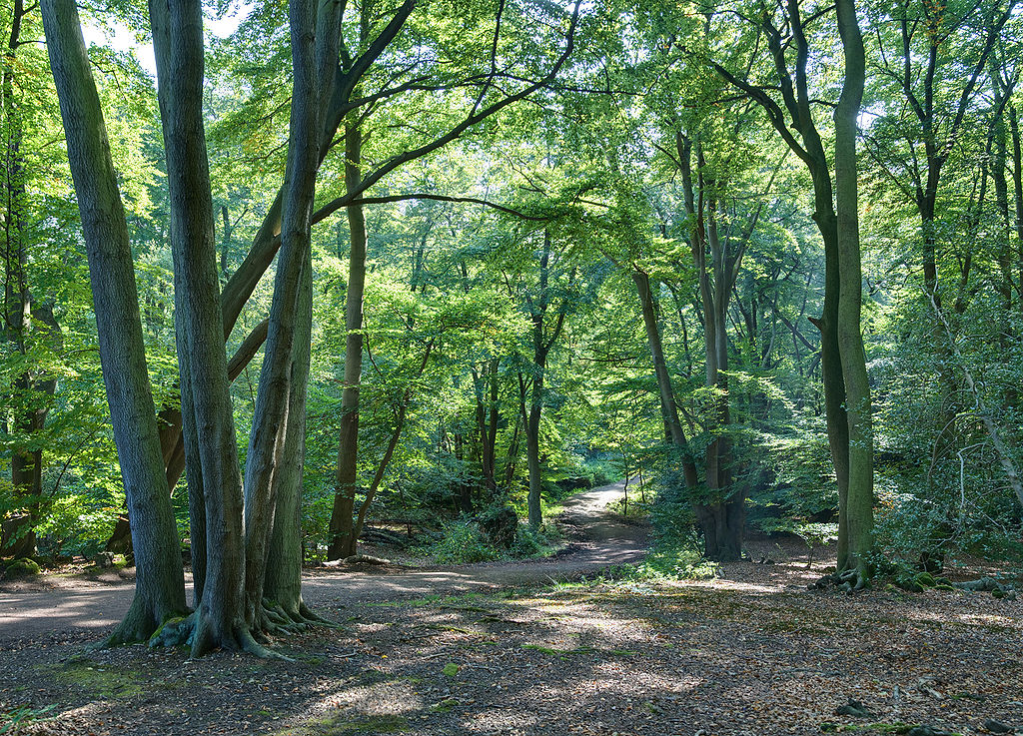
By Diliff - Own work, CC BY-SA 3.0, https://commons.wikimedia.org/w/index.php?curid=4896990
Notes:
Epping Forest in 2008

Slide 10
Notes:
In all the debates about how to protect against floods from intense rain, very little is heard about Britain’s rainforests. These are the closest thing we’ve got to tropical rainforests – woodlands drenched in rain, thick with humid air and criss-crossed with gurgling streams and waterfalls, yet all in a mild climate.
These woodlands are invaluable for protecting against flooding; they act like sponges, soaking up the heavy rain.
Britain’s rainforests are also precious relics of once great swathes of forest strung out along the Atlantic coastline dating to the last ice age, about 10,000 years ago. They now survive in isolated parts of western Scotland, the Lake District, Wales, and West Country, where mild Atlantic winds unleash big rainfalls.
These are magical places that have the feel of Tolkien about them; gnarled old trees and big boulders draped in shaggy green carpets of ferns, mosses, lichens and liver worts. Many of these plants, such as the filmy ferns with translucent fronds one cell thick that can only survive in constant humidity, are extremely rare.
And because the Atlantic air is clean it nurtures extraordinary lichens with names to match their bizarre looks – smokey Joe, octopus suckers, black-eyed Susan, blackberries in custard.
These rainforests largely survive in steep gulleys, slopes and other remote refuges, where they’ve managed to cling on against the ravages of modern life. They need protecting from threats like clumps of rhododendrons, which can smother vegetation. And they are internationally important. Only a few other places in the world have temperate rainforests – woodlands covering less area and getting far less attention than their tropical counterparts.

Slide 11
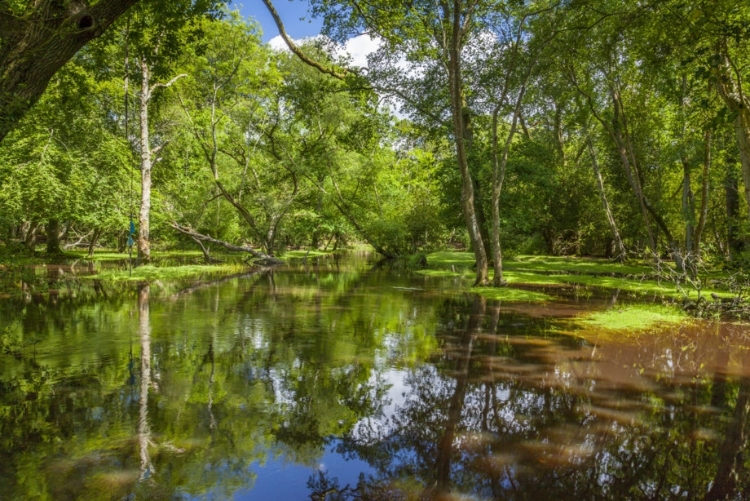
www.nevillestanikkphotography.co.uk/img/6124-Ipley-Bridge-Rivers-Trees-Woodland-Woods.jpg

Slide 12
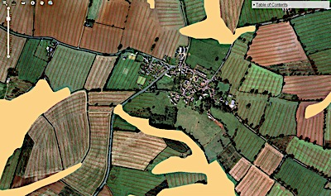
‘A GIS aided study of agriculture and landscape in Midland England’, Williamson et al, 2011, University of East Anglia. The image is of part of Northamptonshire, showing medieval land management.

Slide 13
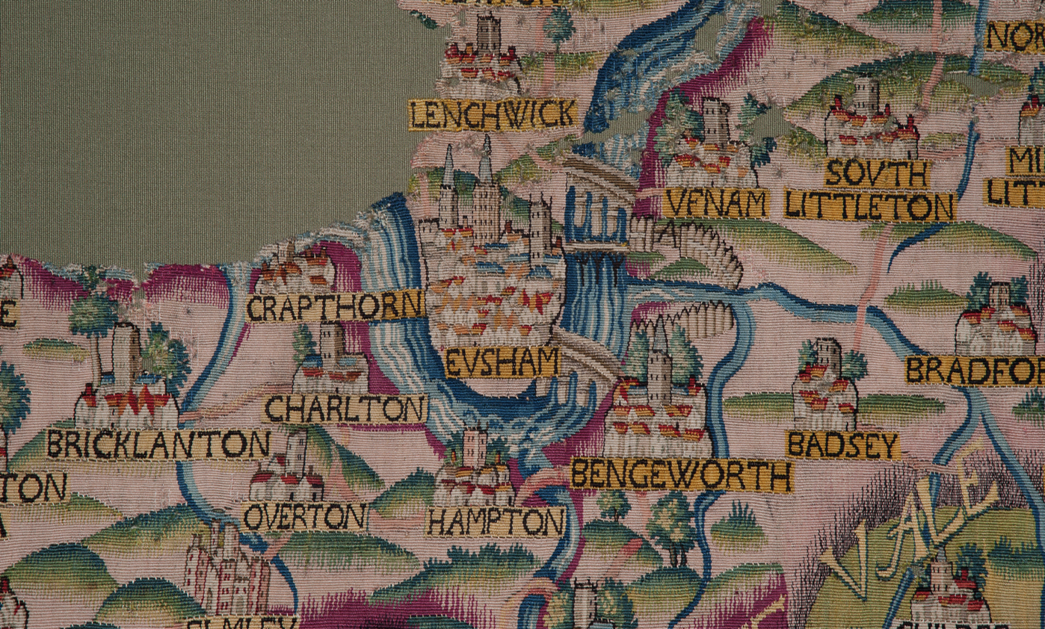
The River Avon, as shown in the Sheldon Tapestry, about 1570. Currently in the Bodleian Library, Oxford

Slide 14
1609 Map of part of Kibworth parish, Leicestershire
How accurate is it?

Slide 16
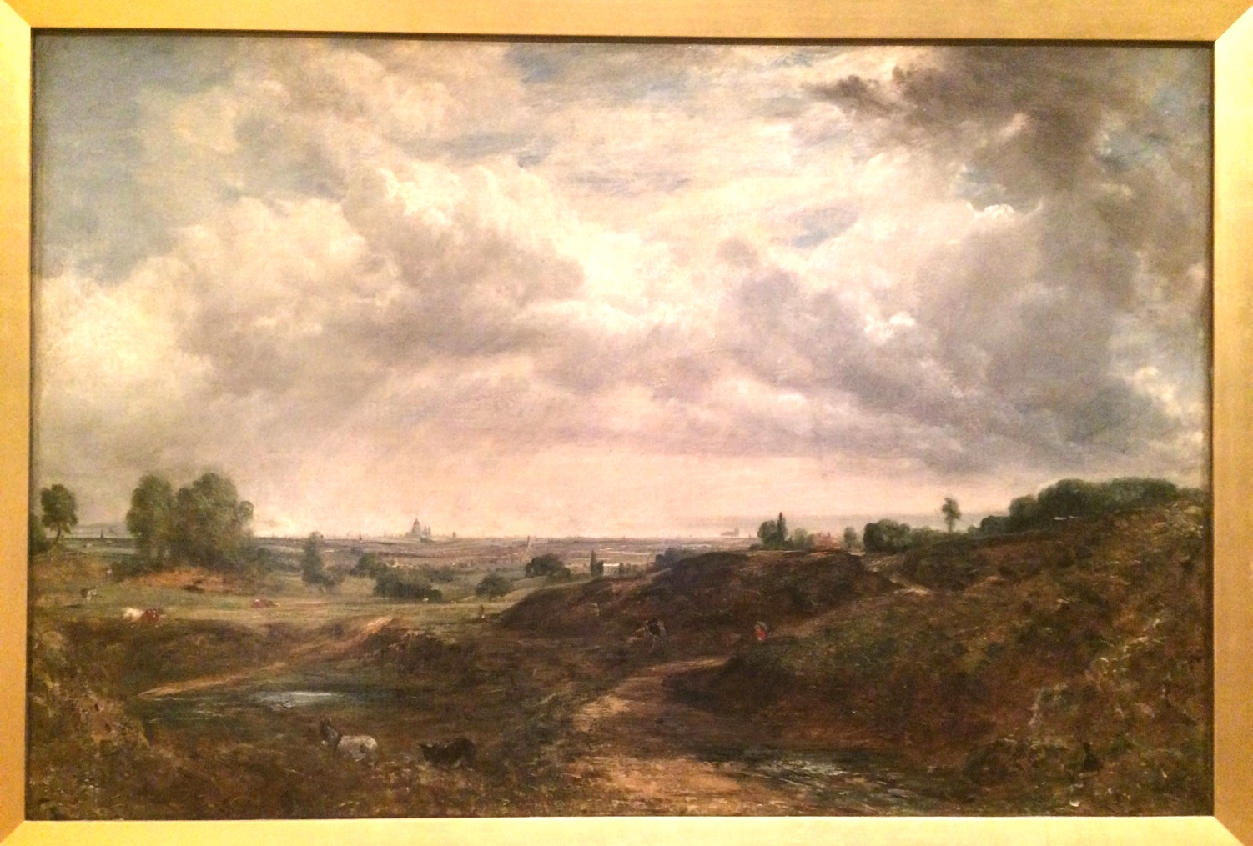
Hampstead Heath, about 1830. John Constable

Slide 17
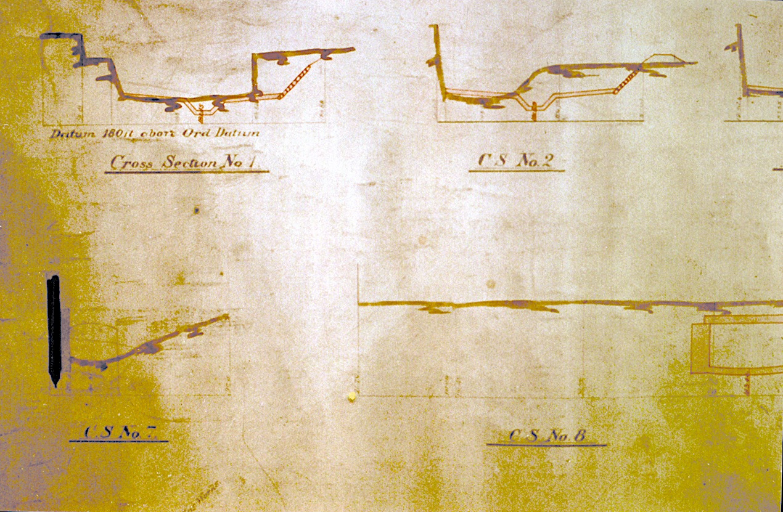
Nineteenth Century Railway Plans showing channel cross sections

Slide 18
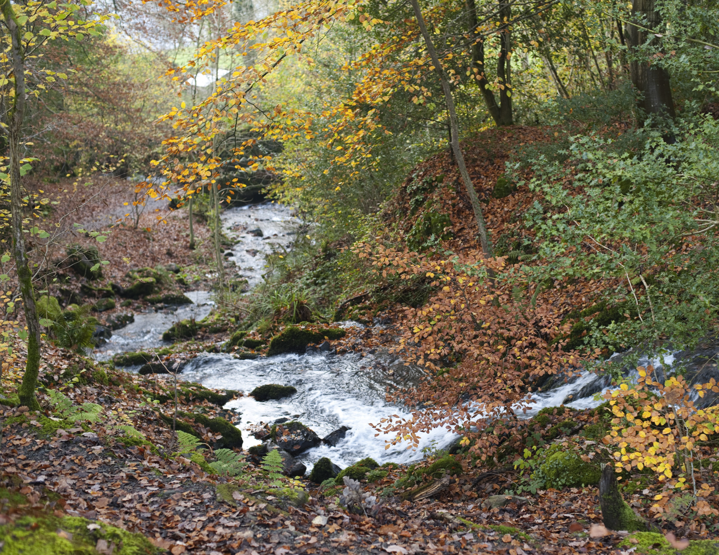
http://www.freeimageslive.co.uk/image/view/5175/_original
Notes:
International body teams up with Earth Day in bid to plant nearly eight billion trees by 2020
The UNFCCC has called on people to show their support for the signing of the Paris Agreement later this month by planting, sketching, photographing, or even hugging a tree.
The international body is seeking to highlight the signing of the landmark climate deal through a global social media campaign. It is making the unusual request alongside the organisers of Earth Day, an annual event which takes place on 22 April - a date which this year coincides with the signing ceremony for the Paris Agreement in New York.
RELATED ARTICLES
Papua New Guinea becomes first country to file offical national climate action plan
Christiana Figueres to step down from UN climate role in July
Two-thirds of people want legally-binding climate deal
Christiana Figueres: Why business matters at COP
Earth Day has chosen trees as its theme for 2016 in order to highlight their important role in maintaining climate stability.
The groups said they are asking people to participate in order to highlight to governments the high levels of public support for the global deal, which aims to limit temperature increases to well below 2C and deliver a net zero emission economy this century.
The new campaign is also hoping to make a practical difference to local environments by encouraging individuals, businesses, and governments to plant nearly eight billion extra trees by 2020.
Christiana Figueres, executive secretary of the UNFCCC, launched the campaign by hugging a Poro tree in her native Costa Rica.
She said planting, hugging or sketching a tree would be "an expression of solidarity, love and hope".
"The Paris Agreement, if fully implemented, offers a prospect of a far better world for billions of people," she said. "Conserving, restoring and extending the Earth's natural or nature-based infrastructure including forests will be a big part of its long term success and long term goal."
Over 100 countries have now said they intend to sign the Paris Agreement at the UN ceremony in New York later month, with India the latest major emitter to endorse the deal. The US, China and the EU have also already signalled they will sign up, meaning countries responsible for at least 61 per cent of all emissions have now pledged to sign the Agreement.
Given states have agreed the deal will enter into force 30 days after at least 55 countries, representing at least 55 per cent of global emissions, ratify it, onerecent analysis from former Marshall Islands adviser Michael Dobson indicated the Paris climate deal could yet enter into force this year - far earlier than many observers expected.
However, as the time taken for governments to ratify international agreements can often take years, the path to full ratification of the Treaty could stretch into 2017.

Slide 20
The Warwickshire Avon at Bidford

Slide 21
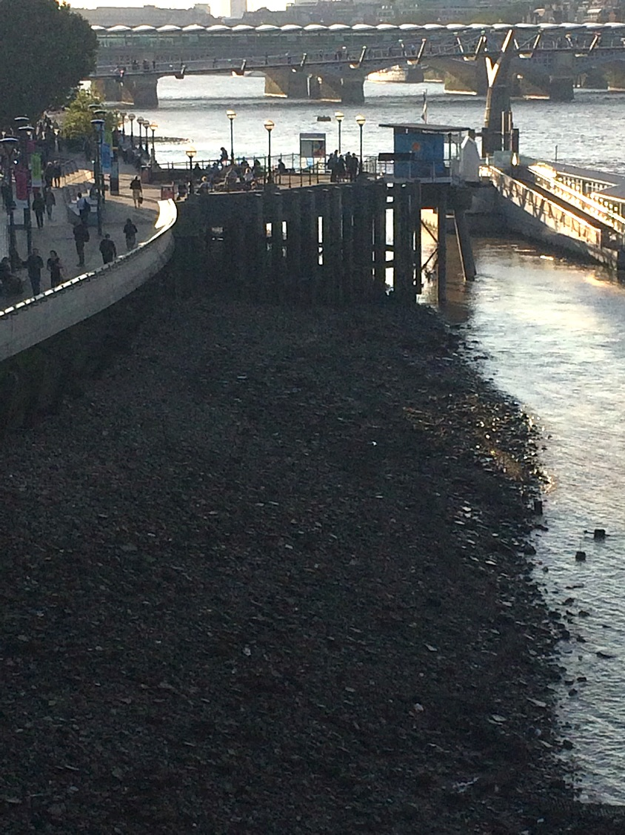
River bed sediment in the tidal Thames- gravel, sand and silt. Similar sediment, but without the pottery fragments, makes up the floodplain and river terraces on which central London sits

Slide 22
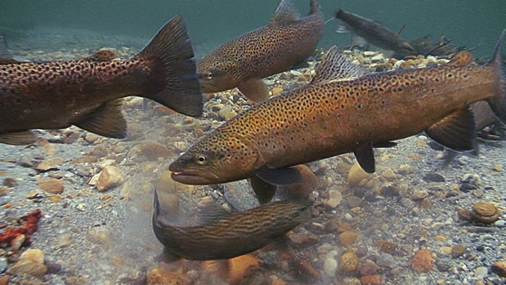
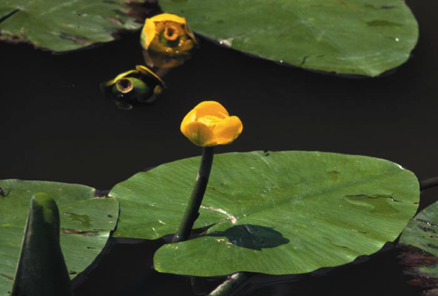
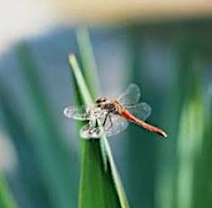
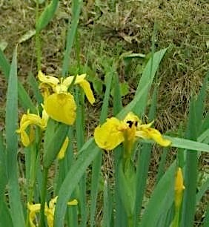
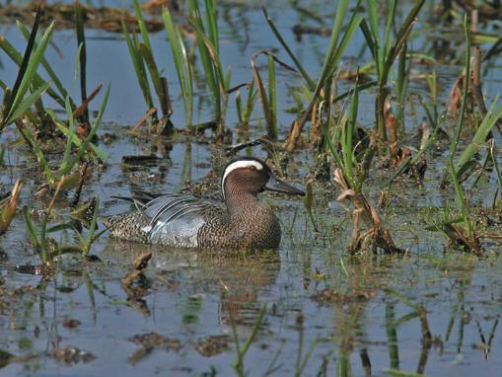

Slide 23
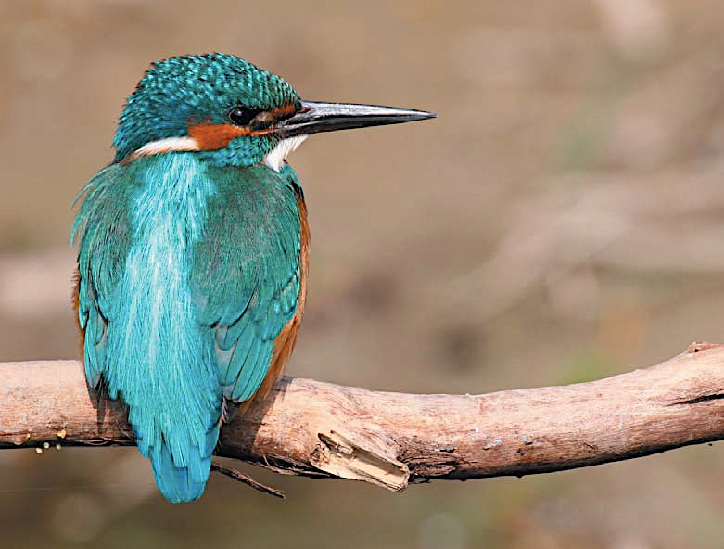

Slide 24
Beavers were a key part of river ecosystems for many centuries

Slide 25
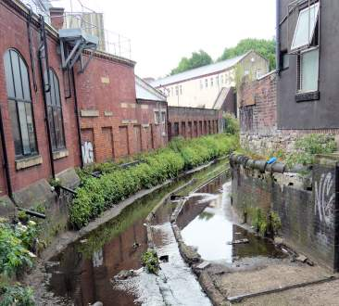

Slide 26
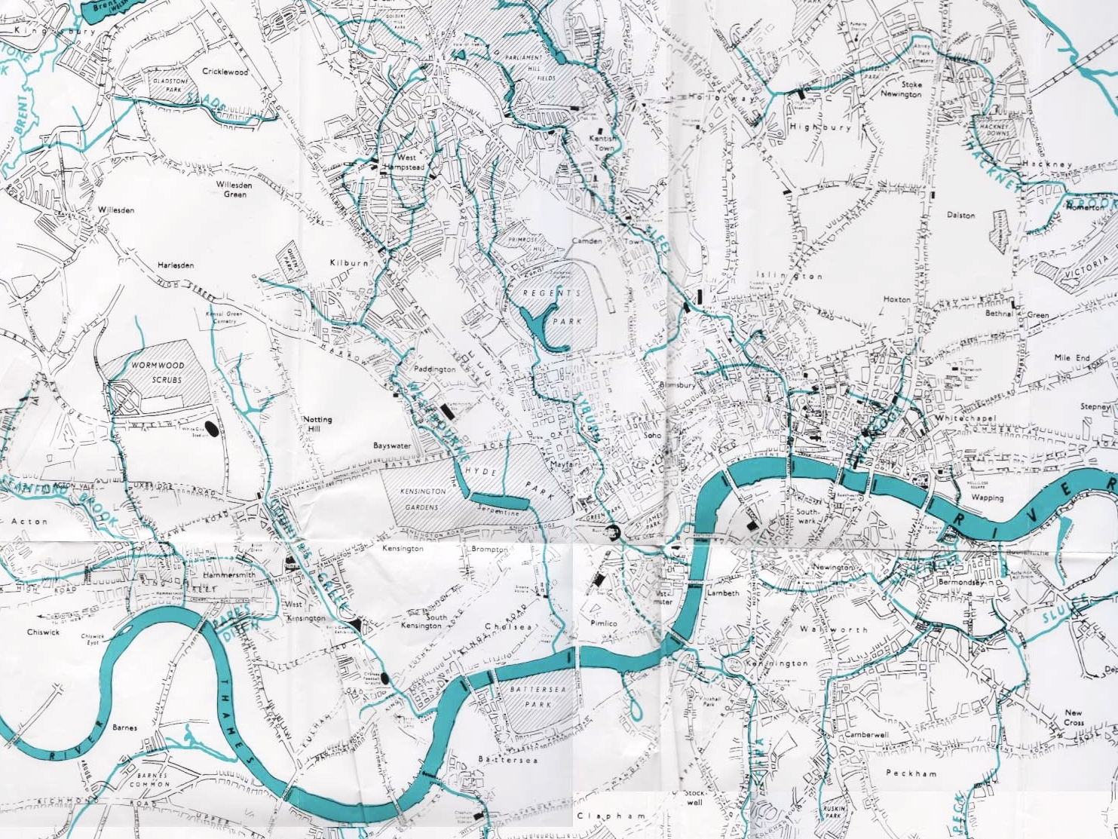
Fleet
Tyburn
Wallbrook
Westbourne
Counter’s Creek
Ravensbourne
Effra

Slide 27
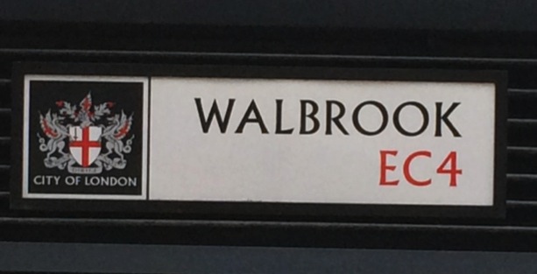
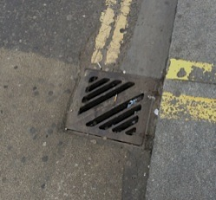
The ‘Lost Rivers of London’

Slide 30
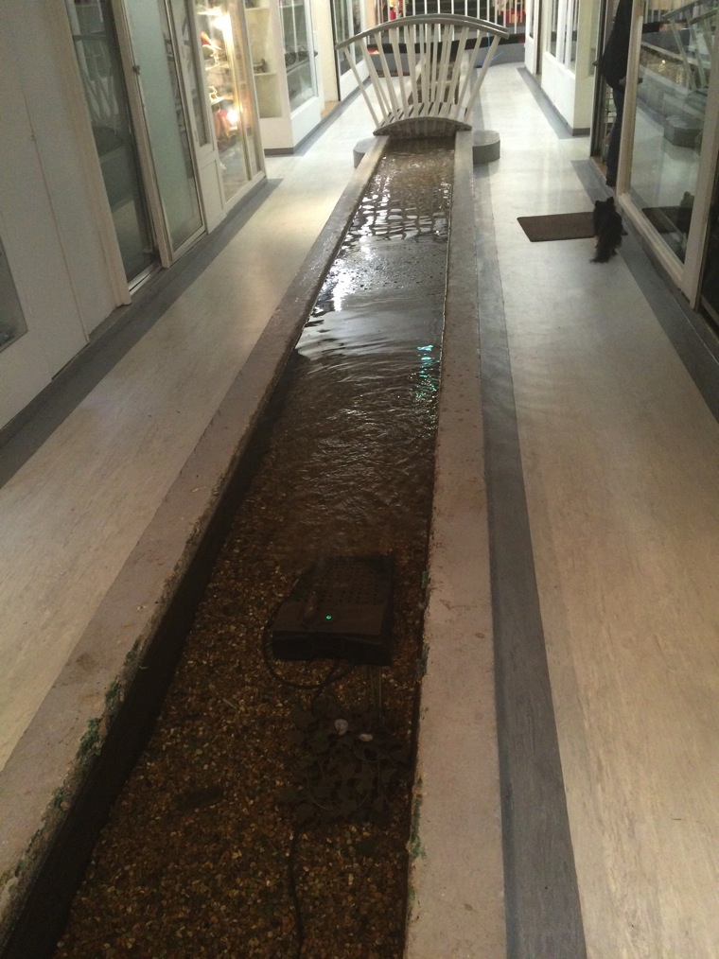
“The River still rises at Shepherd’s Well in Hampstead…. Over the years as these areas became built up the river was culverted but there is still one place that the clean and running water of the River Tyburn may be seen and that is in the basement of Gray’s Mews….”
(perhaps!)

Slide 31
Ecological damage to the Victorian Thames
…When the Thames went to the other extreme in 1840, and again ten years later, it shrank ‘to a mere brook’, so that ‘persons could walk across it’. It would not be an inviting stroll, no matter how much you could save in boat charges or bridge toll. You would have to walk through concentrated essence of sewage; and at every low tide the exposed mudbanks ‘swarmed with bright red worms . . . the boys called them blood-worms’….

Slide 32
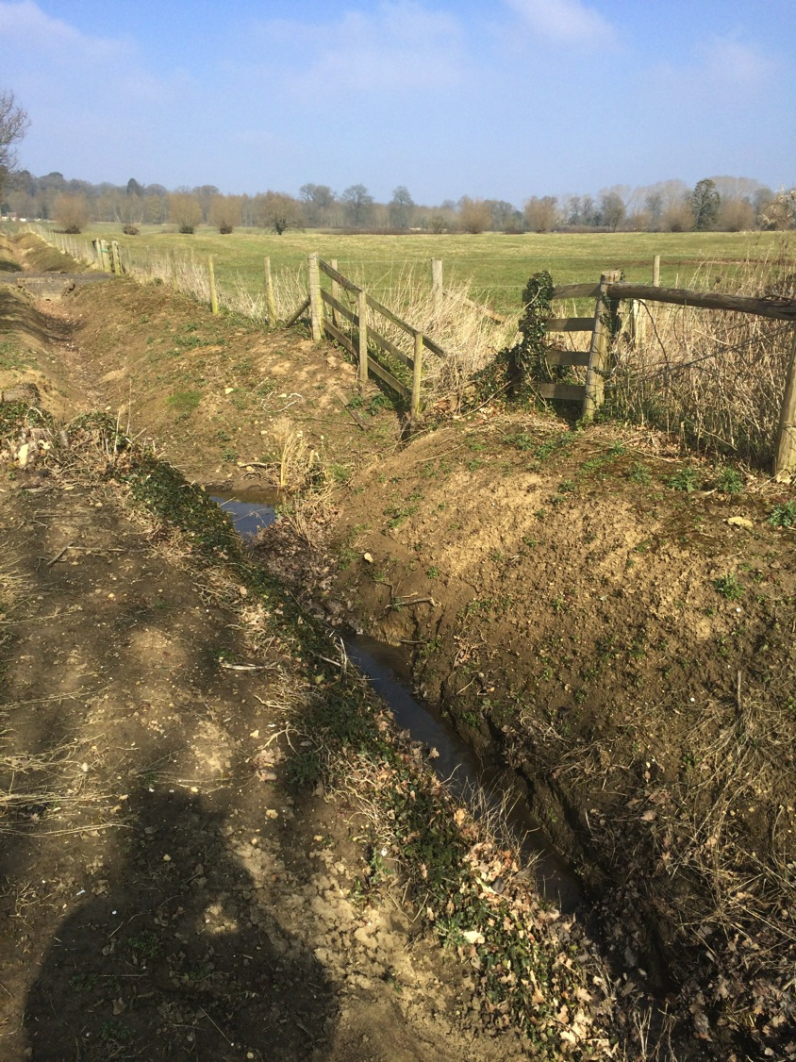
Rural channels are not immune from direct attempts at engineering, through dredging, ditching and culverting

Slide 33
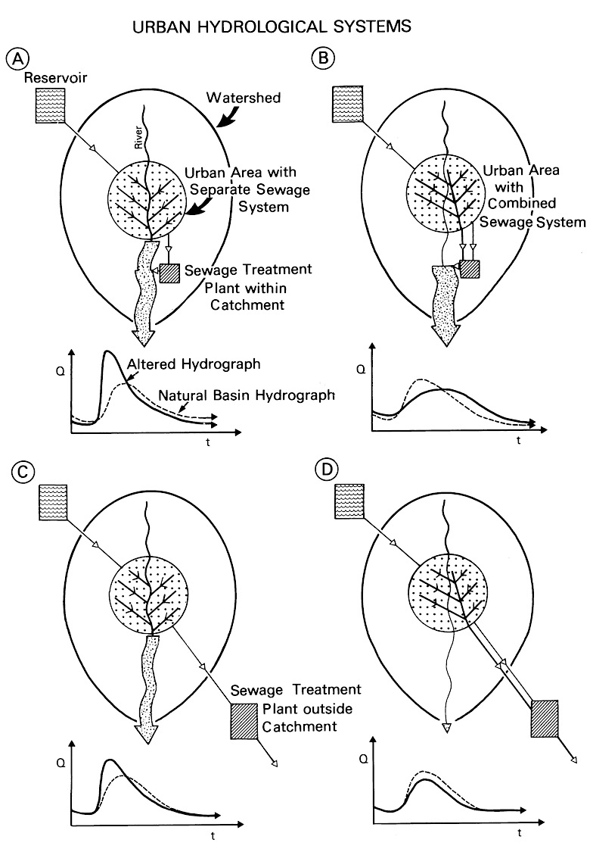
Urban hydrological systems
Typical change in flood flow for modern urban areas

Slide 34
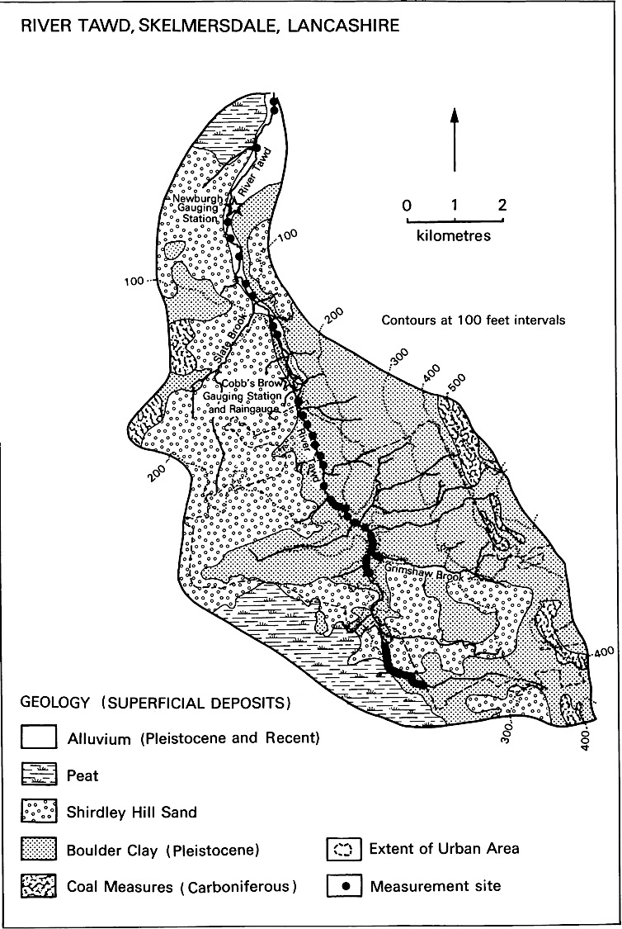
Skelmersdale New Town, built post- World War II in the catchment of the River Tawd, Lancashire

Slide 35
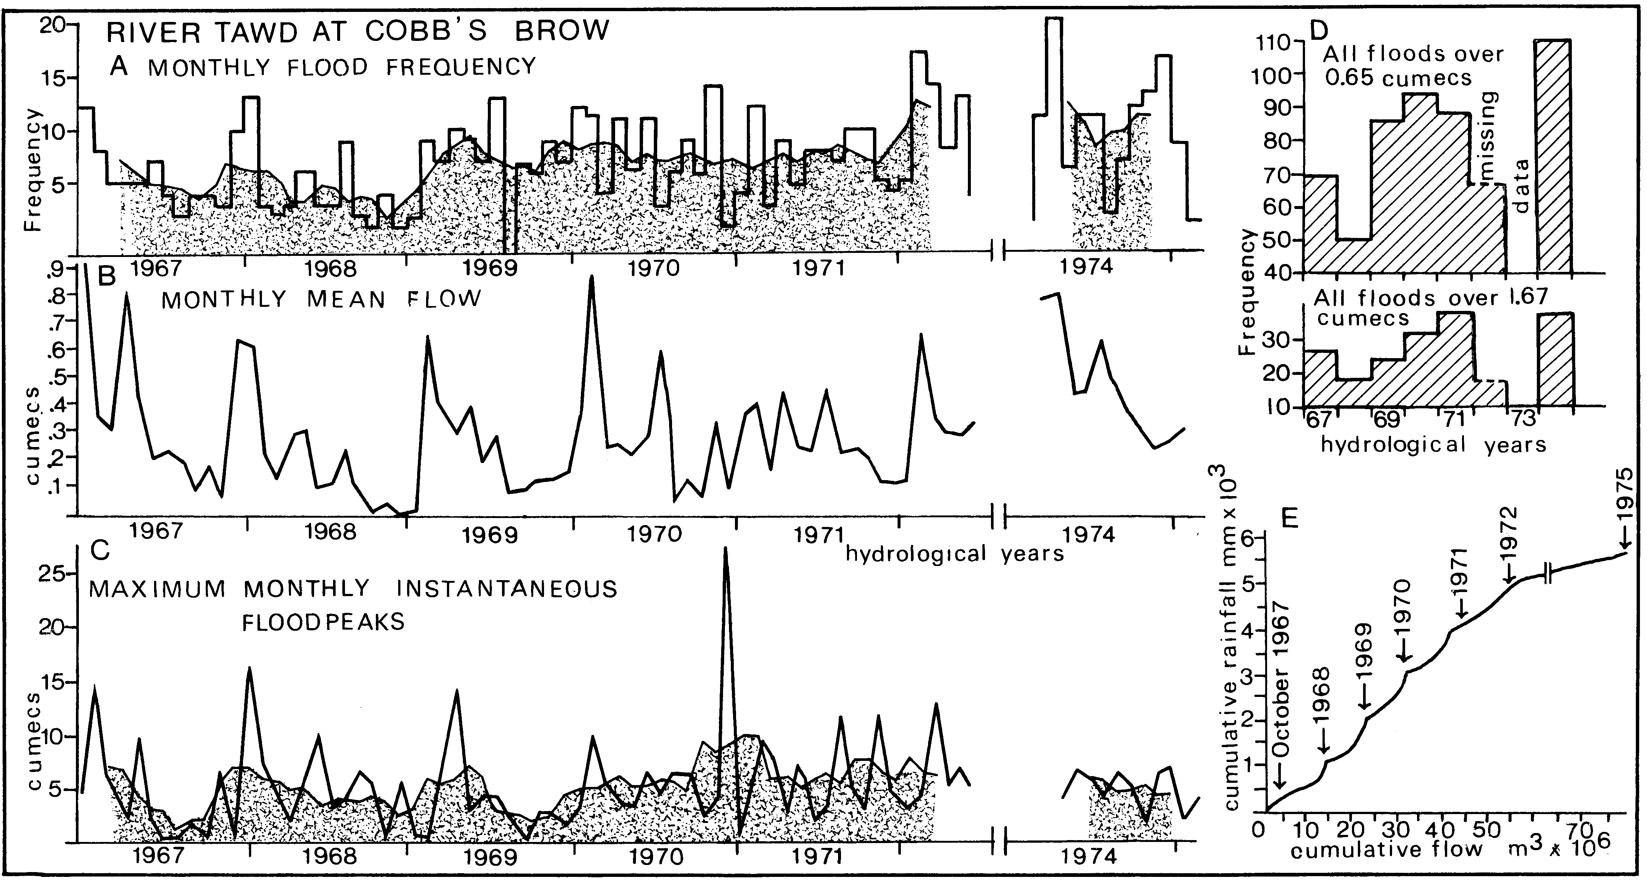
Flow changes may be difficult to detect, even if the data exists

Slide 36
Sometimes the river bank erosion is obvious

Slide 37
Rapid channel migration across the floodplain

Slide 38
Erosion in streams below Stevenage New Town

Slide 39
Rapid bankside erosion exposing tree roots in suburban Leicester

Slide 40
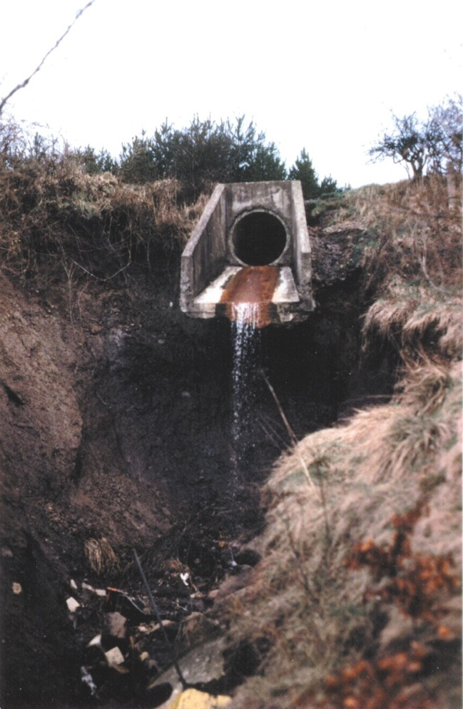
‘Hanging’ tributaries, this, one in Cumbernauld, Scotland, where the main urbanised channel of the Luggie Water has deepened leaving side channels hanging above Note shopping trolley…

Slide 41
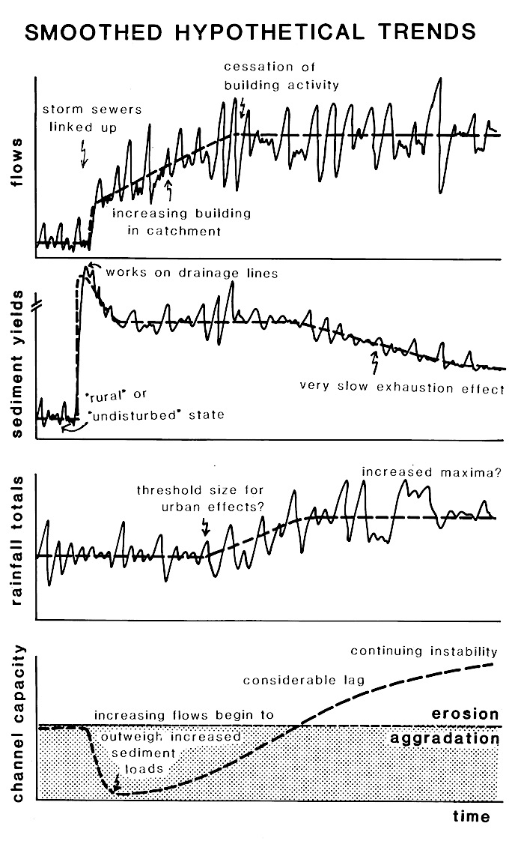
Sewers linked to channel
Flood flows increase
Sediment coming into the channel increases then falls
Rainfall totals increase somewhat
River silts up, then erodes

Slide 42
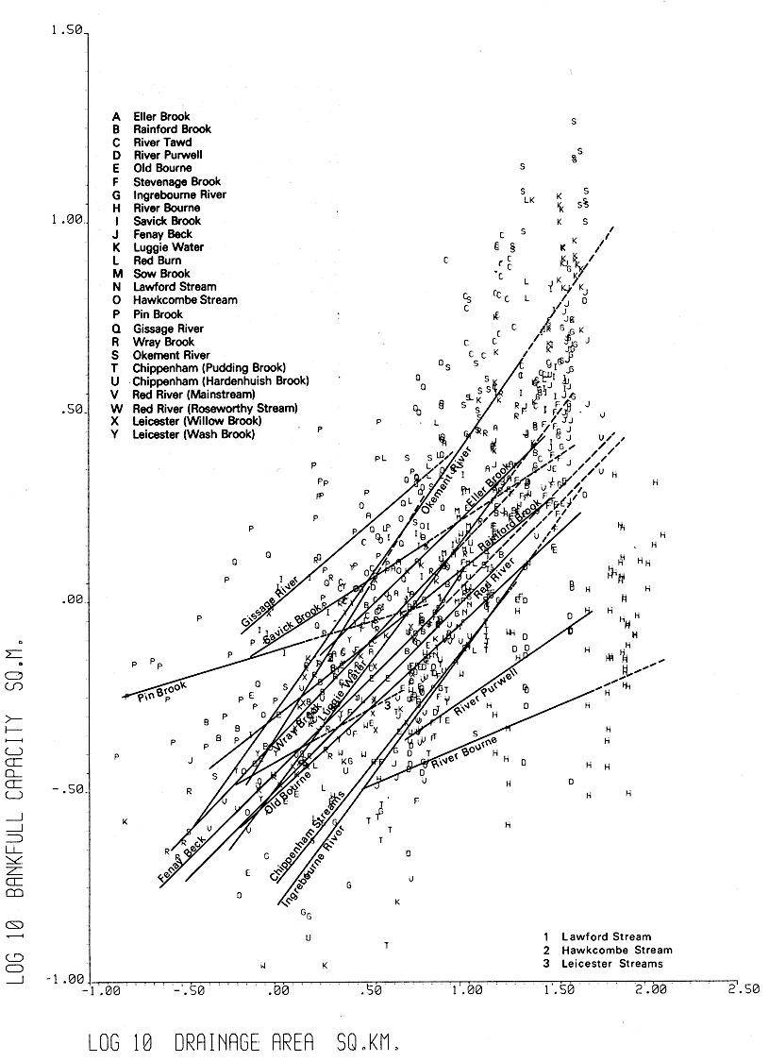
Channel cross sectional area
Linear relationships for many different river channels in England and Scotland
Drainage area of the catchment

Slide 43
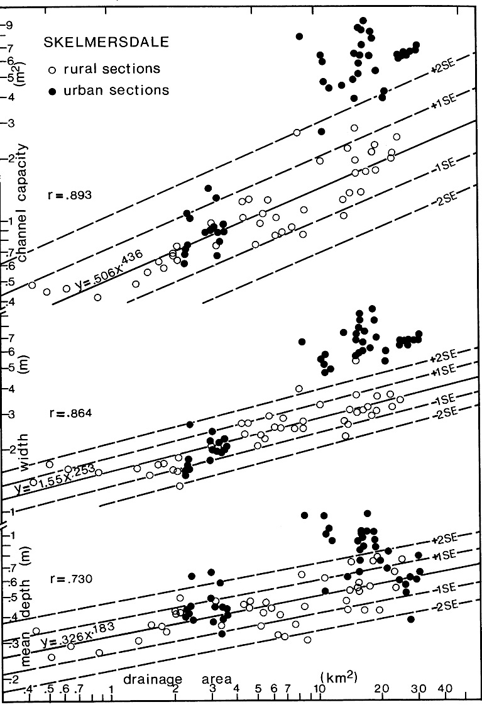
An ergodic hypothesis – a space for time substitution
Urban channels are bigger than their rural equivalents
River capacity (cross sectional area) generally increases with the size of the catchment, in a logarithmic pattern
Width and depth of a channel also increase with increasing size of the catchment
Open circles are rural channels, black dots are urban

Slide 44
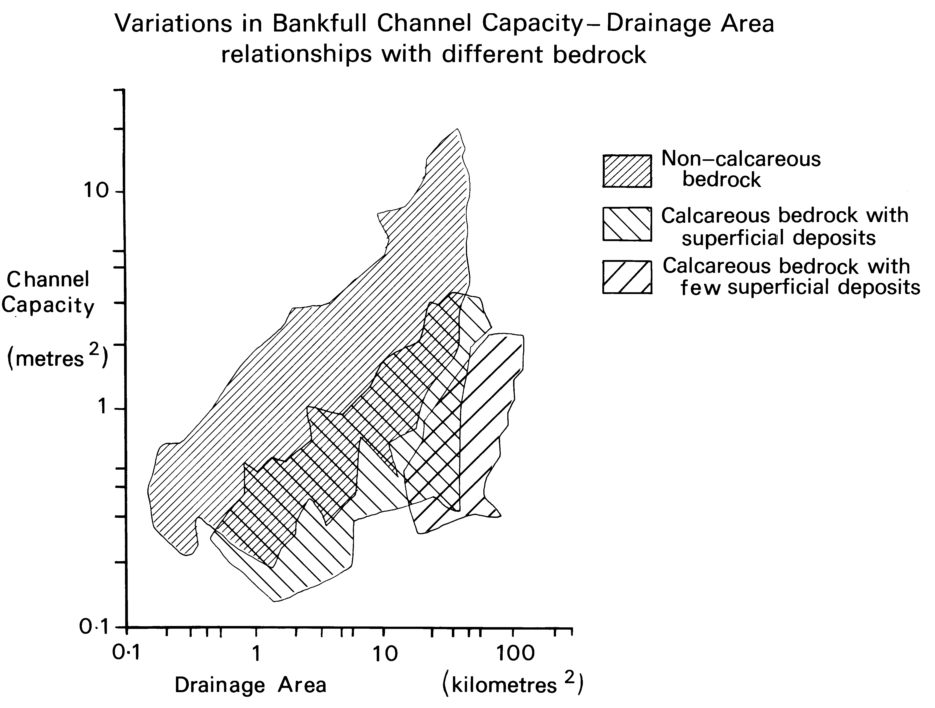
River channels on permeable bedrock are smaller than those on impermeable rocks

Slide 45
The multivariate model for non-urban (‘rural’) channel sizes
C = -3.298 + 0.565 DA + 0.458 DD + 1.456 INTEN + 0.922 GEOL - 0.304 WRAP + 0.557 COMPAC
Where C is channel cross sectional area
DA is drainage area of the catchment
DD is drainage density or the river network
INTEN is a measure of rainfall intensity in the area
GEOL is a geological index relating to permeability of the catchment
WRAP is the ability of the soil to accept winter rainfall
COMPAC is a measure of the circularity of the catchment
The model has good explanatory powers, with r=0.851, ie explaining 73% of the variability in channel cross sectional area

Slide 46
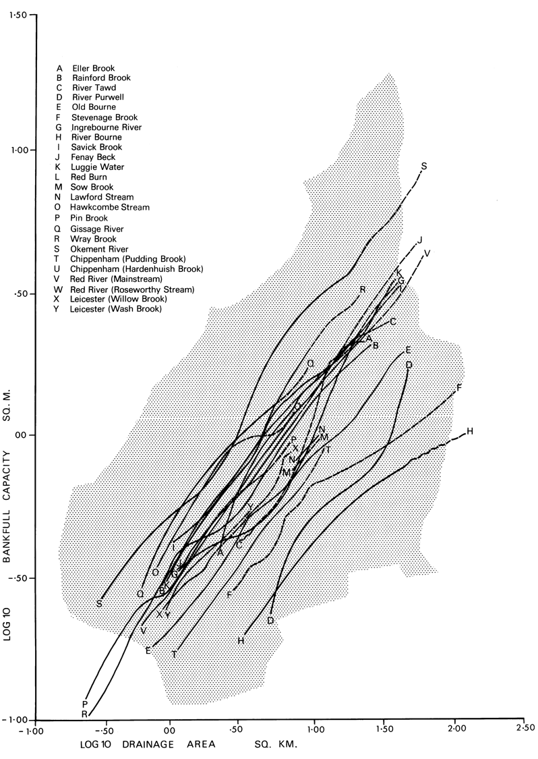
Adding in more variables, produces better estimates of rural channel sizes
Channel cross sectional area
Drainage area of the catchment

Slide 47
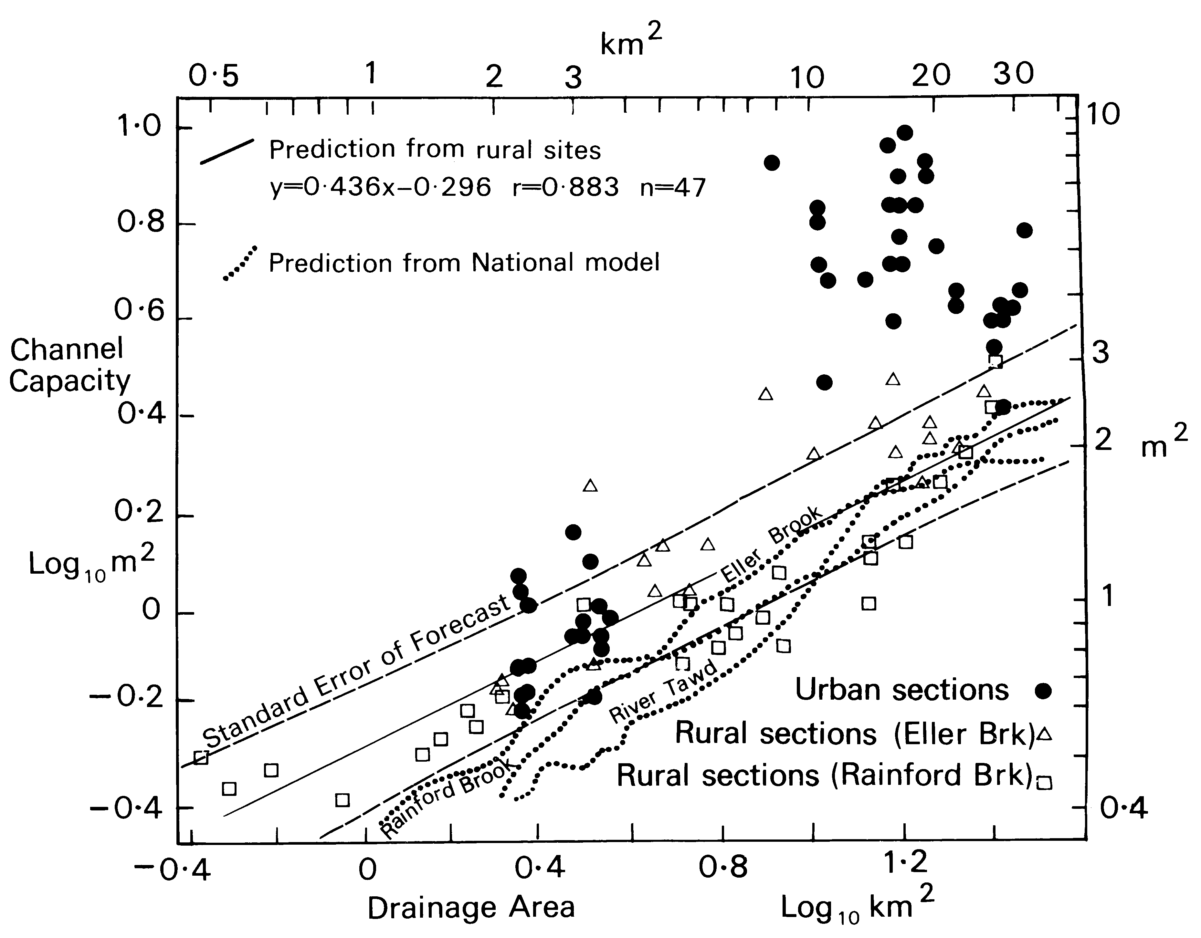
Dotted line is the multivariate estimate of rural channel size

Slide 48
Distance of observed size in comparison with rural equivalent shows amount of enlargement

Slide 49
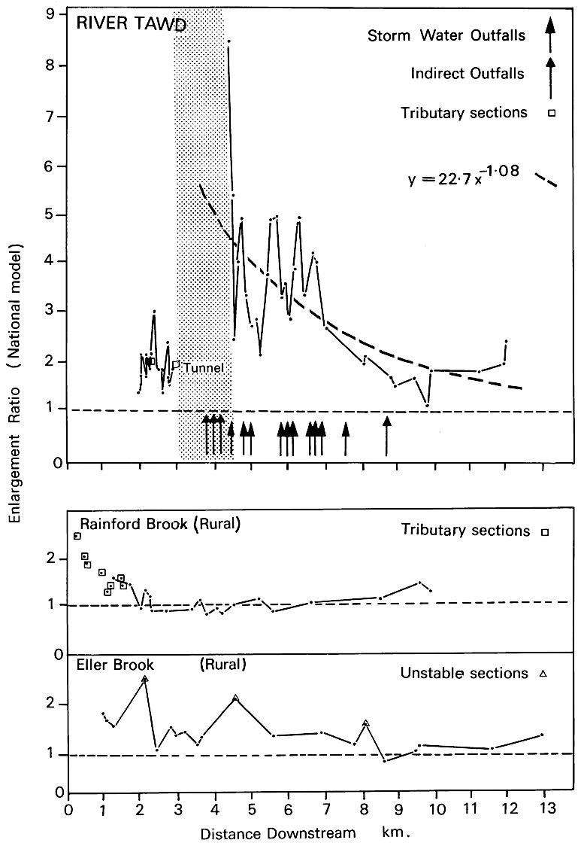
The River Tawd has been very much enlarged by erosion below Skelmersdale New Town, within about twenty years
Just below the town centre, the river channel is eight times the size it was before the town was built
Sewer outfalls

Slide 50
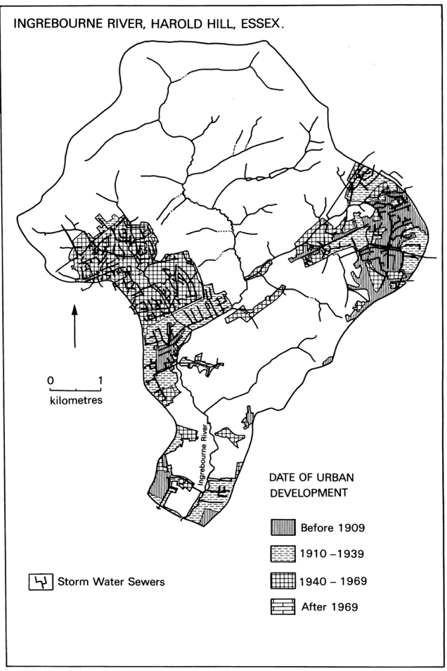
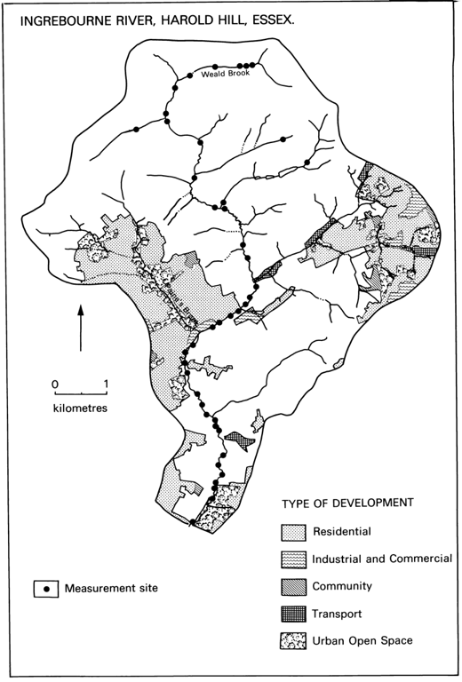
Ingrebourne River, Harold Hill

Slide 51
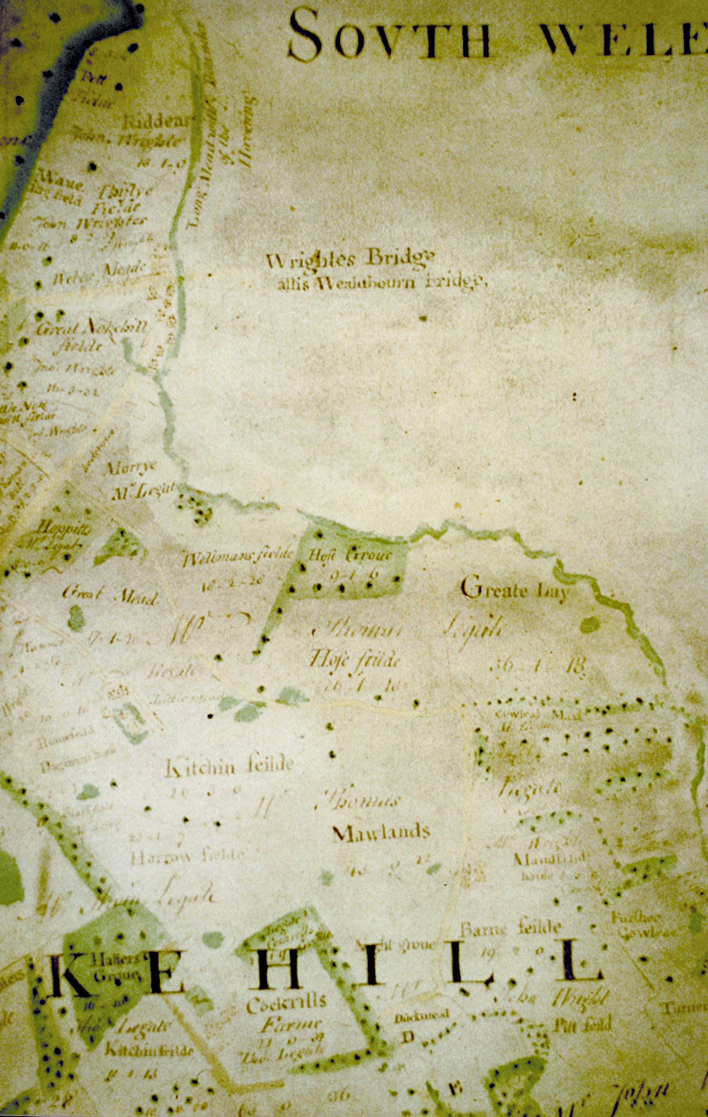
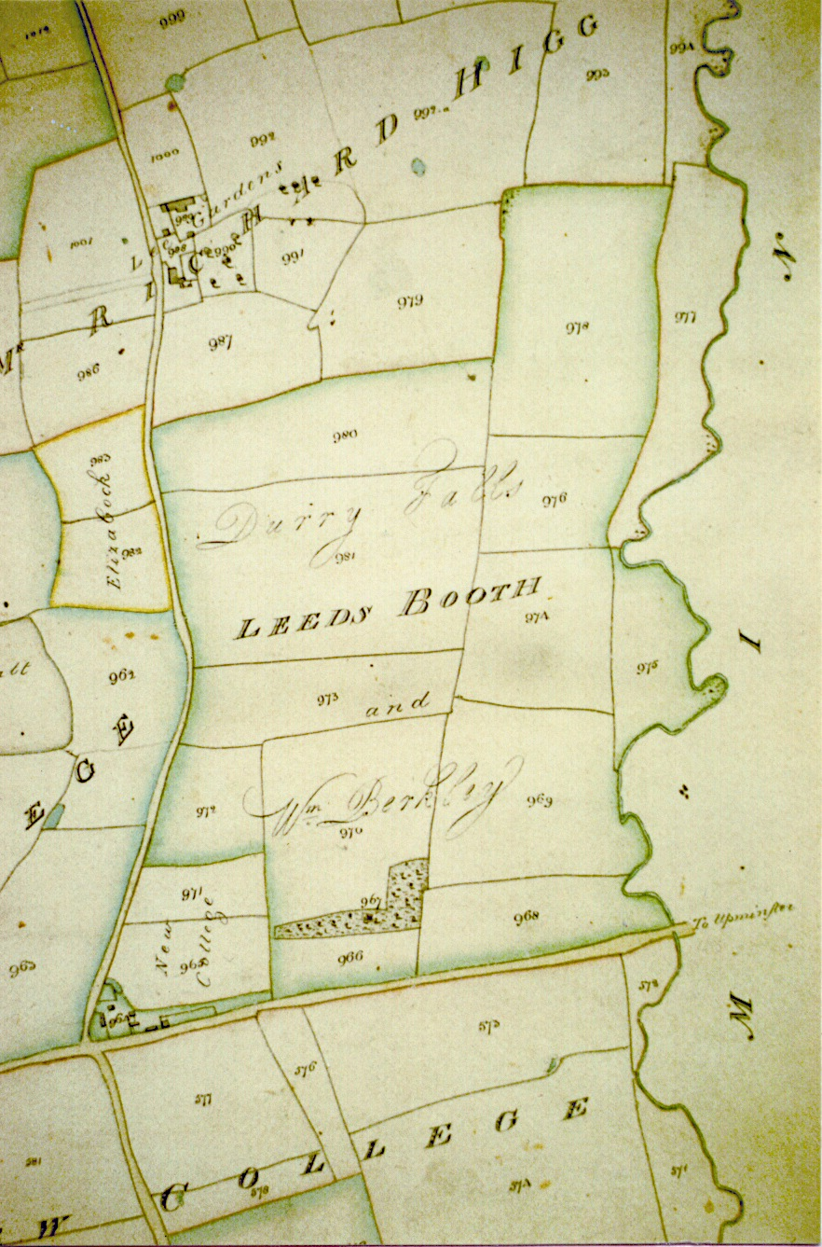
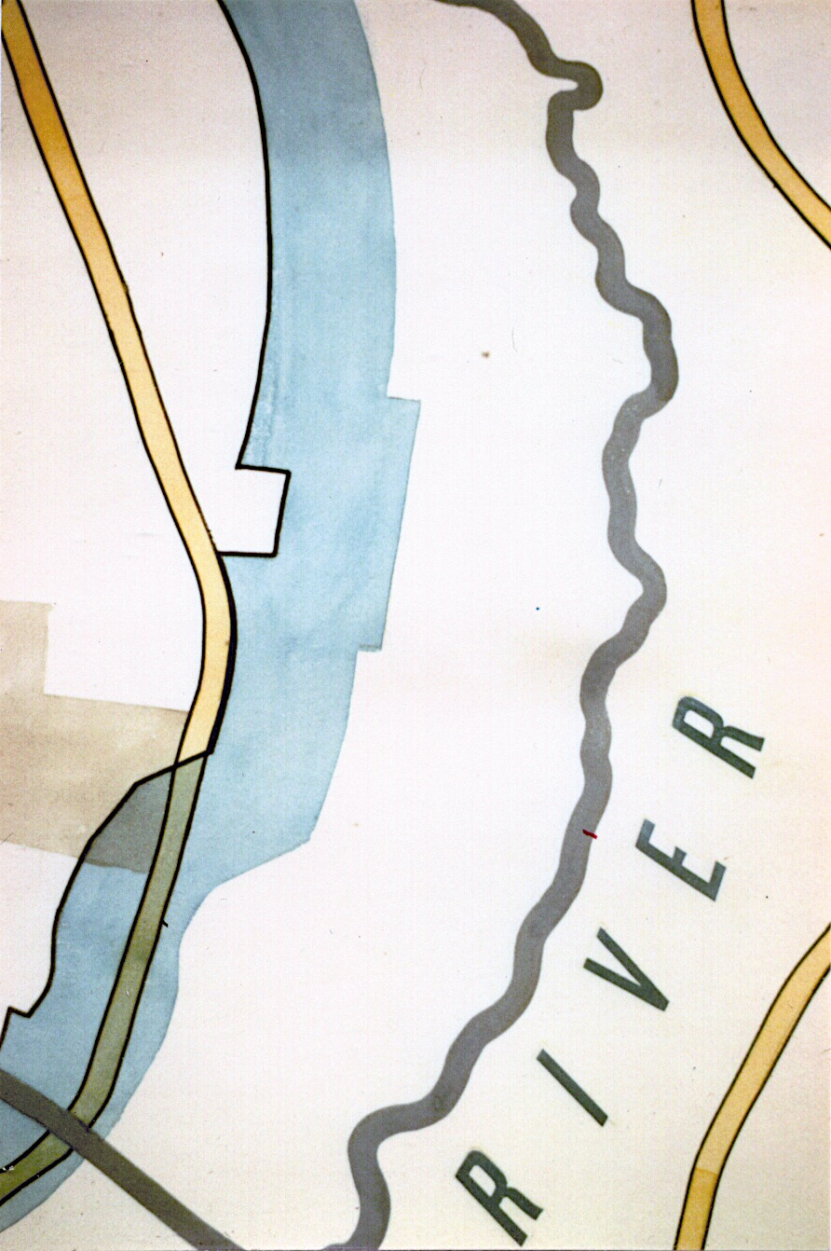
Historic Maps of the River Ingrebourne

Slide 52
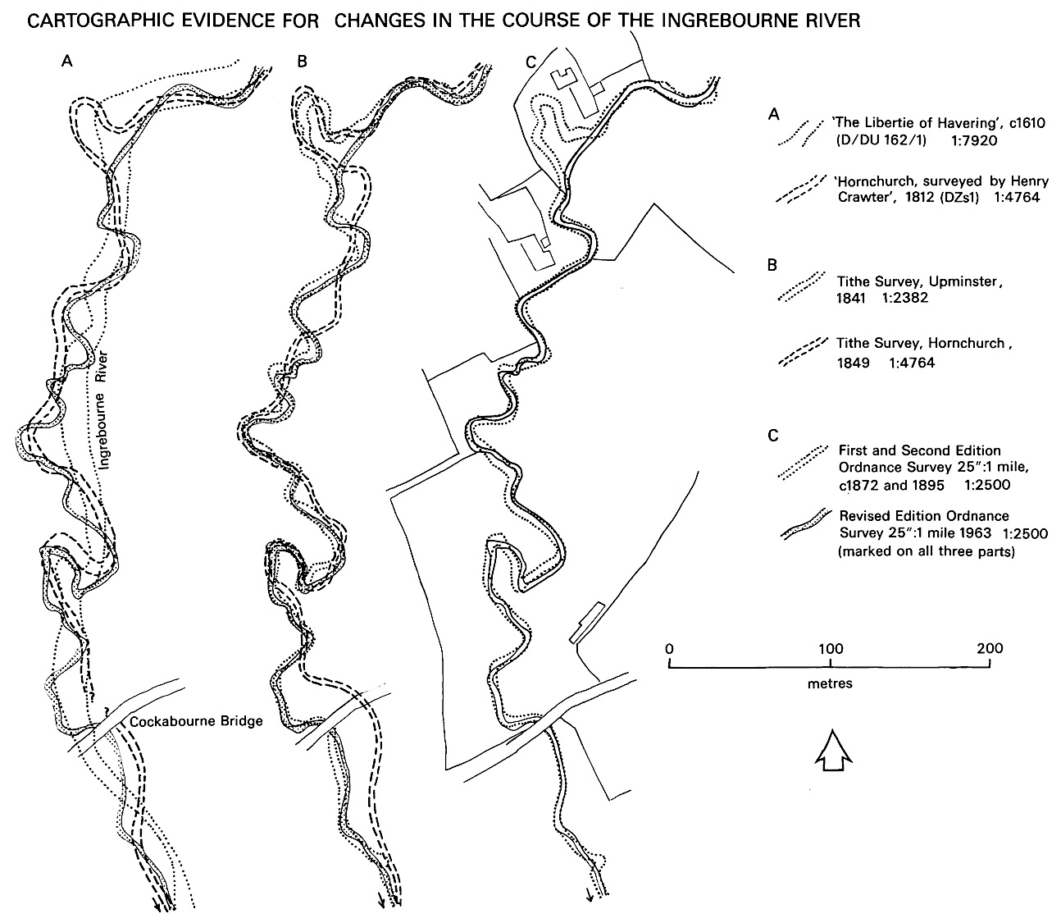
River has straightened, or been straightened a little between 1610 and 1963

Slide 53
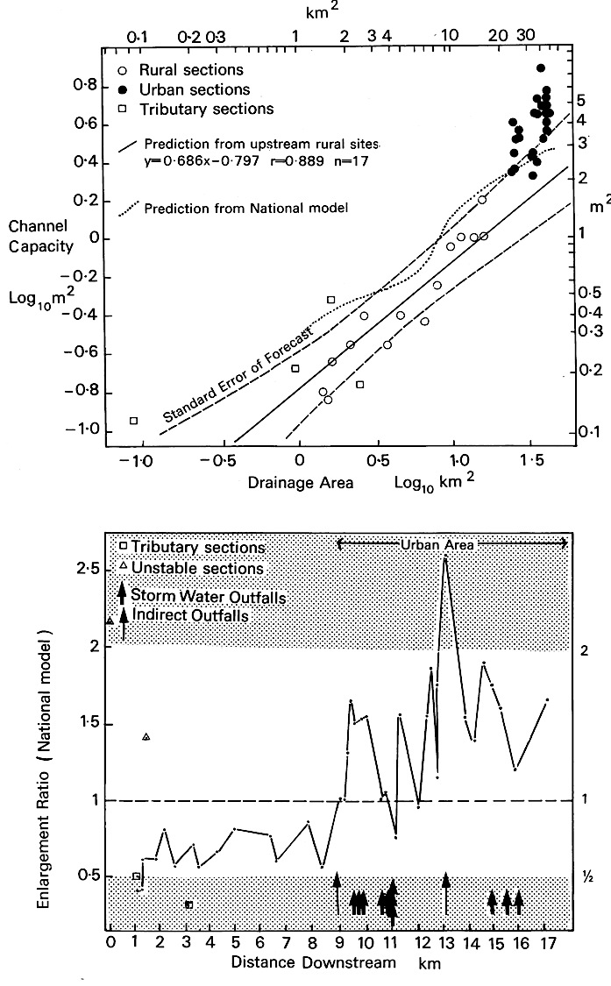
Older settlement at Harold Hill, leading to more modest amounts of erosion in the river channel
Below Harold Hill, the Ingrebourne is about 50 to 100% greater in cross section

Slide 54
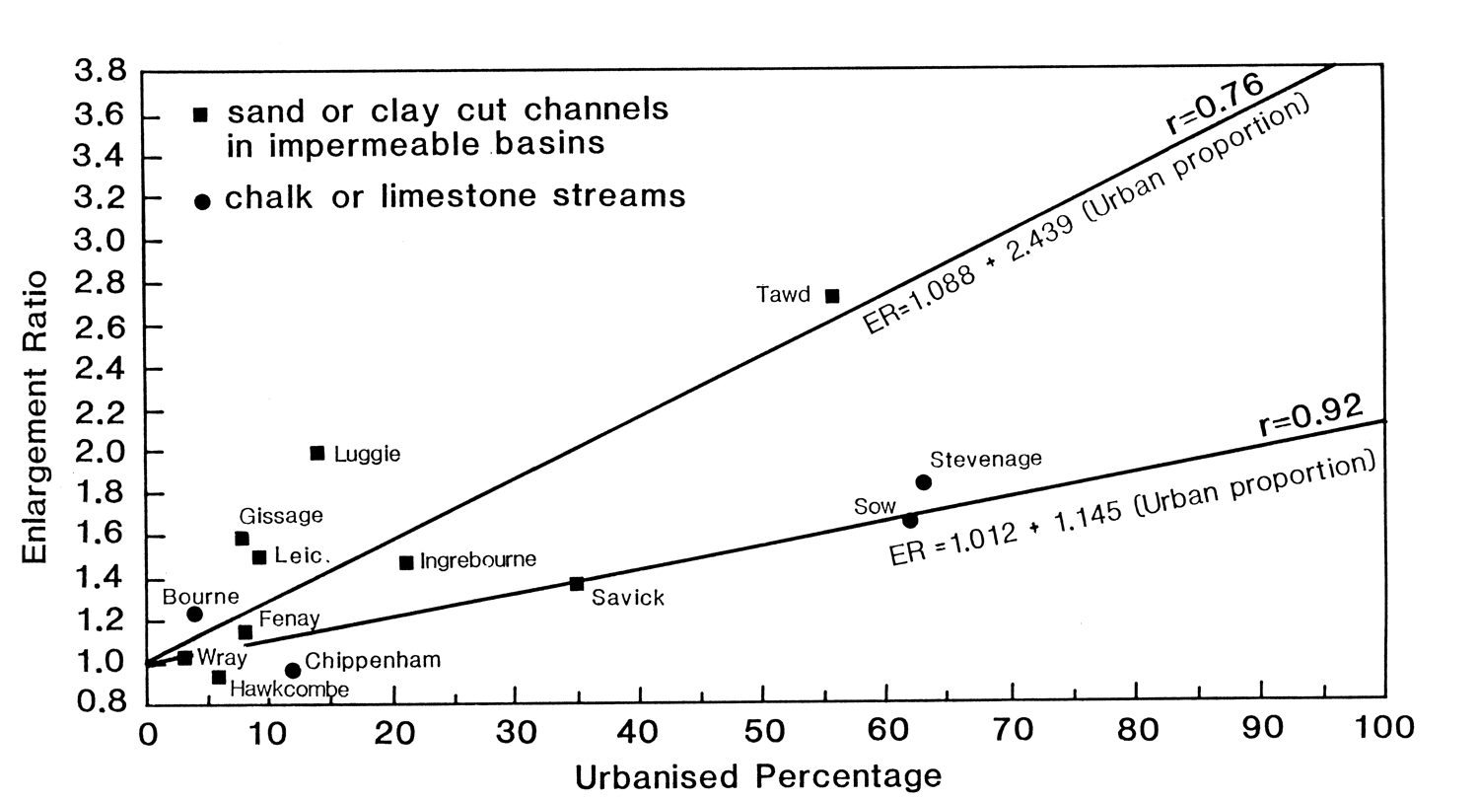
More urbanisation usually leads to greater erosion

Slide 56
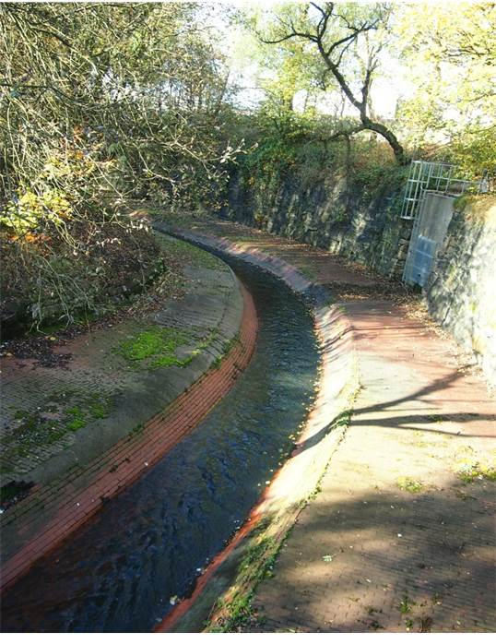
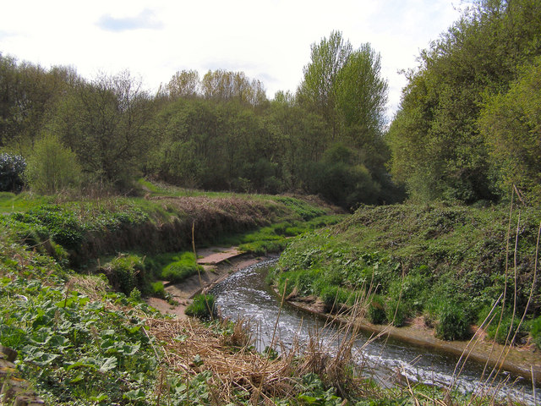
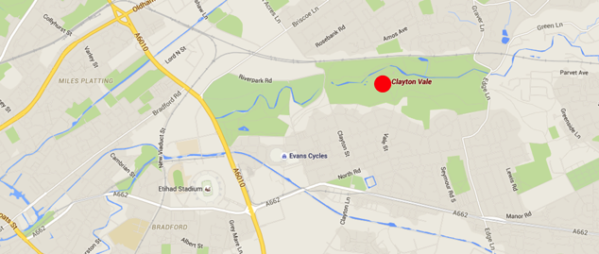
Medlock River, Manchester, unrestored (Sian de Bell, University of Leeds)

Slide 57
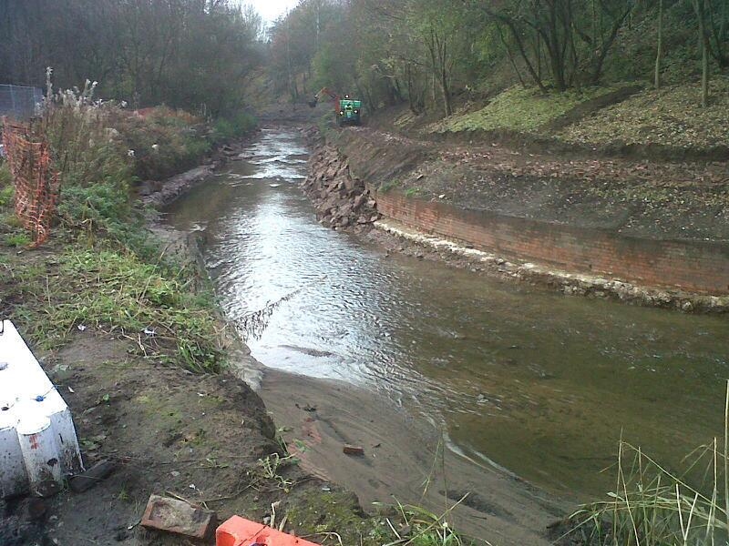
Medlock River, Manchester, the restoration process (Sian de Bell)

Slide 58
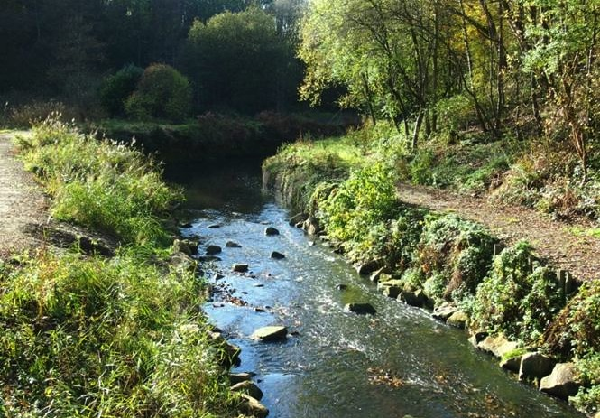
Medlock River, Manchester, restored section (Sian de Bell)

Slide 59
Rewilding Britain, the River Wandle
Notes:
In 1805, the river Wandle, which flows through south London, was described as “the hardest worked river for its size in the world.” It was an urban sewer, poisoned by bleach and dyes from the 90 mills along its length. It was later straightened and canalised to speed water away from homes and businesses.
Find out more about the Wandle TrustVisit website
But in this urban rewilding project, the Wandle Trust is restoring the river to its former glory as a beautiful chalk stream. Almost all the world’s chalk streams are found in England. They are rare and threatened habitats.
The Trust has been putting back features that harboured life in the river, which had been pulled out by overzealous engineers. It runs community cleanups every month, enlisting local people to remove the junk dumped in the water. It has been creating passages through the weirs to enable eels to migrate upstream. Children in local schools have been raising trout to restock the river.
The children’s involvement has encouraged them to see the Wandle as part of their landscape and to start playing in it once more. The project is rewilding children as well as the natural world. And it provides a valuable wildlife corridor right into the heart of the city.

Slide 60
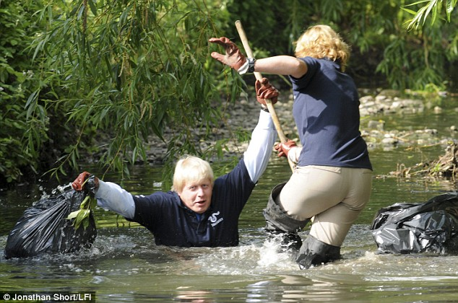
Who IS this river restoration specialist?
Notes:
River Quaggy

Slide 61
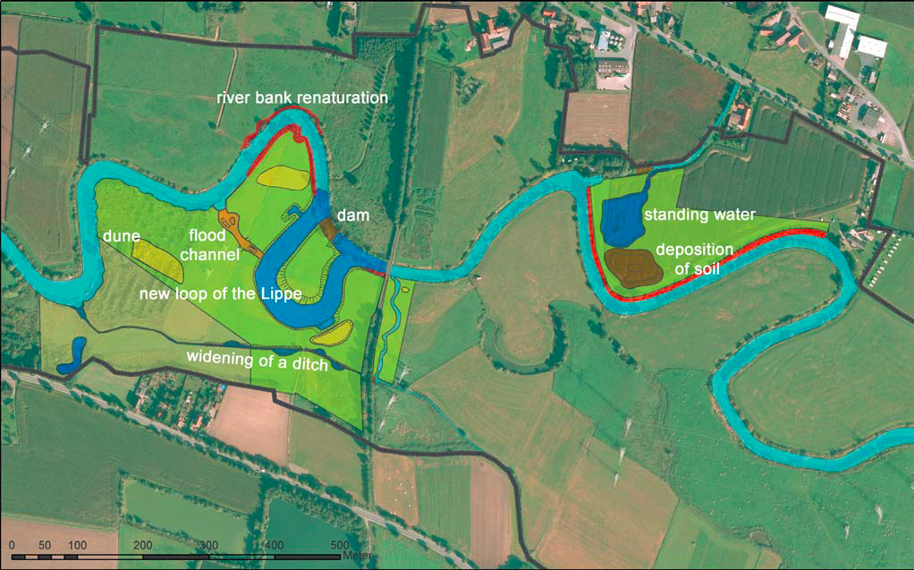
The biggest measure implemented in block D, south-east of Ahlen-Dolberg is the excavation of a new Lippe river loop close to a cycle track connecting Dolberg and Haaren.

Slide 65
Removing wiers to enable fish to pass upstream, and gravel to pass downstream

Slide 66
Wooden groynes to slow water and increase the range of habitats in short length of a very constrained channel

Slide 69
The scientist’s advisory role | Which Restaurant shall we go to? | What should we do about restoring rivers?
Pure Scientist | Here’s a set of guidelines on diet | Here is a set of reports about the state of our rivers.
Science Arbiter | Feel free to ask me specific questions – for example how far is the nearest Thai? | What do you need to know about rivers in order to decide what to do to ‘restore’ them, if anything?
Issue Advocate | You will really like Italian food – go to Giovanni’s | You should increase expenditure on daylighting and re-modelling channelised rivers, and give them more space to meander
Honest Broker of Policy Alternatives | Here is information on the price, distance and menu of all the restaurants around here | Here’s an analysis of human impacts on river channels, and the relative hydrological, social and economic advantages of different restoration actions or none. You choose.
Roger Pielke Jr, (2007) The Honest Broker

