Slide 1
Serving the Capital
Gresham Lecture
‘Saving Londoner’s Lives’
7th March 2011

Slide 2
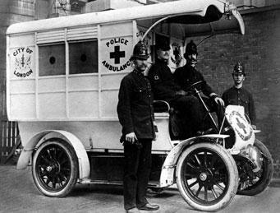

Slide 3
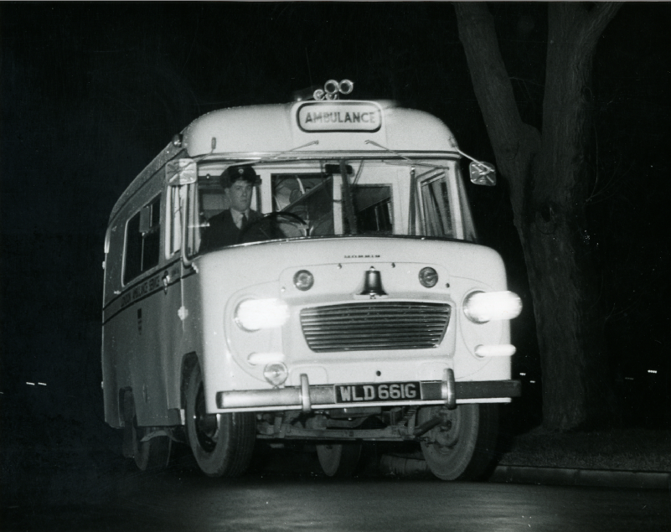

Slide 4
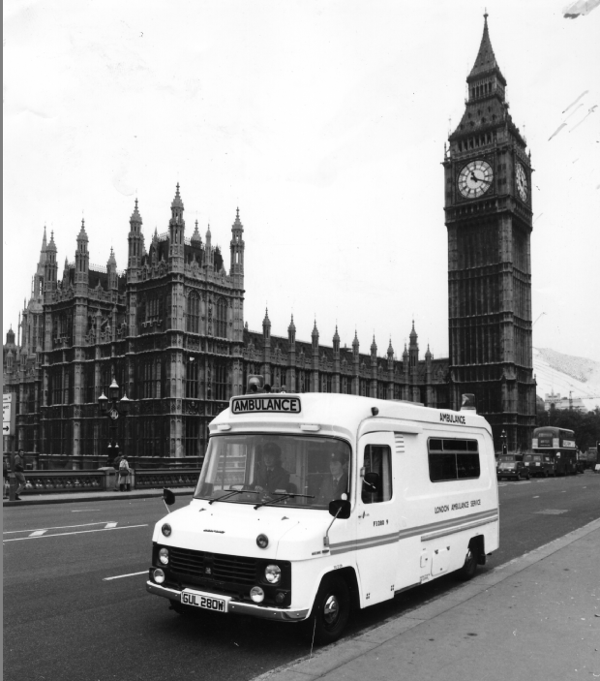

Slide 5
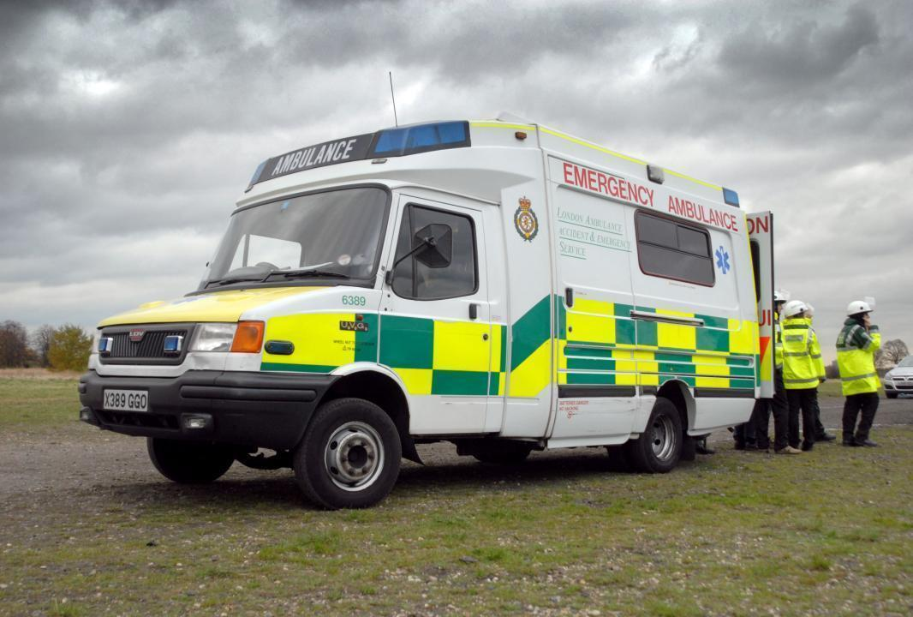

Slide 6
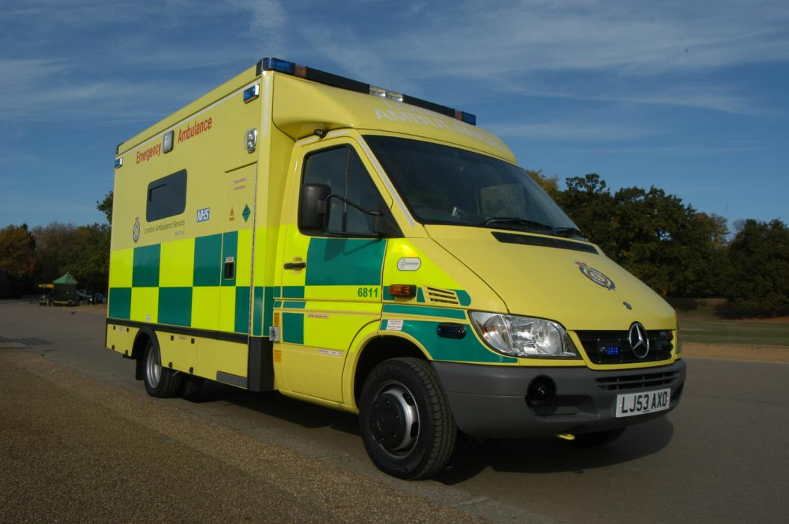

Slide 8
About London
‘These people, and this city, deserve the very best. The inhabitants of a world-class city should not have to settle for anything less than world-class healthcare’
Lord Ara Darzi
620 square miles
Population of over 7.5 million
Changing population
Notes:
London is a world leader in many respects (finance, culture, sport)
The London Ambulance Service plays a key role in ensuring our population has access to world-class healthcare
We have a diverse population, often with specific health needs (refugee and new migrants), access issues and different expectations of the health system (eg. Expectant mothers, polish ambulance service). Meeting these needs is a challenge for us.

Slide 9
About us
Busiest ambulance service in the UK
Only pan-London NHS trust
1.5 million 999 calls each year
1million responses each year
750,000 patients taken to hospital
5,000 staff and nearly 1,000 vehicles
Annual increase in demand of 60,000 more 999 calls
£282m budget
Notes:
A quarter of all ambulance calls in England & Wales
We provide care that is free at the point of delivery

Slide 10
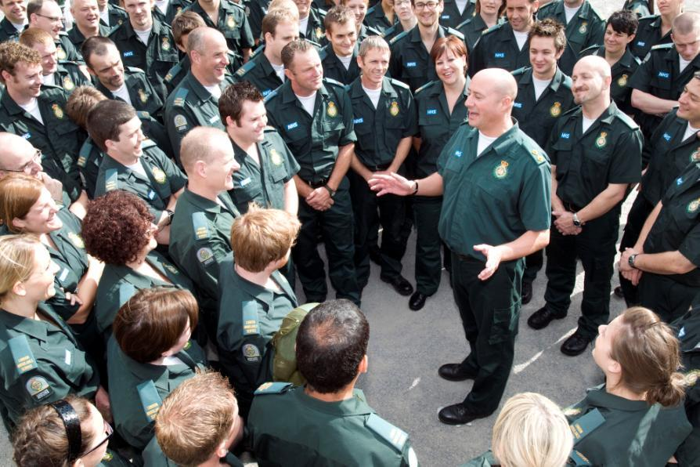

Slide 11
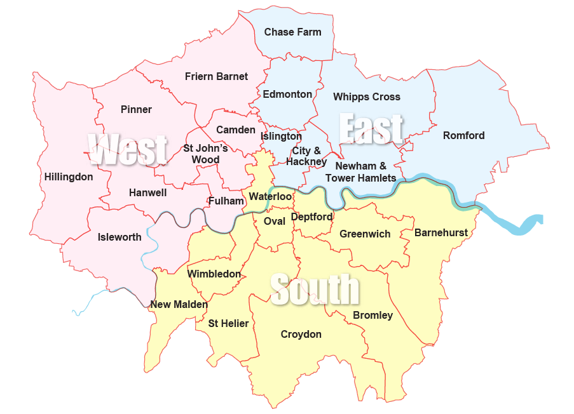

Slide 12
Our patients
Critically ill
Stroke, trauma, heart attacks, cardiac arrest
Urgent
Falls, non-life threatening illness and injury, long-term conditions
Non-emergency transport
Patients who need support in attending
routine healthcare appointments

Slide 13
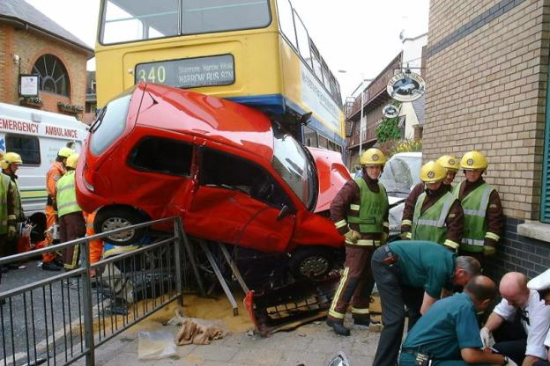

Slide 14
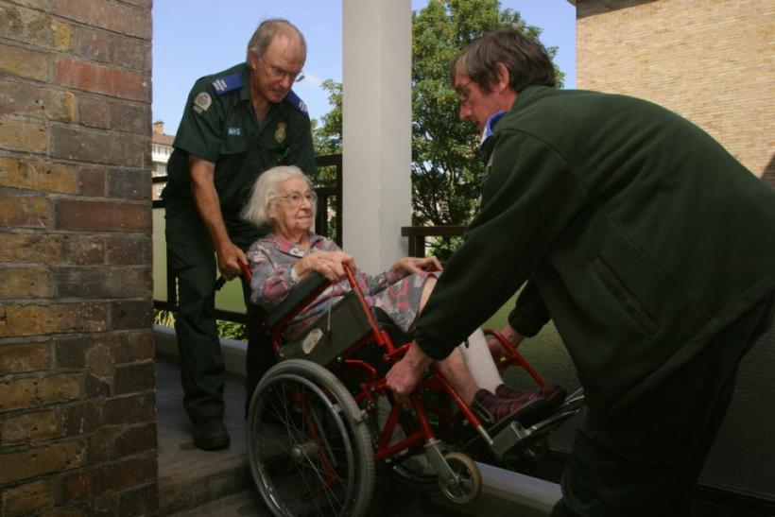

Slide 15
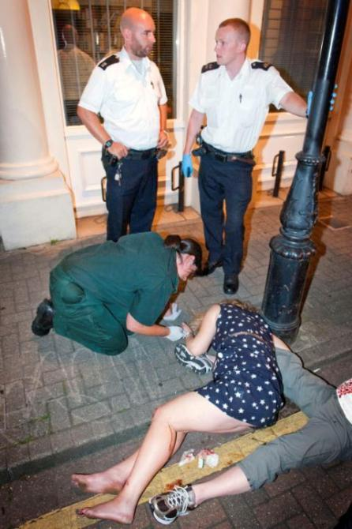

Slide 16
Our Vision
A world-class ambulance service for London that meets the needs of the public and all our
patients, with staff who are well trained,
caring, enthusiastic and proud of the job they
do.

Slide 17
Our priorities
To deliver a timely ambulance response to 999 callers
To develop our service so that patients get better and more appropriate care
To improve patient care without costing more
Notes:
Timely response
Londoners tell us that they want us to arrive quickly
Medical evidence shows that, in the most serious cases, it does make a difference
And currently our key performance target is a time-based measure
Developing our care
Our patients need different levels of care – some need to be stabilised and taken to hospital quickly; others need some form of medical help but not at hospital. More appropriate to go to a walk-in centre, or be referred to GP. Or prescribed medication at home. Some just need advice over the phone.
Our priority is to ensure all our patients get the care that is right for their needs.
Cost
Current financial climate means we, like other NHS organisations, will need to provide better care for less money.
Foundation trust status
We feel we will be in a better position to deliver on these priorities as an NHS foundation trust.
Currently in the process of applying to be an FT.

Slide 18
A timely response to patients
Government-set targets to reach:
75 per cent of life-threatening (Category A) calls within eight minutes
95 per cent of serious but not life-threatening calls (Category B) within 19 minutes
Category C (not serious or life threatening) – local agreement

Slide 19
Types of Calls
Emergency
  Red (Life Threatening)
  Amber (Possibly Life threatening)
  Green (Non-life threatening)
Urgent (Within 3 hours)
Non – Urgent (Pre-booked)

Slide 20
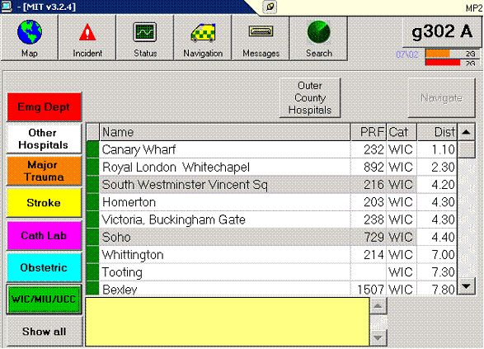
Mobile data terminal (MDT) destination screen

Slide 21
Emergency Call Categorisation
1.5 million 999 calls received
Prioritised by Emergency Medical Dispatchers using
Priority Dispatch Corporation’s Triage System
Current development of bespoke Computer Aided Dispatch ‘Command Point’

Slide 22
Dispatch
Emergency Operations Centre
(& Incident Control room)
Urgent Operations Centre
Clinical Telephone Advice

Slide 23
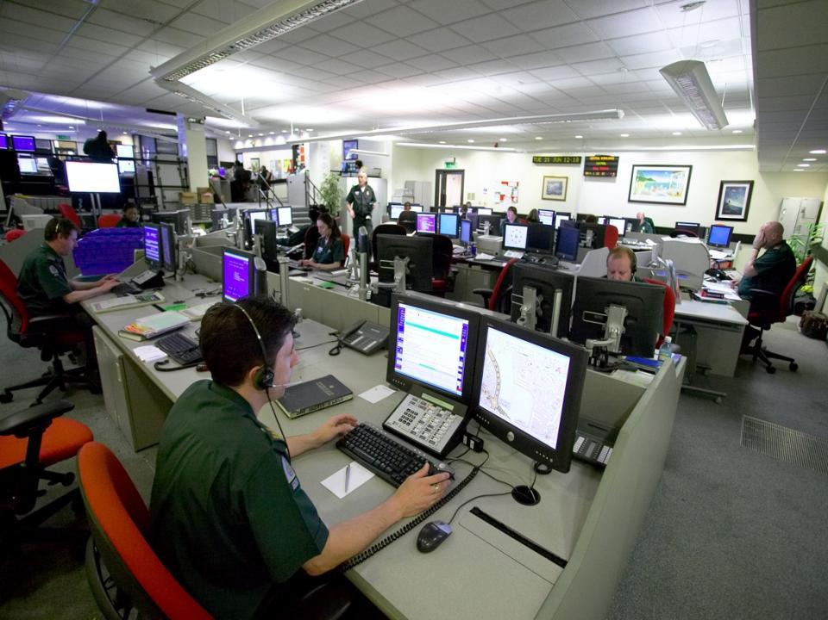

Slide 24
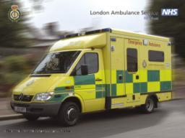
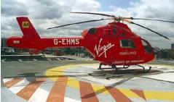
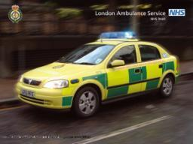
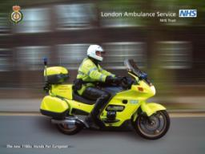
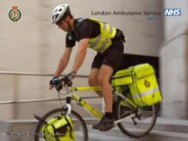
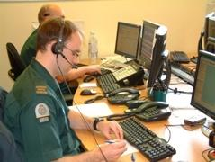
How do we respond?

Slide 25
Care Pathways
Advise patients by telephone – hear & treat
Treat and advise patients on scene – see & treat
Onward referral:
  Falls team, Community Nurse, GP, Outreach teams
Accident & Emergency Unit – Hospital
Minor Injury Units / Walk in Centre
Specialist Units:
    Cardiac, Trauma, Stroke,
Maternity Unit
Mental Health Unit

Slide 26

Our achievements
Met Category A target for last seven years
Met financial targets for last seven years
Improved cardiac arrest survival
Control services award
Healthcare People Management Association recognition of LINC scheme
London Mayor recognition of Rough Sleepers / London Buses initiatives
ASI – 2 recent bravery & 1 Control staff awards

Slide 27
Improving patient care
Means:
Better survival rates for our most seriously ill and injured patients
More patients’ needs resolved outside hospital A&E
Improved patient experience

Slide 28
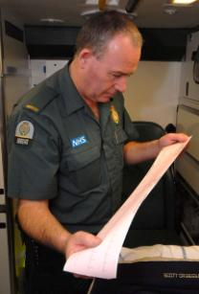
Cardiac care
LAS have been bypassing A&E to convey STEMI patients to specialist cardiac centres since 2006
Journey times have increased by 2mins (average)
Improved patient outcomes
    Reduced length of stay
    Reduction in occurrence of heart attacks
    Reduced risk of stroke & major bleeding
    Reduced incidence of death
Associated long term cost saving

Slide 29


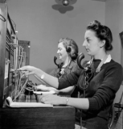
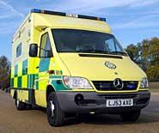
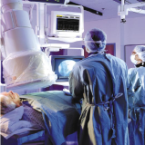
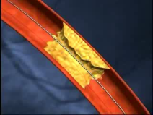
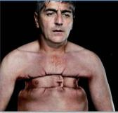
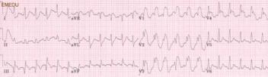
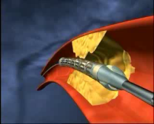
Maximising Early Diagnosis
From Plaque Rupture to Primary PCI
Chest Pain call
Early symptom recognition
Paramedic ECG
Decision for direct transfer
Confirmation in cath lab
Primary PCI

Slide 31
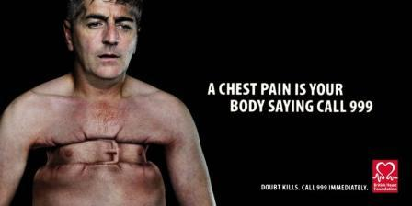

Slide 33
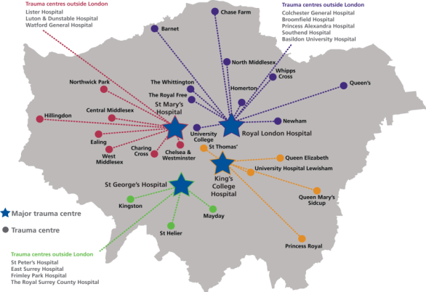
Trauma Centres
Local Trauma units cluster with MAJOR Trauma centres
LAS take seriously injured patients direct to Major centres – improving patient outcomes

Slide 34
Mechanism of serious injury
5th April - 1st June 2010

Slide 35
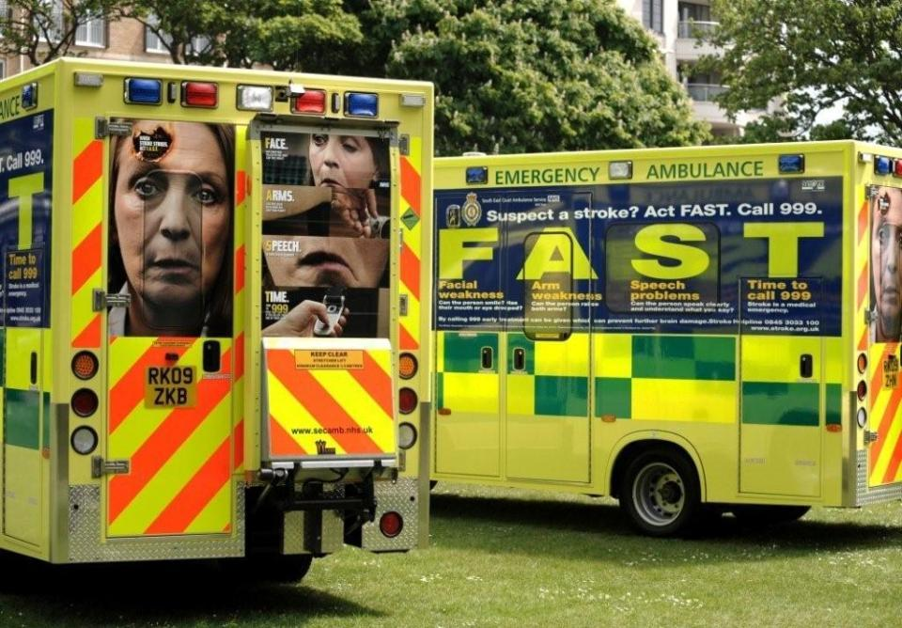
Face Arms & Speech Test

Slide 36
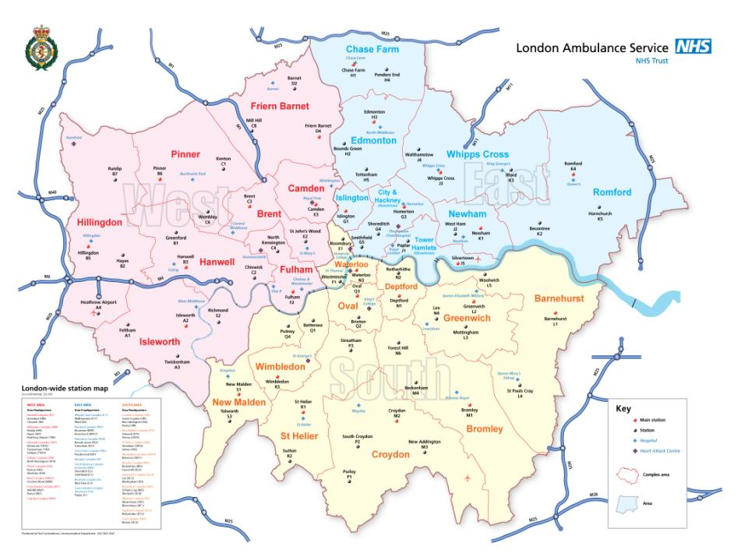
London’s Hyper Acute Stroke Centres
Notes:
The PRU is scheduled to open its HASU later this year, and is being supported by the network to make the necessary improvements to achieve this.
Bexley PCT have been trying to push the LAS to take patients from their area to Darenth valley Hospital which has variable acute stroke services – we have not agreed to this, and will not do so until HfL (Tony Rudd) Recognises DVH as offering equivalent services.

Slide 37
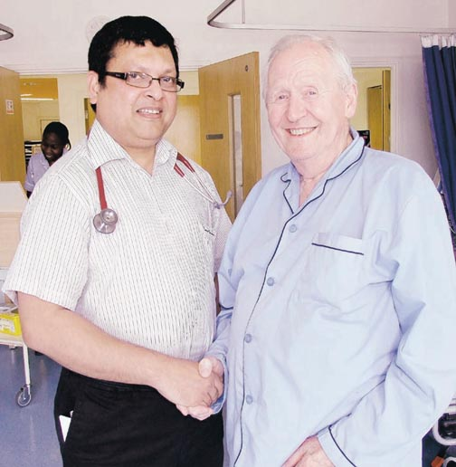
Stroke Case Study
Priority call 09:17 to HASU arrives 09:28
CT scan shows ischemic stroke - thrombolysis and hyperacute stroke care required
“Within an hour, his paralysis corrected. Previously someone with a stroke as serious as this could have expected to spend the rest of their life in a nursing home, if they survived”
( Dr Khan, Stroke Consultant)
Now discharged and back to his hobby of playing the accordion

Slide 38
Current challenges
Meeting response time targets
Providing more care outside hospital; up-skilling our staff
Replacing our 999 call-taking system
Being ready for the Olympic and Paralympic Games
6% year on year increase in demand

Slide 39
By how much is ambulance demand rising?
The number of calls handled by ambulance services in England is increasing by 6.5% each year on average, which is equal to approximately 300,000 extra calls each year.
At an average cost of £200 per call, this represents an additional cost of £60 million pounds each year.

Slide 40
Top ten illness codes
‘Other medical conditions’
Abdominal pains
Pain –other
Generally unwell
No injury or illness
Head injury (minor)
Difficulty in breathing
Minor cuts & bruising
Alcohol related
Possible fracture

Slide 41
Factors Affecting Demand
Seasonal factors
Social/attitude change
Long term conditions
Aging population
Frequent callers
Deprivation
Alcohol
Changes to patient care

Slide 42
What contribution has alcohol-related behaviour made to ambulance demand?
Alcohol-related incidents are increasing in London and nearly 1 in 20 London ambulance incidents are alcohol related.
Binge drinking behaviour and the increasing affordability of alcohol may also be reflected in other ambulance activity trends, such as the significant increase in the number of calls from 20-29 year olds and the changes in the day and time of calls to the ambulance service.
From 2000/01 to 2007/08 there has been a trend for more Trauma and Falls ambulance incidents to occur on the weekend evenings.

Slide 45
“Demand for ambulance services is rising by over 6% each year”
“Changes in people’s attitudes and expectations may mean they are using 999 to get rapid and convenient access to health services”
“A small number of patients account for a disproportionately large portion of ambulance activity”
“Many of patients transported by ambulance to A&E are discharged from A&E without the need for follow-up”

Slide 46

What is the ambulance equivalent of a smoke alarm ?

Slide 48
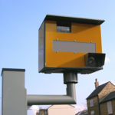

Slide 51
London After Dark
Increase in alcohol related incidents
Increase in RTCs, slips trips and falls
Increase in ‘no patient found’
Increase in staff assaults and abuse
Difficult demand peak between 23.00 and 03.00
Difficulty in locating address / callers
Rough sleepers project

Slide 52
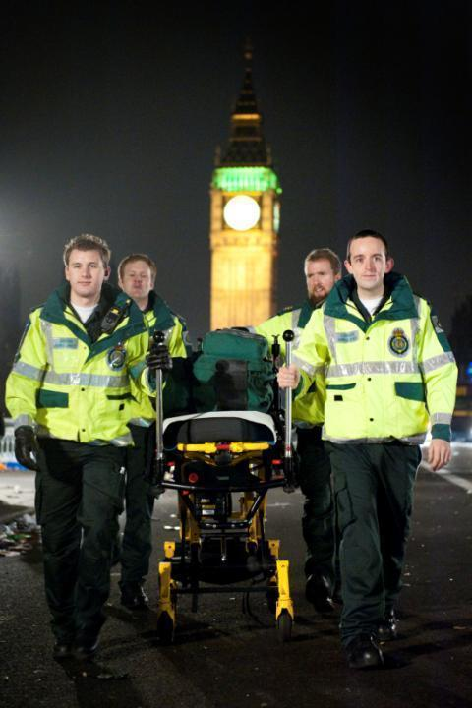

Slide 53
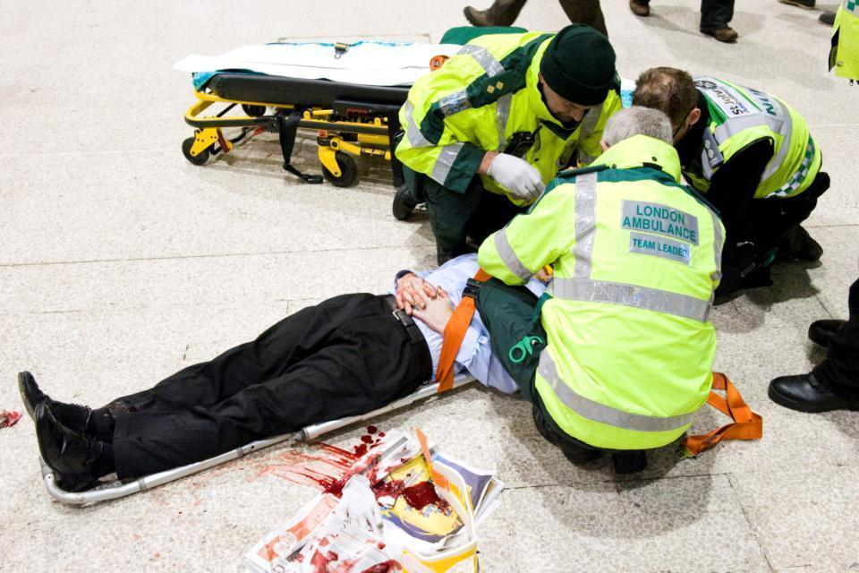

Slide 54
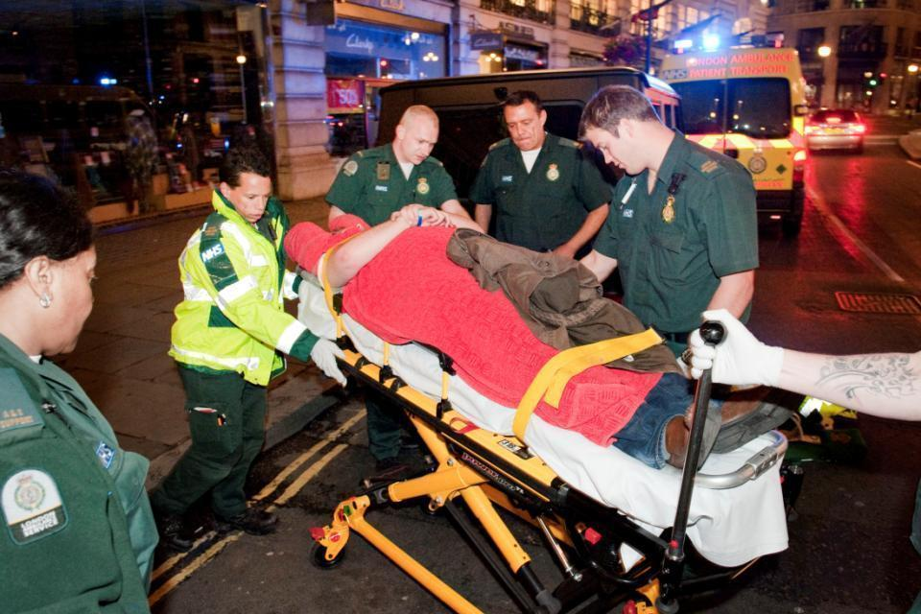

Slide 55
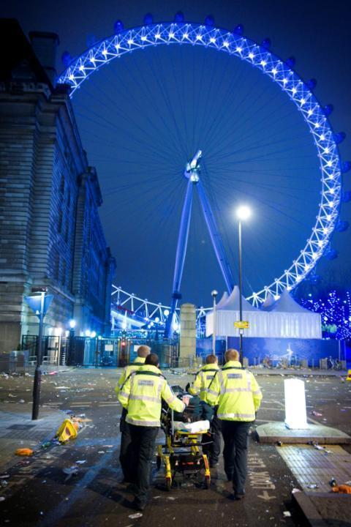

Slide 56
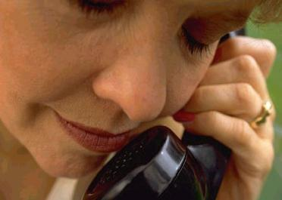
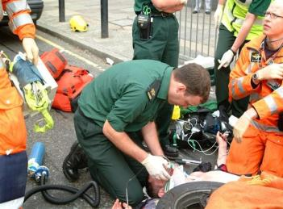
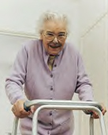
A service that responds appropriately to all our patients
A service that looks, feels and behaves,
and delivers differently

Slide 57


