Slide 1
19th-century taming of the christmas carol
Jeremy Summerly 8 December 2015
Gresham College EC1N 2HH

Slide 2
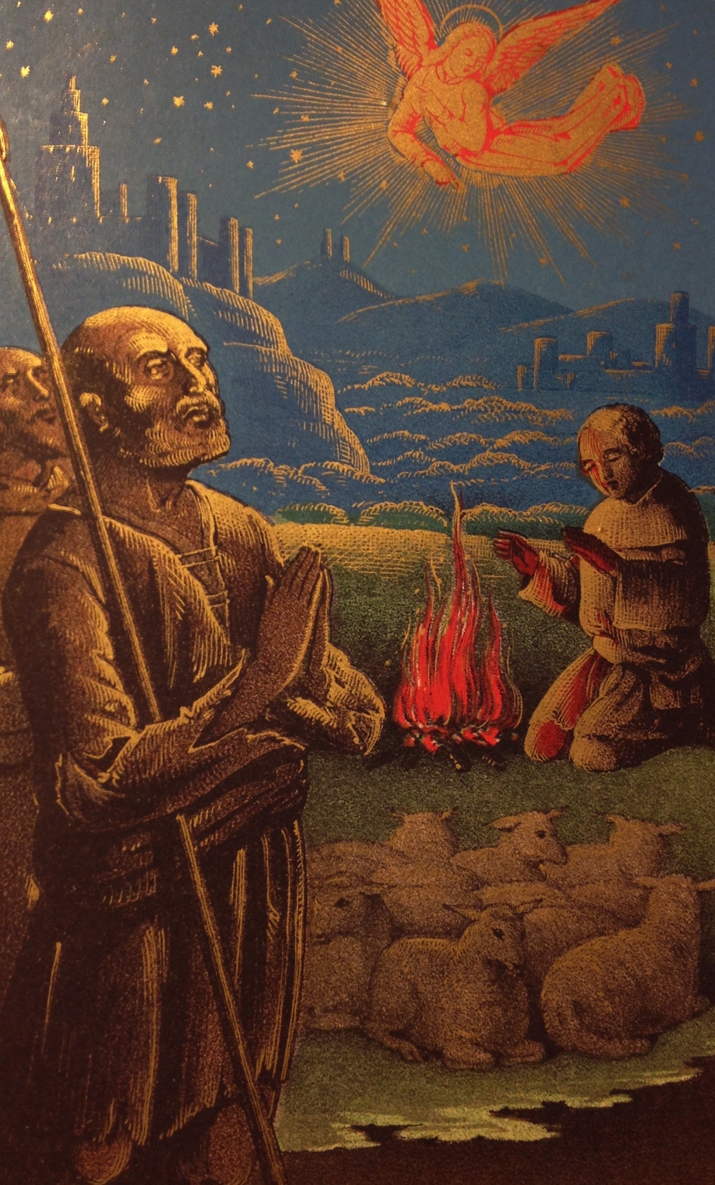

Slide 3
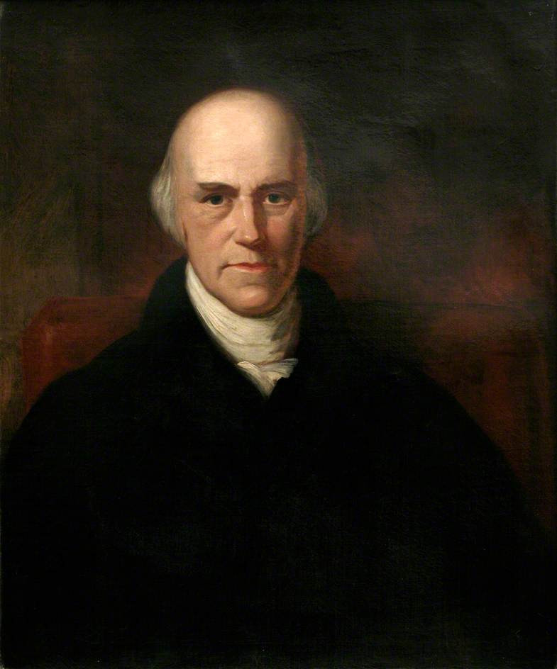
DAVIES GIDDY M.A.

Slide 4
DAVIES GILBERT M.P.

Slide 5
DAVIES GILBERT P.R.S.

Slide 6
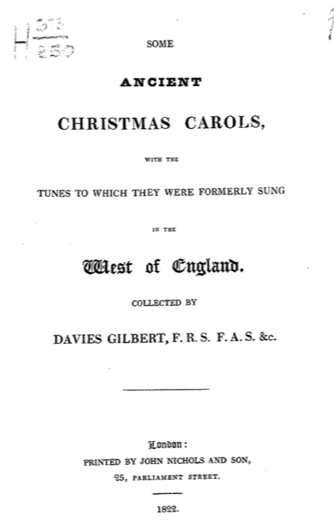

Slide 7
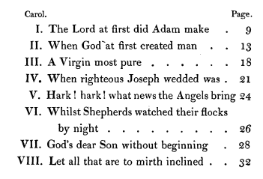

Slide 8
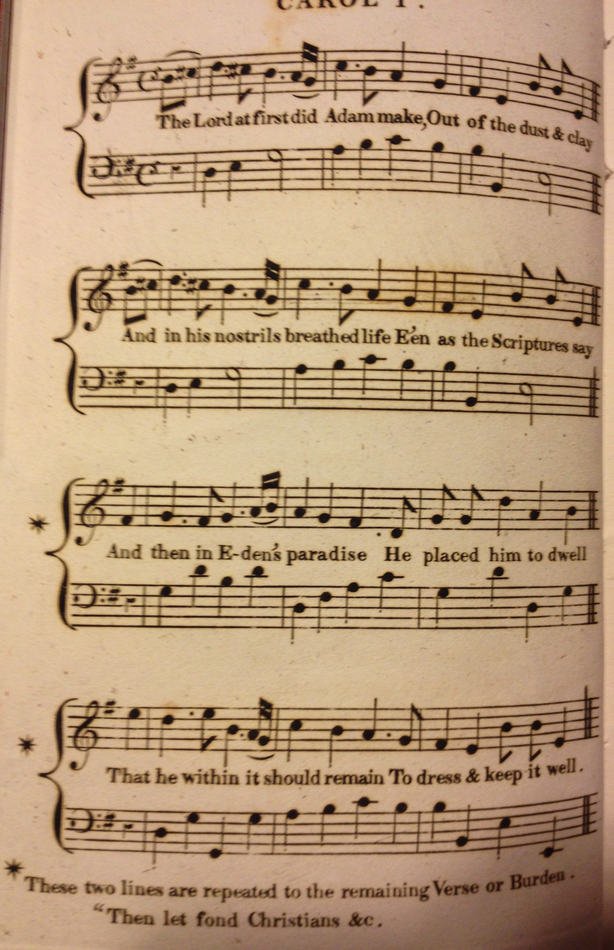

Slide 9
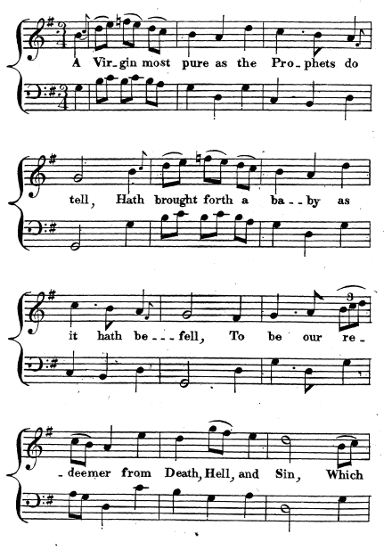
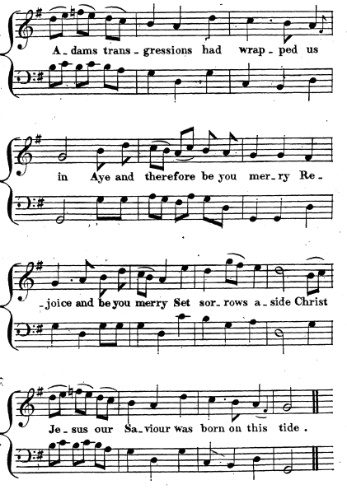

Slide 10
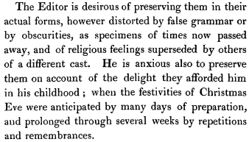

Slide 11
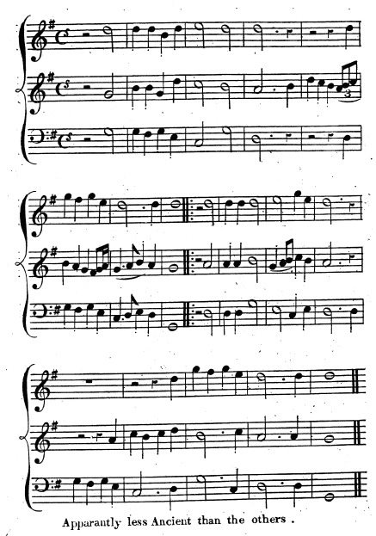
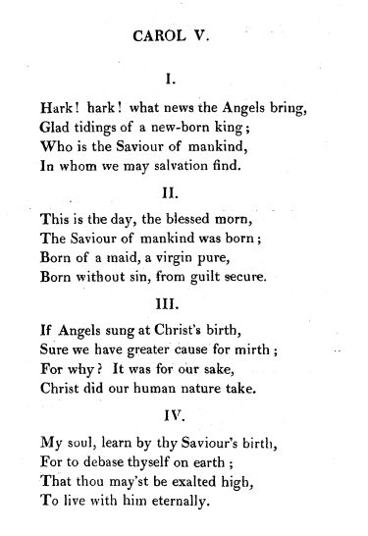

Slide 12
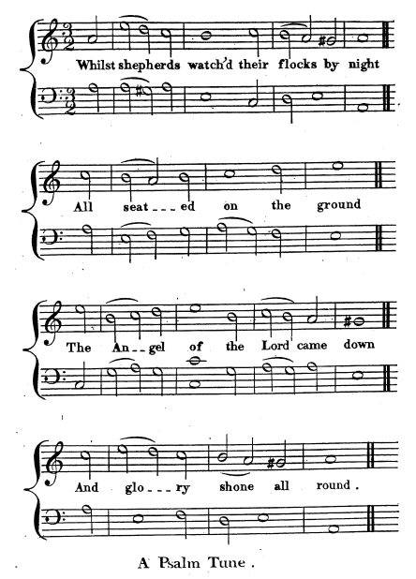

Slide 13
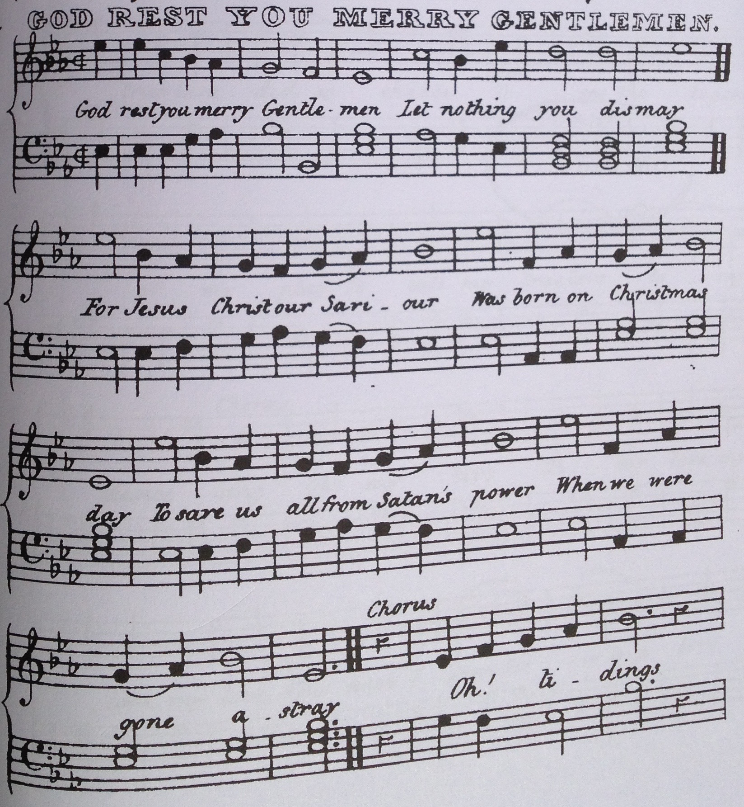
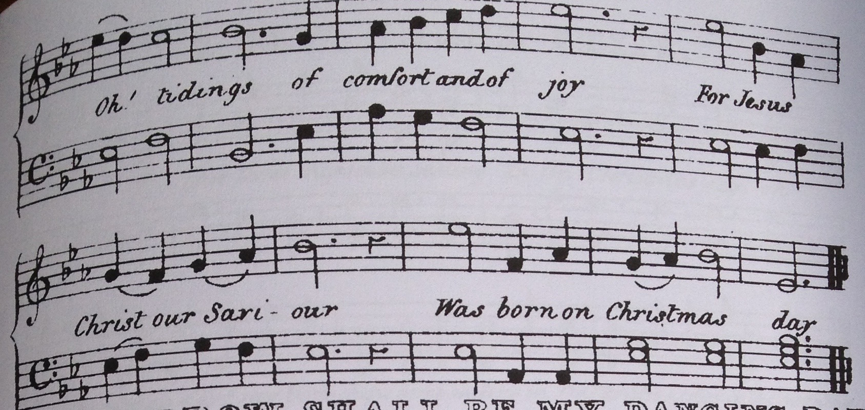

Slide 14
New Oxford book of carols (hugh Keyte)
The eighteen tunes are amateurishly lithographed, with major omissions and mistakes, and the musical transcriptions themselves are mostly on a low level: some are misbarred; several seem to be fumbling transcriptions from performance, with a peculiar style of chordal ‘vamping’ in the bass stave which indicates the harmonies without giving the parts. Such basses as are given are shapeless and repetitive, and cannot bear comparison with the coherent and independent basses in Gilbert’s book; moreover, someone seems to have tried to bring them into conformity with the rules of classical harmony.

Slide 15
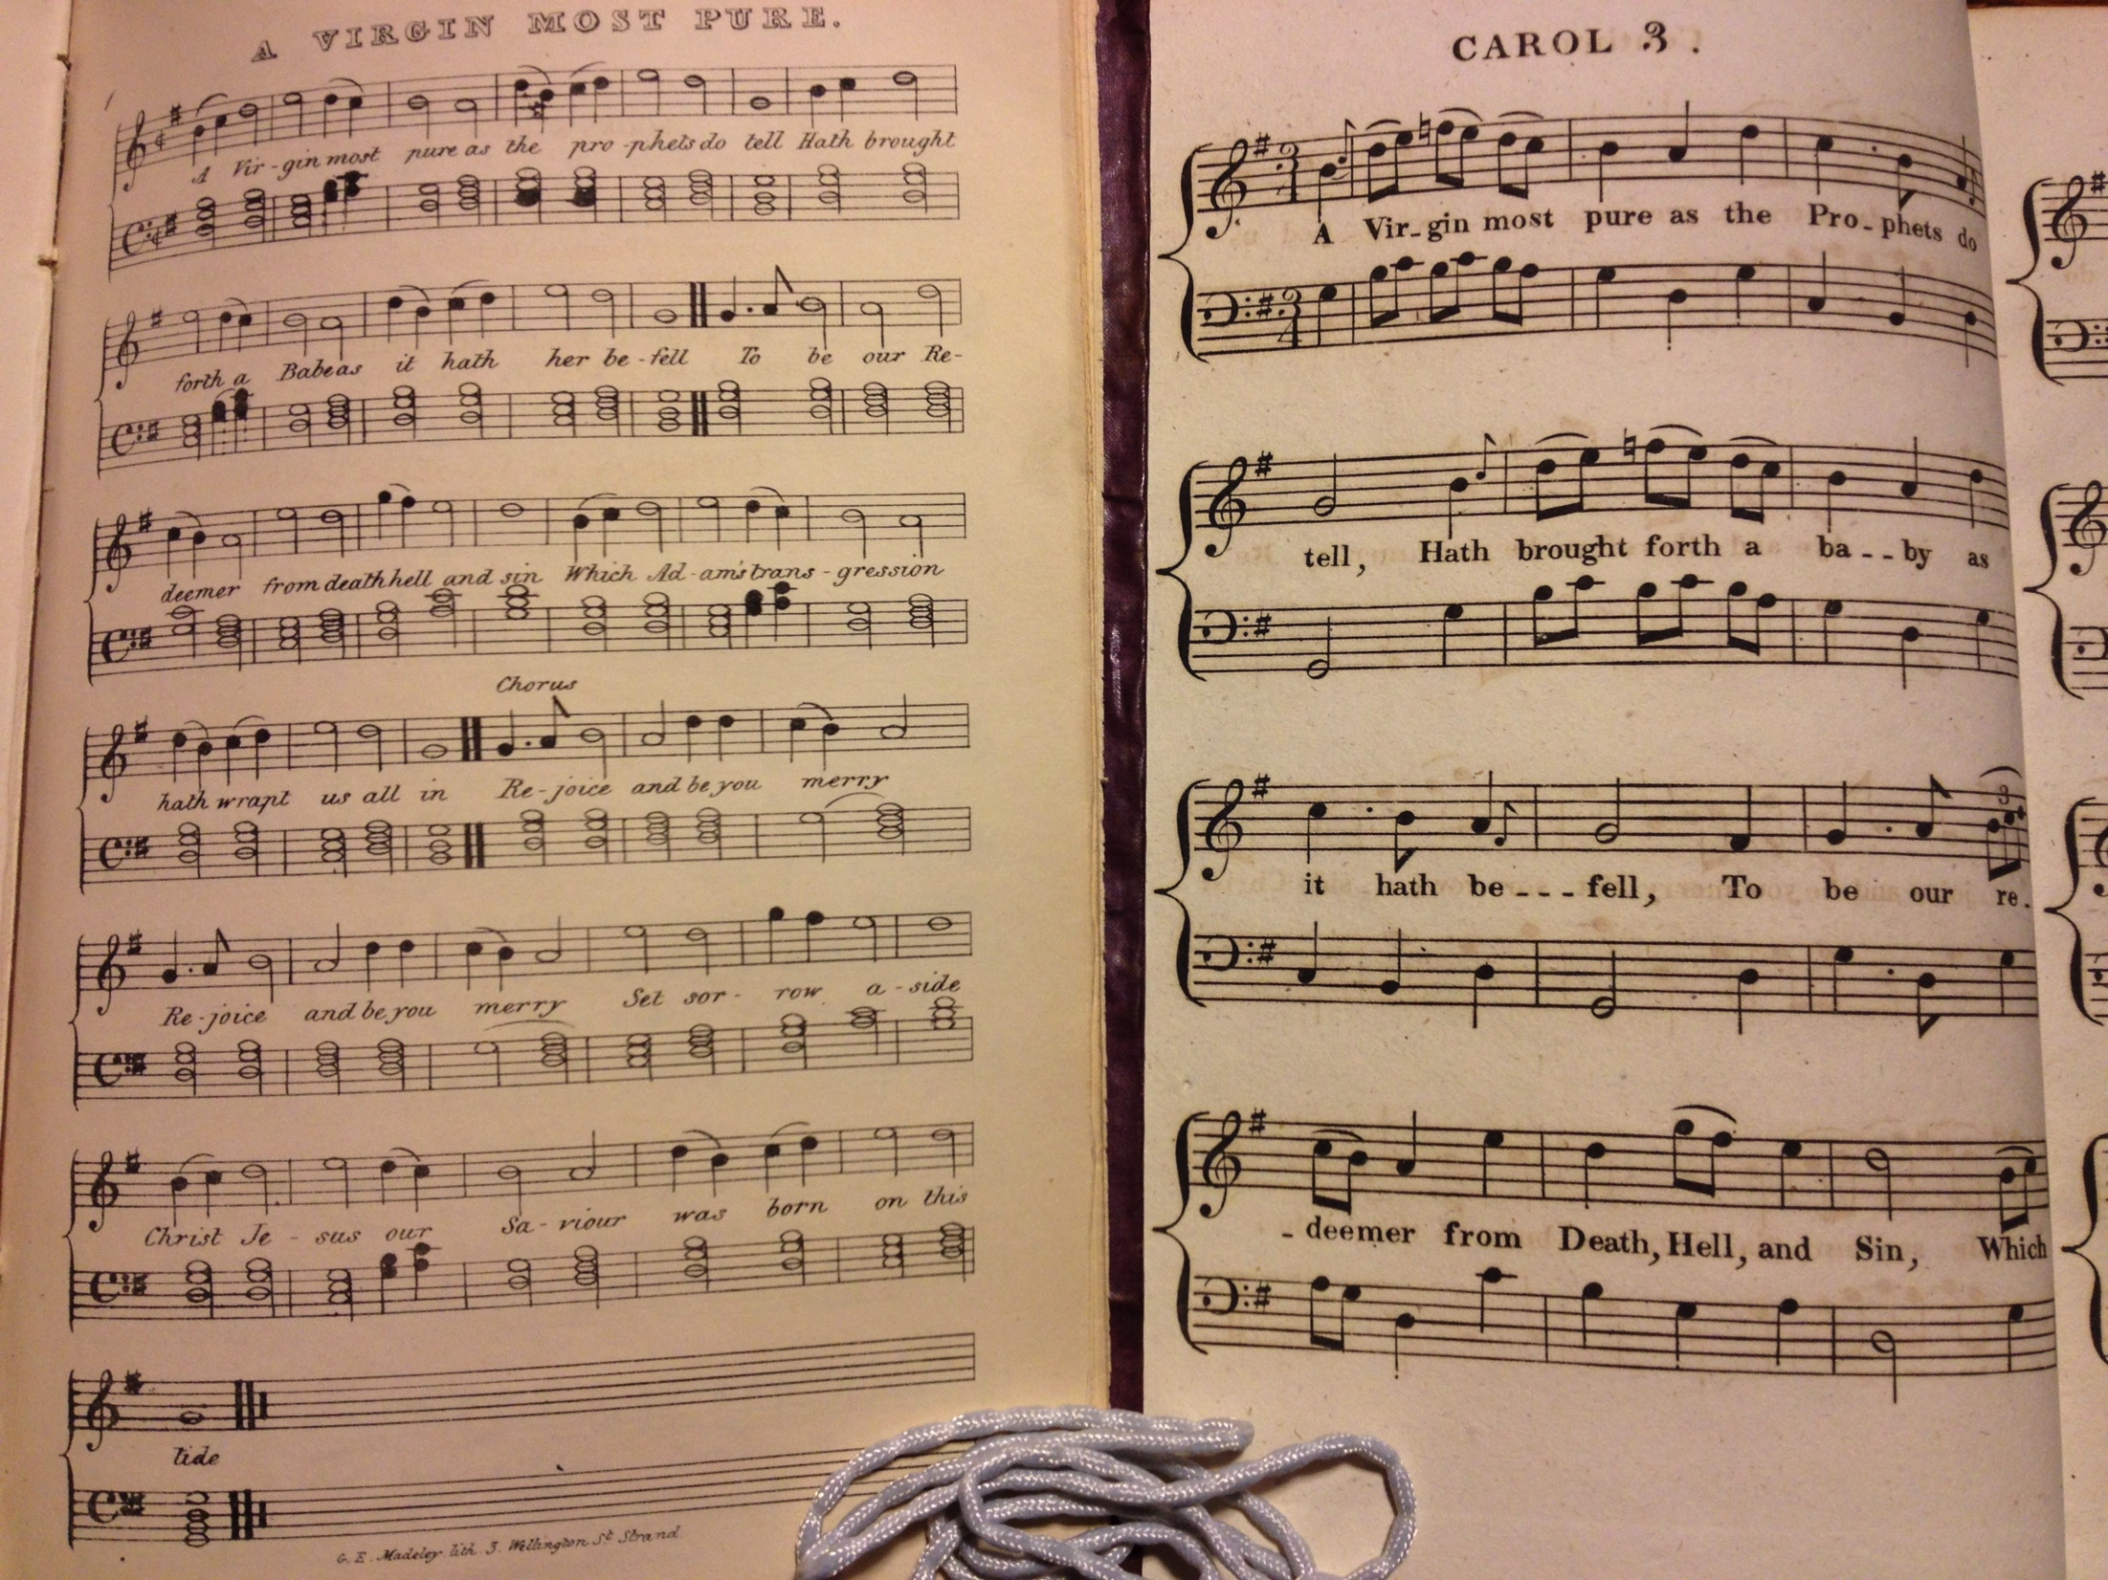

Slide 16
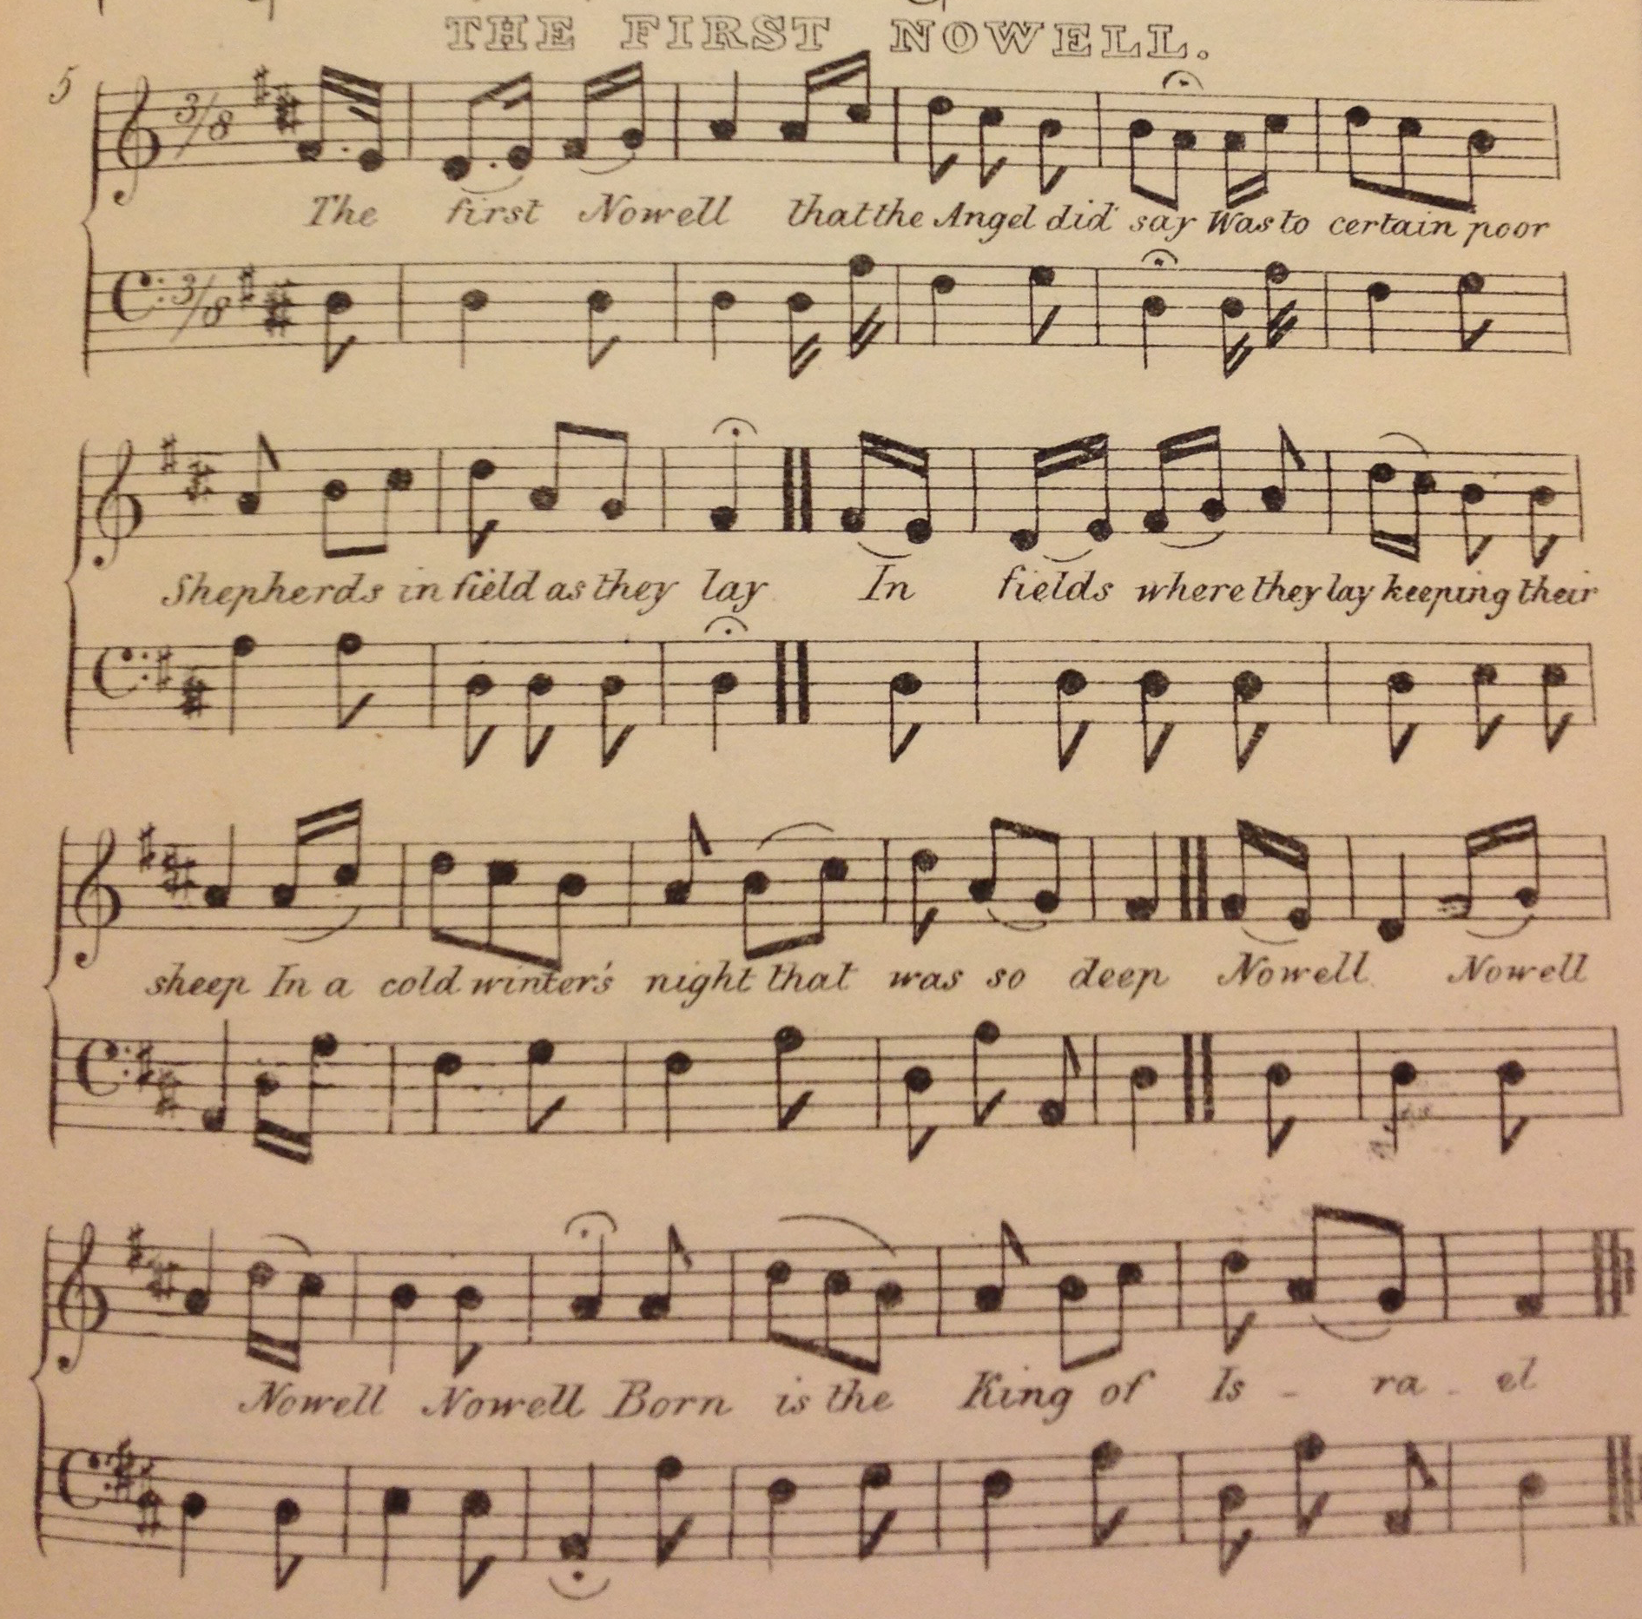

Slide 17
1861
1867 & 1871
Hymns Ancient & Modern
Edited William. H. Monk of King’s College, London
Christmas Carols, Old & New
Edited Rev. Harry Bramley and Dr John Stainer of Magdalen College, Oxford

Slide 18
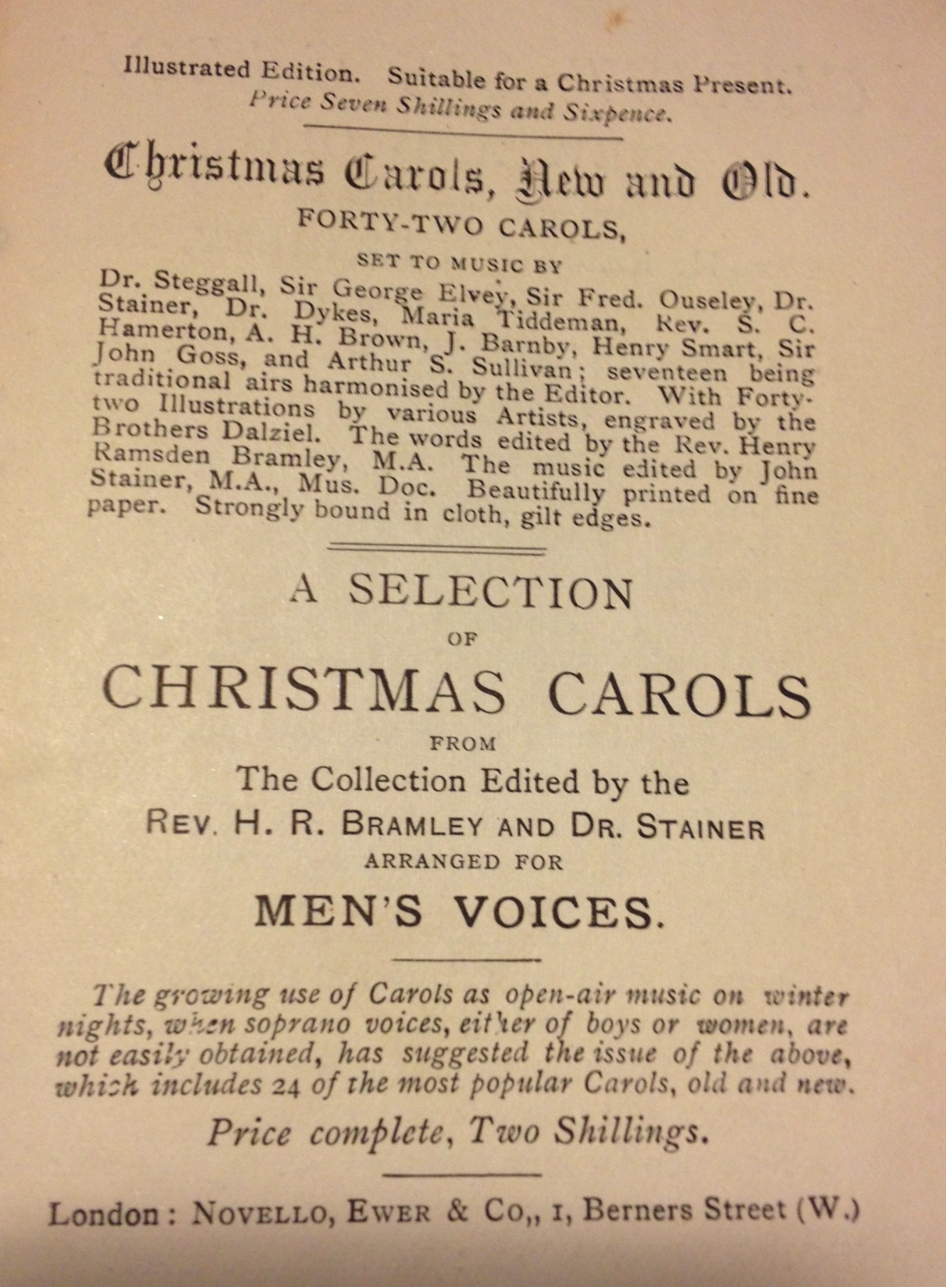

Slide 19
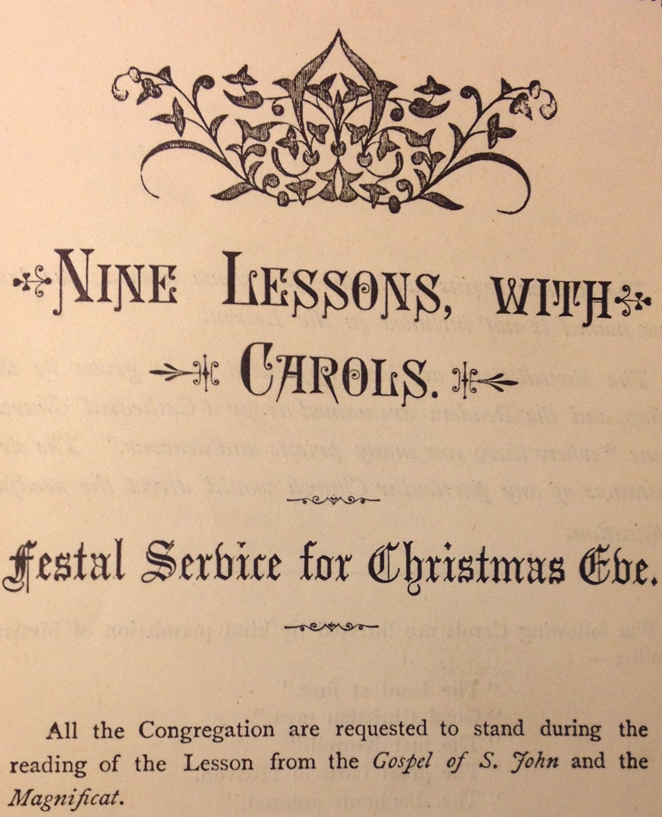

Slide 20
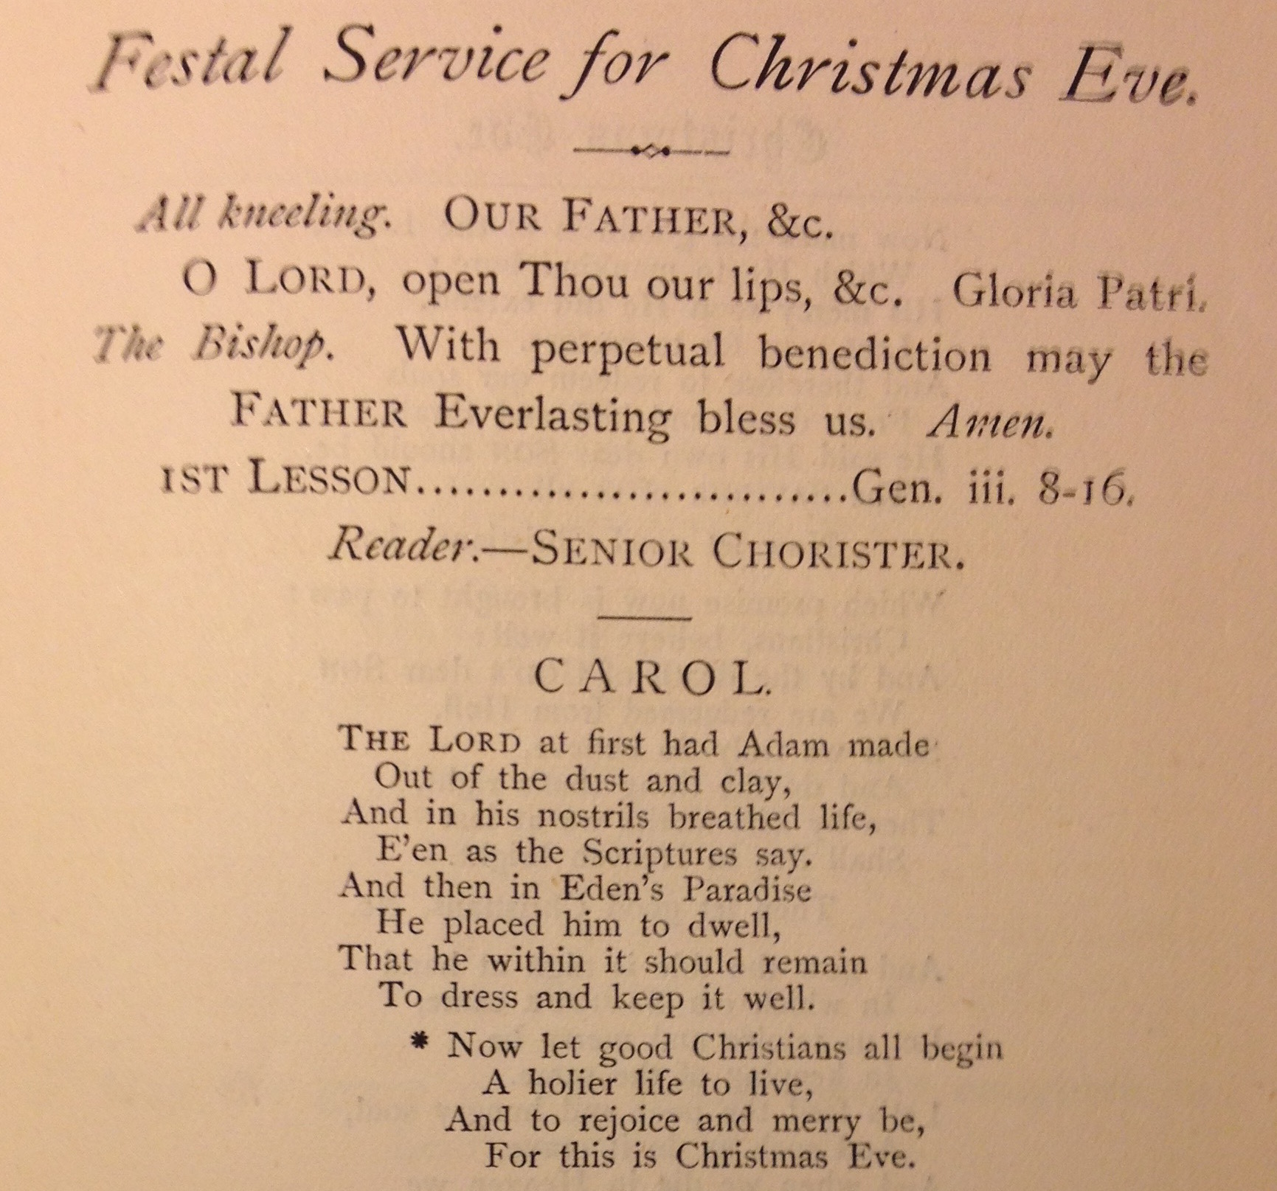

Slide 21
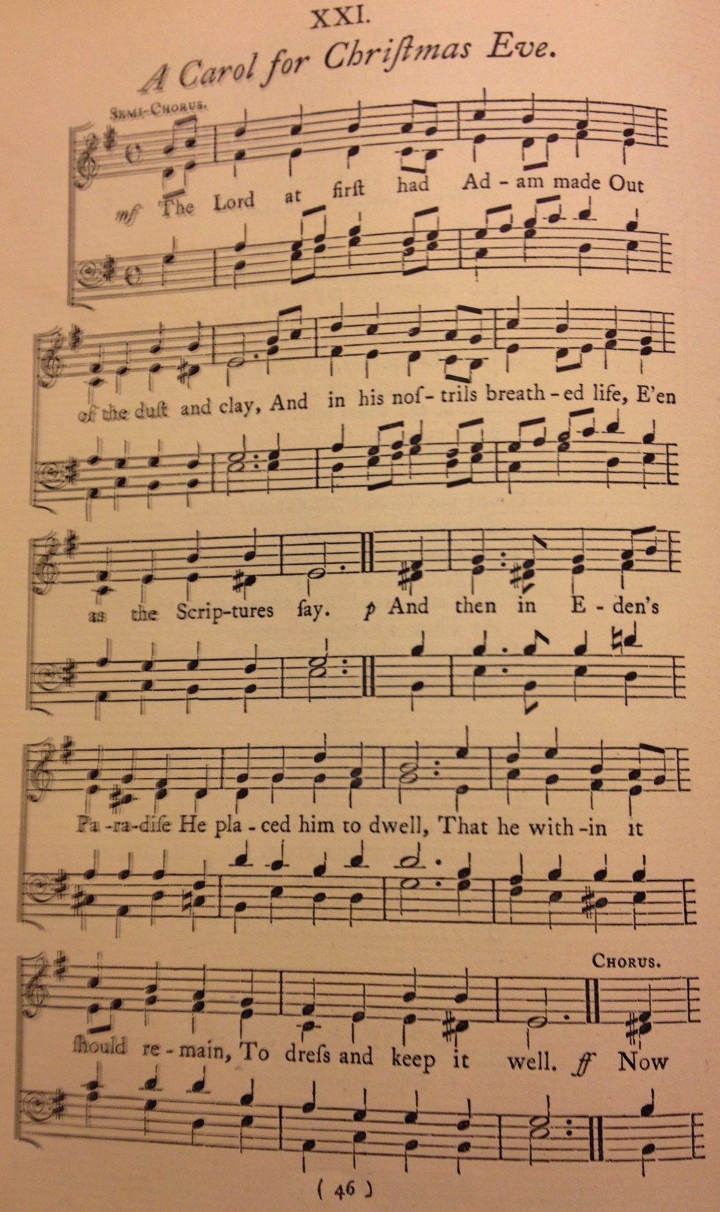
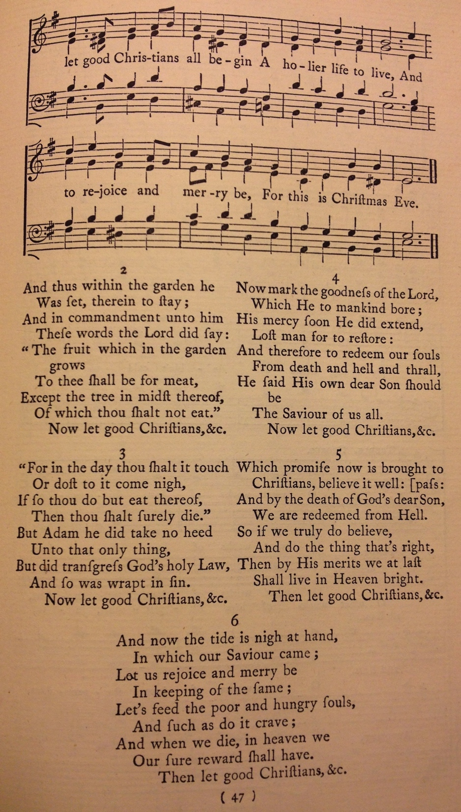

Slide 22
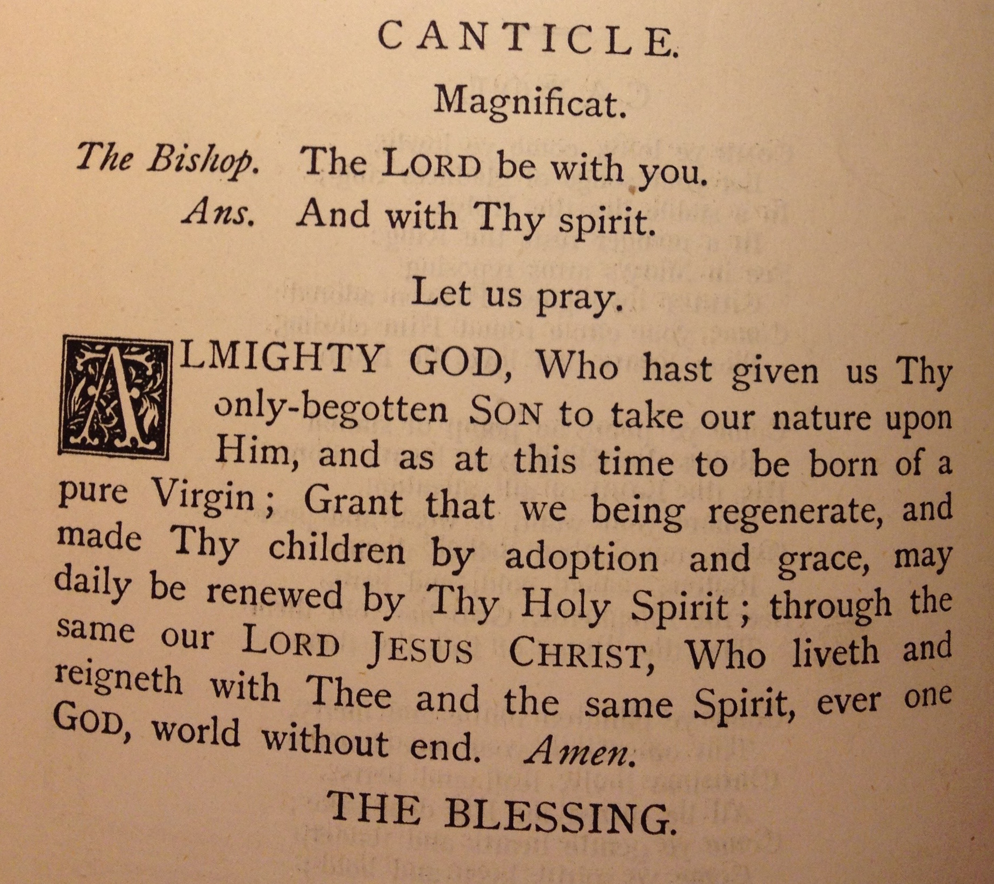

Slide 23
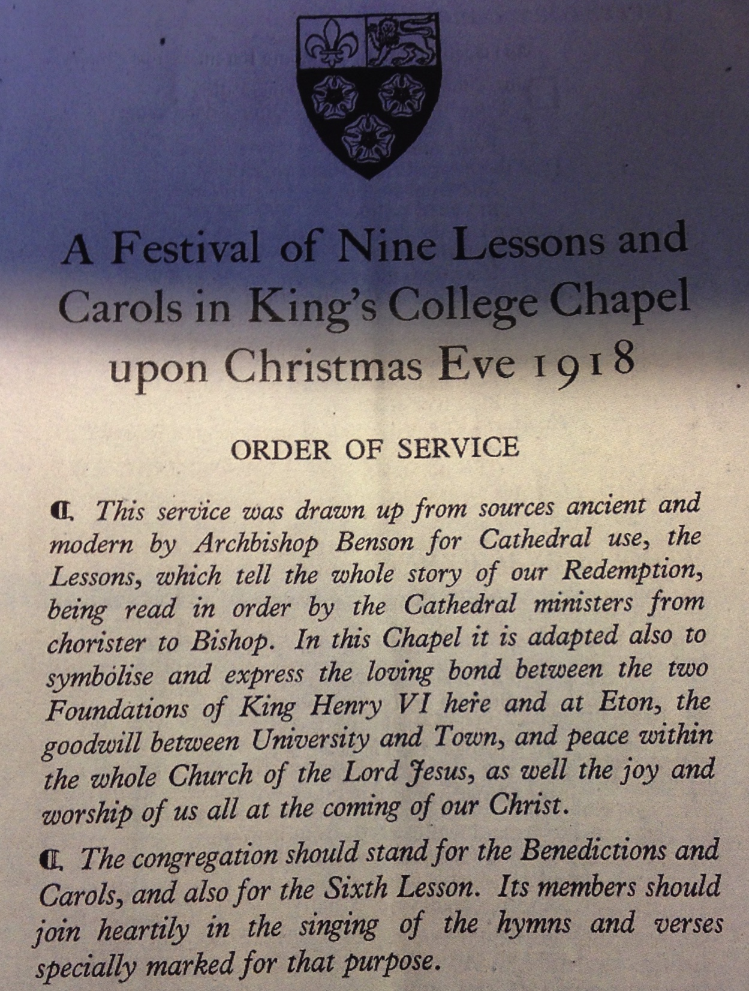

Slide 24
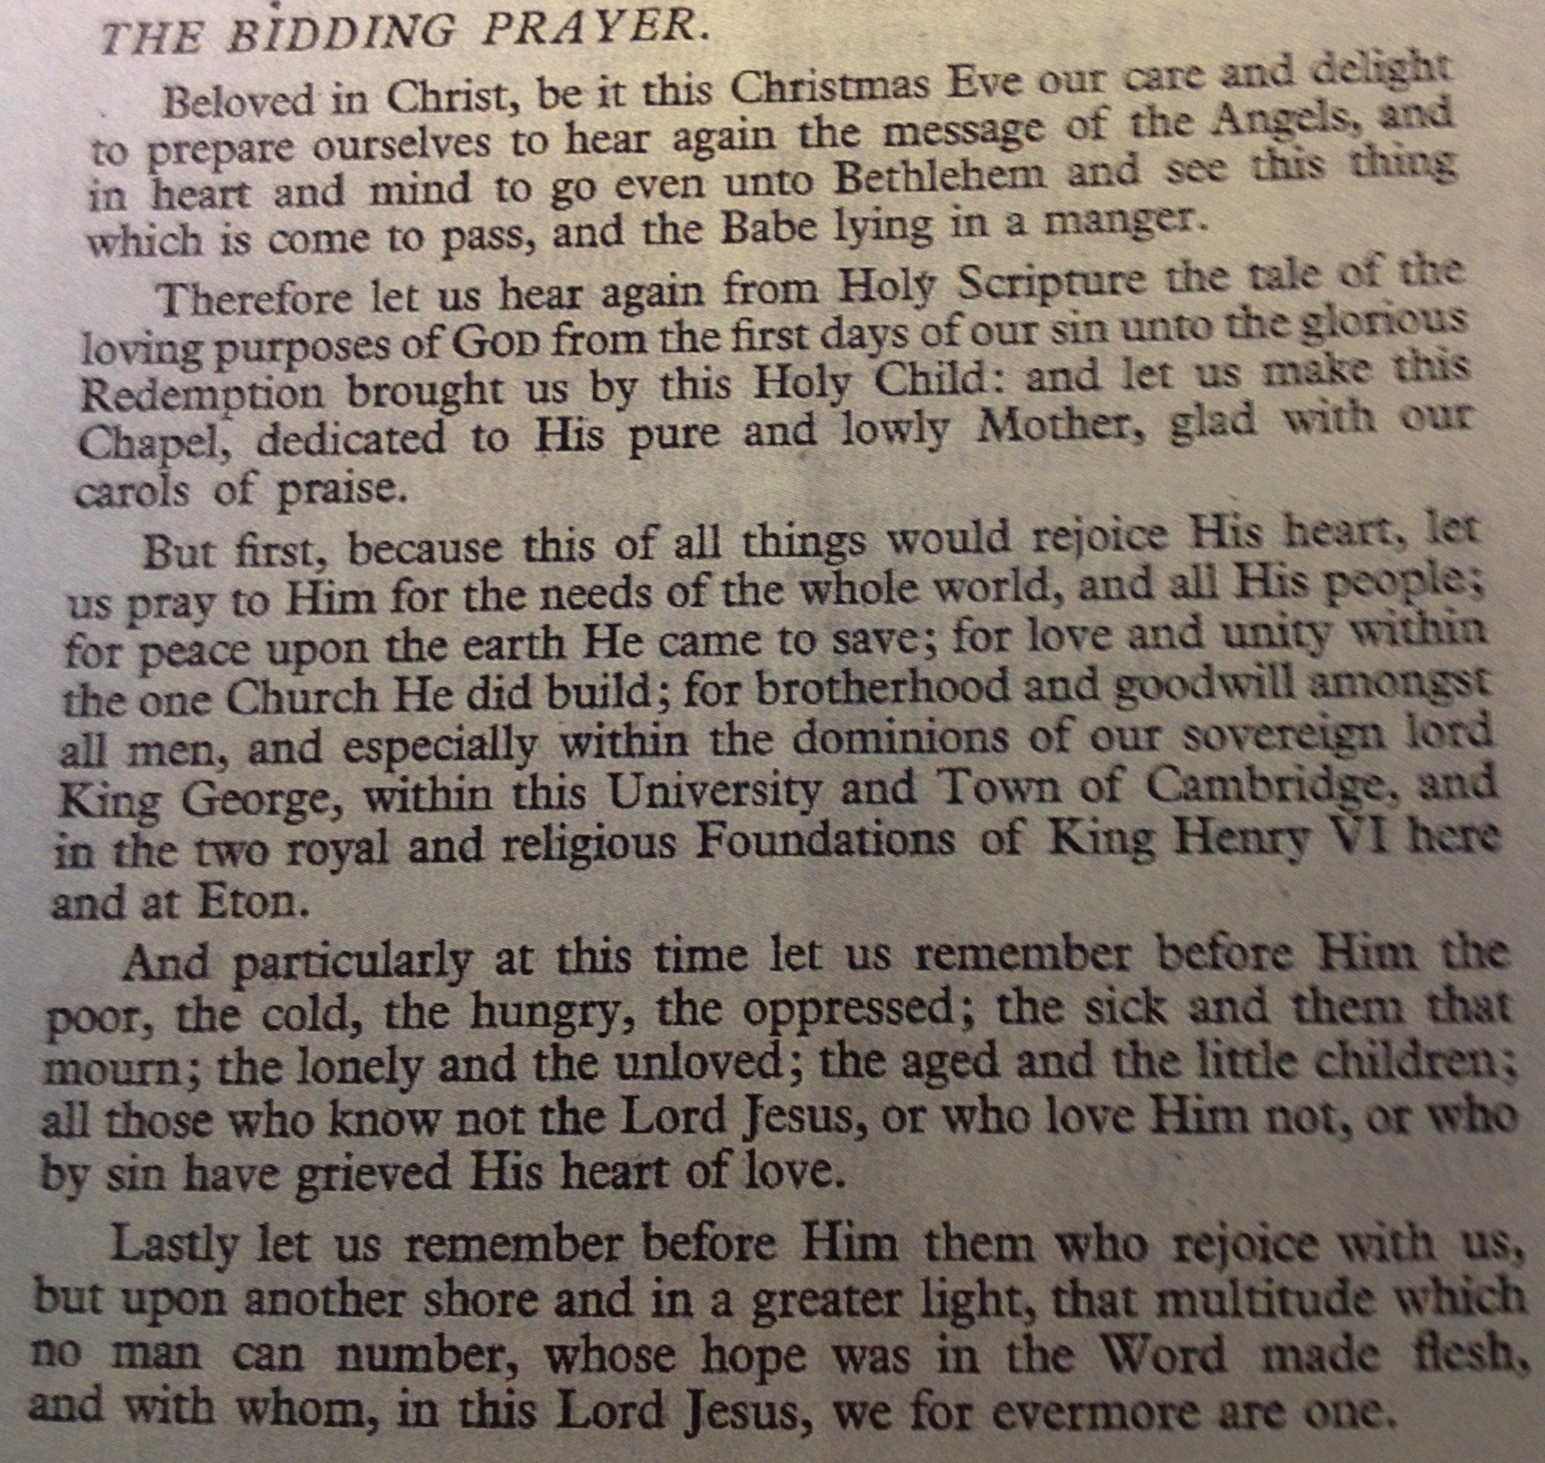

Slide 25
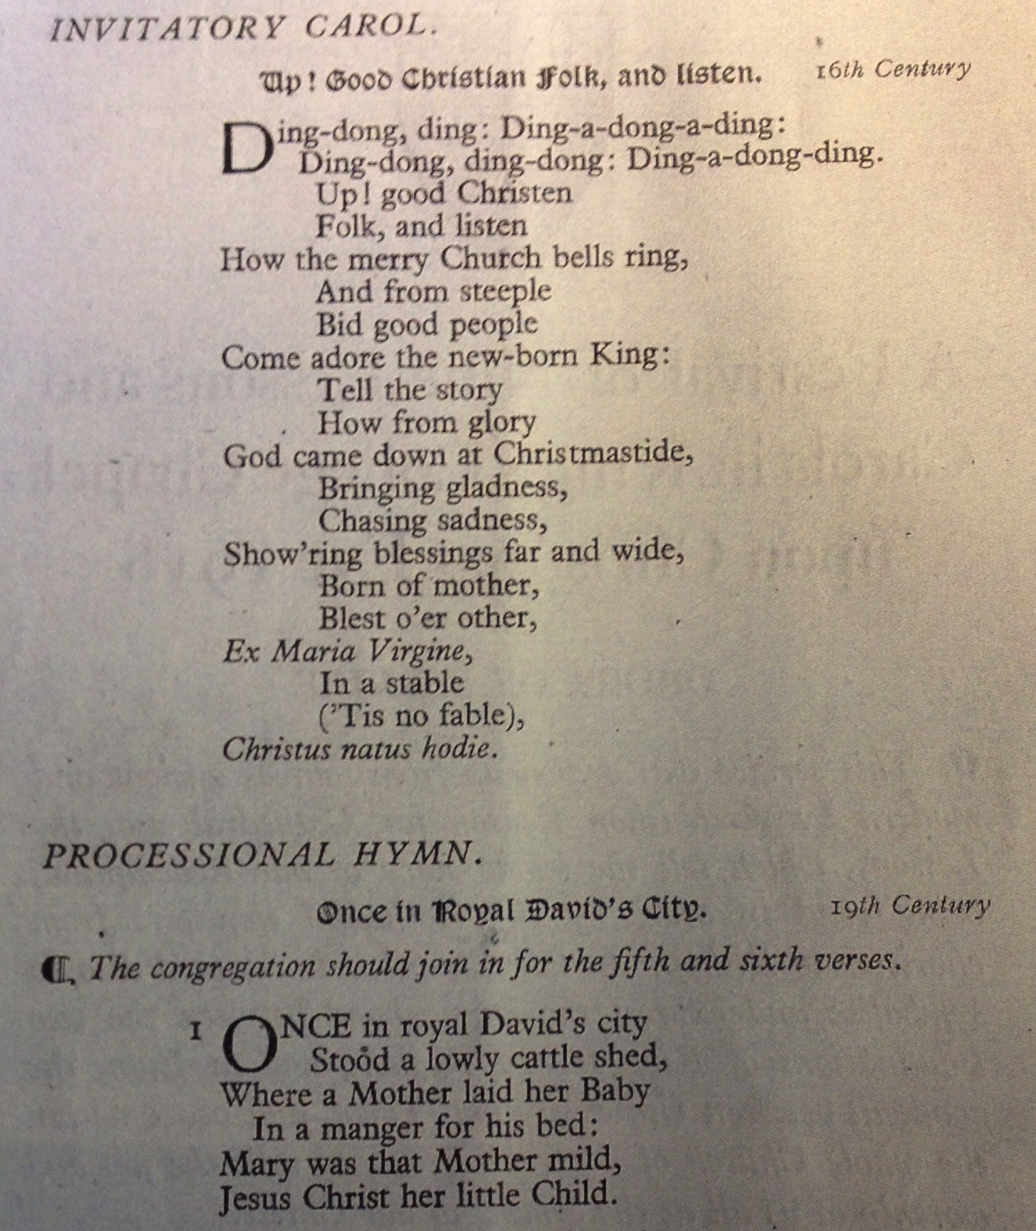

Slide 27
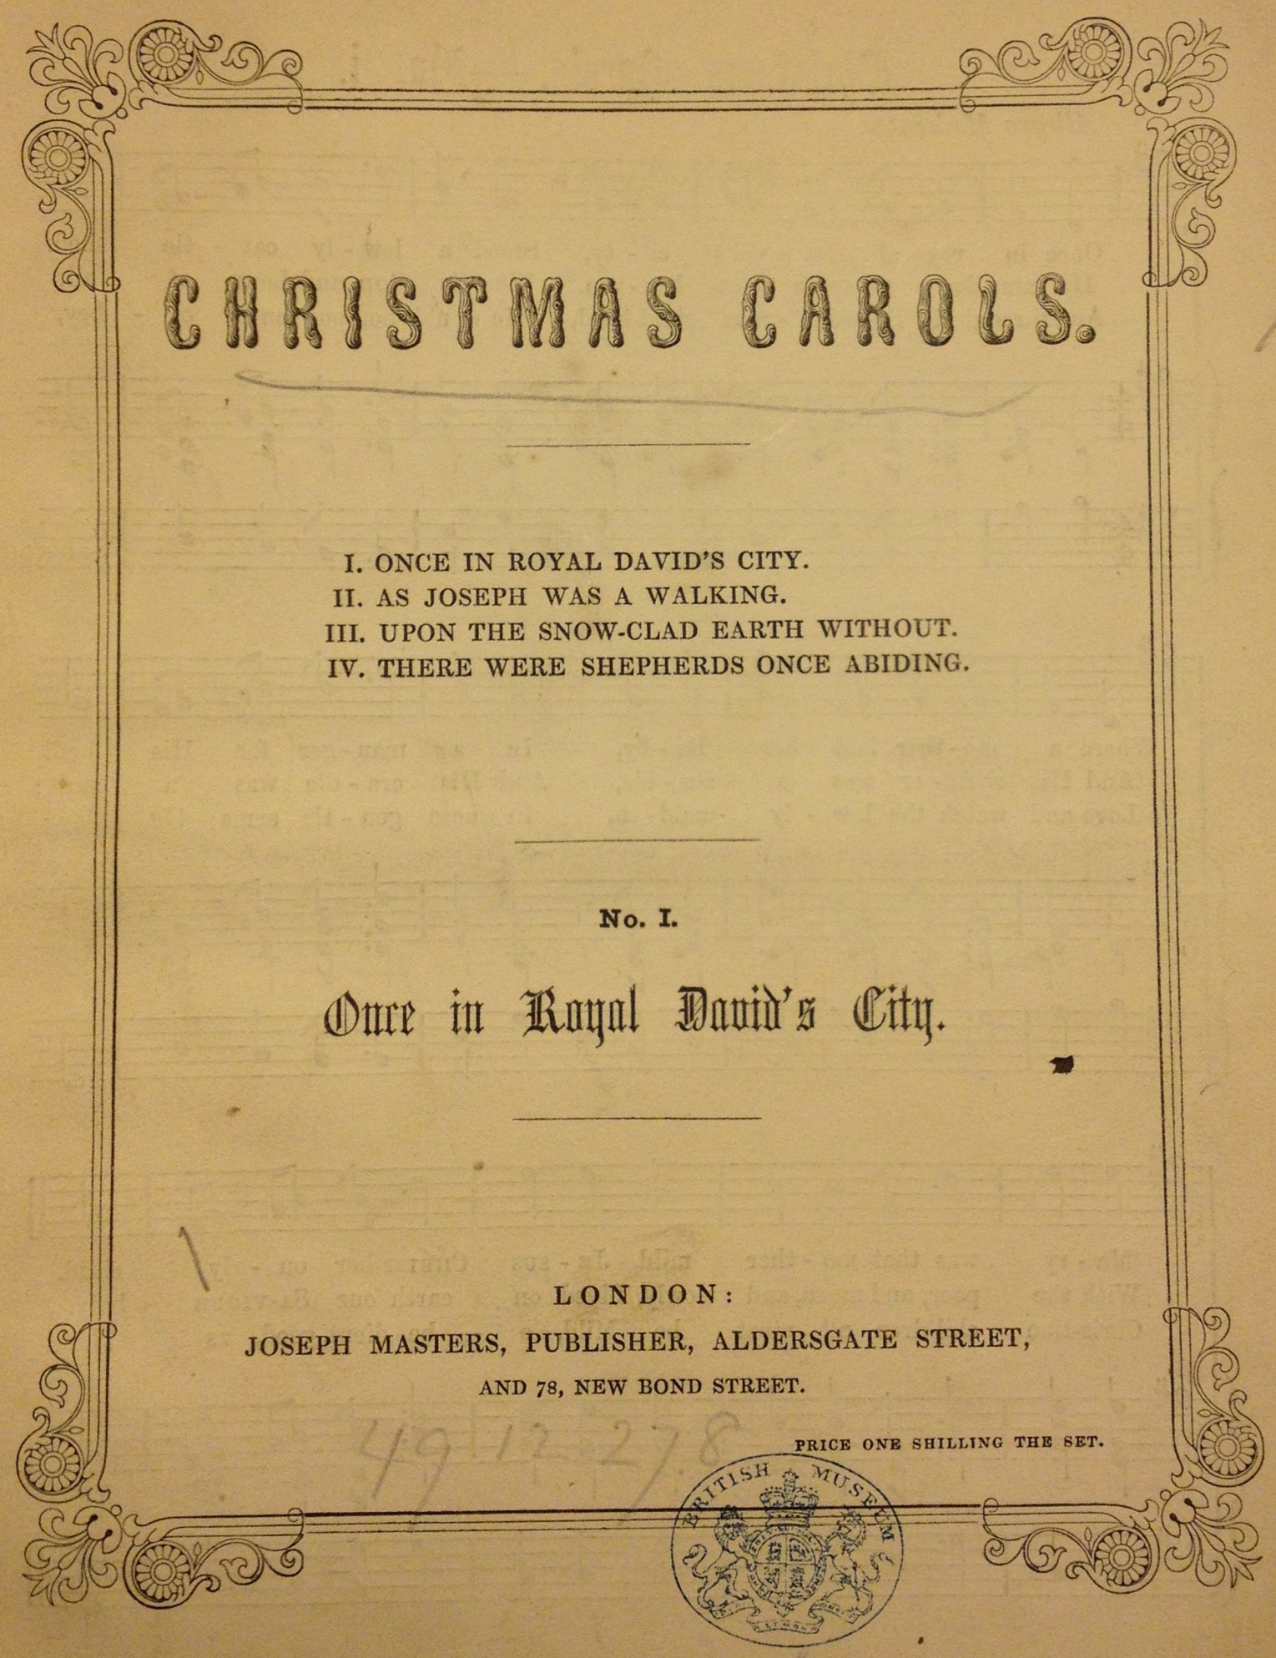
Henry Gauntlett 1849

Slide 28
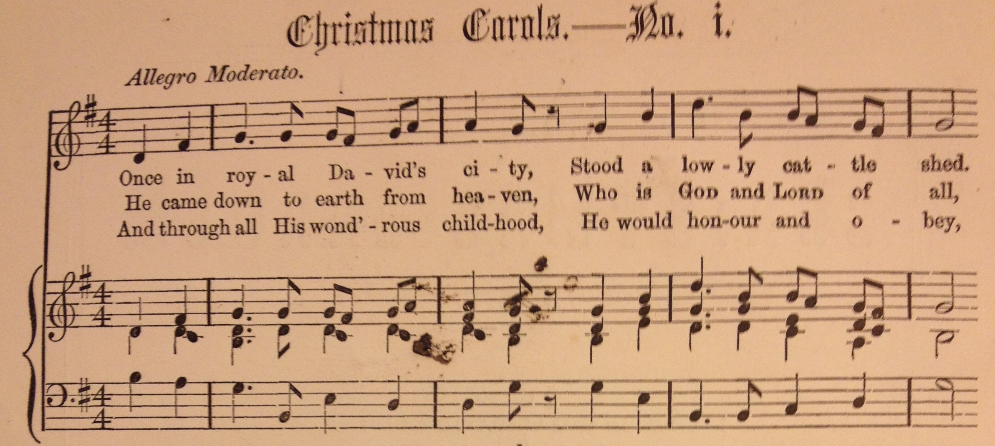

Slide 29
