Slide 1
The Falklands War, 1982
Vernon Bogdanor FBA CBE
Visiting Gresham Professor of Political History

Slide 2
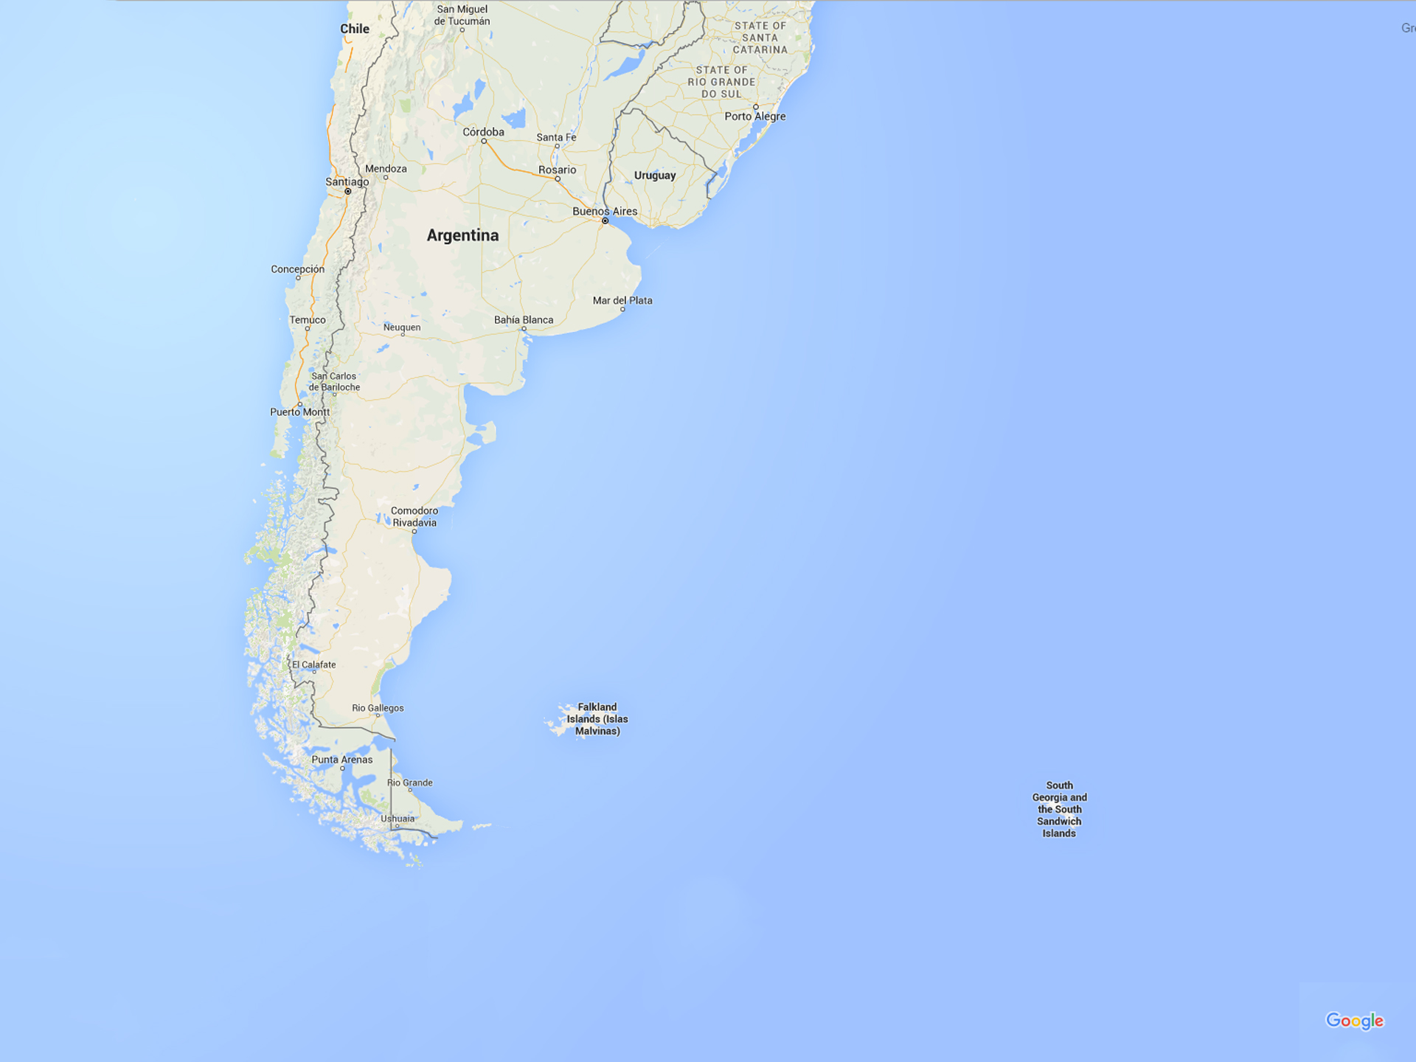

Slide 3
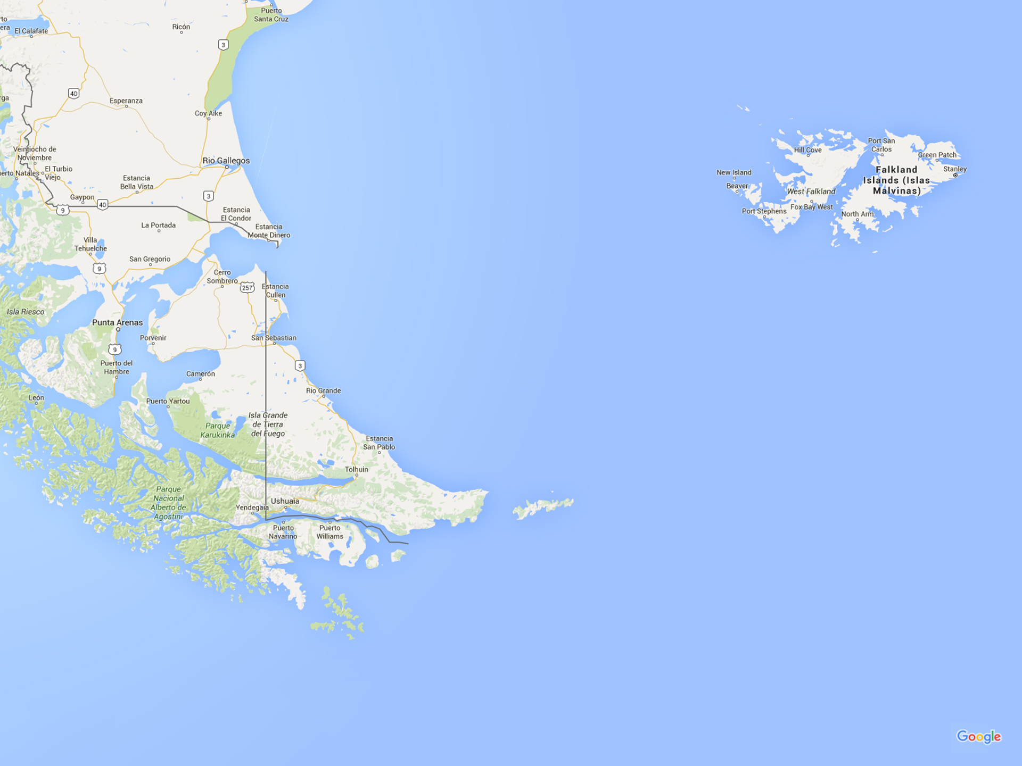

Slide 4
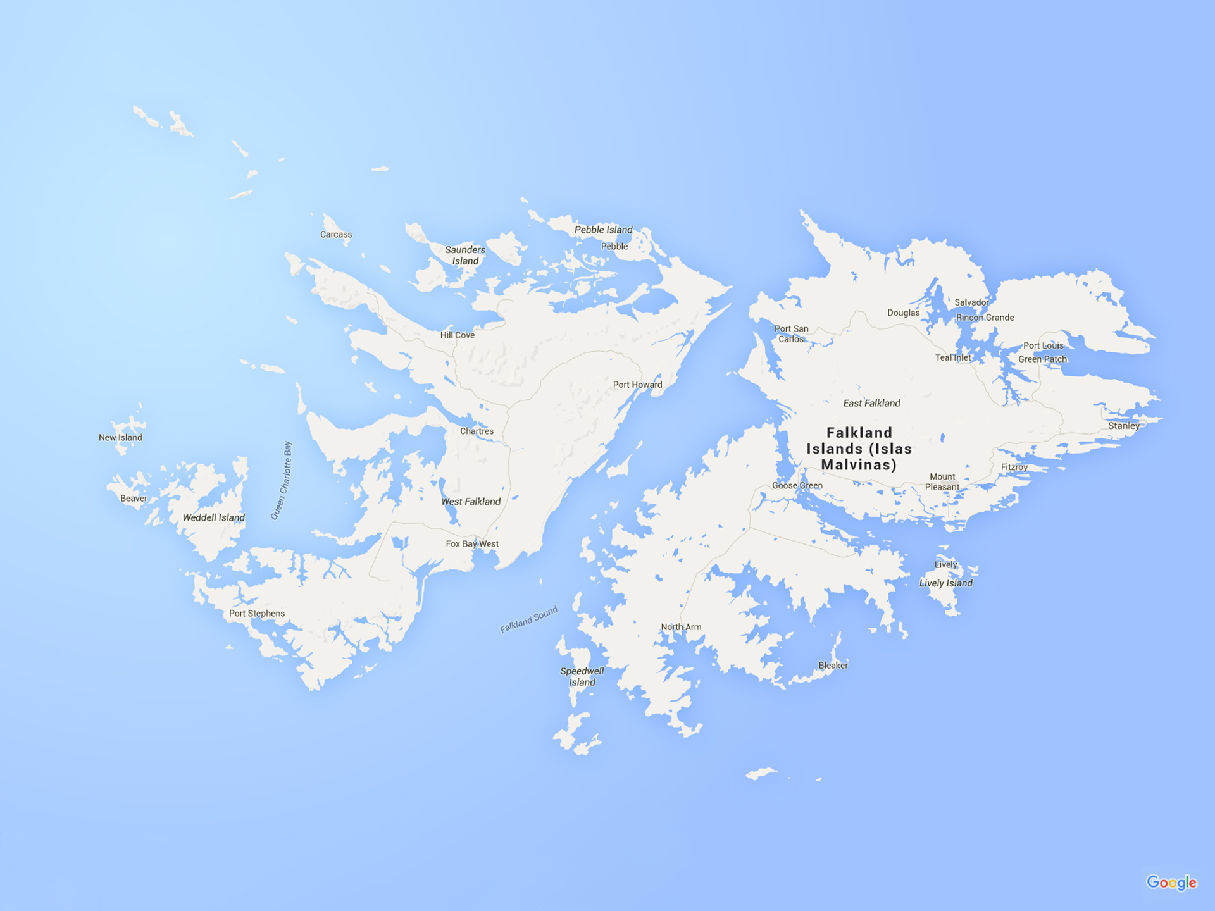

Slide 6
This lecture will be on the Gresham College website soon:
www.gresham.ac.uk

