Slide 1
How Can Software Be So Hard?
Martyn Thomas CBE FREng
Livery Company Professor of Information Technology

Slide 2
The Story So Far …
Society is increasingly dependent on software
There are nearly 20 million programmers worldwide
Cyberattacks are getting much more frequent and successful
Even expert programmers make over 10 errors per KLoC
There can be 10 million KLoC in a car
Many major software projects fail
  25% get cancelled
  Many overrun by more than 100%
  Many do not deliver all of the requirements

Slide 3
What goes wrong?
Two dimensions
The development project fails
  Late, over budget, cancelled
  Requirements keep changing
  Loss of control or loss of customer confidence
The delivered product is not fit for purpose
  Doesn’t meet the users’ needs
  Unreliable, unsafe, insecure, slow, buggy
  Usability problems, too difficult to change
These problems interact: delays in the project cause developers to make decisions that compromise product quality — and finding problems in the product requires rework that causes the project to overrun
Notes:
Some developments stay 90% complete until they are cancelled!

Slide 4
The Software Developer’s Task
– not just to deliver some software
“It is not only the programmer's responsibility to produce a correct program but also to demonstrate its correctness in a convincing manner”
Edsger Dijkstra (EWD249)

Slide 5

Testing software tells you that the tests work – not that the software works
Continuous behaviour means you can interpolate between test results
Discrete behaviour means that you can’t!

Slide 6
Why is software development difficult?
Software is complex
  The complexity of the system is mainly (and correctly) assigned to the software
  Extra features are added because software is so powerful
  Human aspects add complexity (April’s lecture)
Software development is creative
  New applications, new features, or new solutions
Difficult targets for safety/security/reliability
  Pfh 10⁻⁹ for avionics, £B transactions, cybersecurity (3 May lecture)
Legacy systems and the need for compatibility
Few trustworthy components — despite the huge number available
Overconfidence by software developers
Poor tools (and often a very poor choice of tools)
Lack of a profession that could learn from experience

Slide 7
A Simple example of Complexity
Car central locking*
Convenient locking/unlocking of all doors and the boot
Childproof settings must remain effective
All doors shall be locked whilst the car is in motion
Optional locked boot (valet parking)
Automatic unlocking after an accident
Security against theft / carjacking
Low risk of locking oneself out (or in) by accident
… and these actions involve all the doors, windows, ignition, motion sensor, boot catch, impact sensor, indicator lights… and they may interact.
* M A Jackson Where, Exactly, Is Software Development?

Slide 8
Questions and Interactions
Should the boot be locked when the car is stationary but the engine is running?
Should an impact to a stationary and unoccupied car (maybe in a car park) unlock the doors?
What should happen if the car is commanded to lock with one of the windows open? Open how far?
What should happen if a door is not properly closed and cannot lock?
Should it be possible to lock oneself in and to disable any access from outside?
What should happen if the car is losing electrical power?
  Should it differ between occupied and unoccupied?

Slide 9
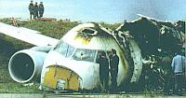
Example of Interacting Requirements
1993 Accident to Airbus A320-211 Aircraft in Warsaw
wet runway, crosswind
Aircraft banked into crosswind
Left wheels touched down 9 seconds after right
pilot applied reverse thrust and spoilers but they were disabled until left gear compressed
Why?
Reverse thrust and spoilers must be disabled in the air
Landing logic requires compression of both L&R gear
Spoilers activate above 72 kts wheel speed or if both landing gear struts are compressed
http://www.rvs.uni-bielefeld.de/publications/Incidents/DOCS/ComAndRep/Warsaw/warsaw-report.html

Slide 10
Requirements are complex
– and they usually change
  Often, the “changes” are things that were overlooked or badly specified – not changes
    Specifications are usually incomplete and ambiguous
This is a major reason for project delays (and for litigation when the client and supplier disagree about whether the “change” is chargeable).

Slide 11
Example: a customer information and billing system for a major utility
Software package and supplier chosen on the basis of a specification drawn up by consultants. Estimated 15 months
Detailed requirements analysis took a year
  Complex interfaces to other systems
  Statutory requirements for report formats
  statutory constraints on the handling of delinquent accounts
  special charging tariffs with hundreds of allowed combinations
  statutory constraints on which users had access to which customer data … …
Timescales slipped by 18 months and nearly bankrupted the company. All the directors were sacked.
Many requirements were non-negotiable. Analysis essential!

Slide 12
Few trustworthy components
Very few software components have a rigorous specification – let alone a guarantee.
Increasingly, programmers copy code from internet web-pages or software libraries.
  Bugs are spread, and there is no support
  Few companies will pay for verified and supported components, other than for major products.

Slide 13
Software Developers are optimists
A professional should know their limitations
  Surgeons specialise, naval architects don’t build aircraft
  Civil engineers and mechanical engineers need sound science before accepting a contract that goes beyond what has been achieved before.
Software developers seem happy to take on applications where they have little experience, and to accept unrealistic targets.
  They like to say “yes”, hoping that things will turn out well …
  … and some like to try fashionable ideas “to get them on my CV”

Slide 14
Poor standards and tools
Many development groups lack tools that support and enforce version control of development artefacts (specifications, designs, plans, code, V&V results etc)
Most programming languages have serious weaknesses that make programming unnecessarily error-prone
Most development groups do not have powerful static analysis tools, build tools, automated regression testing …

Slide 15
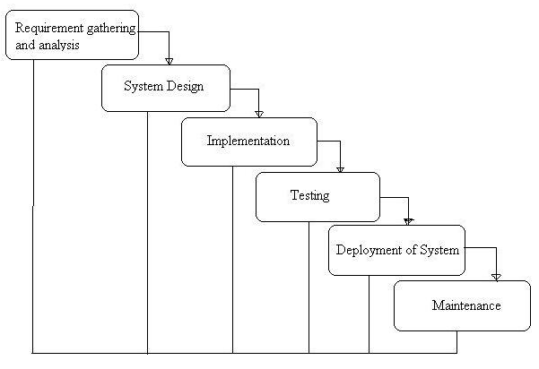
The Waterfall SDLC model of software development

Slide 16
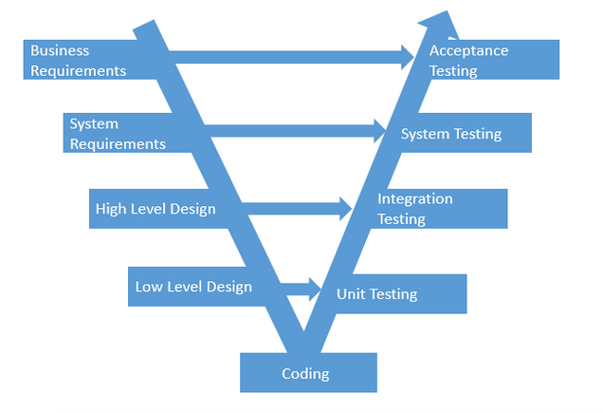
The V model
Notice the overemphasis on testing as the way to validate requirements and verify that they have been correctly implemented.

Slide 17
Agile methods
“welcome changes, focus on working software”
Excellent for prototyping or where the required product is not complex and can be allowed to fail in service.
Dangerous where
  they are an excuse for delaying agreement on the requirements
  the system is safety-critical or security-critical or where in-service failures would be very damaging
  the system architecture is likely to be complex and expensive to change
  the system will have a long in-service lifetime

Slide 18
How do you get the right technical solution to a business requirement?
USE AN ARCHITECT!

Slide 19
Role of the Systems Architect
Help the customer to understand the requirements and possibilities
Propose appropriate and technically feasible high-level solutions (architectures)
Help resolve stakeholder conflicts and agree requirements and architecture
Complete and FORMALISE the technical specification This will eliminate most requirements risk.
Manage supplier selection
Manage the supply contract for the customer
Manage requirement changes
Manage the user acceptance phase

Slide 20
Planning a software development
What are we trying to do? – The Requirements Specification
  Understand the requirements in detail
    Functions and properties
List the risks and uncertainties
  What do we not know?
  What could go wrong?
  What do we need to do to manage the risks?
How are we going to do it? – The Technical Plan
Choose development methods and tools to suit the problem.
How will we know it is good enough? – The Quality Plan

Slide 21
The Quality Plan
List all the deliverables you will produce
  Deliverables between project stages
    Plans, estimates risk register, models, designs, prototypes …
  Deliverables to the customer/user
    Progress reports, Software, documentation, V&V evidence, change management …
Decide what is important for each deliverable, and how each one will be assessed
  Reviews, inspections, conformance to standards, analyses by tools, tests, proofs etc
Document each deliverable and each quality control.

Slide 22
The Resource Plan
Assemble all the identified activities into a hierarchical Work Breakdown Structure
Estimate the effort required for each task, and decide who will do it.
Identify interdependencies between tasks
Draw up an activity network (using a project management tool unless the project is simple)
Derive the end-date and total costs
  Review, rework as necessary, and iterate

Slide 23
Every Project has Risks
The project should maintain a register of risks
  Known unknowns, and known threats to success
  Tasks should be planned to reduce uncertainty and to manage the consequences of risks
    These should involve significant work with evident impact
      What will you do to stop this happening or reduce impact?
      What will you do when this problem occurs, to recover?
  Contingency time in the plan should be allocated and managed against identified risks
Project estimates are therefore a triple (best outcome, probable outcome, worst case).
In a well-managed project, the spread narrows

Slide 24
How Software Development Goes Wrong
Ambiguous, incomplete or contradictory requirements
Underestimated duration or budget
Inadequate management of changes
Incompetence
  Management
  Technical
Complexity – which makes everything else worse
Lack of Board level IT knowledge leads to inadequate business risk management

Slide 25
There are no easy ways to recover
Brooks’ Law: “Adding people to a late project makes it later”. Frederick P Brooks. The Mythical Man Month
Reduce the functionality?
Work harder and longer hours
Cut out some planned activities (often people reduce testing!)
Give up and start again …

Slide 26


Slide 27
How do people get rich writing apps?
They usually start with a fairly simple idea
Very small team, with no pressures on time and budget
Few, if any, security or reliability targets
No need to be careful because no liability
The developers can change the requirements
No-one hears about the projects that failed

Slide 28
Summary
Developing software is hard because:
  it is complex and creative
  The important properties are emergent
  The costs and timescales must be predictable
  There must be evidence that the quality is good enough, which is the hardest thing to achieve
  The industry is still very immature as an engineering profession, with few robust architectures, components, methods and tools.

Slide 29
Please join in the discussions
Please share your views on http://cyberliving.uk and by using the Twitter hashtag #cyberliving

Slide 30
“The price of reliability is the pursuit of the utmost simplicity. “
“There are two ways of constructing a software design: One way is to make it so simple that there are obviously no deficiencies, and the other way is to make it so complicated that there are no obvious deficiencies. The first method is far more difficult.”
C.A.R (Tony) Hoare
Notes:
“There are two ways of constructing a software design: One way is to make it so simple that there are obviously no deficiencies, and the other way is to make it so complicated that there are no obvious deficiencies. The first method is far more difficult.” The price of reliability is the pursuit of the utmost simplicity. It is a price which the very rich find most hard to pay.

