Slide 1
Symposium
What The Dickens?
The City’s Great Financial Scandals: Past And Future
14:00 to 17:00, Thursday, 10 January 2013

Slide 2
Programme
14:00 to 14:15 Greetings – Professor Michael Mainelli
14:15 to 14:45 “A Short History of Financial Scandals”
Edward Chancellor, GMO
14:45 to 15:15 “Modern Pitfalls”
Professor Mike Jones, Professor of Financial Reporting and Head of Department of Accounting & Finance, Bristol University
15:15 to 15:30 Break
15:30 to 16:00 “Great Expectations”
Brandon Davies, Director, Gatehouse Bank
16:00 to 16:45 Panel – “Never Again?”
16:45 to 17:00 Goodbyes – Professor Tim Connell
17:00 to 18:00 Reception (Headmaster’s Office)

Slide 3
Greetings
Professor Michael Mainelli
Fellow & Trustee, Gresham College
Executive Chairman, Z/Yen Group

Slide 4
Definition - Scandal
“an action or event regarded as morally or legally wrong and causing general public outrage”
Middle English (in the sense 'discredit to religion (by the reprehensible behaviour of a religious person)'): from Old French scandale, from ecclesiastical Latin scandalum 'cause of offence', from Greek skandalon 'snare, stumbling block'
[Source: www.oxfordictionaries.com]

Slide 5
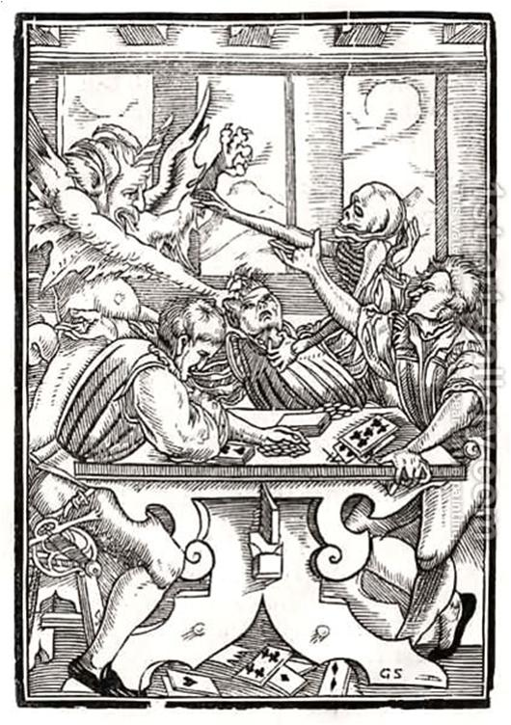
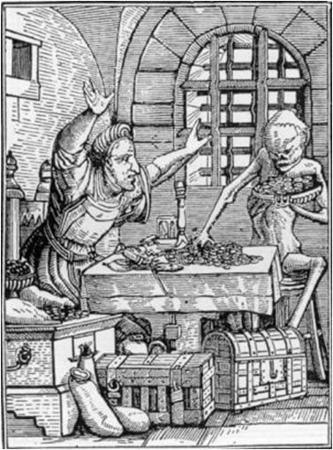
What The Dickens?
“Death and the Devil Come For The Card Player”
“Death and the Devil Come For The Rich Man”
“Dance of Death”, 1538 - by (after) Hans Holbein the Younger

Slide 6
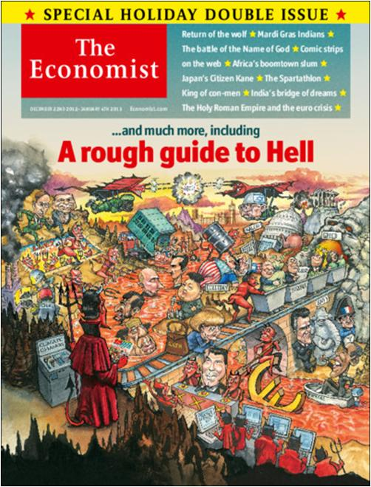
Motive
[The Economist, cover, 22 December 2012]

Slide 7
Means
Hard Work
Go!
Smart Work
Scarcity & Competition
Information Asymmetries
Criminal
Luck
Externalities
Agency Problems
Money Machines
Front-Running

Slide 8
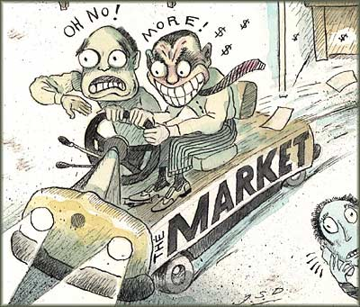
Opportunity Greed, Fear, And A Little Gas
[Source: http://www.fortunewatch.com/handling-greed-and-fear-in-investing/]

Slide 9
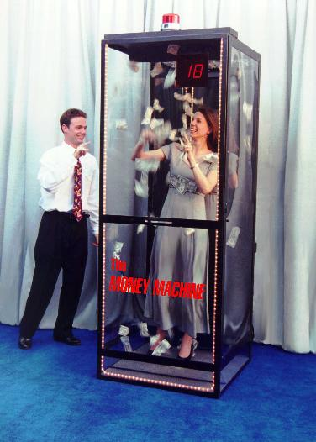
Monopoly Money Machines

Slide 10
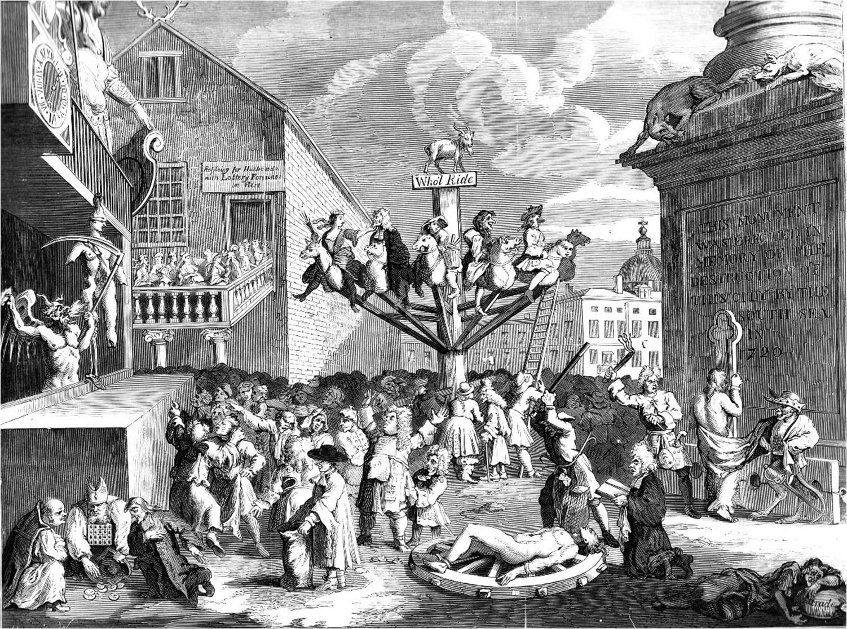
Private Bubbles, Public Debt
[Source: Hogarth's Works published by J. Dicks, 313 The Strand, London. Circa 1880]

Slide 11
Programme
14:00 to 14:15 Greetings – Professor Michael Mainelli
14:15 to 14:45 “A Short History of Financial Scandals”
Edward Chancellor, GMO
14:45 to 15:15 “Modern Pitfalls”
Professor Mike Jones, Professor of Financial Reporting and Head of Department of Accounting & Finance, Bristol University
15:15 to 15:30 Break
15:30 to 16:00 “Great Expectations”
Brandon Davies, Director, Gatehouse Bank
16:00 to 16:45 Panel – “Never Again?”
16:45 to 17:00 Goodbyes – Professor Tim Connell
17:00 to 18:00 Reception (Headmaster’s Office)

Slide 12
First Presentation
“A Short History of Financial Scandals”
Edward Chancellor, GMO

Slide 13
Second Presentation
“Modern Pitfalls”
Professor Mike Jones,
Professor of Financial Reporting and Head of Department of Accounting & Finance, Bristol University

Slide 14
Break
Please come back
to your seats by 15:30

Slide 15
Third Presentation
“Great Expectations”
Brandon Davies, Director, Gatehouse Bank

Slide 16
Panel – Future Prospects
Edward Chancellor
Brandon Davies
Professor Mike Jones
Chair: Professor Tim Connell

Slide 17
Goodbyes
Professor Tim Connell
Life Fellow, Gresham College

Slide 18
Symposium Exam Question
*symposium n., 1. A conference or meeting for the discussion of some subject, esp, an academic topic or social problem. 2. A drinking party with intellectual conversation, music, etc.

