Slide 1
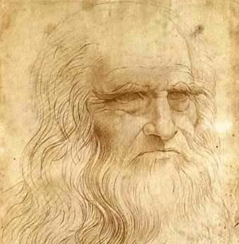
Keeping the heart young in an old body.
Christopher Whitty
Gresham College 2015

Slide 2
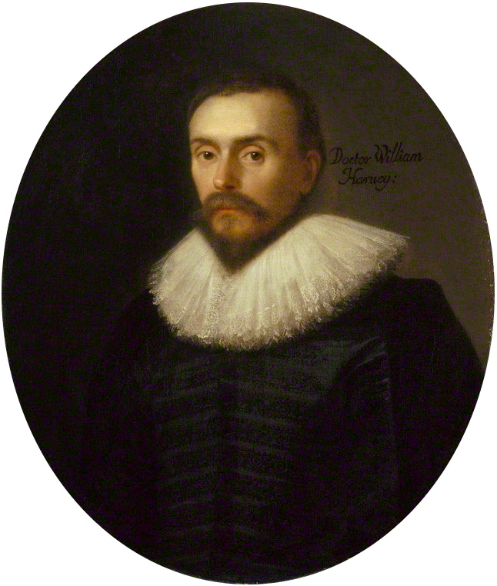
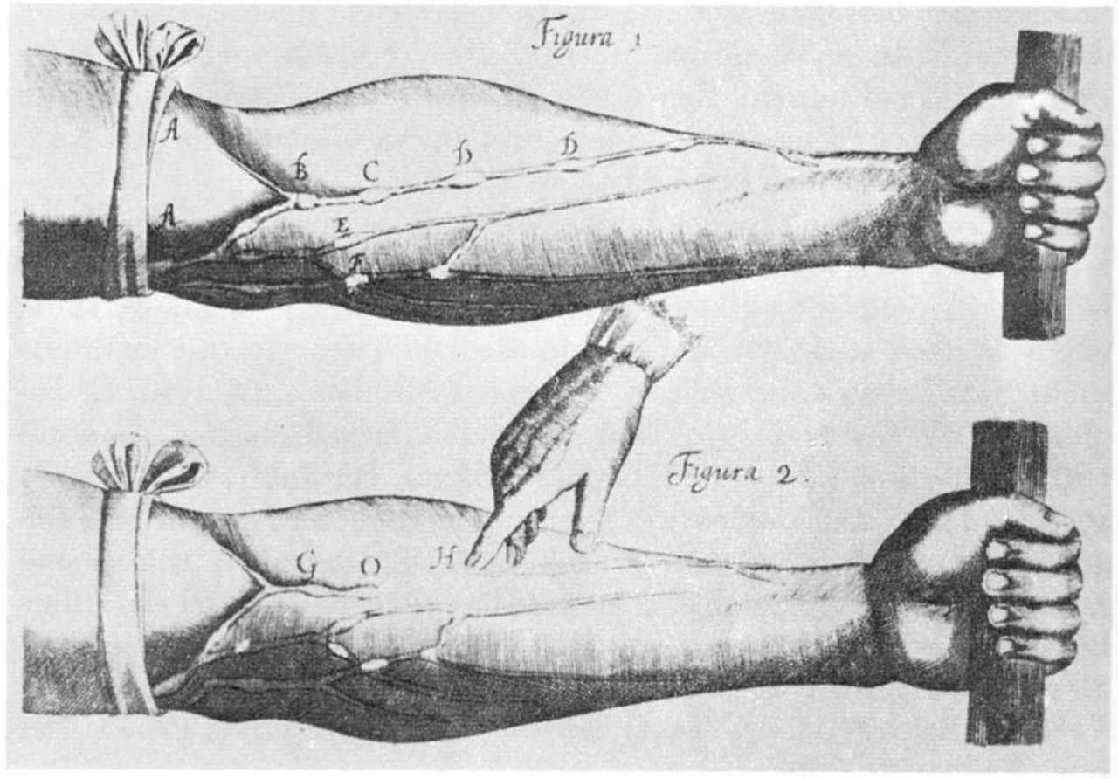
The medical importance of the heart had not been realised in Thomas Gresham’s day (d 1597) .
De Motu Cordis (1628)
William Harvey1578-1657

Slide 3
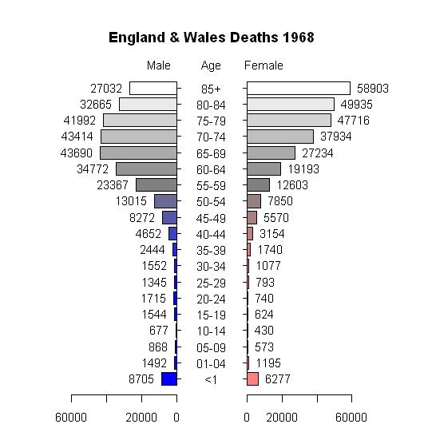
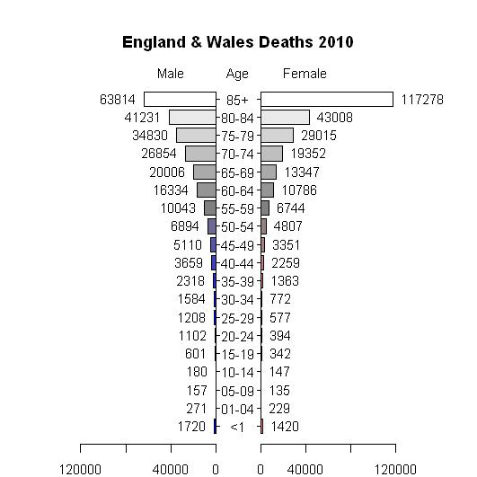
For much of the last 50 years the heart has grown old before the rest of the body. Mortality by age, England and Wales 1968-10. (McCulloch A, Significance)

Slide 4
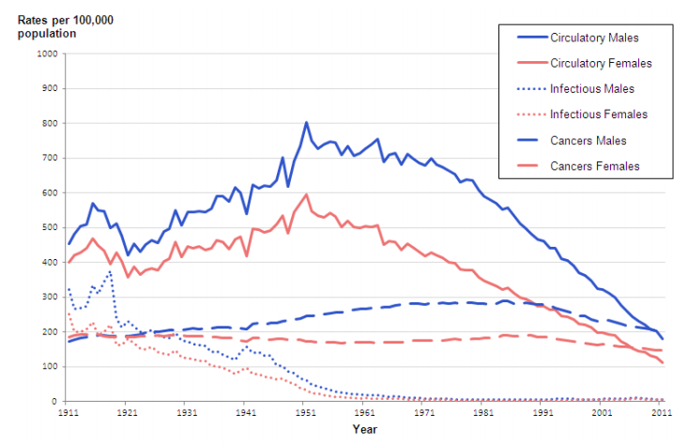
Age-standardised mortality rates England and Wales- circulatory, cancer, infection. (ONS 2014)

Slide 5
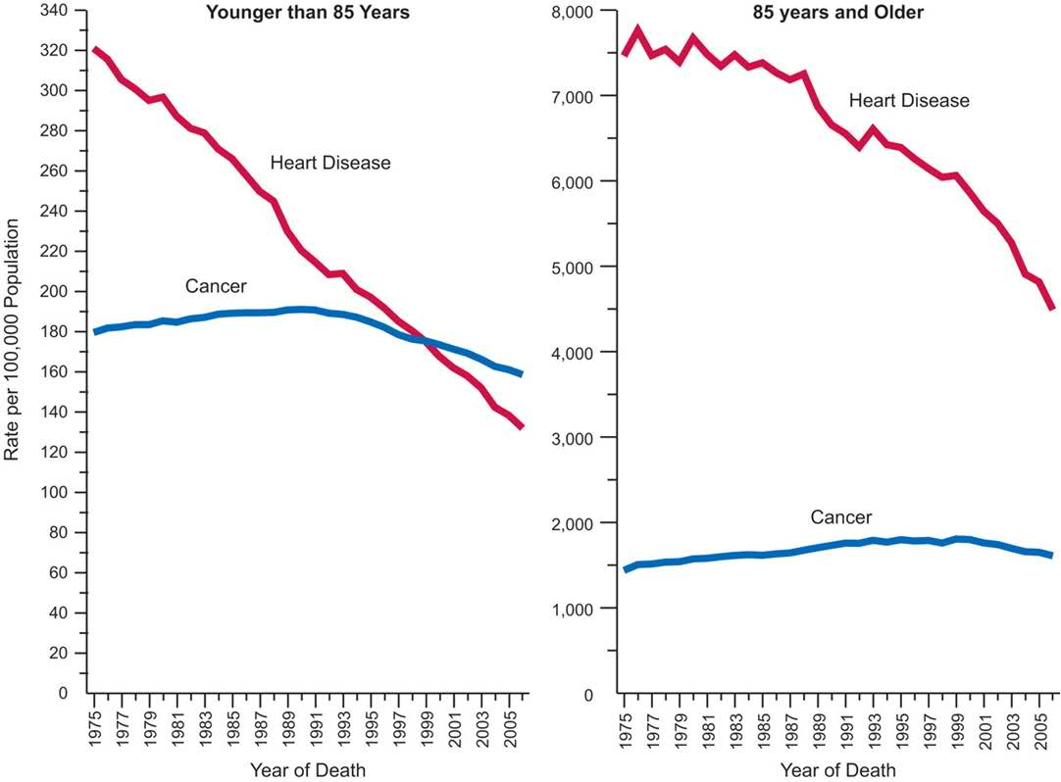
This drop in heart disease is in all ages. (Data from N. America)

Slide 6

Varies across the UK, and in London.
Whether your heart grows old before you do depends on many factors.
Some are under the control of individuals, some rely on health services, some are genetic.
In UK City of London has the lowest mortality rate: 72/100,000. City of Glasgow 198/100,000.

Slide 7
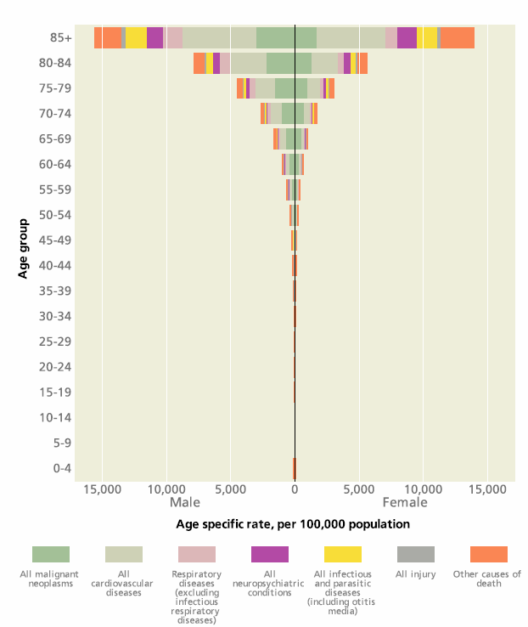
CMO report data
The burden of cardiac disease in the UK and other developed nations is substantial, but falling.
The burden of cardiac disease in middle income countries is moderate but rising fast.

Slide 8
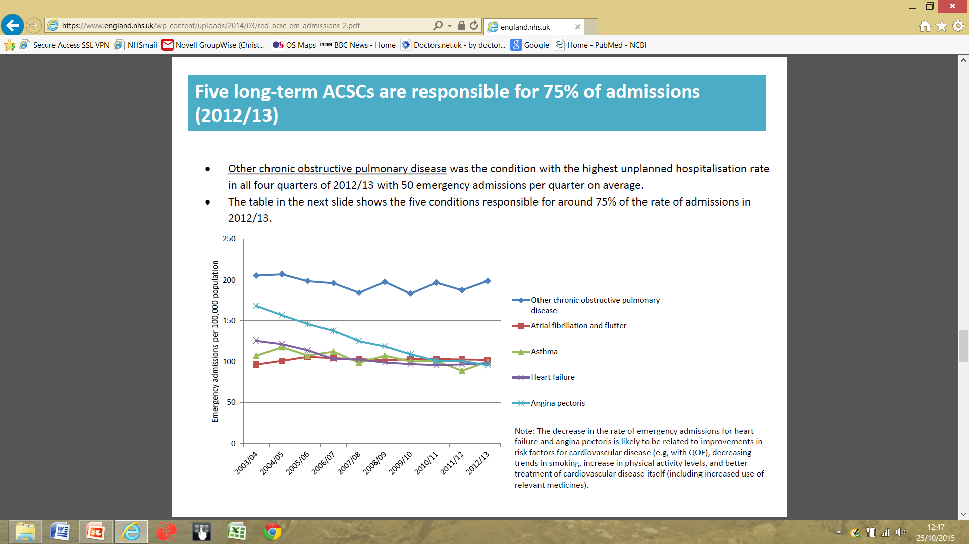
And it is not just deaths, but also severe disease
Angina emergency admissions decreased 6% per year 2003-13; heart failure 3%.
At the same time infections gone up 10% (pneumonia) and 7% (urinary).
In UK people over 75, 7.8% men, 5.9% women have heart failure.

Slide 9
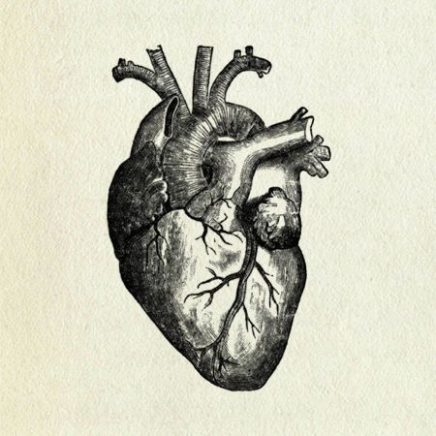
The things that can go wrong with the heart as it ages are not complicated.
It goes too slowly.
It goes too fast.
The valves become inefficient.
The coronary arteries get narrowed or blocked.
The muscle fails for other reasons.
All of these lead to pump failure- heart failure.

Slide 10
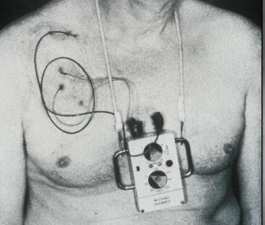
The heart going too slowly.
May be all the time, or intermittent causing dizzy spells and faints.
A few reversible causes, such as low thyroid function, drugs.
Some temporary effects.
For all others- pacemaker.
Diagnosis made easier by ‘Holter’ ECG recorder.
Pacemaker circa 1958

Slide 11
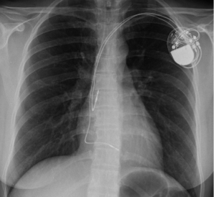
Advances in pacemaker technology.
Dual pacing, long lasting (>7 years), programmable.
Reduce cardiac failure.
In the UK, about 26,000 pacemakers are implanted each year. Average age >75.

Slide 12
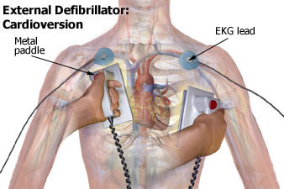
The heart going too fast.
May be all the time, or intermittent causing dizzy spells, faints, falls.
A few reversible causes, such as high thyroid function.
Some temporary effects. Occasionally shocks will be needed.
Image Wiki

Slide 13

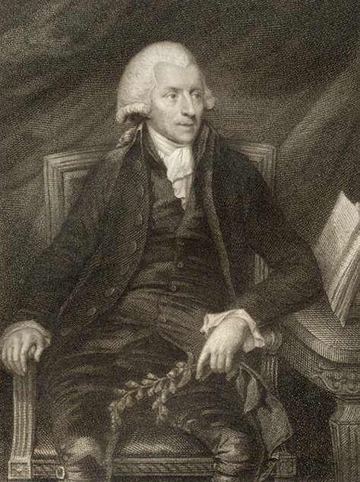
Digoxin
“An account of the foxglove and some of its medical uses; with practical remarks on the dropsy” William Withering 1785.
May have learned it from Mother Hubbard.
Erasmus Darwin tried to scoop him.
Digoxin inhibits the Na-K-ATPase membrane pump.

Slide 14
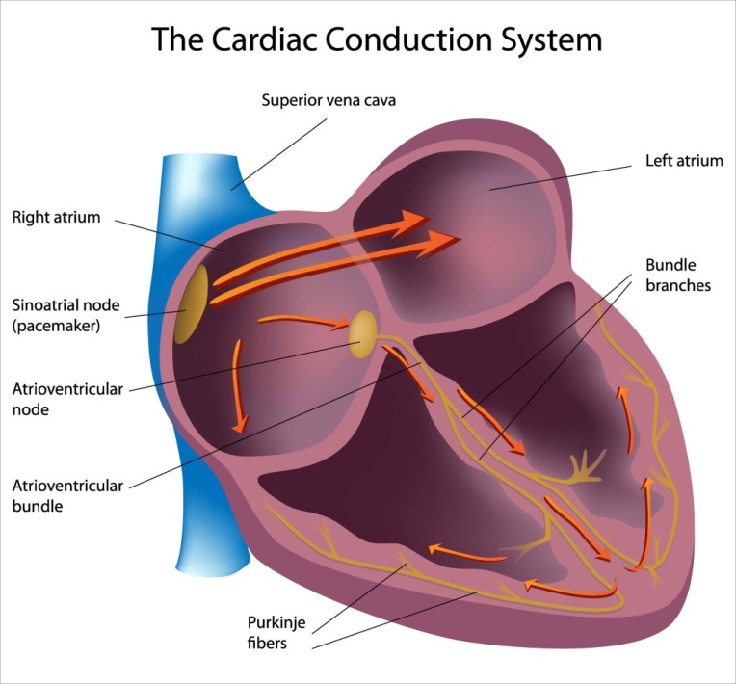
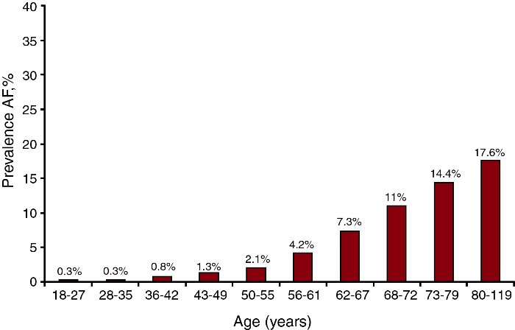
Heart going too fast: atrial fibrillation.
Normally the heart contracts in two stages- the top, then the bottom.
In atrial fibrillation the top is chaotic and drives the main pump too fast.
Strong age component.
Drugs can slow this down. The oldest is digoxin.

Slide 15
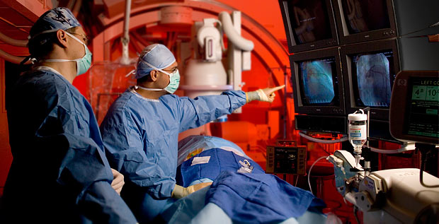
Heart going too fast: tachycardia.
A relatively new permanent method is cardiac ablation (relatively non-invasive).
There is scope to do more in older patients.
Credit CVC group

Slide 16
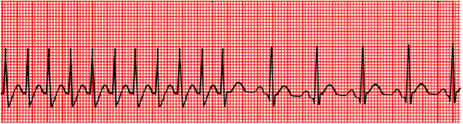
Drugs to reduce tachycardia.
Include:
ß-blockers.
Calcium channel blockers.
Amiodarone.
All major advances- but none ideal so room for further improvement.

Slide 17
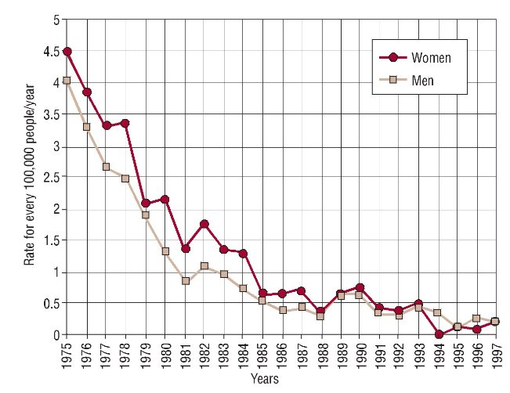
Valves failing.
They can be too narrow (stenosis) or too floppy (regurgitation).
Rheumatic heart disease has dropped in Europe.
Other valve disease age related.
Gómez-Doblas, Andalusia

Slide 18
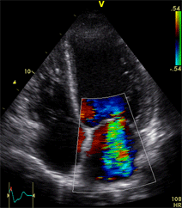
Reliable diagnosis is key, and that depends on imaging.
Current studies of heart valves evolved from observations of bats, SONAR, RADAR and Doppler shifts of stars.
They allow accurate non-invasive diagnosis of the pressure across valves.

Slide 19
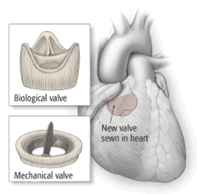
Valve surgery.
Treatment mainly surgical replacement.
Choice between biological (mainly porcine) and mechanical valves.
Credit Harvard Health Publications

Slide 20
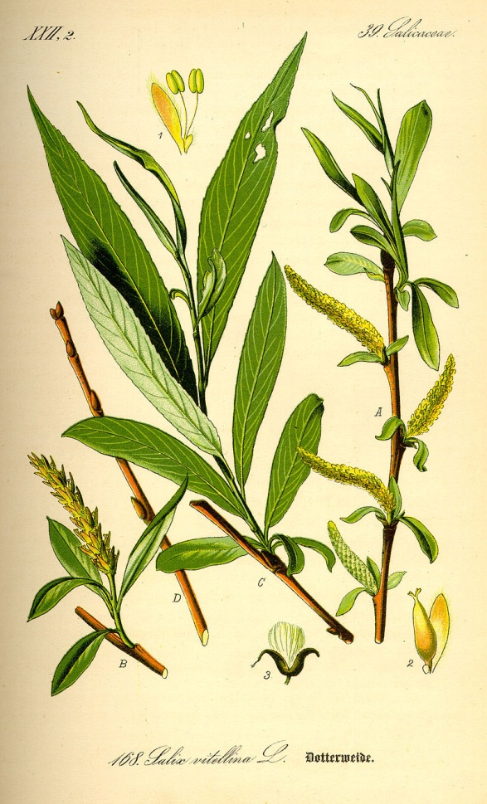
Aspirin.
Willow bark extracts used for fever from at least the time of Hippocrates (400BC).
1763 Rev Edward Stone promoted it for ague over Peruvian bark.
Bayer company from around 1897 Aspirin.
Not until 1971 that its activity against prostaglandins to reduce inflammation understood.
First trial in heart disease 1971.

Slide 21
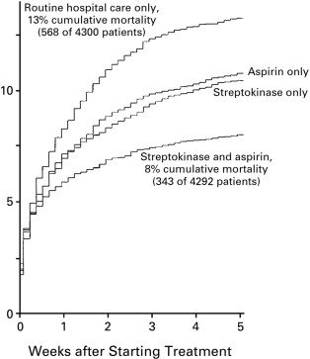
A revolution in heart attack care.
ISIS-2 (1988) trial, around 17k patients with heart attack.
Aspirin 20% better mortality.
Streptokinase ‘clot busting’ drug around 20%.
Mortality 40% better with combined treatment to 8%.
30 day mortality now less than 5% and can be down to 2%.

Slide 22
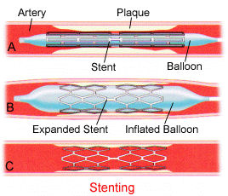
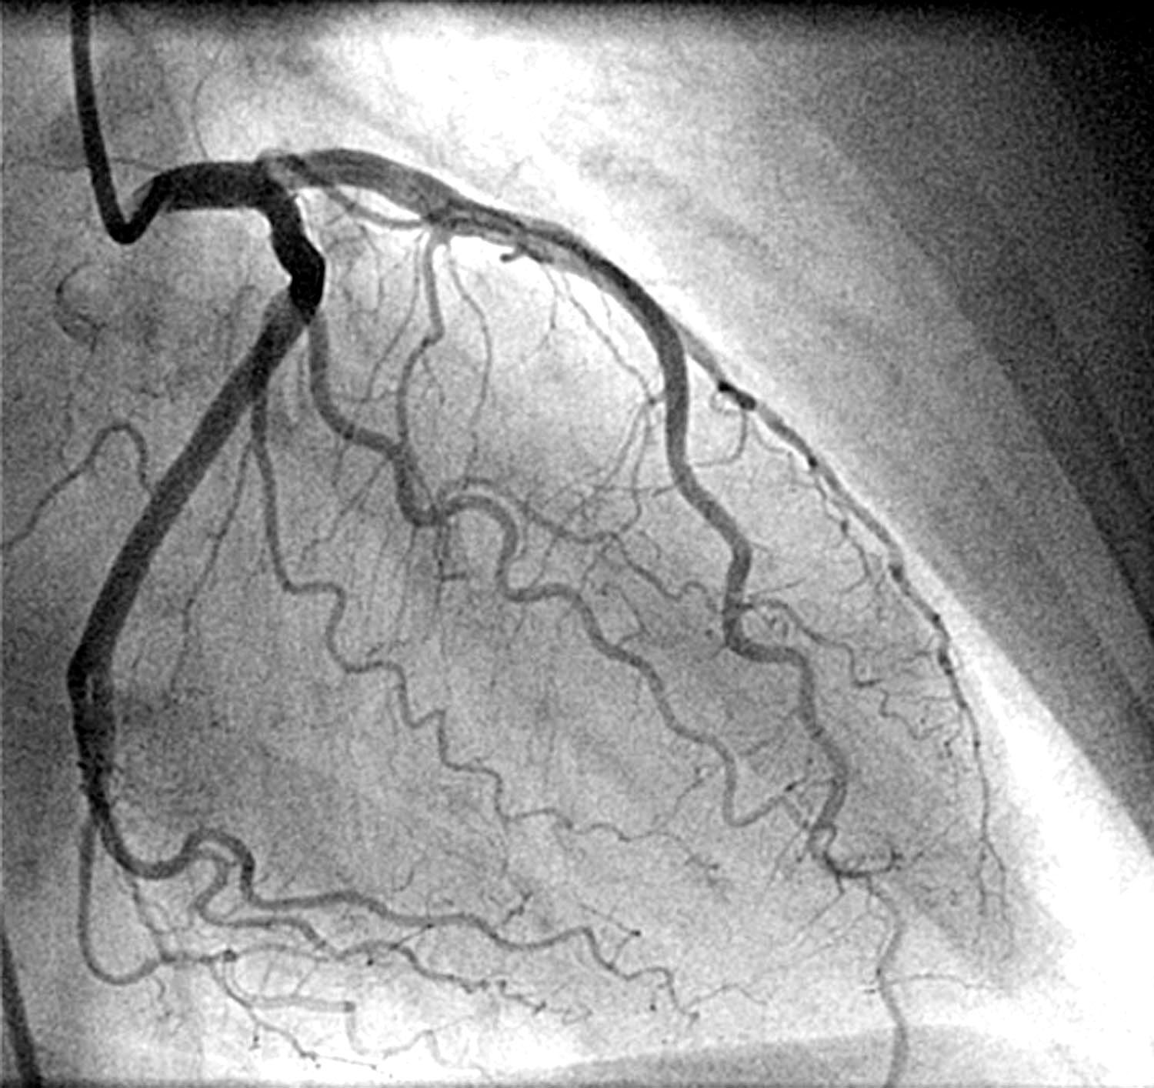
Coronary angiography and stenting.
Credit Dr. David Lipkin

Slide 23
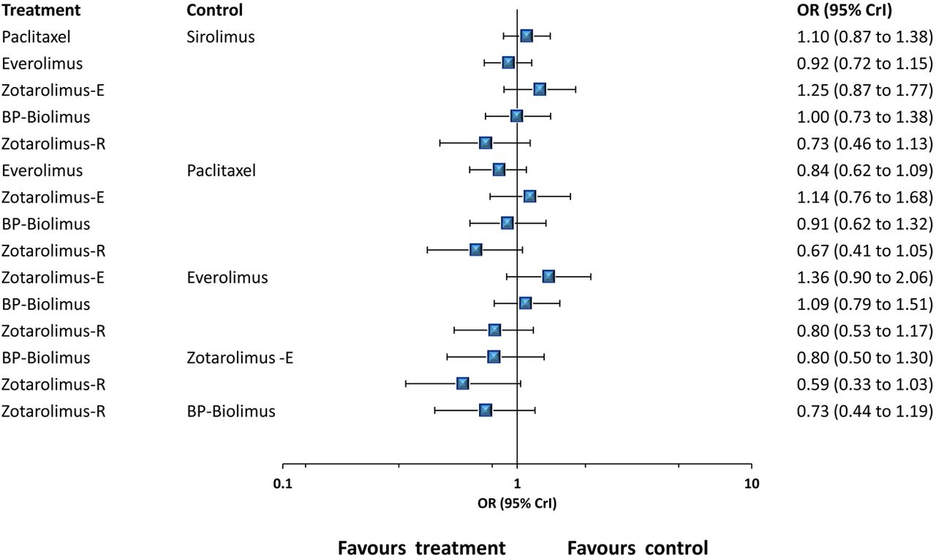
Coronary stenting- heart attack and angina
Gradual improvement in stent design and technique.
New drug-eluting-stents.
Biodegradable stents.
Navarese et al BMJ 2013

Slide 24
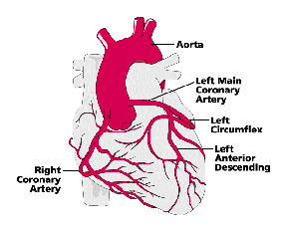
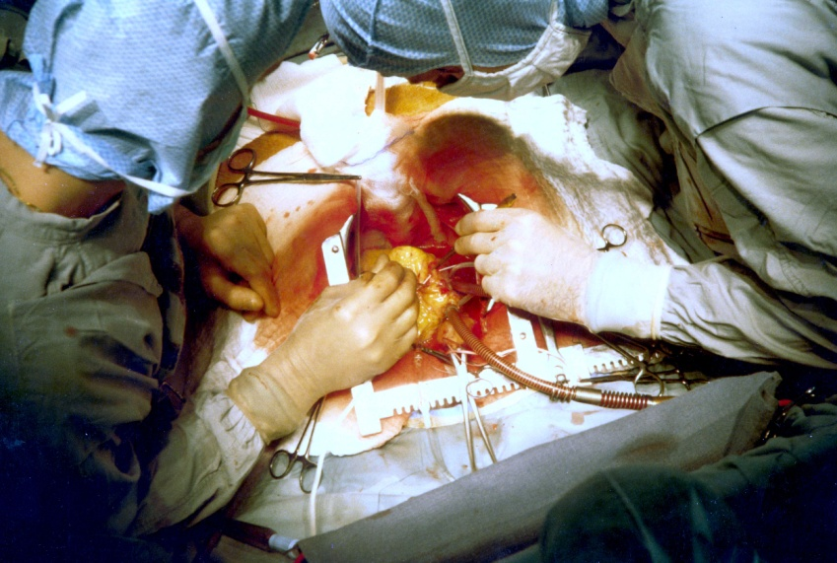
Coronary stenting (angioplasty) v bypass surgery (CABG).
Initial data showed angioplasty reduced symptoms but did not reduce mortality like CABG.
Angioplasty has improved, but there remain situations CABG is the better option.

Slide 25
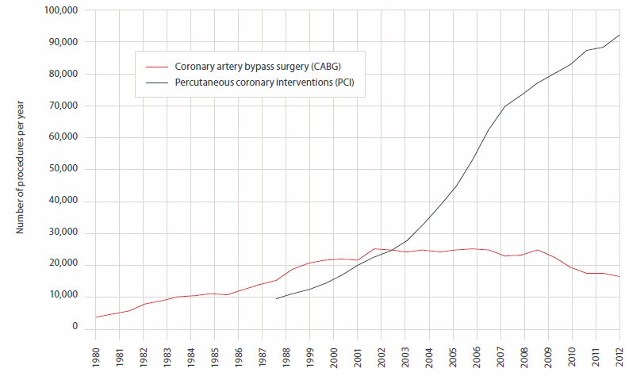
Coronary artery bypass operations v angioplasty, UK 1980-2012 (data BHF).

Slide 26
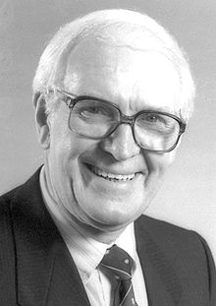
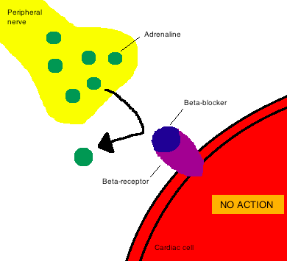

ß blockers
Adrenaline- key to flight-and-fight response.
1948 Ahlquist showed two receptors for catecholamine drugs, α-and β-adrenoceptors.
1965 James Black’s research led to propranolol (and a Nobel Prize).
Subsequently more selective ß-blockers designed.
ß1- heart rate and contraction ß2- smooth muscle and platelets.

Slide 27

ACE-inhibitors
Renin-angiotensin system. Activated when the kidney senses a drop in blood pressure.
Initial chemical shown to block this from Bothrops jararaca Brazilian pit-viper.
Led (by many steps) to captopril, the first of many ACE inhibitors.

Slide 28
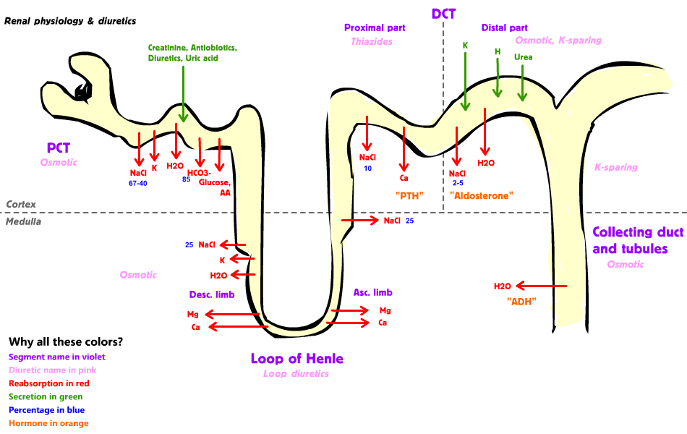
Aldosterone antagonists.
Aldosterone acts on the kidney to conserve sodium and water.
Aldosterone antagonists (spironalactone, eplerenone) block this.

Slide 29
Combination treatment of heart failure.
ACE-inhibitors. Relative risk reduction (RRR) for mortality 26%.
ß blockers RRR around 34%.
Aldosterone RRR up to 30%.
Digoxin may have an additional advantage.
I have used current European Society of Cardiology consensus guidelines.

Slide 30
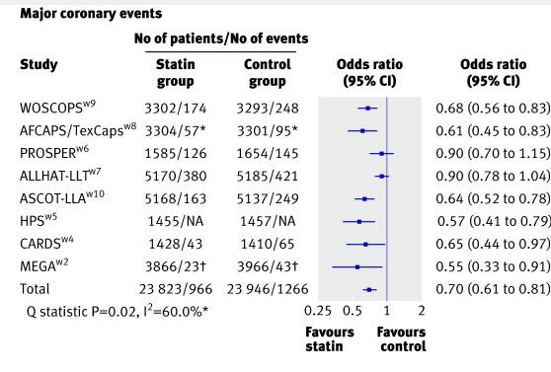
Statins- secondary and primary prevention.
Statins (HMG-CoA reductase inhibitors) reduce LDL cholesterol.
LDL rises progressively with age to 60 (med) or 70 (women).
Overwhelming evidence of benefit in people with previous MI, cardiovascular disease, cardiac risk factors.
Current UK guidelines- 1:10 risk in the next 10 years.
Brugts T et al BMJ 2009

Slide 31
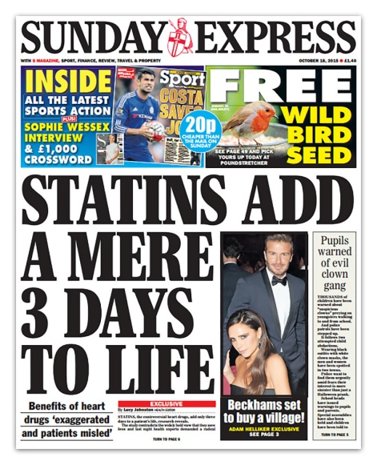
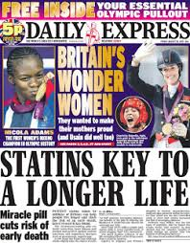
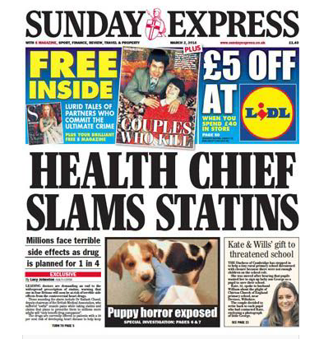
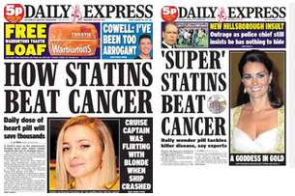
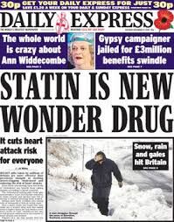
Statins in primary prevention are a balance of risks.
The debate about who they are best for is genuine. But can get distorted.
It is about proper risk assessment.
The elderly are broadly the group at highest risk of cardiovascular disease.
Too few trials only in elderly.

Slide 32
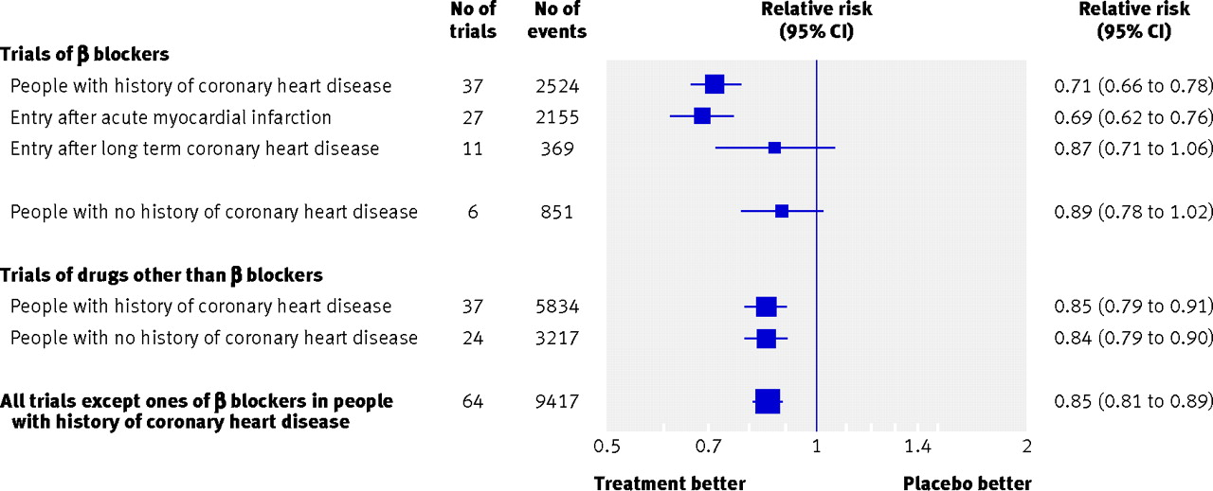
Reducing blood pressure- primary and secondary protection.
Law et al BMJ 2009. Coronary heart events after single measure.

Slide 33
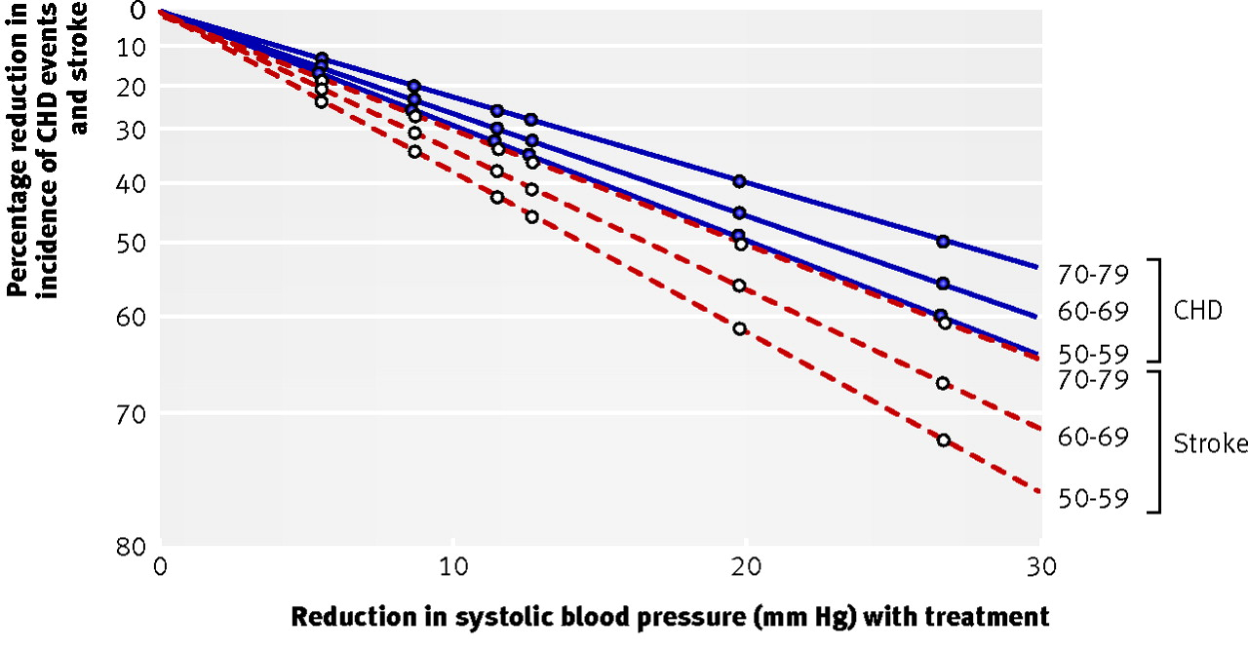
Blood pressure reduction also about balancing risk, but clear benefits at all ages.

Slide 34
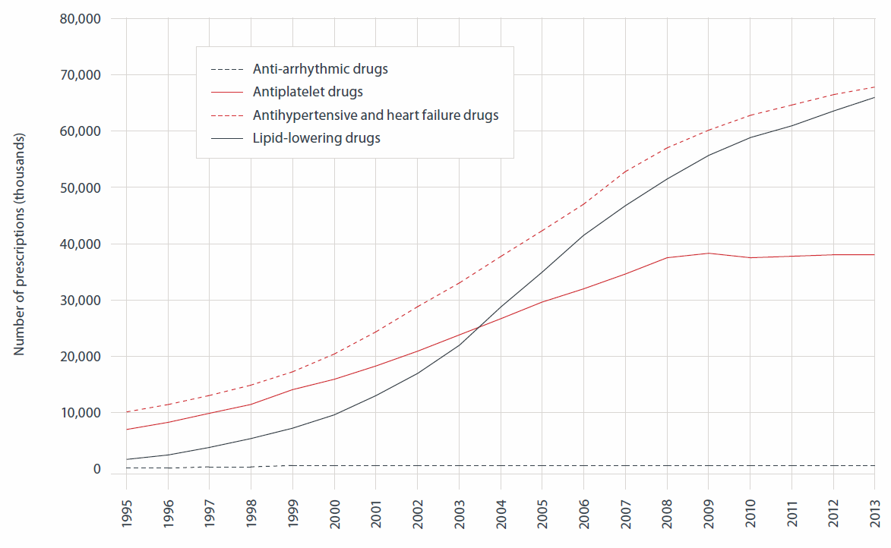
Prescriptions used in prevention and treatment of cardiovascular disease, England 1995-2013. (data BHF)

Slide 35
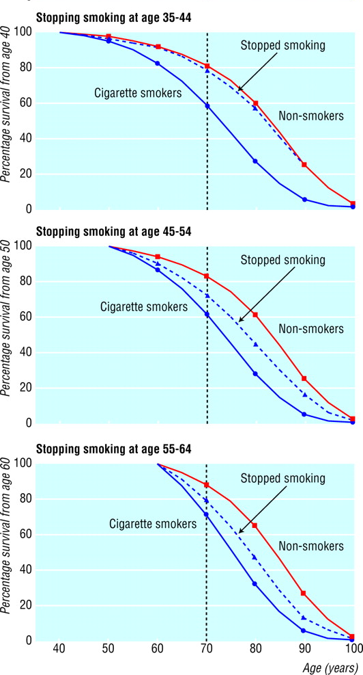
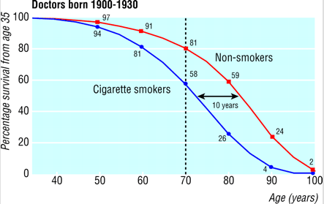
Smoking (Doll, Peto et al 2004)

Slide 36
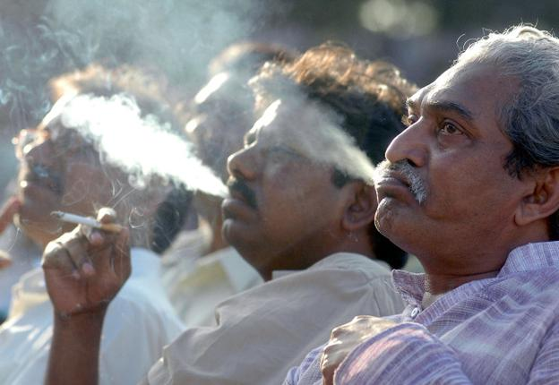
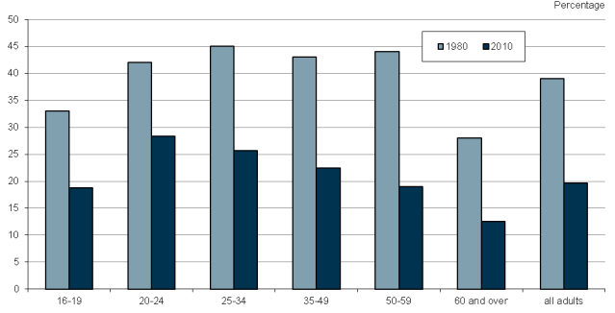
Smoking by age; 1980 and 2010 (ONS 2013)

Slide 37
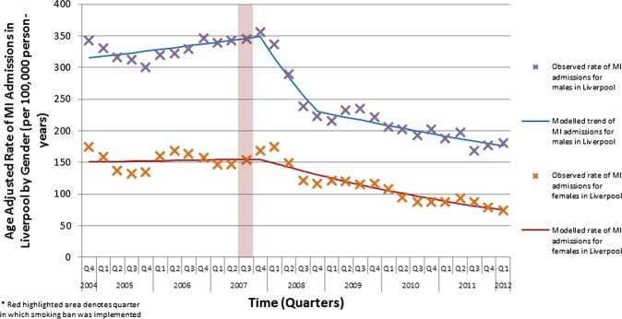
Example: effect of smoke-free legislation
Meta-analysis of smoking bans in public places followed by a 12% reduction in coronary admissions.
Data on R from Liverpool.
Liu et al 2013

Slide 38
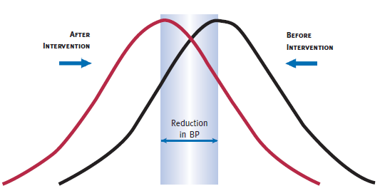
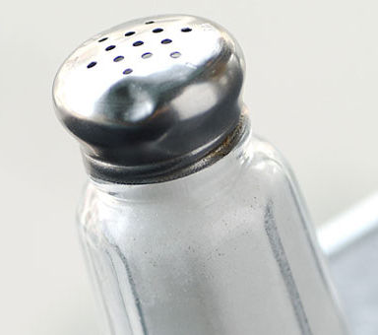
Reductions in salt.
Salt increases blood pressure, and blood pressure of the elderly more salt-sensitive.
UK 15% reduction in salt in the last decade, mainly processed food reformulation.
Many products 20-40% less salt than 10 years ago.
Up to 75% of all salt is processed food and food eaten at home (eg bread).

Slide 39
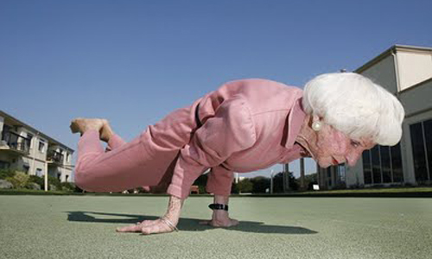
Exercise, better diet, reducing obesity
Everybody knows it’s a good idea….
Credit 92 News HD

Slide 40
This lecture has considered the ways we can slow or reverse the effects of an aging heart.
It goes too slowly.
It goes too fast.
The valves become inefficient.
The coronary arteries get narrowed or blocked.
The muscle fails for other reasons.
All of these lead to pump failure- heart failure.

Slide 41
The heart- a relative success story in the elderly.
Thirty years ago in the UK the heart was much more likely to age compared to the rest of the body then now.
This trend is likely to continue in developed countries, but heart disease will remain a major issue for the elderly.
In middle-income countries it will increase.
Elderly people benefit most from cardiac interventions, but also have most side effects.
Too many trials exclude the elderly.
We will pay a heavy price in cardiac disease in the elderly for being too timid in public health interventions.

