Slide 1
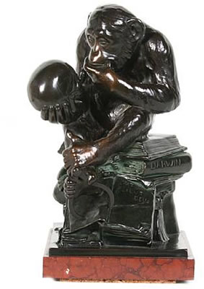
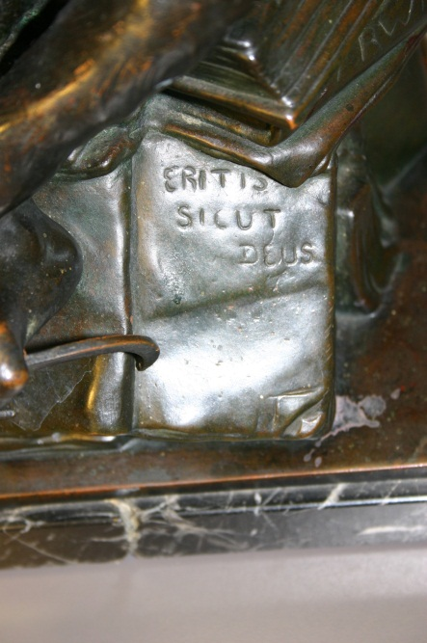
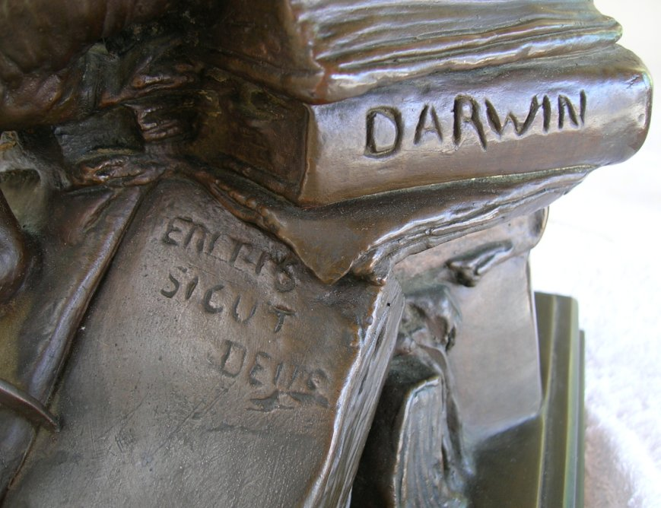
Eritis sicut deus

Slide 2
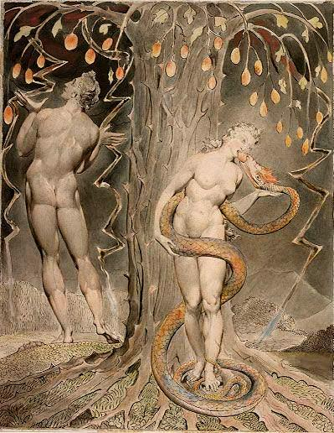
The Serpent’s Promise
“Eritis sicut Deus: scientes bonum et malum”
‘In the day ye eat thereof, then your eyes shall be opened, and ye shall be as gods, knowing good and evil’

Slide 3
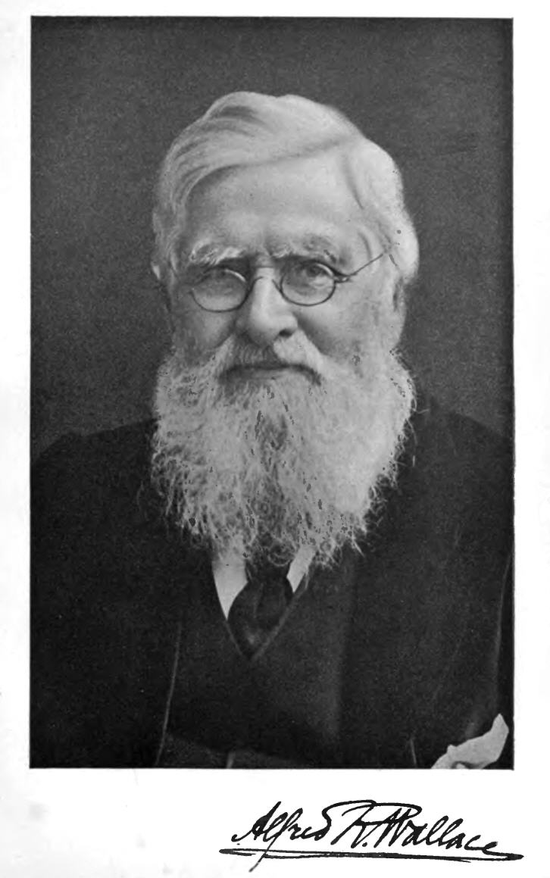

Slide 4
Alfred Russel Wallace: Man has “something which he has not derived from his animal progenitors—a spiritual essence or nature . . . . [that] can only find an explanation in the unseen universe of Spirit.”
Darwin quoting Huxley: spiritualism “not worse than the prevailing superstitions of the country”

Slide 5
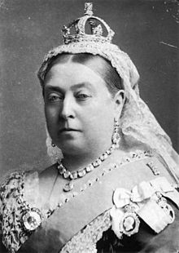
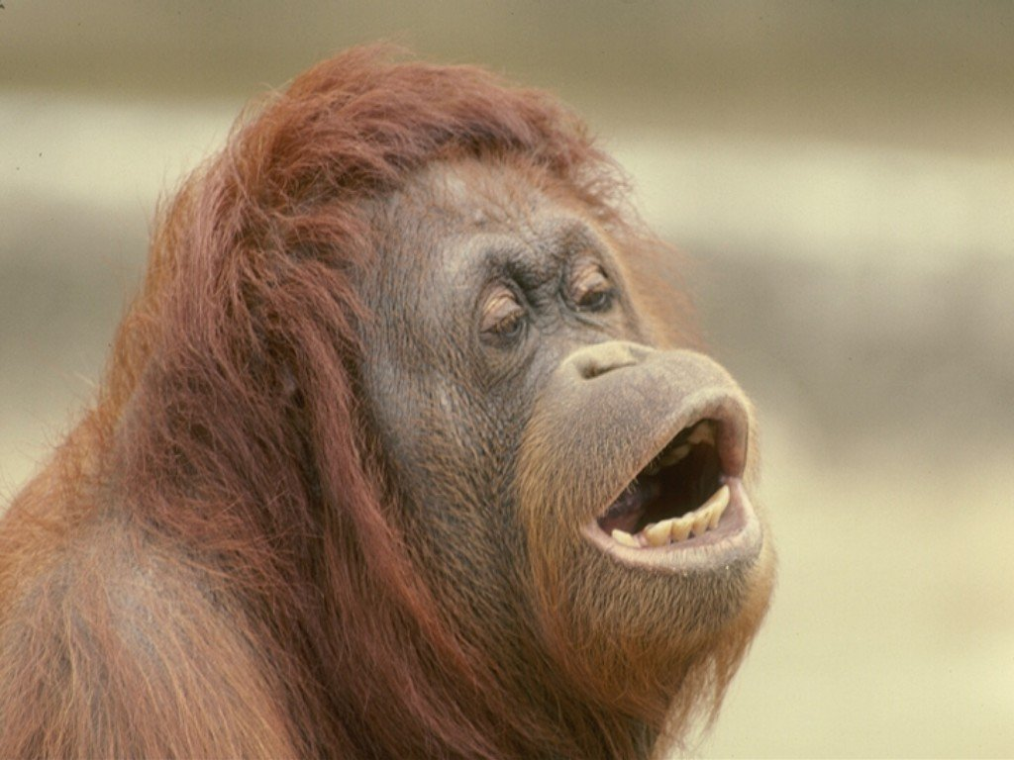
“Frightfully, and painfully, and disagreeably human …”

Slide 6
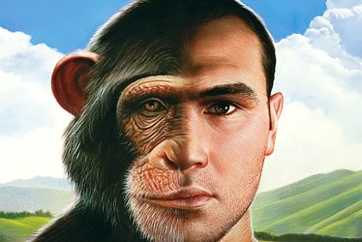
Just another animal?

Slide 7
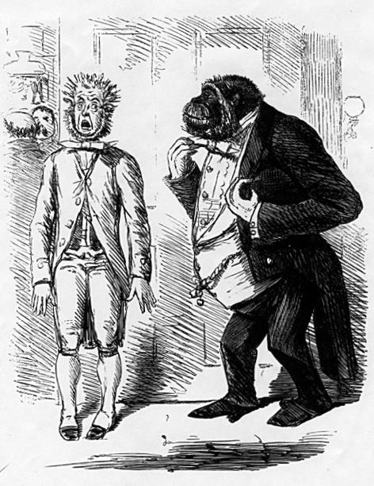

Slide 8
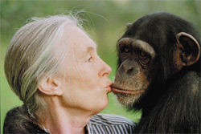
Jane Goodall and friend

Slide 9
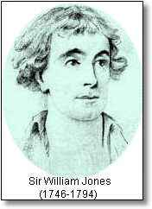


Slide 10

A creationist view of the origin of languages

Slide 12
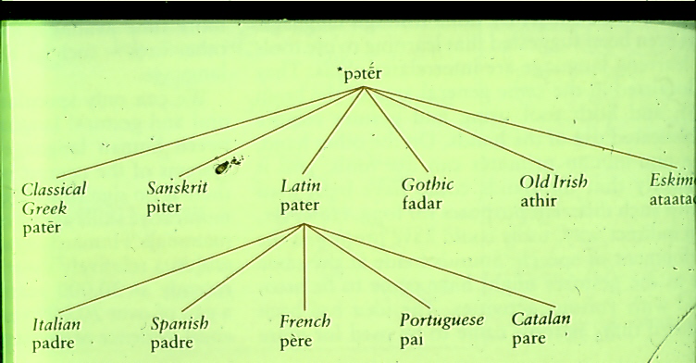

Slide 13
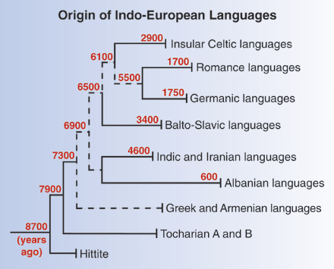

Slide 14
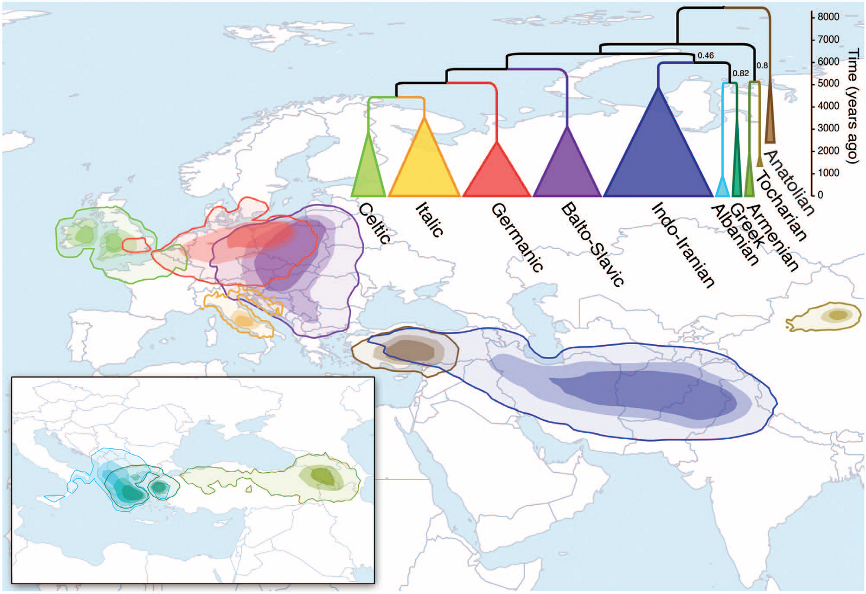
Turkey the home of Proto-Indo-European?

Slide 15
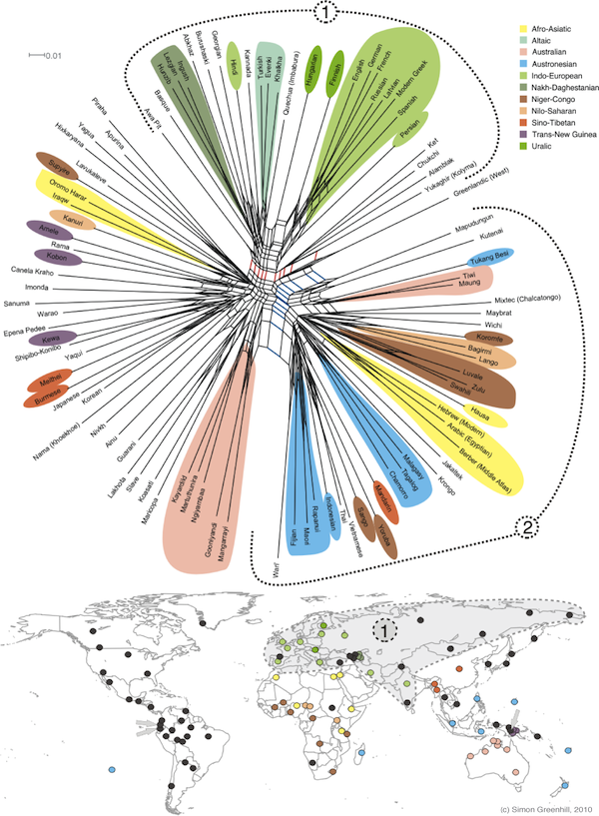
Global language tree – but when did it all begin?

Slide 16
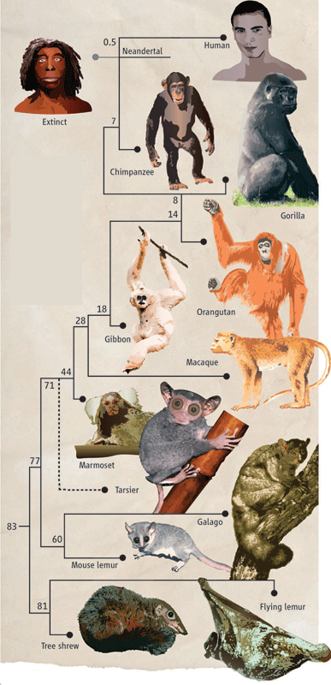

Slide 17
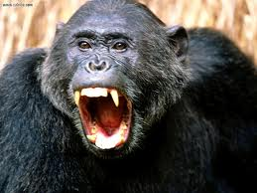
Big teeth, big muscles, lots of hair

Slide 18
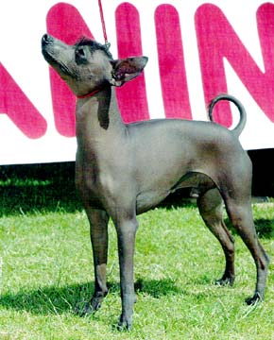
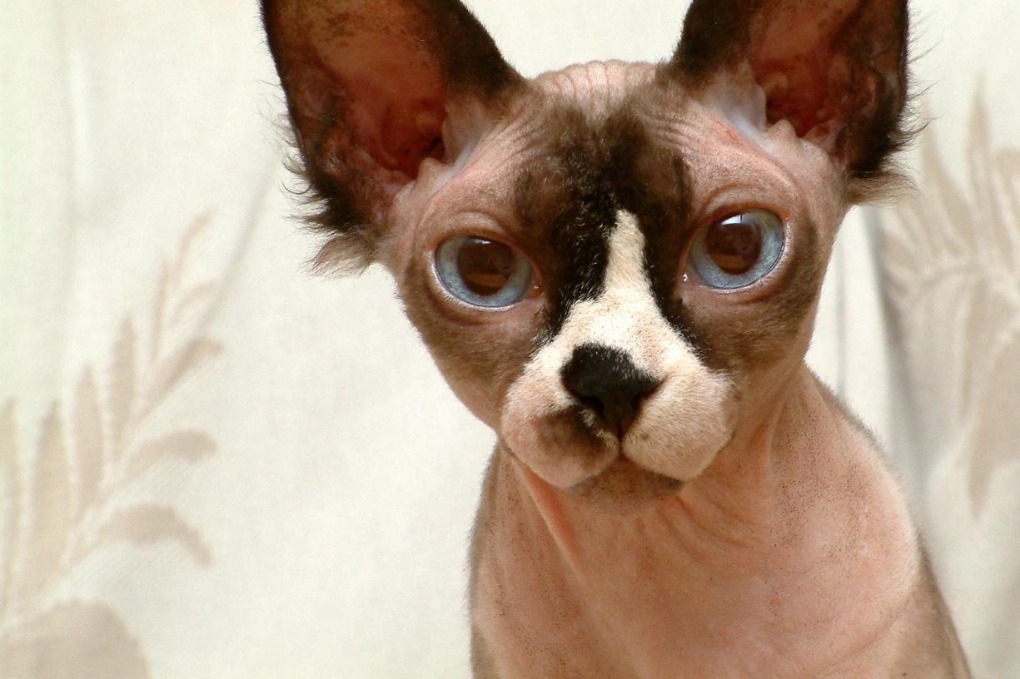
Mexican hairless dog and Sphynx hairless cat; mutation in a “Forkhead Box” [Fox13] gene – note hair on top of head

Slide 19
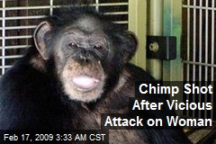


Slide 20
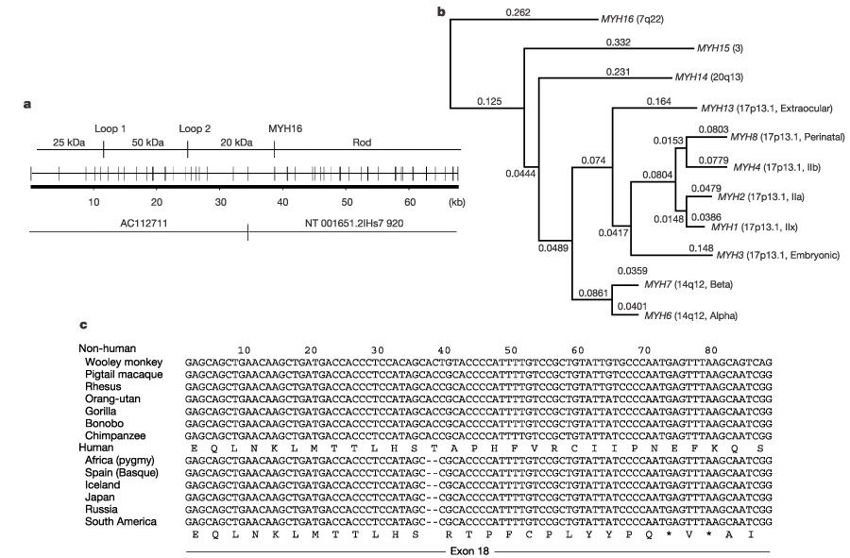
Unique deletion in human sarcomeric myosin (muscle protein) gene

Slide 21
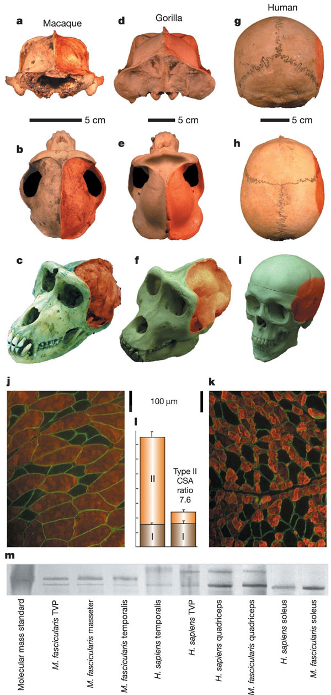
Jaw muscles much reduced in humans cfd to macaques and gorillas

Slide 22
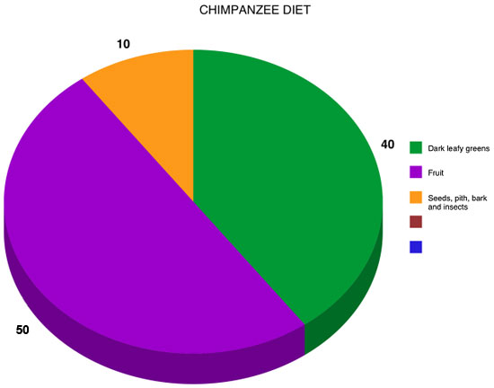
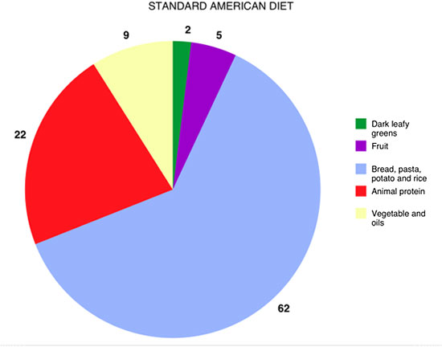
The joy of cooking

Slide 23


Before and after, but then you starve …

Slide 24
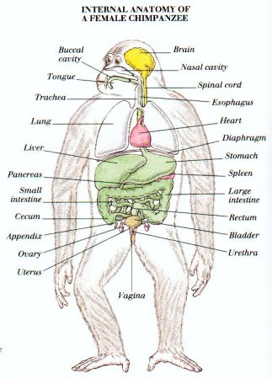
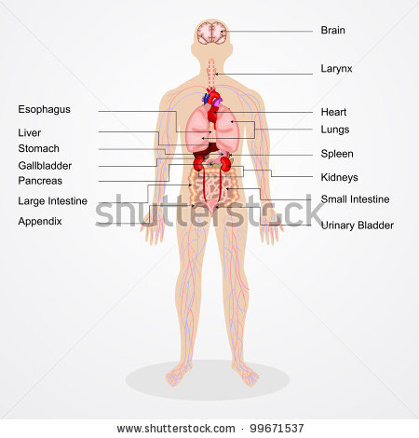

Slide 25
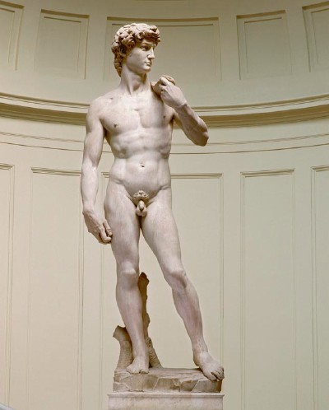
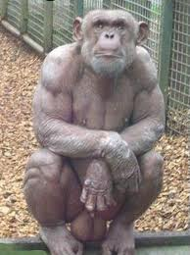
The joy of chimpanzee sex

Slide 26

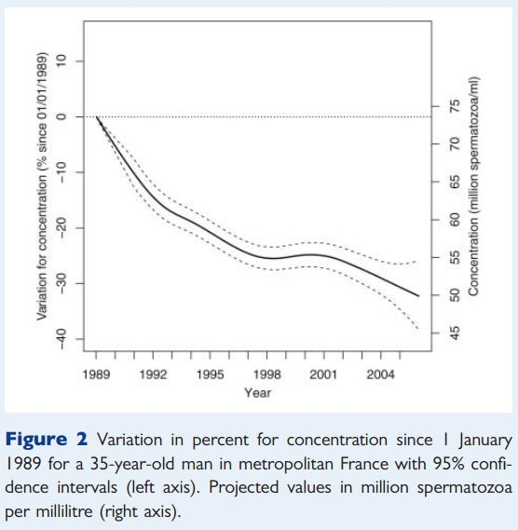
Recent reduction in sperm count (it’s OK, it’s France)

Slide 27
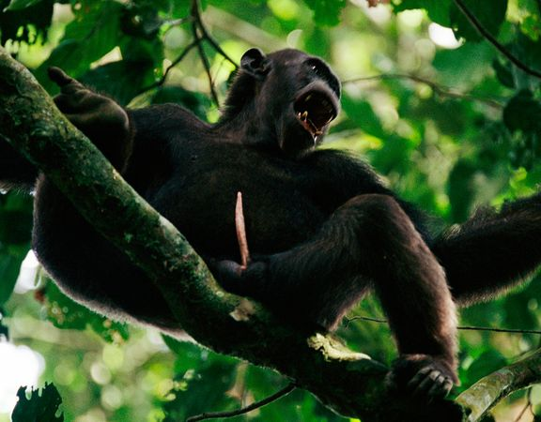
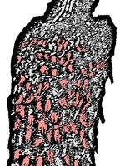
Chimp and another missing human talent; the big picture and a close-up

Slide 28
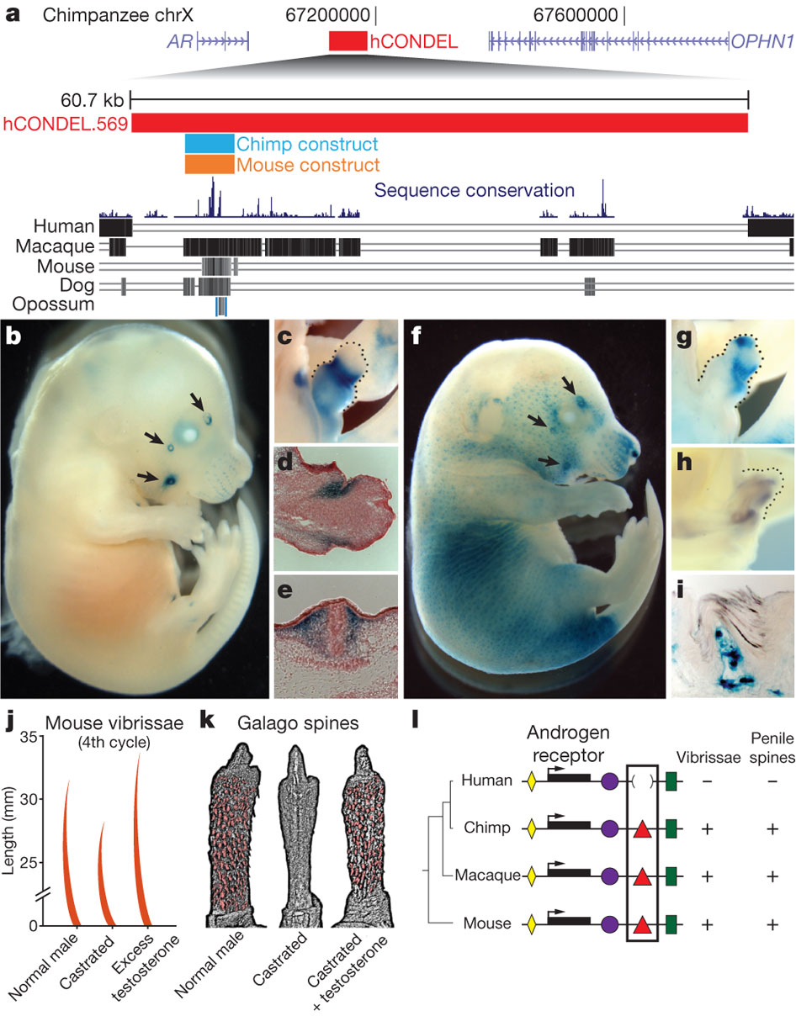
Deleted male hormone receptor in humans – effects on hairiness in mice and spines on primate (galago; bush-baby) and human penis (spineless)

Slide 29
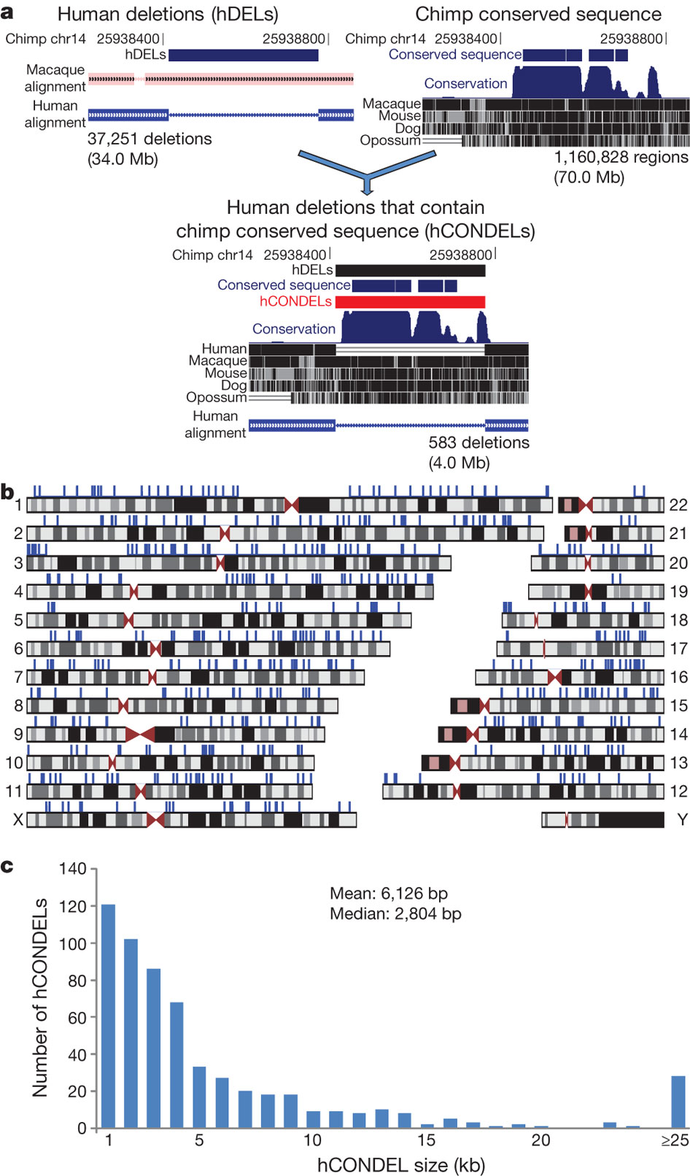
Above – large deletions in human DNA compared to chimp (blue lines); below, distribution of size of deletions in thousands of bases

Slide 30
Over-representation of particular classes of gene regulator deleted in humans compared to chimps, over random expectation; it’s not all in the brain!
Steroid Hormone Receptors 2.96 x
Immunoglobulins 3.84 x
Brain 1.62 x

Slide 31
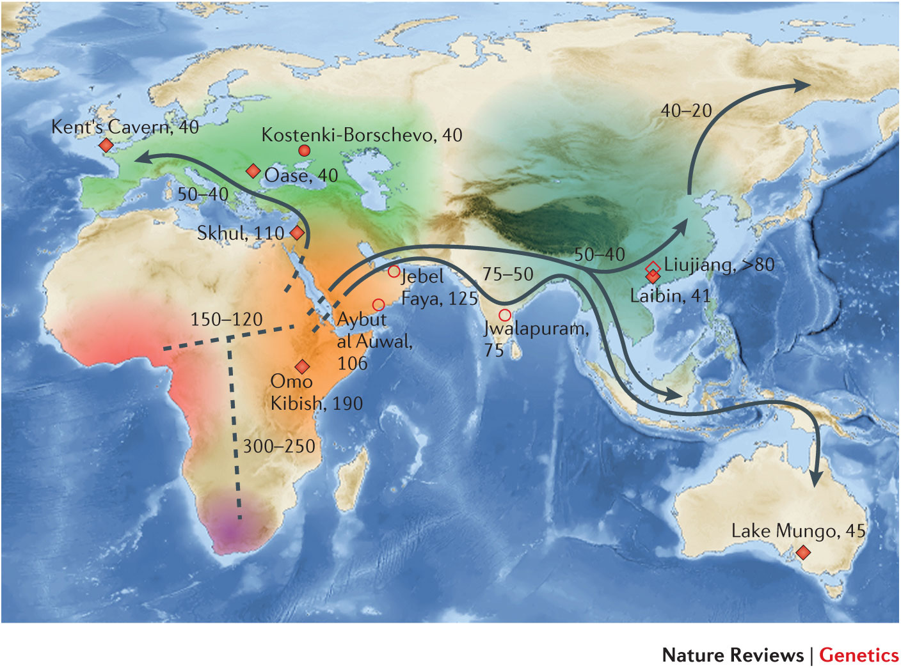
Dates of migration across Old World

Slide 32
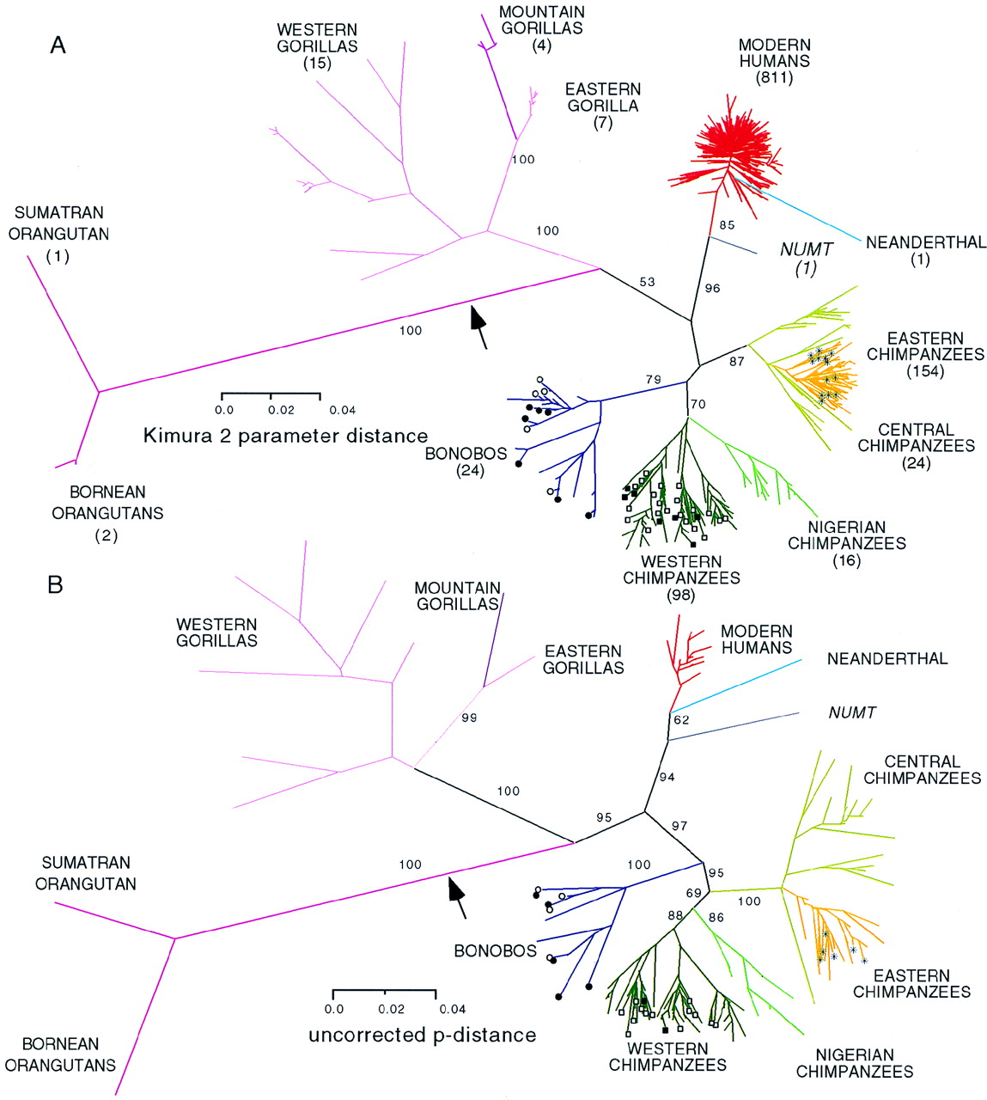

Slide 33
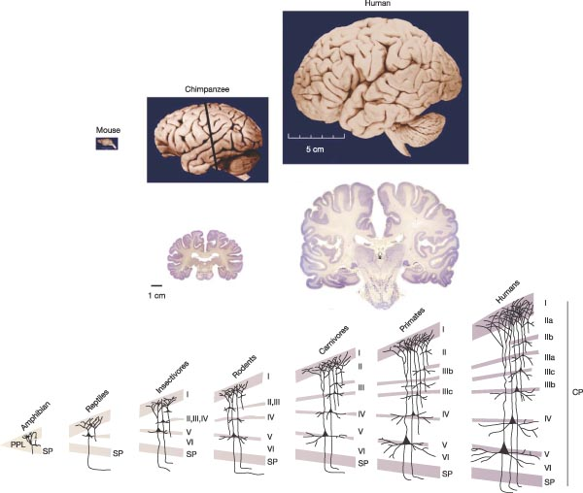

Slide 34
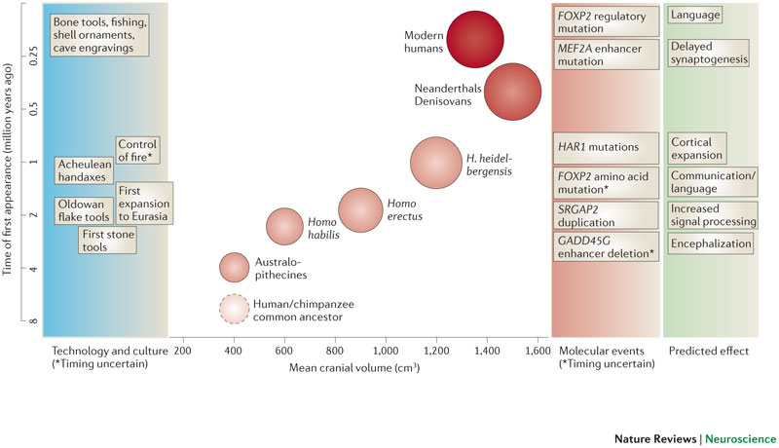
Brain size, time and culture

Slide 35
Numbers of cortical neurones (millions)
Whales 10 500
Elephants 11 000
Horses 1200
Dogs 160
Gorillas 4300
Chimps 6200
HUMANS 12 500

Slide 36

Disruption of “language area” in verbal dyspraxia (foxp2)

Slide 37
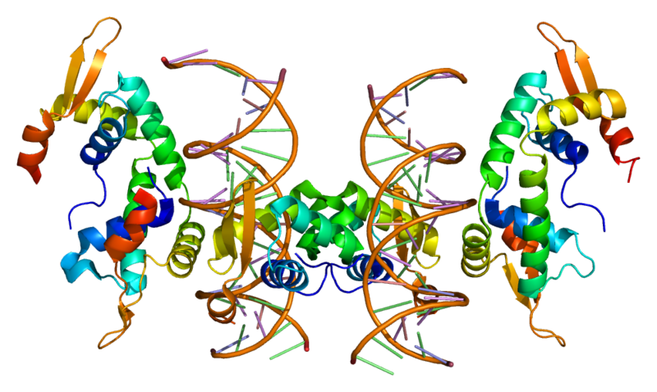
Forkhead box P2 – FOXP2 - structure

Slide 38
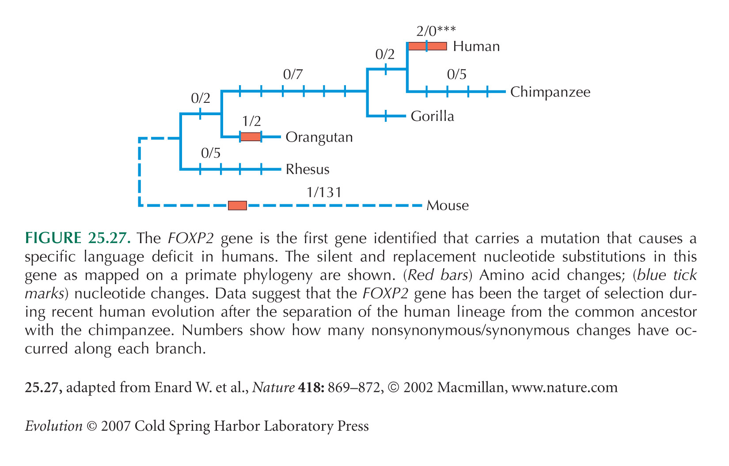
FOXP2 Mutations – involved in language?

Slide 39
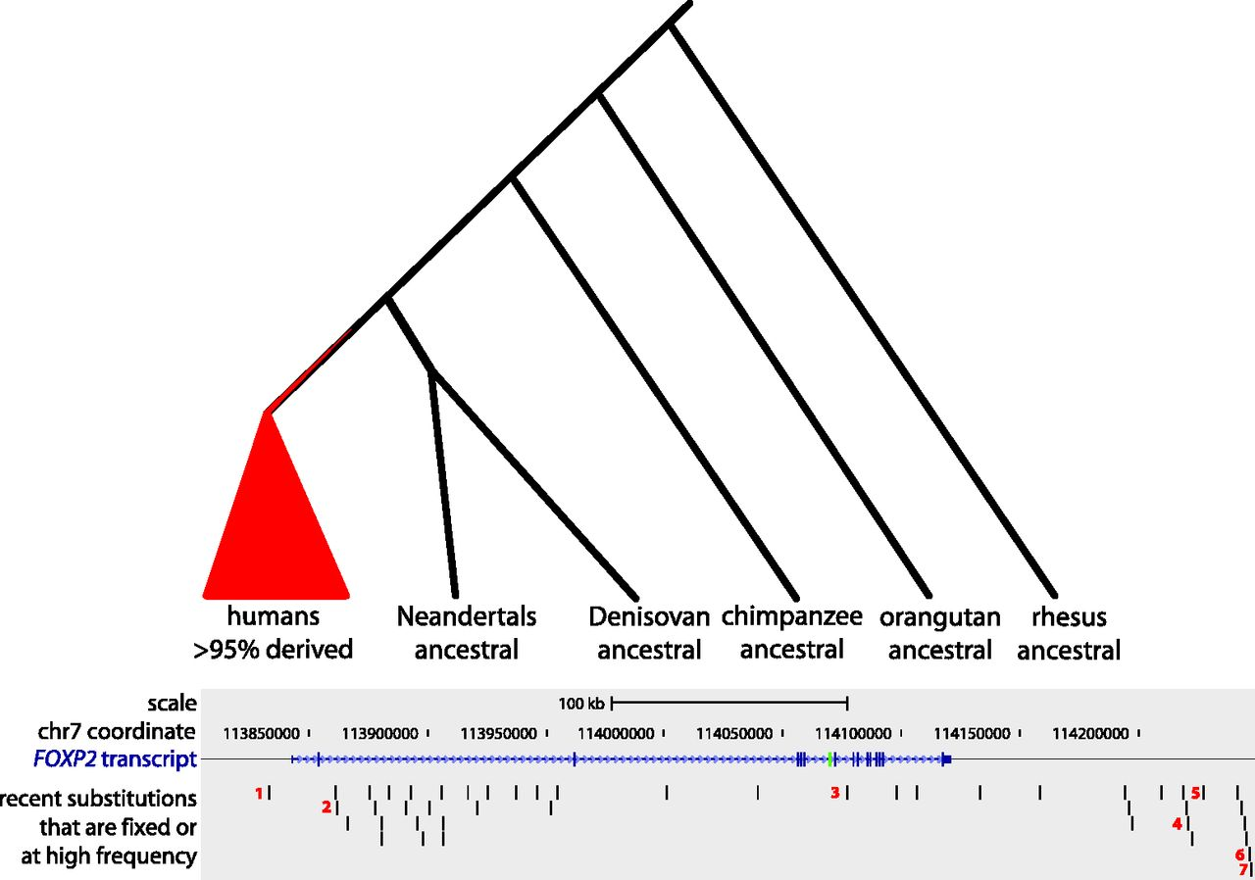

Recent substitutions that are fixed or at high frequency in present-day humans.
Maricic T et al. Mol Biol Evol 2012;molbev.mss271
© The Author 2012. Published by Oxford University Press on behalf of the Society for Molecular Biology and Evolution. All rights reserved. For permissions, please e-mail: journals.permissions@oup.com
Notes:
Recent substitutions that are fixed or at high frequency in present-day humans. Upper panel: schematic illustration of substitutions at high frequency or fixed in humans (red) but ancestral in archaic humans and apes. Lower panel: the FOXP2 region captured encompassing the FOXP2 transcript (blue); vertical lines in the transcript indicate exons; exon 7 is green. Among the 46 recent substitutions, those that overlap with highly conserved regions and/or annotated functional regions are indicated by red numbers: 1) PhastCons score: 0.98, DNaseI hypersensitive, ChIP-seq TFs: CTCF, CEBPB, and Rad21; 2) DNaseI hypersensitive; 3) PhastCons score: 1.00; TFBS conserved: POU3F2; 4) TFBS conserved: CDP; 5) DNaseI hypersensitive, ChIP-seq TFs: NFKB, EBF, and BCL11A; 6) ChIP-seq TFs: c-Jun, STAT1, and BAF155; and 7) ChIP-seq TFs: STAT1, BAF155, c-Fos, Max, and BAF170.

Slide 40
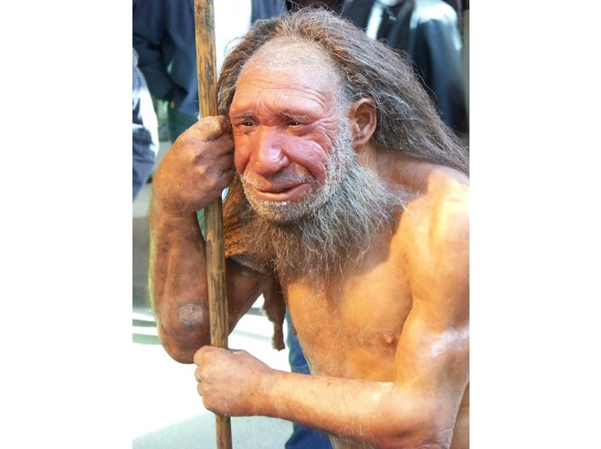

Slide 42

No angels, but …

