Slide 1

Is the economic growth from the emerging economies additional?
Second Gresham Lecture
Douglas McWilliams
Mercers School Memorial Professor of Commerce at Gresham College
with Thras Moraitis, Member of Executive Board Xstrata plc and
Michael McWilliams, Global head of Hydro, Mott MacDonald
Centre for economics and business research ltd
Unit 1, 4 Bath Street, London EC1V 9DX
t: 020 7324 2850 f: 020 7324 2855 e: advice@cebr.com w: www.cebr.com

Slide 2
Objective
To understand the main constraints on world economic growth, to assess the consequences of constrained economic growth and to discuss what policy measures could limit these constraints

Slide 3
Overview
What are the key constraints on world economic growth?:
Economic
Environment
Food
Minerals
Energy
Water

Slide 4
Overview (continued)
Can technologies change the impact of these constraints?
If growth is constrained what are the implications – for the emerging economies and for the Western economies?
What policy measures will allow faster growth by limiting the extent to which shortages hold growth back?

Slide 5
Economic uncertainty
The Western financial crisis is and its aftermath are likely to be with us for perhaps 5-10 more years, constraining growth as balance sheets are rebuilt and governments retrench
The euro problem is going to retard world and especially European growth - either through the disruptive effect of the collapse of the euro or through the long period of internal adjustment to misaligned real exchange rates – this problem could affect economic performance for twenty years or so
When disruptive change is taking place, there is an increased probability of mistaken policies and decisions that will retard growth – we have seen some examples of this and cannot rule out others

Slide 6
The environment
There are serious environmental risks from continued world growth even if there is no acceleration from past levels
Stern report indicates potential loss of 5% of GDP growth from the environment
But this has been largely discredited – but still a possible impact of 1% according to serious study by Peter Lilley
Also needs to be taken into account is the cost of ‘pro environmental’ policies affecting the costs and supplies of primary products and energy

Slide 7
Food supplies
Amount of agricultural land under cultivation has been essentially static since the 1960s
FAO report indicates that it should be possible to generate enough food at least till 2050
$209 billion of gross investment annually (at 2009 prices) will be required
This compares with $142 billion investment annually over the past decade
FAO estimated impact of GM food to reduce the average world price of food by 13-40% (though no timeframe is suggested)
Differential development of GM food is affecting relative competitiveness of economies – main use of GM in US and Latin America including Brazil
NB water requirements

Slide 8
Income trends correlate strongly with urbanisation…as does demand for commodities

Slide 9





Commodities display different demand profiles as economies evolve
Commodity Intensity¹
(Unit consumption/GDP per Capita)
Energy consumption is expected to grow rapidly (trillion kWh)
India GDP: ~$3.2k/capita
China GDP: ~$7.3k/capita
US GDP:
~$42k/capita
Late cycle commodities
e.g. platinum, nickel
Mid-cycle commodities
e.g. copper, lead, zinc
Early cycle commodities
e.g. steel, iron ore
GDP per capita (real, 2005 $US)
Flags show 2010 kWh per capita consumption
Source: IMF, USGS, CIA Factbook
Note: ¹ Stylised intensity curves based on developed countries, Indexed to 100 at maximum
Source: International Copper Association, Xstrata Estimates
Note: Assuming today’s energy mix

Slide 10
Multi-decade structural price trends are not unprecedented
The industrialisation of China and other BRICs represents a demand shift an order of magnitude greater than those in USA, Europe and Japan
Copper Price (real terms)
US$/t
Industrialisation of the USA
Rebuilding of Europe, the growth of Japan and the Oil shock
Industrialisation of China and other BRICs

Slide 11
Maintaining supply from existing sources is becoming increasingly challenging amid rapidly declining ore grades and aging mines
Declining head grades …
…mean producers have to “run harder to
stand still”
Head grades, indexed to 2000 base
Copper supply is falling short of expectations
Source: Wood Mackenzie, Xstrata estimates. Deutsche Bank

Slide 12
Natural resource companies are compelled to access future resources in ‘new’ geographies
Ukraine
(iron ore, thermal coal, coking coal)
Russia
(copper, iron ore, thermal coal, coking coal, zinc, nickel)
Highly Prospective New Frontiers
Kazakhstan
(copper, zinc, oil, FeCr, iron ore)
Mongolia
(copper, thermal coal, coking coal)
Venezuela
(copper, thermal coal, nickel)
Turkey
(copper)
China
(copper, iron ore, thermal coal, coking coal, zinc, nickel, aluminium)
Mexico
(copper, iron ore, thermal coal, zinc)
Rep Congo (iron ore)
Mauritania, Sierra Leone, Guinea
(iron ore)
Eq. Guinea, Cameroon (oil/gas)
India
(copper, iron ore, thermal coal, zinc, nickel)
D.R. Congo and Zambia
(copper)
Colombia
(thermal coal)
Ecuador
(copper)
Tanzania (nickel)
Philippines, Papua New Guinea, New Caledonia
(copper, nickel)
Botswana
(copper)
Mozambique
(thermal coal)
Peru and Chile
(copper, iron ore, zinc)
Brazil
(copper, iron ore, nickel)
South Africa
(iron ore, thermal coal, coking coal, zinc, nickel)
Indonesia
(thermal coal, coking coal, nickel)
Argentina
(copper)
Source: Bloomberg, Wood Mackenzie, WBMS

Slide 13
A substantial proportion of future capital is in these new geographies
Geographic origin of new copper supply to 2020
Value of Au, Cu, Ni, Fe projects started $bn
Cumulative probable mine project supply 2011 to 2020
Source: BrookHunt, MEG, Xstrata estimates
Source: McKinsey

Slide 14
Insufficient infrastructure & associated costs in new geographies drive cost and complexity
Increased Capital Intensity of Projects
Capital Intensity | 2011 US$
1985-2011 Greenfield + Brownfield copper projects | $7,700/t
2012-2015 Greenfield copper projects in construction | $14,970/t
2016-2020 Greenfield unapproved copper projects | $18,600/t
Oyu Tolgoi
Salobo I
Caserones
Tenke
Sierra Gorda
2011 $US/t Cu equivalent annual production
Antapaccay
Capital intensity
Esperanza
Start date
1985 to 2011 greenfield projects
Xstrata projects under construction-combined position
2012 to 2015 greenfield projects in construction
Source: Wood Mackenzie, Xstrata Estimates
Note: bubble size denotes annual copper equivalent production

Slide 15
The vast majority of mega projects have experienced cost and schedule over-runs
Source: McKinsey

Slide 16
Increasingly complex social and government issues are retarding new production
Changing regulation gives a stronger voice to community opposition to mining projects, e.g. new IFC Standard 7
Complex re-negotiations and land purchase requirements
  Increased competition for land between agriculture and mining, e.g. Queensland government are introducing legislation around “strategic cropping land”
NGO involvement
  Growing activism against mining, e.g. Friend’s of the Earth legal challenge to coal projects in Australia in respect of climate change
Resource nationalism
  Increased regulations/taxes/ nationalisation
Source: Goldman Sachs research report, 2011

Slide 17
Increased globalisation and consolidation bring about key challenges for the industry
Emerging Challenges | Examples and Potential Impact
Resource nationalism | Windfall taxes, royalties, carried interest, ‘empowerment’ of indigenous people, allocation of licences, mining licence reviews, etc. – increased complexity and cost
Constrained inputs (especially for project development) | Key engineering and project management skills, fabrication capacity, contractors, etc. – project delays and increased costs
Higher input costs | Energy, fuel, steel, explosives, labour and contractors, strong producer currencies – higher long-term costs
Water shortage | Competition with communities for water in arid areas, cost of providing alternatives (e.g. desalination)
Social licence to operate | Rising community expectations, NGO activity - delayed mining expansion, cost of compliance, focus on community involvement
Growing legislation/regulation | Increased legislation across the board – UK Bribery Act, transparency initiatives, anti-trust, etc., growing organisation complexity and cost of compliance
Environmental/Climate Change regulation impacts | Growing complexity, legislation by country, increased costs, impact on competitiveness
Competition for access to new resources | New ‘strategic’ and commercial acquirers - higher price for control, scarce resources

Slide 18
A symbiotic relationship between producers, governments and other stakeholders is essential
Mining Companies
Communities
Governments
Governments
Benefit from:
Investment in country
Taxes
Employment
Infrastructure
Products vital to society
In return provide:
Security of tenure and a stable investment regime
Transparency
Infrastructure
A skill base
Mining Companies
Benefit from:
The Social Licence to Operate
Access to diverse sources of capital
New resources and business opportunities
Key skills
In return:
Provide vital products
Take on risk of investment
Corporate Social Investment
Provide skills and capabilities
Employ sustainable practices
Provide world-class technologies
Contribute to national and local coffers
Communities
Benefit from:
New infrastructure and advanced technology
Jobs, training and development
Corporate Social investment
Development of and procurement from local suppliers and enterprises
In return provide:
The Social Licence to Operate
Employees
Suppliers

Slide 19
Governments can help alleviate some of the important bottlenecks
A secular change in demand for commodities is being driven by the industrialisation and urbanisation of over a third of the world’s population
The supply of many commodities remains unable to bridge the demand gap
Prices for commodities are likely to remain above historical averages for some time
Governments are inadvertently hampering the development of much needed new sources of key commodities
A symbiotic understanding and approach to resource development is essential to remove unnecessary bottlenecks in supply

Slide 20
Primary energy sources and use by sector
2010 data
Source: own analysis of IEA data
Notes:
Analysis considers primary energy sources; electricity is a secondary source, but fuels used for generation of electricity are included;
Main sources are oil, coal and gas; biomass is used extensively in the developing world;
Hydro and renewables currently account for a small portion of total energy;
Nuclear is significant (6%), but out of favour in many countries, especially post-Fukushima;
End use is dominated by heat (domestic, commercial, retail and municipal), industry, transport and electricity generation.

Slide 21
Region / Country Consumption
Mtoe pa 2010 data
Source: own analysis of IEA data
Notes:
Energy expressed in million tonnes of oil equivalent (Mtoe) – takes account of conversion efficiency for nuclear, hydro and other renewables;
OECD and China account for nearly two-thirds of world energy consumption;
China already consumes similar amount of energy as USA, but with four times the population

Slide 22
Consumption per capita
2010 data
China, India and Africa have more than 50% of the world’s population and consume less than one-quarter of the OECD average per capita consumption.
Source: IEA data
Notes:
USA has high per capita consumption, but not the highest; Gulf states and some island countries are higher; Iceland has highest consumption - more than twice USA;
China, India and Africa account for more than half the world’s population, but average less than one-quarter of OECD per capita consumption;
As these regions increase towards OECD levels there will be a major impact on world consumption;

Slide 23
Growth in consumption by region
Mtoe
+13%
+82%
+11%
Other Major Consumers: China, India, Brazil, Indonesia, Russia and Middle East
Source: IEA data (New Policies Scenario)
Notes:
International Energy Agency (IEA) projects various growth scenarios based on GDP growth, energy intensity, oil price and various policies for demand management and renewable incentives;
Reasonably central “New Policies Scenario” predicts one-third growth in world demand over 25 years;
Main growth is in China, India, Brazil, Indonesia, Russia and Middle East (around 2.5% per annum); outside these countries demand growth is less than 0.5% per annum;

Slide 24
Growth by fuel type
Mtoe
+86%
+61%
+67%
+44%
+13%
+18%
Source: IEA data (New Policies Scenario)
Notes:
Demand for oil and coal continues to grow, but slowly – less than 1% pa;
Growth in gas demand is strong – around 1.5% pa;
Highest demand growth is in nuclear, hydro and other renewables, although starting from a low base;

Slide 25
Depletion of resources
Coal
Oil
Used in 25 years
Resource remaining after 2035
Gas
Nuclear
Analysis of various sources
Notes:
This analysis considers how much of the currently known economic resources will be depleted over 25 years;
Resources are estimates based on current economic and operating conditions;
Rising prices and innovative techniques make further resources economically viable,
Fracking and high cost fields could increase gas resources by a factor of 4;
Shale oil and other non-conventional oils could more than double current oil resources;
Nuclear fuel re-processing could extend uranium resources considerably;
Future new technologies include Thorium generation (within 25 years) and fusion (40 – 50 years?).
CONCLUSION:
Environmental consideration on extraction and consumption will dictate how much fossil fuel we will use in future;
This is likely to be the main constraint on use, rather than shortage of resource.

Slide 26
Cebr base world growth scenario - oil price assumption
WORLD ECONOMIC OUTLOOK
Oil prices, average of Brent crude, WTI and Dubai Fateh, $ per barrel, annual average
26
Notes:
26

Slide 27
Cebr optimistic world growth scenario - oil price assumption
WORLD ECONOMIC OUTLOOK
Oil prices, average of Brent crude, WTI and Dubai Fateh, $ per barrel, annual average
27
Notes:
27

Slide 28

Water resources
Unlike Energy, all water is renewable;
Even consumptive uses, predominantly irrigation, result in recycling through transpiration and precipitation;
There is plenty of water around – 2/3 of the world’s surface is covered in water; or is there?
3% of the world’s water is fresh;
Of that 10% is accessible in lakes and rivers;
Around 40 x 10¹³ cubic metres of renewable “Blue Water” each year in the world;
Average water requirement for food production is 4 cubic metres per day;
World population is around 7 billion
Hence one-quarter of the available water must be harvested to meet demand.
All World’s Water
Fresh Water
Lakes & Rivers
Image credit: USGS

Slide 29
The issues
Location of water:
  People used to live where water is available; now some 1 billion people live in regions where there is insufficient water;
Population Growth
  By 2035 the world’s population will increase from 7 billion to around 8.6 billion (UN estimates)
Urbanisation
  By 2035 the percentage of urban population will grow from 52% to 62% - nearly 2 billion more people in urban environments; (UN estimates)
Changing diet
  With growing wealth the consumption of meat is increasing; 10 times as much water is needed per kilo of beef compared with bread, raising the average per capita requirement (UN waterfootprint.org)
Climate Change
  Impacts on precipitation levels will vary, but more intense rainfall will be harder to harvests
Transboundary issues
  Downstream users in water stressed regions of major rivers such as the Nile, Indus and Jordan are increasingly concerned about upstream abstractions, and about treaties which were made in days of lower population and water demand;
CONCLUSION
There will still be sufficient water in 2035, but there is a need for considerable investment in storage, transfer and treatment infrastructure and in improved food production technology.

Slide 30
Cebr world growth scenario – base assumptions for GDP growth
World real GDP, annual change, chained volume measure 2000, exchange rates weighted

Slide 31
Cebr world growth scenario – optimistic assumptions for GDP growth
World real GDP, annual change, chained volume measure 2000, exchange rates weighted

Slide 32
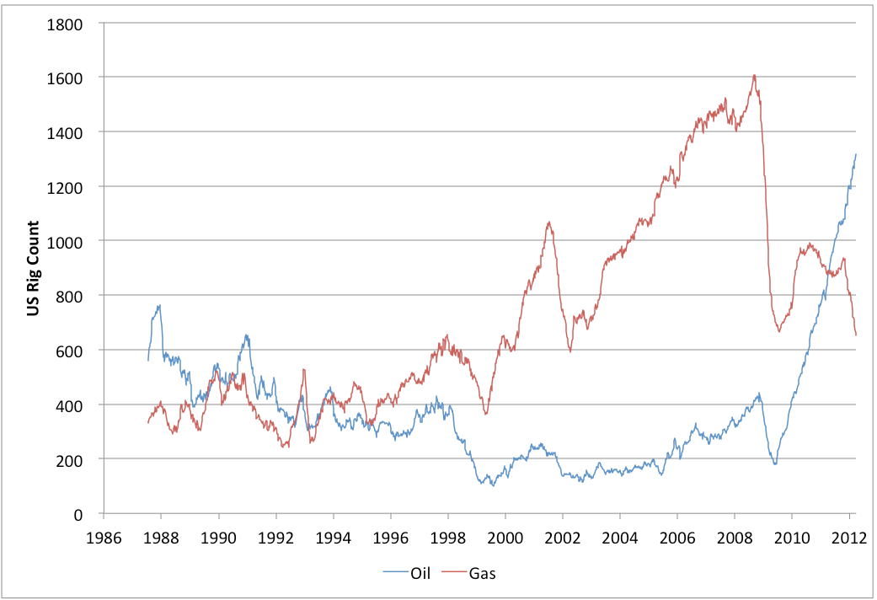
The count for US oil rigs has risen sharply
Source: earlywarn.blogspot.com

Slide 33
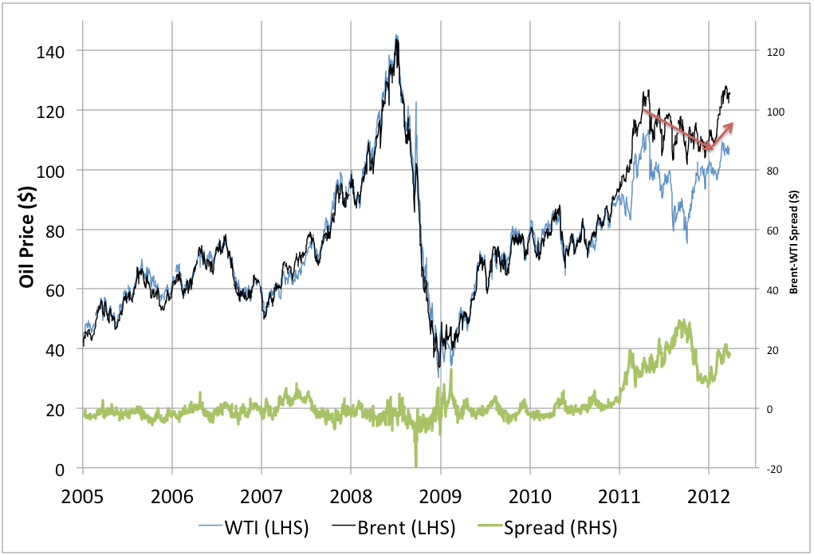
The price of Brent crude has been consistently around $20 higher than WTI since 2011
Source: earlywarn.blogspot.com

Slide 34
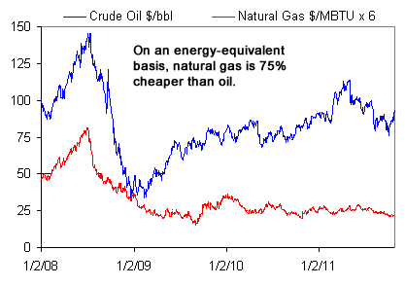
Natural gas is now selling in the US at the equivalent price to $24 a barrel for oil
Source: wallstreetpit.com

Slide 35
Conclusions
It is economically difficult for the world to reorient itself and this in itself is likely to limit growth – and has done so
The environment could hold back growth, though this is not necessary
The technology exists for energy and food supplies to be adequate to allow for growth – fusion power, shale gas and GM foods could be game changers
There are likely to be shortages of minerals to support rapid growth unless government policies change
Further investment in water supplies will be necessary to support rapid growth
Central assumption world economic growth of 3% pa max on a sustainable basis
European growth to be constrained not only by lack of competitiveness but also slow take up of technologies such as GM, nuclear and shale

Slide 36
Is the economic growth from the
emerging economies additional?
Douglas McWilliams, Mercers’ School Memorial Professor of Commerce at Gresham College and Chief Executive of Cebr
Thras Moraitis, Member of Executive Board Xstrata plc and
Michael McWilliams, Global head of Hydro, Mott MacDonald

