Slide 1
The American Way of War in History and Politics
Brian McAllister Linn
Fulbright Distinguished Professor, University of Birmingham
Professor of History, Texas A&M University

Slide 2
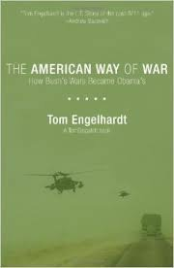
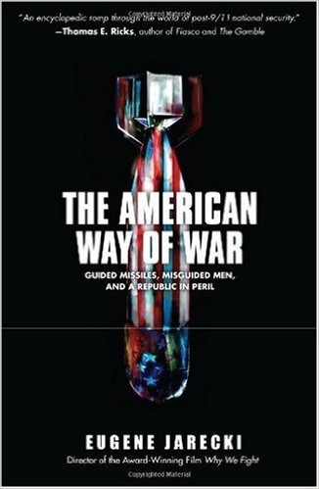
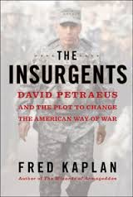
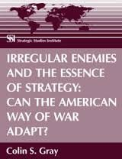
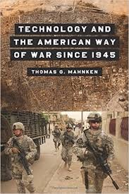
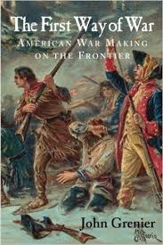
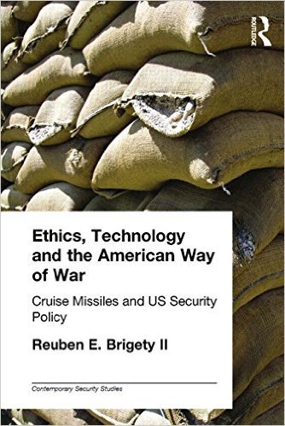

Slide 3
Winners of contest for best description of American Way of War in 25 words or less
“aims to equip the world’s best warfighters for missions that serving both America’s interests and ideals”—Maj. Gen. Charles Dunlop
“We have become the Prussian Army—excellent fire, maneuver and logistics at the tactical level while ignoring strategy and hoping politicians don’t ask embarrassing questions”—Alexander Crowther
"Use a sledgehammer to crack a nut. Occasionally eat a nut, occasionally hit own nuts. Everyone else is scared, horrified and awed in equal measure.”—Jack McDonald, War Studies, King’s College, London

Slide 4
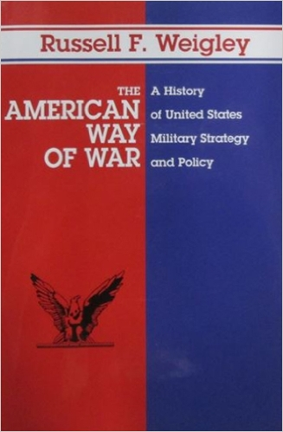

Slide 5
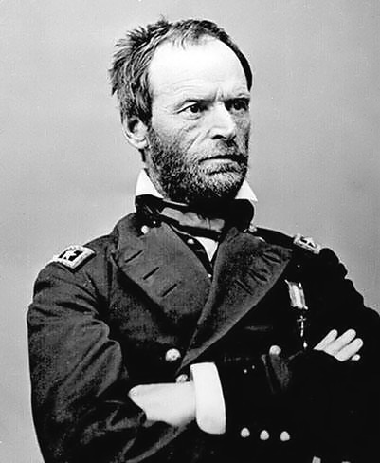
William T. Sherman’s influence on the American Way of War

Slide 6
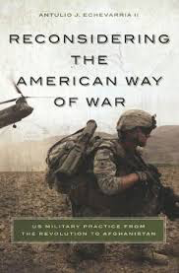
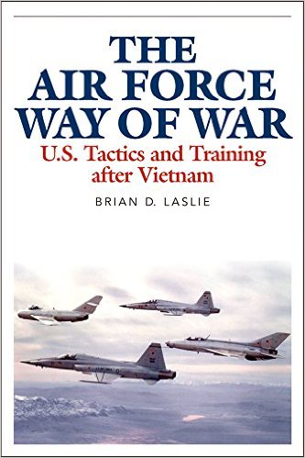
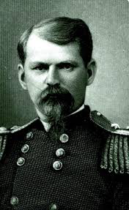
Other Approaches to the American Way of War
Turning points
Colonial War
World War 2
Antulio Echevarria
Redemption narrative
Emory Upton
Prodigal Soldiers
Intellectual concept of war

Slide 7
Revolution in Military Affairs
Technology-based vision of war
Perceived Lessons of the Gulf War, 1990-91
“There is emerging a distinctive American style of warfare, a style that is essentially joint, drawing on the unique capabilities of each service via centralized planning and decentralized execution. This jointness, plus an amalgam of surprise, discriminate use of overwhelming force, high operating tempo, and exploitation of advanced technology, has led to a whole new order of military effectiveness.”—GEN William E. DePuy to GEN Colin Powell, 1991

Slide 10
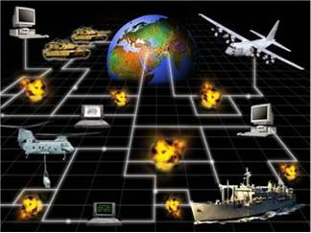
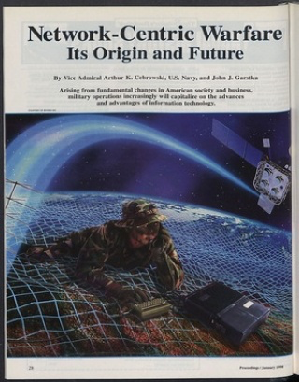
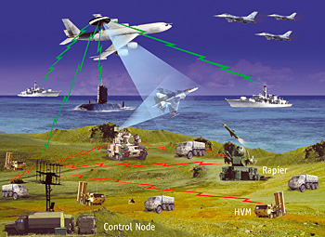

Slide 11
War and Ideology
“Network Centric Warfare was a fundamentally American way of war, one that promised not just better wars, and not just shorter wars, but perhaps an end to war itself. . . . I wanted to see it used to short-circuit wars and warfare in general. I want wars to be obsolete because America become so powerful that no one is willing to take it on, and thus America is willing to take on anyone.”
Thomas Barnett, Pentagon’s New Map (2004)

Slide 16
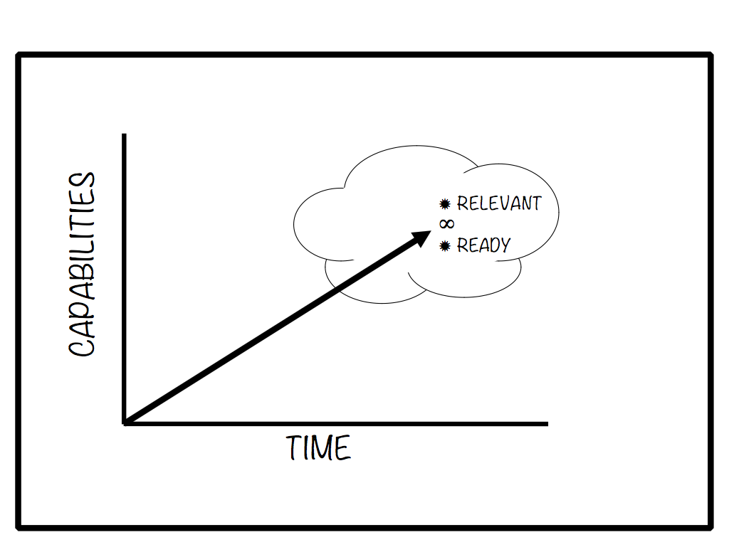
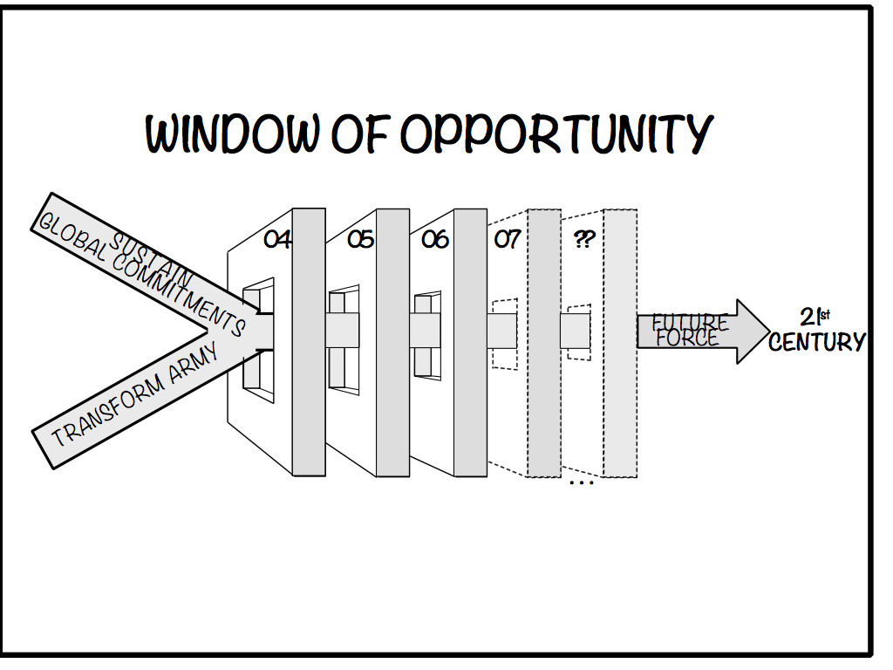
“Our Army At War -- Relevant and Ready …Today and Tomorrow”
A Persistent State of Conflict Will Endure
The Army has an Unprecedented Window of Opportunity to Reshape the Force
We are Transforming Now – We are on the Right Course to Reshape the Force
We Have Built Tremendous Momentum and Support for Our Programs
Strategic Goal: Relevant and Ready … Today and Tomorrow
Intent: Seize the Initiative: Leadership Drives Change
Reinforce Our Centerpiece: Slide 18 Soldiers as Warriors
Tell the Army Story Effectively
Resource
the Force
Change Army Culture to Reflect New Realities
Reinforce Our Centerpiece: Soldiers as Warriors
Tell the Army Story Effectively
Resource
the Force
Change Army Culture to Reflect New Realities
Articulate Strategic Rationale for Future Capabilities
Adapt the
Institutional Army
Maintain Viability
of All-Volunteer
Force
Adapt the
Institutional Army
Maintain Viability
of All-Volunteer
Force
Articulate Strategic Rationale for Future Capabilities
Soldiers are the Army
Our Nation is relying on Soldiers
Supporting GWOT aggressively
Soldier conduct must reflect Army Values (detainee abuse, larceny, and unsafe actions will alienate stakeholders)
Informing the Nation is our obligation – a key responsibility
Effective strategic engagement required to inform stakeholders
“One Message—Many Voices”
Critical outcomes:
Recruit and Retain Quality Soldiers
Maintain Public Support
Resource the Army
Sustained operations are our
new norm – protracted conflict
Must resource for today’s and
tomorrow’s issues:
Sustain Full Scope of Global
Commitments (GWOT is a Subset)
Transform the Army
Enhance Well-being
POM focus: Core Competencies
Must preserve viability
Incorporating new manning concepts
Rebalancing size and
capabilities of components
Must leverage contributions of civilian workforce
Must embrace innovation
Creating Joint and
Expeditionary mindset
Inculcating Warrior Ethos
Building resiliency to
uncertainty – to operate better
in zones of discomfort
Must continue to emphasize
Army contributions to Joint
Team
Create joint interdependence
Leverage every potential tool
Collaborate to develop
Joint solutions
Not business as usual; must support a Joint and expeditionary Army
Must assess changes recommended in ACP
Support needs of force
Create culture of innovation
Draft plan with clear vision
Produce and begin to execute plan in FY 05
Assessment
Leader
Priorities
Reinforce Army Values
Emphasize Warrior Ethos
Adapt training to reflect COE
Balance training and education: “what to think” vs.“how to think”
Foster “culture of engagement”
Prepare people to tell the story
Develop Strategic
Communications, Command Information, and Congressional Engagement plans
Be able to discuss POM
Articulate capabilities and needs
Communicate need for balance
Promote education and career
progression opportunities
Must leverage “window of opportunity” to change
Meet recruiting and retention goals
Care for Soldiers, civilians, and families – and communicate well-being and installation enhancement programs
Enhance safety programs
Manage complexity; Lead change
Reinforce culture of innovation
Understand joint, expeditionary
implications today and tomorrow
Reinforce all parts of Warrior
Ethos (Creed and Values)
Promote Soldier-family resiliency
See opportunities
Build relationships
Provide advice effectively
Develop Joint Ops Concept
Participate as senior leaders in
assessments and studies
Understand essentiality of
this critical task
Counter resistance to change
Develop institutional programs
to influence innovation and
cultural change
Focusing Effort: - Amidst adversity, a range of opportunities is clearly evident. We must capitalize on these opportunities in the strategy development and resourcing processes.
- Strengthen relationships and communication with other Services, Congress, the American public, and our primary customers: the Combatant Commanders and the Joint Team.
Managing Sources of Risk: - Risks do exist in this strategic environment, especially with regard to an uncooperative and adaptive enemy, finite resources, and our pace of operations.
- Clearly, if we lose support for resourcing our programs, or must deploy organizations unexpectedly, we will have to adjust the path of our restructuring.
Creating the Future: - Our Nation and our Army are engaged in a protracted Global War on Terrorism.
How can we apply the lessons we have learned, at all levels, to improve performance?
What decisions could we have made earlier?
What should we be thinking about now?
The Army will remain relevant and ready by providing the Joint Force with essential capabilities to dominate across the full range of military operations.

Slide 17
Donald Rumsfeld

Slide 18
New American Way of War
“The American Way of War refers to the grinding strategy of attrition that U.S. generals have traditionally employed . . . But that was then. Spurred by dramatic advances in information technology, the new American Way of War relies on speed, maneuver, flexibility, and surprise . . . the victory in Iraq shows the military is . . . making the American way of war both more effective and more humane”
Max Boot (2003)

Slide 19
“The political elite that ought to bear the chief responsibility for formulating grand strategy instead nurses ideological fantasies of remaking the world in America’s image. . . Meanwhile, the military elite that could possibly puncture those fantasies and help restore a modicum of realism to US policy instead obsesses over operations . . . Into this void between the illusions of the political class and the fears of the generals disappears the possibility of establishing some equilibrium between ends and means. Instead, the United States careens ever closer to bankruptcy, exhaustion and imperial overstretch.
Bacevich

Slide 20
A New Direction?
“Recent and ongoing conflicts reinforce the need to balance the technological focus of Army with a recognition of the limits of technology and an emphasis on the human, cultural, and political continuities of armed conflict”
“The environment the Army will operate in is unknown. The enemy is unknown, the location is unknown, and the conditions involved are unknown.”
US Army Operation Concept, 2014

Slide 21
Where do we go from here?

