Slide 1
From Wonder to Understanding: Beginning a Journey
Alister McGrath
Gresham Professor of Divinity

Slide 2
Sir Peter Medawar (1915-87)
“… questions that science cannot answer and that no conceivable advance of science would empower it to answer”.

Slide 3
José Ortega y Gasset (1883-1955)
“Scientific truth is characterized by its precision and the certainty of its predictions. But science achieves these admirable qualities at the cost of remaining on the level of secondary concerns, leaving ultimate and decisive questions untouched.”

Slide 4
José Ortega y Gasset (1883-1955)
“We are given no escape from ultimate questions. In one way or another they are in us, whether we like it or not. Scientific truth is exact, but it is incomplete.”

Slide 5
John Dewey (1859-1952)
The “deepest problem of modern life” is that we have failed to integrate our “thoughts about the world” with our thoughts about “value and purpose”.

Slide 6
C. S. Lewis (1898-1963)
“I believe in Christianity as I believe that the Sun has risen, not only because I see it, but because by it, I see everything else.”

Slide 7
Salman Rushdie
“The idea of God” is both “a repository for our awestruck wonderment at life and an answer to the great questions of existence.”

Slide 8
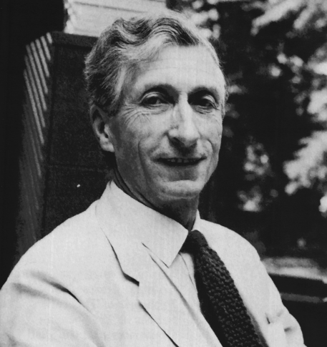
Charles Coulson (1910-74)
Oxford’s first Professor of Theoretical Chemistry

Slide 9
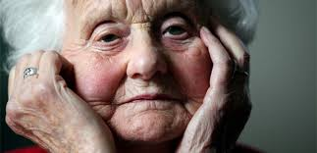
Mary Midgley
“For most important questions in human life, a number of different conceptual tool-boxes always have to be used together.”

Slide 10
Mary Midgley
Looking at a big aquarium:
“We cannot see it as a whole from above, so we peer in at it through a number of small windows ... We can eventually make quite a lot of sense of this habitat if we patiently put together the data from different angles. But if we insist that our own window is the only one worth looking through, we shall not get very far.”

Slide 11
Frank H. T. Rhodes
“Now these are different answers . . . But both are true, both are complementary and not competitive. One answer is appropriate within a particular frame of reference, the other within another frame of reference. There is a sense in which each is incomplete without the other.”

Slide 12
Christian Smith
[We] are animals who must fundamentally understand what reality is, who we are, and how we ought to live by locating ourselves within the larger narratives and metanarratives that we hear and tell, and that constitute what is for us real and significant.

