Slide 1
People, Protection and Parameters Comparing flooding in the UK and the Netherlands
Maurits Ertsen

Slide 2
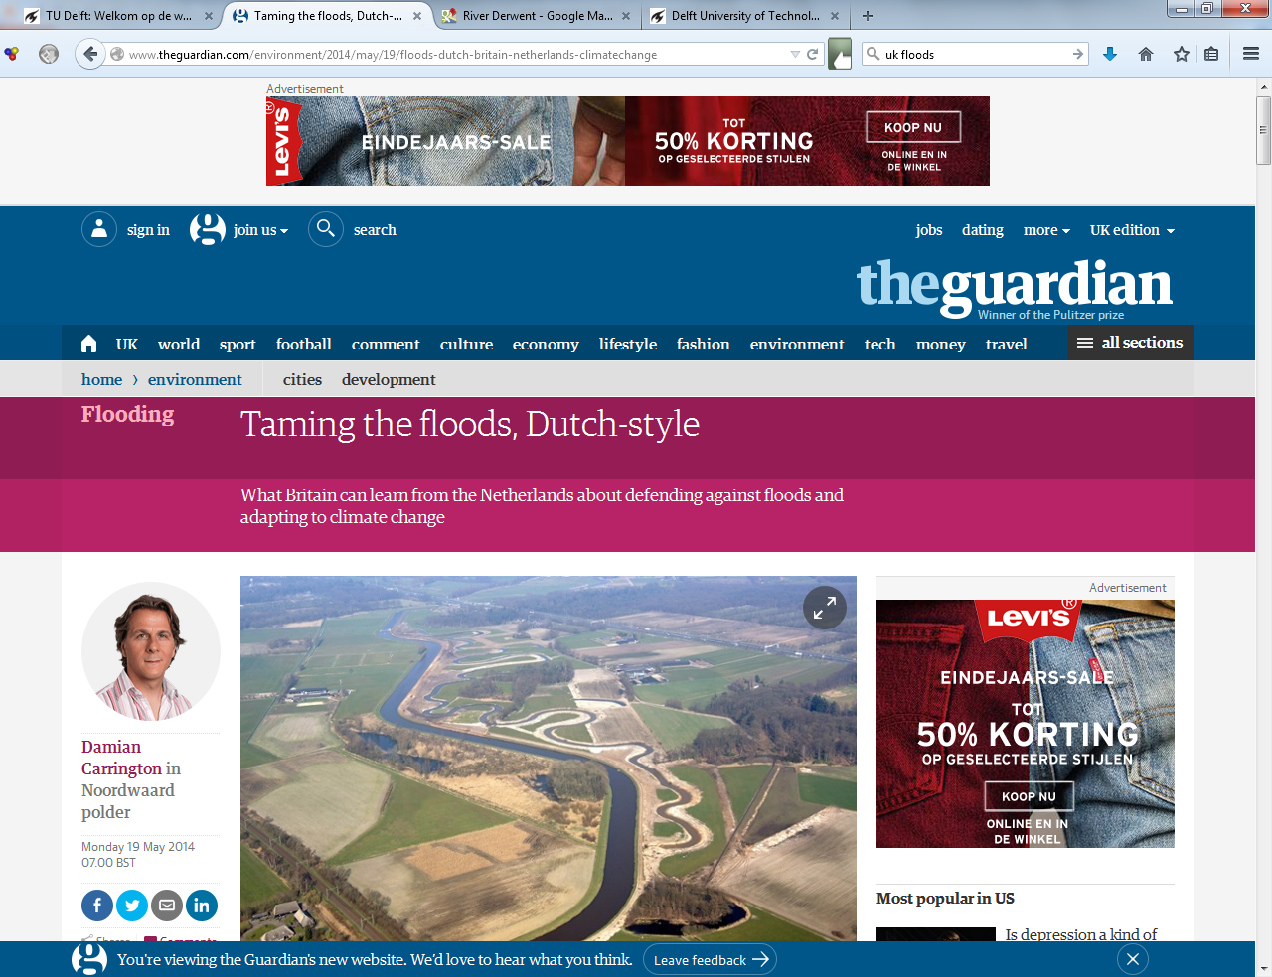
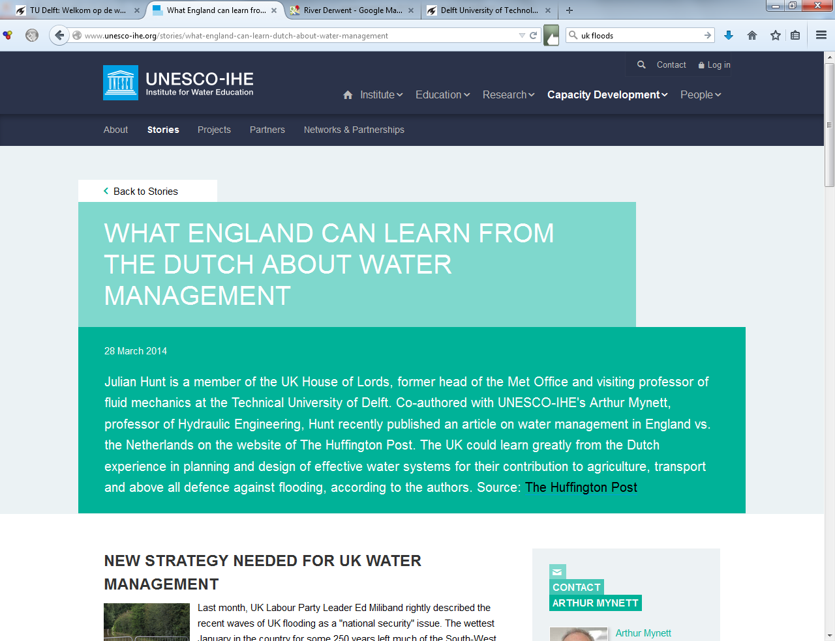
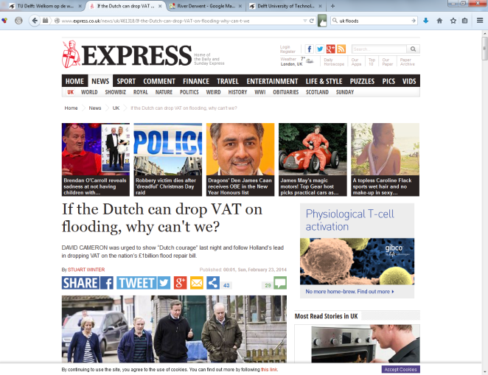

Slide 3
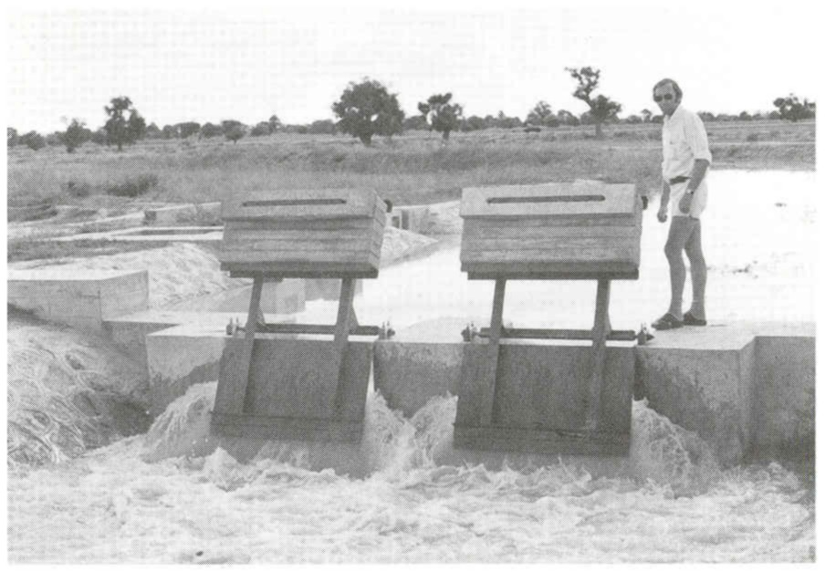

Slide 4
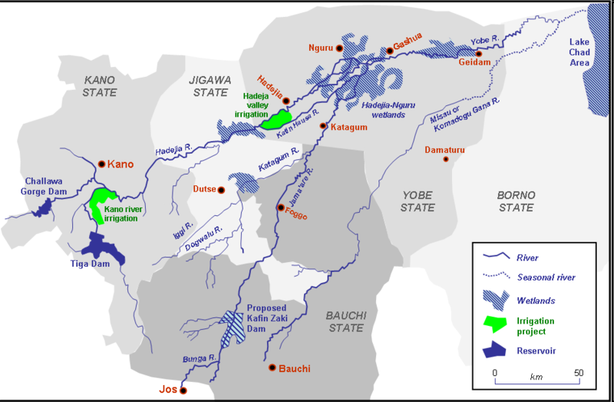
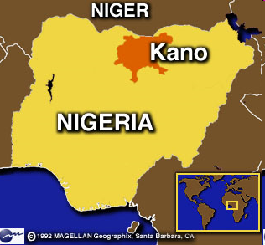

Slide 5
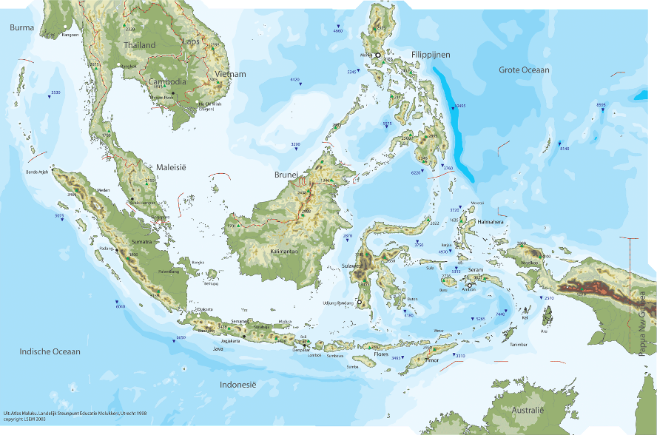

Slide 7
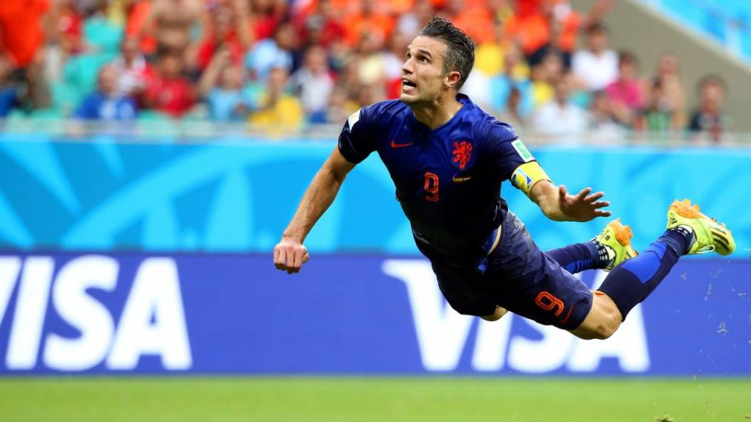
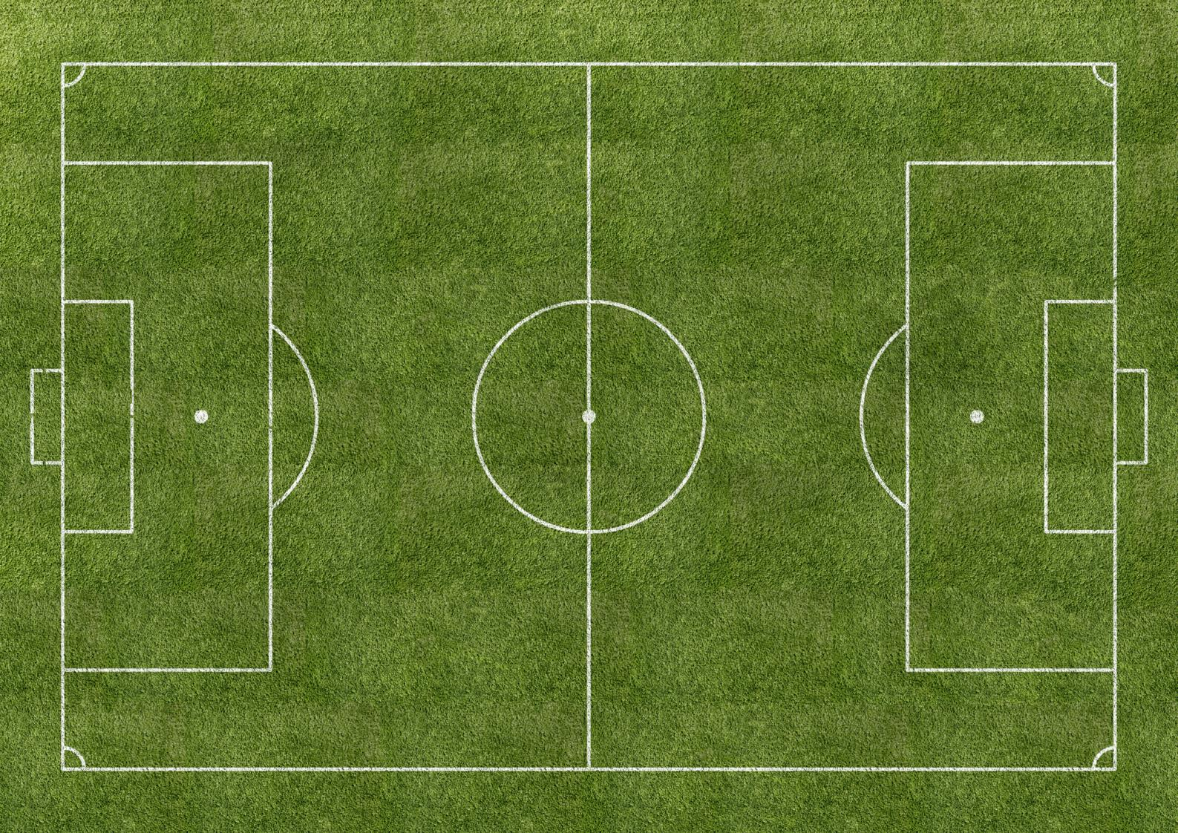

Slide 9
Some theoretical notions…

Slide 10
(1) Guiding principles
(2) Promises and expectations
Technological regime
(3) Design requirements
(4) Design tools
(5) Artefacts and operational rules

Slide 11
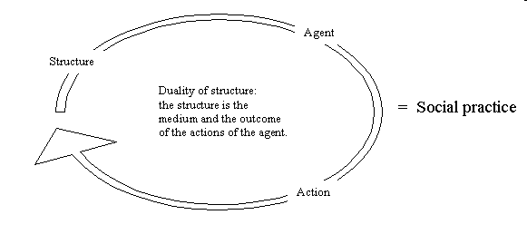
See Sewell 2005 as well

Slide 12
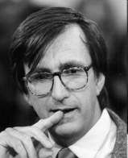
ANT - Actor Network Theory

Slide 13
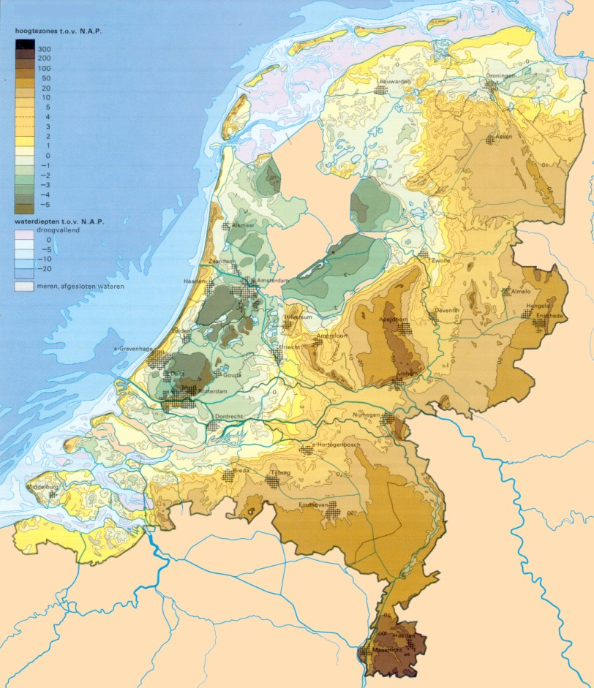
Where does the flooding happen?
Topography of the Netherlands

Slide 14
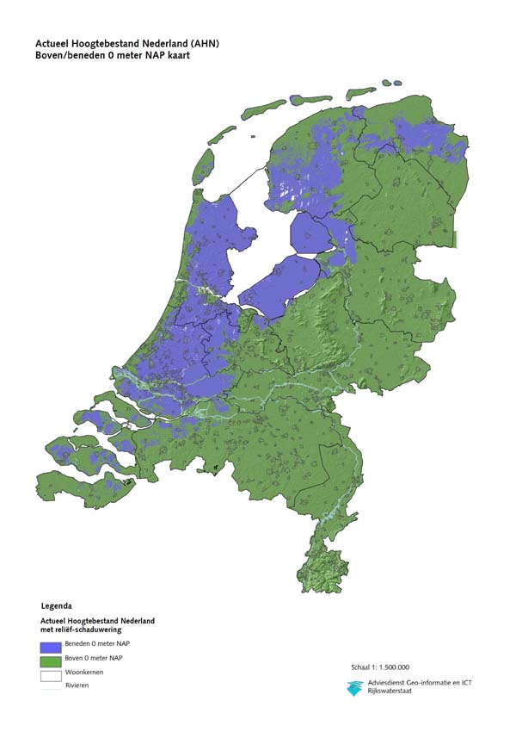
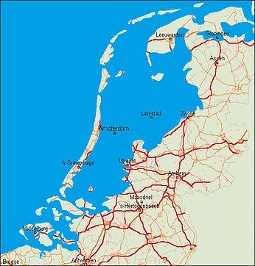
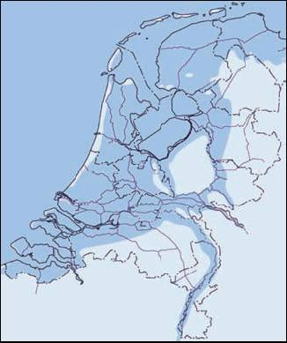
Areas under mean sea level in the Netherlands

Slide 15
Vulnerable areas in the Netherlands in terms of flooding from rivers and sea

Slide 16
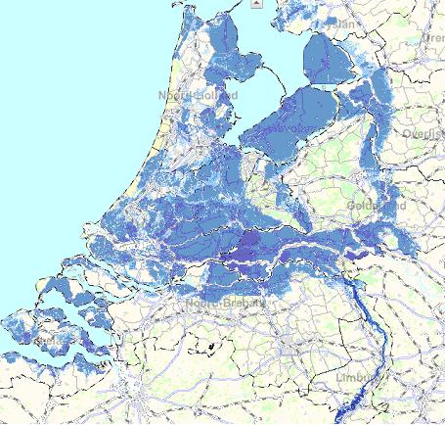

Slide 17
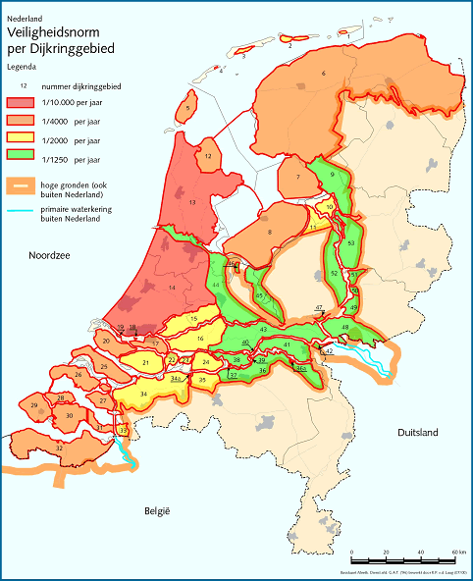
Flooding danger from rivers and sea
Organization of the Netherlands into so-called embankment areas
Different levels of protection
Under debate as we speak

Slide 18
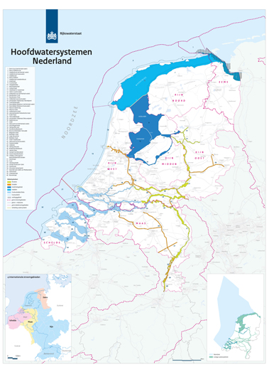
Main water system
National water system
Public Works

Slide 19
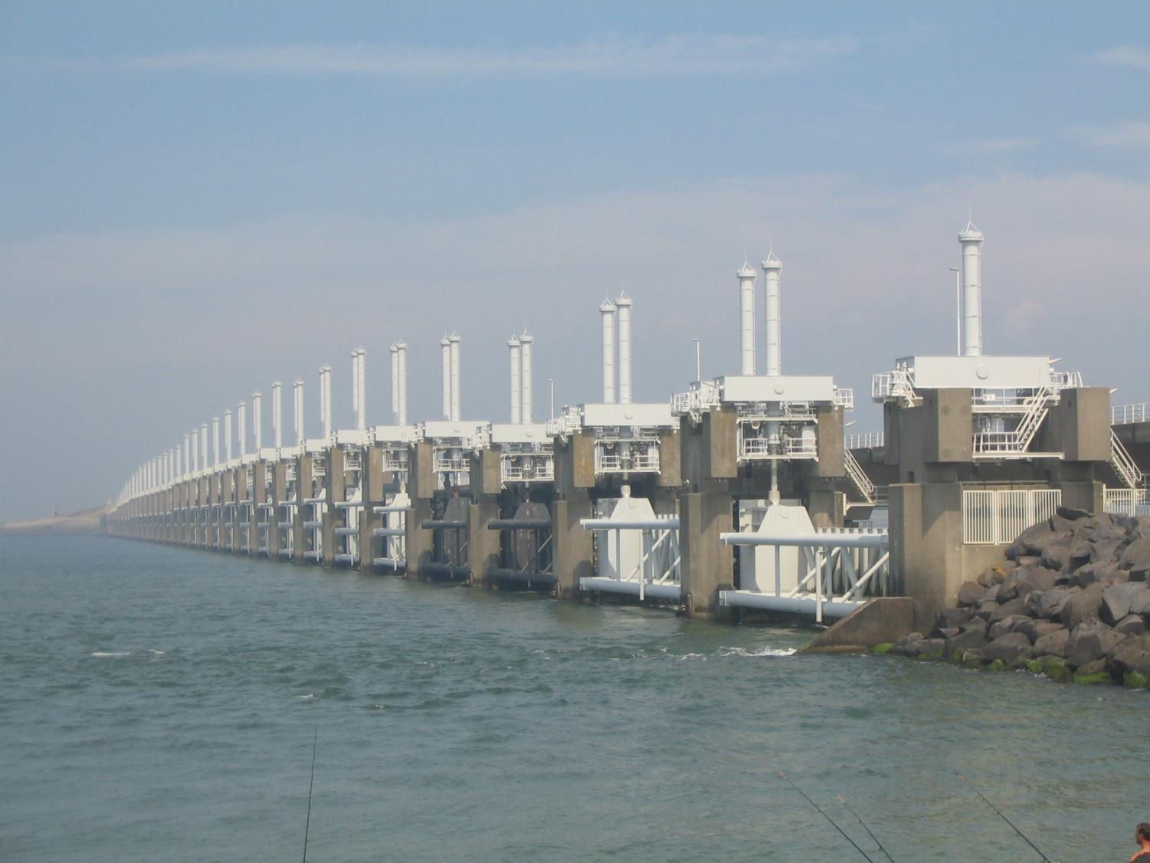
Coastal flood defence: structures

Slide 20
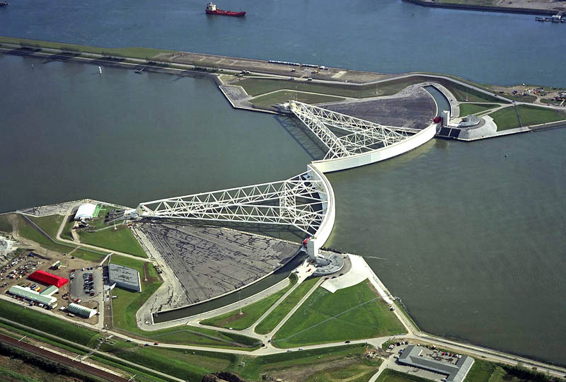
Coastal flood defence: structures

Slide 21
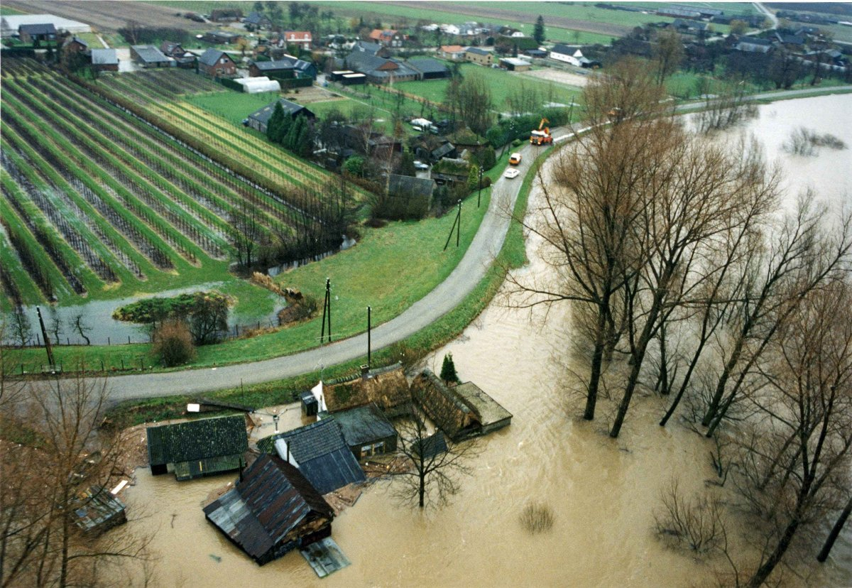
River flood defence: structures

Slide 22
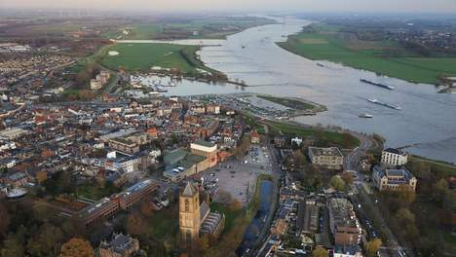
Public Works
The water board

Slide 23
Public Works:
Keep the country dry
Protect the country from flooding
The water board:
Keep the area dry
Protect the area from flooding

Slide 24
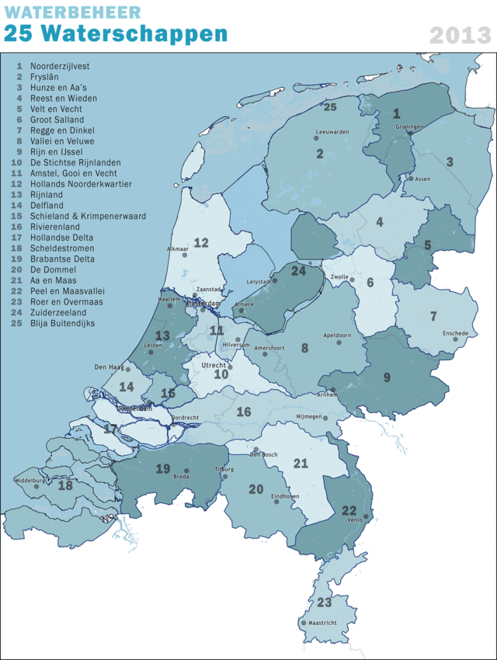

Slide 25
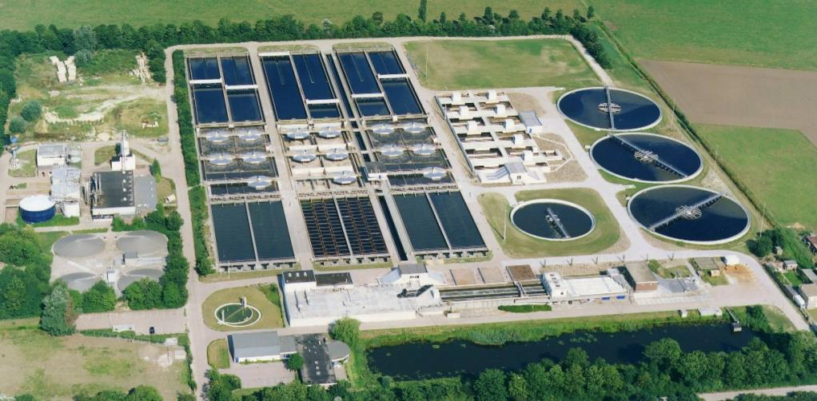
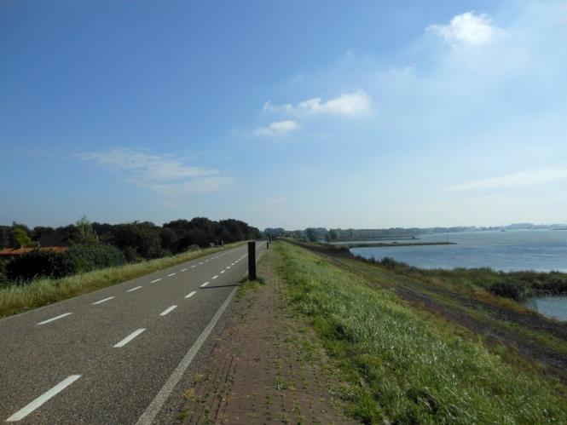
Water management; water quality; roads and embankments

Slide 26
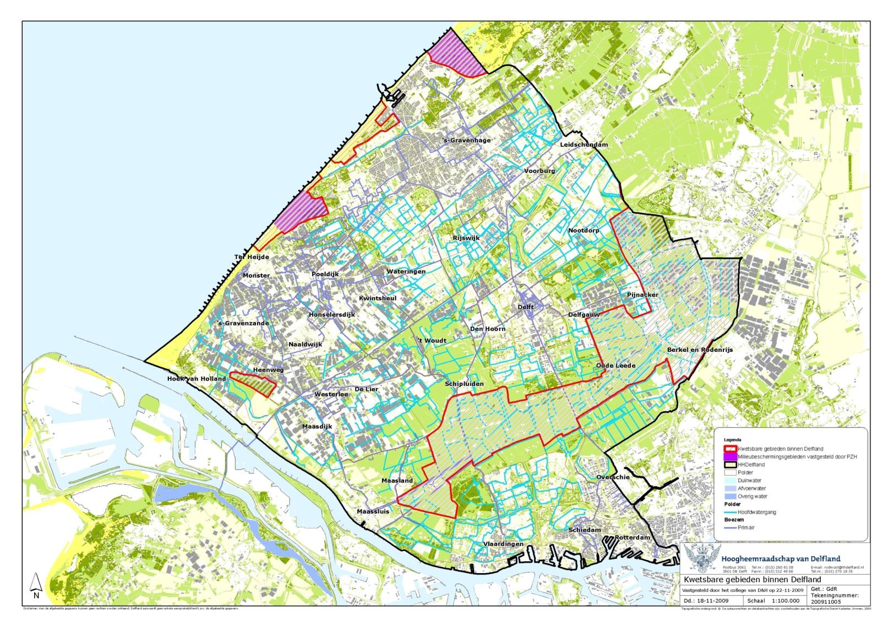
North

Slide 27
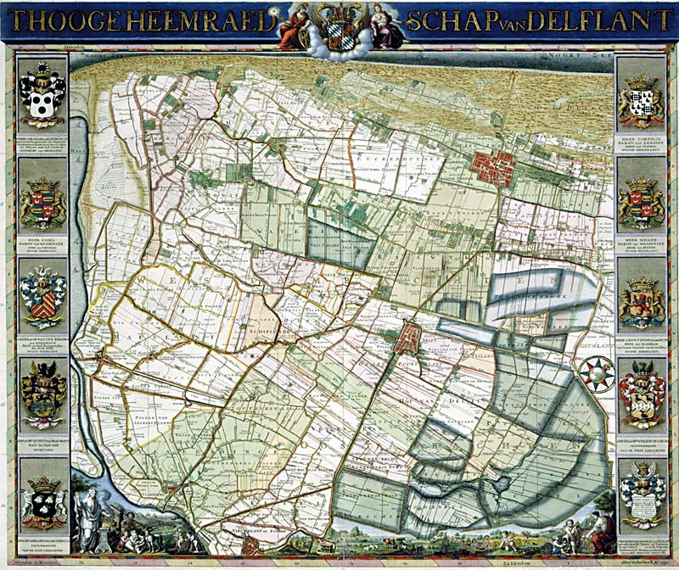
North

Slide 28
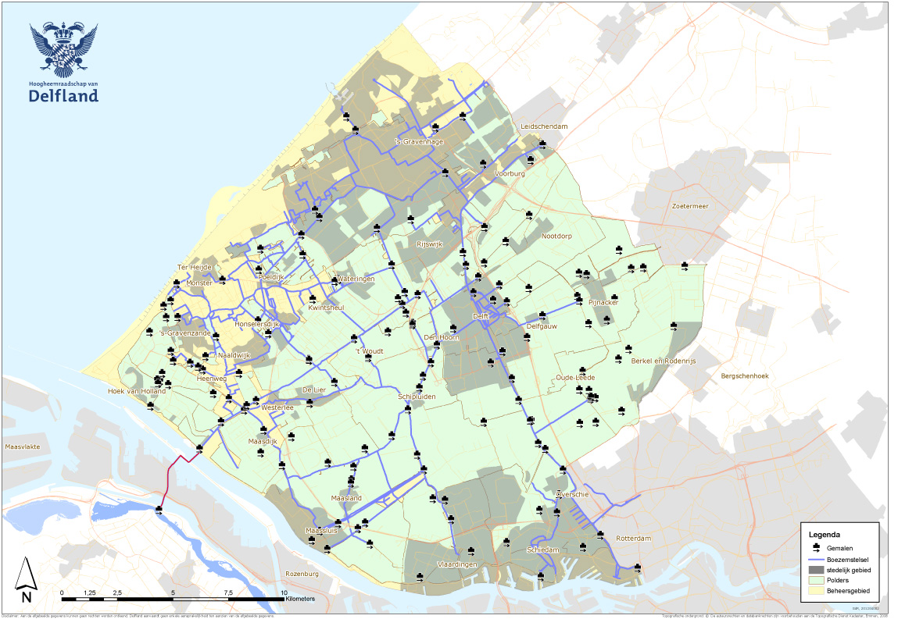
Drainage

Slide 29
Drainage

Slide 30
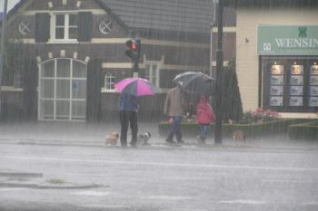
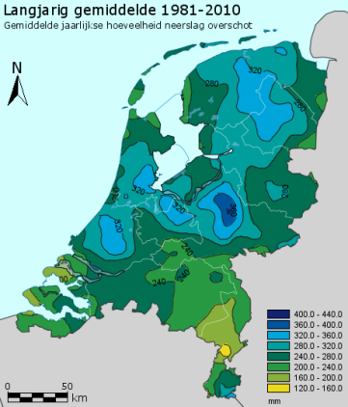

Slide 31
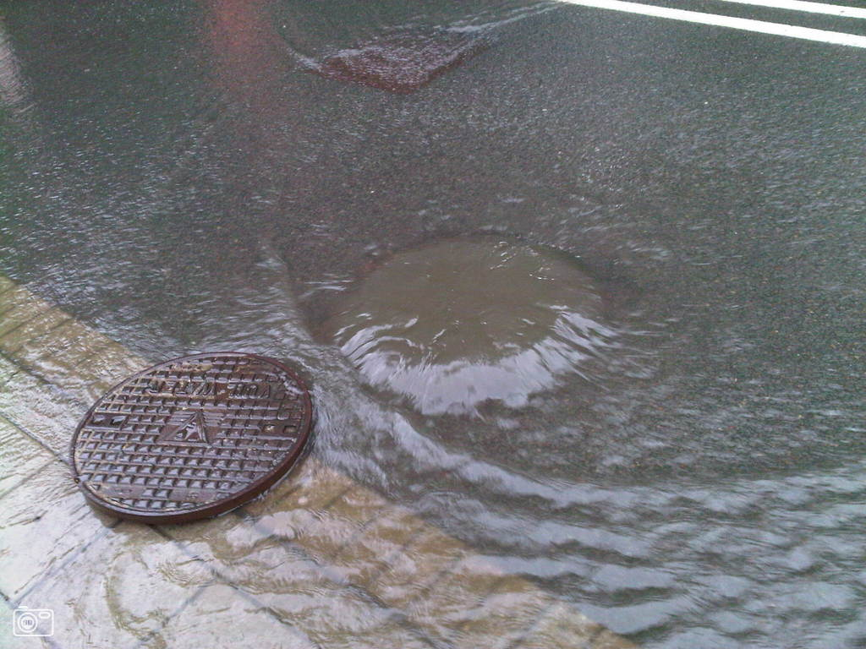

Slide 32
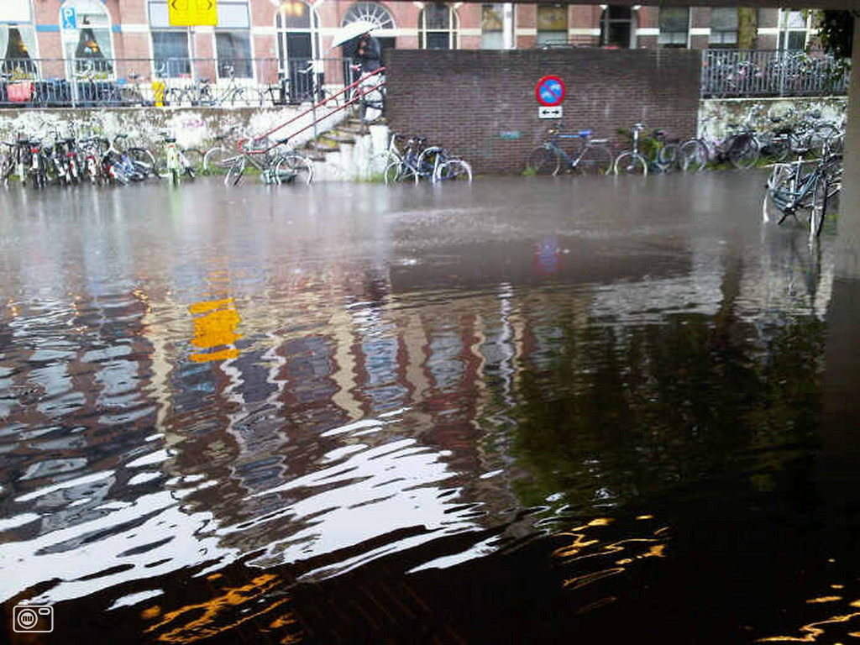
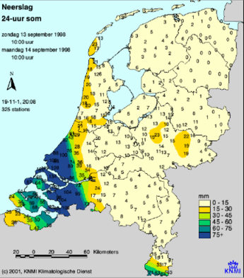

Slide 33
Water security and the Netherlands
Floods from the sea
Tidal effects
Huge amounts of water
Threat to coastal areas
Large part of coastal area in Netherlands is economic core
Floods from the river
Large amounts of water
High water waves
Threat to river areas
May interfere with tidal levels – storm surges
Floods from rainfall
Anywhere
Drainage problem, mainly economic damage
May interfere with storms

Slide 34
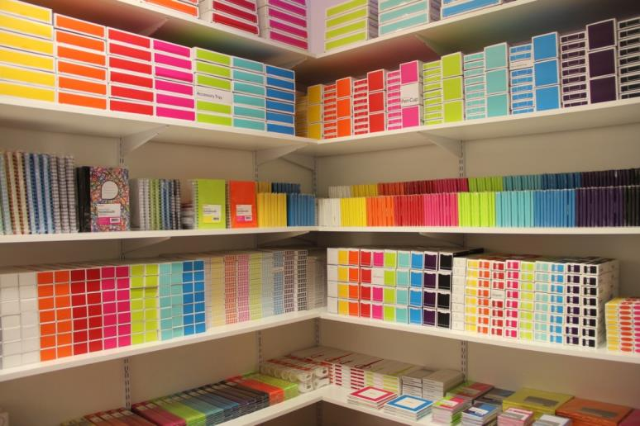
Water security and the Netherlands
Mixed duties
Excessive rainfall: municipality and water board
Sea and River floods: water board and Public Works
But also the province
And the municipality
In Dutch disaster management: the mayor is the first responsible
Unless it is a larger disaster: safety regions

Slide 35
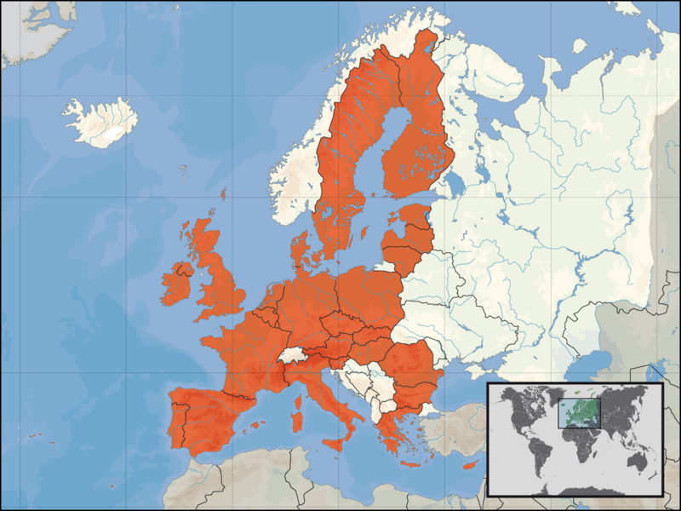
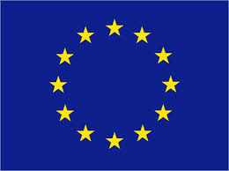
One extra level

Slide 36
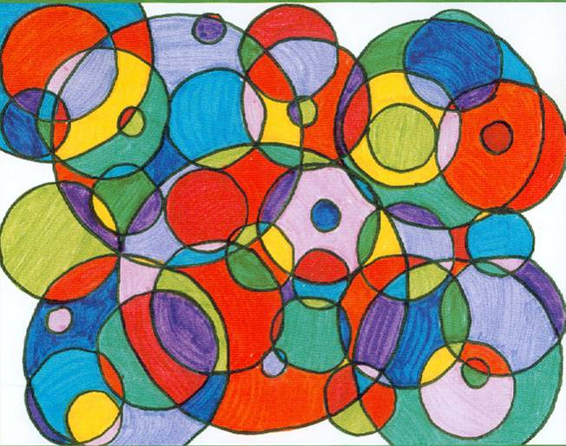

Slide 38
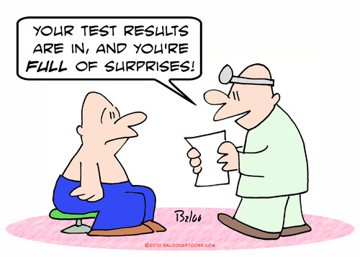
Guiding principles and promises/expectations
Floods should be prevented
Water needs to stay out
Western part of the country needs highest protection levels
Main design requirements
Safety levels
Probability of flooding prescribed in embankment areas
Design tools
Not discussed
Artefacts used
Embankments, barriers, pumps
Disaster procedures

Slide 39
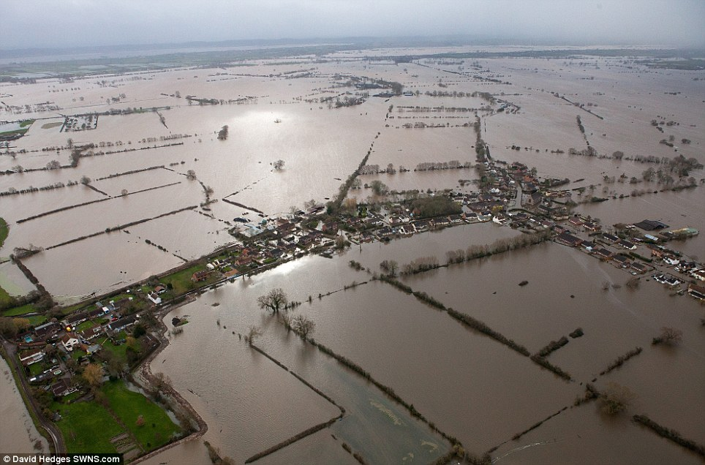

Slide 40
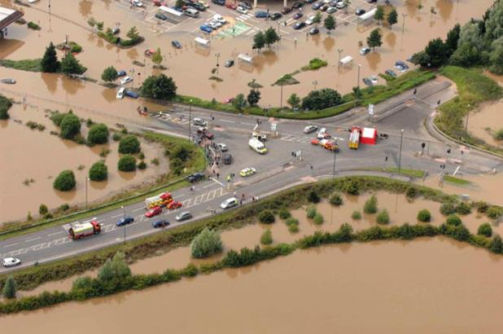
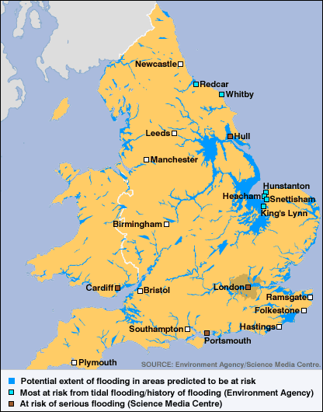
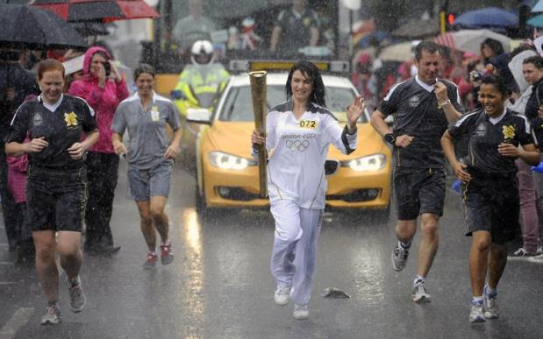
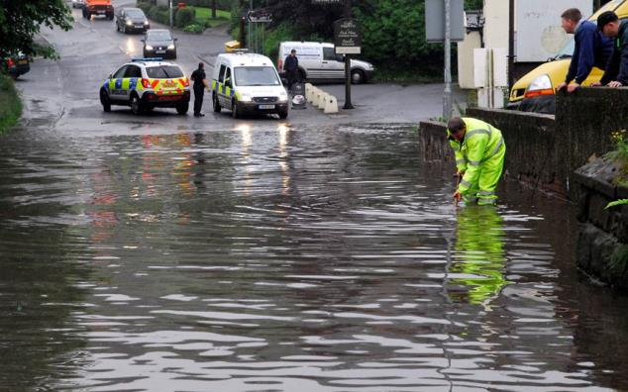

Slide 41
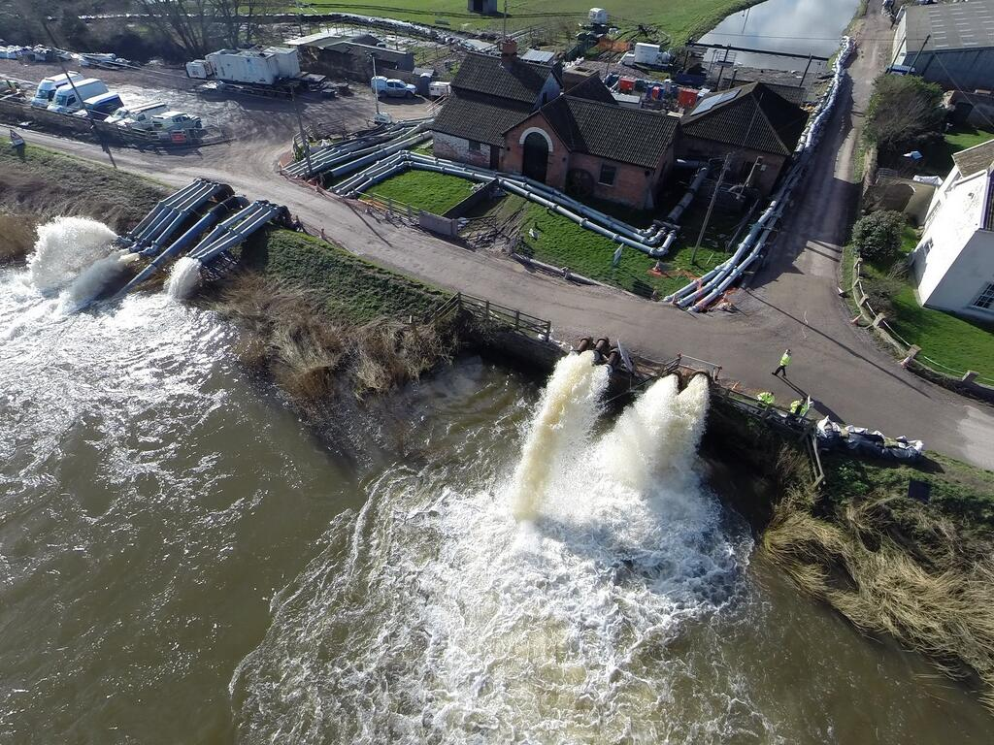

Slide 42
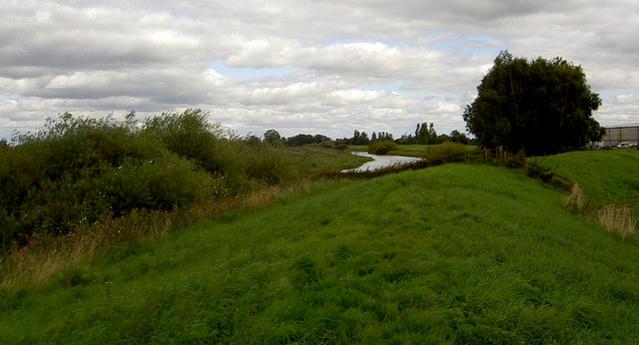
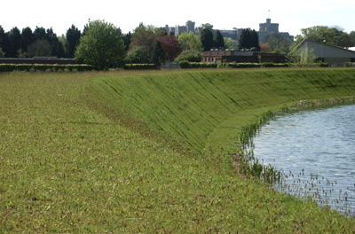
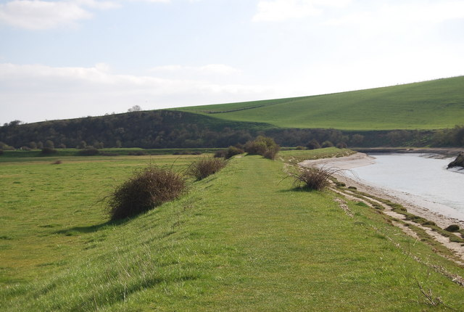
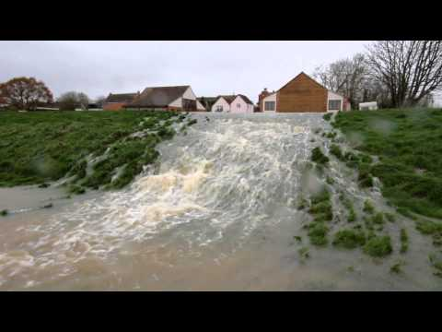

Slide 43
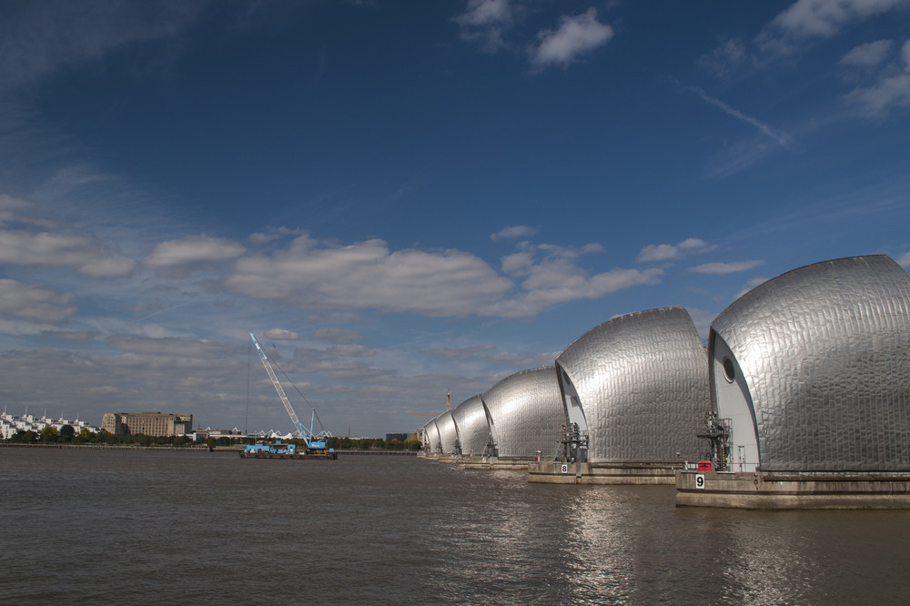

Slide 44
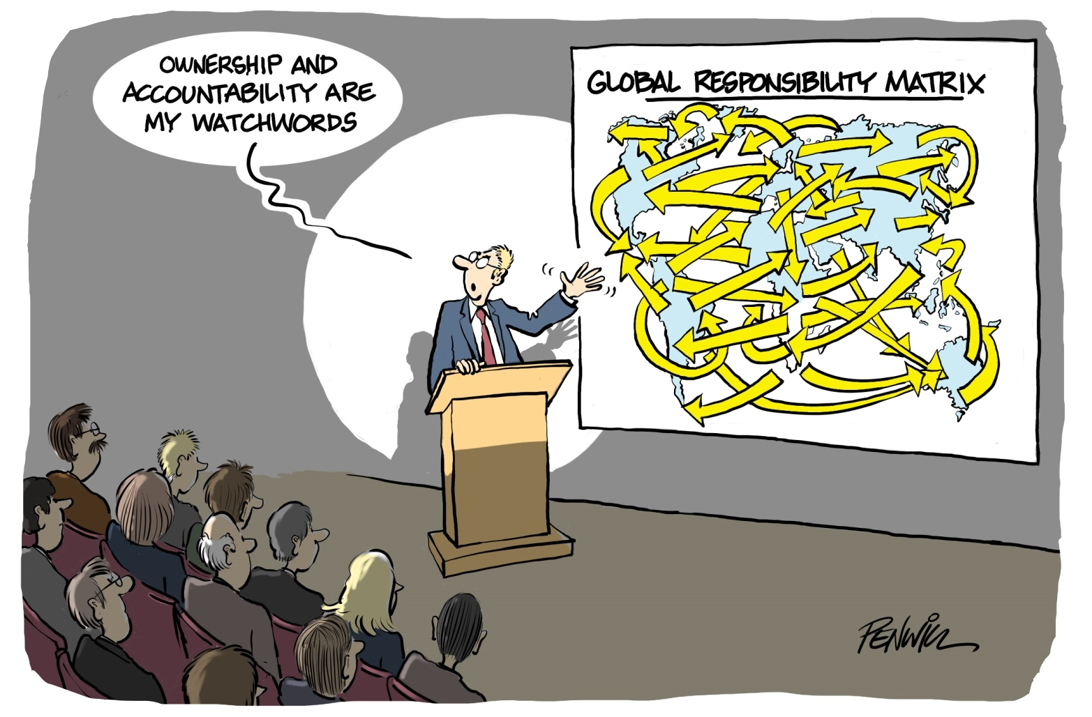

Slide 47
Difference 1:
Rainfall and runoff

Slide 48
Lag time (response time)
The gap in time between the time of peak rainfall and peak discharge
Short lag time + high discharge: more likely to flood
Long lag time + low discharge: less likely to flood

Slide 49
UK rivers:
Short lag times + relatively high discharges

Slide 51
The Rhine
International river!
Discharge comes from outside the Netherlands.
Larger Dutch rivers:
Longer lag times + relatively high discharges
Two issues:
How much water?
Will the water fit in the river?

Slide 52
How to predict inflow in the Netherlands?
The flood wave?
How certain?
How long?
What happens if Germany floods?

Slide 54
Local rainfall, not river discharge!

Slide 55
Difference 2:
Insurance or prevention

Slide 59
Guiding principles and promises/expectations
Dutch flooding policies aim to prevent floods
UK policies aim to deal with the damage of floods
These different principles result in different design requirements
Expressed as safety levels.
Netherlands UK
- Prescribed high standards - Governmental investment, but
- High governments input - additional investment expected
from beneficiaries
Design tools and artefacts are similar
Specific expertise might be:
UK: determine maximum return on investment
Netherlands: new embankment concepts

Slide 62
Historical arguments tend to be used for Dutch involvement – by Dutch and others.
Using the single history of a case (Netherlands as we know) would be strange, however.
Thinking through a technological regime offers options to understand similarities and differences.

Slide 63
Thank you for
your attention

