Slide 1
Singapore at 50: Oil and Water – Inextricably Mixed
Ron Oxburgh

Slide 2
World Population – last 12,000 years
Notes:
Humans have been a devastating invasive species for the rest of the planet

Slide 3
Megacities >15 million people
Majority depend on surface water and are water stressed

Slide 4
Energy & People
Today

Slide 5
Energy & People
ca. 80% of energy from fossil fuels
Today
Notes:
Over 50 years population has doubled but energy use nearly tripled; proportional rise in GHg

Slide 6
World Water Use & People

Slide 7
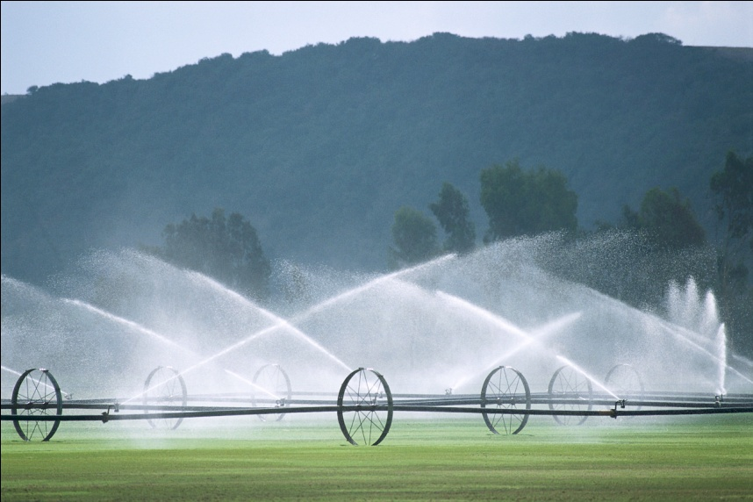
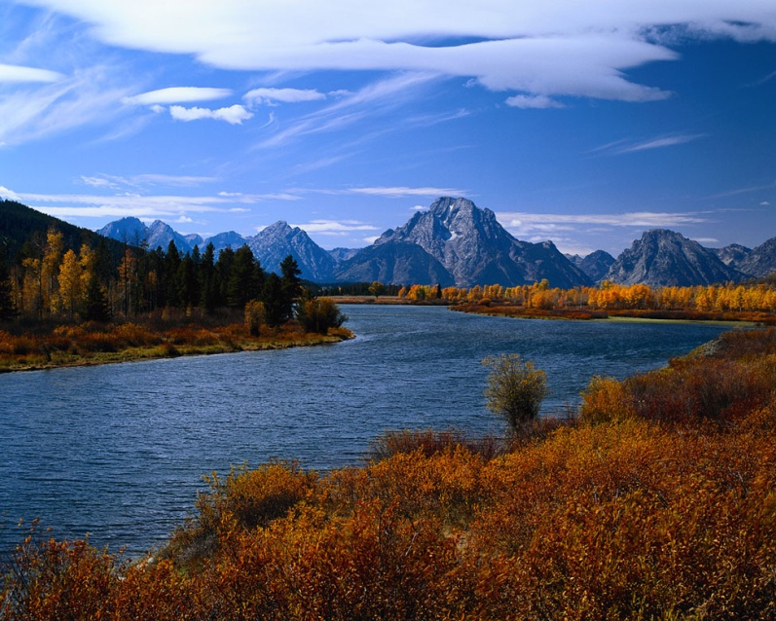
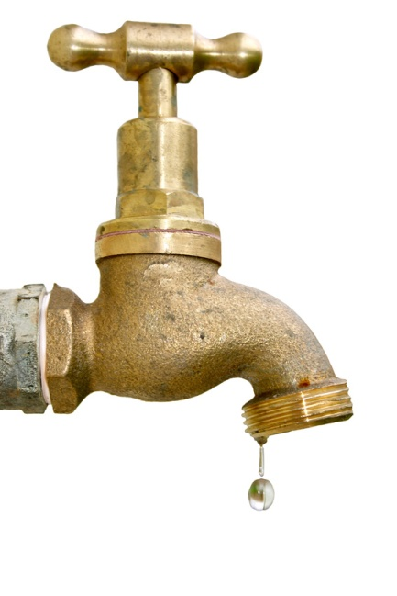
The Three Universal Water Demands
AGRICULTURE
70%
URBAN & INDUSTRY
NATURAL
SYSTEMS
30%
What’s left !

Slide 8
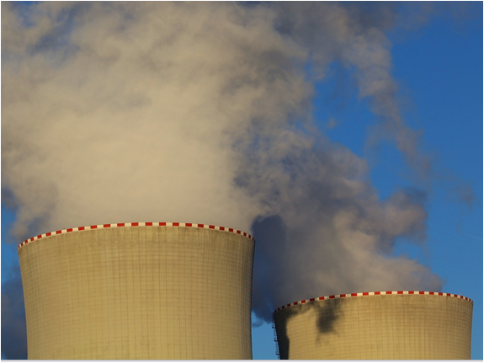
The ‘oil’ / water link
Energy is needed to:
  Purify water
  Move water
Water is essential to:
  Cool all conventional power plants
  Can provide hydro power
  Waste water & sewage for energy
Modern life depends on both but:
  Oil ca. 1000 times more expensive than water
  We use ca. 1000 times more water than oil
  SO:
    cost effective to move oil long distances but not water
    water needs are met locally while oil can be imported

Slide 9
Greenhouse Gases & the Environment
Ocean Warming:
  Sea level rise
  More energy into weather systems
Ocean acidification
The science suggests:
  Marine life problems
  Rainfall changes – distribution & amount
  Droughts
  Extreme storms

Slide 10
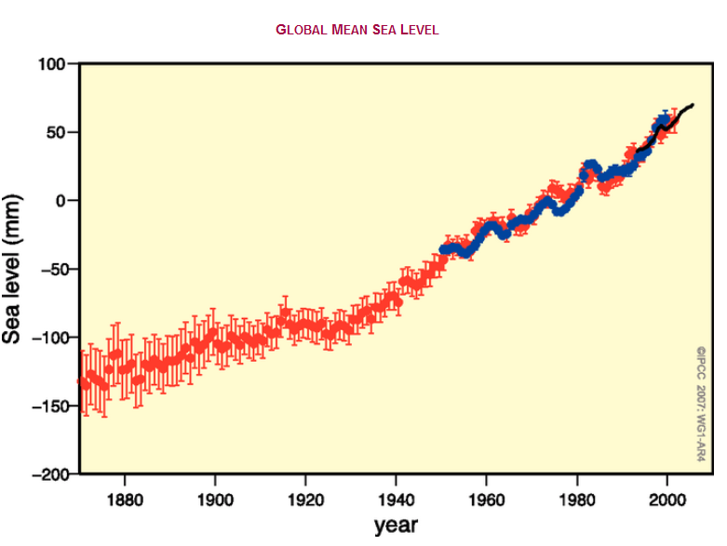
SEA LEVEL
Ocean Warming

Slide 11
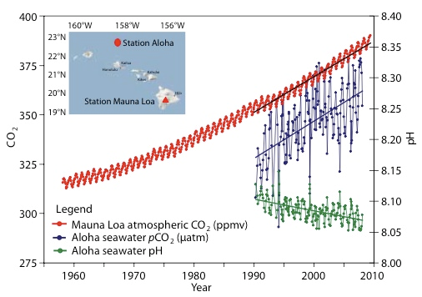
CO₂ in Atmosphere & Ocean
Ocean Acidification: A Critical Emerging Problem for the Ocean Sciences By S.C. Doney, W.M. Balch, V.J. Fabry, and R.A. Feely
Notes:
Wilful and deliberate ignorance of the science and how science works

Slide 12


Slide 13
World CO₂ Emissions by Fossil Fuels
SERIOUS DANGER
CCS?
Gas for coal only a bridge
Oil Alternatives?
10^6 tons CO2/yr
EIA, 2012

Slide 14
Abating CO2 – not easy!
Power systems are expensive, last for decades, slow to change
In developing countries, increase in electricity demand is most cheaply met by coal
Renewables seen as more expensive in near term and, without a means of energy storage, inflexible
In long term fossil fuels will be displaced only by cheaper alternatives
SO:
Improve technology & reduce cost of renewables - STORAGE!
Use FF sparingly and efficiently
While fossil fuel continue to be used, need to control emissions - Carbon capture & storage – CCS

Slide 15
Carbon Capture and Storage
70% cost
Capture
10%
Transport
COAL
CO₂
20%
Storage
COAL
MINE
CO2
Present technology would increase electricity cost by 30-50%
Same as off-shore wind?
Water requirement increased by around 30%

Slide 16
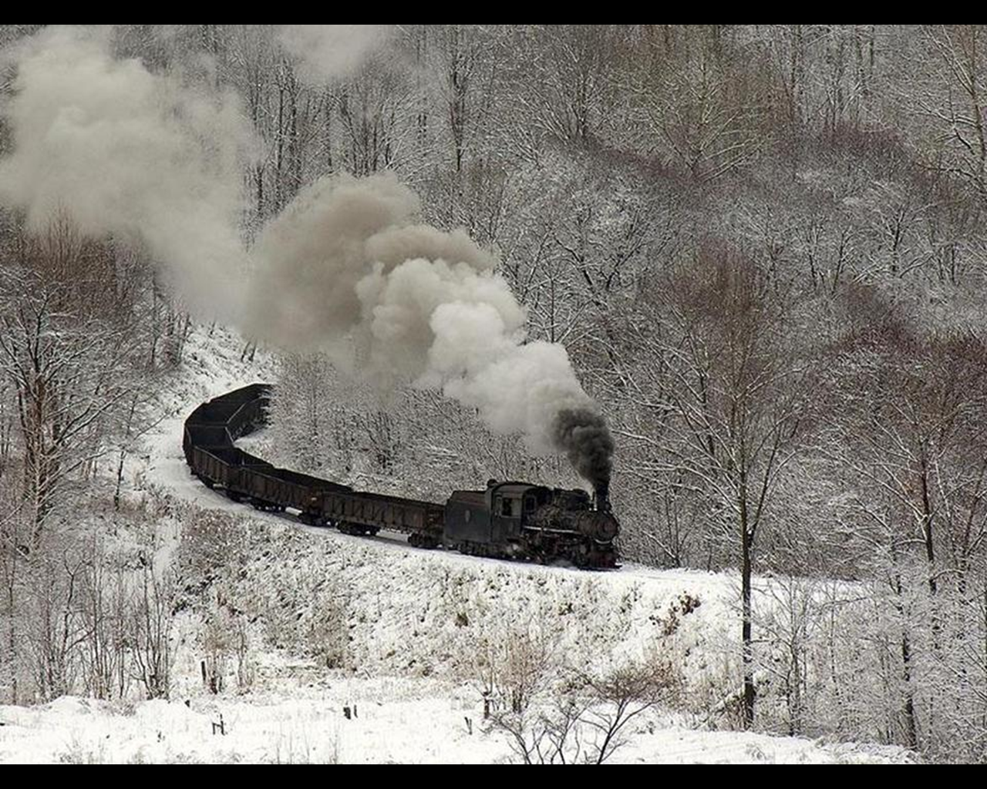
Most of China’s electricity still generated by coal

Slide 17
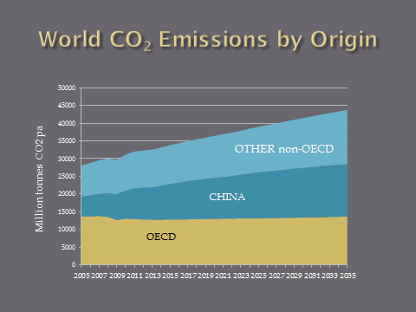
For CCS to become globally significant the additional costs of generating electricity must fall below 10%

Slide 18
Singapore 2015
What does a small, resource-poor but highly educated city state have to offer?
  Technologies for environmental challenges
  Test-bed for new approaches to dense city living

Slide 19
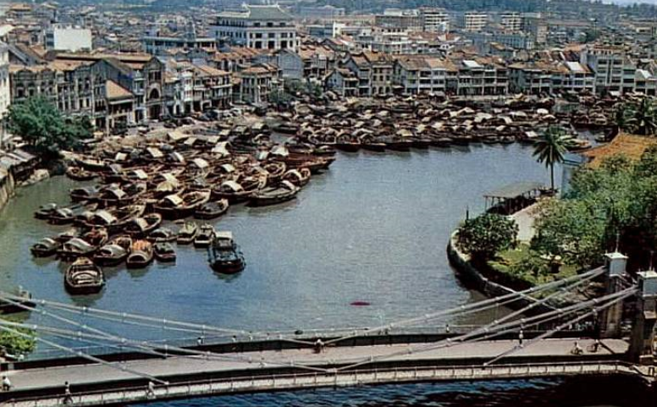
Singapore River ca. 1960

Slide 20

Thames
Pollution
LONDON 1858
river used as a sewer!
Parliament suspended

Slide 21
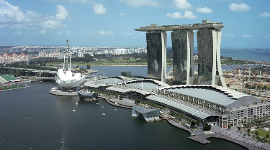
Singapore – beautiful but water-poor
5.3 million People
714 km2 area
2525 mm annual rain
High evaporation

Slide 22
Meeting Singapore’s Water Needs
Ocean
Rain
Reservoirs
Used water treatment
Desalination
Imports
NEWater
25%
25%
50%
Potability Treatment
Used water collection
Supply to people & industry

Slide 23
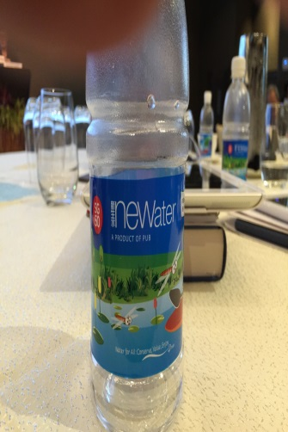
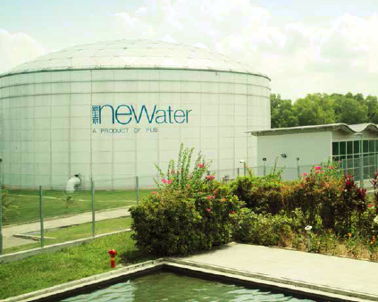

NEWater

Slide 24
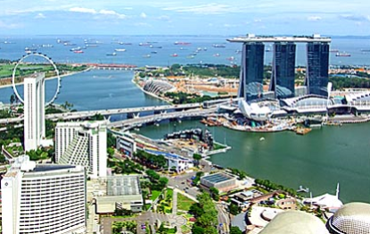
Marina Bay and the Barage

Slide 25
Focussed Investment in Water R&D
Among other areas, major investment in water research in: Industry, Government Institutes & Universities
Successful local start-up companies
Multinationals attracted to do research locally
Highly successful biennial international ‘Water week’
In little over ten years Singapore has become a major international water player

Slide 26
Megacities
Many megacities unplanned
  Grow ahead of the necessary infrastructure
  High population densities
  Typically problems with water, sewage, energy, traffic etc.
Singapore not a megacity but:
  Dense population: over 5 million people in ca. 700km², rainfall of ca 2000mm
  High quality of life made possible by strategies and technologies developed over last 50 years
  Many lessons that may be useful in growing megacities

Slide 27
Quality of life at 7500people/km2
Coherent and integrated approach to infrastructure
Space - dig deep & build high!
Green spaces within the city
Strategic approach to water supply
Reservoirs and catchments for recreation as well as water
Controlled traffic
  Vehicle numbers limit
  Traffic management
Public transport

Slide 28
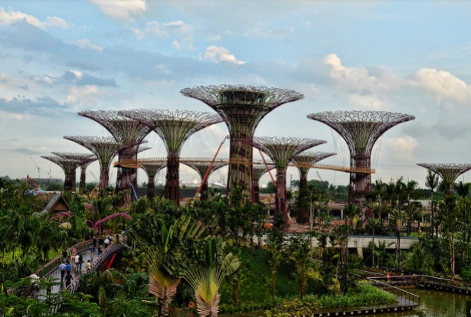
Gardens by the Bay

Slide 29

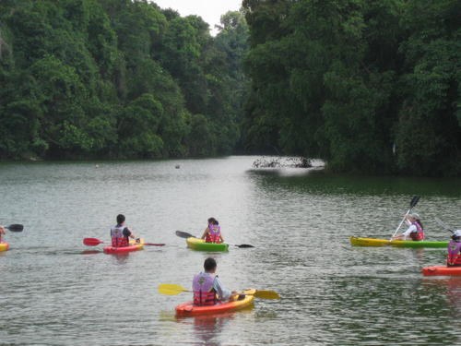
MacRitchie Reservoir Park

Slide 30

MacRitchie Reservoir Park

Slide 31
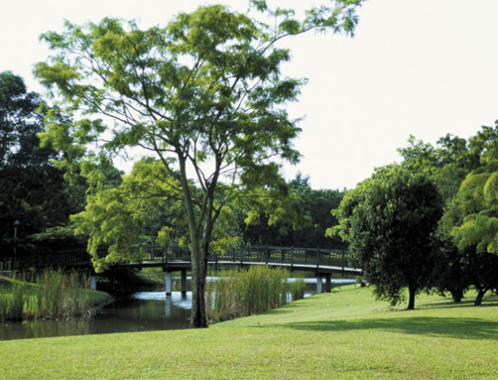
MacRitchie Reservoir Park

Slide 32
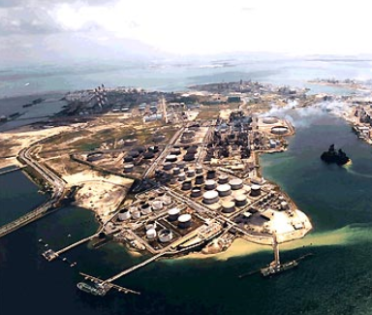
Jurong Island, Singapore

Slide 34
Conclusions
World population, energy & water demand, and G-H gases in the atmosphere - all rising
Urgent to avoid damaging climate change by reducing FF dependence and abating emissions
Locally water & energy shortages inhibit development
Singapore a good model for alleviating water problems by strategy and technology
With 50 years of inspired and inspirational leadership Singapore has evolved from a poor, water-stressed developing country to a leading developed country

Slide 35
Effects
OCEANS
CLIMATE
FRESHWATER
9 B
PEOPLE
Human
ENERGY
PLANTS & Other Life
FOOD
For CCS to become globally significant the additional costs of generating electricity must fall below 10%

