Slide 1
Things of darkness (2): perpetrators of human violence
Professor Gwen Adshead
May 2015

Slide 2
Perpetrators of human violence
Violence as a complex act of human meaning
Not all violence is the same
What do we know about the perpetrators?
Acknowledgments: Peter Aylward, Estelle Moore, Sarita Bose & Martha Ferrito, Antony Perry and the estate of Evie Williams

Slide 3
Warning!
So shall you hear
Of carnal, bloody, and unnatural acts,
Of accidental judgments, casual slaughters,
Of deaths put on by cunning and forced cause.
What bloody man is that?

Slide 4
Violence requires explanation
Each act of violence is complex and outcomes are multiply determined
The model of the bicycle lock: the risk “numbers” that must be activated
Violence has meaning for perpetrators
Thinking systemically: from the individual to the social level
Ecology of violence

Slide 5
CSEW 2011-2012
2.1Million recorded violent crime
D=37.5M implies 6% of population are perpetrators
62% of victims were male
56% not reported
50% caused injury, 10% serious ( GBH, fatal and near fatal)
Children under 1 year are most likely to be victims of violence
So parents of under 1s are most likely perpetrators of violence

Slide 6
CSEW 2012-2013
1 915 000 All violence c.f 2 714 000 in 2003
1085 000 Violence with injury
830 000 Violence without injury
390 000 Intimate partner violence
526 Homicide of which 80% will be men 15 perpetrators will kill themselves
23 killed their children or stepchildren
4 killed children (no relation)

Slide 7
Intimate partner Violence
Accounts for slightly less than half of reported violence
Some suggestion that it may be reducing slightly
Still carries high risk of fatal violence if other risk factors for violence present
Still mainly carried out by men on women
Perpetrators are unusual for males

Slide 8
Sexual violence
53 665 sexual offences recorded
Mainly sexual assaults: 6300 on minors
16 041 rapes BUT it is thought that the number of rapes that take place may be 5x that number
Only 1-2% go to trial
Rape stereotypes and rape prone attitudes in different cultures

Slide 9
Violence against children
Rarely results in arrest or conviction
46 000 children take into care last year in E&W on the grounds of all types of abuse and/or neglect by parents
46 000 perpetrators of abuse and neglect
10% of child abuse results in fatal injury
No treatment programmes for child maltreatment perpetrators

Slide 10
There’s something between us that isn’t there
A woman who injured her child: in response to a question about the relationship with her mother

Slide 11
Homicides: MoJ data
Motives described as ‘normal’ or ‘abnormal’
50% take place in the context of a quarrel, revenge or loss of temper
7% took place in context of a robbery
7% (38) described as ‘irrational acts’
In about 15% ( 85 cases): the circumstances are unknown
Is there a ‘normal’ murderer?

Slide 12
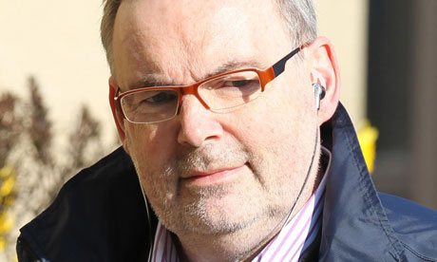
Notes:
Malcolm Webster: killed one wife for insurance money and nearly killed another

Slide 13
Individual risk factors for human violence
Maleness
Youth
Substance misuse (alcohol and illicit drugs)
Antisocial attitudes and beliefs
Childhood adversity and insecure attachment
Paranoid mental states
+ The unpredictable variable……

Slide 14
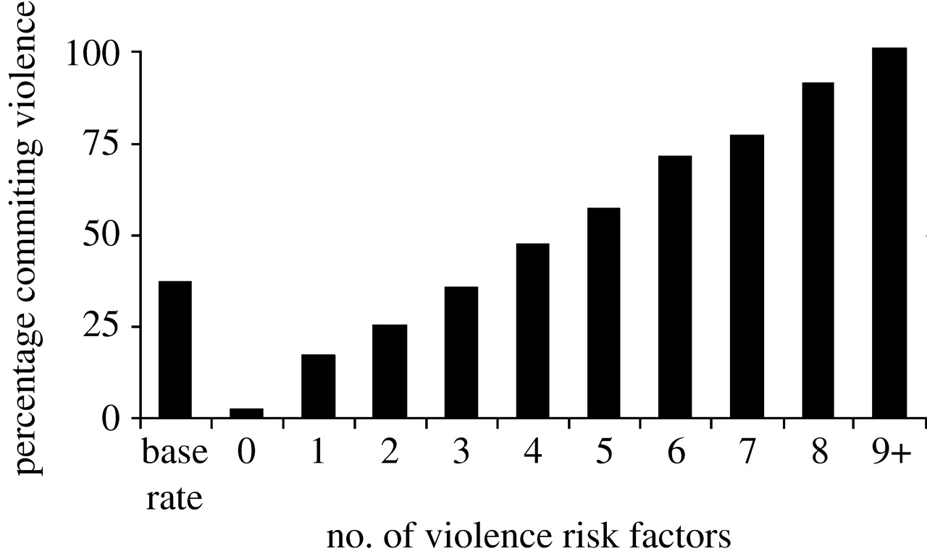

Slide 16
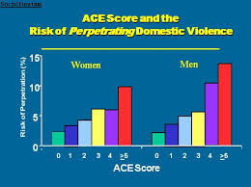

Slide 17
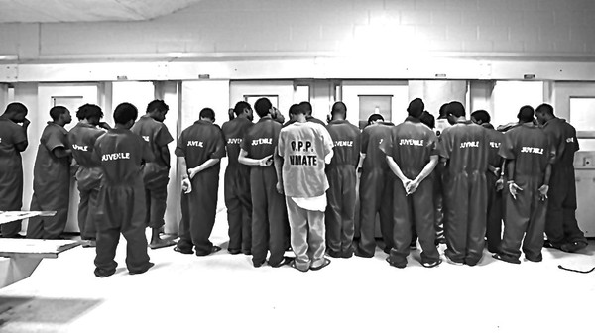

Slide 18
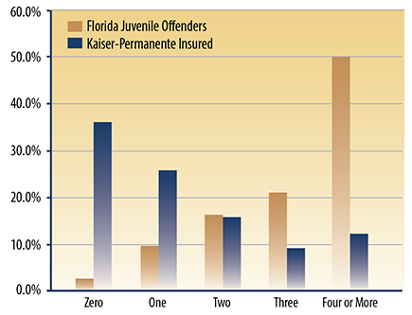

Slide 19
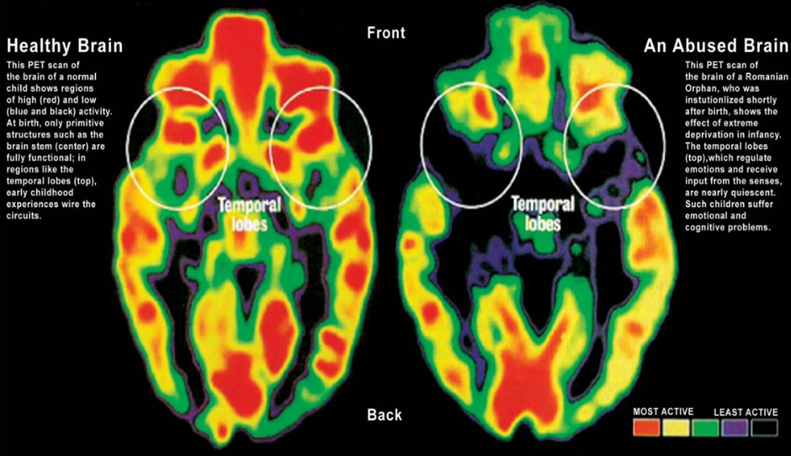

Slide 22
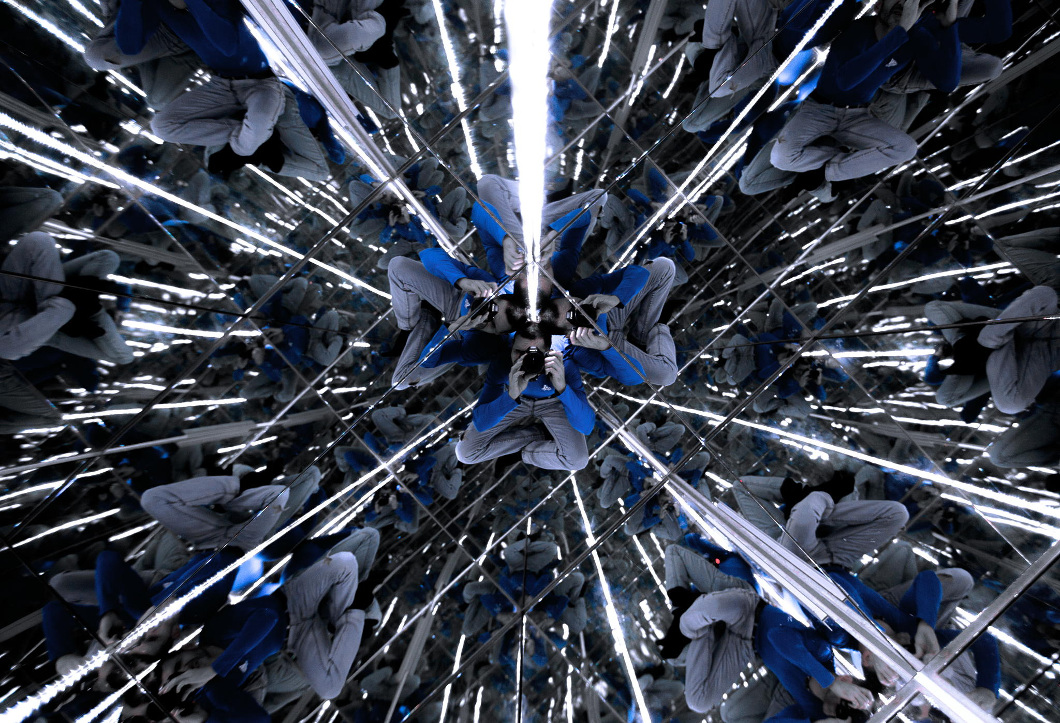
Notes:
The brain cells of an offender blown up

Slide 23
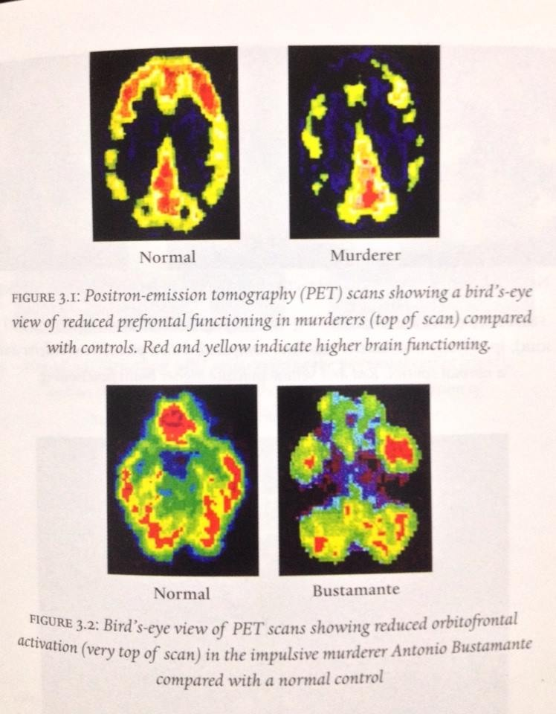

Slide 24
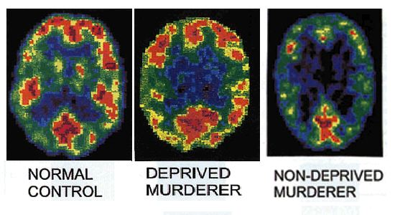

Slide 25
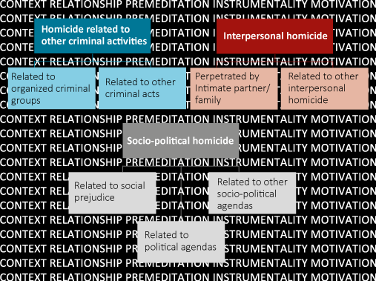
Notes:
UNODC document: motivations for violence

Slide 26
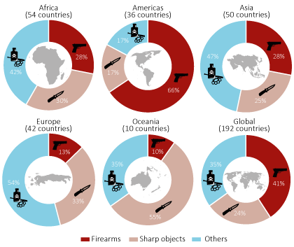

Slide 27
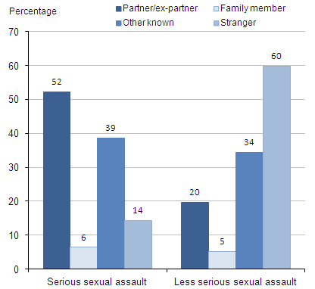
Notes:
Sexual assault perpetrators data 2013

Slide 28
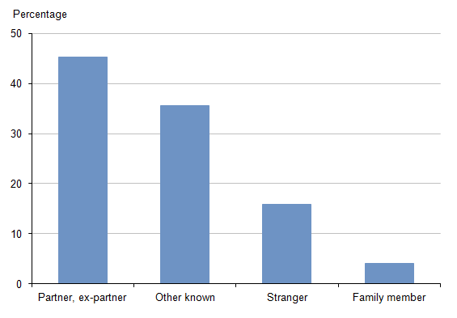
Notes:
Perpetrators of serious sexual assault by relationship CESW 2015

Slide 29
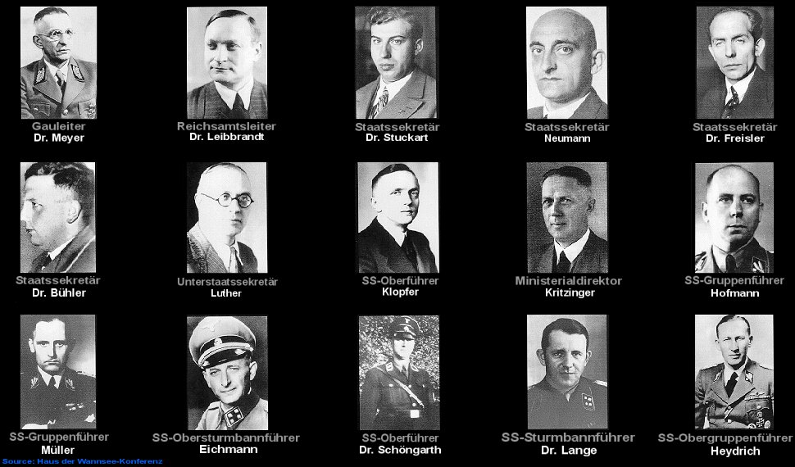

Slide 31
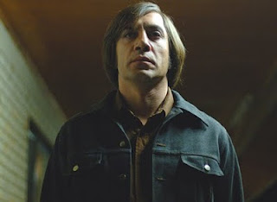
Notes:
Javier Bardem

Slide 32
Robert Hare and the study of psychopathy
A sub-group of violent offenders ( 25-30%)
Interpersonal callousness and deceit
Affective detachment and hypo-responsiveness
Impulsivity and rule breaking
Intelligence may be high; may appear and be charming
Entitlement and contempt for others

Slide 33
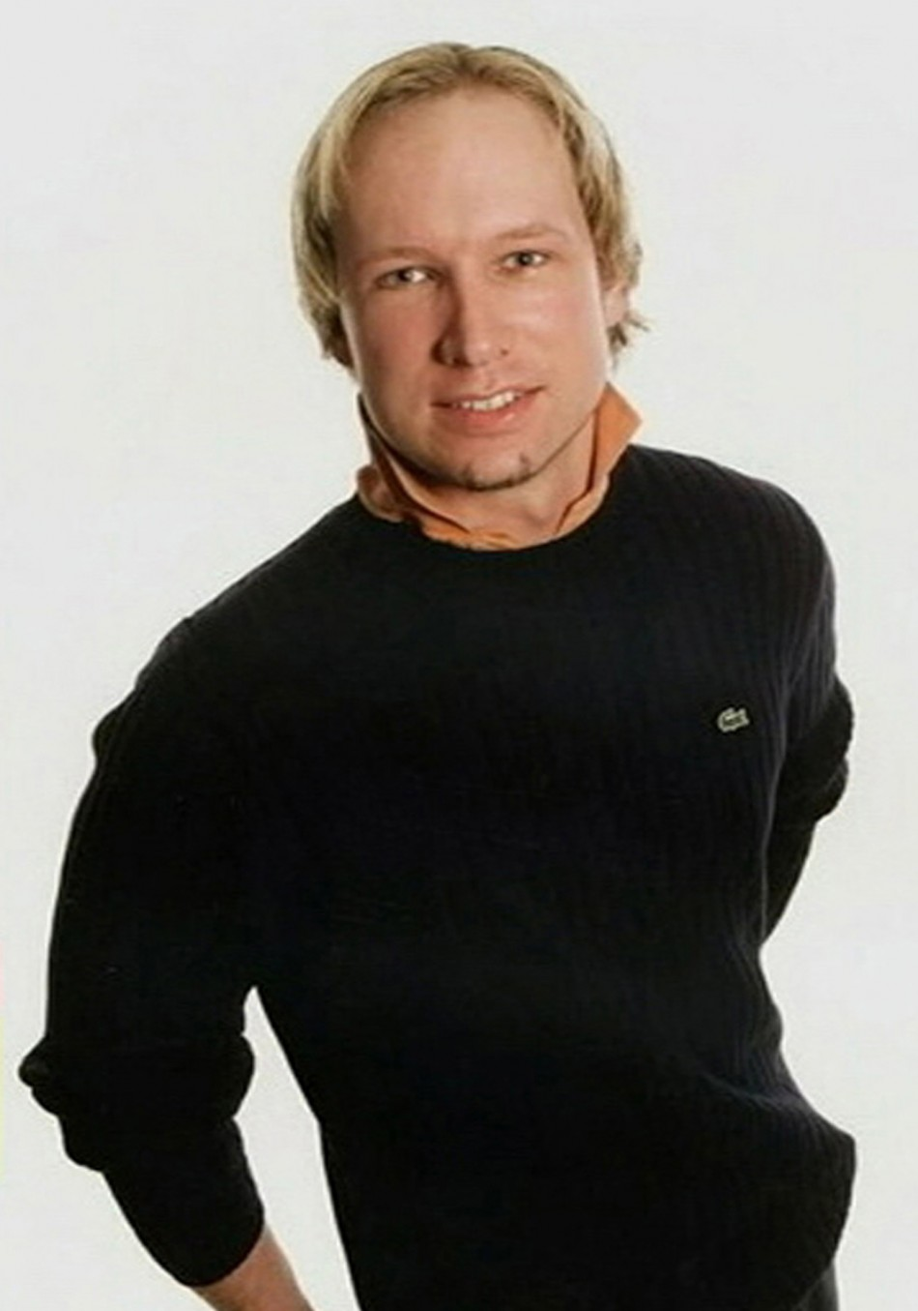

Slide 34
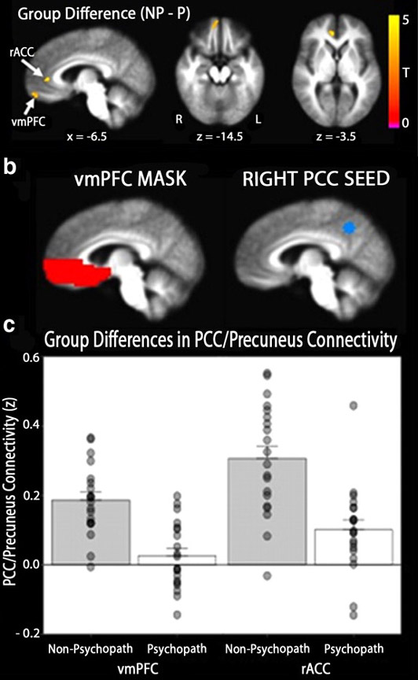

Slide 35
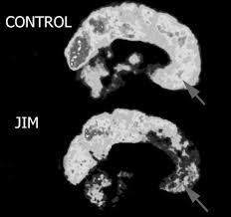
Notes:
James Fallon: claims to have brain of psychopath despite having never done anything remotely antisocial in his life… the warrior gene

Slide 36
Questions about psychopaths
Where do they come from?
Is there a normal distribution in the community? i.e do we all have a ‘bit’ of psychopathy but some have more, and some have less?
Can you be psychopathic and non-violent? Could that be a good thing?

Slide 37
Notes:
The Green party political broadcast

Slide 38
Detachment, psychopathy & attachment
Detachment and Dismissing attachment
Emphasis on normality and strength
The disavowal of, or laughter at, pain
Denigration of neediness and tenderness
Derogation of vulnerability and human connection
Evidence of dismissing attachment in psychopathy and offenders

Slide 39
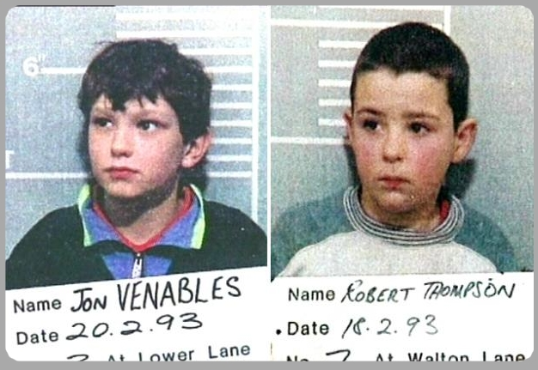

Slide 40
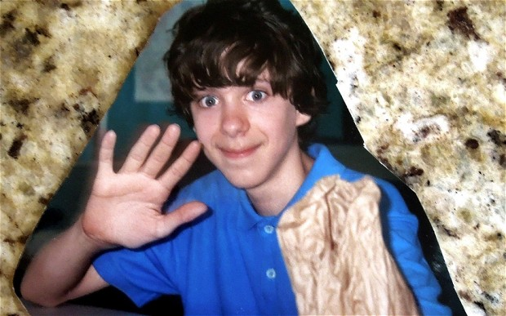
Notes:
Adam lanza: school massacre at Sandy Hook

Slide 41
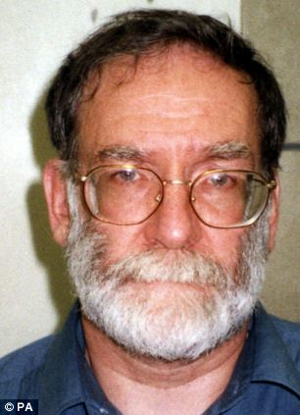

Slide 42
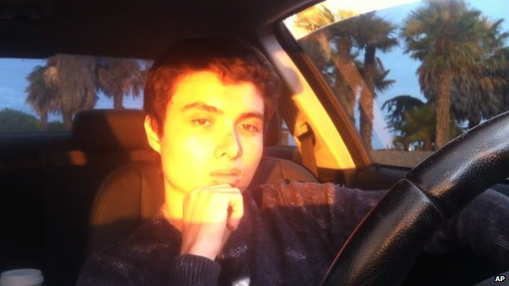
Notes:
Elliott Rodger 2013 his manifesto

Slide 43
What about the women?
An empirical question
No country or culture where men do not make up the majority ( 80%) of violent offenders?
But are the dynamics the same?
Violent women resemble violent men: unusual sub-group of their sex; tend to kill people they have been attached to; attack the vulnerable if they are antisocial, have histories of child abuse and neglect.
Female psychopaths look much like the men

Slide 44
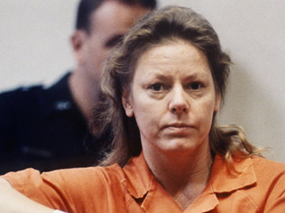
Notes:
Aileen Wuornos: killed 7 men

Slide 45
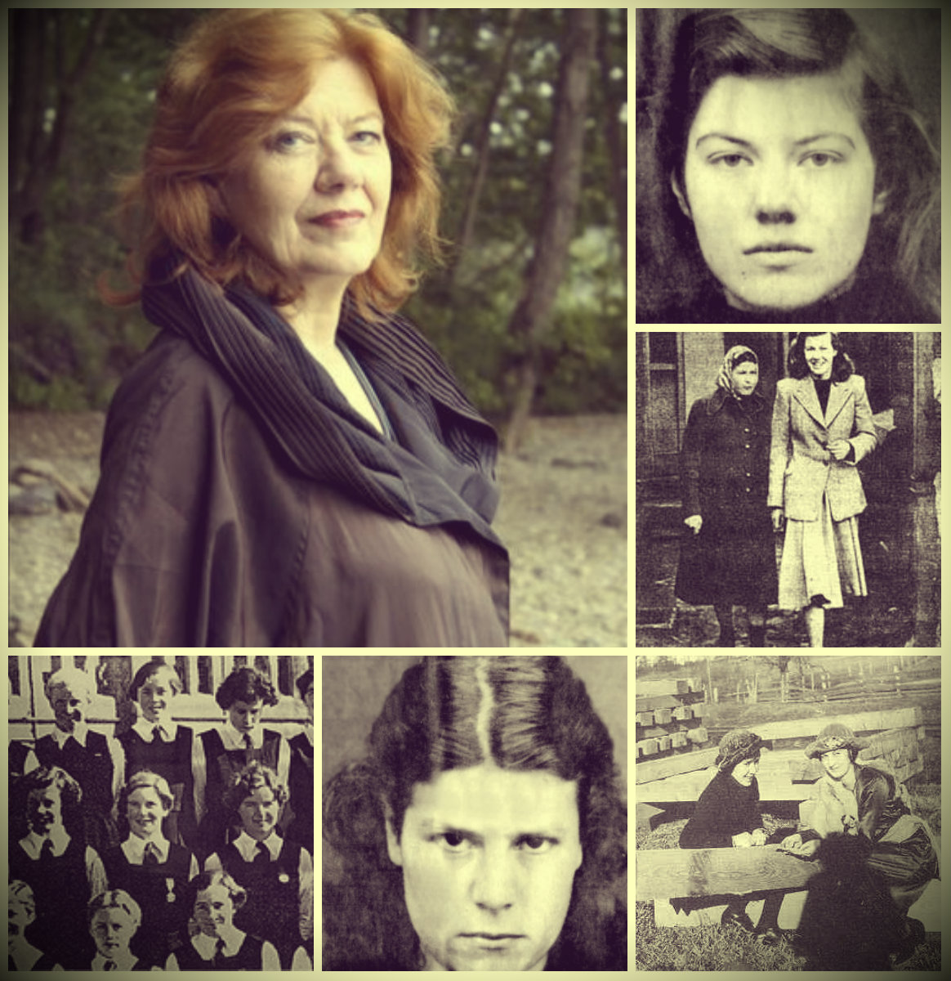

Slide 46
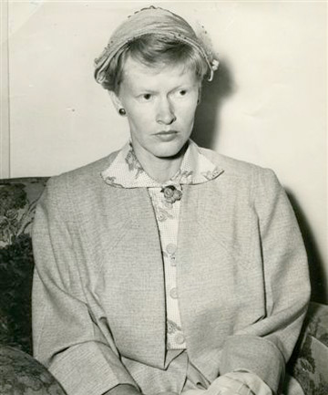

Slide 47
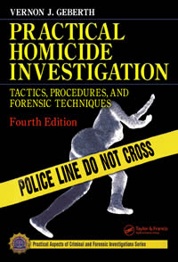

Slide 48
Quotes from people who have killed
I didn't kill him, I love him, it wasn't murder
I'm not guilty... only guilty of love
I had murder in my heart that day
I looked in the mirror and I said ‘Who the f*** are you looking at?’
It’s done, it’s done and I can’t bring her back
Shuffle off your mortal coil, you c***.

Slide 49
Compare and contrast
I am entirely normal. Even when I was doing extermination work I led a normal family life... X had ordered it and had even explained the necessity and I never really gave it much thought to whether it was wrong. I don't know what you mean by being upset about these things because I didn't personally murder anybody. I was just the director of the extermination programme.
I was thinking about the person I killed and how I’d like to say sorry… when I killed my relative, I was mentally ill, but I had no reason to kill my other victim
I

Slide 50
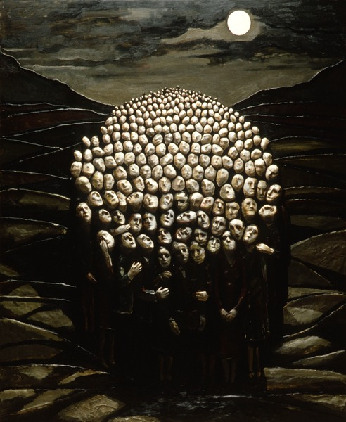

Slide 51
First year of a Homicide Group
If Sam talks about football, it’s not relevant
(But we’d get to know about him… as a person)
But this is isn’t the getting –to‑know‑each‑other group, it’s the Homicide Group.
Why Homicide?
Yes, why? Why not murder?
I don’t think I like murder.
You make it sound more serious.
Murder sounds so graphic.
Why is everyone so fascinated by murder? Waking the dead, Midsummer Murder…
Every night on TV, you can watch something about murder. [Pause]
If you get 7 or 8 crows together, you call it a murder.
In Broadmoor, there’s a myth that the crows are the souls of dead staff.

Slide 52
Another year
Sam is talking about watching TV, and how he likes to watch Star Trek. He talks about the ‘Prime Directive’ for the crew of the Enterprise: to not interfere with the life of the inhabitants of the worlds they visit.
The therapist asks: is that a bit like what we do here? Visit new worlds? Boldly go where non-one has gone before?
Sam looks at the therapist: You do know that I don’t actually think I’m on the Enterprise?!

Slide 53
In a recent group, a man said
I feel I’m stuck in my previous age… the age I was when I did my offence.. Time’s passing here and there are things I’m not doing.. I want to capture time with magazines and pictures to who what I was doing when I was here… What will it be like in 10 years time? Where will we be? What will I think on my deathbed about this time?’

