Slide 1
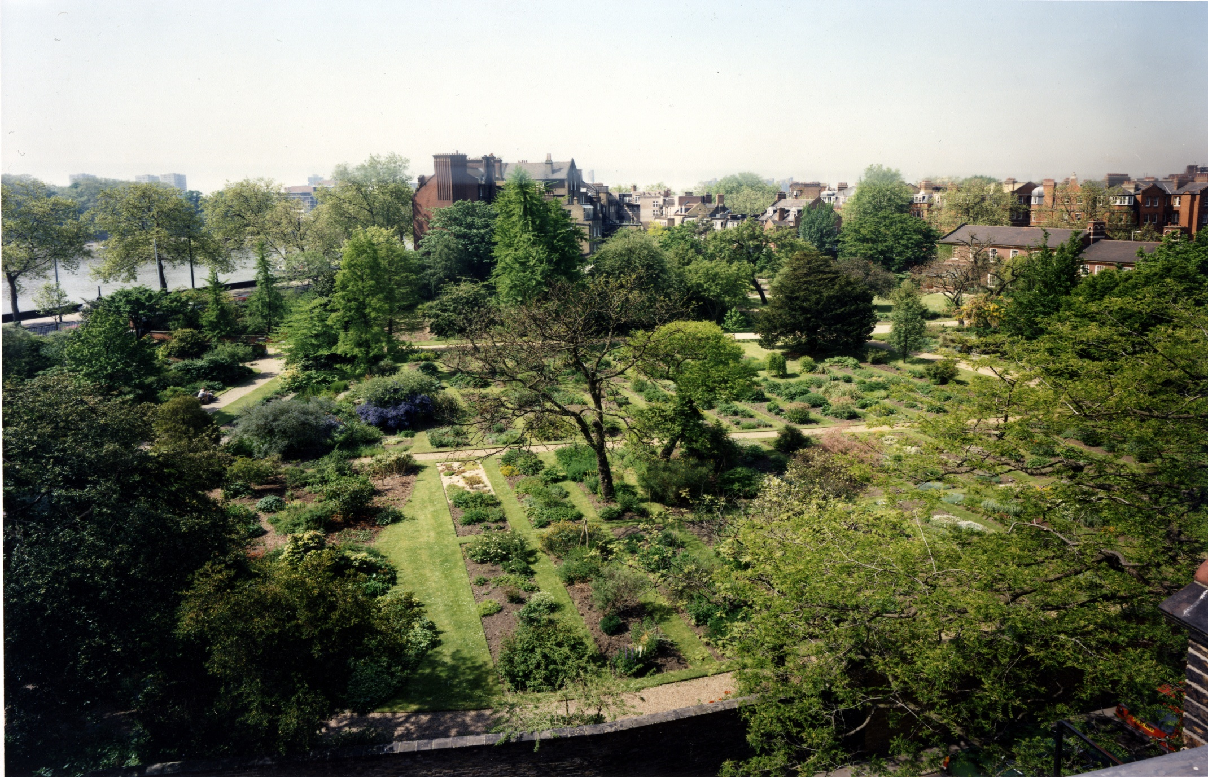
Chelsea Physic Garden Through the ages
By Michael Holland FLS, Head of Education

Slide 2
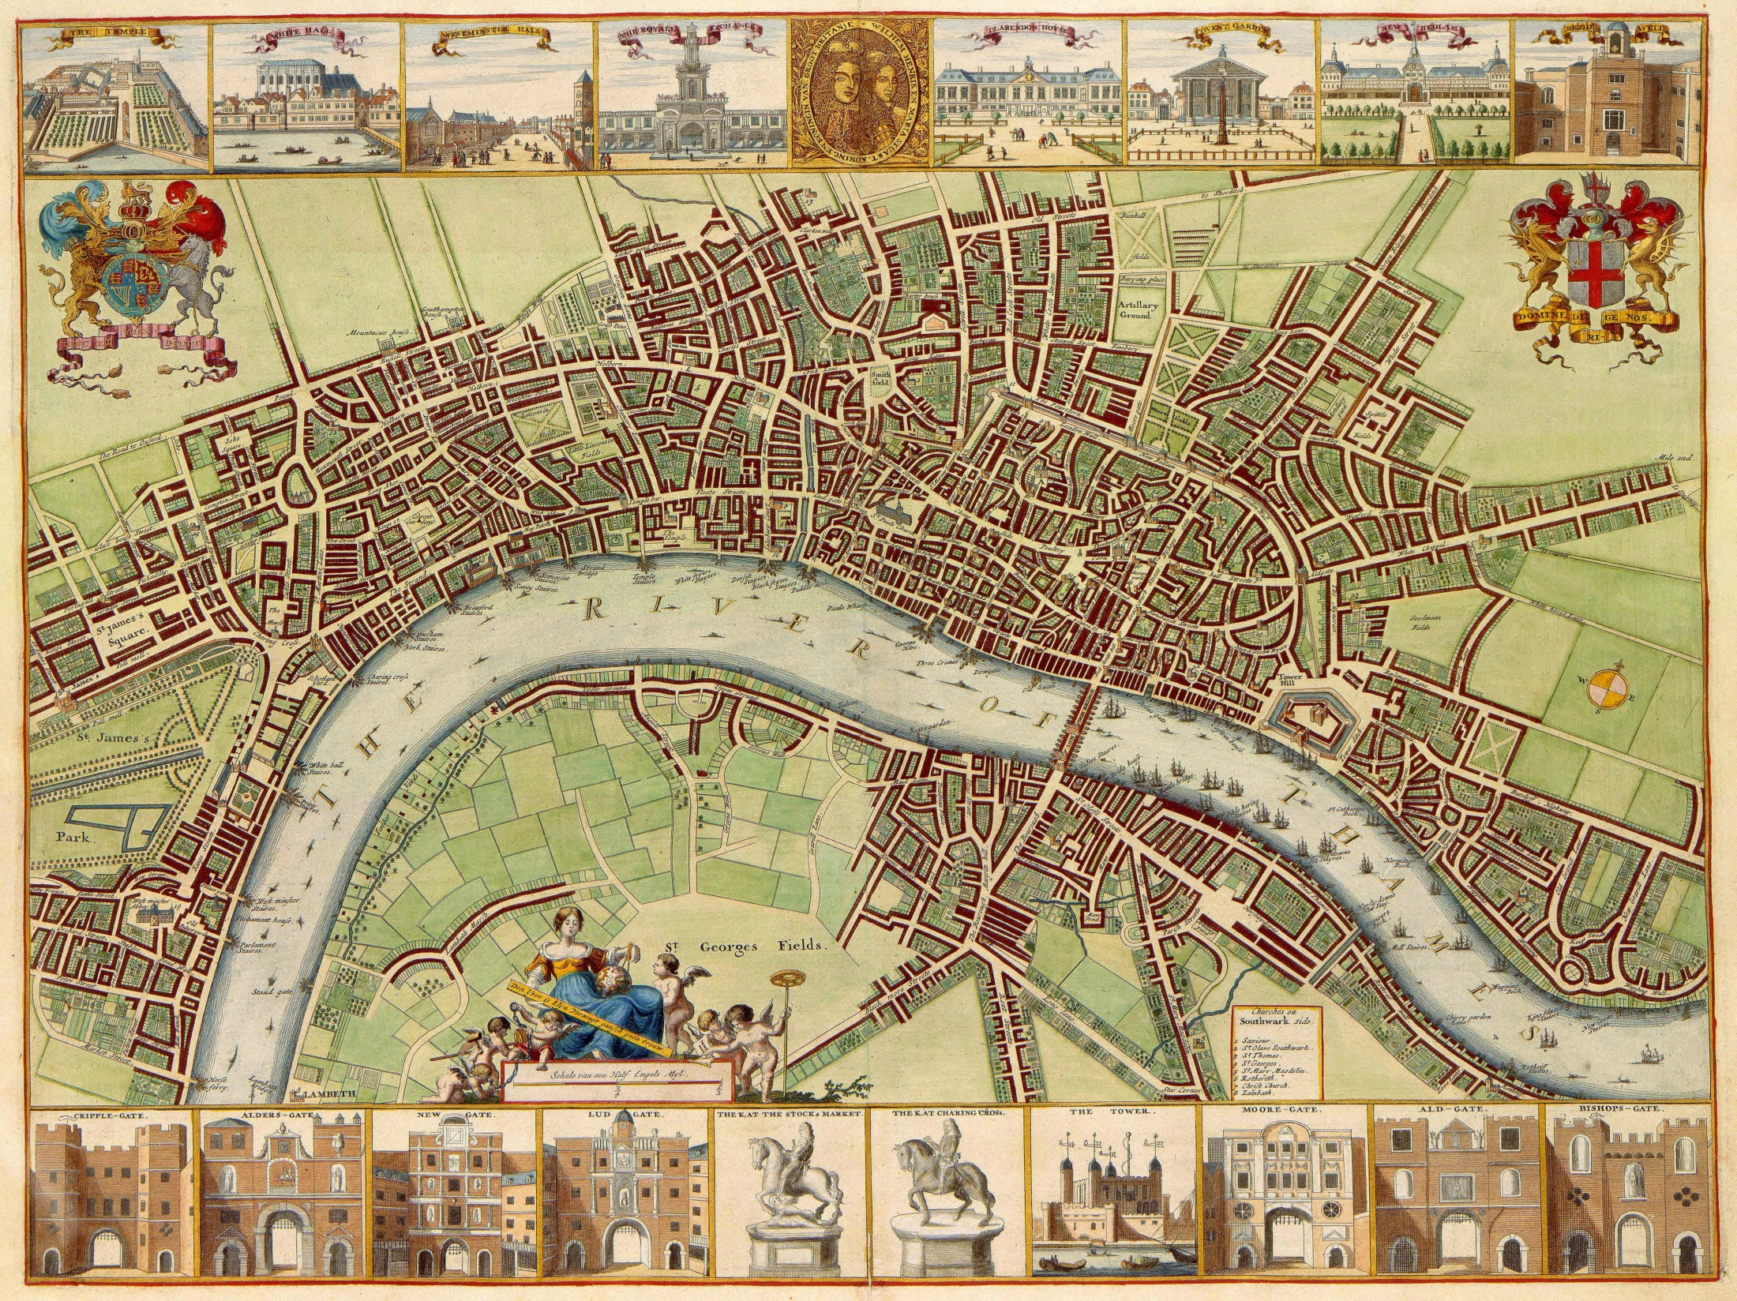
17th Century Beginnings

Slide 3
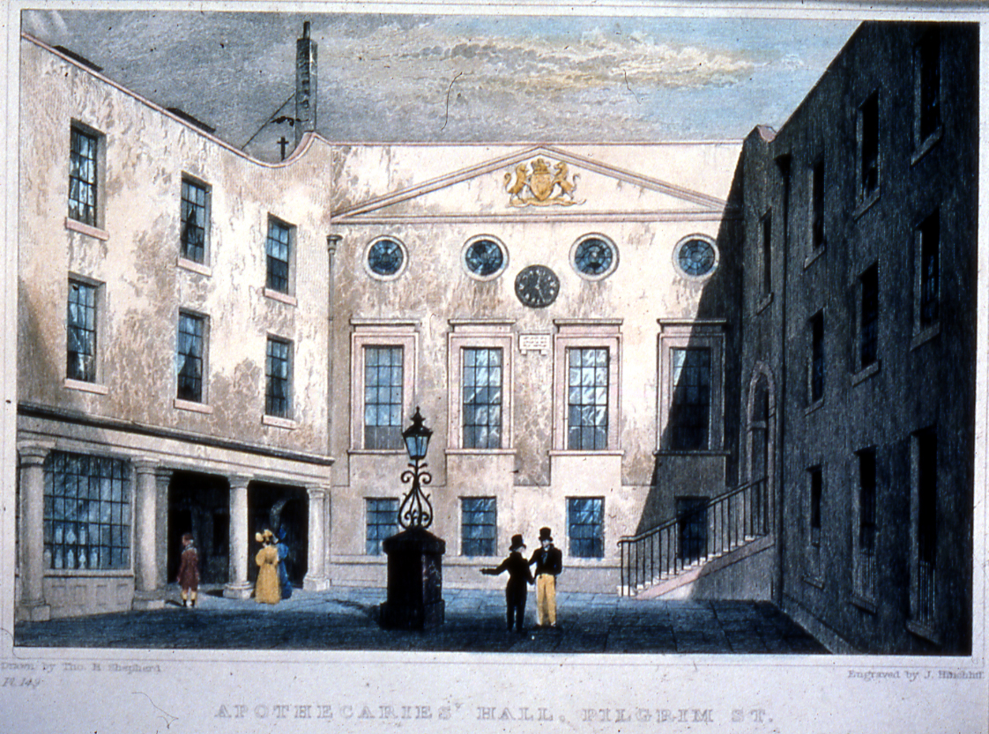

Slide 4
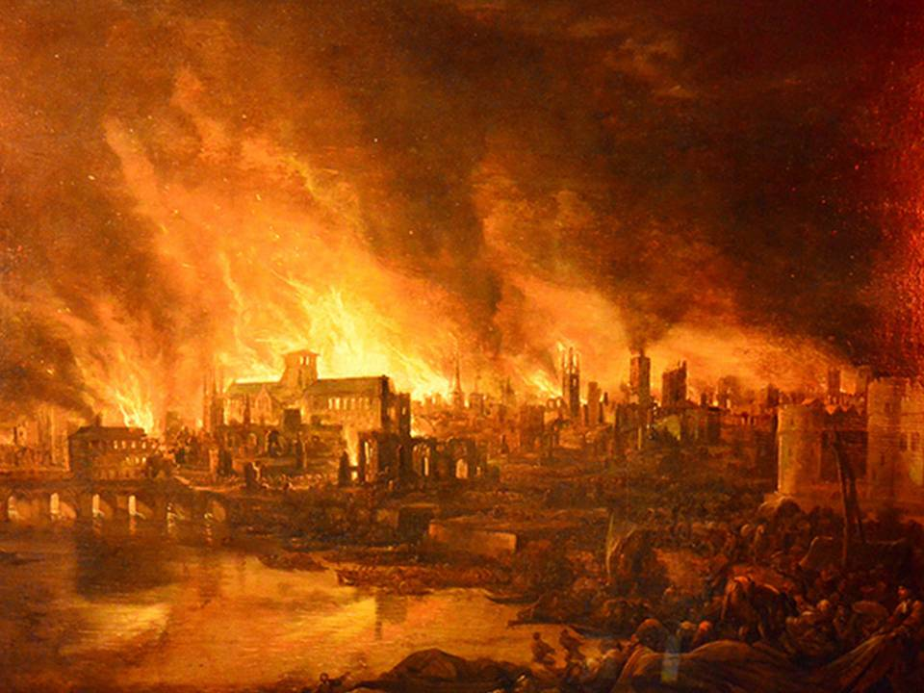

Slide 5
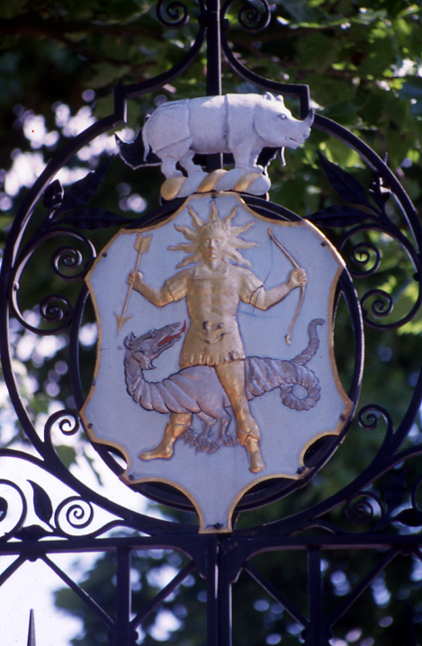
The Apothecaries’ Crest

Slide 6
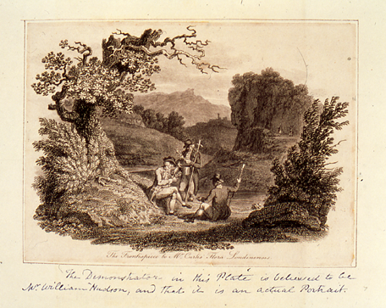
Herborising with Hudson in the 1760’s

Slide 7
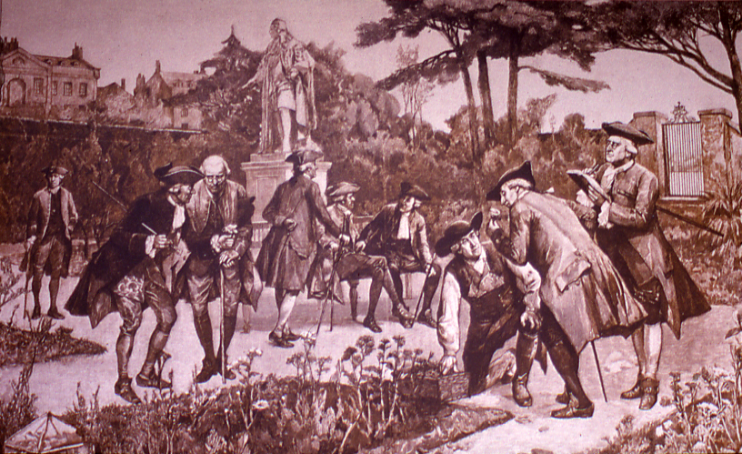
John Watts, Curator/Director from 1680-1692/3

Slide 8
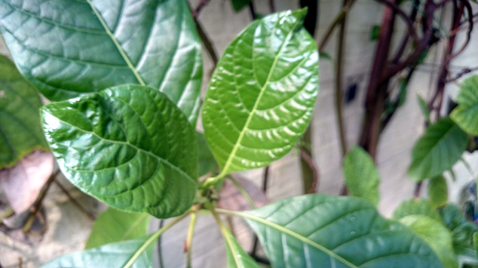
Cinchona pubescens

Slide 9
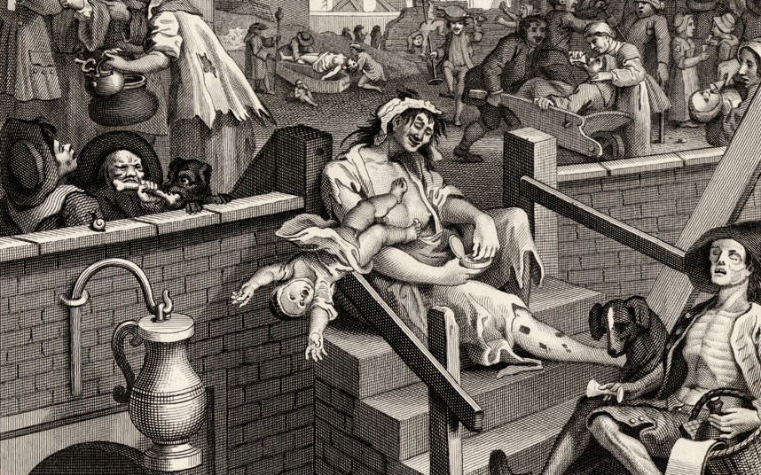
18th Century Correspondence, experiments & exchanges

Slide 10
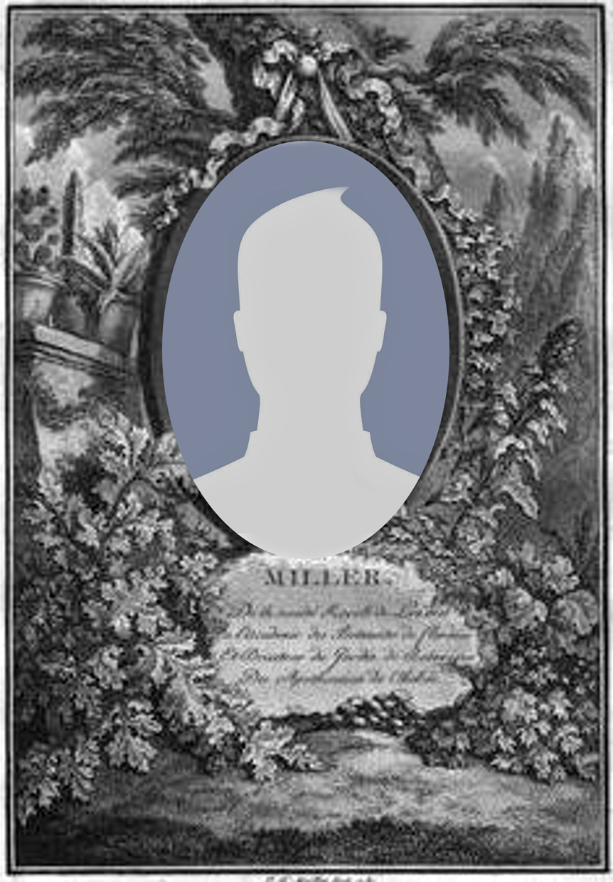
Philip Miller: Gardener from 1722-1770

Slide 11
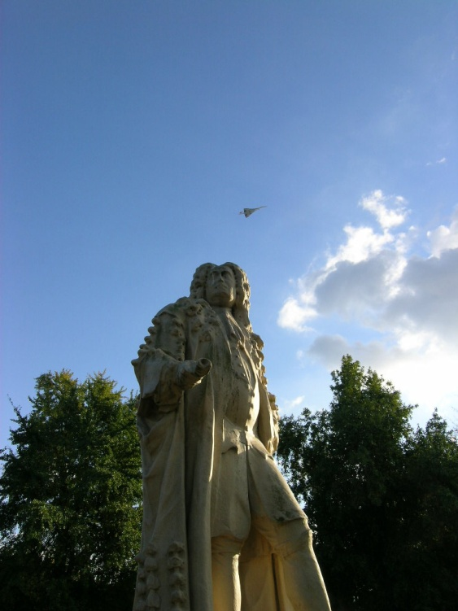
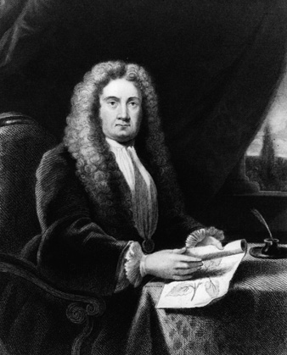
Sir Hans Sloane, 1660-1753

Slide 12
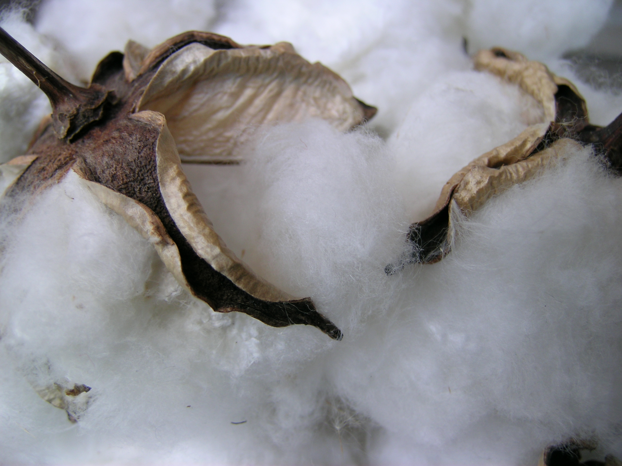
Gossypium hirsutum

Slide 13
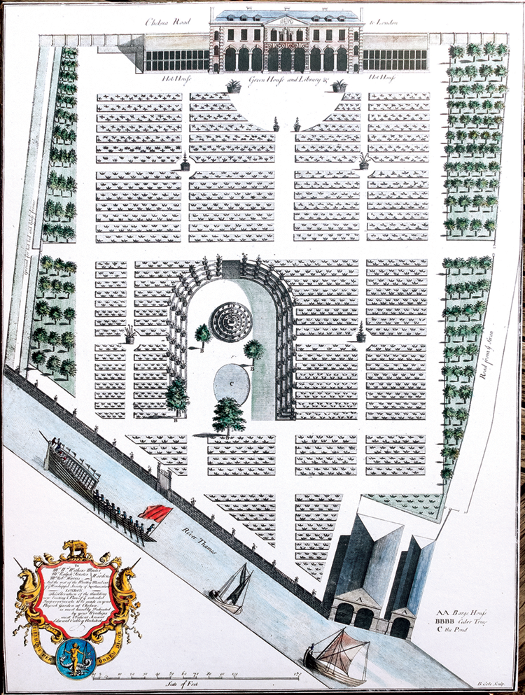
Planned, but uncompleted
improvements 1732

Slide 14
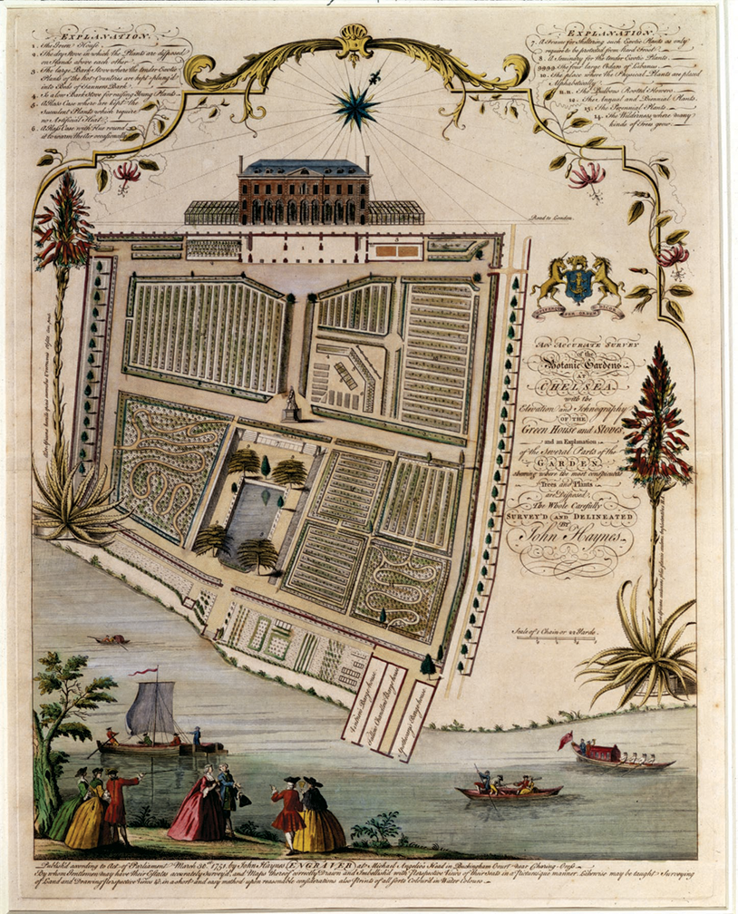
1751 Haynes map

Slide 15
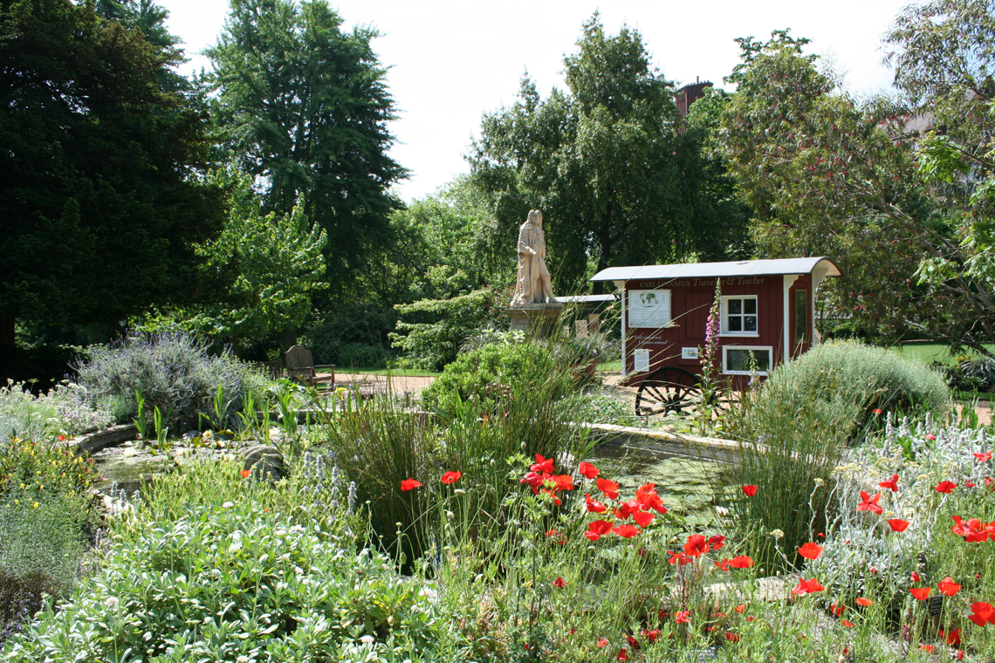

Slide 16
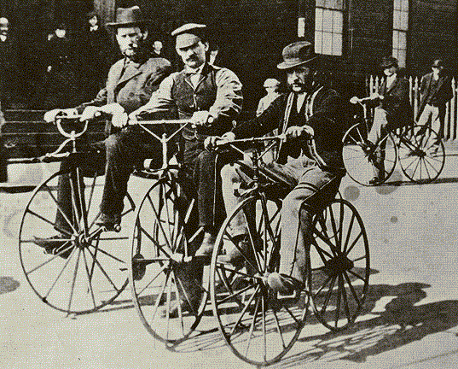
19th Century Empire building via innovation

Slide 17
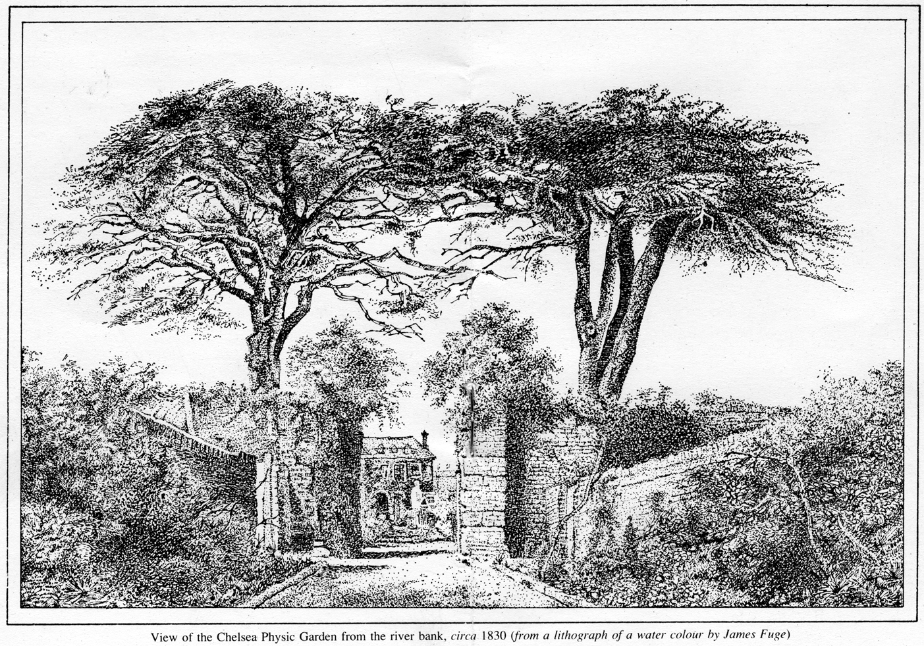

Slide 18
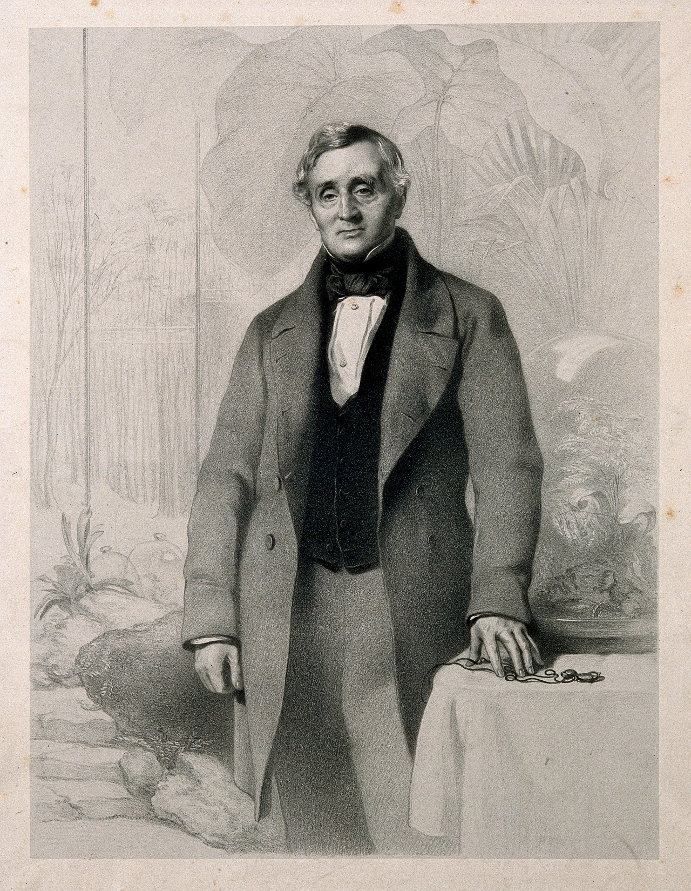
Dr. Nathaniel Bagshaw Ward

Slide 19
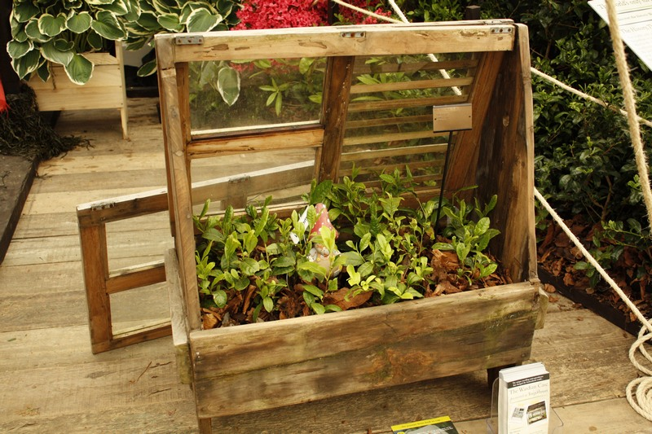
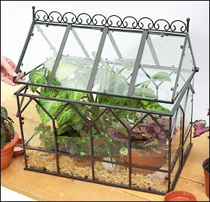

Slide 20
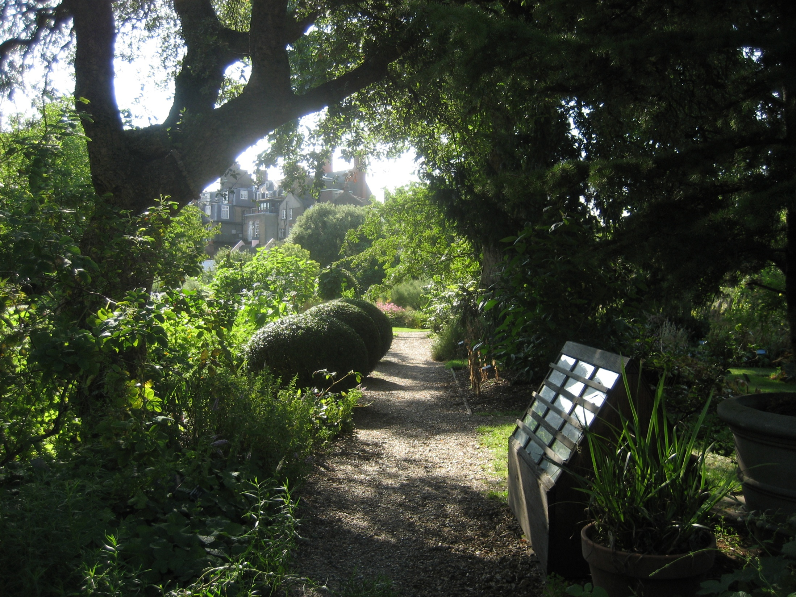
A replica Wardian Case at the Garden (beneath the cork tree)

Slide 21
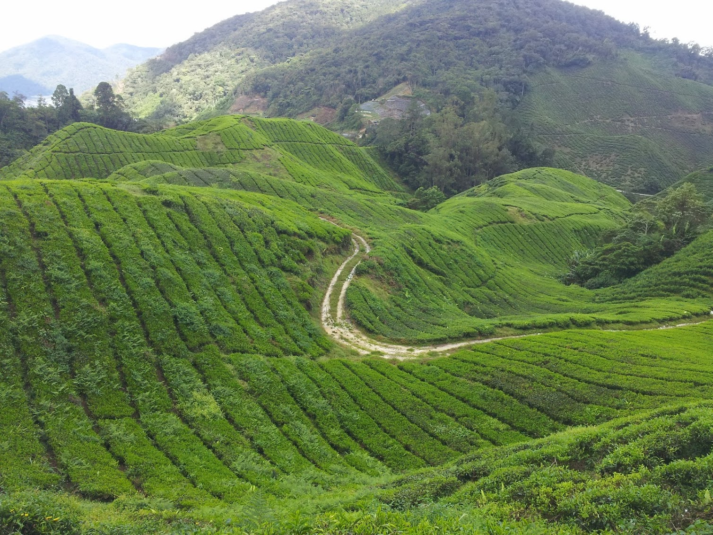
Camellia sinensis

Slide 22
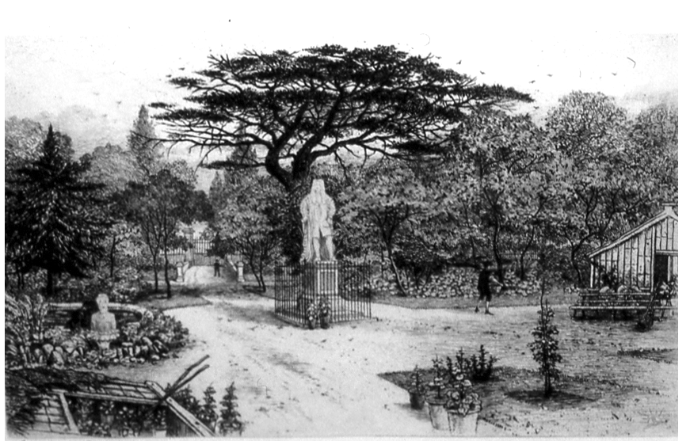
A late 19th Century view towards the Thames

Slide 23
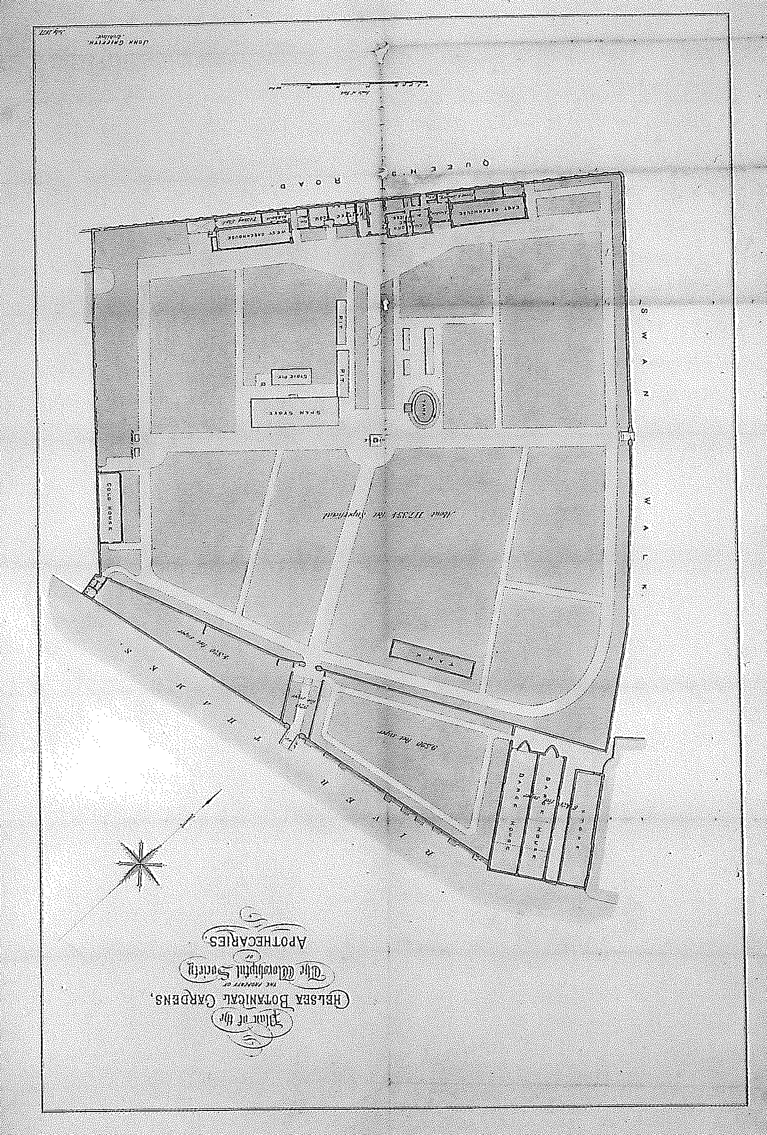
Survey of CPG 1871 by John Griffith

Slide 24
20th Century Research & networks

Slide 25
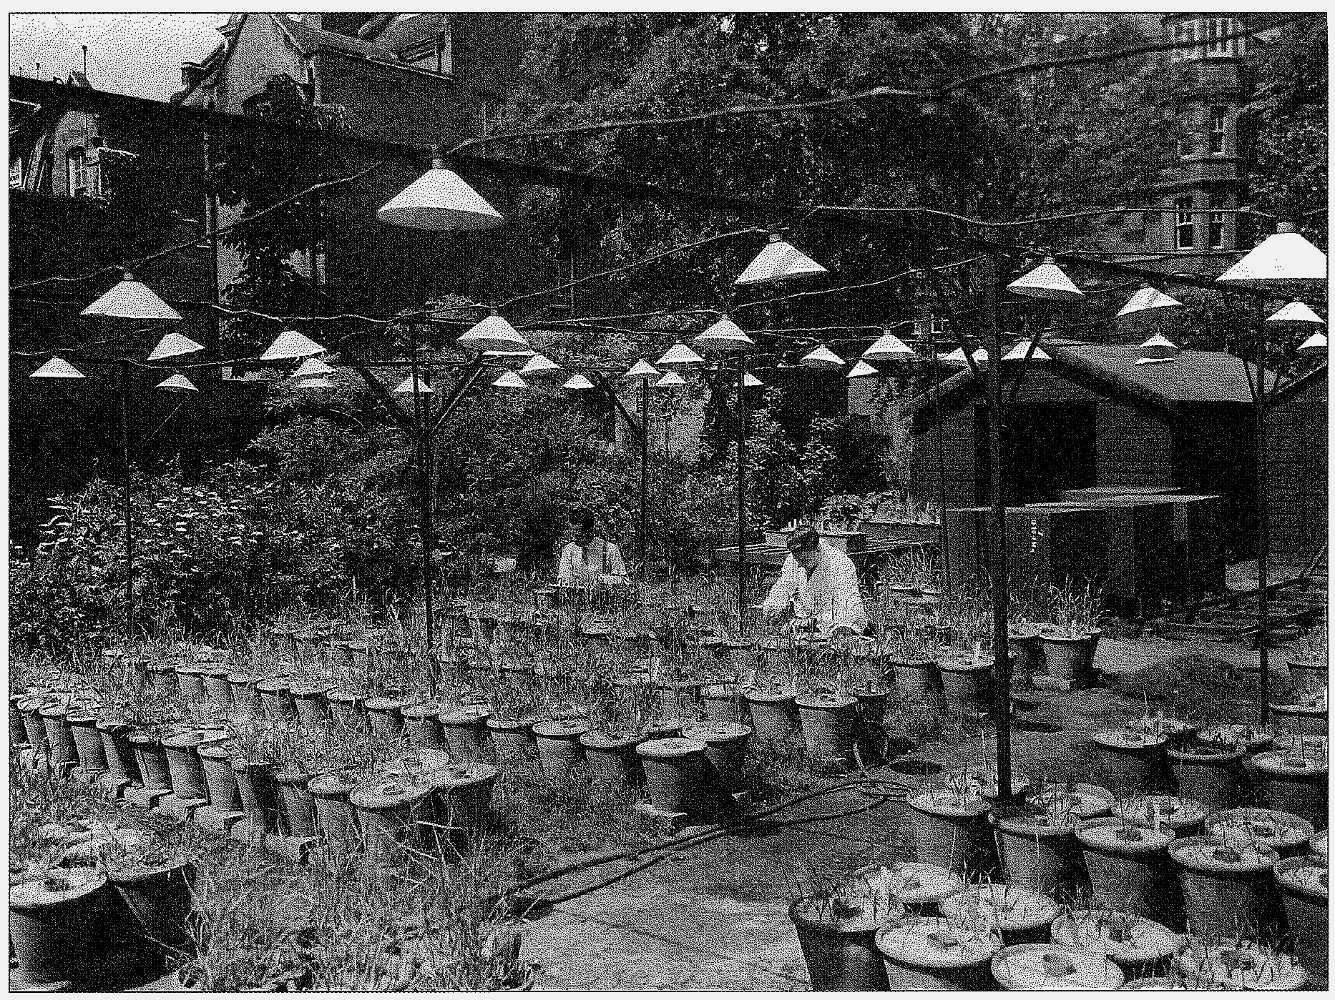
Experiments in vernalisation – 1950’s

Slide 26
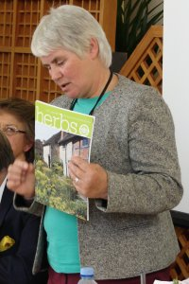
Sue Minter

Slide 27
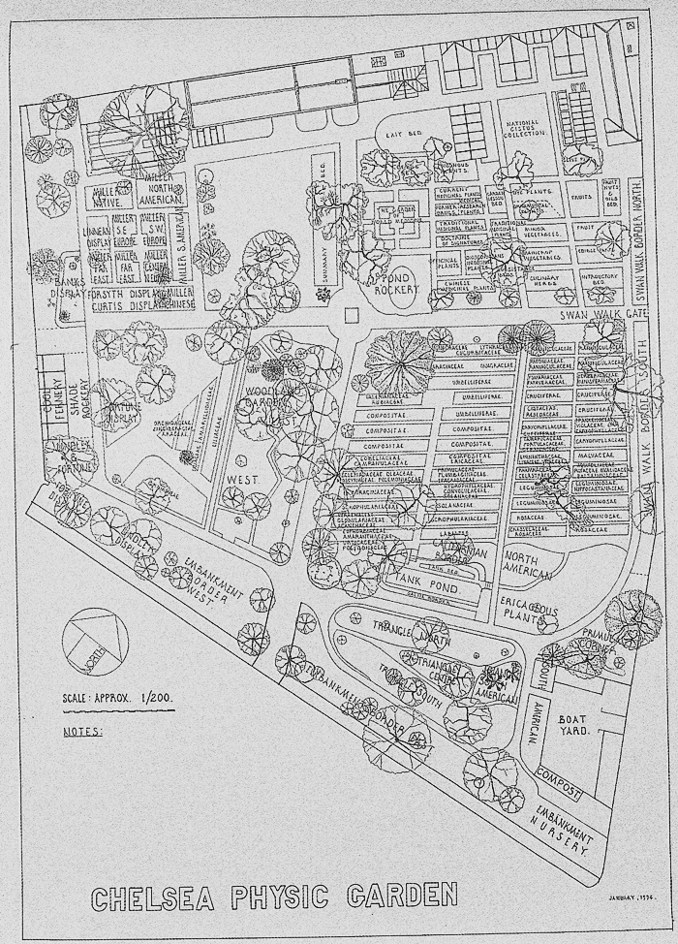
1994 survey drawn by James Parfitt

Slide 28
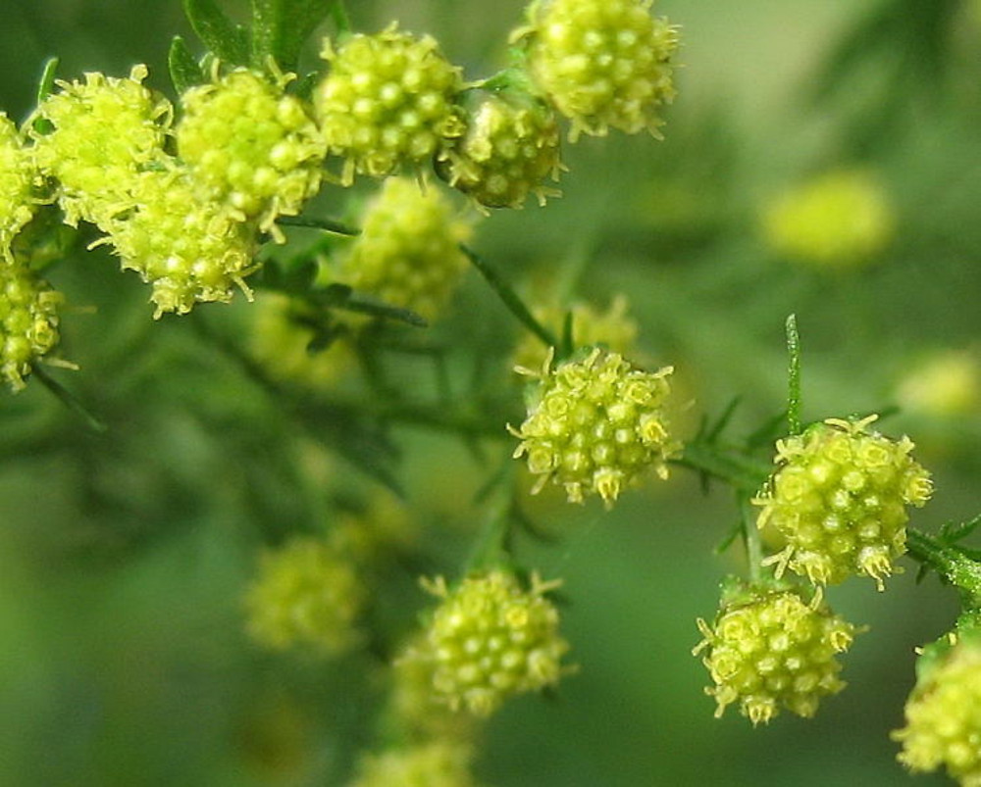
Artemesia annua

Slide 29
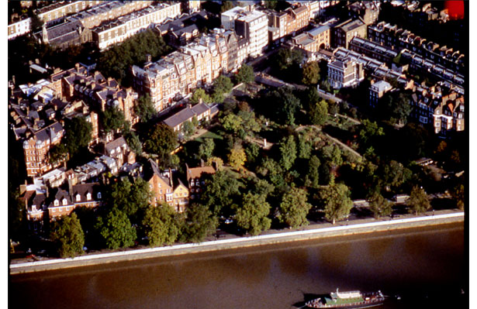
Chelsea Physic Garden

Slide 30
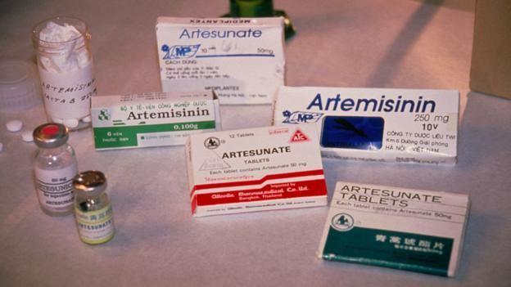
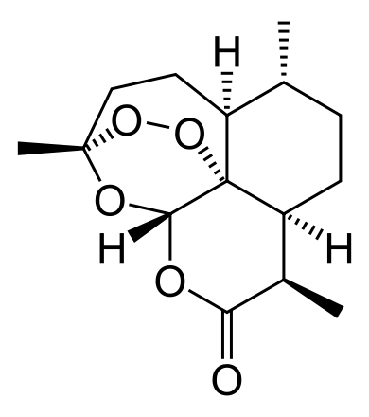
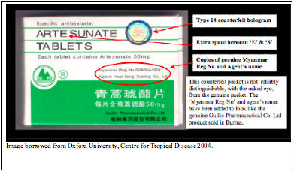
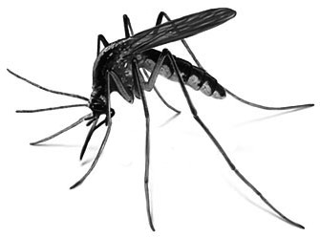

Slide 31
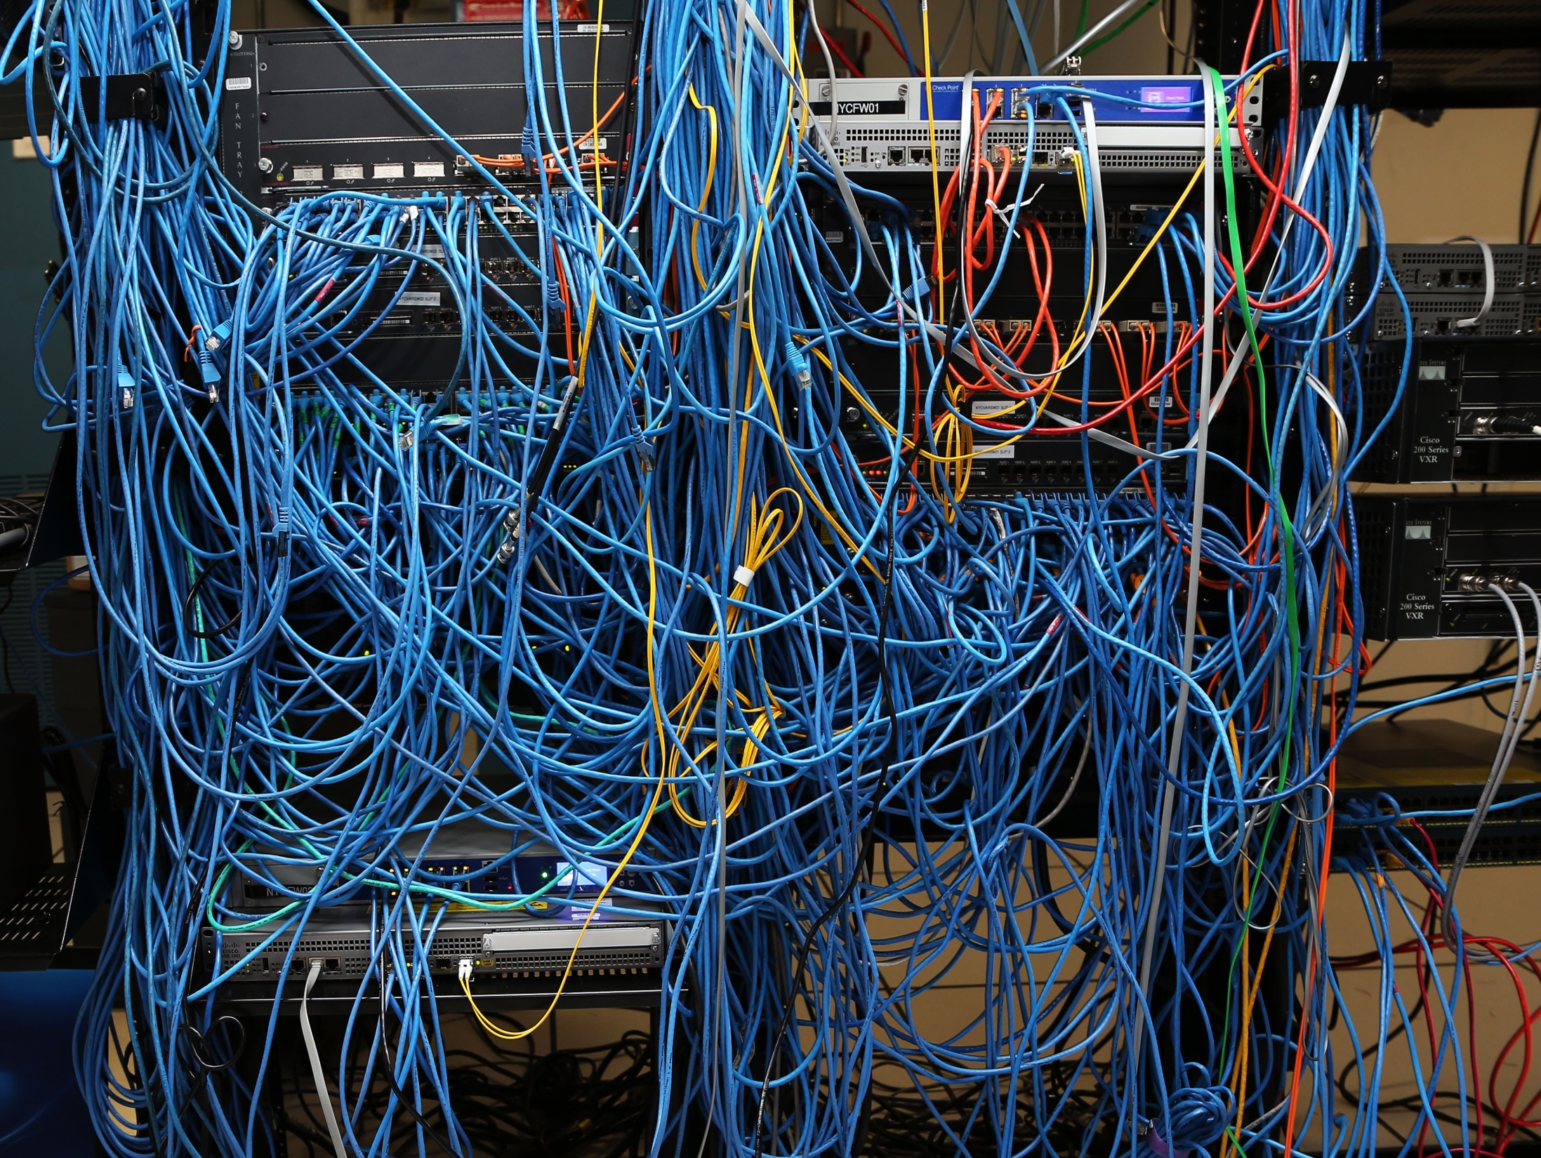
21st Century Making it relevant to our lives

Slide 32
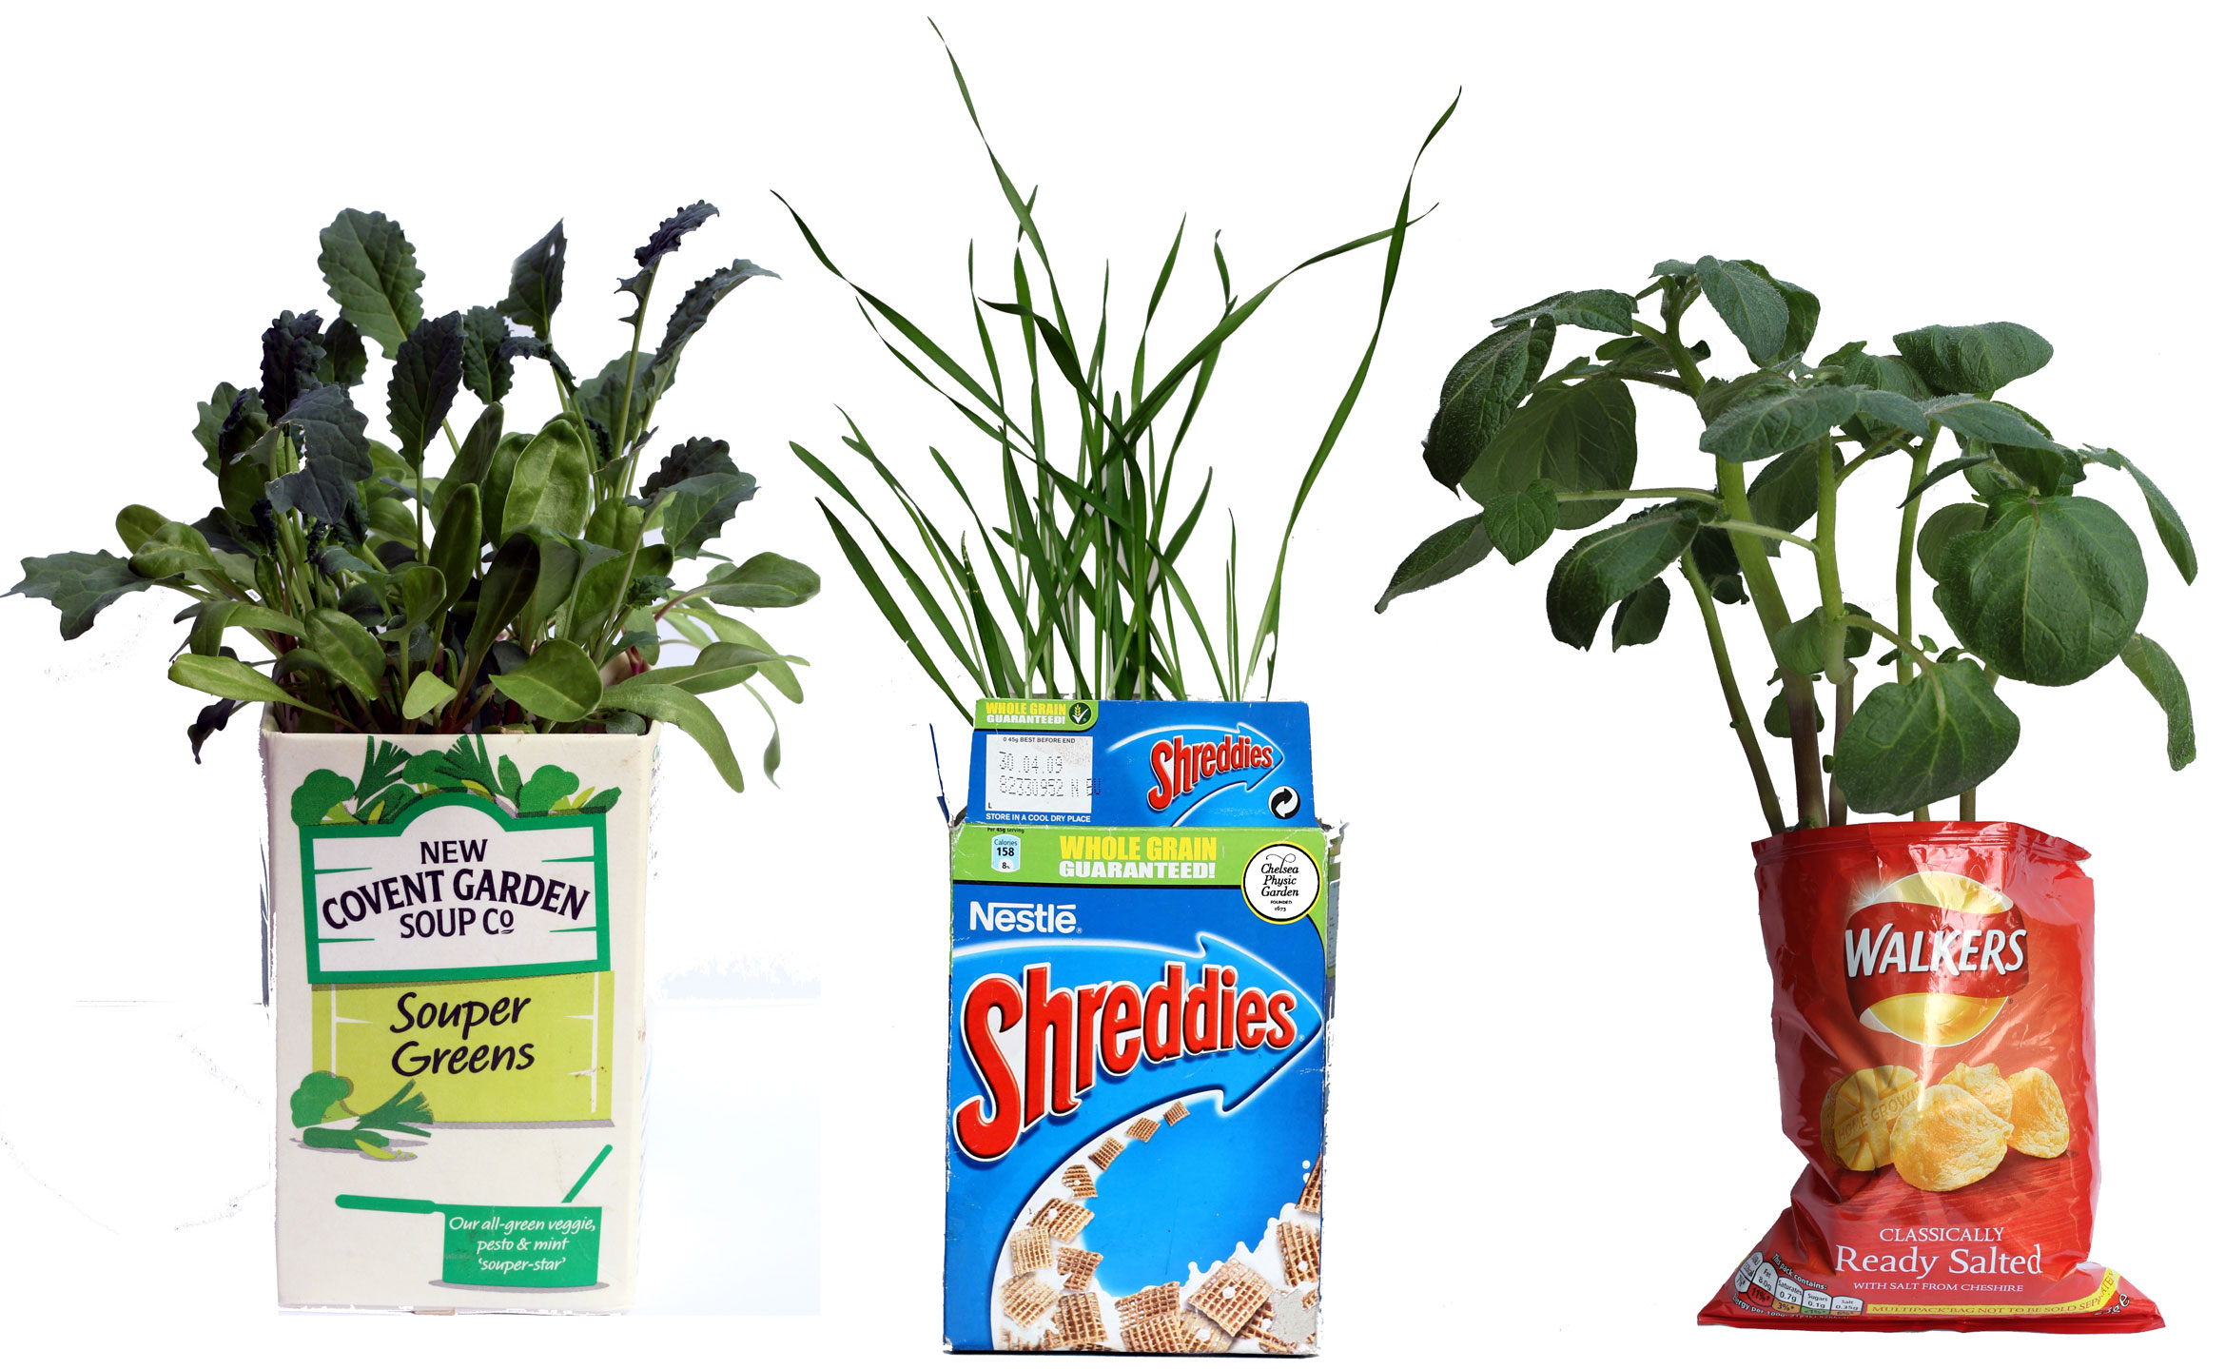

Slide 33
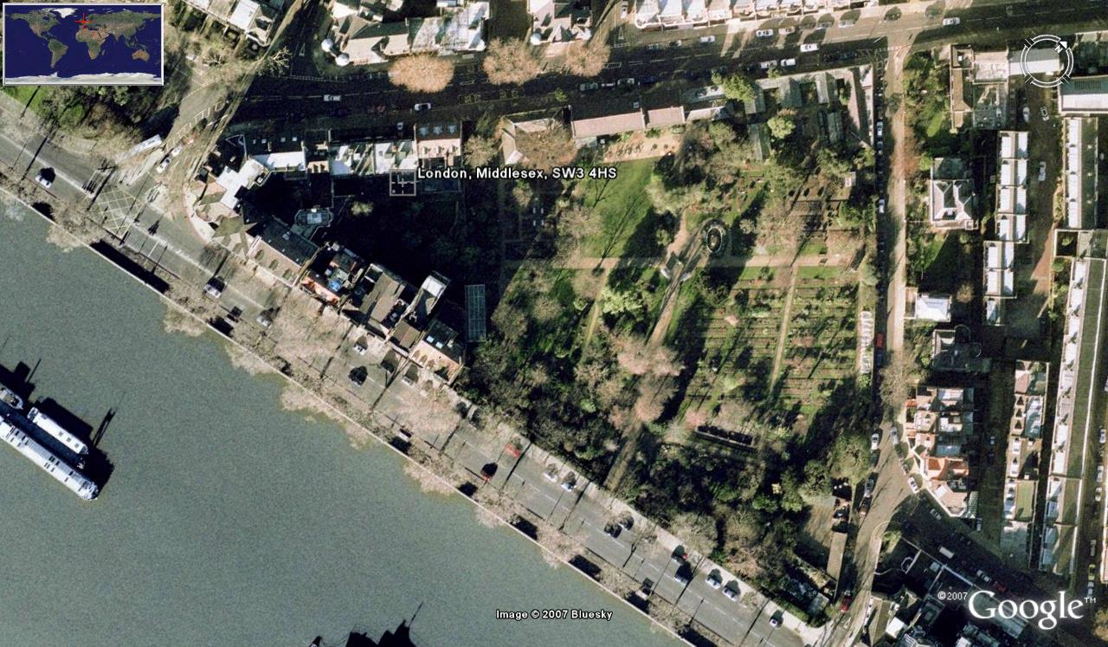

Slide 34
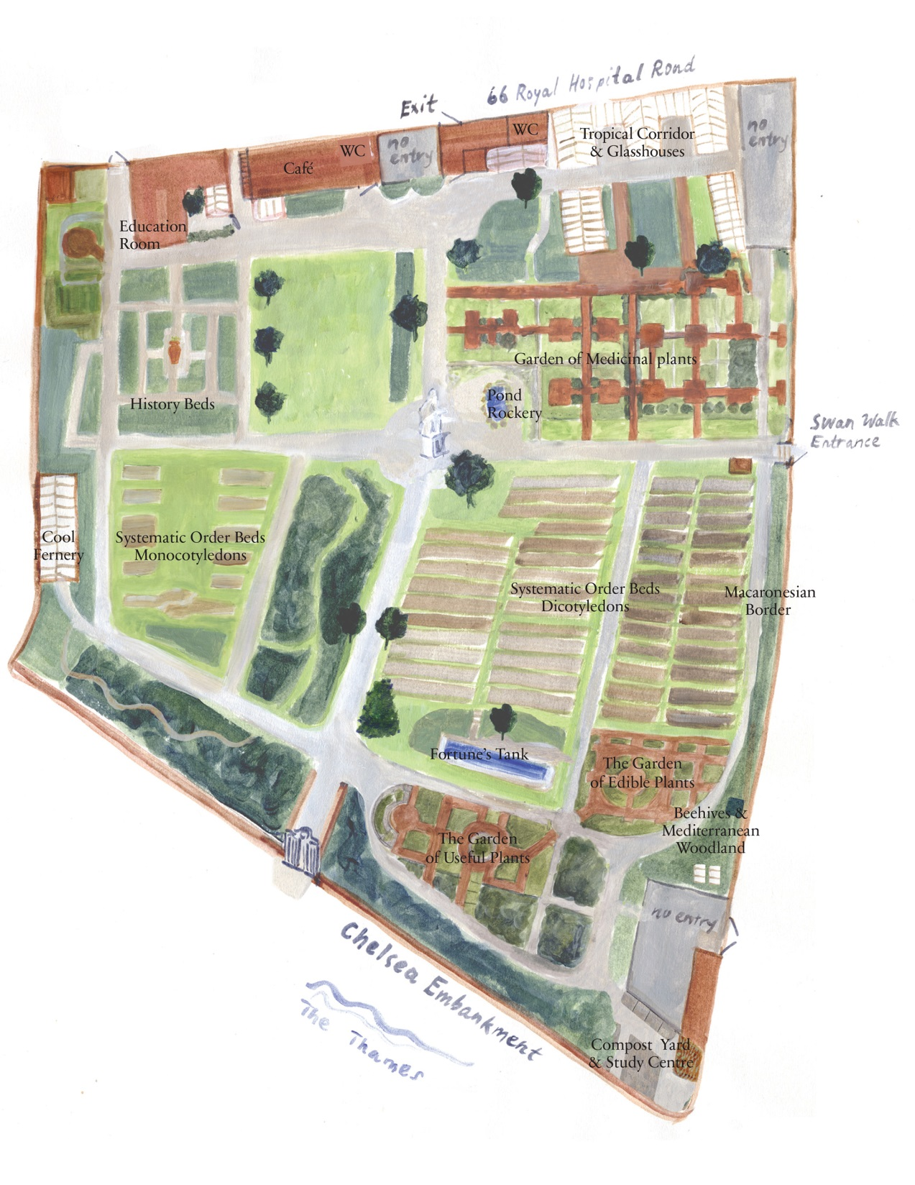
CPG map from 2014 with medicinal ‘rooms’ laid out in North east of the Garden.

Slide 35
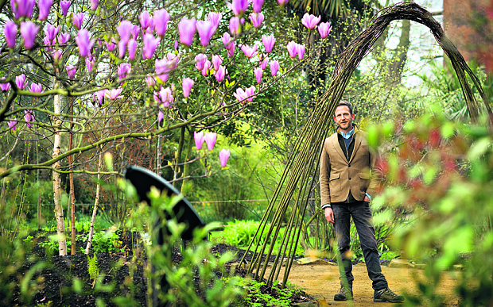
Nick Bailey
© The Daily Telegraph

Slide 36
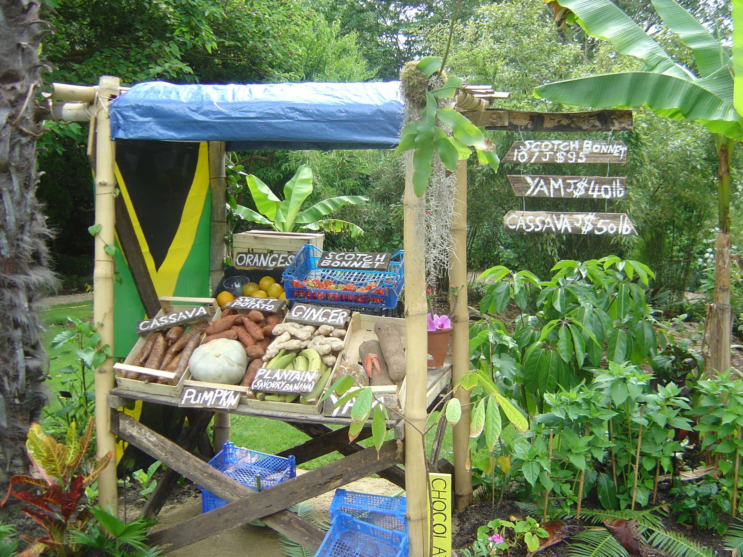

Slide 37
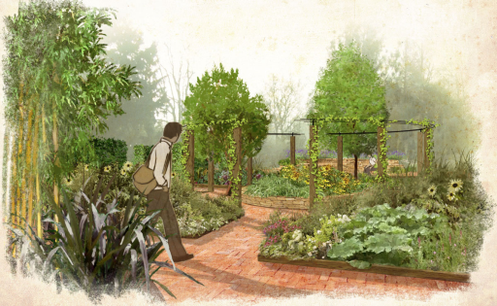
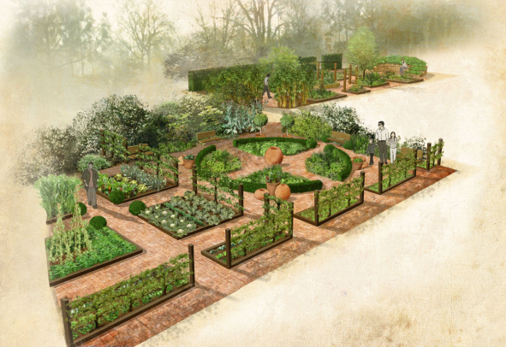
New ‘useful’ beds, including:
Religions
Arts
Fuels
Dyes
Survival
New edible beds including:
Vitamins
Brewing/distillation
Vegetables
Fruits

Slide 38
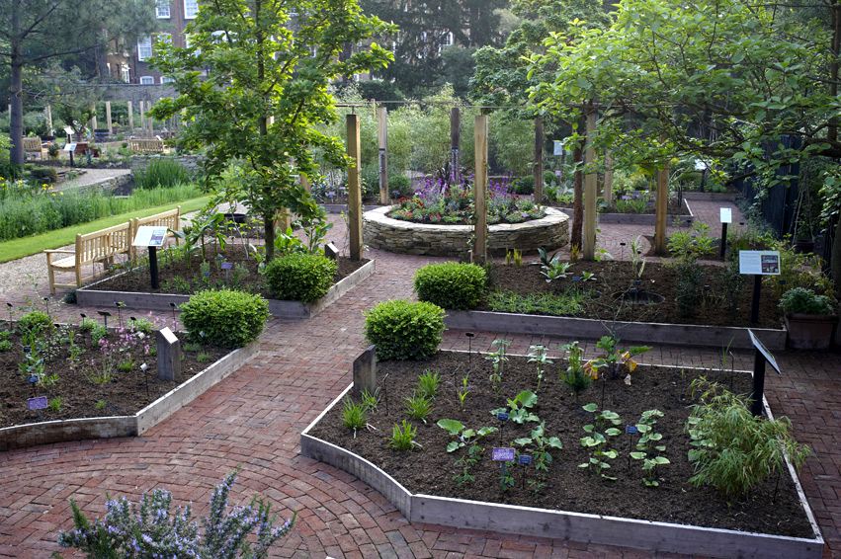
Our new ‘Useful’ beds – opened May 2012
Textiles e.g. nettle
Dyes
e.g. woad
Art & culture e.g. potato
Bee forage
Faith e.g. olive
Survival
e.g. rose
Land restoration
e.g. sunflower
Housing e.g. wheat
Hygiene
e.g. tea tree
Science & technology e.g. bamboo
Perfumery
e.g. rosemary

Slide 39
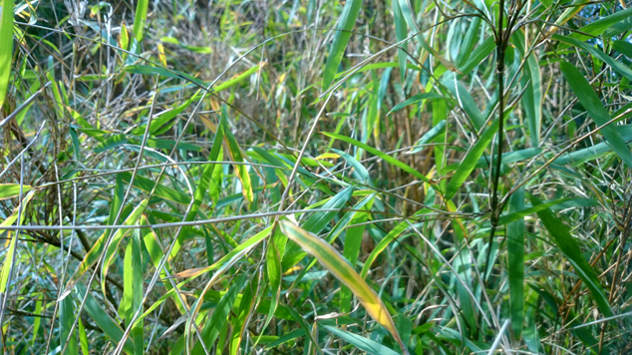
Bamboo

Slide 40
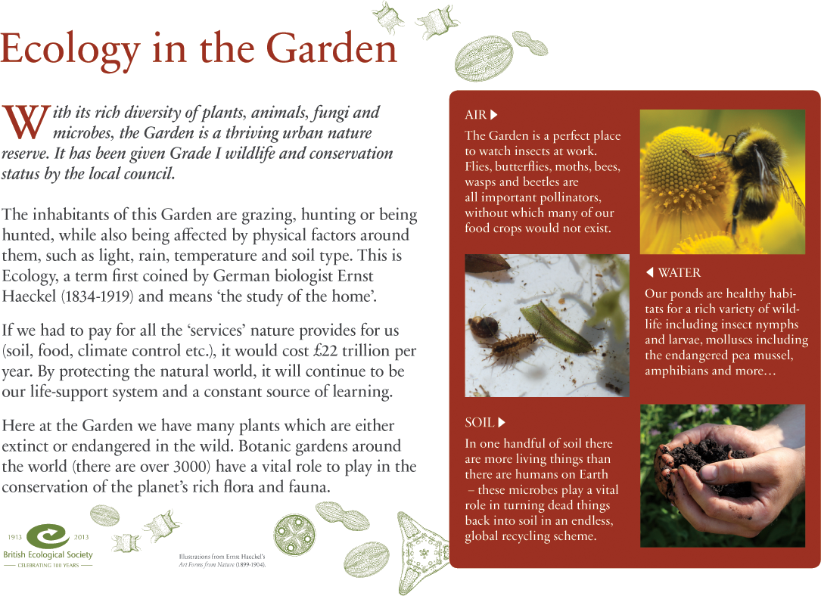

Slide 41
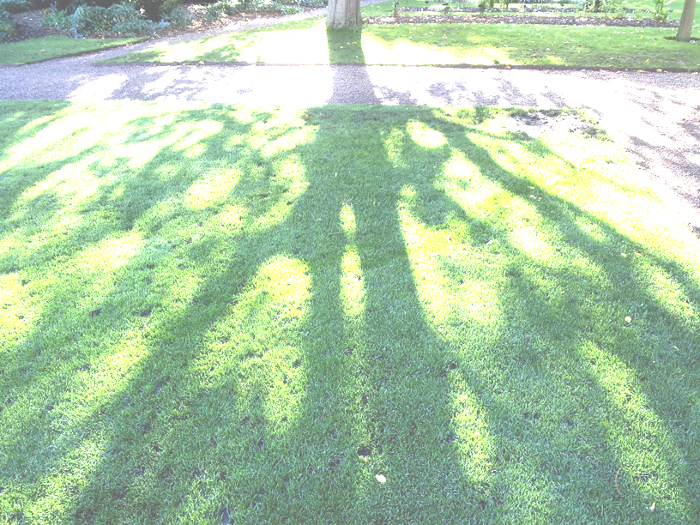
Visiting Chelsea Physic Garden
Adult walks, talks and workshops
Guided tours
Audio Guide & Guide book
Wander on your own
The Café
School visits
Family events
Open Tue-Fri & Sundays, (11am-6pm)
Plus late night Tues & Wednesdays from July-Sept (see www for details)

Slide 43
CHELSEA PHYSIC GARDEN London’s Secret Garden

