Slide 1
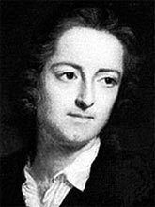

Slide 2
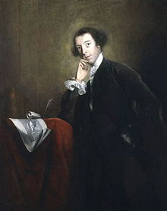

Slide 3
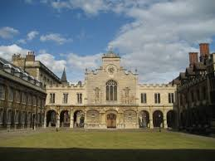

Slide 5
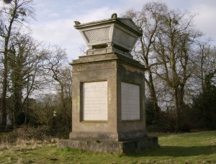

Slide 6
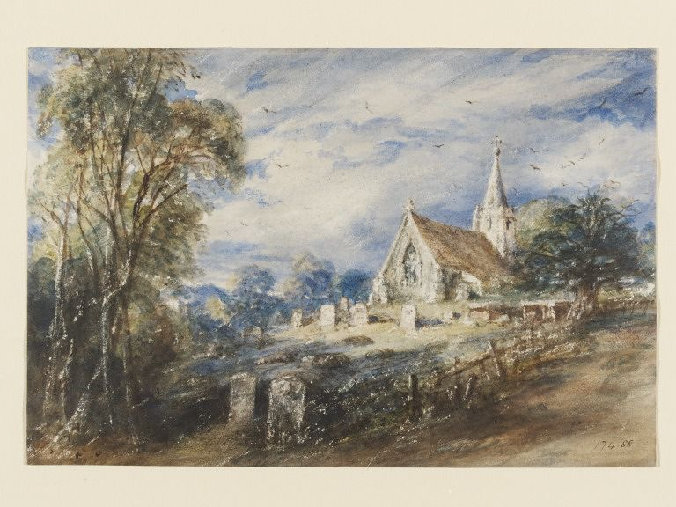
ConstableConstable

Slide 7
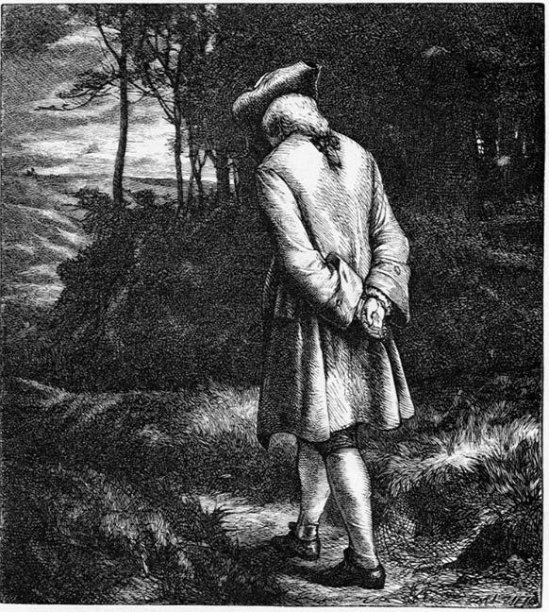

Slide 8
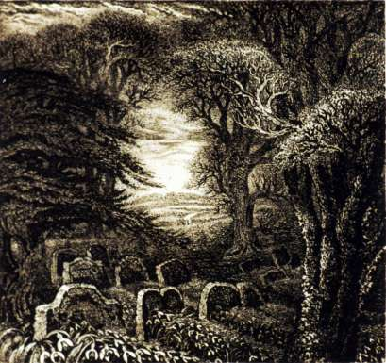

Slide 9
The lives of the humble villagers
The lives of the famous
The ways in which the villagers are prevented from becoming famous
The crimes inextricably involved in ‘success’ as the ‘thoughtless world’ understands it, from which the villagers are immune.

Slide 10
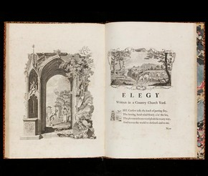

Slide 11
The curfew tolls the knell of parting day

Slide 12
The ploughman homeward plods his weary way’

Slide 13
The curfew tolls the knell of parting day.
The ploughman homeward plods his weary way.
The lowing herd wind slowly o’er the lea
And leaves the world to daRkness and to me.

Slide 14
The ploughman homeward plods his weary way,
The lowing herd wind slowly o’er the lea,
The curfew tolls the knell of parting day.
And leaves the world to darkness and to me.

Slide 15
The curfew tolls the knell of parting day,
The lowing herd wind slowly o’er the lea,
The ploughman homeward plods his weary way,
And leaves the world to darkness and to me.

Slide 16
Wind (s)lowly → wind(s) lowly
Tolls knell → knoll

Slide 17
Now fades the glimmering landscape of the sight,
And all the air a solemn stillness holds

Slide 18
And drowsy tinklings lull the distant folds

Slide 19
The breezy call of incense-breathing morn,
The swallow twittering from the straw-built shed,
The cock’s shrill clarion or the echoing horn,
No more shall rouse them from their lowly bed.
For them no more the blazing hearth shall burn,
Or busy housewife ply her evening care:
No children run to lisp their sire’s return,
Or climb his knees the envied kiss to share.

Slide 20
Here rests his head upon the lap of earth
A youth to fortune and to fame unknown.

Slide 21
Haply some hoary-headed swain may say,
‘Oft have we seen him at the peep of dawn
Brushing with hasty step the dews away

Slide 22
The curfew tolls the knell of parting day,
The lowing herd wind slowly o’er the lea,
The ploughman homeward plods his weary way,
And leaves the world to darkness and to me.

