Slide 1
Safety in the Air
Technology, People & Practice
JOHN TURNER BA(Hons) FRAeS
John Turner Aviation Consultancy Ltd
www.jt-ac.com
Notes:
Thank you for the kind introduction.
The issues behind air safety,
Primarily in context Commercial Air Travel
with lessons from elsewhere.
For those nervous about flying:
Air travel one of the safest ways to travel.
Can only understand air safety by appreciating the threats and the outcomes if safety fails,
Discussion of aircraft accidents and other potentially disturbing aspects is important
To learn how past tragic events have contributed to making flying today safer

Slide 2
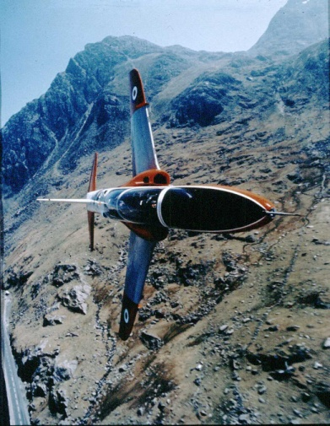
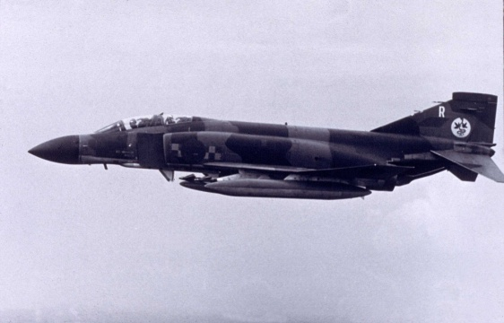
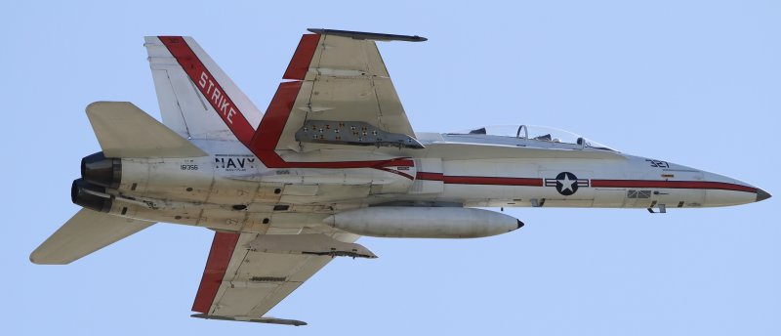
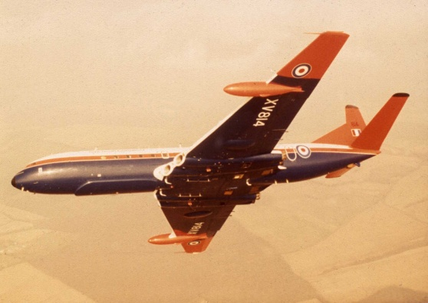
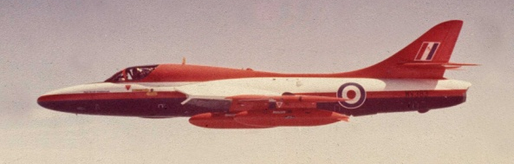
Royal Air Force 1972-1990
Fighter pilot , No 92 Squadron, West Germany
Flight Commander, No 4 Flying Training School
Empire Test Pilot School
Squadron Commander,
Experimental Flying Squadron
Notes:
Fighter pilot
Test pilot school introduction to larger aircraft
Experimental Flying Squadron
– testing new advanced systems

Slide 3
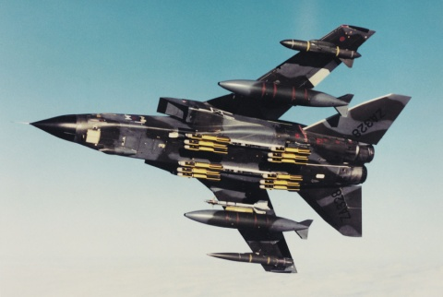
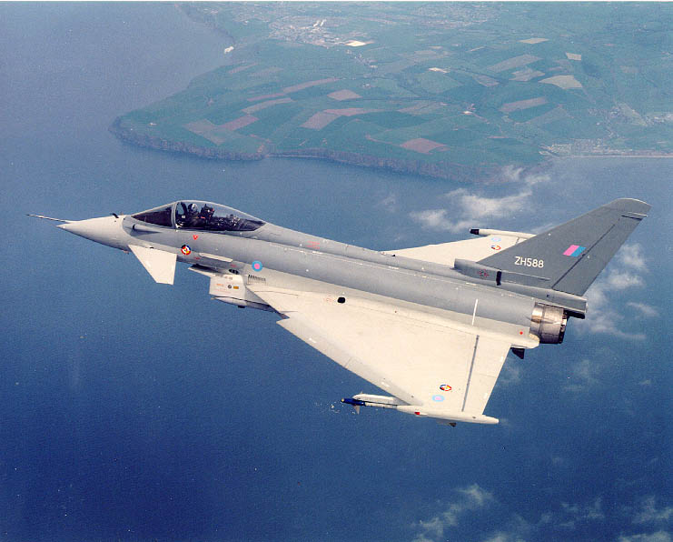
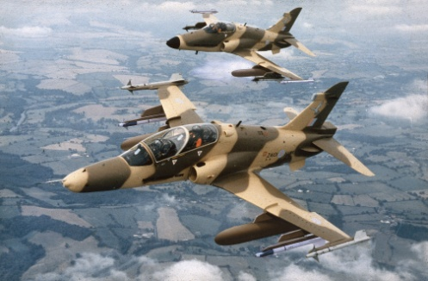
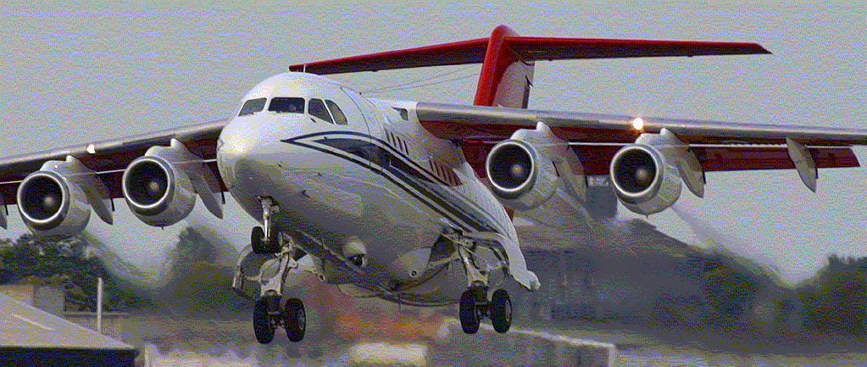
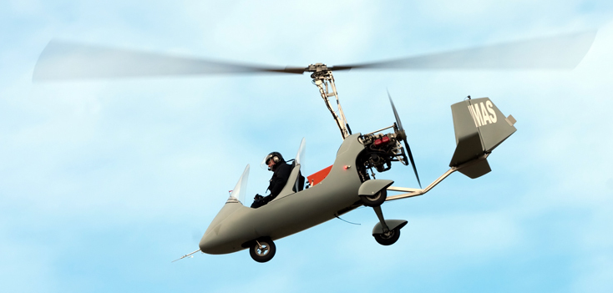
BAE Systems 1990-2010
Tornado ADV project pilot
Eurofighter Typhoon project pilot
Nimrod MRA4 project pilot
Chief Test Pilot – Strategic a/c
Director Flight Operations
Notes:
Similar progression from fighters to large a/c types
1st flight of Nimrod MRA4
Also Unmanned vehicles – 1st flight of Mantis
Unusual move then to gyrocopters to support a company project.

Slide 4
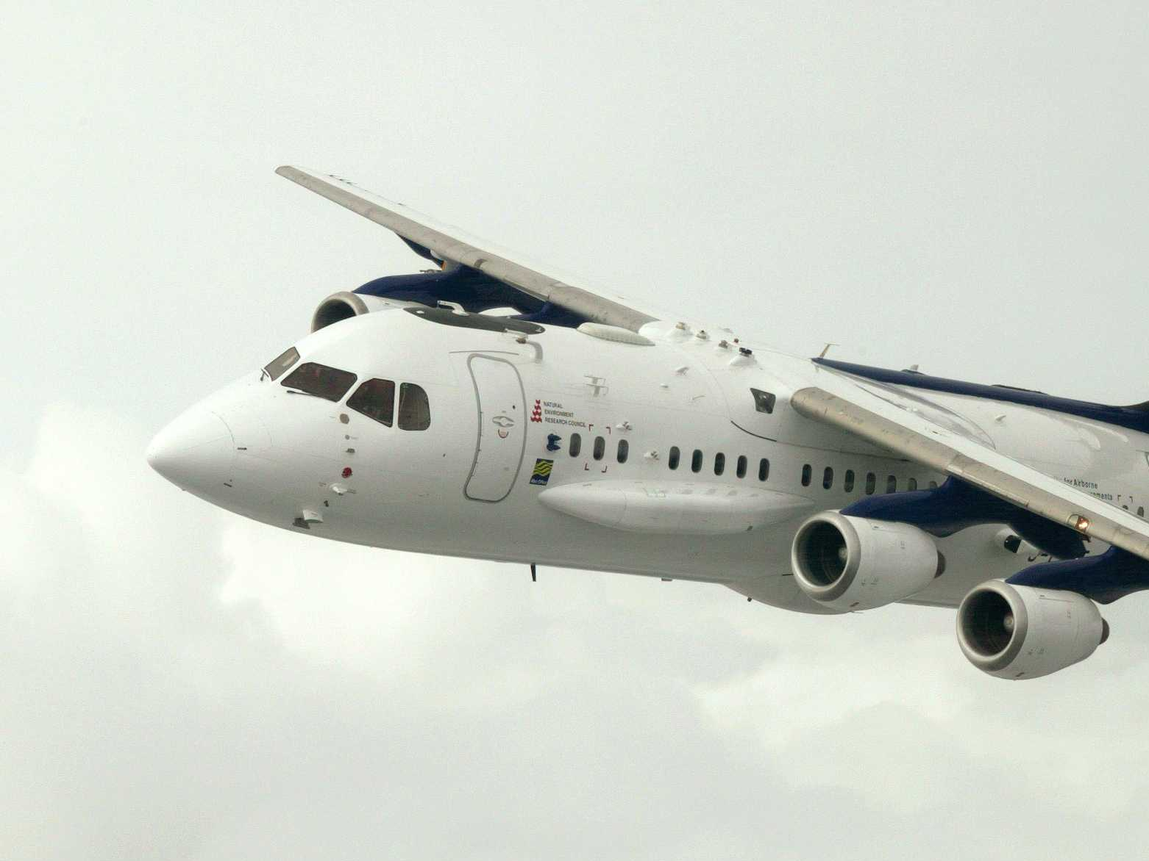
Today’s Agenda
Regulators
A safe flight requires ……
Flying is as safe as ……
Summary & Questions
Notes:
With Subject’s complexity
Cant examination all issues
or any in depth today
Lecture provides Glimpses
What is needed to make a flight safe,
The regulators,
what we can do to help ourselves and
Today’s air travel safety record.
Transcripts – distributed after the lecture - provide much more detail for those who wish it.

Slide 5
REGULATORS
ICAO EASA
FAA
National Regulators
CASA
+ Military national regulators
>10,000 SARPs
in 19 Annexes
Notes:
Regulators - important role – set & monitor standards
International Civil Aviation Organization (ICAO).
UN specialized agency, 1944 Convention on International Civil Aviation (Chicago Convention). Now 191 Members.
Develops Standards and Recommended Practices (SARPs) - States reference ref & develop aviation laws.
No exec power – agreement takes long time
(14 years for no-cost change) & States may not adopt.
Federal Aviation Administration
European Aviation Safety Authority
Significant events can cause quick lead updates
MH370 disappearance – ICAO proposed new aircraft tracking and location beacon requirements
Average of 1.16 flights take off each second!

Slide 6
A Safe Flight requires….
a safe air vehicle to be flown in …
a safe environment by …
a safe crew operating to …
safe procedures and supervised by …
safe management
BAE SYSTEMS Corporate Flying Standard Policy
Notes:
As passenger we see airport at each end of journey and the inside of a cabin & crew in between.
Much more behind the scenes: Safe flight req: SLIDE
5-prongs - BAE Systems Flying Governance Policy
Worldwide aviation activities - include unmanned air vehicles, experimental manned prototypes and production aircraft, display flying, airliners, military training & target aircraft, test pilots, flight test engineers, airline pilots and the company’s employees when they get on an airliner to travel on business, the principles work in every case.
No mention of Regulation; a multi-national tries to apply equal levels of care to all its employees,
Aviation regulators do play an important part in establishing the minimum levels of air safety

Slide 7
Safe Air Vehicle
Designed safely
Manufactured safely
Maintained safely
Prepared for flight safely
Safe Air Vehicle
Notes:
Safe aircraft also sub-divides

Slide 8
Designed safely
Capability
Strength
Operations & Environment
Reliability
No critical single failure
No cascading failures
Specifications
Safe Air Vehicle
Notes:
Capability High speeds, lots of passengers and bags , fuel to travel a long distance.
Jet engines = high alt = Low outside temp and pressure
Pax= warm, low altitude/No thermal suits/O₂ masks
Strength v turbulence, lightning strikes, hailstones, birds
Plus design margin - Federal Aviation Administration (FAA) and EASA requ a minimum factor of 1.5.
Designed for 150% of worst that can happen.
Reliability fundamental requirements:
No single failure is catastrophic. E.g. aircraft door locks
Single fault cannot cascade into an unsavoury result.
Specs Over 112 years since Wright Bros, requirements have grown in size and complexity - learning from history.
FAR Part 25 requirements over 1,800 items in 86 detailed sections - “All lavatory doors must be designed to preclude anyone from becoming trapped inside the lavatory. If a locking mechanism is installed, it must be capable of being unlocked from the outside without the aid of special tools.”

Slide 9
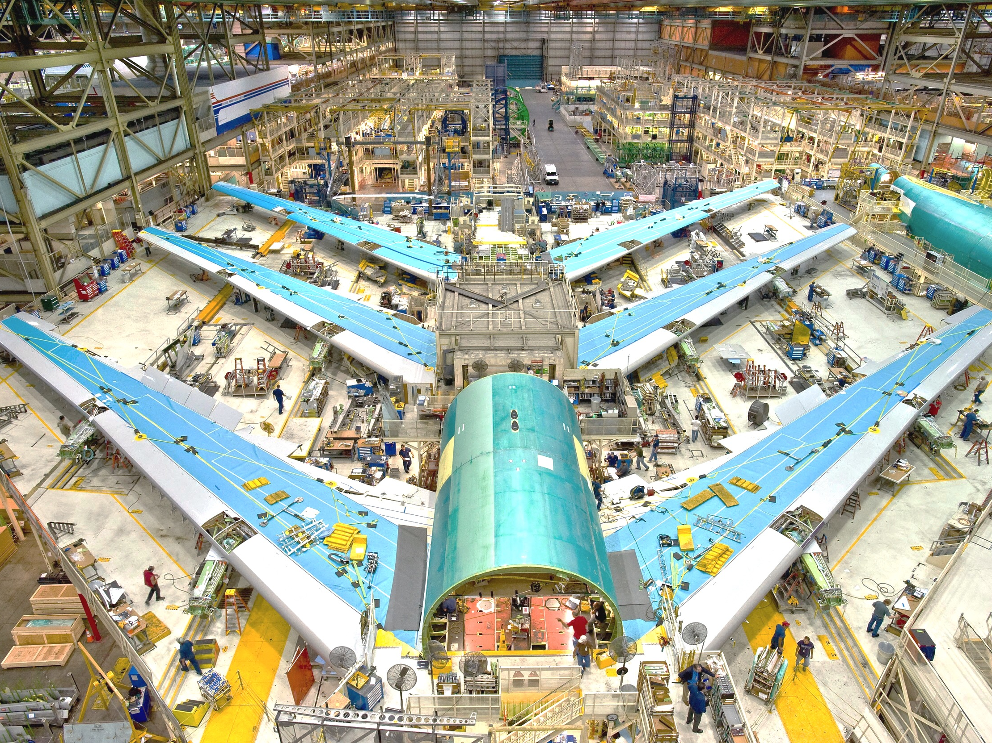
Manufactured safely
Built as designed - or made to fit?
Culture?
Blame : Just : No-Blame
Configuration Control
Software standards
PFAT
Safe Air Vehicle
http://en.m.wikipedia.org/wiki/File:Boeing_747-8_Test_Planes_in_Assembly.jpg
Notes:
Manufacturer- vested safety interest.
Manufacturing: large, multi-skilled team, transform paper/computer design into structure/interdependent systems.
Built as Designed? CAD – initially – tolerances -parts don’t fit precisely Reconciled quick if manufacture & design work together - sometimes tempting for manufacturing to ‘make it fit’, - same issue will persists on follow-on items.
Culture –Company internal culture. All humans make errors incl. design and manufacturing – how handled?
Just Culture instigate/supported by senior mangment encourages honest and open reporting of errors – or only allows immediate corrective action,
JUST is NOT NO-BLAME

Slide 10
Maintained safely
When things go wrong?
JAL 747 1985
Inspection, repair, replacement
Licenced maintenance engineers
Approved maintenance manuals
Two-person checks of critical items
Just Culture
Safe Air Vehicle
Notes:
Japanese Airlines explosive fail - rear pressure bulkhead –severed all 4 systems hyd lines – damaged horizontal stab & vertical rudder. Improper repair years before – undetected fatigue - undermined bulkhead strength - lead to catastrophic fail of entire bulkhead.
Maintenance ongoing Inspection, repair, replacement & replacement of life-expired or worn parts generally conducted under ‘A Check’ - every 250 flight hours ‘B Check’ - approx. 6 monthly, ‘C Check’ - every 20-24 months takes 1-2 weeks & up to 6,000 man hr
Licenced maintenance engineers + approved manuals performance is just as important as the flight crew. Only sign off work for which qualified, use manuals that detail each step of each process.
Two-person checks Critical systems work- flight controls - subject to 'two person checks’ - one does, one checks, both sign off. Another area where culture has a significant safety impact - regulators expect Just Culture

Slide 11
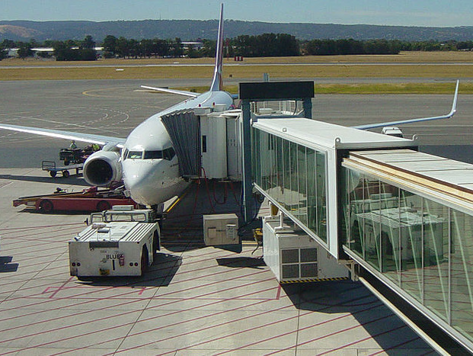
Prepared for flight safely
Daily servicing + Ground Handling
Fuel, oil, hydraulics, toilets, water
Passengers, baggage, cargo, mail
Weight & Balance
Passengers’ hold & carry-on bags
Portable electronic devices?
Lithium batteries?
Safety matches?
Human Factors Training
catering
Safe Air Vehicle
Notes:
Mix of tech & non-tech. Complex series of processes separate a/c from its load (pax, bags, cargo & mail) on arrival & combine it with its load prior to departure
Outside in all wx - noise, jet engines, (or propellers) many vehicles - under pressure foron-time departure
2007: 1 a/c damage incident/5,000 flts - mainly parked.
Dutch & EASA endorsed, HF training - “Ramp Resource Management” for all working on ramp, not just managers, -grnd handling processes & safety regs but also team working, threat & error management, human performance & limitations. Helps create & reinforce positive safety culture - critical and cost-effective first step
Weight and Balance Flight Crew Worry –operating weights – take off performance & CofG – handling affects
Passengers (<2gm lithium metal batteries, <100Wh for lithium ion) allowed in hand & hold luggage. Spares not. Changes – check with the airline website to avoid embarrassment.

Slide 12
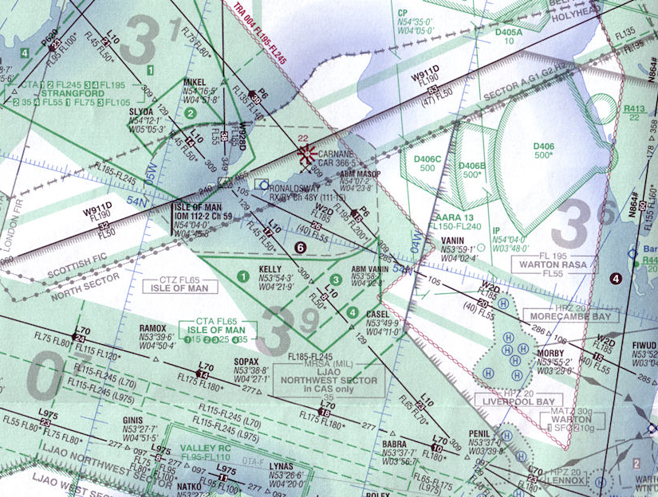
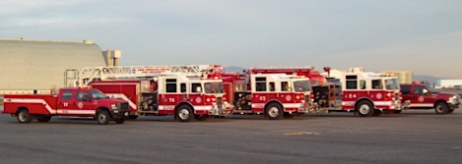
Controlled Airspace & Airways
…in a Safe Environment
Safe Environment
Notes:
Safe Op Environment starts- aerodrome fire & rescue
Start fire-fighting anywhere on the airfield in 2 mins
Bring any aircraft fire under control within 1 minute.
Air Traffic Control (ATC)
alert fire & rescue when necessary – normally coord a/c movement from its stand, to runway, into the air, onwards to landing destination and arrival gate.
Controlled airspace – planned routes segregate airliners from un-known a/c and safe separation from each other. Routes were established from radio beacon to radio beacon – a/c found way, following a pointer on their compass display. With satellite navigation, a/c track centrelines precisely, pass directly over beacons & each other - increased accuracy = reduced separation. (Airliners are now permitted to offset)
How close together do airliners fly? Reflects capabilities & limitations of radar and aircraft altimeters.

Slide 13
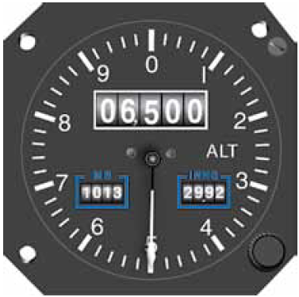
Altimetry
6,500 feet
Safe Environment
Clipart from http://cliparts.co/airplane-pic
Notes:
Altimeters measure atmospheric pressure
For many years: min vertical sep of 1,000’ to 29,000’
2,000’ from 29,000’ to 41,000’
Pressure variation with height reduces at the upper levels
Increased altimeter accuracy,
Higher-level separation reduced to 1,000’
March 1997 ICAO & member states Reduced Vertical Separation Minimum (RVSM)
RVSM aircraft need two independent altimeters
& pass 2 yearly altimeter accuracy monitor flight.
1,000 ft = approx 300 metres

Slide 14
Radar
Reflected pulse
Good range
Fuzzy bearing
Safe Environment
Clipart from http://cliparts.co/airplane-pic
Notes:
In contrast, lateral separation measured in miles,
Limited by the relatively poorer discrimination of ATC radars,
Reflected radar blip spread out
Controllers had to keep aircraft 5 nautical miles apart

Slide 15
Transponders
Data pulse
Position
Callsign
Altitude
Speed
etc. etc.
BA048
012 24
Safe Environment
Clipart from http://cliparts.co/airplane-pic
Notes:
Transponders
Made aircraft more visible to ATC
Transmit large blocks of data about the flight and verify the ‘blip’ return.
Five miles lateral separation remains the general rule,
Reduces to 2 miles or less when radar and the latest aircraft transmitted identification systems permit.
ATC can now separate aircraft flying into Heathrow by time rather than distance
Sustains arrival rates (1 aircraft every 2 min)
Regardless of wind conditions. So, sometimes airliners can be as close as 300 metres vertically, but rarely less than 2 nm horizontally and usually more than 5 nm.

Slide 16
How close?
300 m
2-5 nm
Safe Environment
Clipart from http://cliparts.co/airplane-pic
Notes:
Sometimes airliners can be:
As close as 300 metres vertically,
Rarely less than 2 nm horizontally
Usually more than 5 nm.
1nm = 1852 metres = 1.151 miles

Slide 17
TCAS – Traffic Alert & Collision Avoidance System
Transponder pulses aircraft-aircraft
Traffic Advice of
near-by aircraft
Resolution Advice for
collision risk
Safe Environment
Notes:
TCAS Aircraft detect transponder pulses:
Show potential conflicts / issue resolution guidance.
Provides audio-visual alerts – ROC/D to separate.
After Uberlingen (2002) – identical TCAS responses
Pilots follow TCAS resolution guidance regardless of any ATC instructions until TCAS indicates ‘all clear’.
Small ring = 2 nm
Open blue diamond – no threat – 1,800’ above
Closed blue diamond – Proximate aircraft – 1,000 below and descending (<1,200’ and <6nm)
Yellow circle – Intruding - only 200’ below descending
TA,48-35s closest point f approach(CPA) “Traffic, Traffic”
Red Square – Threat flying level at only 200’ below
RA – 20-30 sec to CPA ‘Climb, Climb”

Slide 18
Automatic Dependent Surveillance-Broadcast (ADS-B)
“Next Gen” enabler
Data pulse
Position
Callsign
Altitude
Speed
AP/AT settings
etc. etc.
Data receive
Weather
ATC information
Safe Environment
Clipart from http://cliparts.co/airplane-pic
Notes:
Advanced transponders like ADS-B
Use sat nav
Transmit precise position, velocity (both vertical and horizontal), altitude
and other details to controllers and nearby aircraft;
can also receive data from the ground:
weather
air traffic information.
Enable USA “Next Gen” & EASA “SESAR”
Single European Sky project

Slide 19
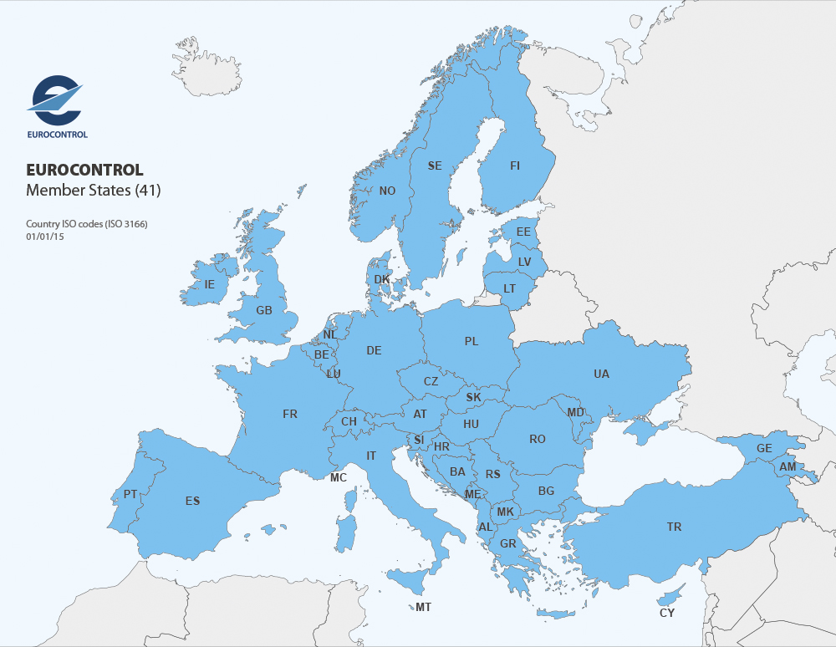
…future developments
Non-ADS-B Aircraft?
Full satellite/ADS-B coverage
Direct routing
Shorter faster routes
more efficient
Reduced separation
more capacity
Safe Environment
Safe Environment
Notes:
‘Next Generation Air Transport System”
Transforms US system from ground (radar) based to satellite-based system:
Increased capacity
Reduced delays
Aircraft fly direct - departure to destination
Expected lateral separation minima will reduce
Direct routing
Reduces journey times
Reduce the environmental impact.
EUROCONTROL, an intergovernmental Organisation with 41 Member States has similar plans for air traffic management across Europe.
Satellite-based surveillance depends on cooperation by aircraft carrying and operating the necessary equipment
= Security issues & challenges for military

Slide 20
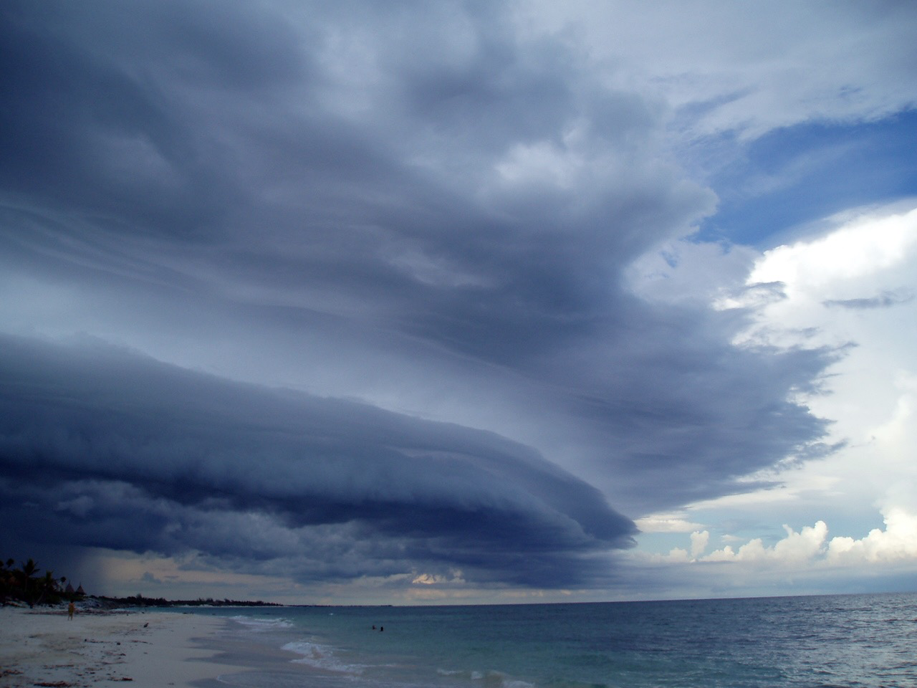
Weather
Forecasts
Cloud
Visibility
Temperature
Wind
Thunderstorms
Turbulence
Icing
Lightning strike
Jetstreams
Pre-flight brief
En-route updates
Prior Landing Approach
Safe Environment
Notes:
Weather has major influence on aviation. Aviator’s defence: accurate pre-flight forecasts, in-flight updates & flight deck technology that indicates thunderstorms, + radios and Aircraft Communications Addressing and Reporting System (ACARS)
Forecasting
Pilots receive Pre-flight briefing on en-route winds & wx - emphasis on predicted thunderstorms & jet streams - turbulence, + forecast for destination and alternate airfields- visibility, amount, ht & type of cloud and anticipated weather. Always plan an alternate in case the destination becomes unsuitable.
In flight, crew obtain updates to get ‘feel ‘ for the likely forecast accuracy & suitability destination wx for landing.
You might not be impressed with TV/radio wx reports. Aviation wx briefings usually quite accurate & increasingly so as satellite info becomes more detailed

Slide 21
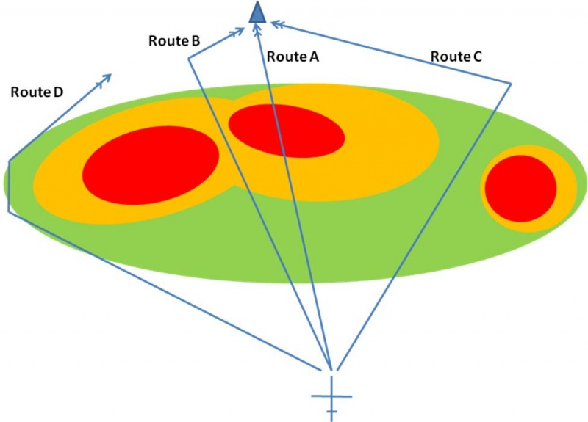
Weather
Safe Environment
Notes:
1 Thunderstorms - Regulators provide detailed guidance The usual drill is:
Weather Radar – to monitor the situation.
Routing – adjusted to what appears a safe option.
Speed – reduced to V_{A}
Cabin – everything strapped down.
Best avoided early. – Destination fuel v clearance.
Weather radar
Route A: Most direct route to destination BUT the biggest risk to both the aircraft and its occupants.
Route B: Tempting to squeeze through the gap - lower Cb cells may develop and close the gap. Tilt down to see Route C: Reasonable balance risk v operational need? Cell to right marked short distance change = wind shear.
Route D: Apart from total avoidance, the lowest risk route but operational implications on fuel reserves, timings, etc.

Slide 22
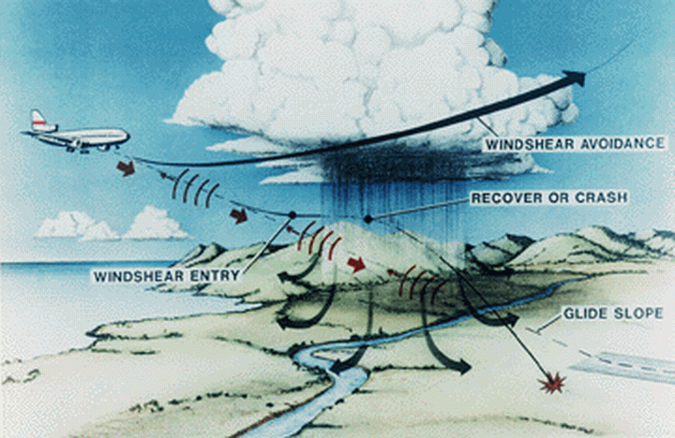
Weather
Safe Environment
Notes:
Microburst Thunderstorms at the airfield.
Rain deluge - sudden, strong downdrafts = microbursts; when air hits ground flows out in all directions.
An aircraft approaching micro-burst sees airspeed becomes sudden airspeed loss on other side (while aircraft’s momentum maintains g-speed)
Risk that pilots (or AT) make major reduction engine pwr – then unable to regain air speed, lose lift & and stall.
Even without thunderstorm, can be marked variation in wind strength with height, called wind shear, creating a similar effect.
Wind shear & Microbursts caused several accidents
Today pilots taught to avoid
Aircraft & airports fitted with equipment to detect wind shear
Alerts pilots before approach or take off.

Slide 23
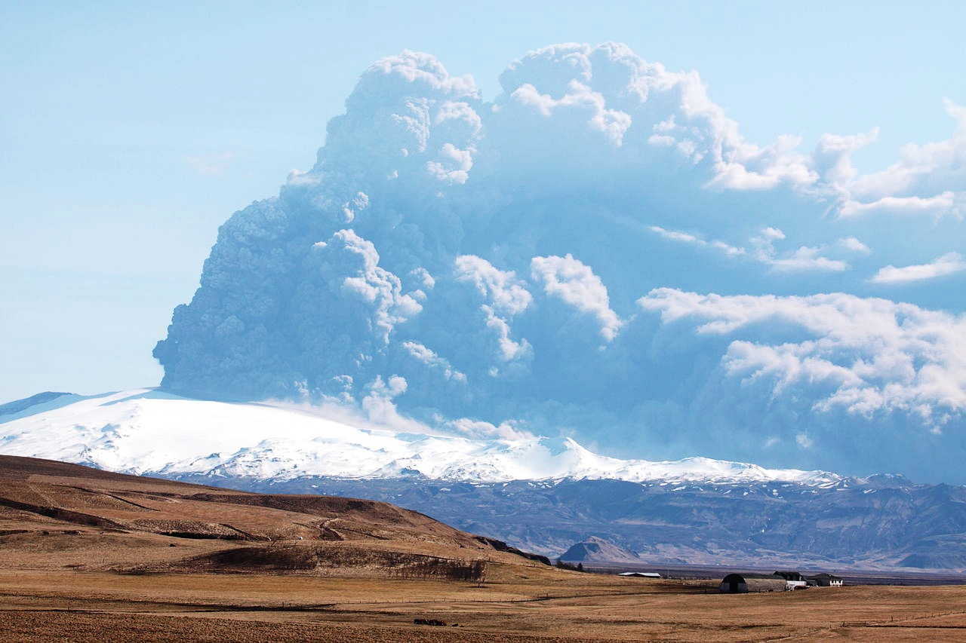
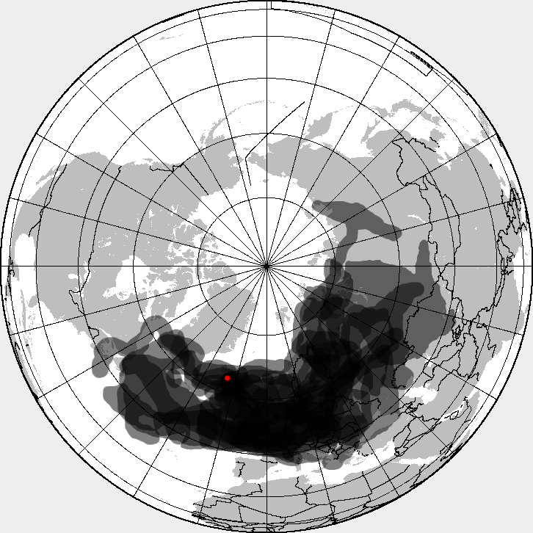
Natural hazards
UK LiDAR network
to
aid future forecasts
Eyjafjallajökull plume on 18 April 2010
Composite map of volcanic ash cloud spanning 14–25 April 2010
Safe Environment
Notes:
Volcanic eruptions challenge engine manufacturers and regulators.
The manufacturers test engines before service
Cant for every particle a volcano could produce.
Despite pleas from airline passengers and operators, the safest course is to avoid the situation altogether; otherwise, we undo the ‘safe environment’ req.
Since Iceland’s Eyja-fjalla-jökull April 2010 eruption:
More done to understand ash composition affects
1st June, UK met office announced network of 9 static & 1 mobile particle-sensing Light Detection and Ranging Systems (LiDARs) installed across UK to improve detection and forecasting of volcanic ash in tfuture.
Met office forecasts used to make decisions on flight across UK airspace, based on the thresholds set by CAA and ICAO. Will contribute to reduced disruption.

Slide 24
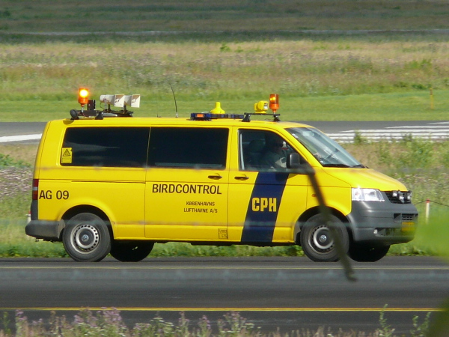
Natural Hazards
Notes:
Seagulls over nesting colony – adept at avoiding
Not so successful with faster moving aircraft.
Aerodromes go to great lengths to keep birds away
growing the grass long, so that feeding birds cannot seek approaching predators and move off to somewhere safer,
bird scaring with loud noise or recorded distress calls and sometimes using real or mechanical raptors, again to dissuade birds from the area.
Also safeguarding surroundings from developments that might attract birds in large numbers.
Rubbish tips,
Food factories with large waste

Slide 25
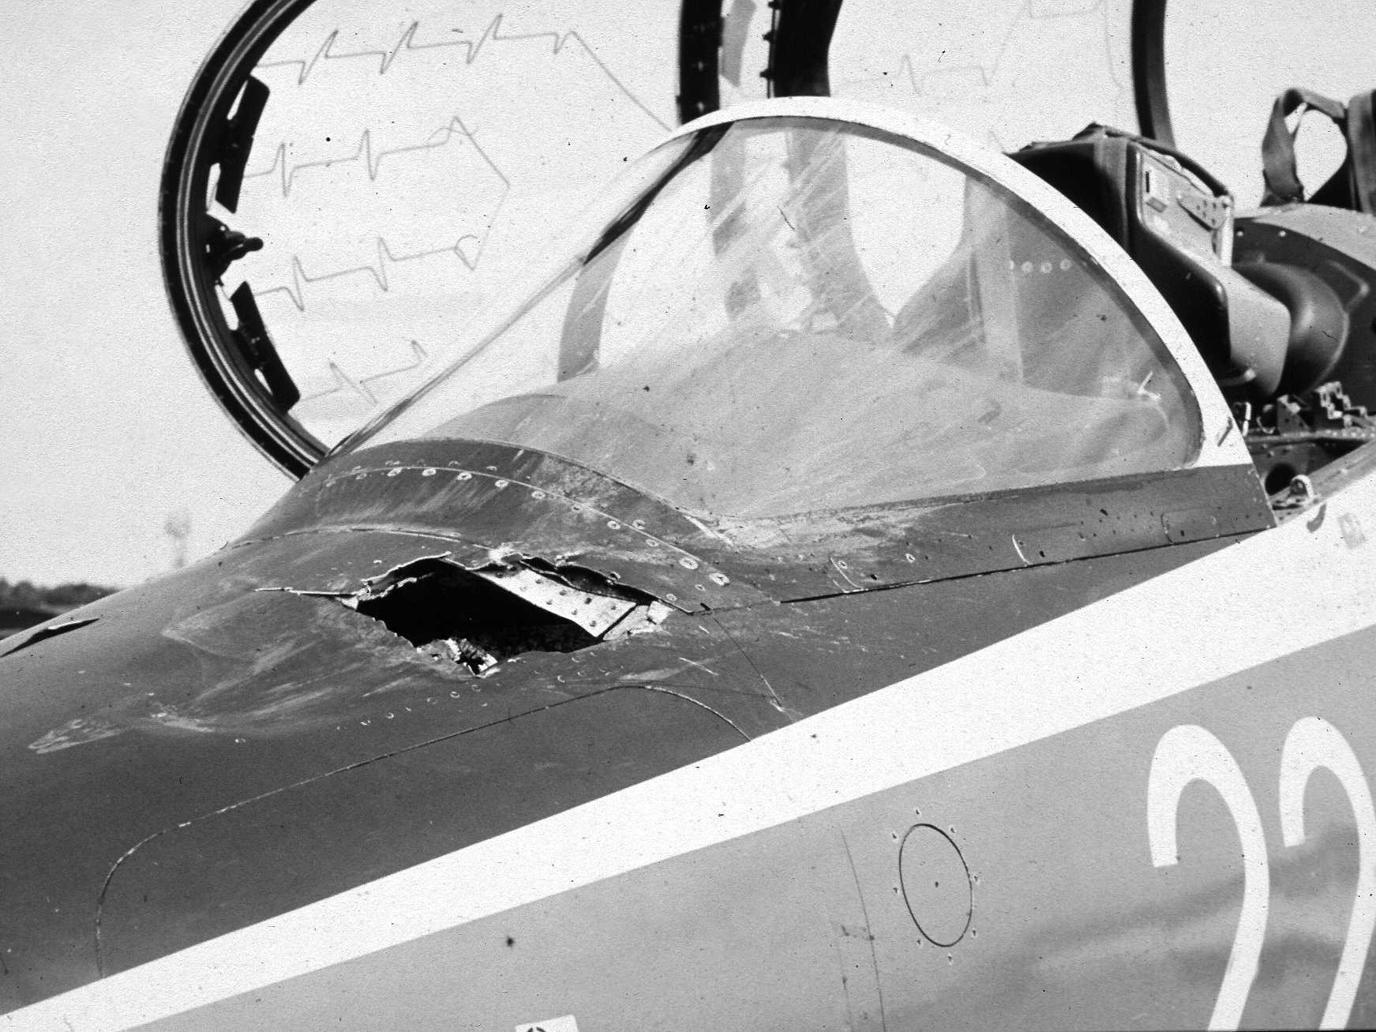
Natural hazards
Safe Environment
13 Sep 1983 Photo: Royal Air Force
Notes:
Usually dive when frightened – impacts relatively rare.
But can be quite dramatic;
1 goose v Hawk flying at low level at 420 kt in 1983.
Damage continued inside as the goose penetrated into the foot well of the front seat, taking out most of the aircraft avionics and electrics on the way;
My first “Mayday” - escaped media attention

Slide 26
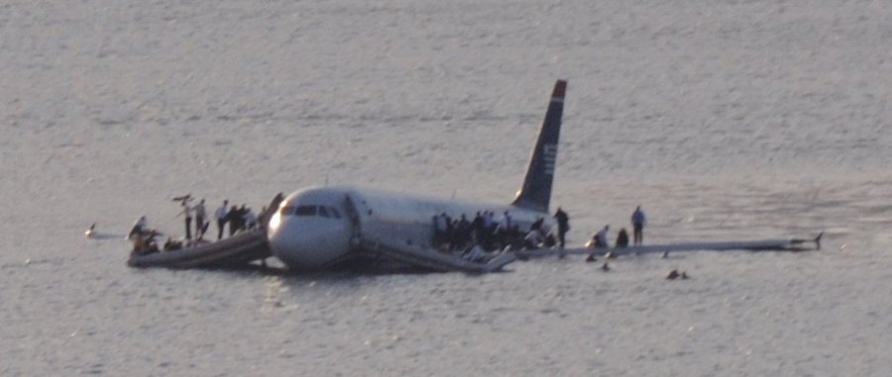
Natural hazards
Saved through
pilot skill!
13 Sep 1983 Photo: Royal Air Force
15 Jan 2009 Photo: Greg Lam Pak Ng
15 Jan 2009 Photo: Greg Lam Pak Ng
Safe Environment
Notes:
Capt. ‘Sully’ Sullenberger did make news Jan 2009
Safe ditching on Hudson River
flock of Canada geese disabled both the engines
He quickly:
Weighed up situation,
Appreciated lack of options,
Chose a completely unscripted and unpractised manoeuvre, gliding safely onto the water
Probably had much to do with his earlier experience in the Air Force and in accident investigation.
His professionalism and judgement saved all 155 on board, most of whom were completely uninjured.

Slide 27
Un-Natural hazards
Safe Environment
Notes:
Laser Attacks
Threat from irresponsible people trying to illuminate aircraft with high-powered laser pointers.
Aviation not the only form of transport prone to attack, which can dazzle and temporarily blind a pilot.
Not confined to the UK, but
this year two instances of pilots suffering permanent eye damage from a high power laser in UK.
Intergovernmental UK Laser Working Group is collating evidence and investigating what measures, such as import controls and changes in the law could provide an effective deterrent.

Slide 28
Safe Crew
Air Transport Pilot Licence = £100,000
1,000 hours: 200 flying, 800 ground
14 theory exams
Multiple flight tests
Pilot Aptitude?
Safe Crew
Notes:
Licencing
It costs about £100,000 to complete an integrated training course and gain an airline pilot’s licence. This involves some 200 hours of flying, nearly 800 hours of ground instruction in aircraft systems, international weather, aviation theory and law and successfully passing 14 multiple-choice exams set by the CAA on behalf of EASA. This of course assumes that the student had the aptitude to become a pilot as well as the financial support necessary. (Some flying schools will accept anyone with the necessary funds but the Air Pilots offer an independent assessment based on the aptitude tests used by the Royal Air Force at Cranwell for those contemplating a career as a pilot.)

Slide 29
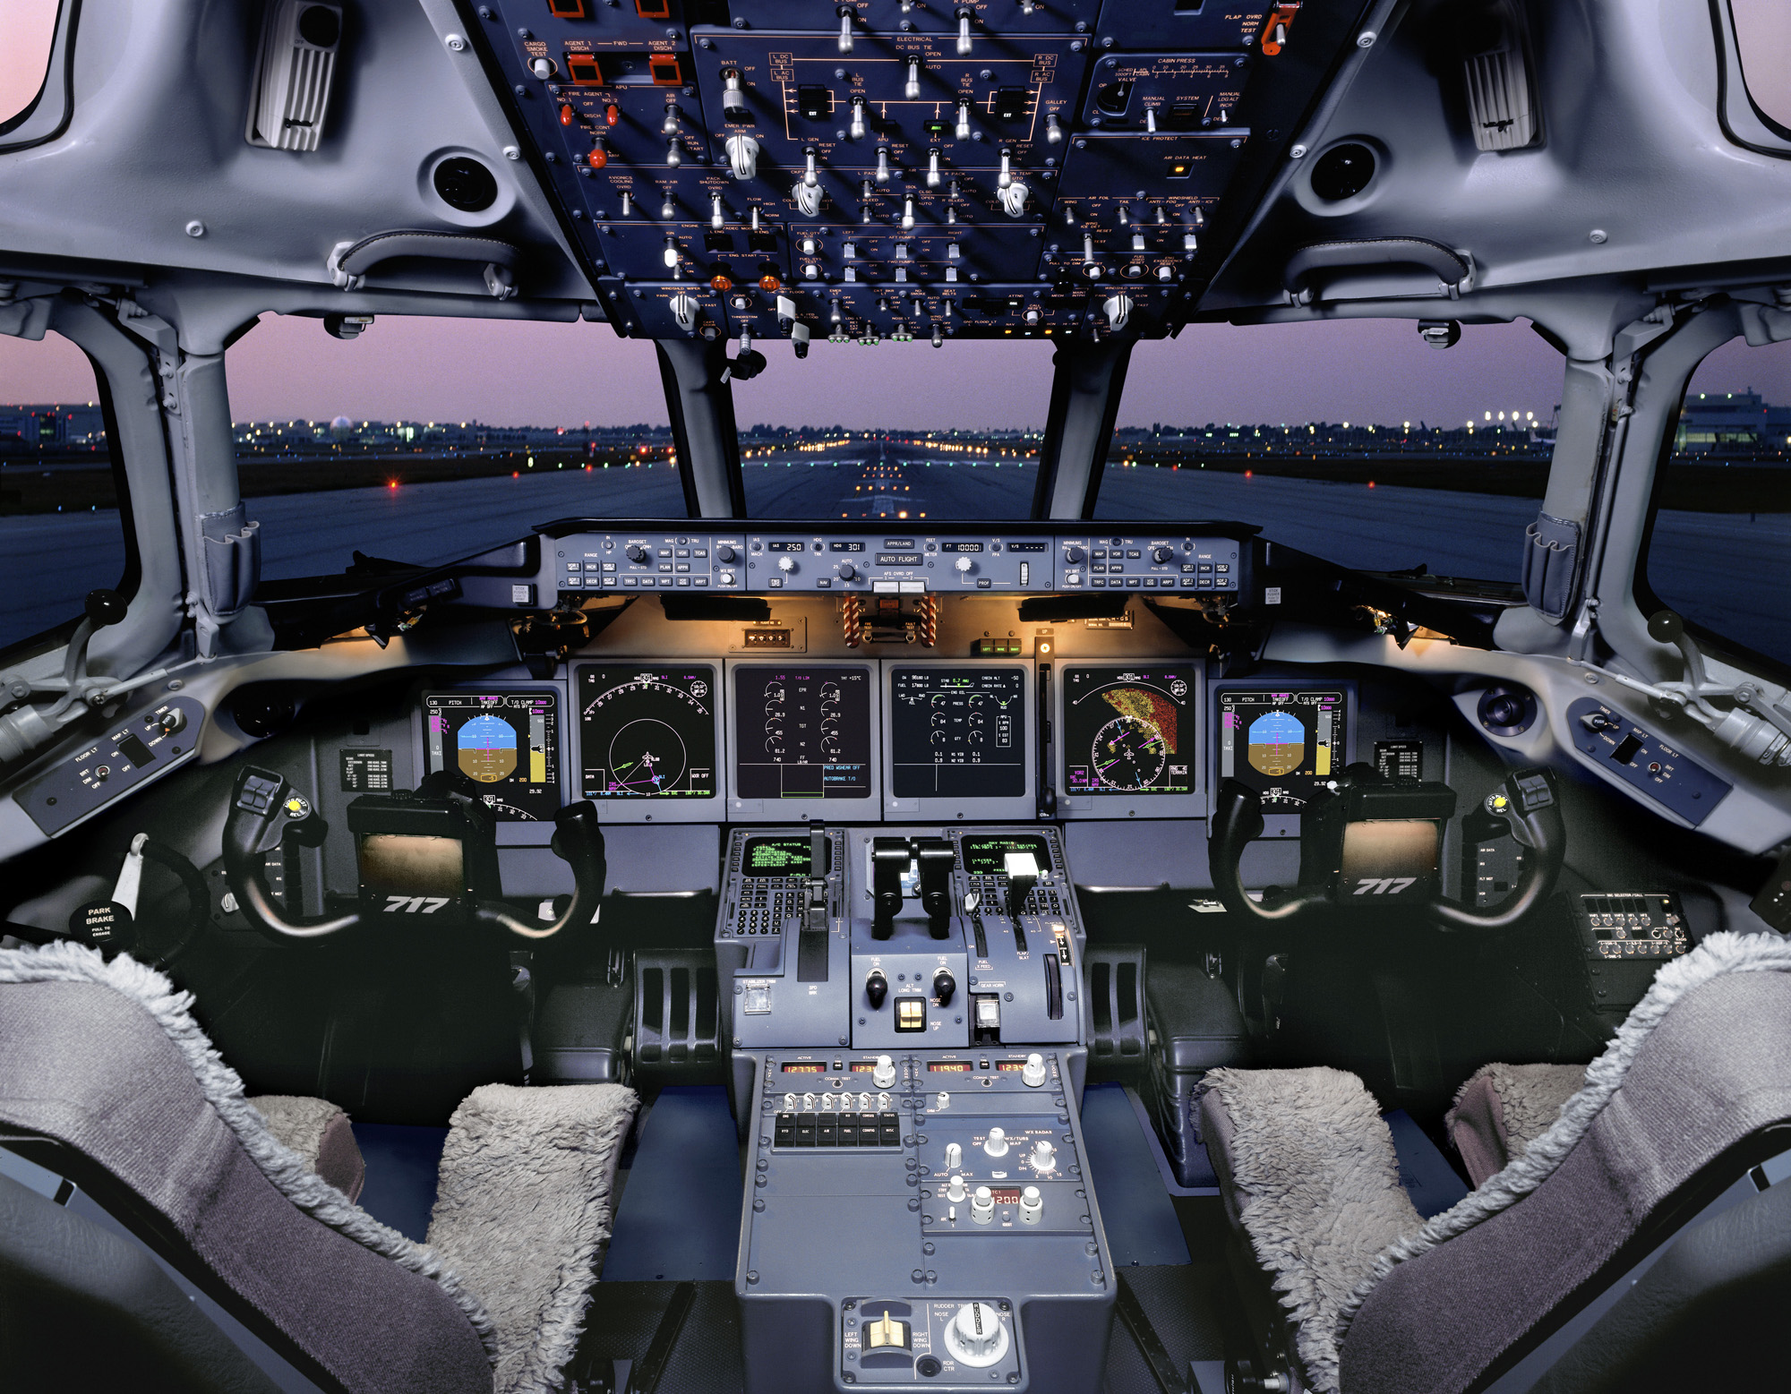
Safe Crew
Airliner Type Rating
£10,000-20,000
Self-funded?
Computer-Based Training
Simulator training & test
Airline-specific training
– SOPs, Automation, Line checks
Safe Crew
Notes:
Gaining a licence is just the first step. Next you must complete ‘Type Training’ to learn about the aircraft you will fly with the airline.
More ground instruction, usually computer based training (CBT)
then simulator lessons and a flying test.
TYPE RATING Kicks off cycle of training and testing that continues until retirement.
‘Annual’ Licence Proficiency Check (LPC) examination of manual flying skills in the simulator accompanied by Operators Proficiency Checks (OPC) to monitor compliance with airline standard operating procedures (SOPs) and
‘Line Checks’ flown with company training pilots.

Slide 30
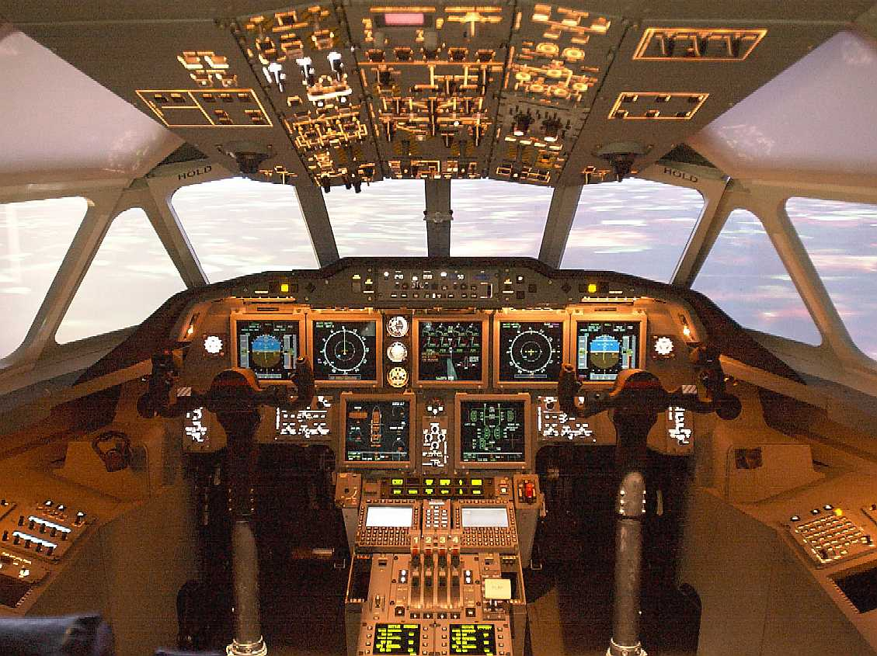
The Automation Conundrum
Human Error Accidents Dominate
Technical Failures
Reduce
Flight Deck Automation
(Advanced AP+AT)
Pilot makes decisions, computers do the work
Pilots Mandated
to use Automatics
Reduced Accident Rates compared to manual flight
Safe Crew
Notes:
Over recent decades, as aircraft systems became increasingly reliable, the proportion of accidents attributed to human (and often pilot) error increased.
Led a drive for increasing automation and complex Advanced Flight Control Systems (AFCS)
not only capable of protecting the aircraft from stalling but could also control the aircraft from just after take off to landing have become increasingly common.
Increased use of automation reduced rate of human error incidents,
Airlines mandated crews not to ‘hand fly’ unless it was essential; some now insist that the pilot retains the auto-throttle engaged even when hand flying.
Eventually, it seemed, we would be able to dispense with the pilot altogether!

Slide 31
The Automation Conundrum
Pilots less able to cope when automation fails
Technical Failures
Reduce
Flight Deck Automation
Autoflight
Pilot makes decisions, computers do the work
More manual handling practice?
MORE AUTOMATION?
Pilots Mandated
to use Automatics
Upset Prevention
& Recovery Training
Reduced Accident Rates compared to manual flight
Safe Crew
Notes:
Two accidents suggested there was a problem.
Aircraft entered a stall & pilots were unable to recover.
Both at night with an unexpected AP disengagement.
Other factors involved but both indicated crews unprepared for a sudden, unexpected reversion to manual flying.
A number of Upset Prevention and Recovery Training (UPRT) initiatives have occurred as a response
Some airlines started already without regulator mandate
(Colgan Air 3407 Q400 into Buffalo 2009
Air France 447 A330 towards Paris 2009)

Slide 32
Safe Crew
Annual/6 monthly medical
Operator training
First Aid
Emergency Equipment
Fire & Rescue
Crew Resource Management(CRM)
(Human Factors training)
Safe Crew
Notes:
Medical each year/ six months with
qualified Aviation Medical Examiner (AME) doctor.
heart, lungs, kidney functions, circulation, hearing, eyesight, internal organs, reflexes
Includes review of physical health since last medical & assessment of mental attitudes.
in effect, a ‘spot check’.
No European consensus: health screen or to predict likelihood of future incapacitation.
Pilots and cabin crew - fire fighting techniques (including practice at finding and extracting survivors from within a smoke-filled aircraft cabin), first aid & the aircraft emergency equipment.
Regular Crew Resource Management (CRM) training, looks at Human Factors and how they can be deployed effectively to improve flight safety and effectiveness.

Slide 33
Safe Procedures
Flight Deck Door
Safe Procedures
Notes:
Armoured flight deck doors,
Withstand small arms fire and a grenade
Introduced rapidly in all the larger airliners following the 2001 9/11 attacks on USA.
Use of airliner as a weapon much less likely.
Also curtailed hijacking & people killed in hijacks
Also made communication between flight deck and cabin crew much more difficult
Not liked on introduction – now accepted and comms loss mitigated by procedures.

Slide 34
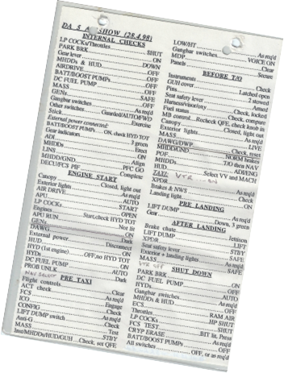
Safe Procedures
Flight Deck Door
Remove uncertainly
Coordination
Familiar sequence
Trigger events
Sterile Flight Deck
Checklists
Aerodrome SIDs & STARS
Safe Procedures
Notes:
Good procedures remove uncertainty
Provide familiar sequence – practiced & trigger events.
Door closed = captain speech
Engine start = safety brief
Bing-bongs post take off pre-landing
Similar flight deck procedures help pilots coordinate complex actions during departure, climb, cruise and descent and approach and landing with the minimum of conversation
Checklist challenge & response
Sterile’ flight deck
Standard Instrument Departures, Standard Arrivals, Final Approach
determined by the airfields & approved by regulators
aircraft can depart & arrive in safety,
Accounts for airliner performance
normal and failure conditions.

Slide 35
Safe Management
Provides/ensures all the above!
Risks ALARP
risk aggravators
risk mitigations
Safety Management
Systems (SMS)
Safe Management
Notes:
ALARP – as low as is reasonably practicable
Management needs good understanding of:
Unusual risk factors in aviation
Things that will aggravate or mitigate those risks
Many airlines well managed, - those that pilots want to work for and keep their pilots to retirement age of 65.
Safety Management System structured to cover:
Policy and objectives, statement by CEO
Described by name who does what for safety
Operational risks and mitigations.
Continuing safety assurance - incident reports & invest
Constructed thoroughly & reviewed regularly helps keep things safe.
You are not safe because you have an SMS
You are safer if you use it.

Slide 36
Safe Management
Regulator’s Maximum
= Operator’s Minimum?
Pilot contracts?
Business models?
Safe Management
Notes:
Max & Mins - Pilot’s annual hours/rest = airline roster
Airlines under commercial pressure
Flight & cabin crew get minimum training mandated
Manufacturers seek regulator agreed min training too
OK is new really was easier & not more complex
Contracts - Pay 2 fly, 7-8 month, exp FO-> new FO
Creates uncertainty, pilots switching airline more freq.
Disrupts annual training sequence, pilot SOP familiarity
Denmark investigation - reports to EASA this year.
Business Models
Airline business, aircraft & operating base co-located
Now, could be in 3 different countries (regulators)
Commercial benefit?
Regulator oversight fragmented.
Not necessarily wrong
EASA ’New Business Models Working Group’, with reps from 11 nations (including UK) & EC investigating

Slide 37
Safe Management
Integrated
Safety
Culture
JUST
OPEN
REPORTING
LEARNING
INFORMED
Safe Management
Notes:
Blame->Just Culture improves operational safety
Effectiveness only as good as treatment of last issue.
Further work – B Lamb & N Clutton (2010) (aimed at health & social care) showed:
Need 5-pronged approach (details in Transcript) to generate a sustainable culture that adds safety:
Integrated Safety Culture
Also, one we’d all like to work in!
As with SMS, another area where it is not enough to have a policy;
Essential everyone behaves in way policy requires.
AIM: Progressive reduction in human factor errors that otherwise lead to:
Unsafe practice, Unsafe aviation
& Unnecessary company expense.

Slide 38
Flying is safer than …. ?
Facts & Figures
Notes:
Real question "How likely am I to have an accident?"
Before talking statistics, will look at some past accidents to put this into context. This for two reasons:
Any organisation has an agenda - its statistics support that agenda. Most of my data will be raw from ICAO - includes cargo-only flights but is the ICAO category most of us are in when we buy an air ticket.
Statistical analysis usually ends percentage level of risk - meaningless in real life – no such thing as 23% dead. I will stick to whole numbers!
(If you are a private pilot or going for a flight with a private pilot your risk of an accident is many times higher than for a commercial flight.)

Slide 39
An airline history …
1970 – DC8 9 crew, 100 pax killed (spoilers)
1978 – DC9 2 pax killed (tyre burst, hi speed abort)
1983 – DC9* 23 pax killed
1983 – B767*
1997 – CRJ100 (poor wx – aborted landing)
2008 – A318 3 serious injuries (wake vortex)
2008 – B767*
2015 – A320 23 injured (poor wx + landing ?)
Notes:
A western airline (that I like to fly with)
8 accidents reported in 44½ years since 1 Jan 1970
1 not seem an accident in the usual sense.
Fatal accidents in the 1970s i
Mix of human factor and technical failures but the 1983 fatal accident aircraft landed safety.
1997 & 2015 accidents in the landing phase
latter remains under investigation.
In 2008, people were injured when the aircraft flew through the wake of another airliner that was some 10 nm away
Timely reminder to keep seatbelt fastened.
Will look in more detail at 3 of these…

Slide 40
Date | Aircraft | Outline of events | Outcome
June 1983 | DC9 | Electrical problems - toilet fire | Landed safely. 5 crew, 41 passengers, 23 passengers died in cabin from smoke/fire.
Changed aviation regulations around the world:
New requirements to:
Install smoke detectors in lavatories
Emergency lighting leading to exit doors
Increased fire fighting training & equipment for crew members.
Flying is safer than …?
Notes:
Toilet Fire
1983, a toilet fire
Caused aircraft electrical problems
Fire spread causing dense smoke.
After landing, aircraft was evacuated immediately
23 people perished.
This event caused:
Ban on smoking in the lavatories
Introduction of smoke detectors
Also prompted
installation of emergency lighting on the floor - which way to go crawling beneath a layer of smoke.
Revealed: Cabin crew did not receive sufficient training or practice in the use of fire fighting equipment that was on board the aircraft, prompting a change in training requirements.

Slide 41
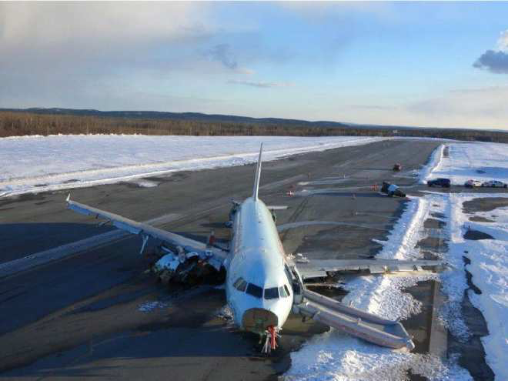
Gimli ‘glider’
Date | Type | Outline of events | Outcome
July 1983 | Boeing 767 | Fuel gauges inoperative. Pre-flight Servicing error - lb/kg - 1/2 intended fuel on board, both engines stopped in flight | Glided to an All Engines Out landing at disused airfield (1/2 a runway). 5 crew, 61 passengers none seriously injured
Saved through
pilots’ skill!
Flying is safer than …?
Notes:
1983 accident started with unserviceable fuel gauges,
flight crew reliant on the daily servicing team
loaded the correct quantity of fuel, but in lbs not kgs;
tanks contained less than half the fuel expected.
First one engine stopped, then the other.
B767 normally supplies elec & hyd
Pilots - a few analogue instruments + hyd from RAT
Nothing in Emerg checklist on flying with no engines
Captain experienced glider pilot
FO calculating glide perf – Mech alt & ATC range.
In ground before reaching airfield
FO remembered disused air force base (GIMLI)
Not aware ½ now a racetrack
Capt side-sliped to achieve a touch down heavily but successfully on the remaining ½ half of runway
Only 17 minutes after running out of fuel.

Slide 42
Date | Aircraft Type | Outline of events | Outcome
Jan 2008 | Boeing 767 | FO behaving strangely & clearly mentally impaired. | FO restrained & removed from flight deck. Capt. aided by a non-commercial pilot.
Two-pilots mitigate one becoming ill/incapacitated.
New public focus on pilot mental health since Germanwings 4U9525
Flying is safer than …?
Notes:
Pilot sickness
In January 2008, the First Officer on a Boeing 767 became unwell, appearing disorientated and confused.
Removed from the flight deck
Captain assisted by a passenger who had flight experience, though not a professional licence, during the diversion to a nearly airfield.
The unusual nature of the event meant it was reported to the regulator and appears in the list of airline accidents though many might not see it as such.
However, this is a good time to discuss another First Officer event that ended very differently.

Slide 43
Pilot Suicide/Murder?
Date | Aircraft | Operator | Location | Pax & Crew | Remarks
Mar 2015 | A727 | German Wings | France | 150 | FO locked Captain out of flight deck – AP set to descend into ground
Nov 2013 | ERJ190 | LAM* | Namibia | 33 | Captain locked in alone on flight deck – AP set to descend into ground
Oct 1999 | B767 | EgyptAir | North Atlantic | 217 | Relief FO shut off engines & descended. Captain returned, unable to gain control
Dec 1997 | B737 | Silk Air | Indonesia | 104 | FDRs stopped in sequence. A/C descent, into river. No technical reason found
Aug 1994 | ATR42 | Royal Air Maroc | Morocco | 44 | Captain cut AP & flew into ground. FO unable to overcome the Captain
Feb 1992 | DC-8 | Japan Airlines | Japan | 24 | On Approach, Captain flew a/c into ground, FO unable to overcome Captain
*Mozambique Airlines
771 passengers & crew
Flying is safer than …?
Notes:
Accidents span intro of locked flight deck doors and
FAA req 2 people on flight deck at all times - more to ensure someone could open the door from the inside than , rather than prevent pilot suicide.
After Germanwings ‘2 person rule’ is common practice.
BUT:
Some accidents had two pilots on the flight deck.
Also prompted re-evaluation of medical oversight of professional pilots.

Slide 44
Pilot ‘catches’
Event | Persons on Board
Gimli Glider B767 | 66
Sullenberger A320 Hudson River | 155
BA38 double engine fail on approach to Heathrow | 136
A380 crew following engine uncontained failure | 469
826
Flying is safer than …?
Notes:
Pilot ‘catches’
Have already heard of
2 instances where
Pilots saved their passengers
despite devastating technical issues.
Without any research (media rarely covers good news):
I’ve added 2 more incidents
Quickly eclipse the number of lives lost with
A greater number saved by pilots.

Slide 45
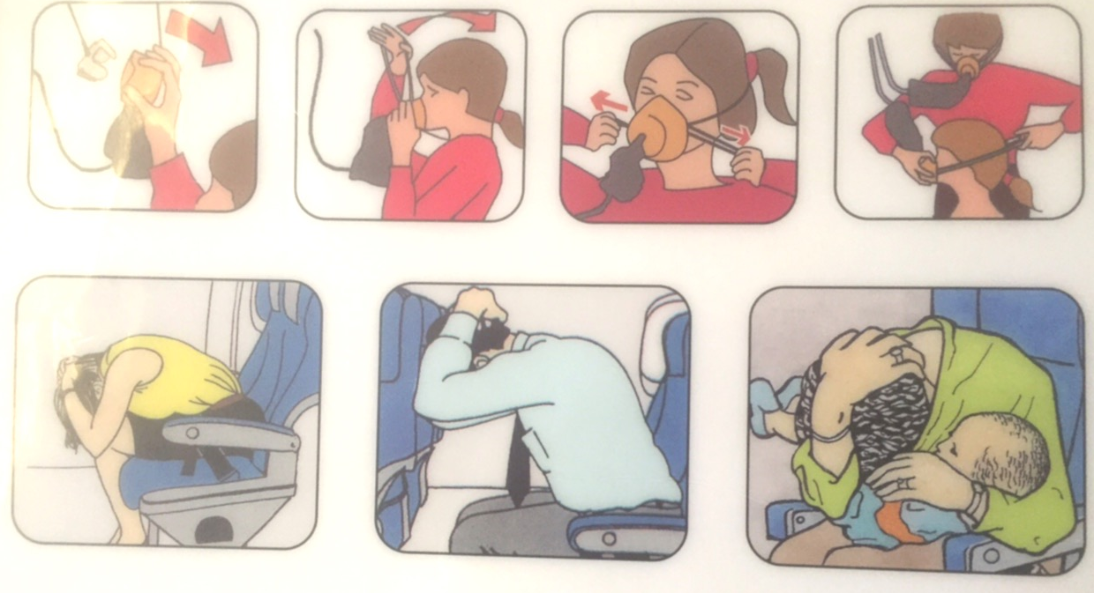
Helping ourselves?
Notes:
A final thought before the hard figures.
The aircraft can float or land heavily but relatively intact.
I always read the safety card
How are the doors opened – don’t want to be trapped
Where is/How is life jacket secured – vary a/c to a/c
Finally, look at the brace position - RAF Flight Safety Magazine advice after British Midland accident at Kegworth in 1989:
Seatbelt fully tight and low on your lap.
Legs not under your seat or the one in front, geometrically locked with heels firmly on the floor.
Head below height of seat in front & protected by hands, one on top of the other
One hand can release the belt buckle
Two broken hands can’t.
Be ready & fit to exit aircraft as quickly as poss.

Slide 46
The statistics
YEAR | Worldwide Air Accidents (ICAO) | World Deaths (ICAO) | GB Pedestrian Deaths (DfT) | GB All Road Deaths (DfT)
2009 | 102 | 655 | 500 | 2222
2010 | 104 | 626 | 405 | 1850
2011 | 118 | 373 | 453 | 1901
2012 | 99 | 388 | 420 | 1754
2013 | 90 | 173 | 398 | 1713
2014 | 21* | 990* | Not available | 1760
Flight International 2014 report on fatal air accidents :
Scheduled Passenger 3
Regional and Commuter 4
Non-passenger 12
(Excludes MH17 shoot-down and Antanov air ambulance loss near Tunis on 21 Feb)
X 4
*Aviation Safety Network figures, includes MH17 (298) in Ukraine & disappeared MH370 (239)
**DfT Statistical Release 6 Nov 14 - Rolling years ending Q2 DfT*** Transport Data
Flying is safer than …?
Notes:
The Statistics
The number of flights annually is on the rise again
In first 45 minutes of this lecture, more than 2700 airliners will have taken off around the world.
In 2014 only 21 fatal air transport accidents, which despite the 990 deaths recorded make it the safest year for air travel.
figures include the shoot-down of MH17 in Ukraine
disappearance of MH370
an ambulance flight that crashed in Libya.
Breaking the 2014 figures down gives us:
4 scheduled passenger flights,
4 regional and commuter passenger flights
1 ambulance flight;
the remaining 12 were cargo-only flights.

Slide 47
The statistics
YEAR | Worldwide Air Accidents (ICAO) | World Deaths (ICAO) | GB Pedestrian Deaths** (DfT) | GB All Road Deaths** (DfT)
2009 | 102 | 655 | 500 | 2222
2010 | 104 | 626 | 405 | 1850
2011 | 118 | 373 | 453 | 1901
2012 | 99 | 388 | 420 | 1754
2013 | 90 | 173 | 398 | 1713
2014 | 21* | 990* | Not available | 1760
*Aviation Safety Network figures, includes MH17 (298) in Ukraine & disappeared MH370 (239)
**DfT Statistical Release 6 Nov 14 - Rolling years ending Q2 DfT*** Transport Data
>4,700 pedestrians killed in USA alone in 2013
Flying is safer than …?
Notes:
The Statistics
Verses pedestrian deaths in just Great Britain
Today we are as likely to be killed crossing the road as the global population is to die in an air transport accident.
In USA, annual pedestrian deaths (in a country that tends to drive everywhere) run at about 4,700, which dwarfs even the 990 air transport deaths in 2014.

Slide 48
The statistics
2014
Only 8 fatal accidents to Scheduled, Regional & Commuter flights
in the whole world
Flying is safer than …?

Slide 49
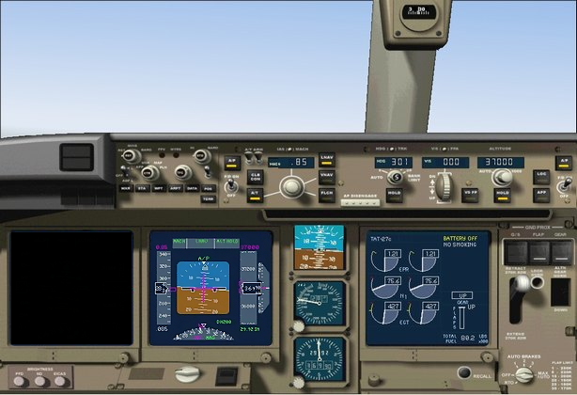
Conclusions
Summary & Questions?
jt-ac.
com
Notes:
Air travel today is exceptionally safe.
Many airlines have an enviable record.
Air safety will need to respond to new technologies,
introduction of lithium batteries,
and to continuing commercial pressures on airlines.
The drive for reduced (and less personalised) training - founded on a belief that each airliner is easier to fly than its predecessor - at last under regulatory challenge as automation conundrum becoming understood.
Hopefully public will once more realise that piloting is a highly skilled profession operating in a complex and sometimes challenging environment and is not about just pressing a few buttons.
Finally, recent trends show that your chance of being involved in an airline accident is exceptionally small;
You should be more worried about driving your car or crossing the road than about taking a trip by air.

