Slide 1
Gauss and Germain
Raymond Flood
Gresham Professor of Geometry

Slide 3
Sophie Germain 1st April, 1776 – 27th June, 1831

Slide 4
Carl Friedrich Gauss 30th April, 1777– 23rd February, 1855
Gauss at age 26

Slide 5
Carl Friedrich Gauss 30th April, 1777– 23rd February, 1855
Sum the integers from 1 to 100 :
Gauss noted they can be arranged in fifty pairs each summing to 101
101 = 1 + 100 = 2 + 99 = … = 50 + 51
So the answer is 50 x 101 = 5050
Gauss at age 26

Slide 6
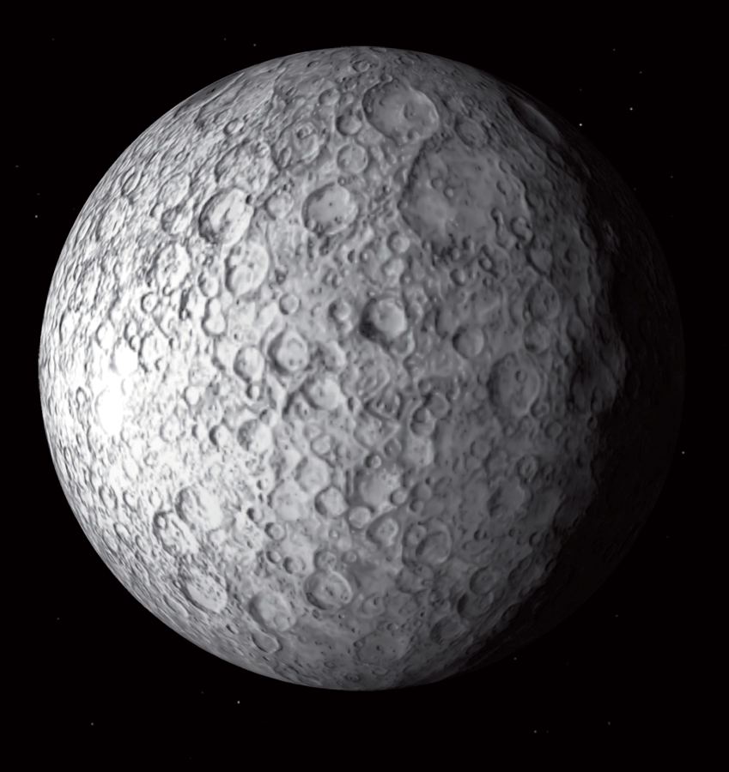
Carl Friedrich Gauss 30th April, 1777– 23rd February, 1855
Ceres
Gauss at age 26

Slide 7
Carl Friedrich Gauss 30th April, 1777– 23rd February, 1855
Orbit of Ceres from Gauss’s notebooks
Ceres

Slide 8
Disquisitiones Arithmeticae (Discourses in Arithmetic), 1801
Mathematics is the queen of the sciences, and arithmetic the queen of mathematics

Slide 9
Modular Arithmetic
We define a ≡ b mod n and say a is congruent to b mod n whenever a and b have the same remainders when we divide by n. An equivalent way of describing this is that n divides a – b.

Slide 10
Modular Arithmetic
We define a ≡ b mod n and say a is congruent to b mod n whenever a and b have the same remainders when we divide by n. An equivalent way of describing this is that n divides a – b.
Examples: 35 ≡ 11 mod 24, 18 ≡ 11 mod 7, 16 ≡ 1 mod 5

Slide 11
Modular Arithmetic
We define a ≡ b mod n and say a is congruent to b mod n whenever a and b have the same remainders when we divide by n. An equivalent way of describing this is that n divides a – b.
Examples: 35 ≡ 11 mod 24, 18 ≡ 11 mod 7, 16 ≡ 1 mod 5
If a ≡ b mod n and c ≡ d mod n

Slide 12
Modular Arithmetic
We define a ≡ b mod n and say a is congruent to b mod n whenever a and b have the same remainders when we divide by n. An equivalent way of describing this is that n divides a – b.
Examples: 35 ≡ 11 mod 24, 18 ≡ 11 mod 7, 16 ≡ 1 mod 5
If a ≡ b mod n and c ≡ d mod n
Addition: a + c ≡ b + d mod n

Slide 13
Modular Arithmetic
We define a ≡ b mod n and say a is congruent to b mod n whenever a and b have the same remainders when we divide by n. An equivalent way of describing this is that n divides a – b.
Examples: 35 ≡ 11 mod 24, 18 ≡ 11 mod 7, 16 ≡ 1 mod 5
If a ≡ b mod n and c ≡ d mod n
Addition: a + c ≡ b + d mod n
Multiplication: ac ≡ bd mod n

Slide 14
Cancellation or division
This is trickier!
It is true that 10 ≡ 4 mod 6 but we cannot divide by 2 to get 5 ≡ 2 mod 6 as it is not true!
If ac ≡ bc mod n then we know that
n divides ac – bc which is (a – b)c but we cannot conclude that n divides (a – b) unless n and c have no factors in common. In particular this will happen if n is a prime and n does not divide into c.

Slide 15
Modular Arithmetic
We define a ≡ b mod n and say a is congruent to b mod n whenever a and b have the same remainders when we divide by n. An equivalent way of describing this is that n divides a – b.
Examples: 35 ≡ 11 mod 24, 18 ≡ 11 mod 7, 16 ≡ 1 mod 5
If a ≡ b mod n and c ≡ d mod n
Addition: a + c ≡ b + d mod n
Multiplication: ac ≡ bd mod n
Cancellation: If ac ≡ bc mod p and p is a prime and p does not divide c then a ≡ b mod p.

Slide 16
Quadratic residues
11 ≡ 1² mod 5
so we can think of 1 as being the square root of 11 in mod 5 arithmetic
7 ≡ 6² mod 29
so we can think of 6 as being the square root of 7 in mod 29 arithmetic

Slide 17
Quadratic residues
11 ≡ 1² mod 5
so we can think of 1 as being the square root of 11 in mod 5 arithmetic
7 ≡ 6² mod 29
so we can think of 6 as being the square root of 7 in mod 29 arithmetic
Definition: p is a quadratic residue of q if p is congruent to a square modulo q i.e. there is an integer x so that p ≡ x² mod q
11 is a quadratic residue modulo 5
7 is a quadratic residue modulo 29
5 ≡ 4² mod 11 so 5 is a quadratic residue modulo 11

Slide 18
Quadratic Reciprocity Theorem
The quadratic reciprocity theorem is concerned with when two primes p and q have a square root modulo each other
Example: 13 and 29 have a square root modulo each other since
29 ≡ 16 mod 13 and 13 ≡ 100 mod 29

Slide 19
Two families
Primes congruent to 1 mod 4
5 13 17 29 37 41 53 61 73 79 89 97 101…
Primes congruent to 3 mod 4
3 7 11 19 23 31 43 47 59 67 71 83 103 …

Slide 20
Primes congruent to 1 mod 4
5 13 17 29 37 41 53 61 73 79 89 97 101…
Two primes from this family either both have a square root modulo the other or neither has: If the primes are p and q
then p ≡ x² mod q has a solution if and only if q ≡ x² mod p does

Slide 21
Primes congruent to 1 mod 4
5 13 17 29 37 41 53 61 73 79 89 97 101…
Two primes from this family either both have a square root modulo the other or neither has: If the primes are p and q
then p ≡ x² mod q has a solution if and only if q ≡ x² mod p does
Example: For 13 and 29 they both have as 29 ≡ 16 mod 13 and 13 ≡ 100 mod 29

Slide 22
Primes congruent to 1 mod 4
5 13 17 29 37 41 53 61 73 79 89 97 101…
Two primes from this family either both have a square root modulo the other or neither has: If the primes are p and q
then p ≡ x² mod q has a solution if and only if q ≡ x² mod p does
Example: For 5 and 13 neither of them has – just write out the square residues i.e. calculate all the residues
x² mod 5 and x² mod 13

Slide 23
Primes congruent to 3 mod 4
7 11 19 23 31 43 47 59 67 71 83 103 …
For two primes from this family one and only one of them has square root modulo the other.
If the primes are p and q then p is a square mod q if and only if q is not a square mod p.

Slide 24
Primes congruent to 3 mod 4
3 7 11 19 23 31 43 47 59 67 71 83 103 …
For two primes from this family one and only one of them has square root modulo the other.
If the primes are p and q then p is a square mod q if and only if q is not a square mod p.
Example: p = 7 and q = 11.
Now 11 ≡ 2² mod 7 but there is no x so that
7 ≡ x² mod 11. Just calculate for every x!

Slide 25
One prime from each family
Primes congruent to 1 mod 4
5 13 17 29 37 41 53 61 73 79 89 97 101…
Primes congruent to 3 mod 4
3 7 11 19 23 31 43 47 59 67 71 83 103 …
The situation is the same as if they were both from the first family. For 29 and 7 they both have.
7 ≡ 6² mod 29 and 29 ≡ 1² mod 7

Slide 26
Primes in Arithmetic Progressions
Dirichlet in 1837 made essential use of the theorem of quadratic reciprocity to prove that any arithmetic progression
a, a + d, a + 2d, a + 3d, …,
where a and d have no common factors contains infinitely many primes

Slide 27
Richard Taylor developed with Andrew Wiles the Taylor-Wiles method, which they used to help complete the proof of Fermat’s Last Theorem.
https://www.ias.edu/about/publications/ias-letter/articles/2012-summer/modular-arithmetic-taylor

Slide 28
Battle of Jena, 1806
Duke of Brunswick
1735 - 1806

Slide 29
Gauss letter of 30 April, 1807
The scientific notes with which your letters are so richly filled have given me a thousand pleasures. I have studied them with attention and I admire the ease with which you penetrate all branches of arithmetic, and the wisdom with which you generalize and perfect.

Slide 30
Fermat’s marginal note
Cubum autem in duos cubos, aut quadratoquadratum in duos quadratoquadratos, et generaliter nullam in infinitum ultra quadratum potestatem in duos eiusdem nominis fas est dividere cuius rei demonstrationem mirabilem sane detexi. Hanc marginis exiguitas non caperet
It is impossible to separate a cube into two cubes, or a fourth power into two fourth powers, or in general, any power higher than the second, into two like powers. I have discovered a truly marvellous proof of this, which this margin is too narrow to contain.

Slide 31
Fermat’s ‘Last Theorem’
The equation
x^{n} + y^{n} = z^{n}
has no whole number solutions if n is any integer greater than or equal to 3.
Only need to prove for n equal to 4 or n an odd prime.
Suppose you have proved the theorem when n is 4 or an odd prime then it must also be true for every other n for example for n = 200 because x²⁰⁰ + y²⁰⁰ = z²⁰⁰ can be rewritten (x⁵⁰)⁴ + (y⁵⁰)⁴ = (z⁵⁰)⁴
so any solution for n = 200 would give a solution for n = 4 which is not possible.

Slide 32
Let p be an odd prime such that 2p + 1 is also prime. Then x^{p} + y^{p} = z^{p} implies p divides xyz

Slide 33
Here is what I have found:
The Plan
For any given prime, p, to find an infinite number of other primes, called auxiliary primes, satisfying particular conditions
These conditions would allow her to deduce that each of these auxiliary primes would have to divide one of x, y or z in any solution
But since there are an infinite number of them there can be no solution!

Slide 34
If x³ + y³ = z³ then 7 divides xyz
7 satisfies the condition to be an auxiliary prime for 3
The structure of the proof is to assume that 7 does not divide xyz and obtain a contradiction, forcing us to conclude that 7 does divide xyz
x³ + y³ ≡ z³ mod 7
Now a³ ≡ $±$1 mod 7 whenever 7 does not divide a
1³ ≡ 1 mod 7, 2³ ≡ $1$mod 7, 3³ ≡ $−1$mod 7, 4³ ≡ $1$mod 7, 5³ ≡ $−1$ mod 7,and 6³ ≡ $−1$ mod 7
So x³ + y³ ≡ z³ mod 7 becomes $±1$ + $±1$ ≡ $±1$ mod 7
which is impossible so 7 must divide xyz

Slide 35
Sophie Germain was a much more impressive number theorist than anyone has ever previously known.

Slide 36
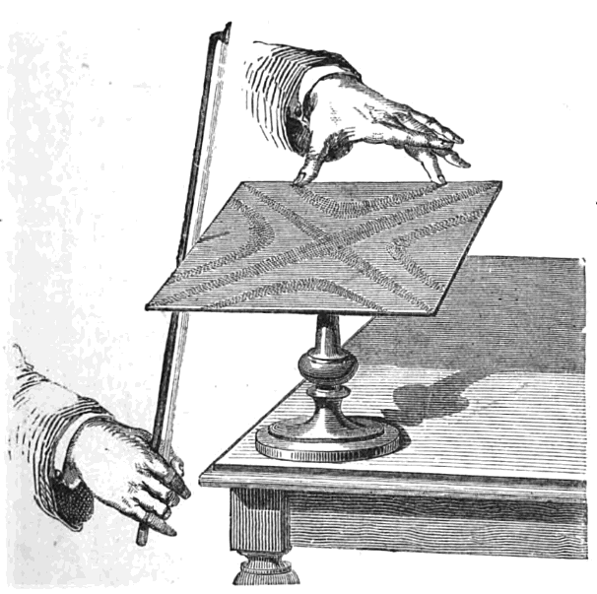
Chladni patterns from his 1809 book Traité d’Acoustique

Slide 37
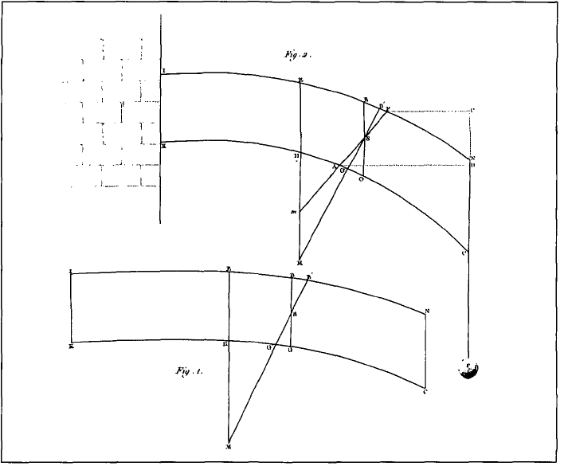
Formulate a mathematical theory of elastic surfaces and indicate just how it agrees with empirical evidence
Sophie Germain's sketch of an elastic bar and its radius of curvature when bent by an external force, taken from her book on the theory of elastic surfaces (1821)

Slide 38
Curvature at a point on a curve
Given a curve, C, and a point, P, on it there is a unique circle or line which most closely approximates the curve near P. Define the curvature at P to be the curvature of that circle or line.
Define the curvature at each point of a circle to be 1 over the radius

Slide 39
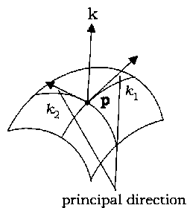
Curvature on a surface
Different normal planes will give different curves and out of all these different curves one will have greatest curvature and one will have least curvature. They are called the principal directions and the principal curvatures at the point are the curvatures in these directions.

Slide 40
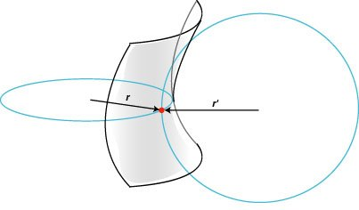
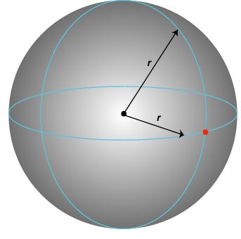
Curvature on surfaces
Cylinder: Principal curvatures are 0 and 1 over radius of cylinder
Saddle: Principal curvatures are 1/r and 1/r'’
If the two circles are on the opposite side of the surface, we say the curvature is negative
Sphere: Principal curvatures are both 1 over radius of sphere

Slide 41
The efforts of Sophie Germain, of Navier and of Poisson … were part of a historical process that involved rigourous analysis, competent experiment, ingenious hypotheses, fertile concepts, and the extension of mathematical prowess: a process, also, that involved intellectual prejudice, personal antipathy, political maneuvering, and the use of position for the benefit of friends. Out of all this a theory of elasticity emerged.

Slide 42
Sophie Germain Aged 14 , Illustration from "Histoire Du Socialisme," circa 1880, by Auguste Eugene Leray
A statue of Sophie Germain standing in the courtyard of the Ecole Sophie Germain, a lycée in Paris

Slide 43
1 pm on Tuesdays at the Museum of London
Einstein’s Annus Mirabilis, 1905
Tuesday 20 October 2015
Hamilton, Boole and their Algebras
Tuesday 17 November 2015
Babbage and Lovelace
Tuesday 19 January 2016
Gauss and Germain
Tuesday 16 February 2016
Hardy, Littlewood and Ramanujan
Tuesday 15 March 2016
Turing and von Neumann
Tuesday 19 April 2016

