Slide 1
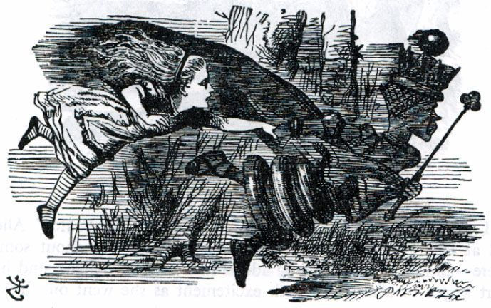
“Now, here, you see, it takes all the running you can do, to keep in the same place”(Alice in Wonderland)

Slide 2
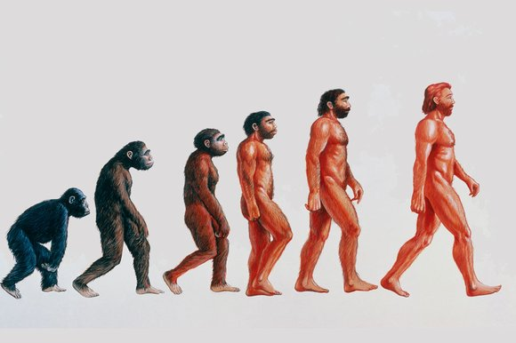
Onwards and upwards …

Slide 3
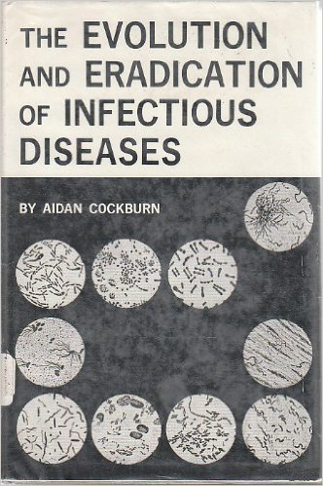
… into the1960s – the age of optimism

Slide 4
Life expectancy in Britain
Of every million born, how many made it to 21 years old?
1601 347 827
1701 498 791
1801 582 317
1901 738 245
2001 989 926

Slide 5
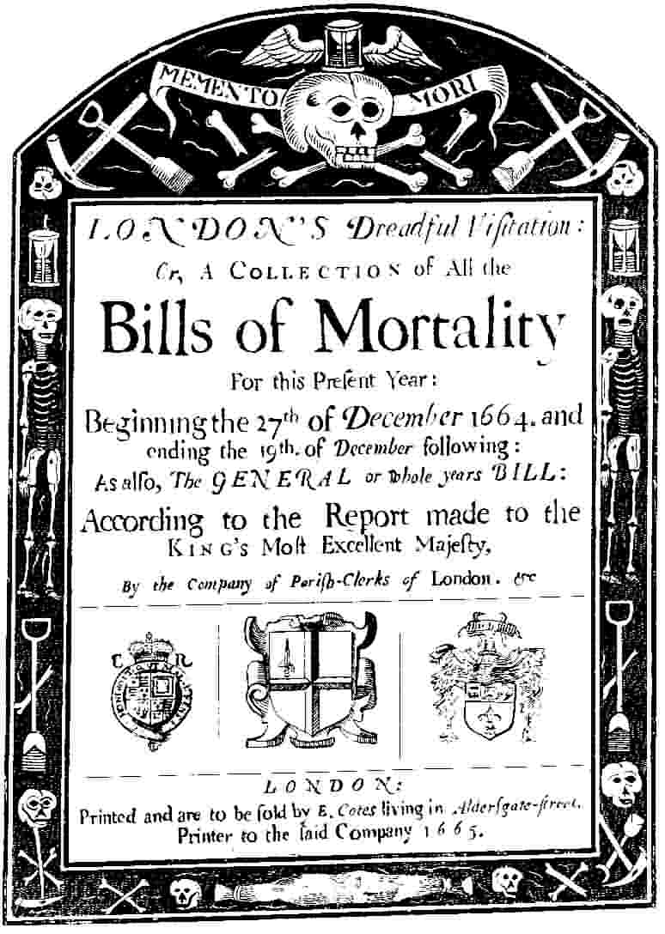
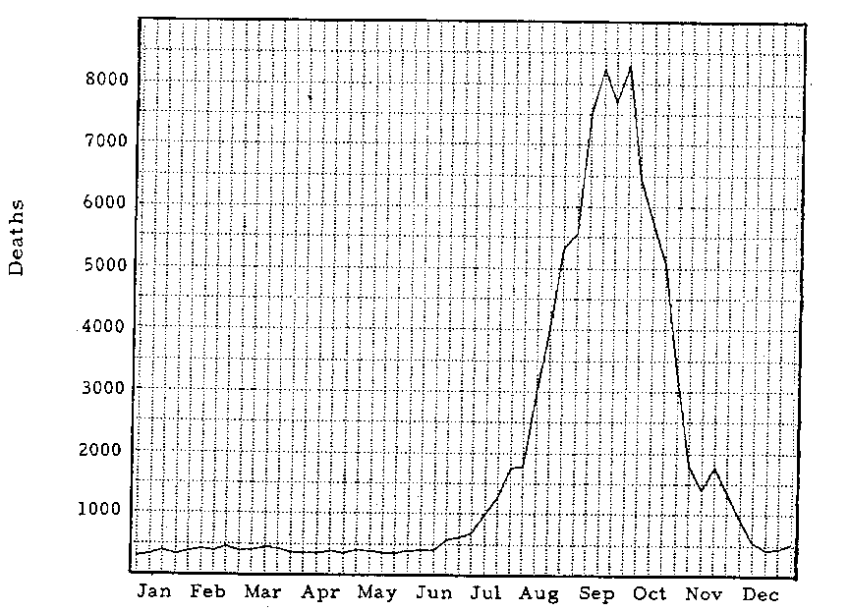
Plagues …

Slide 6
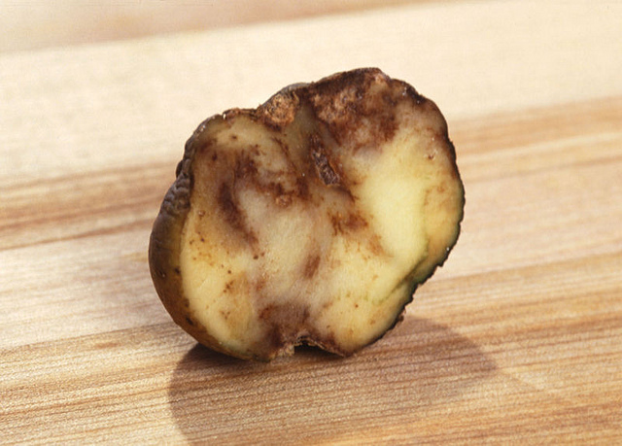
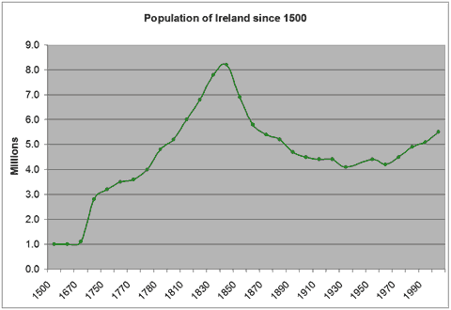
… and pests: potato blight and the Irish Famine

Slide 7
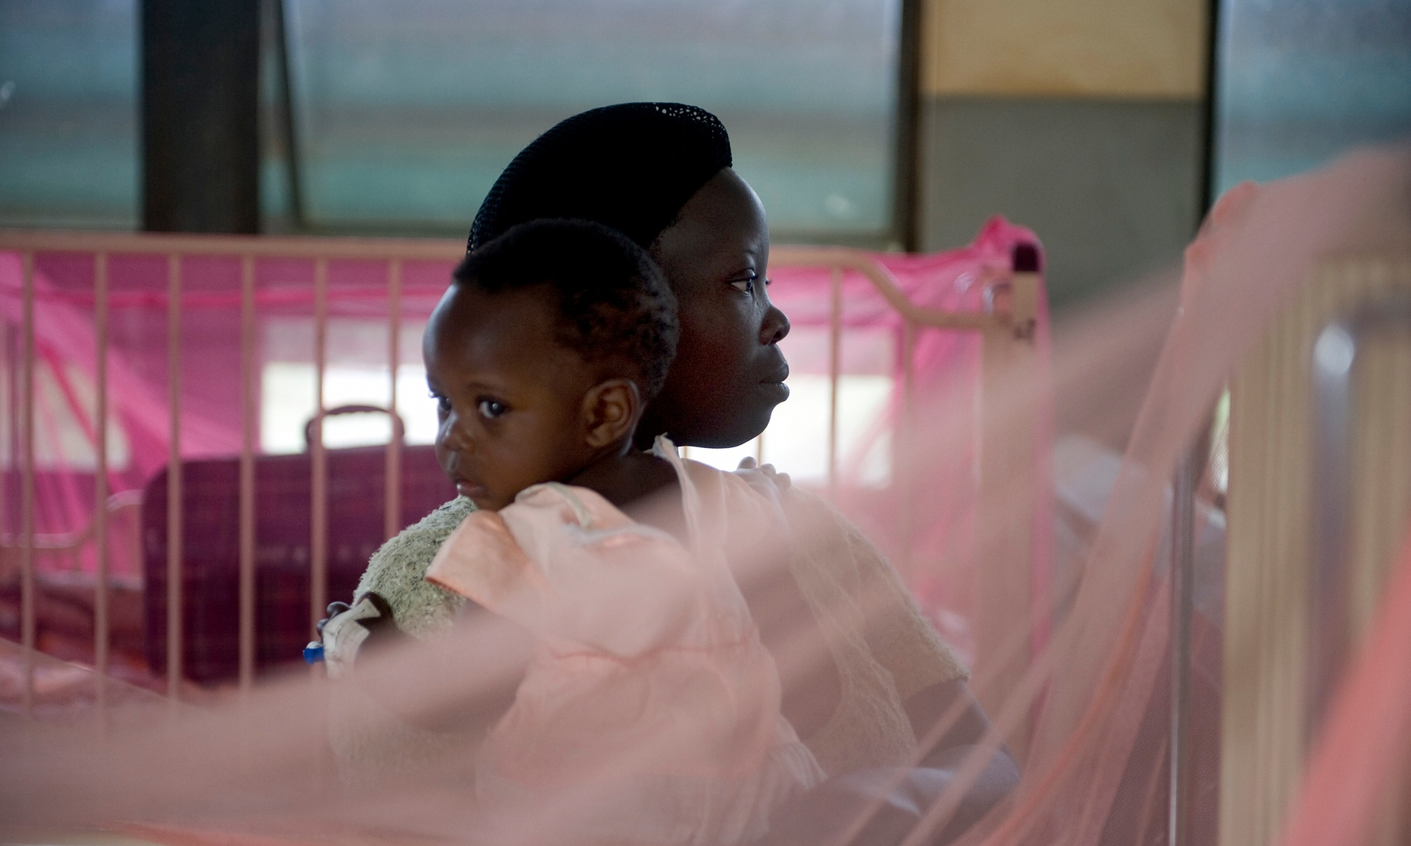
The Observer, 14th Feb 2016
Zika forest: birthplace of virus that has spread fear across the world

Slide 8
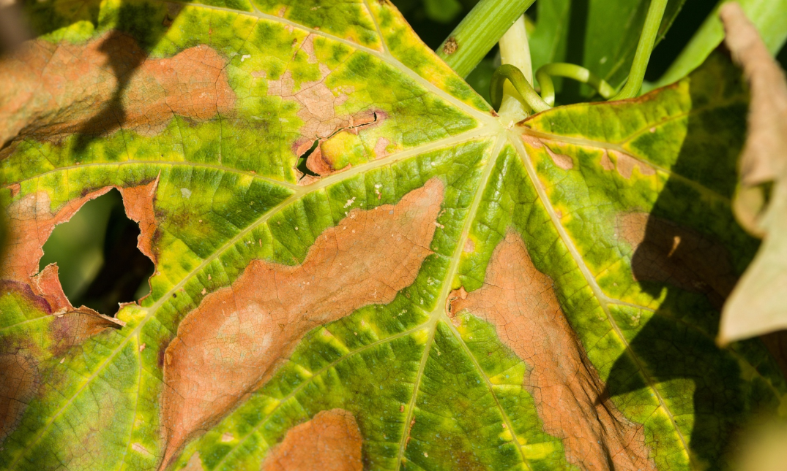
And on the facing page …
Phony peach: the disease that threatens to devastate Britain’s trees and plants
Xylella fastidiosa has wreaked havoc in the US and Europe and could dwarf the impact of ash dieback in the UK

Slide 9
WHO – 2016 outbreaks until last Friday
12 February 2016 Yellow Fever – Angola
12 February 2016 Zika virus infection – United States of America
12 February 2016 Microcephaly – United States of America
12 February 2016 Guillain-Barré syndrome – Colombia and Venezuela
10 February 2016 Human infection with avian influenza A(H7N9) virus – China
8 February 2016 Guillain-Barré syndrome – Brazil
8 February 2016 Guillain-Barré syndrome – France - Martinique
8 February 2016 Zika virus infection – Maldives
8 February 2016 Zika virus infection – Region of the Americas
2 February 2016 Middle East respiratory syndrome coronavirus (MERS-CoV) – Saudi Arabia

Slide 10
29 January 2016 Circulating vaccine-derived poliovirus – Lao People’s Democratic Republic
29 January 2016 Middle East respiratory syndrome coronavirus (MERS-CoV) – Thailand
27 January 2016 Lassa Fever – Nigeria
27 January 2016 Zika virus infection – Dominican Republic
26 January 2016 Middle East respiratory syndrome coronavirus (MERS-CoV) – Saudi Arabia
26 January 2016 Middle East respiratory syndrome coronavirus (MERS-CoV) – United Arab Emirates
26 January 2016 Human infection with avian influenza A(H5N6) virus – China
21 January 2016 Zika virus infection – France - Saint Martin and Guadeloupe
21 January 2016 Guillain-Barré syndrome – El Salvador
21 January 2016 Zika virus infection – Haiti
20 January 2016 Zika virus infection – Bolivia
20 January 2016 Zika virus infection – Guyana, Barbados and Ecuador

Slide 11
19 January 2016 Human infection with avian influenza A(H7N9) virus – China
11 January 2016 Human infection with avian influenza A(H5N6) virus – China
8 January 2016 Microcephaly – Brazil
8 January 2016 Zika virus infection – United States of America - Puerto Rico
8 January 2016 Zika virus infection – France - French Guiana and Martinique
7 January 2016 Middle East respiratory syndrome coronavirus (MERS-CoV) – Oman
4 January 2016 Middle East respiratory syndrome coronavirus (MERS-CoV) – Saudi Arabia
4 January 2016 Human infection with avian influenza A(H5N6) virus – China

Slide 12
2016 Plant disease outbreaks (p1/22)
First Report of ‘Candidatus Phytoplasma asteris’ Subgroup 16SrI-A Associated with a Disease of Potato (Solanum tuberosum) in Lithuania
Lilac (Syringa sp.) Hosts a New ‘Candidatus Phytoplasma pruni’-related Strain in Utah: Ribosomal RNA and secY Genes Distinguish the Phytoplasma from Previously Described Lineages
First Report on Phytoplasmas Infecting Wild Apples and Wild Pears in Croatia
First Report of Orostachys malacophyllus Soft Rot Caused by Pectobacterium carotovorumsubsp. carotovorum in Korea
First Report of Xanthomonas campestris pv. zinniae Causing Bacterial Leaf and Flower Spot Disease of Zinnia elegans in Jilin Province, China
Candidatus Phytoplasma aurantifolia (16SrII Group) Associated with Witches’ Broom Disease of Bamboo (Dendrocalamus strictus) in India

Slide 13
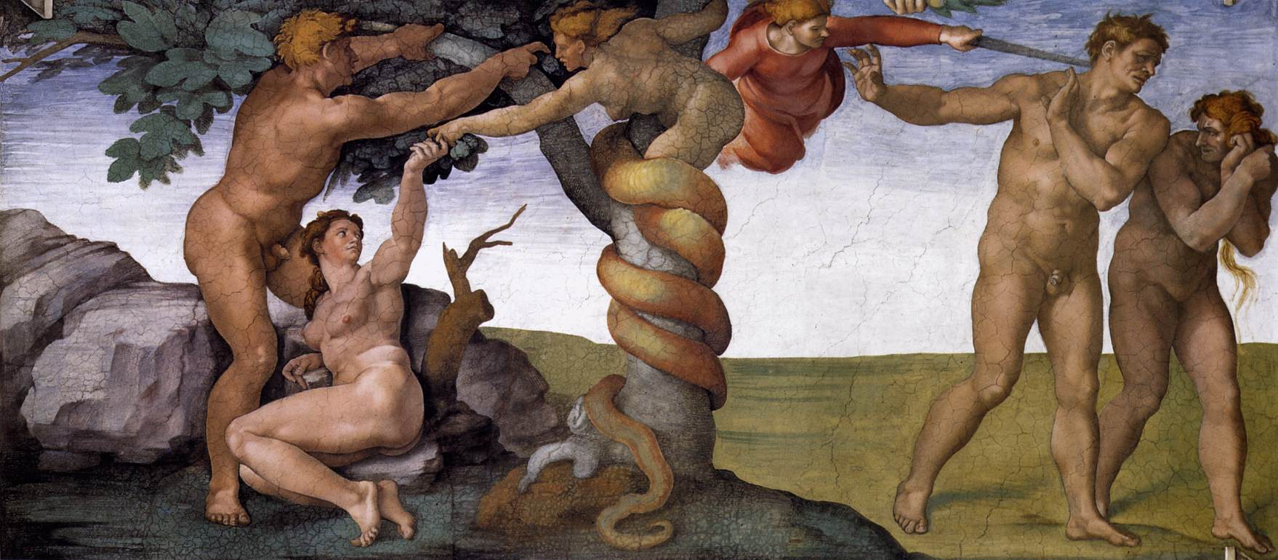
The Race Begins: “In the sweat of thy face shalt thou eat bread … the Lord God sent him forth from the garden of Eden to till the ground ...”

Slide 14
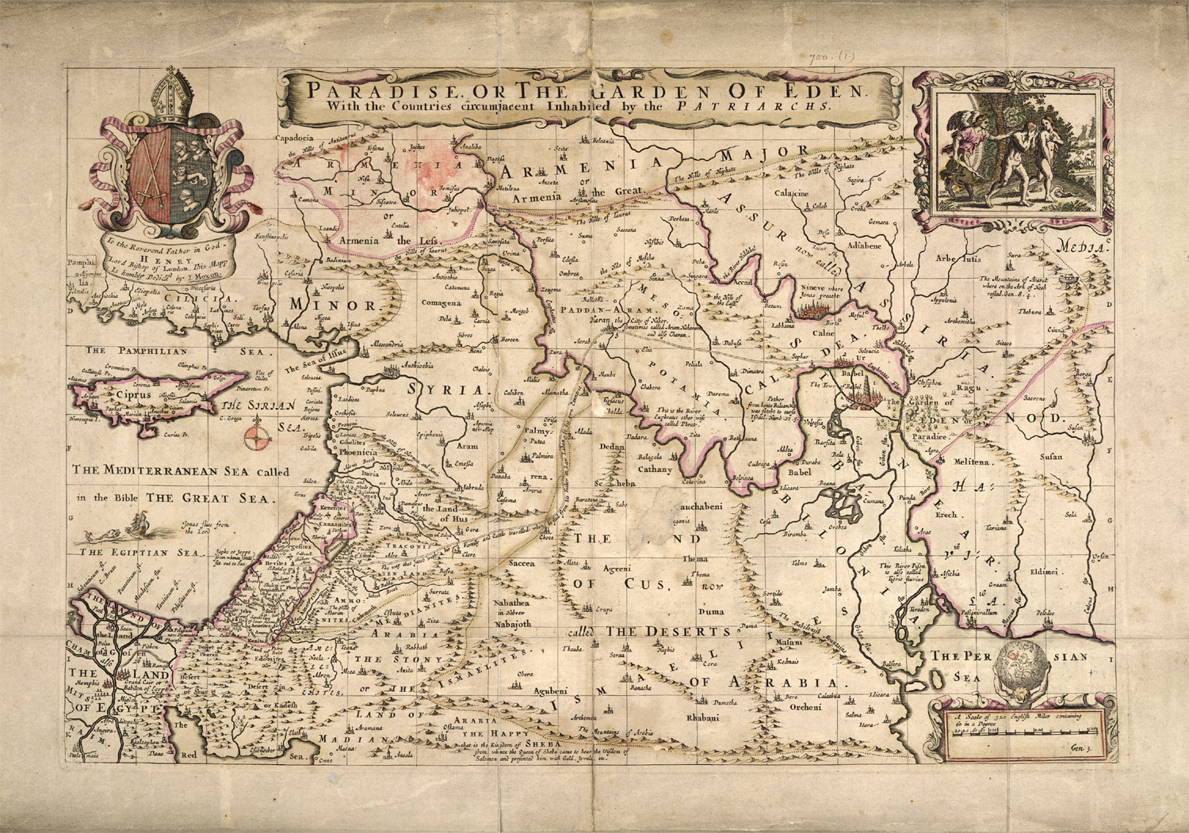
East of Eden, to the Land of Nod …

Slide 15
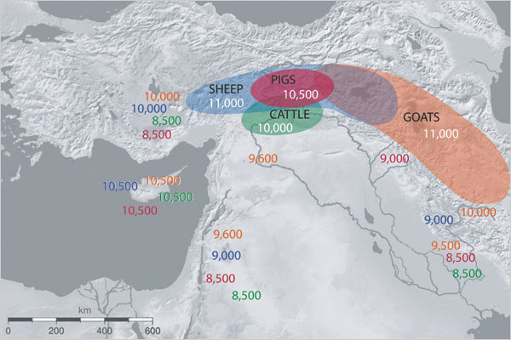

Slide 16
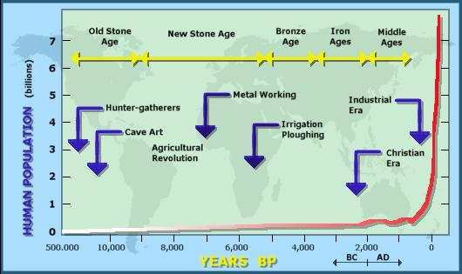
“That in blessing I will bless thee, and in multiplying I will multiply thy seed as the stars of the heaven, and as the sand which is upon the sea shore” Genesis 22: 17

Slide 17
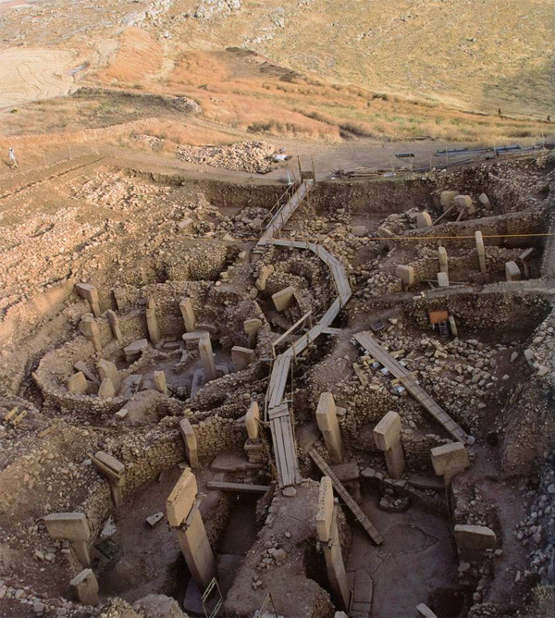
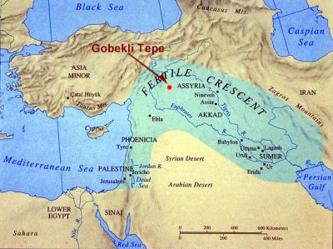
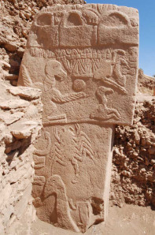
Göbekli Tepe: the first dense human population, c10 000BC?

Slide 18
Population booms (red) and busts (blue) after arrival of farming in Europe (blue arrows)

Slide 19
Diseases in the Bible (a small selection)
Jehoram: “ his bowels fell out by reason of his sickness: so he died of sore diseases.” (2 Chron 21:18)
Job: “He hath shriveled me up” (Job 16:8).
“He is lunatick, and sore vexed: for ofttimes he falleth into the fire, and oft into the water. (Matthew 17:15)
“The Lord shall smite thee with a consumption, and with a fever, and with an inflammation, and with an extreme burning”. (Deut 28:22)
“And a woman having an issue of blood twelve years, which had spent all her living upon physicians, neither could be healed of any” (Luke 8:42)
”When a man shall have in the skin of his flesh a rising, a scab, or bright spot, and it be in the skin of his flesh like the plague of leprosy; then he shall be brought unto Aaron the priest, or unto one of his sons the priests”
(Leviticus 14: 56)

Slide 20
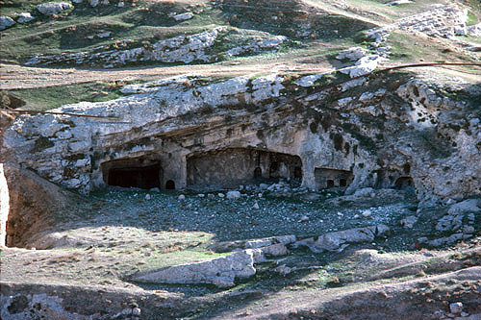
Haceldama: The Field of Blood, bought with Judas’ 30 pieces of silver

Slide 21
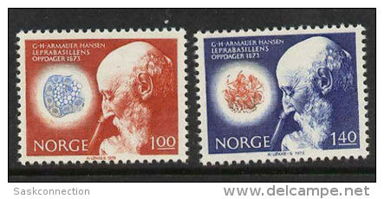
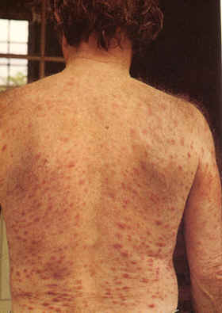
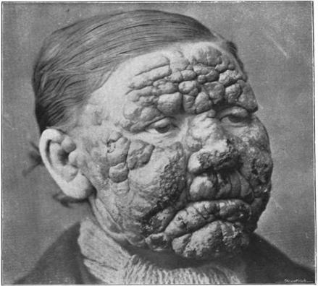
Mild and severe leprosy (Hansen’s disease), its agent and its discoverer

Slide 22
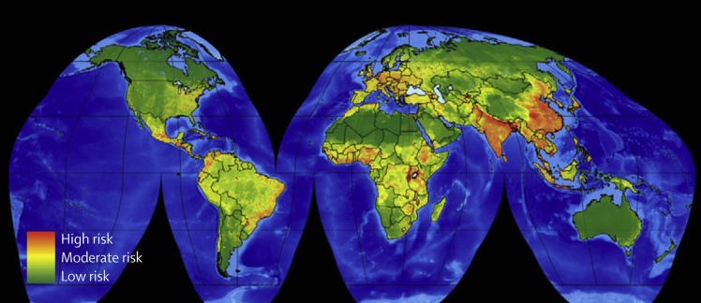
Global hotspots for emerging diseases of domestic animals from wildlife

Slide 23
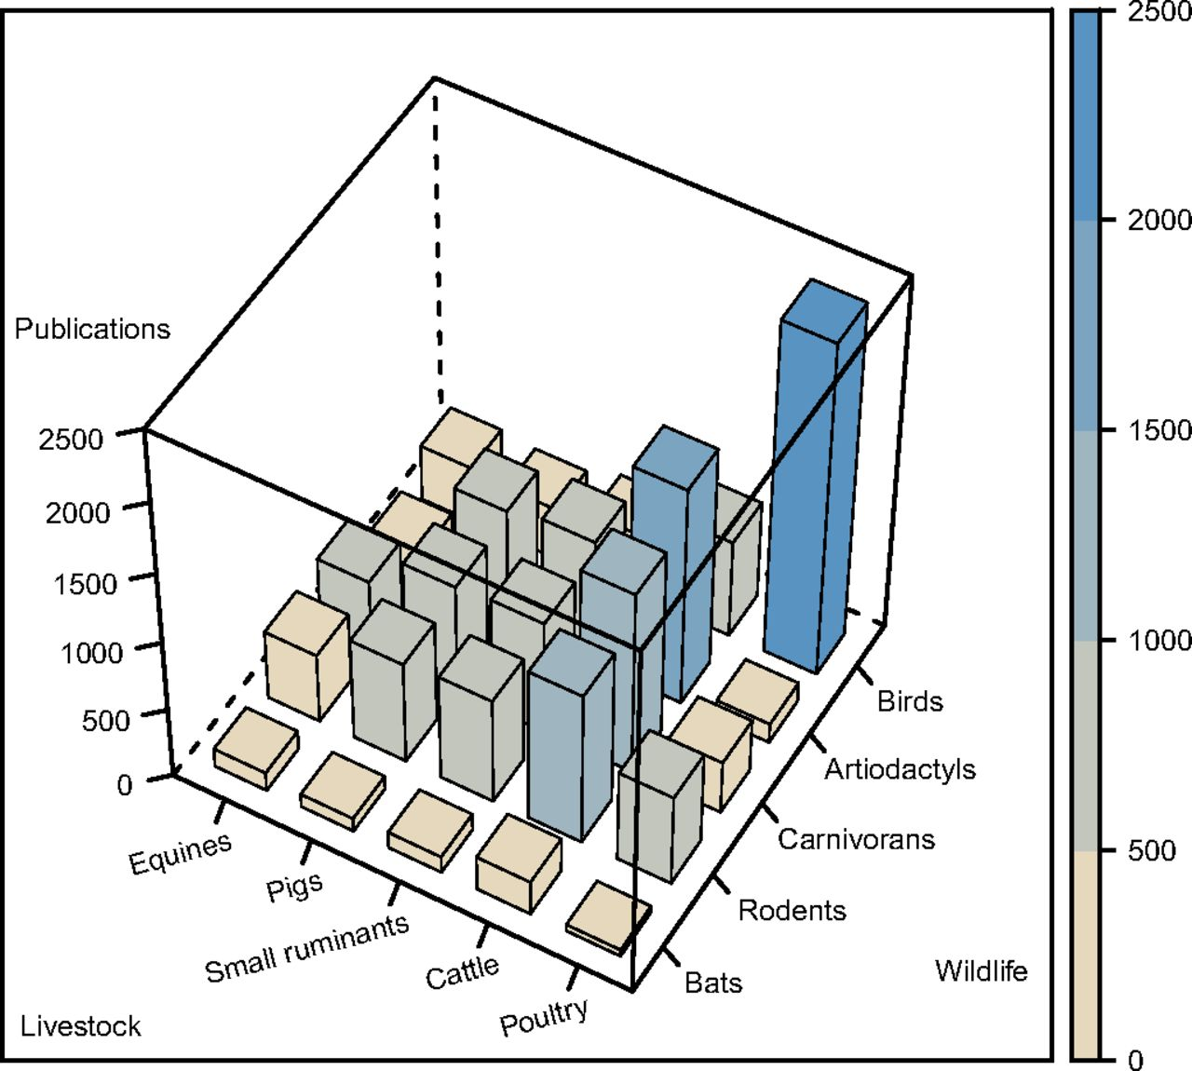
Transfer of infectious diseases from wild to domestic animals
Anke K. Wiethoelter et al. PNAS 2015;112:9662-9667
©2015 by National Academy of Sciences
Notes:
Prominent wildlife–livestock interfaces reported in scientific literature. Shown are the five most frequently cited wildlife and livestock groups (Dataset S1); only publications with one disease (n = 13,293) were included.

Slide 24
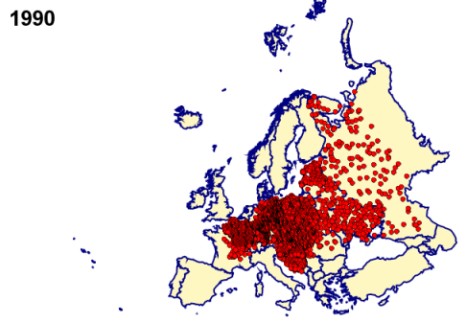
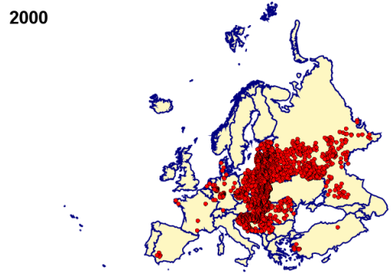
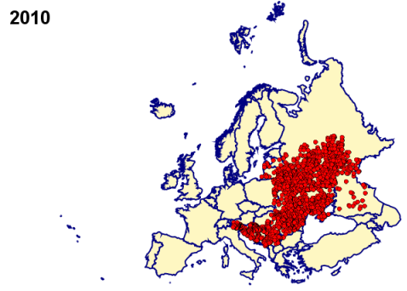
Dog domestication 33kya in N China; in Middle East by origin of farming. Rabies still in Europe but in decline
Rabies, Stage 1: dog to man, never man to man

Slide 25
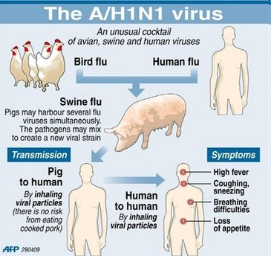
Swine flu viruses are recombinants between three viruses
Swine flu: Stage 2: Animal to man, but cannot sustain a long human epidemic

Slide 26
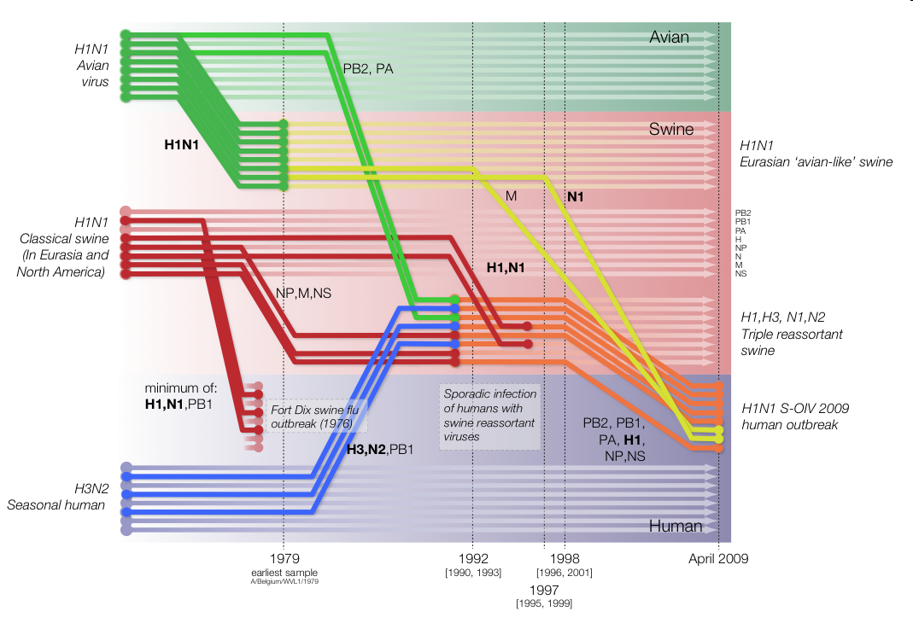
Using genes to track the origin of the 2009 H1N1 flu epidemic

Slide 27
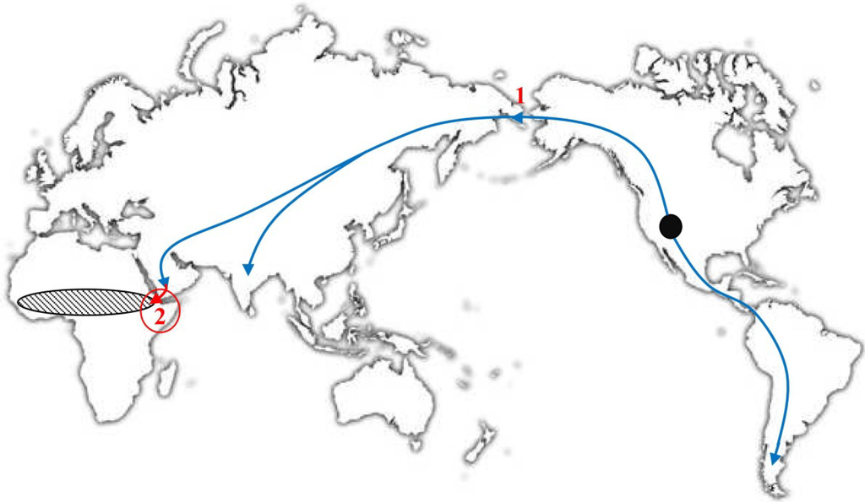
Black circle: origin of camelids 45 MYA. Arrows: migration (1: into Asia c2MYA, 2: introduction of domesticates into East Africa c4000YA); hatched: distribution of naked sole gerbils
Smallpox,Stage 3: Wild to domestic animal, persistent human epidemic

Slide 28
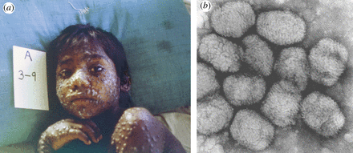
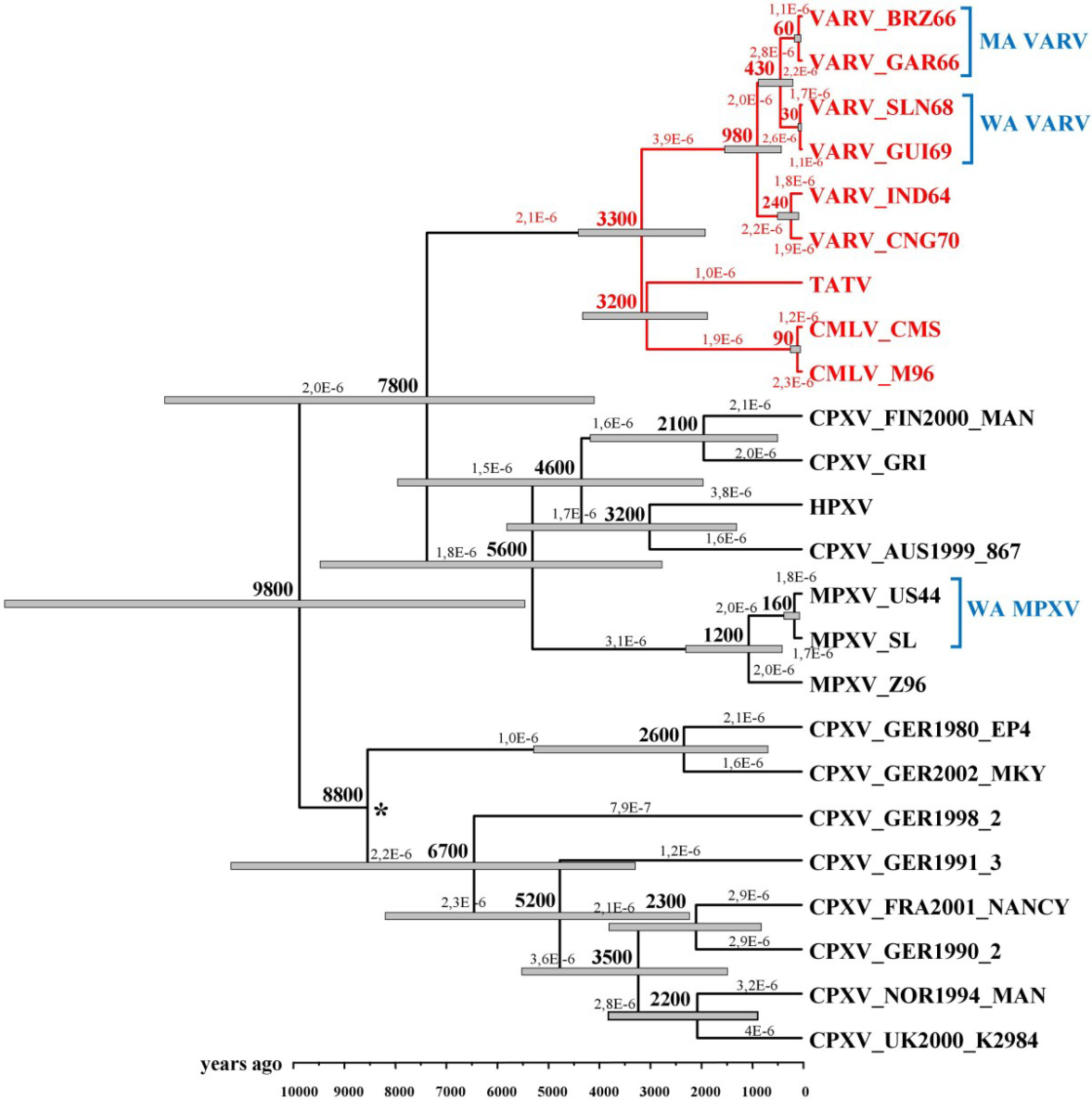
A pox virus family tree: smallpox (VARV), camelpox (CMLV) and gerbilpox (TATV). Others are horsepox, cowpox, monkeypox and more

Slide 30
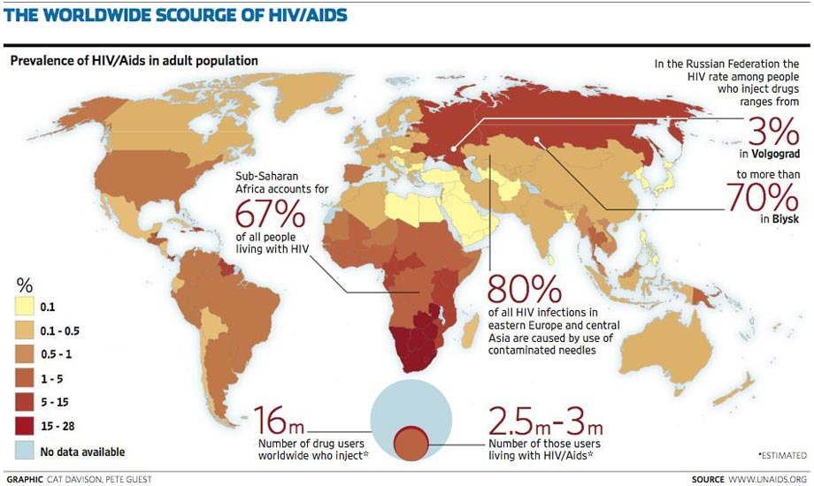
A global view of HIV infection in 2013
35 million people living with HIV

Slide 31
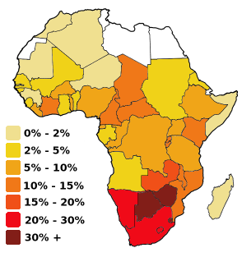
AIDS in Africa

Slide 32
Projected population structure with and without AIDS epidemic, Botswana 2020
Age (years)
Population (thousands)

Slide 33
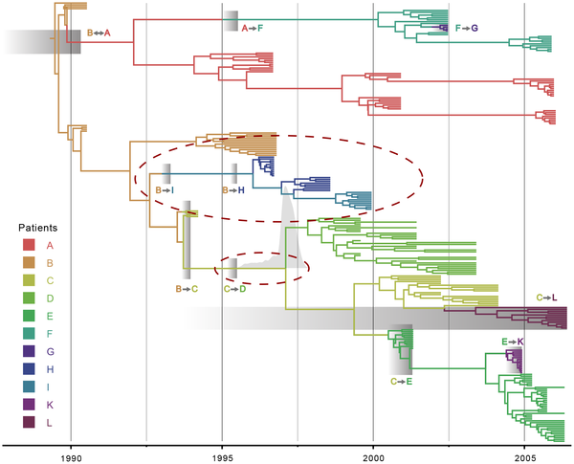
Pedigree of HIV transmission between known sources of infection over 15 years: a small bottleneck on infection followed by mutation and increased diversity within each patient
Vrancken B, Rambaut A, Suchard MA, Drummond A, Baele G, et al. (2014) The Genealogical Population Dynamics of HIV-1

Slide 34
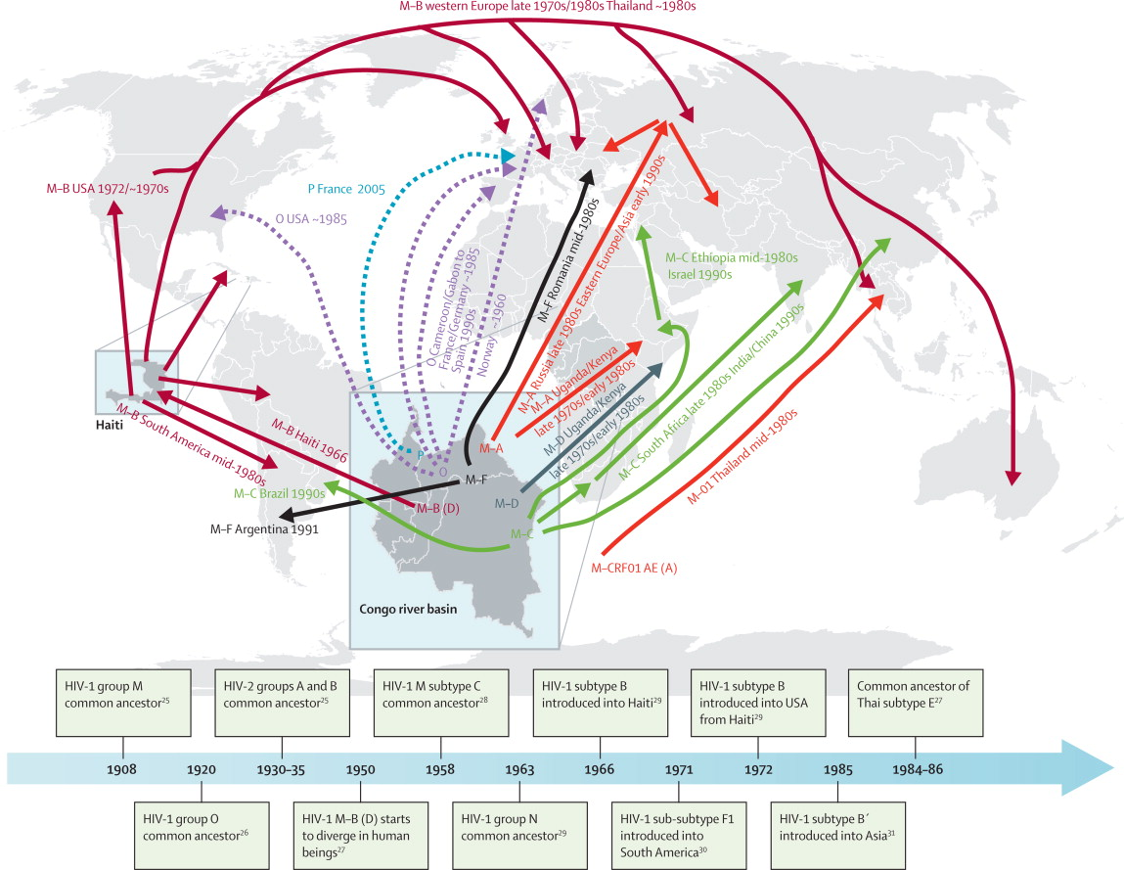
Spread of HIV from genetic data

Slide 35
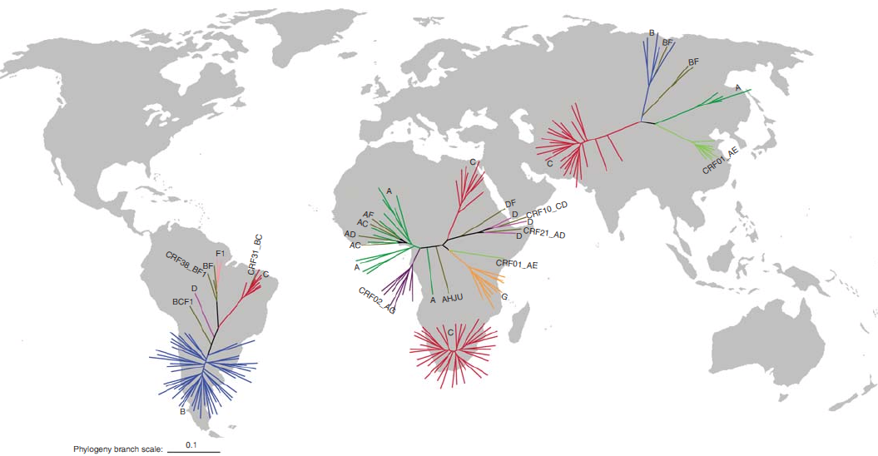
Local evolution of HIV within low-income countries

Slide 36
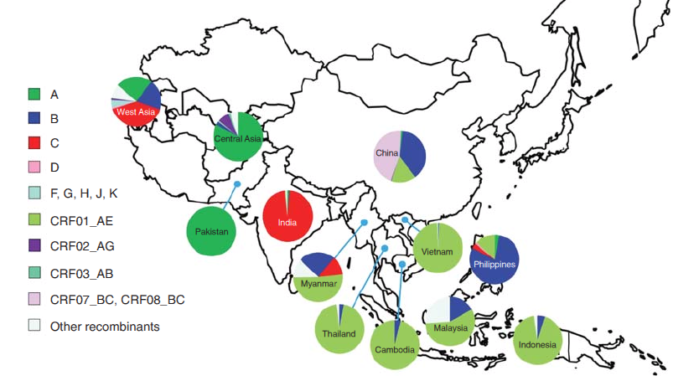
Recombinant (“scrambled”) HIV spreading in S Asia

Slide 37
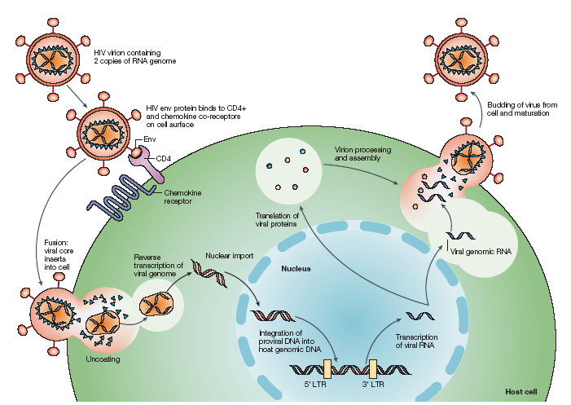
HIV lifecycle

Slide 38
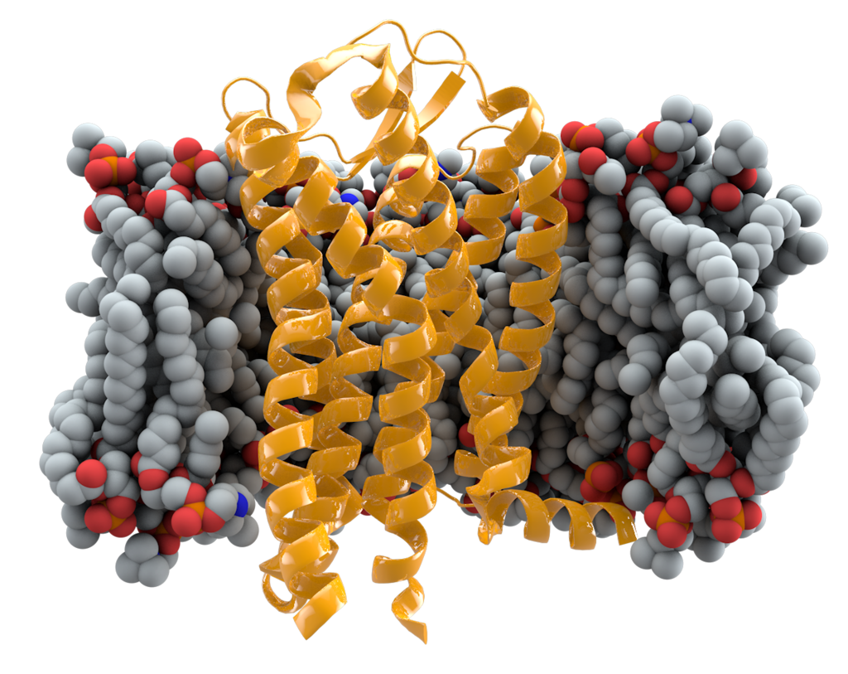
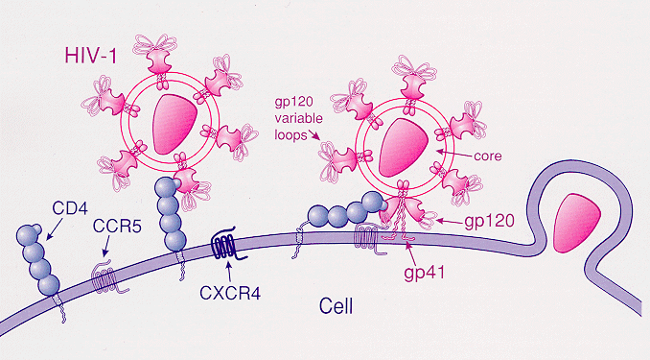
The CCR5 receptor (yellow) in the cell membrane (grey) with HIV particles attaching

Slide 39
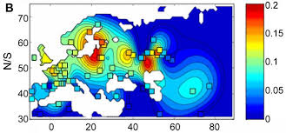
HIV: Frequency of protective CCR5 deletion: absent from most of Africa

Slide 40
Effect of one copy of CCR5 deletion on progression to AIDS

Slide 41
Two more human variants that affect time to symptoms (there may be many more)

Slide 42
HIV – huge individual differences in pre-symptomatic viral load …

Slide 43
Similarity in HIV load (“heritability”)between donor and recipient – a viral rather than a host effect
No of couples | Similarity in viral load
97 | 36% (6 to 66%)
141 | 44% (19 to 69%)
195 | 26% (8 to 44%)
433 | 33% (20 to 46%)

Slide 44
… with effects on survival and infectivity: genes of both virus (?30% of effect) and host involved

Slide 45
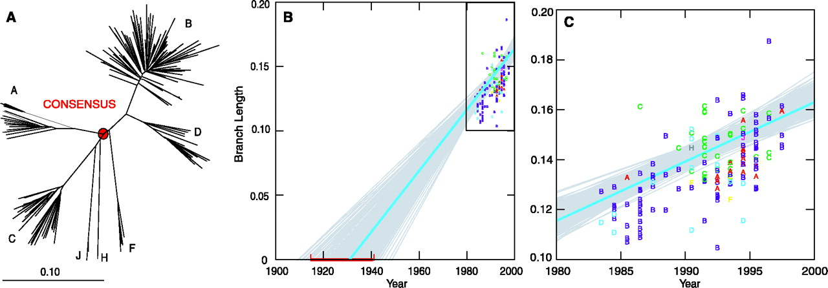
Estimating the origin of HIV from divergence in recent strains

Slide 46
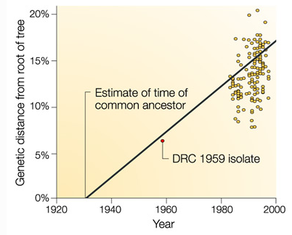
The fossil virus

Slide 47
The 1959 virus on the tree

Slide 48
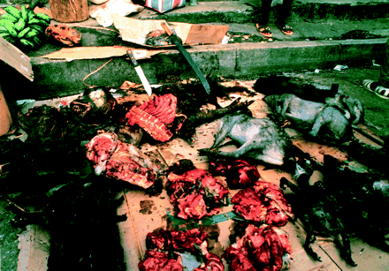
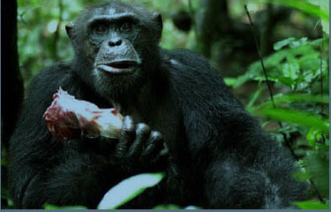
Bushmeat in Sierra Leone butcher; chimps like monkey meat too – spreads SIV?

Slide 49
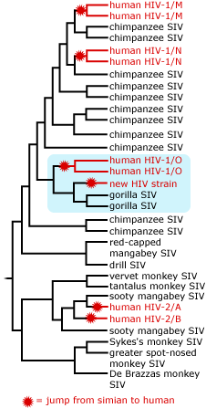
Chimp, gorilla and monkey sources for HIV: M is the common type

Slide 50
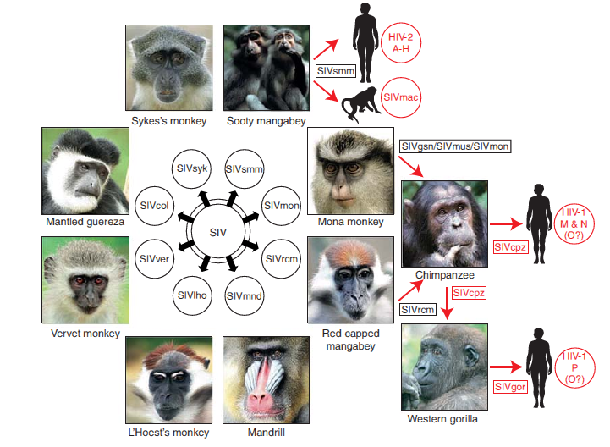
SIV/HIV in primates: transmissions to humans in red

Slide 51
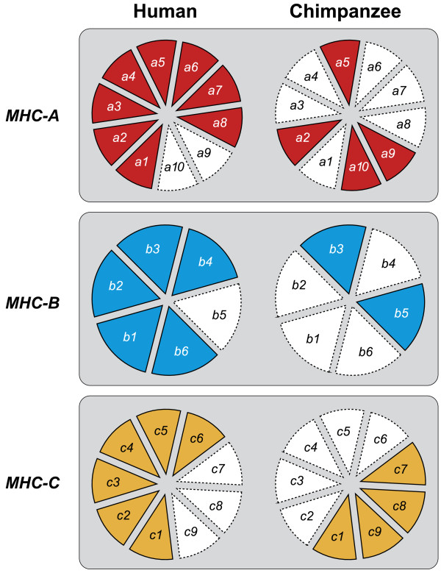
Big shifts in immune system genes in chimps cfd to humans – ancient response to SIV epidemic?

Slide 52
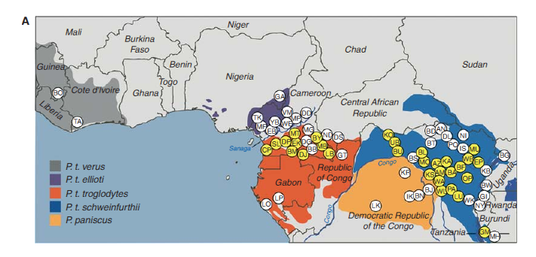
SIV (yellow) in chimpanzees: not everywhere

Slide 53
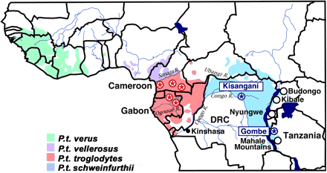
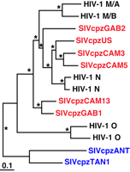
Simian immunodeficiency virus in wild chimps; two chimp forms give two human subtypes
(M is the abundant one)

Slide 54
Origin of HIV-1M from Cameroon chimp: population explosion in Kinshasa sparked off major epidemic

Slide 55
Effects of first drugs (1995) and high activity anti-retroviral therapy (1997) on HIV deaths
Notes:
The age-adjusted rate of death due to HIV disease increased almost linearly from 6 deaths per 100,000 population in 1987 to 17 deaths per 100,000 population in 1994 and 1995, then decreased to 7 deaths per 100,000 population in 1997, and almost leveled off at about 5 deaths per 100,000 after 1998. The age-adjusted HIV death rate decreased 28% from 1995 to 1996, 45% from 1996 to 1997, 18% from 1997 to 1998, and 3% or less in each of the next 4 years.
The decrease in the rate in 1996 and 1997 was largely due to improvements in antiretroviral therapy. Prophylactic medications for opportunistic infections and the prevention of HIV infection may also have contributed to this decrease. The leveling of the rate after 1998 may reflect a lack of access to or effectiveness of therapy among some persons. Possible reasons for this include delay in diagnosis of HIV infection until symptoms have occurred, inadequate treatment after diagnosis, difficulty in adherence to medication regimens, and development of viral resistance to therapy.
To eliminate the effect of changes in the age distribution of the population, rates have been adjusted to appear as though the age distribution of the population in every year was the same as that of the US population in 2000 (the Public Health Service standard for age-adjustment). For comparison with data for 1999 and later, data for the years before 1999 were modified to appear as if the underlying cause had been selected according to ICD-10 rules instead of ICD-9 rules.

Slide 56
Collapse (and recovery) of African life expectancy after the epidemic

Slide 57
Neglected emerging and re-emerging tropical diseases

Slide 58
Global intensity map of five major emerging and re-emerging diseases (dengue, rabies, cysticercosis, Chagas’ disease, trypanosomiasis)
Tim K. Mackey et al. Clin. Microbiol. Rev. 2014;27:949-979
Notes:
Global intensity map of EReNTD regions of endemicity. Data are from the World Health Organization (2013). We used the following definitions when coding the data for regions of endemicity for each EReNTD according to WHO data: dengue, most of the country is at risk for dengue; rabies, most of the country is at high risk for rabies; Chagas disease, the disease is present in the country; cysticercosis, the disease is reported as endemic in the country; human African trypanosomiasis, the disease is present in the country.

Slide 59
Global fertility – number of children per woman

Slide 60
Recent and future population growth (log scale)

Slide 61
“My dear, here we must run as fast as we can, just to stay in place. And if you wish to go anywhere you must run twice as fast as that.” Alice in Wonderland

Slide 65
Bottlenecks on transmission of HIV

