Slide 1
When Maths Doesn’t Work:
What we learn from the Prisoners’ Dilemma
Tony Mann, 16 February 2015

Slide 2
Paradoxes and Games
16 February – When Maths Doesn't Work: What we learn from the Prisoners' Dilemma
16 March – Two Losses Make a Win: How a Physicist Surprised Mathematicians

Slide 3
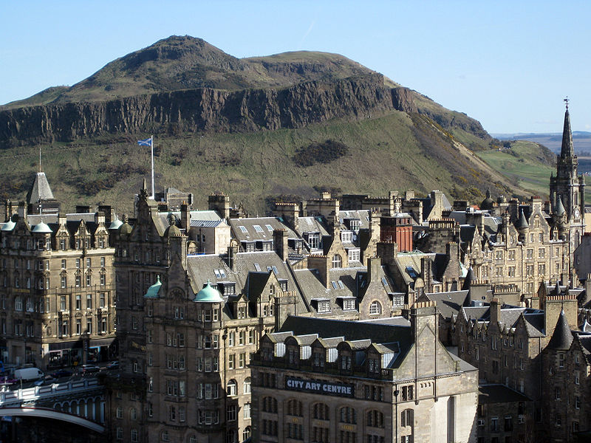
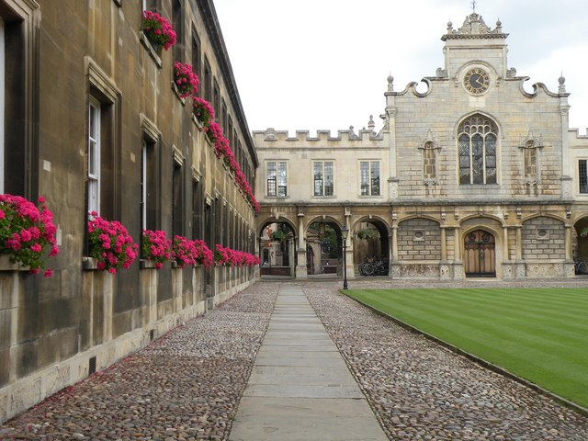
A personal account

Slide 4
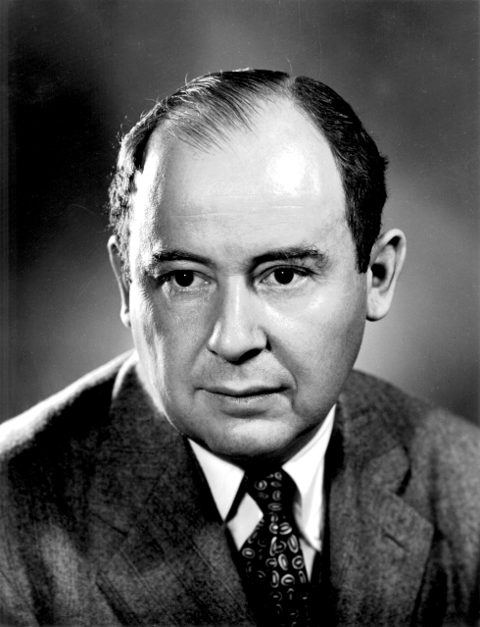
Theory of Games and Economic Behaviour
John von Neumann and Oskar Morgenstern, 1944

Slide 5
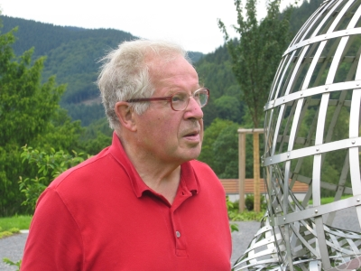
Sir Peter Swinnerton-Dyer
Lecture, Quintic Society, c.1976

Slide 6
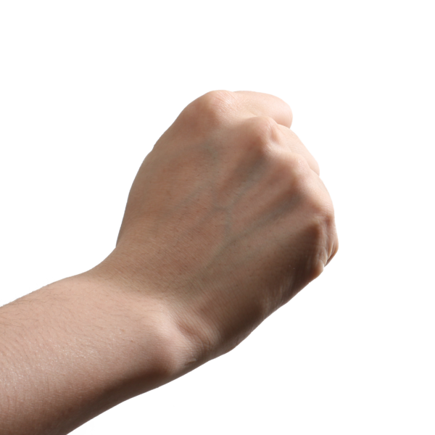
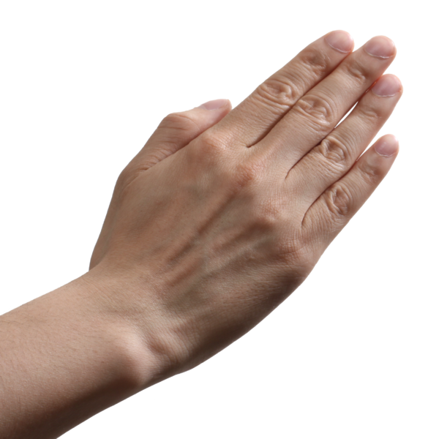
Rock, Paper, Scissors

Slide 7
Rock, Paper, Scissors
My choice | Opponent’s choice
 | Rock | Paper | Scissors
Rock | Draw | Lose | Win
Paper | Win | Draw | Lose
Scissors | Lose | Win | Draw

Slide 8
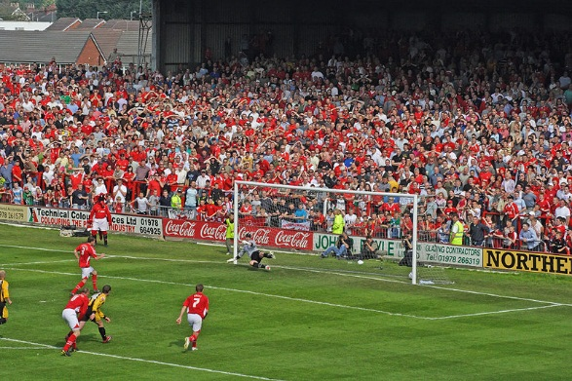
Penalty Kick

Slide 9
Penalty Kick
Striker’s choice | Goalkeeper’s choice
 | Goes left | Goes right | Waits
Left | 0.95 | 0.4 | 0.7
Right | 0.4 | 0.95 | 0.7

Slide 10
Rock, Paper, Scissors

Slide 11
Using Maths
Assume the worst
Opponent will exploit our strategy if they can
We want to minimise our maximum possible expected loss

Slide 12
Rock, Paper, Scissors
My choice | Opponent’s choice
 | Rock | Paper | Scissors
Rock | 0 | - 1 | 1
Paper | 1 | 0 | - 1
Scissors | - 1 | 1 | 0

Slide 13
My choice | Opponent’s choice
 | Rock | Paper | Scissors
Rock | 0 | - 1 | 1
Paper | 1 | 0 | - 1
Scissors | - 1 | 1 | 0
I choose Rock with probability ρ, Paper with probability π and Scissors with probability σ.
Assume ρ is bigger than either of the others
If my opponent plays Paper every time, my expected outcome is
1 x σ – 1 x ρ
which is negative
I do best to make ρ, π and σ all equal to 1/3.ρ,

Slide 14
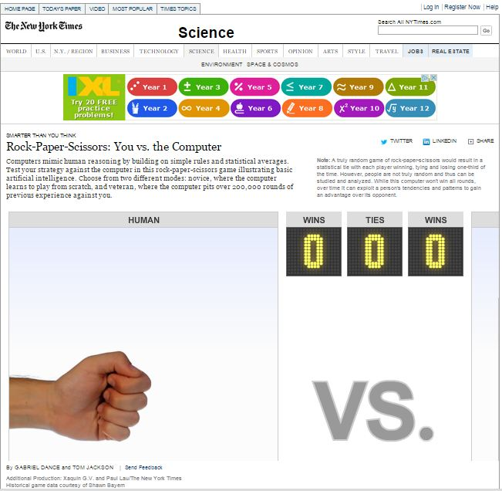
http://www.nytimes.com/interactive/science/rock-paper-scissors.html

Slide 15
Variants
French: Pierre, papier, ciseaux, puits
Well beats rock and scissors but loses to paper
German: Adds Bull which drinks well, eats paper, stabbed by scissors and crushed by rock ,

Slide 16
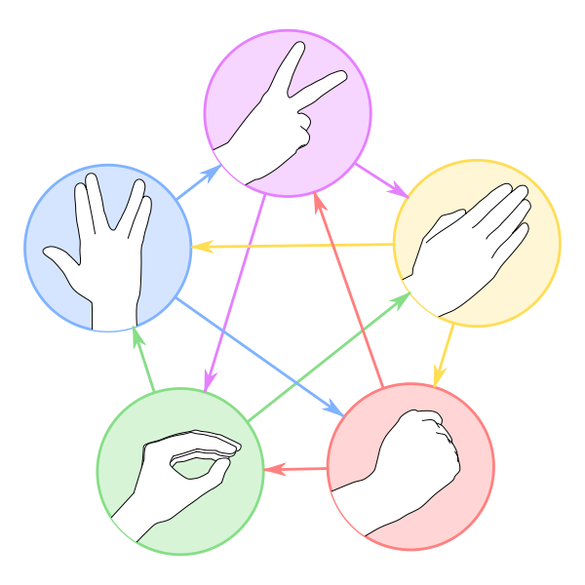
Rock – paper – scissors – lizard – Spock

Slide 17
Zero-Sum Games
Sum of both players’ outcomes is zero
One player’s winnings exactly match the other player’s loss

Slide 18
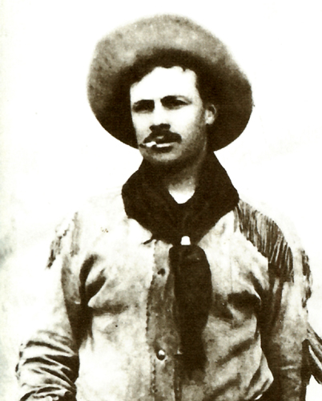
The Prisoners’ Dilemma
Sheriff seeking bank robbers
Arrests two cowboys
Offers each a deal

Slide 19
The Prisoners’ Dilemma
If neither admits crime, both get two years in gaol for another offence
If one admits it and implicates the other, he gets off with six months and other gets 20 years
If both admit it, 15 years each

Slide 20
Prisoner’s Dilemma
My choice | Partner’s choice
 | C (Co-operate) | D (Defect)
C (Co-operate) | -2 | -20
D (Defect) | -0.5 | -15

Slide 21
Prisoner’s Dilemma
My choice | Partner’s choice
 | C (Co-operate) | D (Defect)
C (Co-operate) | -2 | -20
D (Defect) | -0.5 | -15

Slide 22
The Prisoners’ Dilemma
Mathematician-cowboys get 15 years each
Non-mathematical cowboys get 2 years each

Slide 23
Examples of the Prisoners’ Dilemma
1970s wage demands and inflation
Whooping-cough vaccination

Slide 24
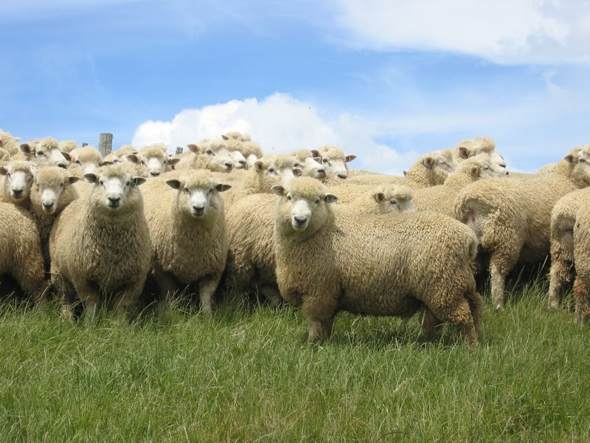
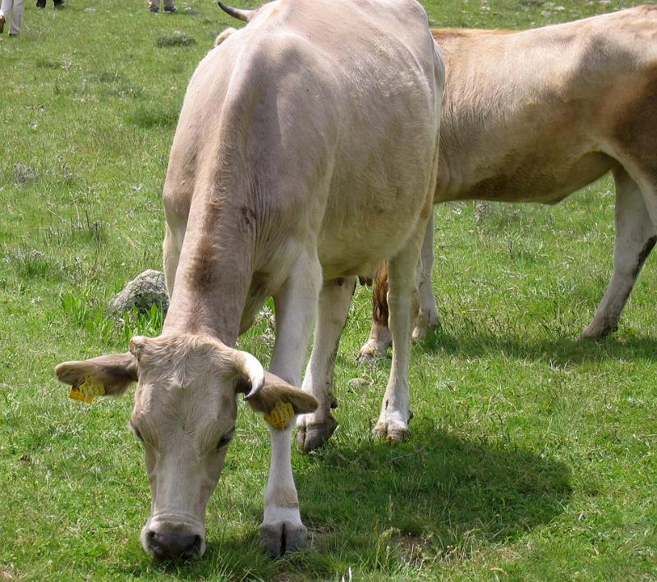
The Tragedy of the Commons

Slide 25
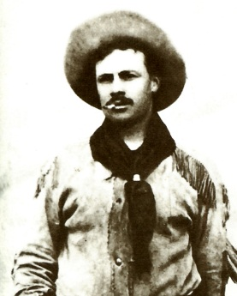
The Prisoners’ Dilemma
Maths doesn’t work?
It is rational to be selfish?
We need a nanny state?

Slide 26
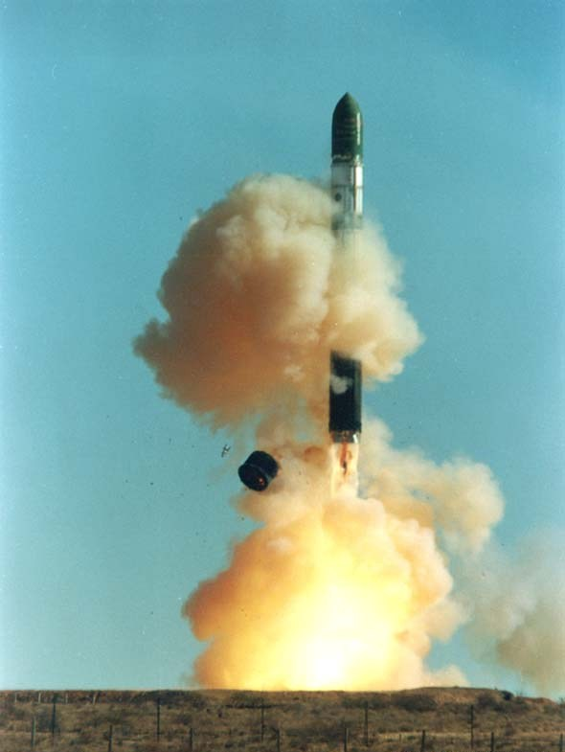
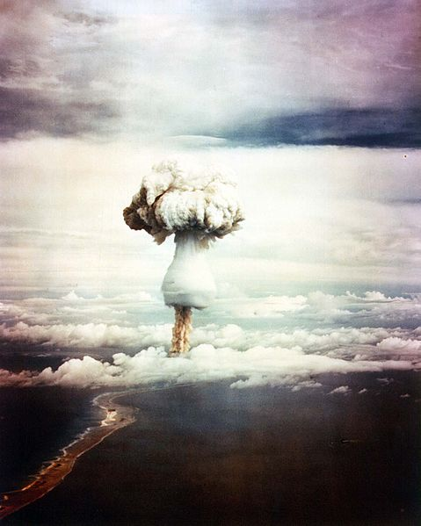
The Cold War

Slide 27
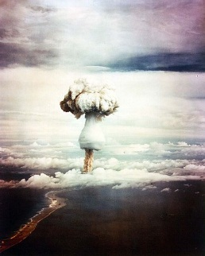
Cold War Arms Race
Us | Other superpower
 | Use resources for other things | Expand nuclear arsenal
Use resources for other things | Military stalemate: social benefits | Military disadvantage
Expand nuclear arsenal | Military advantage | Military stalemate: less social benefit

Slide 28
Cold War Arms Race
Us | Other superpower
 | Use resources for other things | Expand nuclear arsenal
Use resources for other things | Military stalemate: social benefits | Military disadvantage
Expand nuclear arsenal | Military advantage | Military stalemate: less social benefit

Slide 29
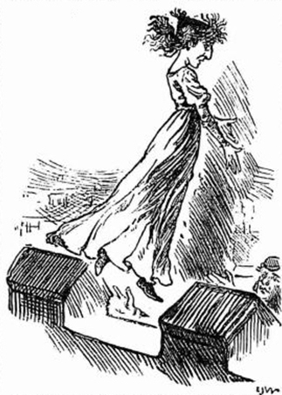
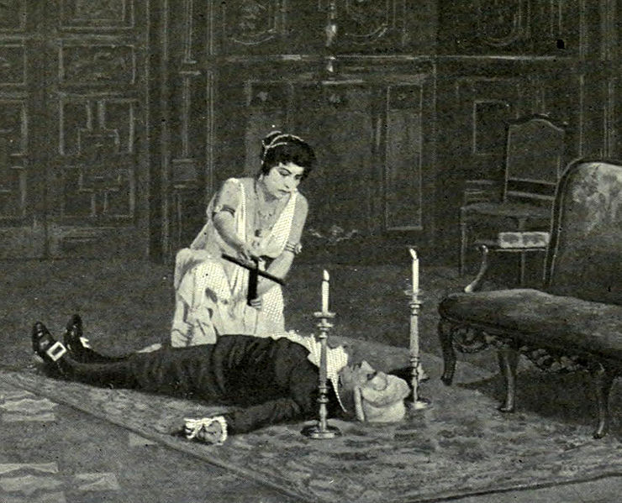
Tosca

Slide 30
Tosca
Tosca’s viewpoint
Tosca | Scarpia
 | Co-operate (fake bullets) | Defect (real bullets)
Co-operate (doesn’t kill Scarpia) | OK | Worst
Defect (kills Scarpia) | Best | Pretty bad

Slide 31
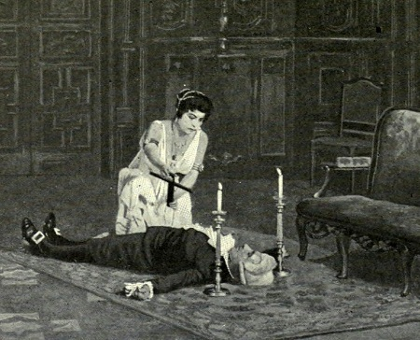
Tosca
Scarpia’s viewpoint
Scarpia | Tosca
 | Co-operate (doesn’t kill Scarpia) | Defect (kills Scarpia)
Co-operate (fake bullets) | OK | Worst
Defect (real bullets) | Best | Pretty bad

Slide 32
Tosca
Scarpia’s viewpoint
Scarpia | Tosca
 | Co-operate (doesn’t kill Scarpia) | Defect (kills Scarpia)
Co-operate (fake bullets) | OK | Worst
Defect (real bullets) | Best | Pretty bad

Slide 33
Prisoners’ Dilemmas

Slide 34
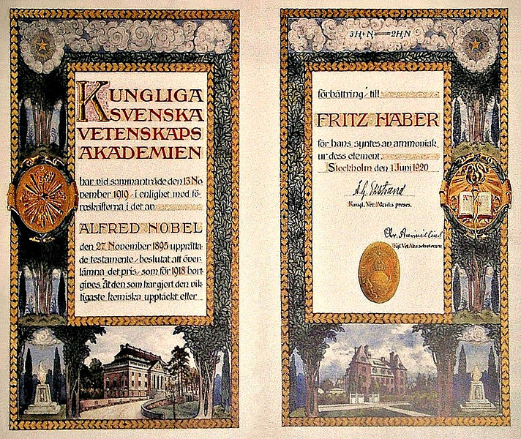
Nobel Prizes
Twelve game theorists have won a Nobel Prize

Slide 35
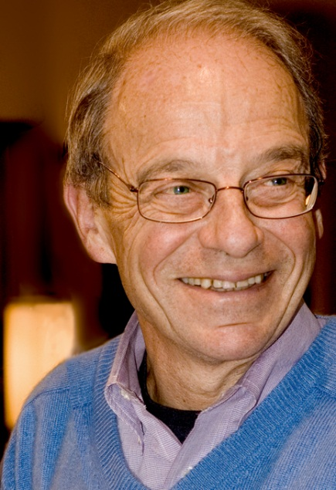
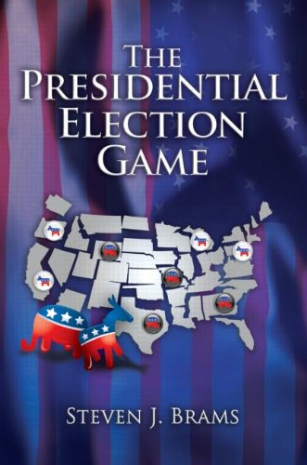
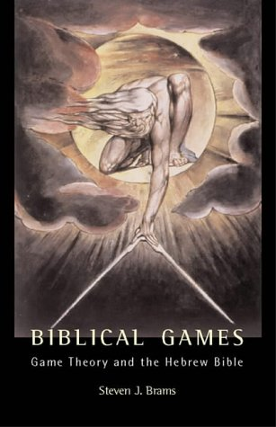
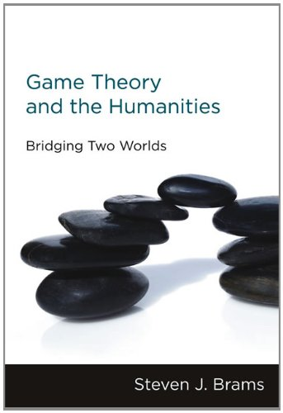
Steven J. Brams

Slide 36
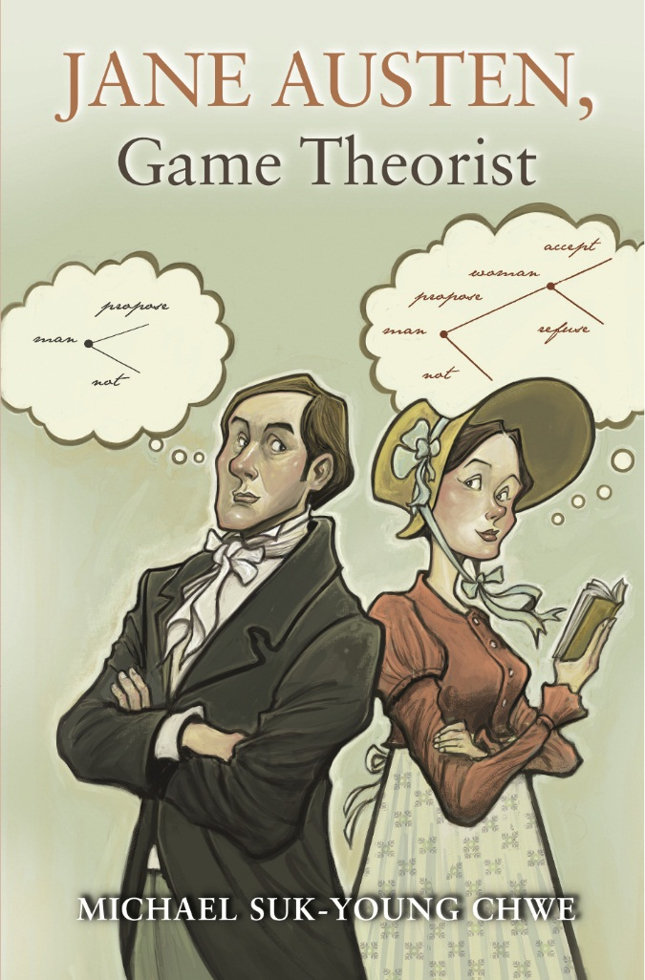
Jane Austen and Game Theory

Slide 37
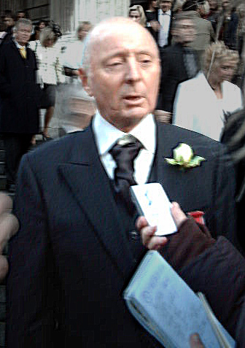
Golden Balls

Slide 38
Golden Balls
 | Opponent’s Choice
 | Split | Steal
Split | Half of Jackpot | 0
Steal | Whole of Jackpot | 0

Slide 39
Golden Balls
 | Opponent’s Choice
 | Split | Steal
Split | Half of Jackpot | 0
Steal | Whole of Jackpot | 0

Slide 40
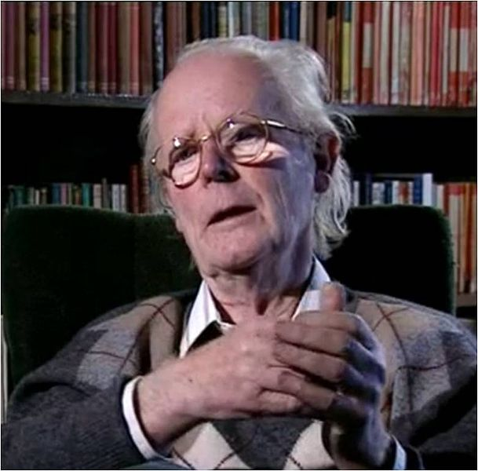
Biology

Slide 41
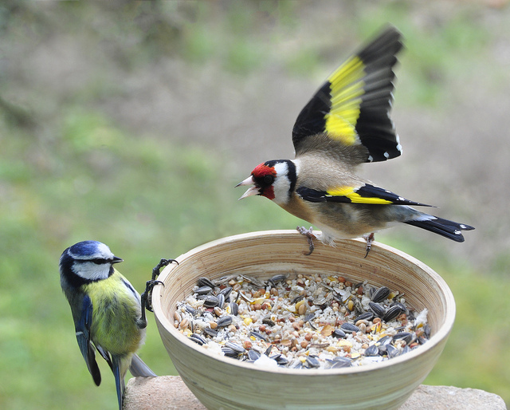
Birds

Slide 42
Hawks and Doves
Food worth 50 units
Birds may fight – loser suffers injury worth 100 units
Competitive display – cost 10 units to each bird
“Hawk” always fights, “dove” concedes food to a hawk

Slide 43
Hawks and Doves
 | Hawk | Dove
Hawk | ½ x 50 – ½ x 100 = – 25 | + 50
Dove | 0 | (½ x 50 + ½ x 0) – 10 = +15

Slide 44
Hawks and Doves
Evolutionary stable strategy: 58% are hawks
No incomers with a different strategy can exploit the colony

Slide 45
Robert Axelrod
Scientific American, May 1983
Iterated Prisoners’ Dilemma
Computer tournaments
Invited people to submit strategies

Slide 46
Winning Strategy
Anatol Rapoport’s Tit for Tat
Start by Co-operating
Then do whatever opponent did on previous round

Slide 47
Tit for Tat
Never outscores its immediate opponent!
But stimulates mutually rewarding behaviour from opponents

Slide 48
Tit for Tat
Nice – never first to defect
Forgiving – doesn’t bear grudges
Retaliatory – if you defect it defects back
Clear – easy for opponent to understand

Slide 49
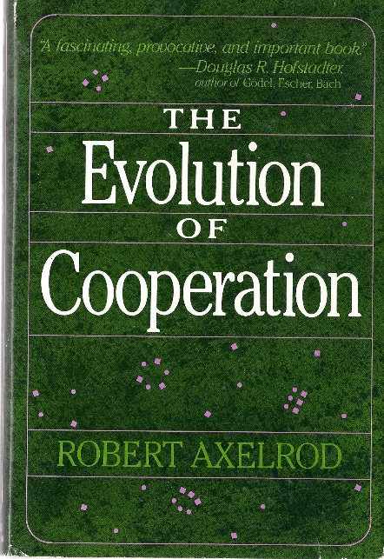
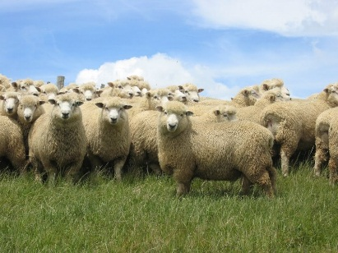
Game Theory
Rather than the Tragedy of the Commons defining the human condition,
the Prisoners’ Dilemma explains the evolution of co-operation

Slide 50
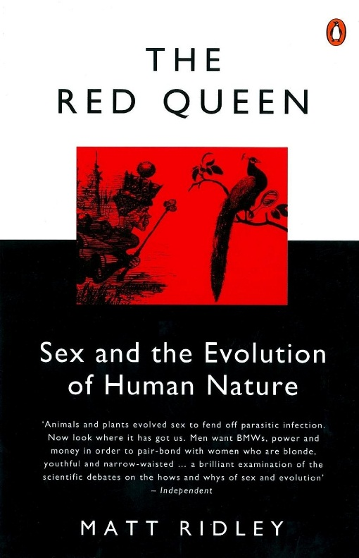
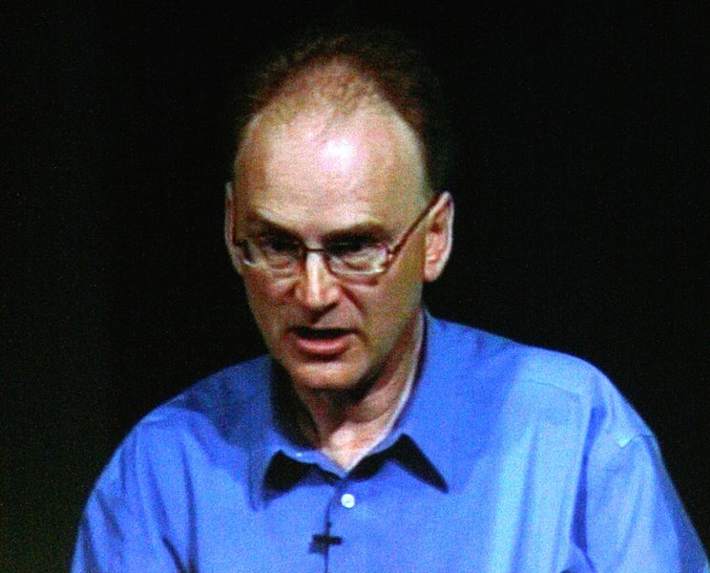
Matt Ridley

Slide 51
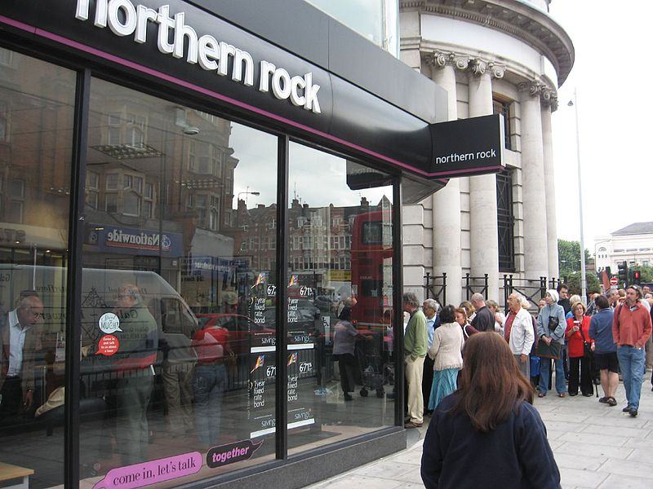
Matt Ridley

Slide 52
The Tragedy of the Commons

Slide 53
Matt Ridley

Slide 54
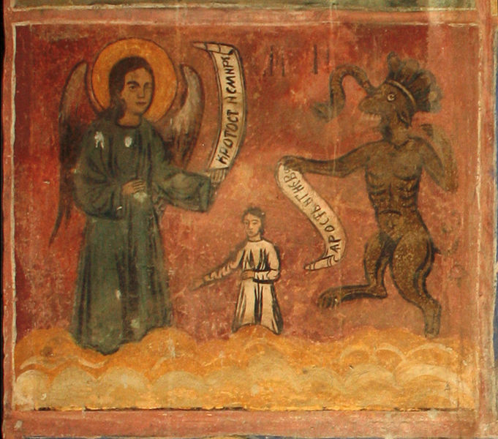
Anger

Slide 55
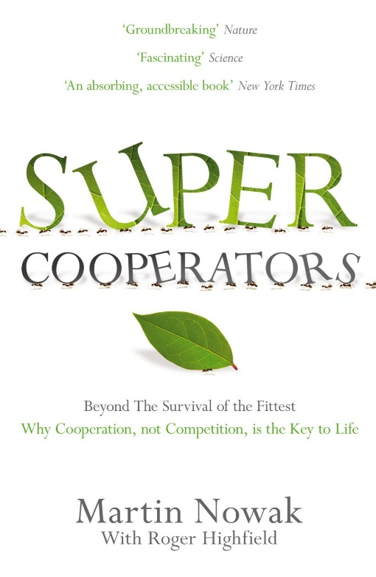
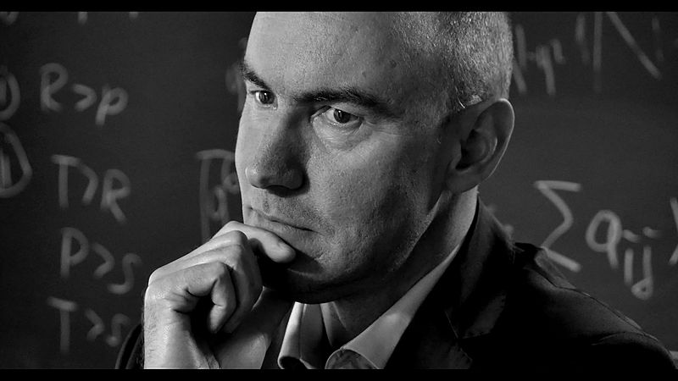
The Science of Co-operation

Slide 56
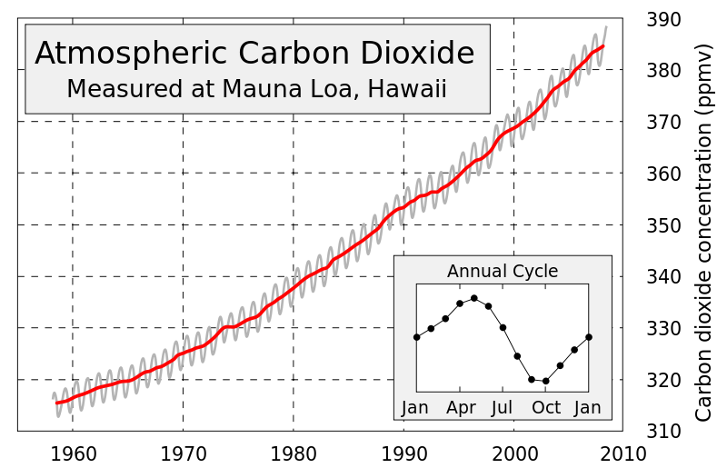
Our hope for international co-operation?

Slide 57
A Personal Story of the Prisoners’ Dilemma
A refutation of game theory?
A fascinating paradox?
Solution to the problem
of the evolution of altruism?
Tool for exploring co-operation?
Our best hope for the future?

Slide 58
The Prisoners’ Dilemma
“There’s still so much more left to find out. We have only explored a small subset of this extraordinary game … Our analysis of how to solve the Dilemma will never be completed. This Dilemma has no end.”
Martin Nowak

Slide 59
Thank you for listening
a.mann@gre.ac.uk
@Tony_Mann

Slide 60
Acknowledgments and picture credits
Thanks to Noel-Ann Bradshaw
and everyone at Gresham College
Slide design – Aoife Hunt
Picture credits
Images from Wikimedia Commons they are used under a Creative Commons licence: full details can be found at Wikimedia Commons
Photograph of lecturer: Noel-Ann Bradshaw; T-shirt: www.thinkgeek.com
Edinburgh: Tilmandralle, Wikimedia Commons, public domain
Peterhouse, Cambridge: Robert Edwards, Wikimedia Commons
University of Greenwich: University of Greenwich
John von Neumann: Los Angeles National Laboratory., Wikimedia Commons. http://www.lanl.gov/resources/web-policies/copyright-legal.php
Sir Peter Swinnerton-Dyer: Renate Schmid, Wikimedia Commons
Rock, paper, scissors: Photo by Fluff, modified by Sertion, Wikimedia Commons
Penalty kick by Ryan Valentine (Wrexham), 2007: Markbarnes, Wikimedia Commons
Rock, paper, scissors, lizard, spock: DMacks, Wikimedia Commons
Cowboy, sheriff, sheep, cows: Microsoft clip art
Greenhouse George mushroom cloud: National Nuclear Security Administration, public domain
Dnepr rocket: ISC Kosmotras, Wikimedia Commons
Tosca: EJ Wheeler cartoon, Punch 1888, public domain
Tosca and Scarpia – pre-1914 production, Metropolitan Opera House, New York, Wikipedia, public domain
Jasper Carrott: HugoVK, Wikimedia Commons
John Maynard Smith: Web of Stones, Wikimedia Commons
Nobel Prize: Wikimedia Commons, public domain
Steven J. Brams: Eva Brams, Wikimedia Commons
Matt Ridley: Tara Hunt, Wikimedia Commons
Northern Rock: Alex Gunningham, Wikimedia Commons
Anger: fresco from Saint Nicolas church in Cukovets, Bulgaria: Edal Anton Lefterov, Wikimedia Commons
Martin Nowak: Filip Antoni Malinowski, Wikimedia Commons
Mauna Loa Carbon Dioxide graph: Sémhur / Wikimedia Commons

Slide 61
Further Reading
John von Neumann and Oskar Morgenstern, Theory of Games and Economic Behaviour (Princeton, 60th anniversary edition, 2004)
Steven J. Brams, Game Theory and the Humanities: Bridging Two Worlds (MIT Press, 2011)
Robert Axelrod, The Evolution of Co-operation (Penguin 1990; Basic 2009)
Matt Ridley, The Origins of Virtue (Penguin, 1997)
Martin Nowak with Roger Highfield: Super Cooperators: Evolution, Altruism and Human Behaviour, or Why We Need Each Other to Succeed (Canongate, 2011)

