Slide 1
This is not my beautiful house…this is not my beautiful wife…
images and illusions of investment banking

Slide 2

Admiral General Aladeen – investment banker…

Slide 3

Lesson # 1
Know what you are looking for…

Slide 4
So what IS an investment bank?
Advisory – Led
Agency – Based
Markets - Centric

Slide 5

Lesson # 2 - Be observant!

Slide 6

The Universal Banking model…

Slide 7

Bowled out in interview # 2

Slide 8
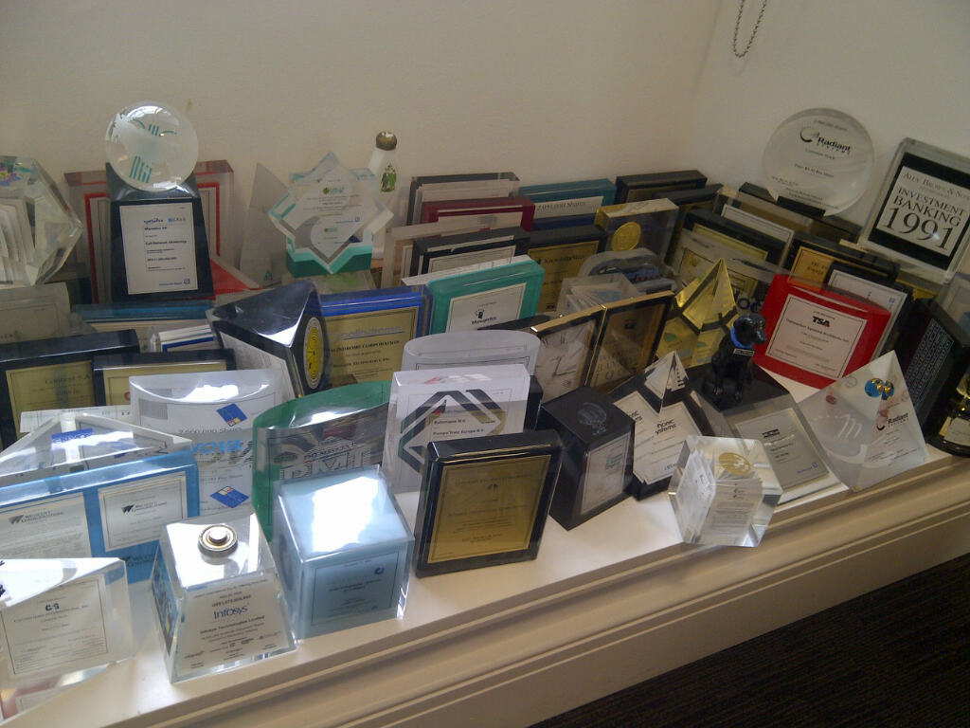
Lesson # 3 – Have fun!

Slide 9
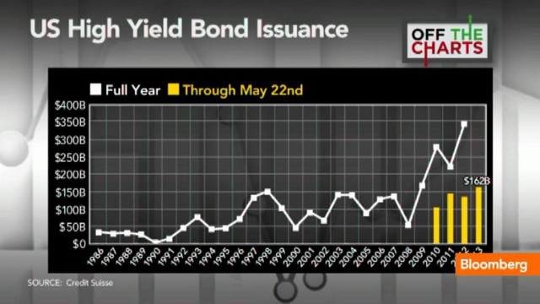
Debt issuance surges…

Slide 10

What could possibly go wrong…?

Slide 11
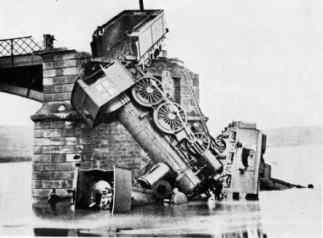
This did not end well

Slide 12


New Requirements…

Slide 13
An investment bank now is:
Advisory – led
Agency – based
Markets – centric
Global in outlook and execution
Capital-intensive, albeit episodically

Slide 14
Classic investment banking is a large market

Slide 15
Lesson # 4 – remember Lesson # 3
Add value to clients!
Have fun!

Slide 16
This is not my beautiful house…this is not my beautiful wife…
images and illusions of investment banking

