Slide 1
Hamilton, Boole and their Algebras
Raymond Flood
Gresham Professor of Geometry

Slide 2
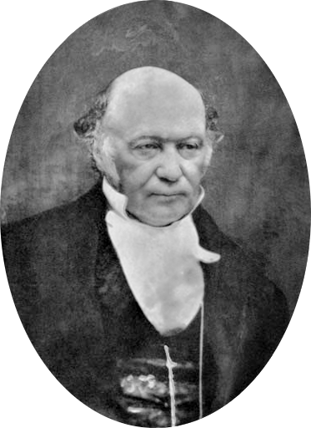
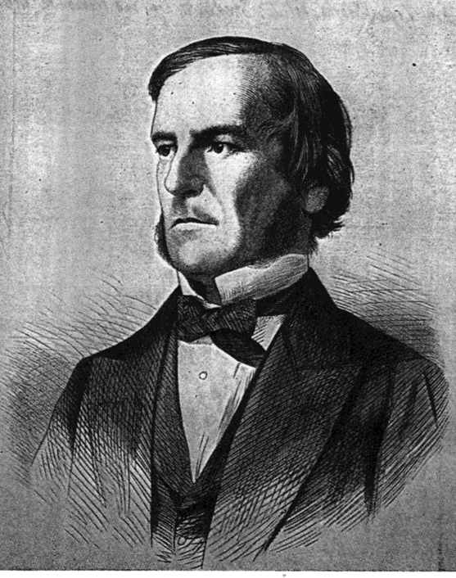
Hamilton, Boole and their Algebras
William Rowan Hamilton 1805–1865
$ij = −ji$
George Boole 1815–1864
$x^{2}$ $=x$

Slide 3
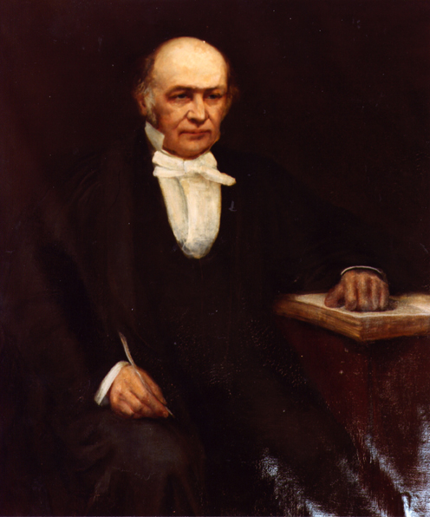
William Rowan Hamilton 1805–1865

Slide 4
William Rowan Hamilton 1805–1865
One thing only have I to regret in the direction of my studies, that they should be diverted – or rather, rudely forced – by the College Course from their natural bent and favourite channel. That bent, you know is Science – Science in its most exalted heights, in its most secret recesses. It has so captivated me - so seized on …. My affections – that my attention to Classical studies is an effort and an irksome one.”
Letter to his sister Eliza 1823

Slide 5
Trinity College, Dublin
Dunsink Observatory

Slide 6
Conical Refraction Hamilton’s prediction of the behaviour of a ray of light passed through a prism with biaxial symmetry
Humphrey Lloyd
1800–81

Slide 7
$$\sqrt{−1}$$

Slide 8
$$\sqrt{−1}$$
Leonhard Euler:
Of such numbers we may truly assert that they are neither nothing, nor greater than nothing, nor less than nothing, which necessarily constitutes them imaginary or impossible.
.

Slide 9
$$\sqrt{−1}$$
Leonhard Euler:
Of such numbers we may truly assert that they are neither nothing, nor greater than nothing, nor less than nothing, which necessarily constitutes them imaginary or impossible.
Augustus de Morgan:
We have shown the symbol $\sqrt{−1}$to be void of meaning, or rather self-contradictory and absurd.
.

Slide 10
Suppose that we try to calculate with the symbol $\sqrt{−1}$
We find that addition is easy:
(2 + 3$\sqrt{−1}$) + (4 + 5$\sqrt{−1}$) = 6 + 8$\sqrt{−1}$

Slide 11
Suppose that we try to calculate with the symbol $\sqrt{−1}$
We find that addition is easy:
(2 + 3$\sqrt{−1}$) + (4 + 5$\sqrt{−1}$) = 6 + 8$\sqrt{−1}$
And so is multiplication (replacing $\sqrt{−1}$ x $\sqrt{−1}$whenever it appears by $−1)$
(2 + 3$\sqrt{−1}$) x (4 + 5$\sqrt{−1}$)
= (2 x 4) + (3$\sqrt{−1}$ x 4) + (2 x 5$\sqrt{−1}$) + (15 x $\sqrt{−1}$ x $\sqrt{−1}$)
= (8 $−$ 15) + (12 +10)$\sqrt{−1}$= $−$7 + 22$\sqrt{−1}$

Slide 12
We call the object a + b$\sqrt{−1}$ a complex number
the number a is its real part, and the number b is its imaginary part
Nowadays, we usually use the letter i to mean $\sqrt{−1}$
so that i² = $−$1

Slide 13
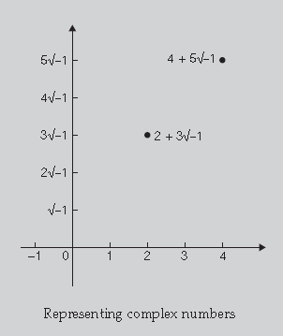
Representing Complex numbers geometrically
Caspar Wessel in 1799
In this representation, called the complex plane, two axes are drawn at right angles – the real axis and the imaginary axis – and the complex number a + b $\sqrt{−1}$ is represented by the point at a distance a in the direction of the real axis and at height b in the direction of the imaginary axis.

Slide 14
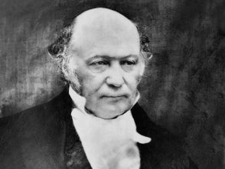
Is there any other algebraic representation of complex numbers that reveals all valid operations on them?

Slide 15
Is there any other algebraic representation of complex numbers that reveals all valid operations on them?
We define a complex number as a pair (a, b) of real numbers.

Slide 16
Is there any other algebraic representation of complex numbers that reveals all valid operations on them?
We define a complex number as a pair (a, b) of real numbers.
They are added as follows: (a, b) + (c, d) = (a + c, b + d);

Slide 17
Is there any other algebraic representation of complex numbers that reveals all valid operations on them?
We define a complex number as a pair (a, b) of real numbers
They are added as follows: (a, b) + (c, d) = (a + c, b + d)
They are multiplied as follows: (a, b) x (c, d) = (ac - bd, ad + bc)

Slide 18
Is there any other algebraic representation of complex numbers that reveals all valid operations on them?
We define a complex number as a pair (a, b) of real numbers
They are added as follows: (a, b) + (c, d) = (a + c, b + d)
They are multiplied as follows: (a, b) x (c, d) = (ac - bd, ad + bc)
The pair (a, 0) then corresponds to the real number a
the pair (0, 1) corresponds to the imaginary number i
Then (0, 1) x (0, 1) = (-1, 0)
which corresponds to the equation
i x i = - 1

Slide 19
Triadic fancies
Hamilton now looked at number triples such as (a, b, c)
He wrote them as: a + bi + cj where i² = j² = $−$1
Addition was easy:
(1 + 2i + 3j) + (4 + 5i + 6j) = (1 + 4) + (2i + 5i) + (3j + 6j)
= 5 + 7i + 9j

Slide 20
How to multiply triples?
How could we define (1 + 2i + 3j) x (4 + 5i + 6j)?
If we multiply them out in the analogous way to complex numbers and use i² = j² = $−$1 we obtain
(4 – 10 – 18) + (5 + 8)i + (6 + 12)j + (12 + 15)ij
What is this term ij?

Slide 21
Every morning on my coming down to breakfast, your brother William Edwin and yourself used to ask me. ‘Well, Papa, can you multiply triplets?’ Whereto I was always obliged to reply, with a sad shake of the head ‘No, I can only add and subtract them’

Slide 22
Division law
If D, E are triples with D non zero
then there must be a triple X so that
D multiplied by X equals E
We can think of this as meaning that D divides E
Examples: 3 x $\frac{17}{3}$ = 17 and (1 + i)x(1 – i)/2 = 1

Slide 23
The law of the modulus
The modulus of a + bi + cj is just $\sqrt{a^{2}+ b^{2}+ c^{2}}$
Hamilton wanted his method of multiplication to have the following property:
the modulus of (a + bi + cj)(x + yi + zj) equals the modulus of (a + bi + cj) times the modulus of (x + yi + zj)

Slide 24
i² = j² = k² =ijk = $−$1
16th October 1843

Slide 25
Quaternions a + bi + cj + dk where i² = j² = k² =ijk = -1

Slide 26
Quaternions a + bi + cj + dk where i² = j² = k² =ijk = –1
ijk = –1
ijkk = –k
–ij = –k
ij = k

Slide 27
Quaternions a + bi + cj + dk where i² = j² = k² =ijk = –1
ijk = –1
ijkk = –k
–ij = –k
ij = k
ijk = –1
jiijk = –ji
–jjk = –ji
k = –ji

Slide 28
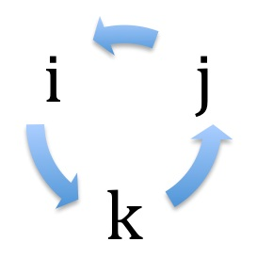
(a + bi + cj + dk)(w + xi + yj + zk)
Clockwise
ij = k, jk = i, ki = j
Anticlockwise
ji = –k, ik = – j, kj = – i

Slide 29
And how the One of Time,
of Space the Three,
Might in the Chain of Symbols girdled be

Slide 30
A quaternion has a “scalar” and “vector” part
If q₁ and q₂ are two quaternions with no scalar terms
then “scalar” part of q₁q₂ is the negative of the dot product of the vectors q₁ and q₂
while the “vector” part of q₁q₂ is the vector product of the vectors q₁ and q₂

Slide 31
Vince, J (2011). Quaternions for Computer Graphics. 1st. ed. London: Springer
Quaternions can be used to achieve the transformation of any directed line in three dimensions to any other directed line which is why they are of use in computer graphics.

Slide 32
George Boole 1815–64
J.M.W. Turner, Cathedral Church at Lincoln, 1795

Slide 33
Appointed Professor of Mathematics at Cork, 1849

Slide 34
Boole’s Laws of Thought

Slide 35
Boole: A new algebra
Let the symbol x denote the class of all white things
And the symbol y denote the class of all sheep
Then he used the compound symbol xy to denote the class of all white sheep

Slide 36
Boole: A new algebra
Let the symbol x denote the class of all white things
And the symbol y denote the class of all sheep
Then he used the compound symbol xy to denote the class of all white sheep
And if z denotes the class of all horned things
then
zxy = all horned white sheep

Slide 37
Boole: A new algebra
Again if x = all white things
And y = all sheep
Then xy = yx
Since the class of all white things that are sheep is the same as the class of all sheep that are white

Slide 38
Boole: A new algebra
If every member of class x (say being a man) is also a member of class y (say being human) then
xy = x
and in the special case when x and y are the same
xx = x

Slide 39
Boole: A new algebra
If every member of class x (say being a man) is also a member of class y (say being human) then
xy = x
and in the special case when x and y are the same
xx = x
or using the analogy of multiplication of numbers we can write
x² = x
for all classes x

Slide 40
Addition
If x and y are classes,
x + y
denotes the class of all objects which belong to class x or to class y.
if x is the class of all women and y is the class of all men then x + y is the class of all humans.
Then once again we have commutativity as
x + y = y + x
We have other results similar to what we see in arithmetic, for example
z(x + y) = zx + zy
If z is the class of all Europeans then the left hand side is the class of all European humans while the right hand side is the class of European women or European men.

Slide 41
Universal and empty class
Boole also used the symbol 1 to denote the universal class, the symbol 0 for the empty class and he wrote 1 – x for the class of all objects not in x.
If x = all white things
Then (1- x) = all things not white
Since objects cannot be white and not white at the same time
x(1 – x) = 0
or x – x² = 0
or x² = x as before

Slide 42
Symbolic Algebra
All As are B, all Bs are C: therefore all As are C
Let a equal the class of all As
Let b equal the class of all Bs
Let c equal the class of all Cs
In Boole’s notation the hypotheses are
a = ab and b = bc
Then by substitution a = ab = a(bc) = (ab)c = ac so
a = ac so all As are C

Slide 43
Claude Shannon 1916–2001

Slide 44
Shannon says that the hindrance between two points a and b on a circuit is 0 if current can flow and 1 otherwise
If the switch between a and b is closed the hindrance is 0 and if open the hindrance is 1
The hindrance of two switches X and Y in series is written X + Y
The hindrance of two switches X and Y in parallel is written XY

Slide 45
Shannon says that the hindrance between two points a and b on a circuit is 0 if current can flow and 1 otherwise
If the switch between a and b is closed the hindrance is 0 and if open the hindrance is 1
The hindrance of two switches X and Y in series is written X + Y
The hindrance of two switches X and Y in parallel is written XY
Postulates:
a closed circuit in series with an open circuit is an open circuit
a closed circuit in parallel with an open circuit is a closed circuit

Slide 51
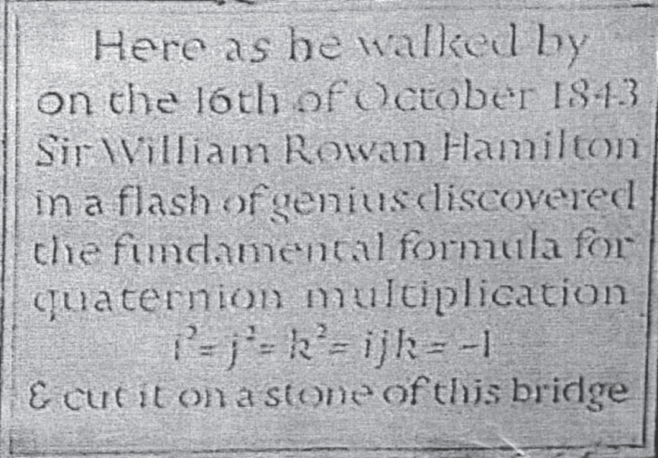
Memorials

Slide 52
Hamilton
Boole
http://www.maths.tcd.ie/pub/HistMath/People/Hamilton/
Des McHale, George Boole, A Prelude to the Digital Age,
Cork University Press, 2015

Slide 53
1 pm on Tuesdays at the Museum of London
Einstein’s Annus Mirabilis, 1905
Tuesday 20 October 2015
Hamilton, Boole and their Algebras
Tuesday 17 November 2015
Babbage and Lovelace
Tuesday 19 January 2016
Gauss and Germain
Tuesday 16 February 2016
Hardy, Littlewood and Ramanujan
Tuesday 15 March 2016
Turing and von Neumann
Tuesday 19 April 2016

