Slide 1
Möbius and his Band
Raymond Flood
Gresham Professor of Geometry

Slide 2
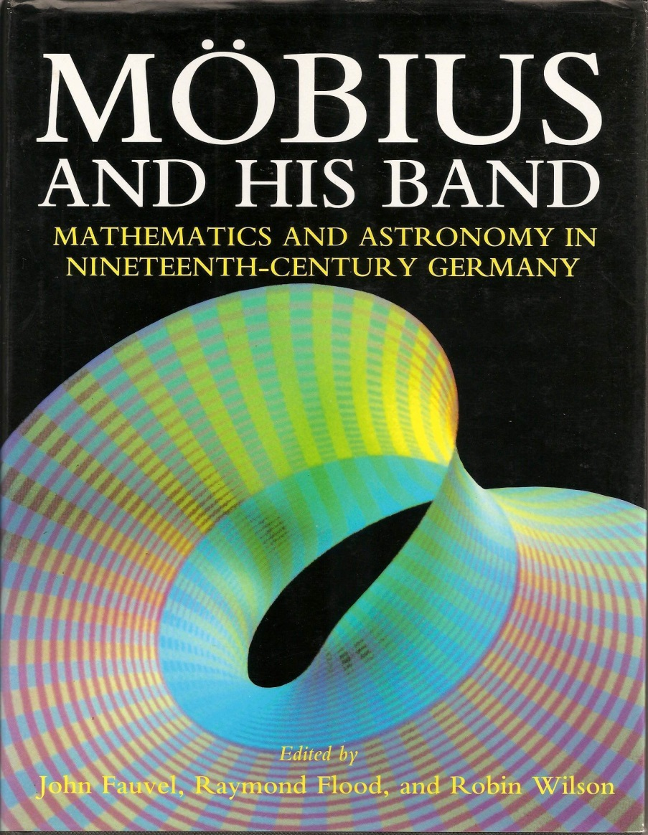
August Ferdinand Möbius 1790 – 1868
Overview
A Saxon mathematician
Five princes, functions and transformations
Möbius Band - one and two sided surfaces
Cutting up!
Klein bottle
Projective geometry

Slide 3
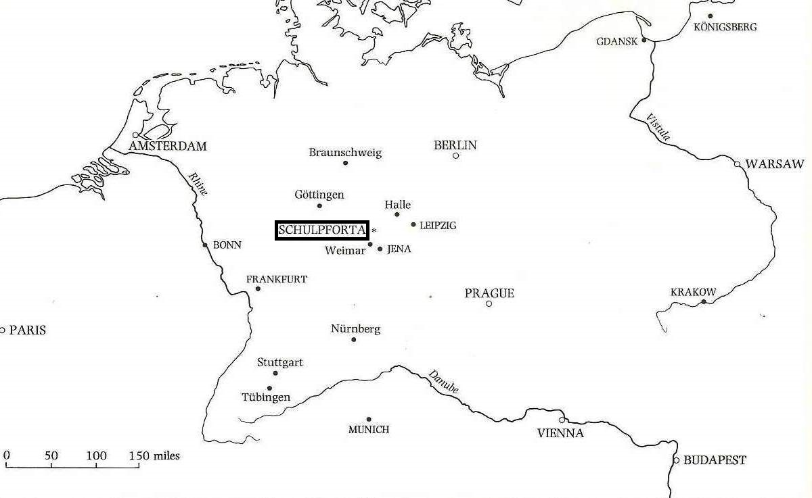
August Ferdinand Möbius 1790 – 1868
1790 Born in Schulpforta, Saxony
1809 Student at Leipzig University
1813–4 Travelled to Göttingen (Gauss)
1815 Wrote doctoral thesis on The occultations of fixed stars
1816 Appointed Extraordinary Professor of Astronomy at Leipzig

Slide 4
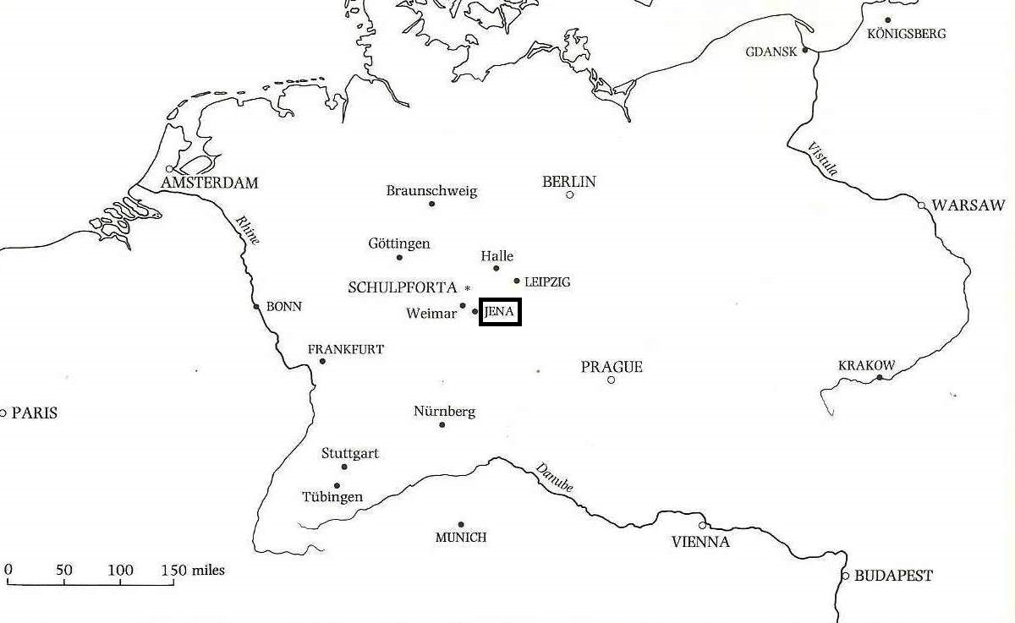
August Ferdinand Möbius 1790 – 1868
1790 Born in Schulpforta, Saxony
1809 Student at Leipzig University
1813–4 Travelled to Göttingen (Gauss)
1815 Wrote doctoral thesis on The occultations of fixed stars
1816 Appointed Extraordinary Professor of Astronomy at Leipzig
French troops presenting the captured Prussian standards to Napoleon after the battle of Jena

Slide 5
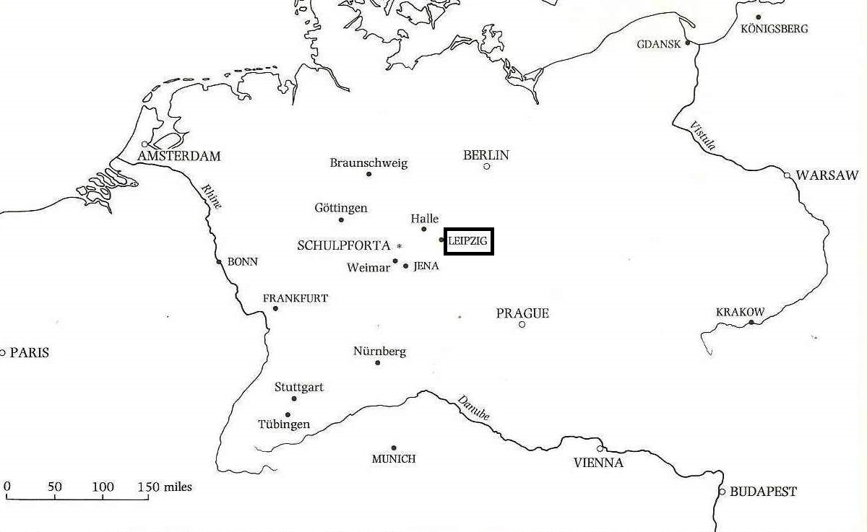
1790 Born in Schulpforta, Saxony
1809 Student at Leipzig University
1813–4 Travelled to Göttingen (Gauss)
1815 Wrote doctoral thesis on The occultations of fixed stars
1816 Appointed Extraordinary Professor of Astronomy at Leipzig
The market square, Leipzig, in an engraving of 1712. The university is at the top of the picture.

Slide 6
1818–21 Leipzig Observatory developed under his supervision
1844 Appointed Full Professor in Astronomy, Leipzig
1848 Appointed Director of the Observatory
1868 Died on 26 September in Leipzig
Leipzig Observatory (1909)

Slide 7
THE FIVE PRINCES
In his classes at Leipzig around 1840, Möbius asked the following question of his students:
There was once a king with five sons. In his will he stated that after his death the sons should divide the kingdom into five regions in such a way that each one should share part of its boundary with each of the other four regions. Can the terms of the will be satisfied?
This is one of the earliest problems from the area of mathematics now known as topology. The answer to the question is no.

Slide 8
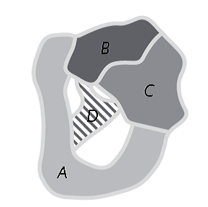
THE FIVE PRINCES
In his classes at Leipzig around 1840, Möbius asked the following question of his students:
There was once a king with five sons. In his will he stated that after his death the sons should divide the kingdom into five regions in such a way that each one should share part of its boundary with each of the other four regions. Can the terms of the will be satisfied?
This is one of the earliest problems from the area of mathematics now known as topology. The answer to the question is no.

Slide 9
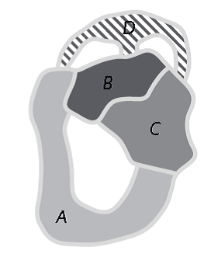
THE FIVE PRINCES
In his classes at Leipzig around 1840, Möbius asked the following question of his students:
There was once a king with five sons. In his will he stated that after his death the sons should divide the kingdom into five regions in such a way that each one should share part of its boundary with each of the other four regions. Can the terms of the will be satisfied?
This is one of the earliest problems from the area of mathematics now known as topology. The answer to the question is no.
From R.J. Wilson Four Colours Suffice

Slide 11
Cylinder and Torus

Slide 12
Möbius band

Slide 13
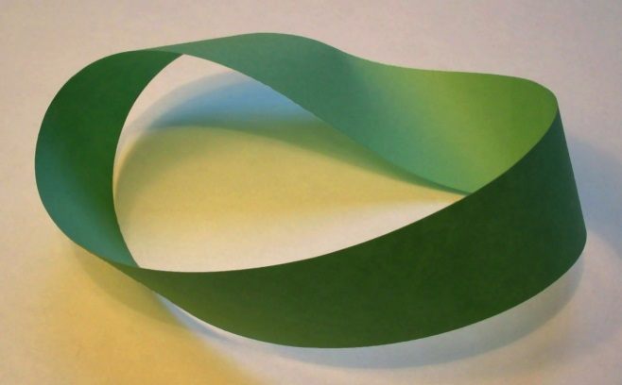
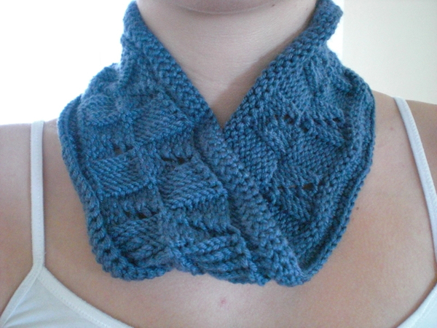
Möbius band

Slide 14
M.C. Escher‘s Möbius’s Strip II (1963)
Gary Anderson in 1970 (right) and his original design of the recycling logo.

Slide 15
Johann Benedict Listing 1808 - 1882
He wrote the book Vorstudien zur Topologie in 1847. It was the first published use of the word topology
In 1858 he discovered the properties of the Möbius band shortly before, and independently of, Möbius

Slide 16
Stigler’s Law: No scientific discovery is named after its original discoverer

Slide 17
Stigler’s Law: No scientific discovery is named after its original discoverer
Stigler named the sociologist Robert K. Merton as the discoverer of "Stigler's law“. This ensures his law satisfied what it said!

Slide 18
The Möbius band is not orientable

Slide 19
The Möbius band is not orientable

Slide 20
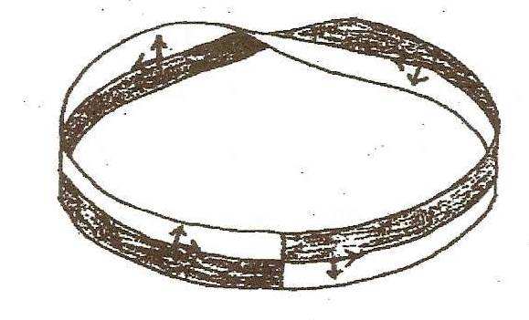
The Möbius band is not orientable

Slide 21
Bisecting the cylinder

Slide 22
Bisecting the Möbius band

Slide 23
Bisecting the Möbius band
A mathematician confided
That a Möbius band is one-sided
And you’ll get quite a laugh
If you cut one in half,
For it stays in one piece when divided
Anonymous

Slide 24
Bisecting the Möbius band

Slide 25
Bisecting the Möbius band

Slide 26
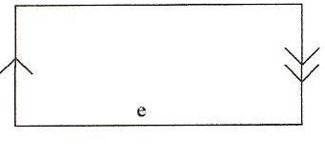
Bisecting the Möbius band
Flip the right hand rectangle so that double arrows match up

Slide 27
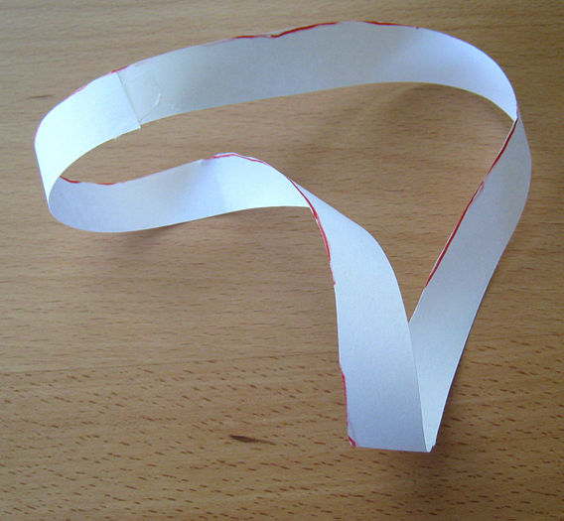
Bisecting the Möbius band
Flip the right hand rectangle so that double arrows match up
Join up single arrows to get a cylinder, two sided with two edges

Slide 28
Cutting the Möbius band from a third of the way in

Slide 29
Cutting the Möbius band from a third of the way in
This middle one is a Möbius band

Slide 30
Cutting the Möbius band from a third of the way in
This middle one is a Möbius band
Top and bottom rectangle
Flip the top one and join to get a cylinder

Slide 31
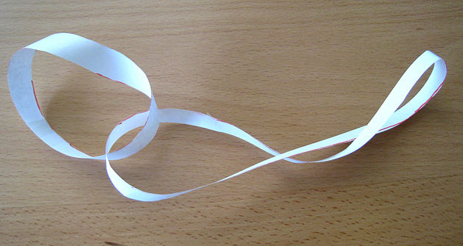
Cutting the Möbius band from a third of the way in
This middle one is a Möbius band
Top and bottom rectangle
Flip the top one and join to get a cylinder

Slide 32
Why are the cylinder and Möbius band interlinked?

Slide 33
Bisecting when there are two half twists
In general if you bisect a strip with an even number, n, of half twists you get two loops each with n half-twists. So as here a loop with 2 half-twists splits into two loops each with 2 half-twists

Slide 34
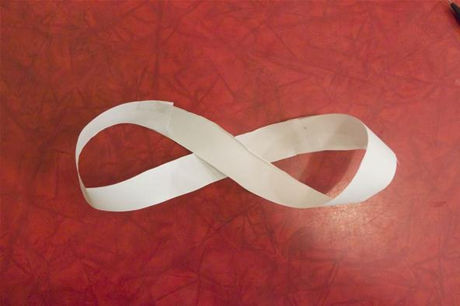
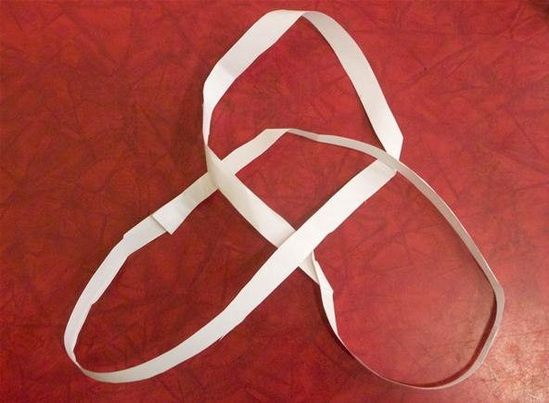
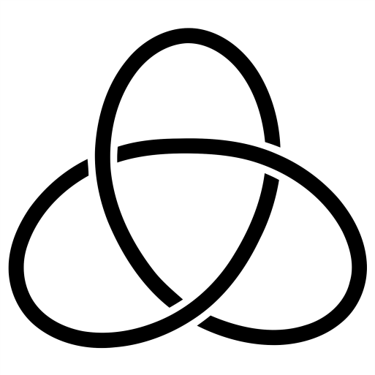
Bisecting when there are three half twists
A loop with 3 half twists gives a loop, a trefoil knot with 8 half twists.
In general when n is odd, you get one loop with 2n + 2 half-twists.

Slide 35
Immortality by John Robinson, sculptor, 1935–2007
Centre for the Popularisation of Mathematics
University of Wales, Bangor
http://www.popmath.org.uk/centre/index.html

Slide 36
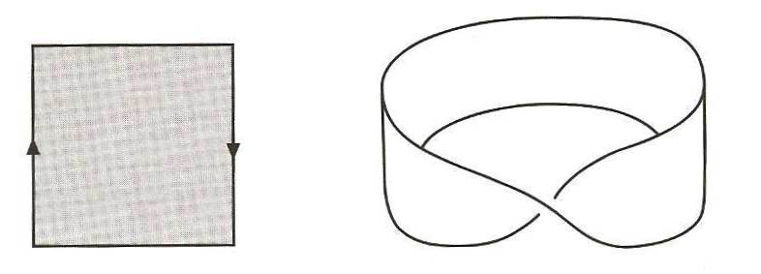
Cylinder, Torus and Möbius band

Slide 37
Klein Bottle

Slide 38
Klein Bottle

Slide 39
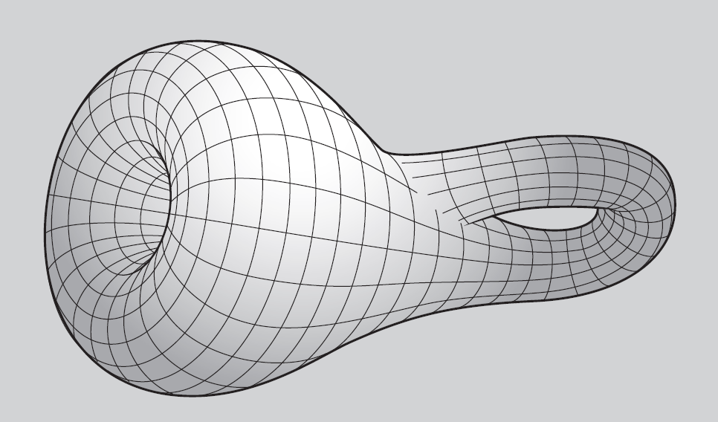
Klein Bottle

Slide 40
Non intersecting

Slide 41
Non intersecting
A mathematician named Klein
Thought the Möbius band was divine.
Said he: “If you glue
the edges of two,
You’ll get a weird bottle like mine.”
Leo Moser

Slide 42
Projective Plane

Slide 43
Projective Plane
Parallel lines meeting at infinity

Slide 44
Barycentric coordinates – 1827 (the barycentre is the centre of mass or gravity)
Example: point P = [2, 3, 5] = [20, 30, 50]
In general, if not all the weights are zero, a point is all triples [ka, kb, kc] for any non-zero k

Slide 45
Points at infinity
Every Cartesian point in the plane can be described by barycentric coordinates. These are the barycentric coordinates [a, b, c] with a + b + c is not zero.
But what about points with barycentric coordinates [a, b, c] where a + b+ c is zero?
Möbius called these extra points as points lying at infinity – each one of these extra points them corresponds to the direction of a family of parallel lines.

Slide 46
Light from a point source L projects the point P and the line l on the first screen to the point P′ and the line l′ on the second screen.

Slide 47
An example in which the intersecting lines PN and QN on the first screen are projected to parallel lines on the second screen.

Slide 48
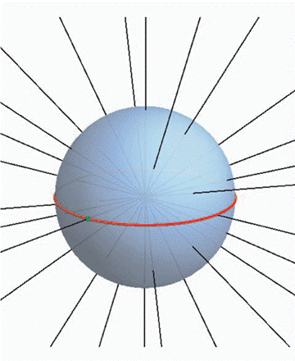
Projective Plane
Point corresponds to a triple of weights so is triples of numbers [a, b, c] defined up to multiples
Now think of these triples of numbers
[a, b, c] as a line through the origin in ordinary three dimensional Euclidean space
So a point in projective space is a line in three dimension Euclidean space.
Similarly a line in projective space is a plane through the origin in Euclidean space

Slide 49
Duality
In projective space
Any two points determine a unique line
Any two lines determine a unique point
This duality between points and lines means that any result concerning points lying on lines can be ‘dualized’ into another one about lines passing through points and conversely.
One duality between Points and lines in the projective plane is the association:
[a, b, c] ↔ ax + by + cz

Slide 50
Projective Plane as a rectangle with sides identified

Slide 51
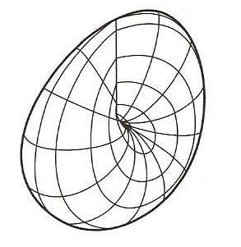
Classification of non-orientable surfaces
A family of one sided surfaces without boundary can be constructed by taking a sphere, cutting discs out of it and gluing in Möbius Bands instead of the discs.
Projective plane is a sphere with one Möbius band glued onto it
Klein bottle is a sphere with two Möbius bands glued onto it

Slide 52
Möbius’s legacy
His mathematical taste was imaginative and impeccable. And, while he may have lacked the inspiration of genius, whatever he did he did well and he seldom entered a field without leaving his mark.
No body of deep theorems … but a style of thinking, a working philosophy for doing mathematics effectively and concentrating on what’s important.
That is Möbius’s modern legacy. We couldn’t ask for more.
Ian Stewart, Möbius and his Band, eds Fauvel, Flood and Wilson

Slide 53
1 pm on Tuesdays Museum of London
Fermat’s Theorems: Tuesday 16 September 2014
Newton’s Laws: Tuesday 21 October 2014
Euler’s Exponentials: Tuesday 18 November 2014
Fourier’s Series: Tuesday 20 January 2015
Möbius and his Band: Tuesday 17 February 2015
Cantor’s Infinities: Tuesday 17 March 2015

