Slide 1

Cantor’s Infinities
Raymond Flood
Gresham Professor of Geometry

Slide 2
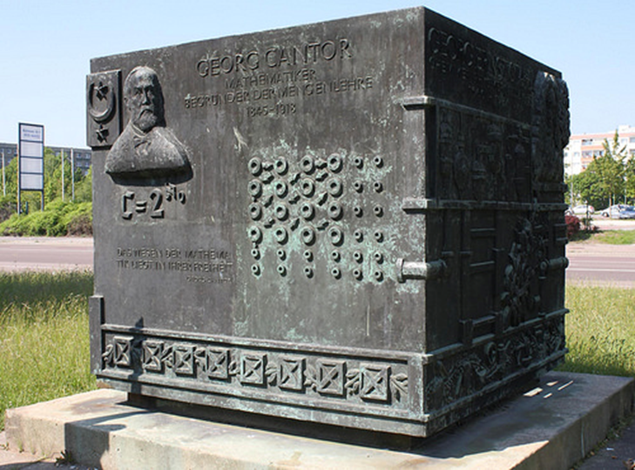
Georg Cantor
1845 – 1918
Cantor’s infinities
Bronze monument to Cantor in Halle-Neustadt

Slide 3
Georg Cantor
1845 – 1918
Cantor’s infinities
Sets
One-to-one correspondence
Countable
Uncountable
Infinite number of infinite sets of different sizes
Continuum hypothesis
Reception of Cantor’s ideas

Slide 4
Set: any collection into a whole M of definite and separate objects m of our intuition or of our thought
Broadly speaking a set is a collection of objects
Example: {1, 3, 4, 6, 8}
Example: {1, 2, 3, …, 66} or {2, 4, 6, 8, …}
Example: {x : x is an even positive integer} which we read as:
the set of x such that x is an even positive integer
Example: {x : x is a prime number less than a million} which we read as:
The set of x such that x is a prime number less than a million

Slide 5
One-to-one correspondence
Two sets M and N are equivalent … if it is possible to put them, by some law, in such a relation to one another that to every element of each one of them corresponds one and only one element of the other.
If M and N are equivalent we often say that they have they have the same cardinality or the same power
If M and N are finite this means they have the same number of elements
But what about the case when M and N are infinite?

Slide 6
Countable
N = {1, 2, 3, …} the set of natural numbers
E = {2, 4, 6, …} the set of even natural numbers

Slide 7
Countable
N = {1, 2, 3, …} the set of natural numbers
E = {2, 4, 6, …} the set of even natural numbers
A set is infinite if it can be put into one-to-one correspondence with a proper subset of itself.
A proper subset does not contain all the elements of the set.

Slide 8
Countable
N = {1, 2, 3, …} the set of natural numbers
E = {2, 4, 6, …} the set of even natural numbers
Z = {… -3, -2, -1, 0, 1, 2, 3, …} the set of all integers

Slide 9
Any set that could be put into one-to-one correspondence with N is called countably infinite or denumerable
The symbol he chose to denote the size of a countable set was ℵ₀ which is read as aleph-nought or aleph-null.
It is named after the first letter of the Hebrew alphabet.
Cardinality of E = cardinality of Z = cardinality of N = ℵ₀

Slide 10
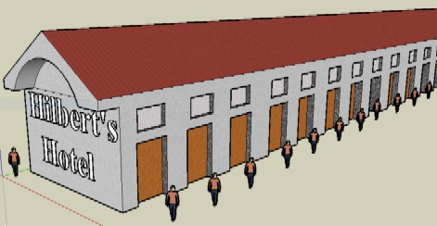
Hilbert’s Grand Hotel
One new arrival
Image Credit: MathCS.org

Slide 11
Hilbert’s Grand Hotel
One new arrival
everybody moves up a room
New arrival put in room 1
Done!
1 + ℵ₀ = ℵ₀

Slide 12

Hilbert’s Grand Hotel and 66 new arrivals
66 new arrivals

Slide 13
Hilbert’s Grand Hotel and 66 new arrivals
66 new arrivals
everybody moves up 66 rooms
So if they are in room n they move to room n + 66
New arrivals put in rooms 1 to 66
Done!
Works for any finite number of new arrivals.
66 + ℵ₀ = ℵ₀

Slide 14
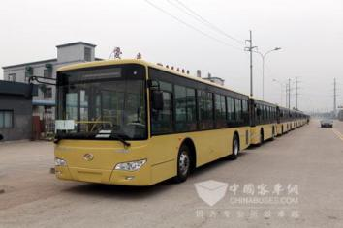
Hilbert’s Grand Hotel and an infinite number of new arrivals

Slide 15
Hilbert’s Grand Hotel and an infinite number of new arrivals
Everybody moves to the room with number twice that of their current room. All the odd numbered rooms are now free and he uses them to accommodate the infinite number of people on the bus
ℵ₀ + ℵ₀ = ℵ₀

Slide 16
Countably infinite number of buses each with countably infinite passengers

Slide 17
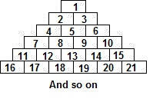
Countably infinite number of buses each with countably infinite passengers

Slide 18
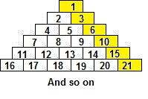
Countably infinite number of buses each with countably infinite passengers

Slide 19
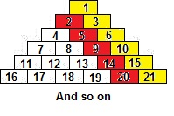
Countably infinite number of buses each with countably infinite passengers

Slide 20
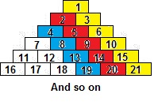
Countably infinite number of buses each with countably infinite passengers

Slide 21
Countably infinite number of buses each with countably infinite passengers
ℵ₀ times ℵ₀ = ℵ₀

Slide 22
I see what might be going on – we can do this because these infinite sets are discrete, have gaps, and this is what allows the method to work because we can somehow interleave them and this is why we always end up with ℵ₀.

Slide 23
I see what might be going on – we can do this because these infinite sets are discrete, have gaps, and this is what allows the method to work because we can somehow interleave them and this is why we always end up with ℵ₀.
Afraid not!

Slide 24
I see what might be going on – we can do this because these infinite sets are discrete, have gaps, and this is what allows the method to work because we can somehow interleave them and this is why we always end up with ℵ₀.
Afraid not!
A rational number or fraction is any integer divided by any nonzero integer, for example, 5/4, 87/32, -567/981.
The rationals don’t have gaps in the sense that between any two rationals there is another rational
The rationals are countable

Slide 25
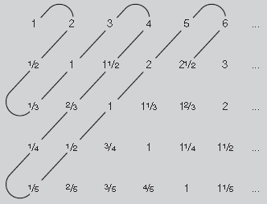

The positive rationals are countable
the first row lists the integers,
the second row lists the ‘halves’,
the third row the thirds
the fourth row the quarters
and so on.
We then ‘snake around’ the diagonals of this array of numbers, deleting any numbers that we have seen before: this gives the list
This list contains all the positive fractions, so the positive fractions are countable.

Slide 26
The Reals
We will prove that the set of real numbers in the interval from 0 up to 1 is not countable. We use proof by contradiction
Suppose they are countable then we can create a list like
1 ↔ x₁ = 0.256173…
2 ↔ x₂ = 0.654321…
3 ↔ x₃ = 0.876241…
4 ↔ x₄ = 0.60000…
5 ↔ x₅ = 0.67678…
6 ↔ x₆ = 0.38751…
. . . .
. . . .
n ↔ x_{n} = 0.a₁a₂a₃a₄a₅ …a_{n} …
. . . .
. . . .
. . . .

Slide 27
1 ↔ x₁ = 0.256173…
2 ↔ x₂ = 0.654321…
3 ↔ x₃ = 0.876241…
4 ↔ x₄ = 0.60000…
5 ↔ x₅ = 0.67678…
6 ↔ x₆ = 0.38751…
n ↔ x_{n} = 0.a₁a₂a₃a₄a₅ …a_{n} …
. . . .
. . . .
Construct the number
b = 0.b₁b₂b₃b₄b₅ …
Choose
b₁ not equal to 2 say 4
b₂ not equal to 5 say 7
b₃ not equal to 6 say 8
b₄ not equal to 0 say 3
b₅ not equal to 8 say 7
b_{n} not equal to a_{n}

Slide 28
Then b = 0.b₁b₂b₃b₄b₅ … = 0.47837… is NOT in the list
The reals are uncountable!
1 ↔ x₁ = 0.256173…
2 ↔ x₂ = 0.654321…
3 ↔ x₃ = 0.876241…
4 ↔ x₄ = 0.60000…
5 ↔ x₅ = 0.67678…
6 ↔ x₆ = 0.38751…
n ↔ x_{n} = 0.a₁a₂a₃a₄a₅ …a_{n} …
. . . .
. . . .
Construct the number
b = 0.b₁b₂b₃b₄b₅ …
Choose
b₁ not equal to 2 say is 4
b₂ not equal to 2 say is 7
b₃ not equal to 2 say is 8
b₄ not equal to 2 say is 3
b₅ not equal to 2 say is 7
b_{n} not equal to a_{n}

Slide 29
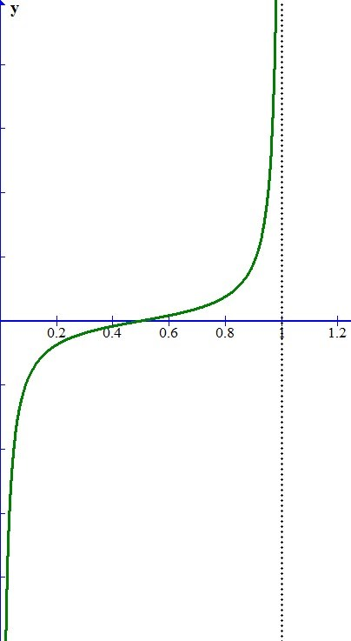

The cardinality of the reals is the same as that of the interval of the reals between 0 and 1
The cardinality of the reals is often denoted by c
for the continuum of real numbers.
y = $\frac{2x−1}{x− x^{2}}$

Slide 30
The rationals can be thought of as precisely the collection of decimals which terminate or repeat e.g.
5/4 = 1.25000000 …
17/7 = 2.428571428571428571 …
-133/990 = - 0.134343434…
The decimal expansion of a fraction must terminate or repeat because when you divide the bottom integer into the top one there are only a limited number of remainders you can get.
1/7 starts with
0.1 remainder 3 then
0.14 remainder 2 then
0.142 remainder 6 then
0.1428 remainder 4 then
0.14285 remainder 5 then
0.142857 remainder 1 which we have had before at the start so process repeats
A repeating decimal is a fraction e.g.
Consider x = 0.123123123123 …
This has a repeating block of length 3
Multiply by 10³ to get
1000 x = 123.123123123 …
Subtract x
x = 0.123123123 …
999x = 123
x = 123/999 = 41/333
The irrationals are those real numbers which are not rational
So their decimal expansions do not terminate or repeat

Slide 31
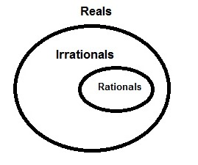
Cardinality of some sets
Set | Description | Cardinality
Natural numbers | 1, 2, 3, 4, 5, … | ℵ₀
Integers | …, -5, -4, -3, -2, -1, 0, 1, 2, 3, 4, 5, … | ℵ₀
Rational numbers or fractions | All the decimals which terminate or repeat | ℵ₀
Irrational numbers | All the decimals which do not terminate or repeat | c
Real numbers | All decimals | c

Slide 32
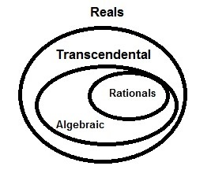
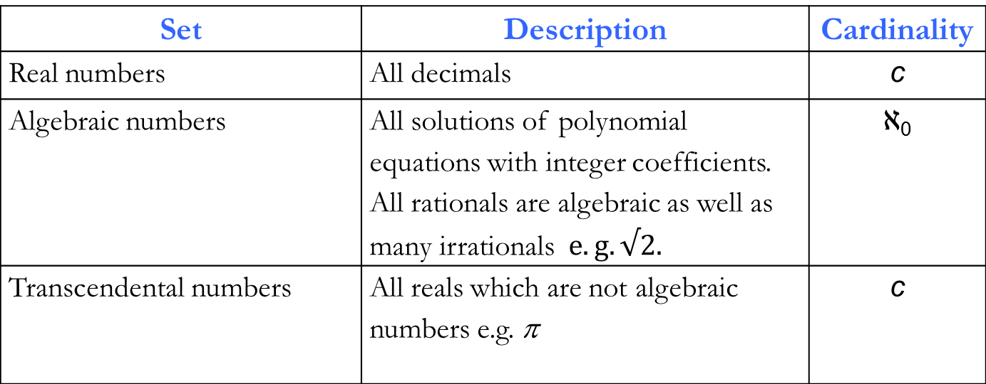
Cardinality of some sets
Set | Description | Cardinality
Real numbers | All decimals | c
Algebraic numbers | All solutions of polynomial equations with integer coefficients. All rationals are algebraic as well as many irrationals $e.g. √2.$ | ℵ₀
Transcendental numbers | All reals which are not algebraic numbers e.g. π | c

Slide 33
Power set of a set
Given a set A, the power set of A, denoted by P[A], is the set of all subsets of A.
A = {a, b, c}
Then A has eight = 2³ subsets and the power set of A is the set containing these eight subsets.
P[A] = { { }, {a}, {b}, {c}, {a, b}, {a, c}, {b, c}, {a, b, c} }
{ } is the empty set and if a set has n elements it has 2^{n} subsets.
The power set is itself a set

Slide 34
No set can be placed in one-to-one correspondence with its power set

Slide 35
No set can be placed in one-to-one correspondence with its power set
B is the set of each and every element of the original set A that is not a member of the subset with which it is matched.
B = {a, b, d, f, g, …}

Slide 36
Now B is just a subset of A so must appear somewhere in the right-hand column and so is matched with some element of A say z

Slide 37
Now B is just a subset of A so must appear somewhere in the right-hand column and so is matched with some element of A say z
Is z an element of B?

Slide 38
Case 1: Suppose z is an element of B
Then z satisfies the defining property of B which is that it consists of elements which do not belong to their matching subset so z does not belong to B!
Contradiction

Slide 39
Case 2: Suppose z is not an element of B
Then z satisfies the defining property of B which is that it consists of elements which do not belong to their matching subset so z does belong to B!
Contradiction!

Slide 40
Infinity of infinities
Reals have smaller cardinality than the power set of the reals.
Which is smaller than the power set of the power set of the reals
Which is smaller than the power set of the power set of the power set of the reals
Which is smaller than the power set of the power set of the power set of the reals
etc!

Slide 41

${ c =2}^{ℵ_{0}}$
Indeed we can show that the reals have the cardinality of the power set of the natural numbers which is often written as above and this is our last example of transfinite arithmetic!

Slide 42
Continuum hypothesis
The Continuum hypothesis states:
there is no transfinite cardinal falling strictly between ℵ₀ and c
Work of Gödel (1940) and of Cohen (1963) together implied that the continuum hypothesis was independent of the other axioms of set theory

Slide 43
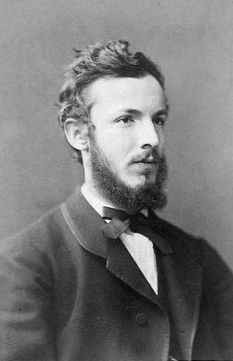
Cantor’s assessment of his theory of the infinite
My theory stands as firm as a rock; every arrow directed against it will return quickly to its archer. How do I know this? Because I have studied it from all sides for many years; because I have examined all objections which have ever been made against the infinite numbers; and above all because I have followed its roots, so to speak, to the first infallible cause of all created things.
Cantor circa 1870

Slide 44
Academic year 2015–16 dates for your diary!
Tuesdays 1 pm
Museum of London
20 October 2015
17 November 2015
19 January 2016
16 February 2016
15 March 2016
19 April 2016

