Slide 1
Spring Conference 2010
Structuring Cleantech Investment

Slide 2
Welcome
Simon Mills
Head of Sustainable Development
City of London Corporation

Slide 3
Behind Today

Slide 4
Agenda
14:30 - 14:45 Welcome
14:45 - 15:15 Keynote Speech
Jason Langley
15:15 - 16:00 Panel – Carbon Monitoring, Reporting and Investment
16:00 - 16:15 Break
16:15 - 17:15 Panel – Regional Cleantech Investment, Linking Up
17:15 - 17:30 Closing Remarks
17:30 - 18:30 Reception

Slide 5
Keynote Speech
“Securitisation in Renewable Energy: Hercules or Hydra”
Jason Langley, Corporate Finance Manager
AXA Investment Managers

Slide 6
Panel 1 – 15:15 to 16:00
“Carbon Monitoring, Reporting and Investment”
Mark C Lewis, Managing Director, Deutsche Bank
Hassen Bali, Vice President, Markit Environmental Registry
Richard Poulden, Vice Chairman, Sirius Exploration plc
Michael Wilkins, Managing Director and Head of Global Carbon Markets, Standard & Poor’s Ratings Services
Chair: Professor Michael Mainelli, Z/Yen Group

Slide 7
16:00 to 16:15

Slide 8
Panel 2 – 16:15 to 17:15
“Regional Cleantech Investment,
Linking Up”
Stuart Buchanan, CEO, MTR4U
Martin Myerscough, CEO, GreenBottle
Robert Hokin, eco-Connect
Isabel Dedring, Mayor’s Environment Advisor, London Mayor’s Office
Chair: Professor Michael Mainelli, Z/Yen Group

Slide 9
Closing Remarks
Professor Michael Mainelli
Z/Yen Group & London Accord

Slide 10
The Story So Far
2010
80 Reports
2009
Index-linked carbon bonds
2008
ESG growth
2008
Policy impact
2007 report
2007
Report Launch
2006
Recruitment
2005
Concept

Slide 11
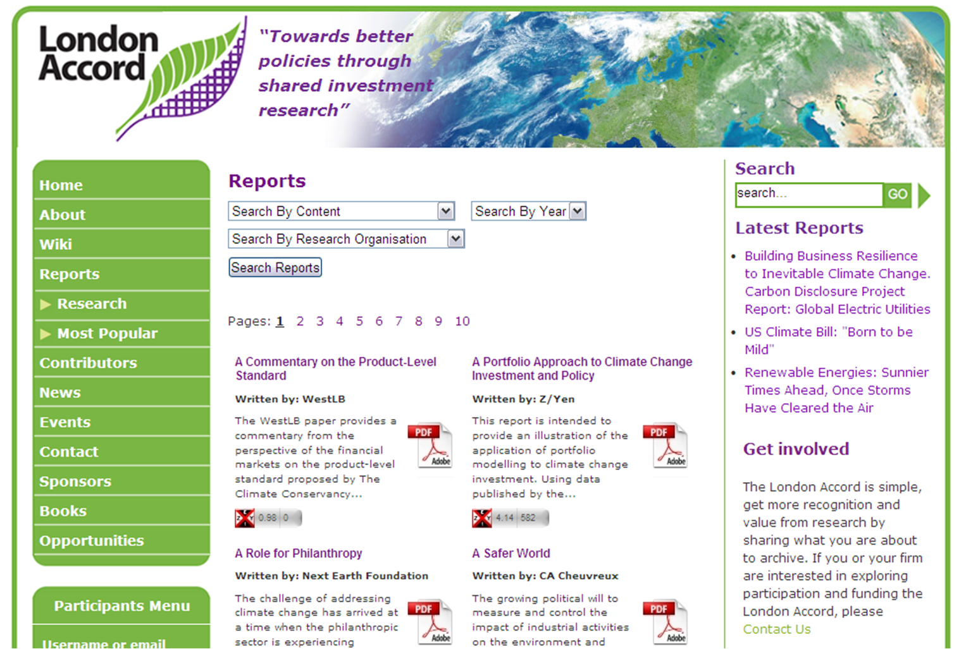
Community

Slide 12
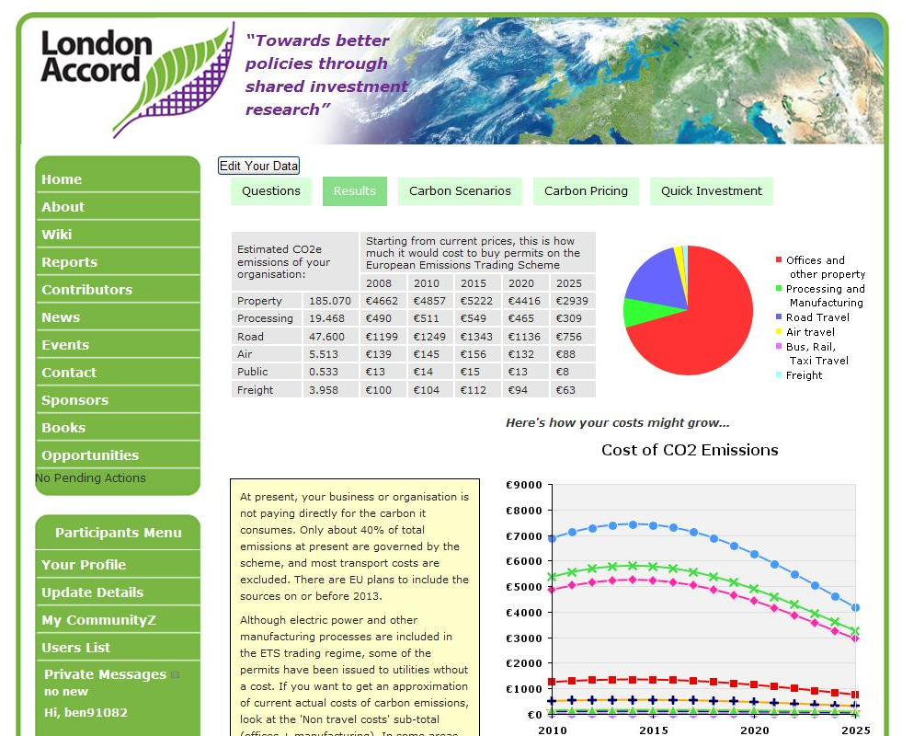
Tools

Slide 13
Outlook 2010
Links with Natural Environment
Research Council
on water and forestry
Links with Long Finance Initiative
Drinks reception – 14:00, Tuesday, 22 June
Autumn Conference – 14:30 – 18:45, Tuesday, 12 October
“Whose Brains? ESG Data and Intellectual Property”
What else might/should be done?

Slide 14
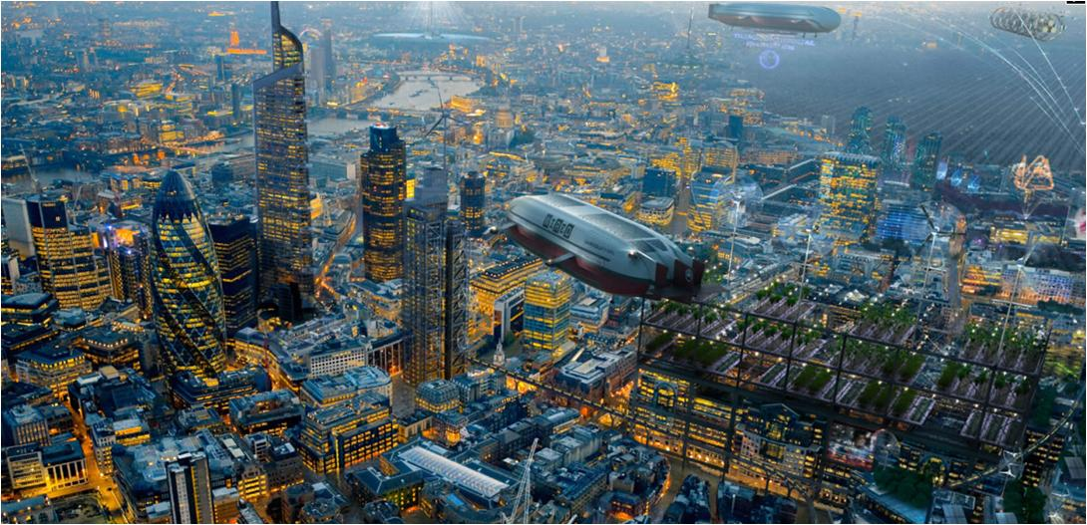
Reception GMJ “London Futures 2”

Slide 15
Thank You!

